Slide 1
Chapter 13: I/O Systems
I/O Hardware
Application I/O Interface
Kernel I/O Subsystem
Transforming I/O Requests to Hardware Operations
Streams
Performance

Slide 2
I/O Hardware
Incredible variety of I/O devices
Common concepts
  Controller
  Bus
  Port
I/O instructions control devices
Devices have addresses, used by
  Direct I/O instructions
  Memory-mapped I/O

Slide 3

A Typical PC Bus Structure

Slide 4
Controller Registers
A device controller typically consists of four registers
  Data-in
  Data-out
  Status
  Control

Slide 5
Polling
Determines state of device
  command-ready
  busy
  Error
Busy-wait cycle to wait for I/O from device

Slide 6
Interrupts
CPU Interrupt-request line triggered by I/O device
Interrupt handler receives interrupts
Maskable to ignore or delay some interrupts
Interrupt vector to dispatch interrupt to correct handler
  Based on priority
  Some nonmaskable
Interrupt mechanism also used for exceptions

Slide 7
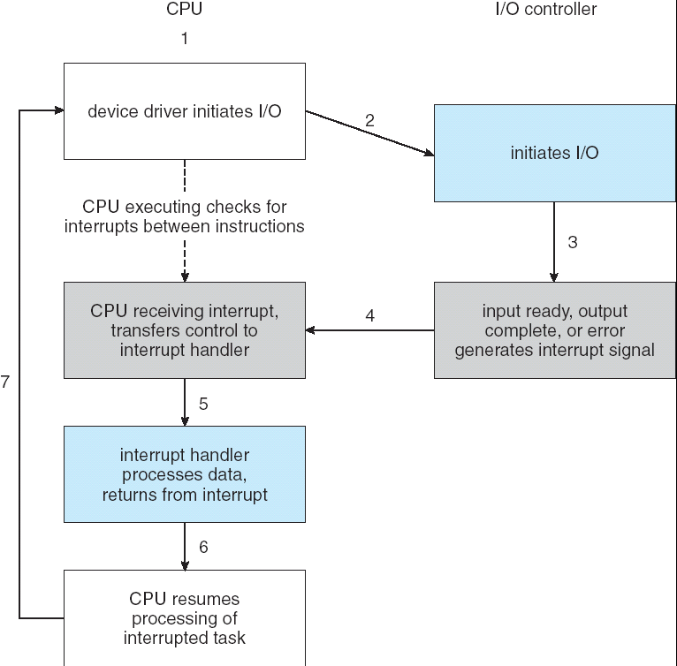
Interrupt-Driven I/O Cycle

Slide 8
Direct Memory Access
Used to avoid programmed I/O for large data movement
Requires DMA controller
Bypasses CPU to transfer data directly between I/O device and memory

Slide 9

Six Step Process to Perform DMA Transfer

Slide 10
Block and Character Devices
Block devices include disk drives
  Commands include read, write, seek
Character devices include keyboards, mice, serial ports
  Commands include get, put

Slide 11
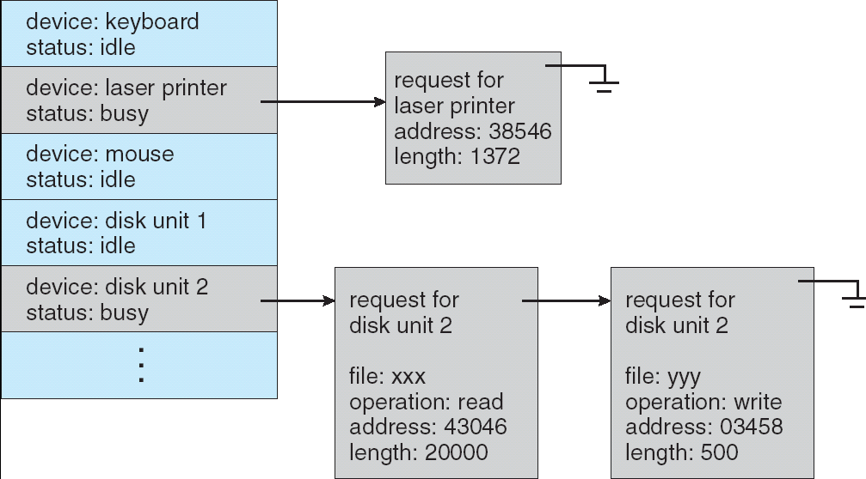
Device-status Table

Slide 12
Kernel I/O Subsystem
Caching - fast memory holding copy of data
  Always just a copy
  Key to performance
Spooling(Simultaneous Peripheral Operation On-Line)
  Hold output for a device, if device can serve only one request at a time
  i.e., Printing

Slide 13
Exercises
  13.7
  13.9
  End of Chapter 13

