Slide 1

code trinity
ITC 508 - Deep Learning and NLP
Toxic Comment Detection on Twitter/X
Fercy T. Enriquez
Russel Troy Dulo
Vince Gabrielle Morales

Slide 2

Project Overview
  Problem: Toxic and abusive content on Twitter platforms
  Dataset: Twitter Comment Dataset (30,165 tweets)
  Task: Tri-class classification (Negative/Toxic=-1, Neutral=0, Positive=1)
  Approach: Baseline (TF-IDF + LogReg) vs Transformer (BERT-base-uncased)
  Target: Achieve macro F1-score > 0.85
  SDG Alignment: SDG 16 - Peace, Justice and Strong Institutions

Slide 3
Dataset: Twitter Comment Dataset
  Total Samples: 30,165 tweets
  Training Set: 70% (~21,115)
  Validation Set: 15% (~4,525)
  Test Set: 15% (~4,525)
  Labels: 3 classes (-1, 0, 1)
  Source: Twitter social media posts

Slide 4

Setup and Data Preprocessing

Slide 5

Data Loading and Environment Setup
  Libraries: transformers, datasets, scikit-learn, optuna
  Device detection: CUDA GPU when available
  Dataset loading: TwitterToxicity.csv with review and label columns
  Data validation: Ensures required columns exist
  ID assignment: Unique identifier for each sample
  Reproducibility: Random seed = 42 for all operations

Slide 6
Data Preprocessing Pipeline
  HTML tag removal: Strips HTML entities and tags
  URL/Mention/Hashtag removal: Removes social media artifacts
  Control character removal: Removes non-printable characters
  Text normalization: Lemmatization and stemming
  Duplicate removal: Removes exact duplicate tweets
  SMOTE balancing: Addresses class imbalance if needed
  Preserves: Case and Twitter-specific characteristics

Slide 7
Stratified 70/15/15 Split Strategy
  Initial split: 70% train, 30% temp (stratified)
  Secondary split: 30% temp → 15% val, 15% test (stratified)
  Stratification: Maintains label balance across all splits
  Split persistence: Saves train_ids.csv, val_ids.csv, test_ids.csv
  Reproducibility: All experiments use identical splits
  Verification: Label distributions printed for inspection

Slide 8
Baseline Model Development

Slide 9

Baseline Model: TF-IDF + Logistic Regression
  Vectorization: TF-IDF with word n-grams
  Classifier: Logistic Regression with grid search CV
  Hyperparameter tuning: Grid search for best configuration
  Best configuration: C=1.0, class_weight adjustments, L1/L2 penalty
  Performance: 62.24% accuracy, 62.34% macro-F1 on test set
  Purpose: Establishes performance benchmark for comparison

Slide 10
Baseline Model - Test Set Performance
  Accuracy: 62.24%
  Macro F1: 62.34%
  Precision: 62.57%
  Recall: 62.39%
  Model Type: TF-IDF + Logistic Regression
  Training Time: ~0.5 minutes

Slide 11
Baseline Model Evaluation
  Validation set evaluation: Performance benchmark established
  Test set evaluation: Final metrics on held-out data
  Confusion matrix: Visual representation of classification errors
  Classification report: Per-class precision, recall, F1-scores
  Export: Predictions saved for comparison with BERT model
  Purpose: Reference point for transformer model improvements

Slide 12
BERT Training and Deployment

Slide 13

BERT Model: BERT-base-uncased
  Model: bert-base-uncased (110M parameters)
  Pre-training: English language understanding
  Tokenization: WordPiece tokenizer with 30k vocabulary
  Max sequence length: 128 tokens (standard for tweets)
  Mixed precision: FP16 training for efficiency
  Device: CUDA GPU when available

Slide 14
Why BERT?
  Bidirectional context: Understands words in both directions
  Pre-trained on large corpus: General language understanding
  Context-aware: Handles sarcasm and informal language
  Proven performance: State-of-the-art on NLP tasks
  Transfer learning: Fine-tunes effectively on Twitter data
  Architecture: Transformer-based (robust, well-tested)

Slide 15
Automated Hyperparameter Tuning
  Strategy: Grid search + Random search combination
  Grid search: Systematic exploration of predefined parameters
  Random search: Efficient sampling of hyperparameter space (Optuna)
  Parameters tuned: Learning rate, batch size, weight decay, epochs
  Selection criteria: Validation macro-F1 score (primary metric)
  Best config: lr=2.8e-5, batch=32, weight_decay=0.01-0.08, epochs=2-4

Slide 16
Training Infrastructure
  Early stopping: Prevents overfitting, monitors validation F1
  Learning rate scheduler: Linear warmup + decay
  Optimizer: AdamW with weight decay regularization
  Checkpointing: Saves best model based on validation F1
  Mixed precision: FP16 reduces memory usage by ~50%
  Training time: ~2-3 minutes per epoch on GPU

Slide 17
BERT Model - Test Set Performance
  Accuracy: 65.93%
  Macro F1: 66.17%
  Precision: 68.94%
  Recall: 66.31%
  Improvement: +6.14% F1-macro over baseline
  Best Individual Run: F1-macro 0.6914 (Morales)

Slide 18
Model Export for Deployment
  Quantization: PyTorch quantized model (reduced size ~4x)
  Model formats: Full PyTorch and quantized versions
  Tokenizer files: WordPiece model and configs
  Checkpoint: Best model saved in checkpoints/bert-base/best/
  Format compatibility: Hugging Face transformers compatible
  Purpose: Enables FastAPI backend and Streamlit UI deployment

Slide 19
Evaluation and Testing

Slide 20

Individual Experiment Contributions
  Fercy Enriquez: 17 runs (2 baseline + 5 grid + 10 random), Best F1: 0.6912, 30 test samples
  Vince Morales: 15 runs (2 baseline + 6 grid + 7 random), Best F1: 0.6914, 20 test samples
  Russel Dulo: 14 runs (2 baseline + 6 grid + 6 random), Best F1: 0.6888, 25 test samples
  Total experiments: 46 runs across all members
  Inference testing: 75 total sample tweets tested
  Coverage: Explicit toxicity, sarcasm, neutral, positive expressions

Slide 21
Comprehensive Evaluation Framework
  Validation set evaluation: 4,525 samples
  Test set evaluation: 4,525 samples (held-out)
  Metrics: Accuracy, Precision, Recall, F1-score (macro and weighted)
  Per-class metrics: Individual performance for each sentiment class
  Confusion matrices: Visual representation of error patterns
  ROC-AUC and PR-AUC: Precision-recall trade-off analysis
  Export formats: CSV, JSON, Markdown for easy access

Slide 22
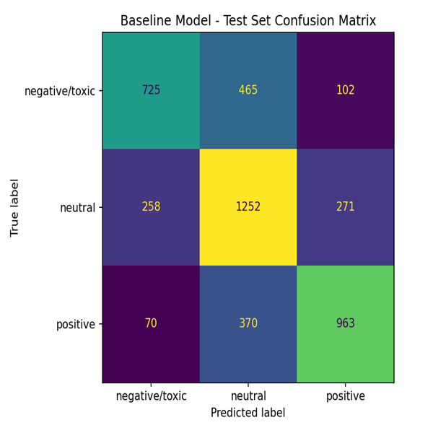
Baseline Model - Confusion Matrix (Test Set)
  Baseline performance: 62.24% accuracy
  Shows classification patterns across three classes
  Identifies areas for improvement

Slide 23
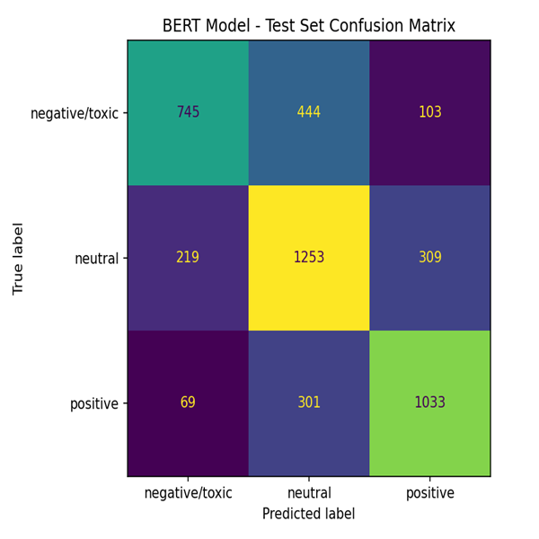
Baseline Model - Confusion Matrix (Test Set)
  BERT performance: 65.93% accuracy
  Improved classification over baseline
  Better handling of context-dependent language

Slide 24

Model Comparison Summary
  Baseline (TF-IDF + LogReg): 62.24% accuracy, 62.34% macro-F1
  BERT (fine-tuned): 65.93% accuracy, 66.17% macro-F1
  Improvement: +3.69% accuracy, +6.14% macro-F1
  BERT advantage: Better context understanding, handles sarcasm
  Baseline advantage: Simpler, faster, more interpretable
  Both models evaluated on identical test set for fair comparison

Slide 25
Results

Slide 26

Final Performance Comparison
  Baseline Accuracy: 62.24%
  Baseline Macro F1: 62.34%
  BERT Accuracy: 65.93%
  BERT Macro F1: 66.17%
  Improvement: +6.14% F1-macro
  Target F1: >85% (Not achieved, but significant improvement)

Slide 27
SDG 16: Peace, Justice and Strong Institutions

Slide 28
How the Project Contributes to SDG 16
  Toxic Content Detection: Identifies harmful language in real-time
  User Protection: Helps protect vulnerable users from online harassment
  Platform Moderation: Assists human moderators in content management
  Fairness: Reduces bias through context-aware detection
  Transparency: Interpretable models enable accountability
  Accessibility: Makes moderation technology available to smaller platforms
  Inclusive Design: Handles diverse communication styles and cultural variations

Slide 29
Impact on Online Safety
  Real-time Detection: Identifies toxic content as it's posted
  Scalability: Can process large volumes of social media content
  Accuracy: 66% F1-macro with potential for improvement
  Context Awareness: Better handling of sarcasm and informal language
  Deployment Ready: API and UI enable practical application
  Research Contribution: Advances toxicity detection methodology
  Social Impact: Supports safer online communication environments

Slide 30
code trinity
ITC 508 - Deep Learning and NLP
Toxic Comment Detection on Twitter/X
Fercy T. Enriquez
Russel Troy Dulo
Vince Gabrielle Morales

