Slide 1
Grading System
CS591 P1
Xinyun Cao, Qichao Hong, Yuang Liu, Zhitong Wu

Slide 2
Outline
Motivation and introduction -- Qichao Hong
Our Enhancements -- Xinyun Cao
Demo time -- Yuang Liu
Future improvements -- Zhitong Wu
Q&A

Slide 3
Motivation and introduction
Main drawbacks of Microsoft Excel:
Table does not highlight the row of the selected cell
Inconvenient statistical calculations
No inherent way to reuse grading criteria within Excel
Difficult to give multiple kinds of grades in one table

Slide 4
Motivation and introduction
Our Enhanced Grading System:
Reuse grading criteria from previous courses
Easily modify grading criteria of a given course
Easily keep track of students
Assign and modify assignments with single parts or multi parts
Get statistical number in a flexible way
Give final grade and export csv file
Archive a course but still can view and modify the grade.

Slide 5
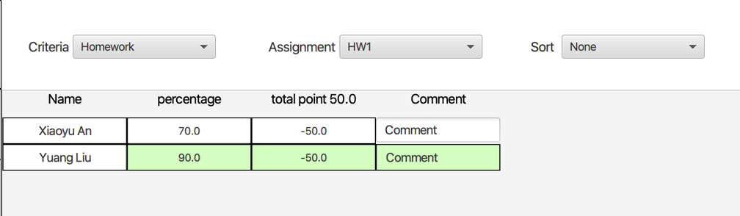
Enhanced Design
Highlight the student row when give grade to that student.

Slide 6
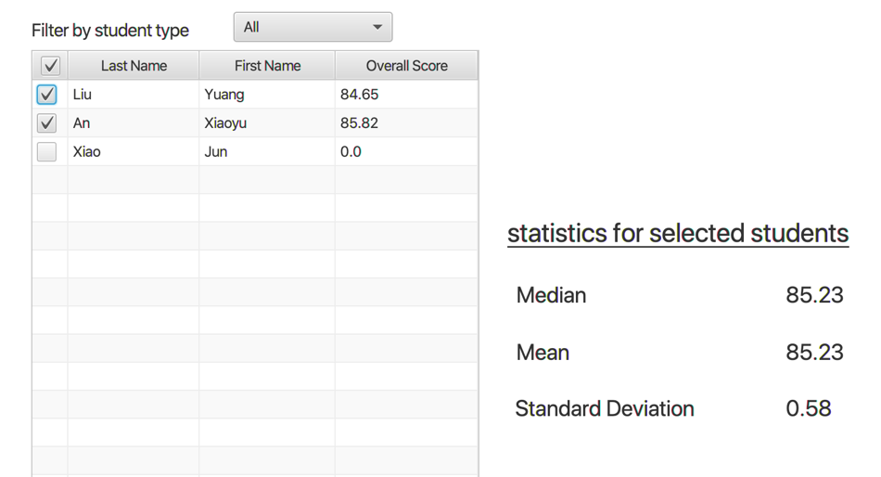
Enhanced Design
Can deselect students who are not account for the statistical number.

Slide 7
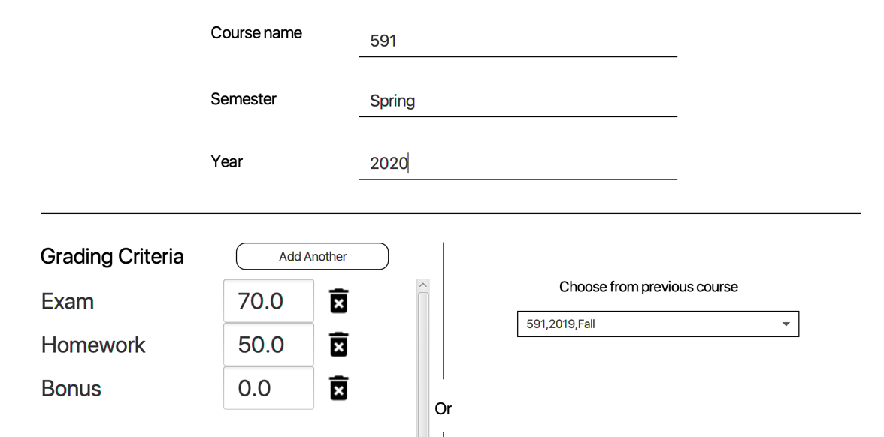
Enhanced Design
Creating courses based on a template.

Slide 8
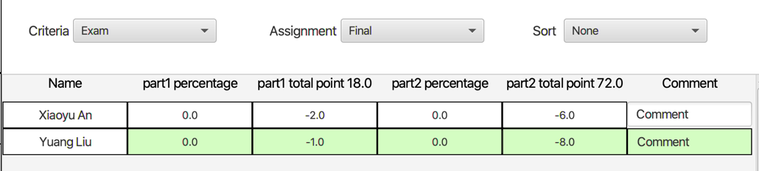
Enhanced Design
Easy way to give both percentage kind or credits kind grade in one table.

Slide 9

Demo Time !!!

Slide 10
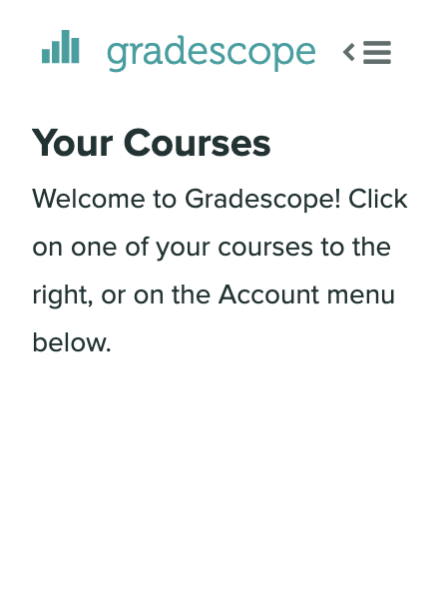
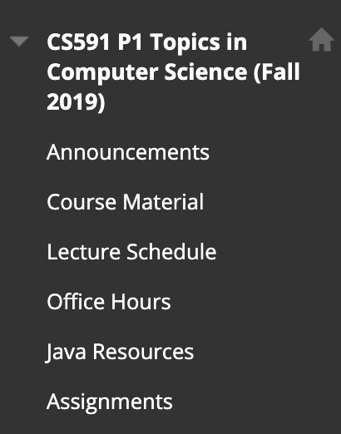
Future Improvements
Connect with current web-based grading system such as Grade Scope or Black Board.

Slide 11
Future Improvements
Visualize the statistical data.

Slide 12
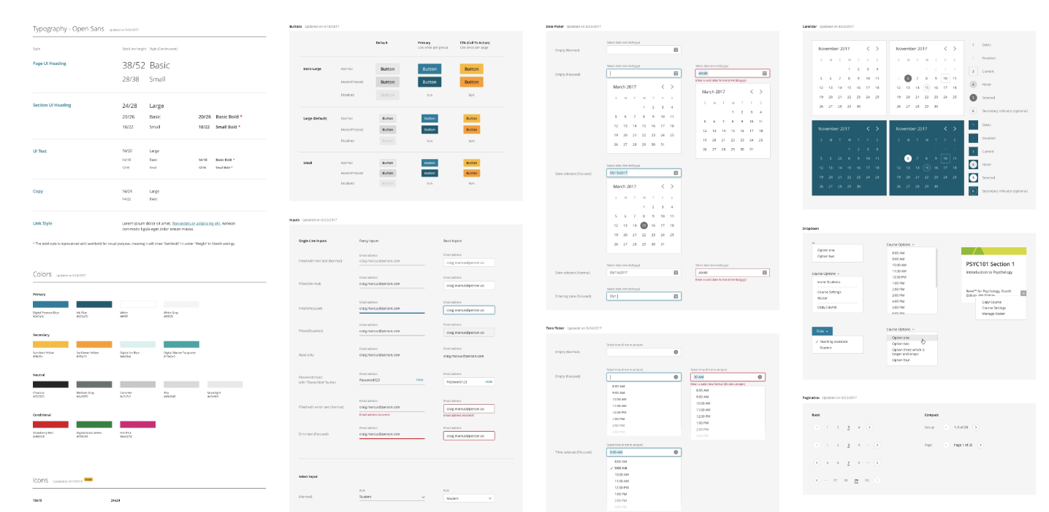
Future Improvements
Use other UI framework to beautify the UI.
Notes:
Make the UI much more user friendly.

Slide 13

Thank you
Q&A

