Slide 1
Grading System
CS591 P1
Xinyun Cao, Qichao Hong, Yuang Liu, Zhitong Wu

Slide 2
Outline
Motivation and introduction -- Qichao Hong
Highlighted features -- Xinyun Cao
Demo time -- Yuang Liu
Future improvements -- Zhitong Wu
Q&A

Slide 3
Motivation
Main drawbacks of Microsoft Excel:

Slide 4
Motivation
Main drawbacks of Microsoft Excel:
Excel won’t highlight the student under grading, which will make some confusion when give grades to students.

Slide 5
Motivation
Main drawbacks of Microsoft Excel:
Excel won’t highlight the student under grading, which will make some confusion when give grades to students.
Excel is inflexible on getting the statistical number, our customer has to write some functions on the table. Besides, our customer cannot deselect some students she is not interested in, for that Excel operates the data based on the column.

Slide 6
Motivation
Main drawbacks of Microsoft Excel:
Excel won’t highlight the student under grading, which will make some confusion when give grades to students.
Excel is inflexible on getting the statistical number, our customer has to write some functions on the table. Besides, our customer cannot deselect some students she is not interested in, for that Excel operates the data based on the column.
Every time start a new course, our customer has to create a new break down by herself even if the break down is totally the same with the last year.

Slide 7
Motivation
Main drawbacks of Microsoft Excel:
Excel won’t highlight the student under grading, which will make some confusion when give grades to students.
Excel is inflexible on getting the statistical number, our customer has to write some functions on the table. Besides, our customer cannot deselect some students she is not interested in, for that Excel operates the data based on the column.
Every time start a new course, our customer has to create a new break down by herself even if the break down is totally the same with the last year.
Hard to give multi kinds of grades in one table.

Slide 8
Introduction To our system
A grading system that allow you:

Slide 9
Introduction To our system
A grading system that allow you:
Create course based or not based on a template

Slide 10
Introduction To our system
A grading system that allow you:
Create course based or not based on a template
Manage criteria of that course

Slide 11
Introduction To our system
A grading system that allow you:
Create course based or not based on a template
Manage criteria of that course
Add and modify students

Slide 12
Introduction To our system
A grading system that allow you:
Create course based or not based on a template
Manage criteria of that course
Add and modify students
Assign and modify assignments with single parts or multi parts

Slide 13
Introduction To our system
A grading system that allow you:
Create course based or not based on a template
Manage criteria of that course
Add and modify students
Assign and modify assignments with single parts or multi parts
Give grade to assignments

Slide 14
Introduction To our system
A grading system that allow you:
Create course based or not based on a template
Manage criteria of that course
Add and modify students
Assign and modify assignments with single parts or multi parts
Give grade to assignments
Get statistical number in a flexible way

Slide 15
Introduction To our system
A grading system that allow you:
Create course based or not based on a template
Manage criteria of that course
Add and modify students
Assign and modify assignments with single parts or multi parts
Give grade to assignments
Get statistical number in a flexible way
Give final grade and export csv file

Slide 16
Introduction To our system
A grading system that allow you:
Create course based or not based on a template
Manage criteria of that course
Add and modify students
Assign and modify assignments with single parts or multi parts
Give grade to assignments
Get statistical number in a flexible way
Give final grade and export csv file
Archive a course but still can view and modify the grade.

Slide 17
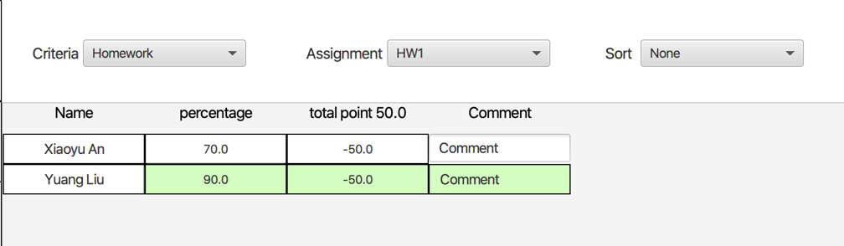
Highlighted features
Highlight the student row when give grade to that student.

Slide 18
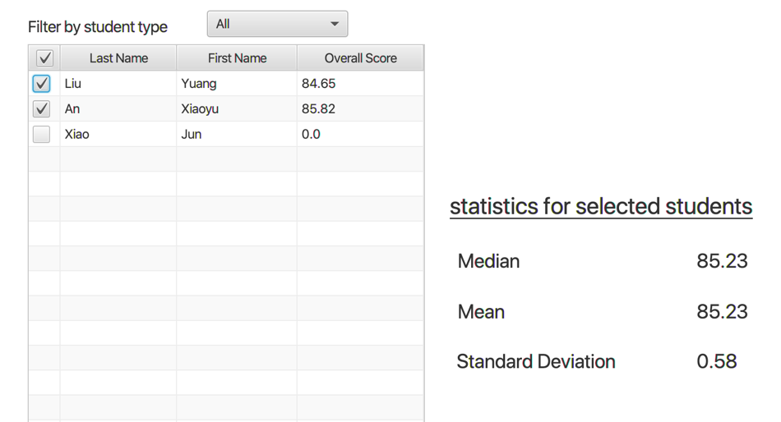
Highlighted features
Can deselect students who are not account for the statistical number.

Slide 19
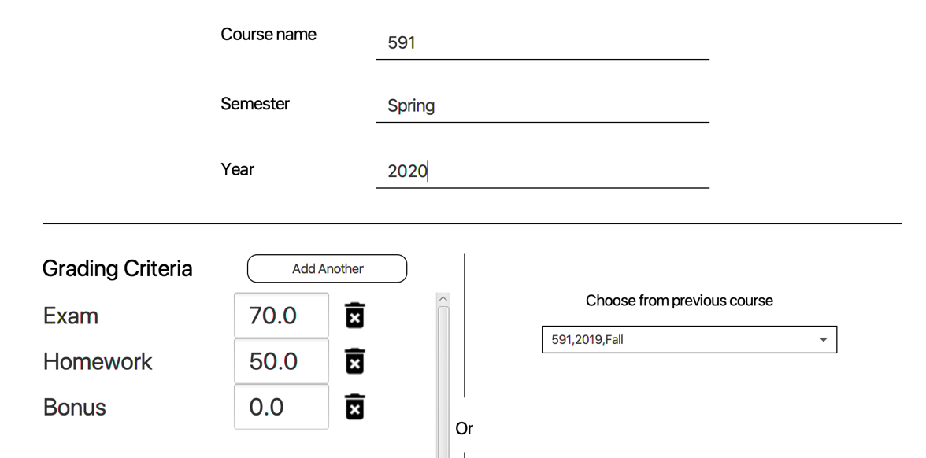
Highlighted features
Creating courses based on a template.

Slide 20
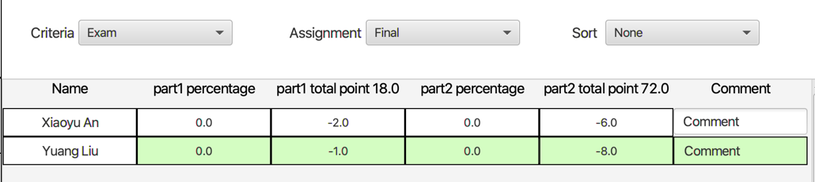
Highlighted features
Easy way to give both percentage kind or credits kind grade in one table.

Slide 21
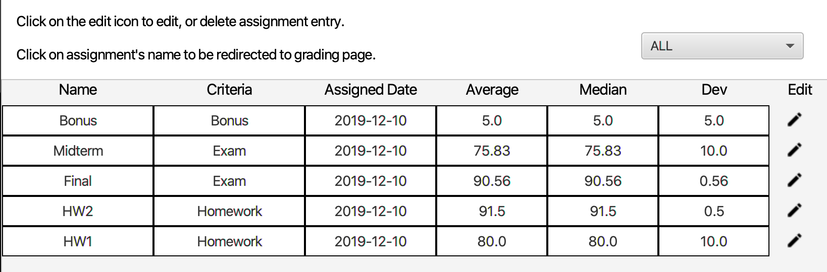
Highlighted features
Clicking the assignment name under the ‘Assignment’ tab will redirect to the grading page.

Slide 22
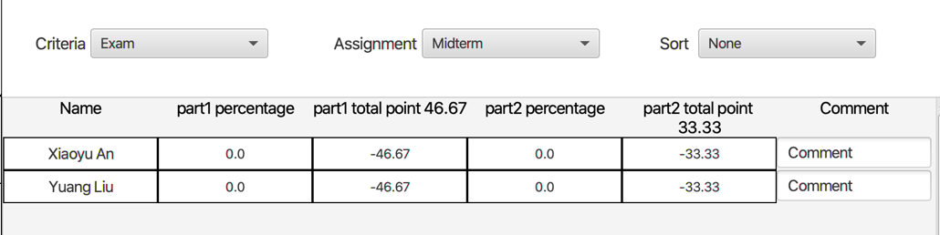
Highlighted features
Clicking the assignment name under the ‘Assignment’ tab will redirect to the grading page.

Slide 23
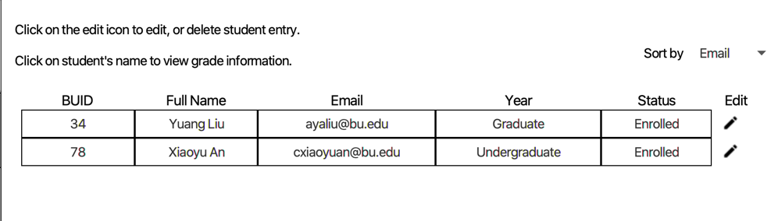
Highlighted features
Clicking the students’ name under the ‘Students’ tab and ‘Statistical’ tab will redirect to the detail score distribution for that student.

Slide 24
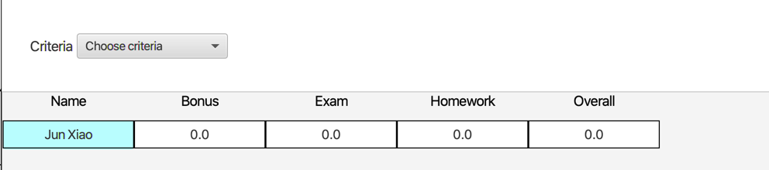
Highlighted features
Clicking the students’ name under the ‘Students’ tab and ‘Statistical’ tab will redirect to the detail score distribution for that student.

Slide 25

Demo Time !!!

Slide 26
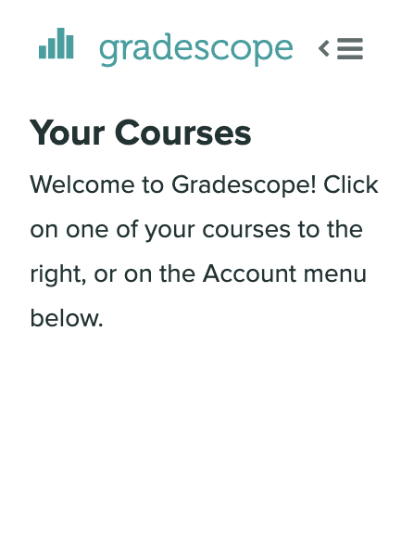
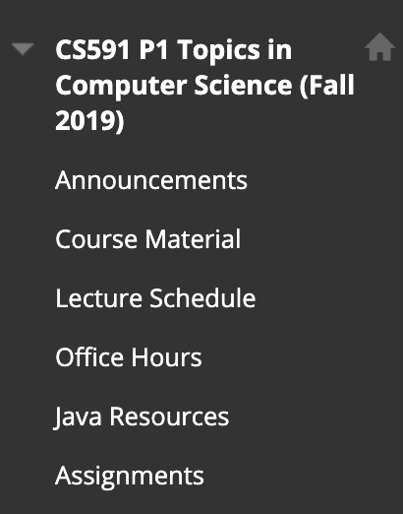
Future Improvements
Connect with current web-based grading system such as Grade Scope or Black Board.

Slide 27
Future Improvements
Visualize the statistical data.

Slide 28
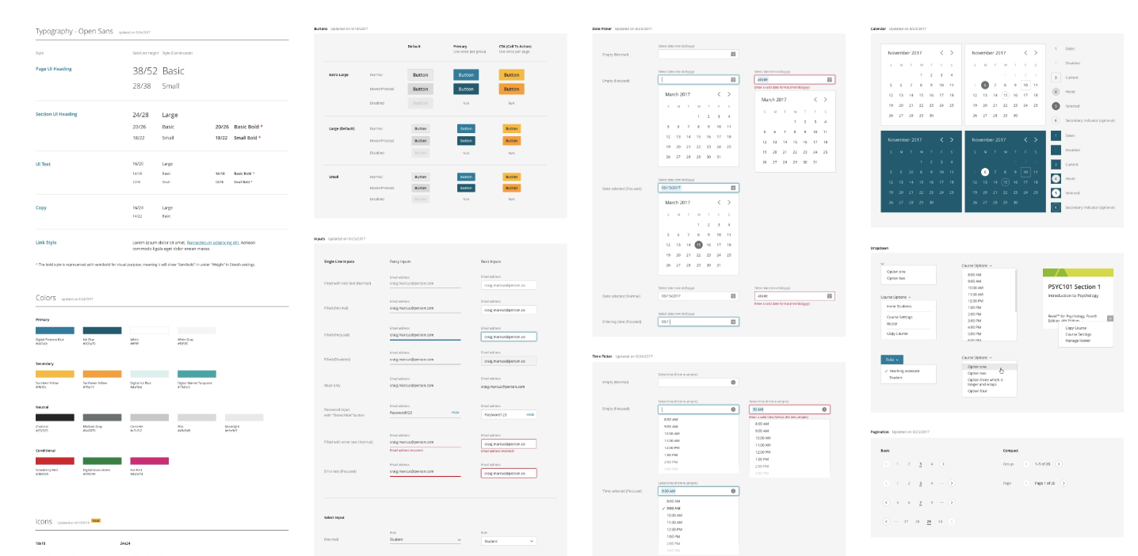
Future Improvements
Use other UI framework to beautify the UI.

Slide 29
Future Improvements
Expand the row under grading and shrink other instead of highlight.
Much more kinds of grade such as letter based grade for assignments or other kind of grade.

Slide 30
Thank you

Slide 31
Q&A

