Slide 1
Grading System
CS591 P1
Xinyun Cao, Qichao Hong, Yuang Liu, Zhitong Wu

Slide 2
Outline
Introduction -- Qichao Hong
Highlighted features -- Xinyun Cao
Demo time -- Yuang Liu
Future works and conclusion -- Zhitong Wu
Q&A

Slide 3
Introduction
A grading system that allow you:
Create course
Manage criteria of that course
Add and modify students
Assign and modify assignments with single parts or multi parts
Give grade to assignments
Get statistical number
Give final grade and export csv file
Archive a course but still can view and modify the grade.

Slide 4
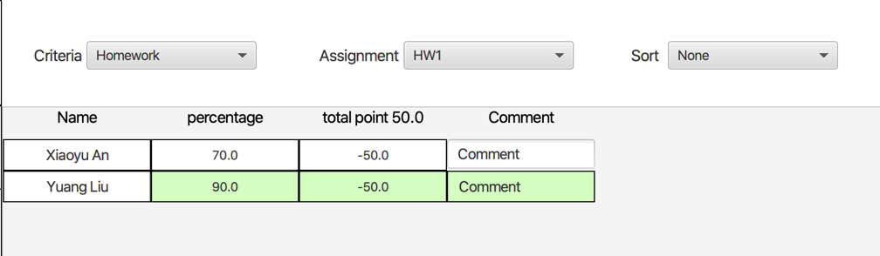
Highlighted features
Highlight the student row when give grade to that student.

Slide 5
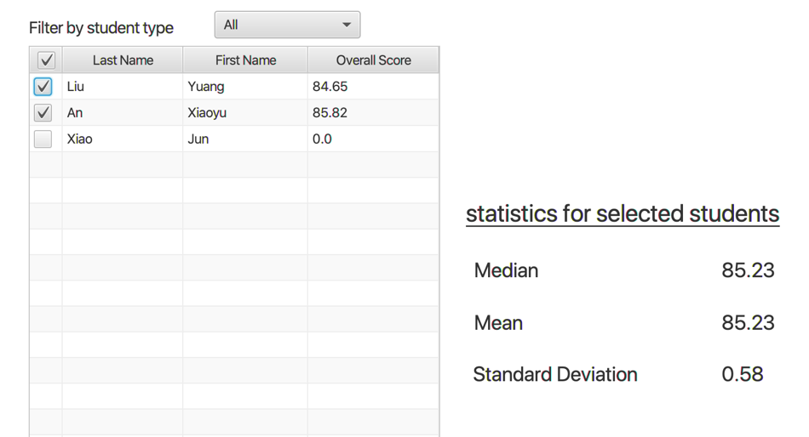
Highlighted features
Can deselect students who are not account for the statistical number.

Slide 6
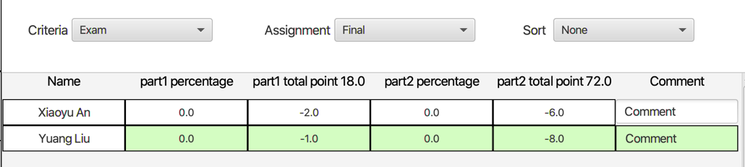
Highlighted features
Easy way to give both percentage kind or credits kind grade in one table.

Slide 7
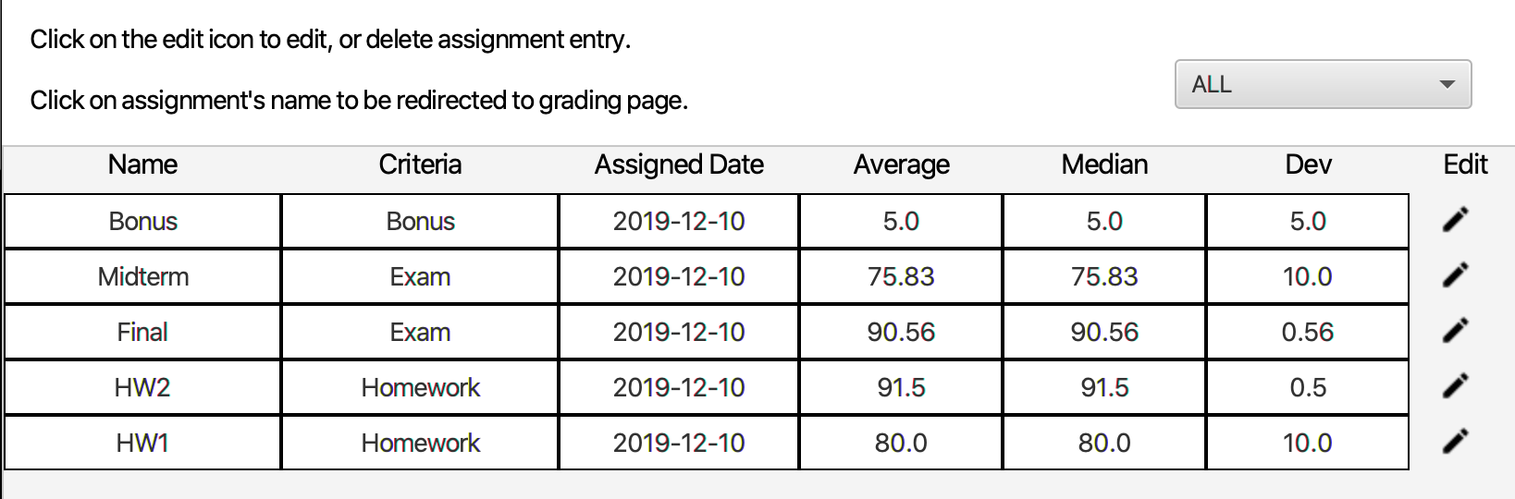
Highlighted features
Clicking the assignment name under the ‘Assignment’ tab will redirect to the grading page.

Slide 8
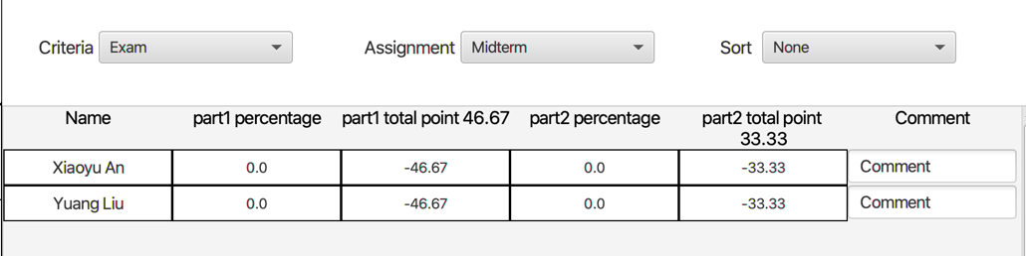
Highlighted features
Clicking the assignment name under the ‘Assignment’ tab will redirect to the grading page.

Slide 9
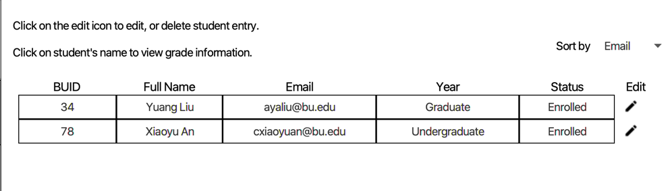
Highlighted features
Clicking the students’ name under the ‘Students’ tab will redirect to the detail score distribution for that student.

Slide 10
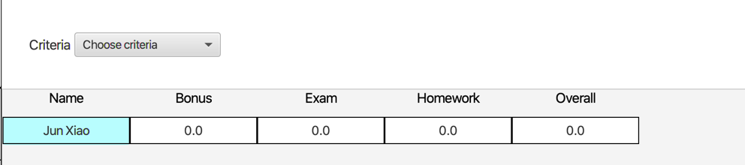
Highlighted features
Clicking the students’ name under the ‘Students’ tab will redirect to the detail score distribution for that student.

Slide 11
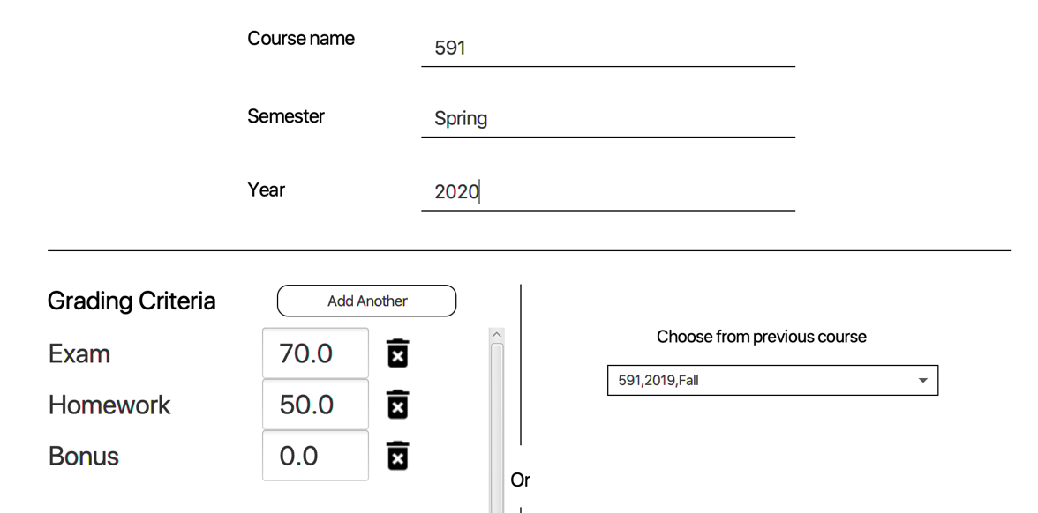
Highlighted features
Creating courses based on a template.

Slide 12
Demo Time !!!

Slide 13
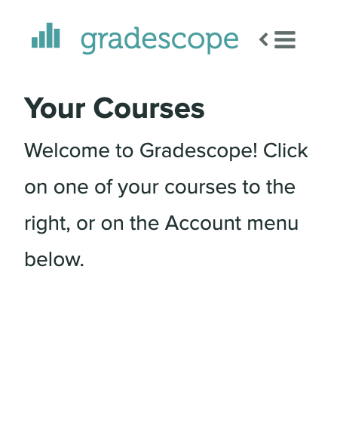
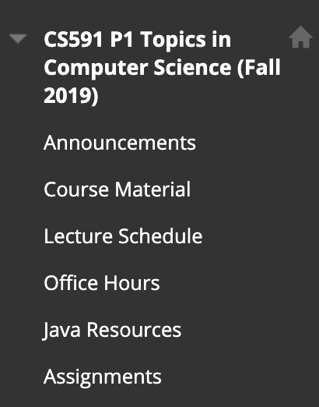
Future Improvements and conclusion
Connect with current web-based grading system such as Grade Scope or Black Board.

Slide 14
Future Improvements and conclusion
Visualize the statistical data.

Slide 15
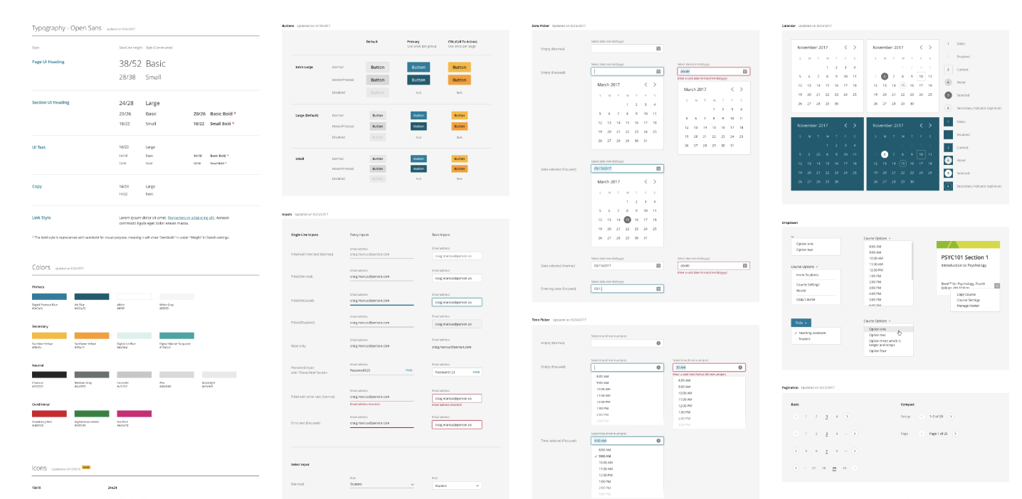
Future Improvements and conclusion
Use other UI framework to beautify the UI.

Slide 16
Future Improvements and conclusion
Expand the row under grading and shrink other instead of highlight.
Much more kinds of grade such as letter based grade for assignments or other kind of grade.

Slide 17
Thank you

Slide 18
Q&A

