Slide 1
Arduino Paint
Austin Thein & Katie Corra

Slide 2
Project Description
There is a “drawing area” inside the center of a frame. Users can place a long thin object inside this area. By moving the object around, you can “paint” pixels on an LED screen.

Slide 3
Project Features
Makes use of proximity sensors in the 4 corners of a rectangle. These proximity sensors are used to triangulate the point being drawn in the drawing area.
LED screen to display what the user has drawn.

Slide 4
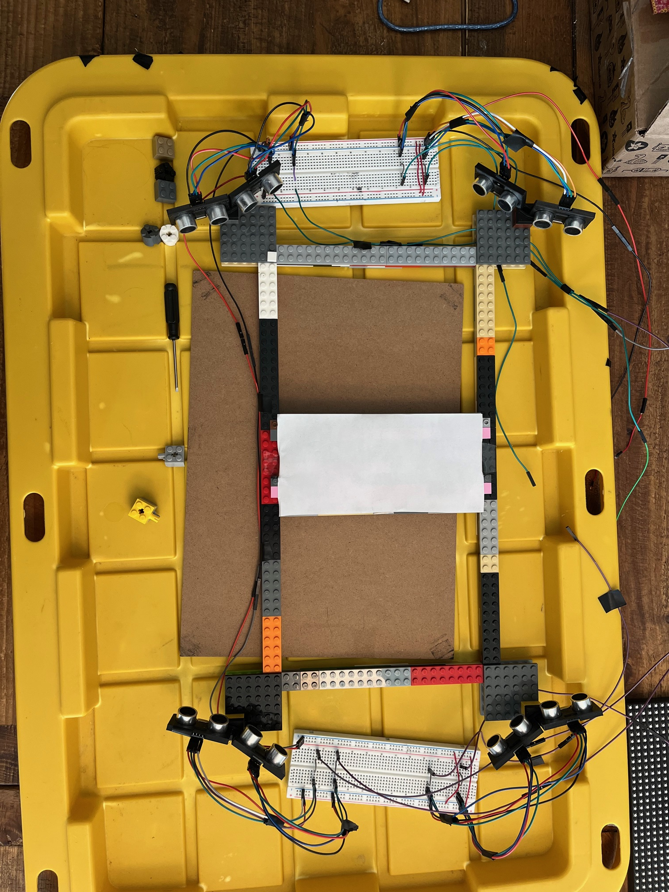
How it works
We have 2 proximity sensors in each corner of the rectangle. We are using 2 per corner so that the combined angle of effect of the sensors is greater than it would be with just one.
By pinging each sensor individually, we can take the minimum distance from each corner and create a circle for each corner, where the center is the location of the corner relative to the center and the radius is the distance returned by the proximity sensors.
With these 4 circles, we can calculate the point of intersection between all the circles, and then draw that point onto the screen.
Final sensor arena

Slide 5
Challenges we ran into
The sensors were a nightmare. We had to test two different models of sensors (an IR model and ultrasonic sensor model), 17 sensors in total. We had to make sure that each sensor had a accurate reading and had to measure the angle of effect each sensor had.
Each sensor was fine on its own, but after wiring everything together, they would give very inaccurate readings. We “fixed” it by multiplying the distance returned by some magic number, which was a very unsatisfying solution.
Because of our LED screen, we had very few pins to work with. We were forced to use pins 0 and 1, which are the pins the Uno uses for Serial output. Because of this, we were not able to print out any of the distances for each sensor when we were testing with all 8 sensors active. This made testing very annoying.

Slide 6
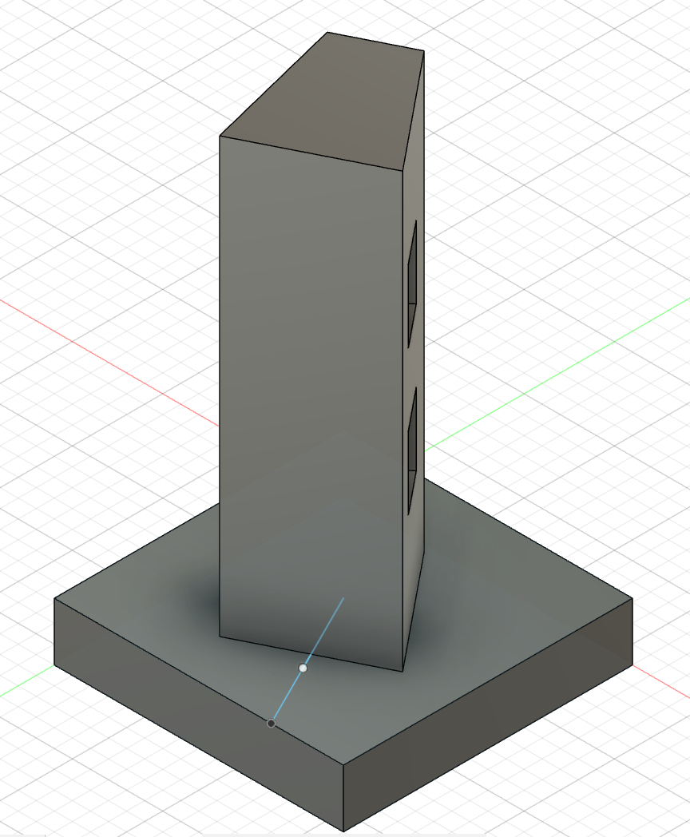
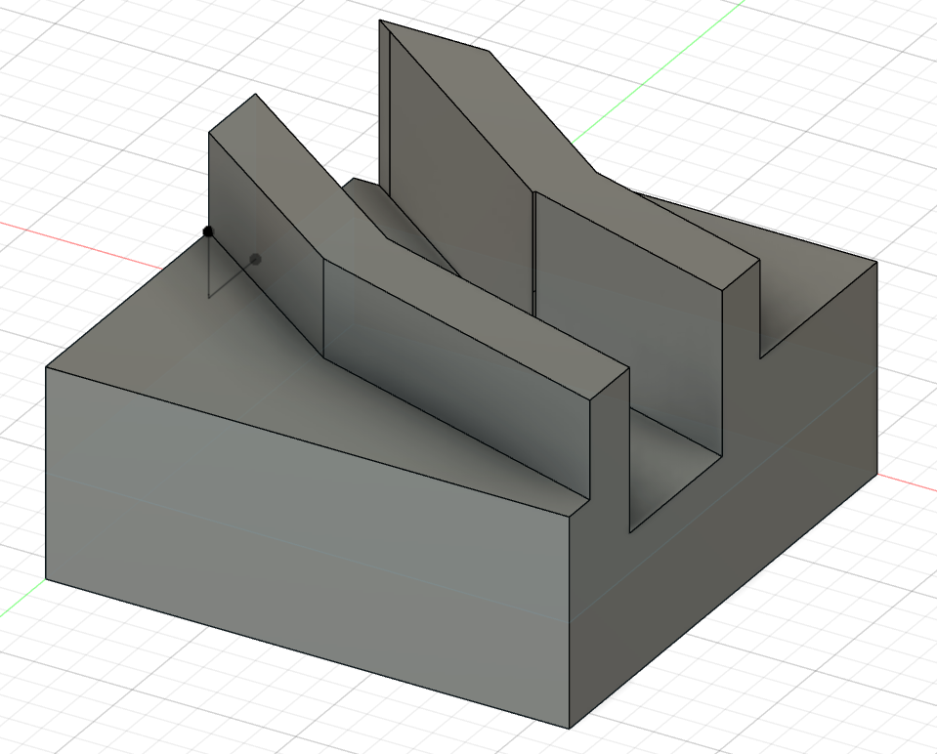
Challenges we ran into (part 2)
We decided to 3D print most of our components, as a lot of them relied on very specific angles to ensure that we could maximize the angle of effect of each corner.
However, our 3D prints changed a lot as our ideas for implementation changed. We had to go through over 5 different iterations of the models before we settled on what we now have.
To print out just one iteration took over 3 hours, so there was a large gap between modeling and the finished print. During one of the prints, we decided midway through on a better model and had to scrap the whole print. All in all, printing everything took over 20 hours.
Initial mount design
Final mount design

Slide 7
Features to add
We would have liked to add some buttons that allow you to change color/brush size, as well as a button that allows you to erase.
We would have liked to have a larger area to draw on, since ours is rather small
Cleaning up wires: putting the breadboards underneath the drawing area so they’re hidden and out of the way.

