Slide 1
Problem of Hospital location

Slide 2
Introduction
My native country is Morocco with HDI (Human developpement index) value for 2018 is 0.676, which put the country in the medium human development category positioning it at 121 out of 189 countries and territories. Between 1990 and 2018, Morocco's HDI value increased from 0.458 to 0.676, an increase of 47.7 percent.

Slide 3
Problem
The problem to solve is to find the place where to build a hospital, so to find the neighbor where there is less hospital, I will do this for only one city as an example but we can do the same for all cities.

Slide 4
Data section
We will need data about hospital in Marrakech city, in order to do our analysis about neighbors, to know the ones that have less hospitals and one with less hospitals.
So we will use Foursquare location data to solve the problem in combination with other data from official institute in Morocco.
-Data about health in Morocco : www.Hcp.ma

Slide 5
Getting hosptal ocation from foursquare
This category Id is used for URLS in foursquare in order to extract hospitals
Our URL become like this
“'https://api.foursquare.com/v2/venues/explore?&categoryId=4bf58dd8d48988d196941735&client_id={}&client_secret={}&v={}&ll={},{}&radius={}&limit={}'”

Slide 6
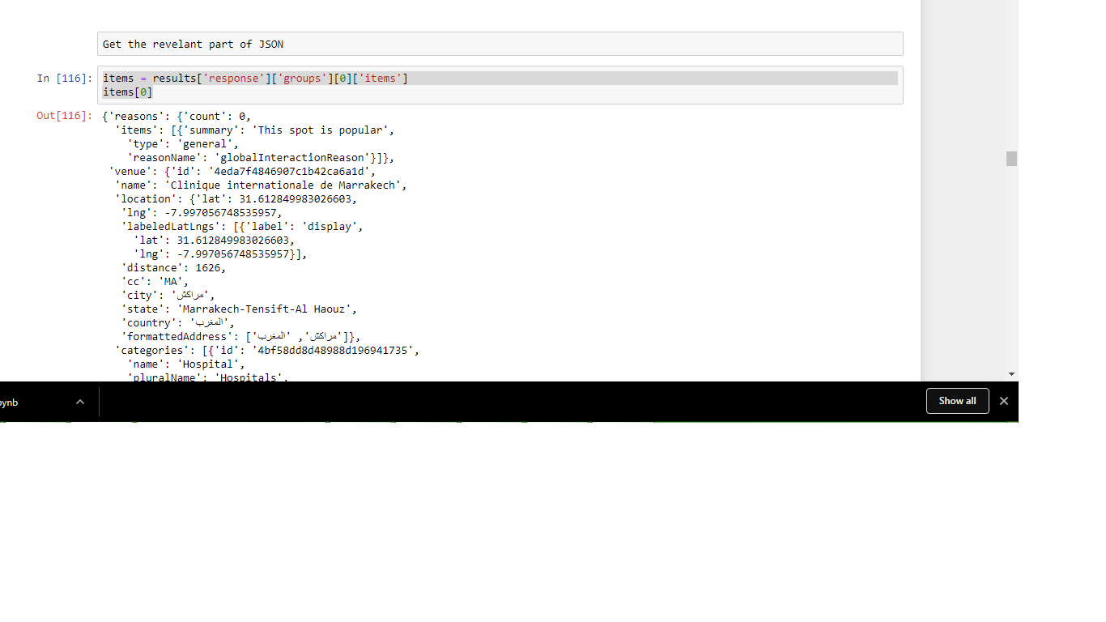

Slide 7
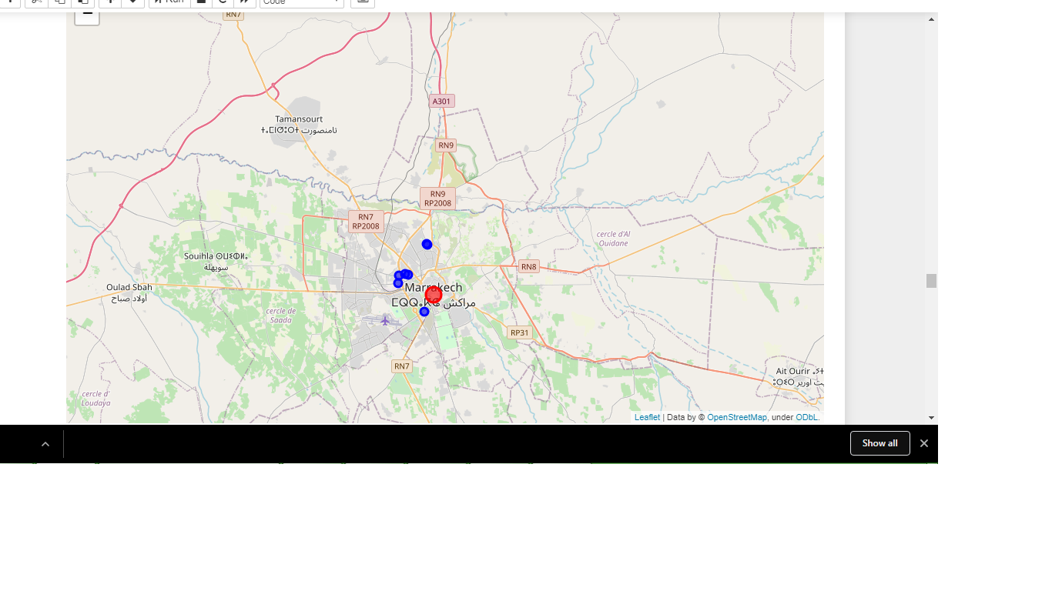

Slide 8
DISCUSSION
Different epsilon parameters in the DBSCAN Model return different number of clusters with similar results. The best result is as presented. However I believe that the results are quite satisfying

Slide 9
Conclusion
To sum up, the adventurer can go to purple cities such as Marrakech with a lot of theater opportunities at the center of the city.

