Slide 1
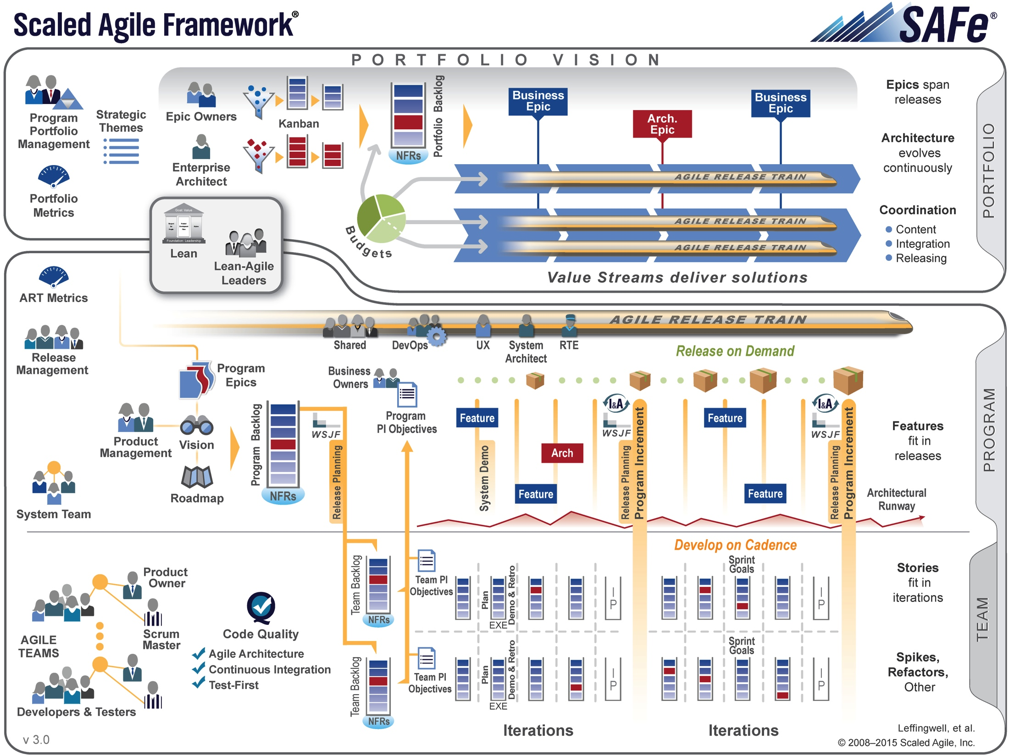
Scaled Agile Framework™ Big Picture

