Slide 1
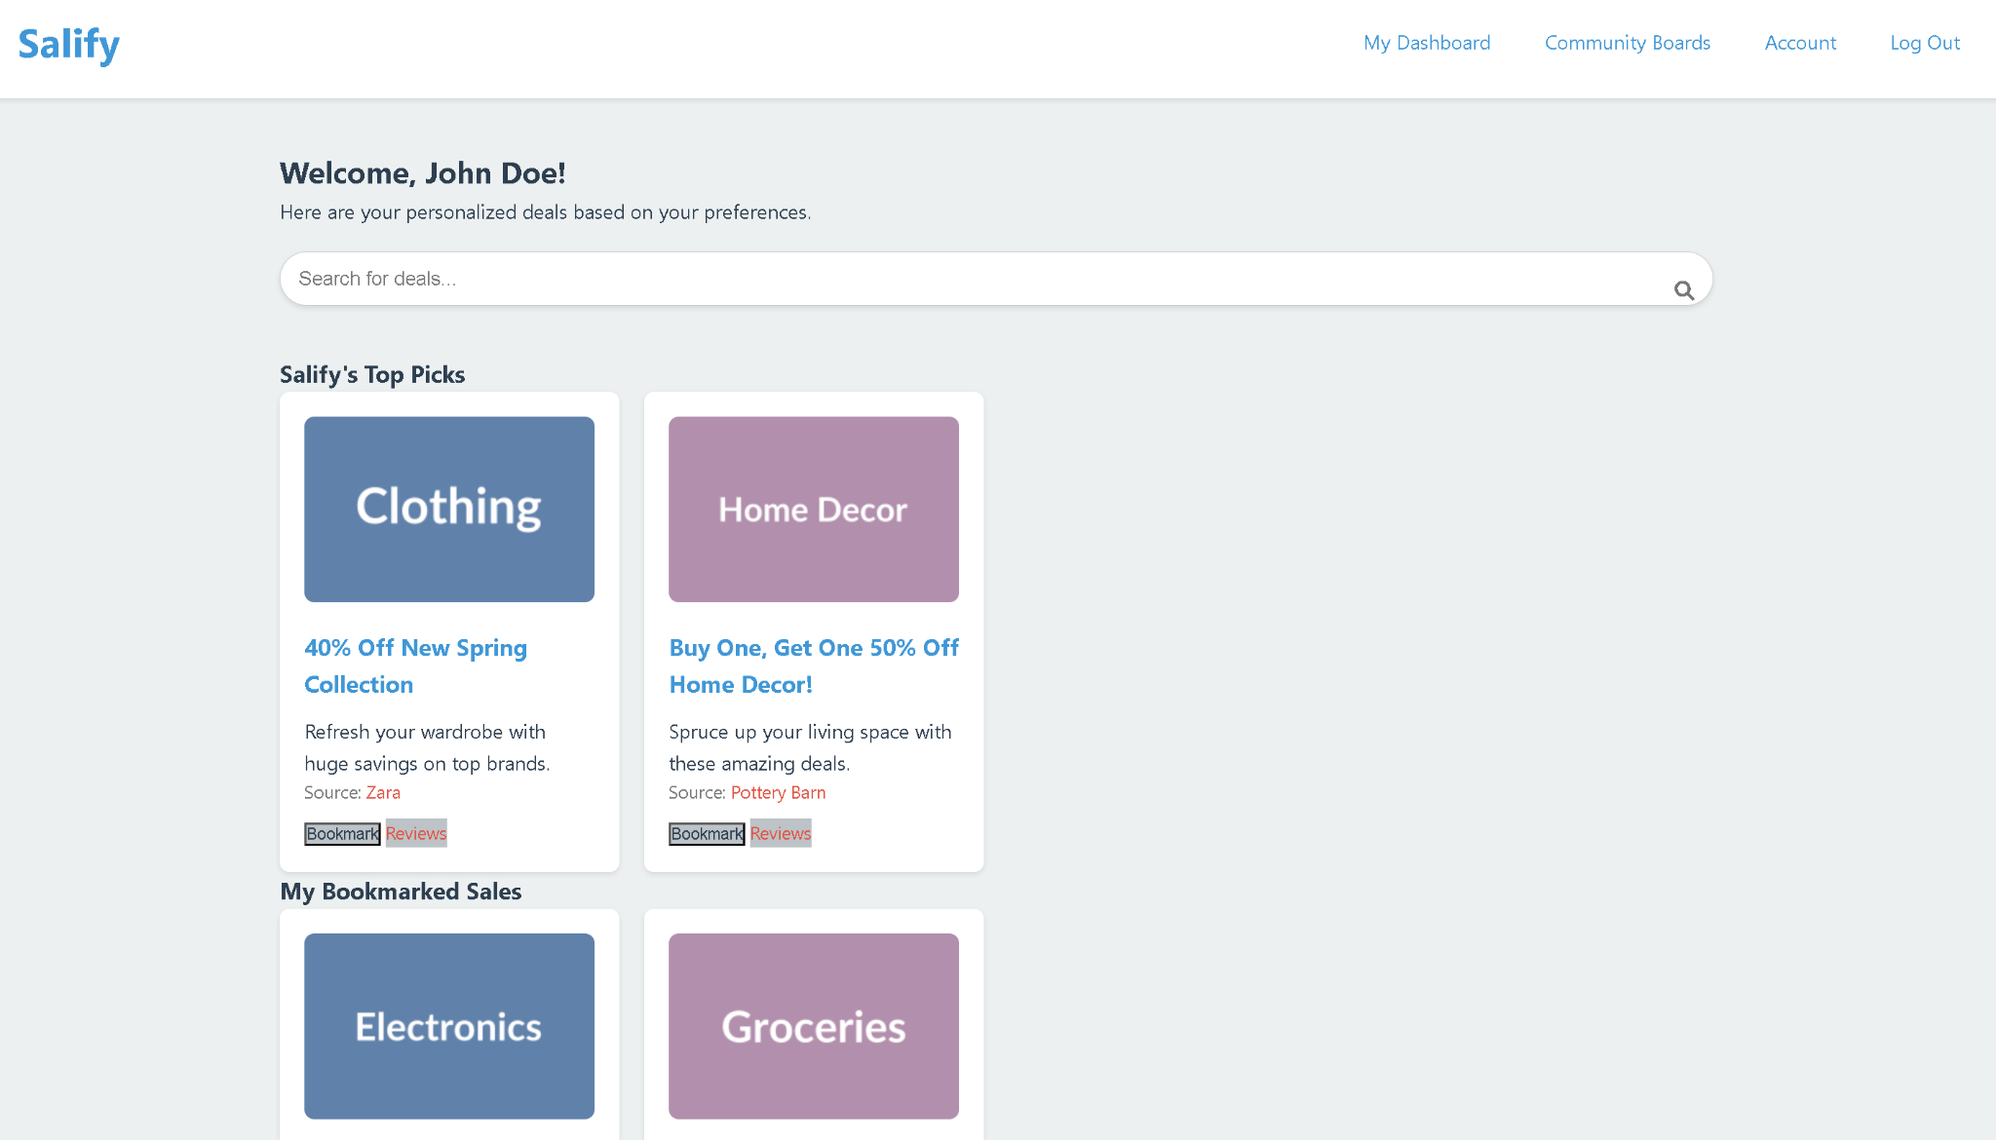
Salify
By: Franklin Lagos
&
Papa Dieng

Slide 2
Ever tried finding the best deals?
Looking for deals can be time-consuming.
Unknown Legitimacy of sellers.
Are there any coupons to further reduce the price?

Slide 3
Salify
A community-driven website to view available deals found and shared by users from all kinds of local or online stores.

Slide 4
Features
View deals shared by users.
Create board to share deals.
Search for deals in specific categories.
Bookmark boards from other users to be notified of new updates.
Review boards to inform other users.

Slide 5
Future features
Recommend deals to board creators.
Mark select categories as “Do not recommend”

