Slide 1
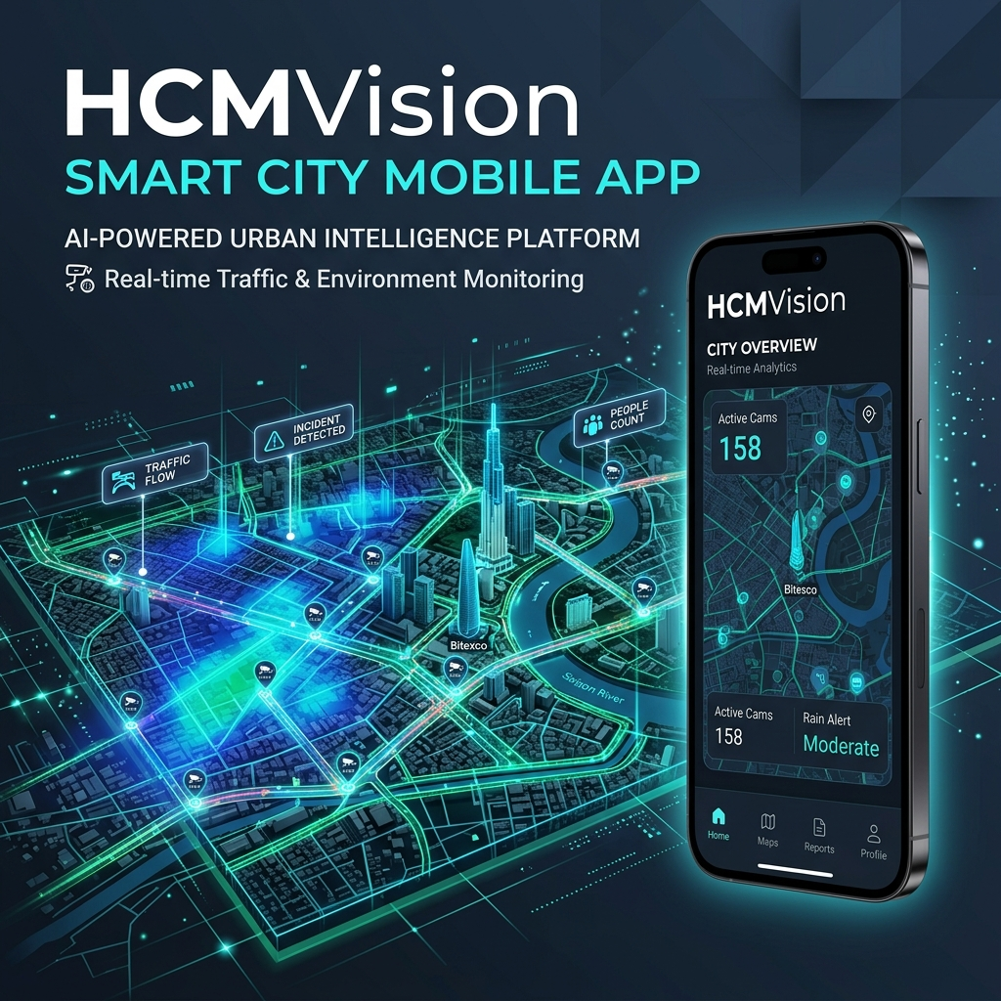
PROJECT DEMO PRESENTATION
HCMVISION
Smart Urban Traffic & Flood Monitoring System Powered by AI Camera Surveillance Network
React Native / Expo 56
Smart Safe Route
AI Vision Pipeline
Real-time Alert
PRESENTATION DETAILS
• Academic Advisor: Evaluation Committee / Faculty of IT • System Architecture: Cross-Platform Mobile App (iOS / Android) & Cloud API • Deployment Status: Live Demo APK & Production Cloud API on Render

Slide 2
PROBLEM STATEMENT & MOTIVATION
Urban Mobility & Flooding Challenges in Ho Chi Minh City
1. Severe Urban Rain Flooding
HCMVISION SOLUTION GOALS
TP.HCM experiences 40+ recurrent flood hot spots. Heavy rains combined with high tides cause severe street submergence and traffic gridlock.
Transforming existing municipal CCTV infrastructure using Artificial Intelligence (AI Vision) ✔ Automated Rain & Congestion Detection from CCTV stream snapshots. ✔ Interactive Real-Time Rain Heatmap showing flood intensity across city wards. ✔ Smart Safe Routing algorithm guiding commuters away from flooded roads. ✔ Ward-Level Push Alerts delivering targeted location warnings to citizens.
2. Generic Weather Forecasts
Standard weather apps report city-wide forecasts, lacking street-level or ward-level flooding resolution for commuters.
3. Unutilized Municipal Cameras
Hundreds of public traffic CCTV cameras are only viewed manually, lacking automated real-time Computer Vision intelligence.
HCMVision | Smart Urban Traffic & Weather Monitoring System
Demo Presentation 2026

Slide 3
SOLUTION OVERVIEW
HCMVision Core 4-Pillar Architecture
1. AI Camera Surveillance
2. Smart Safe Routing
Monitors 100+ municipal traffic cameras, automatically analyzing Rain Level, Traffic Congestion, and AI Classification Confidence Scores.
Intelligent Check Route Safety algorithm: Analyzes route polyline buffers, evaluates flood risk, and suggests safe alternative paths.
3. AI Assistant & Alerts
4. Admin & Health Portal
24/7 AI Traffic Chatbot for natural language query assistance & location-based Push Notifications when rain probability exceeds thresholds.
Comprehensive admin dashboard: Monitors stream Ingestion Jobs, Camera Health/Offline status, and AI Model Audit verification logs.
HCMVision | Smart Urban Traffic & Weather Monitoring System
Demo Presentation 2026

Slide 4
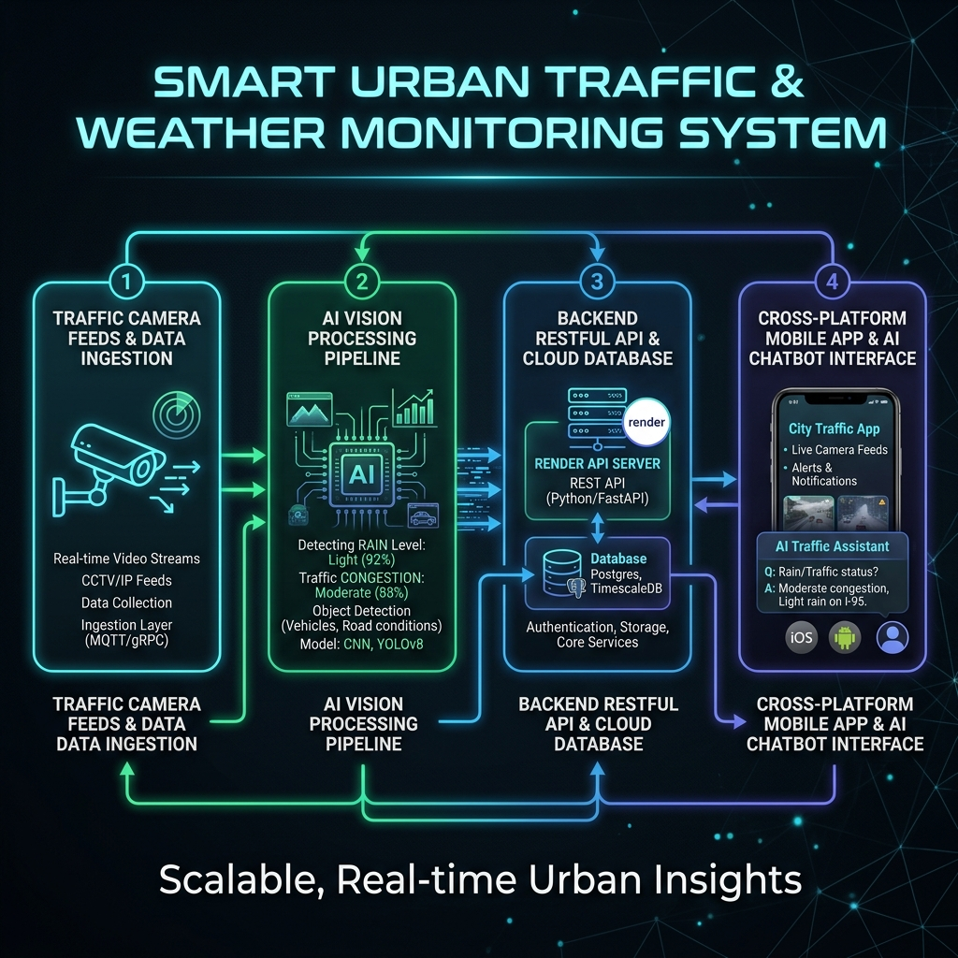
TECHNICAL ARCHITECTURE
System Architecture & AI Data Processing Pipeline
TECHNOLOGY STACK
Frontend App:
React Native (Expo SDK 56), TypeScript, Expo Router
State & Query:
TanStack React Query v5, AsyncStorage, SecureStore
Maps & UI:
React Native Maps, Reanimated, Expo Glass Effect
Backend Cloud:
RESTful API (Production on Render Cloud / Swagger)
AI Vision Model:
Computer Vision Pipeline (Rain, Traffic & Redaction)
AI Assistant:
Remote LLM Engine (Qwen / Fallback Smart Handler)
HCMVision | Smart Urban Traffic & Weather Monitoring System
Demo Presentation 2026

Slide 5
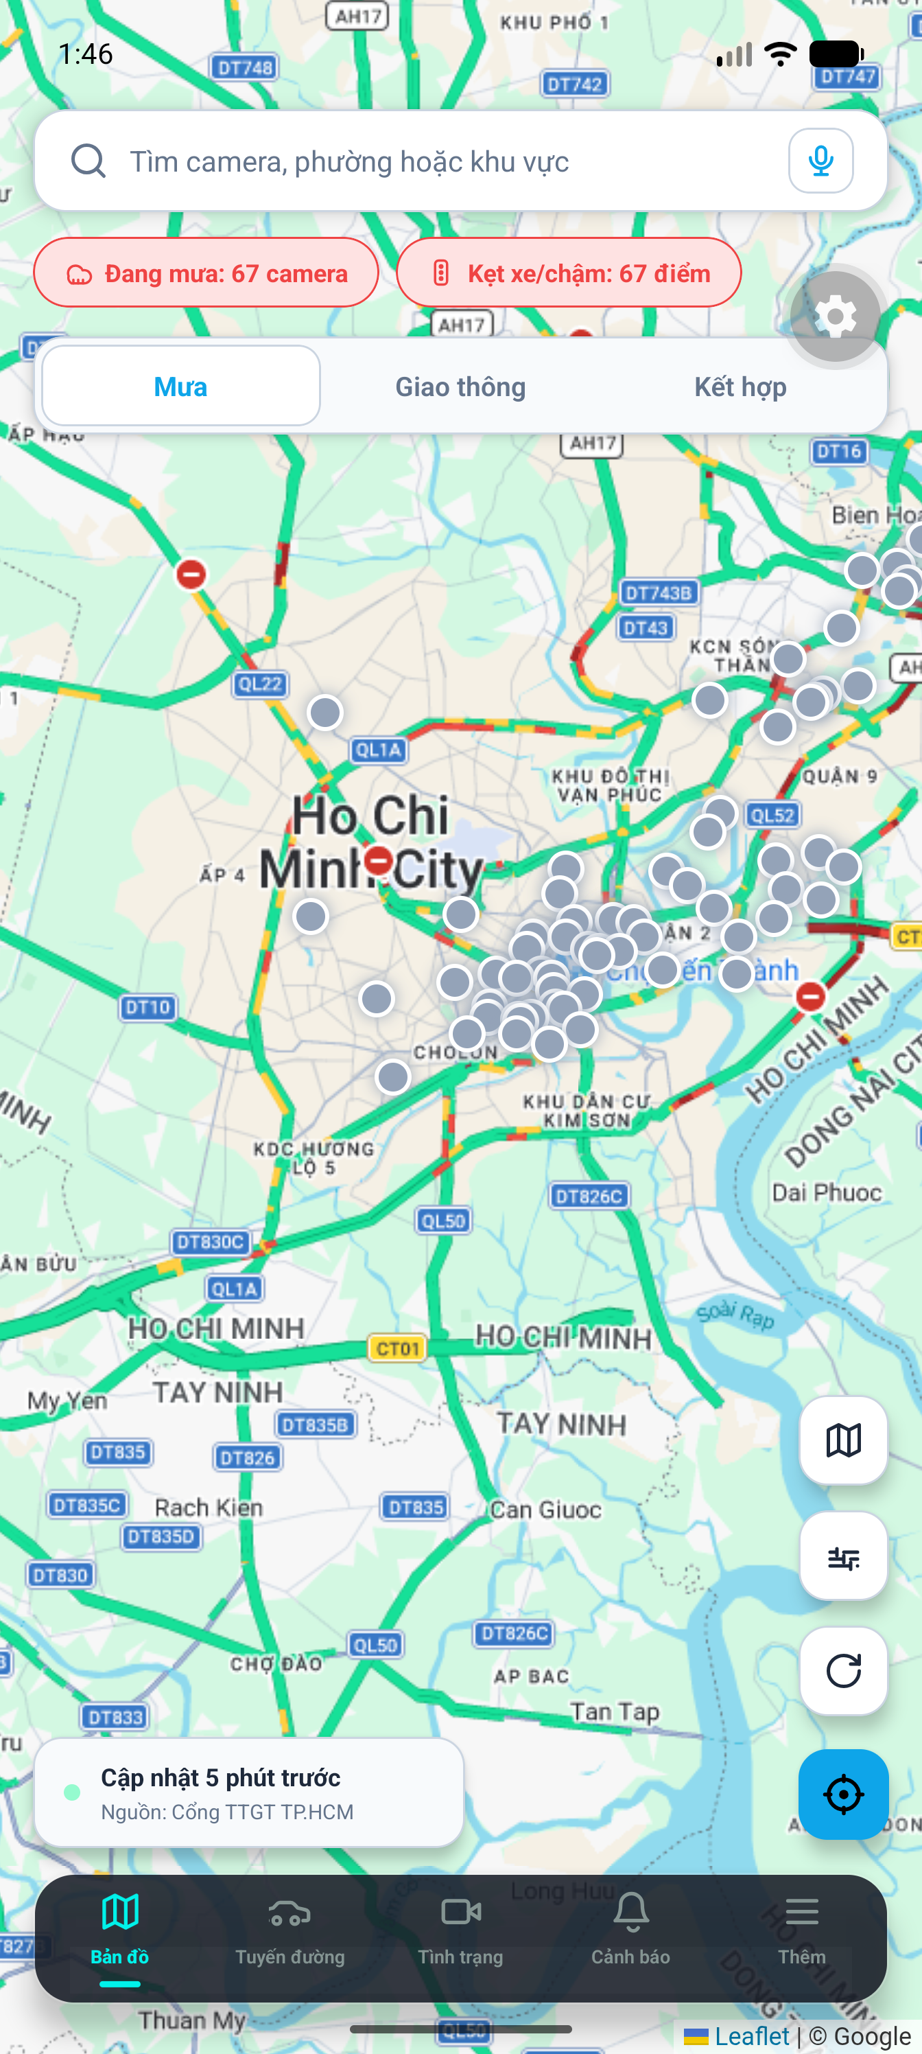
MAP & EXPLORE
Interactive Map: Real-Time Rain Heatmap & Camera Network
MAP & EXPLORE FEATURES
LIVE MOBILE APP INTERFACE
▸ Real-Time Camera Visualization Displays color-coded markers for Normal, Raining, Jammed, and Offline municipal traffic cameras. ▸ Dynamic Rain Heatmap Layer Automated rainfall intensity overlay computed from live camera AI weather logs in real-time. ▸ Granular Spatial Filtering Filter cameras by District/Ward boundaries, favorite camera lists, or active flood alerts.
HCMVision | Smart Urban Traffic & Weather Monitoring System
Demo Presentation 2026

Slide 6
SAFE ROUTING
Check Route Safety Algorithm & Risk Assessment
CHECK ROUTE SAFETY ALGORITHM
CHECK ROUTE API RESPONSE STRUCTURE
1. Accepts Origin & Destination GPS coordinates. 2. Extracts route polyline points and generates a spatial buffer corridor. 3. Cross-references live WeatherLogs & AI Camera data recorded in the last 30 mins. 4. Computes Risk Level: SAFE, WARNING, or HIGH RISK. 5. Outputs specific risk warnings and automatically suggests safe alternative routes.
Field Name | Description & Schema Meaning
isSafe | Boolean (true: Safe route / false: Flood risk)
riskLevel | Severity: SAFE / WARNING / HIGH_RISK
summary | Route status summary (e.g. 2 cameras reporting rain)
recommendation | Actionable navigation advice for drivers
warnings[] | Array of camera warning logs with lat/lng & rain levels
HCMVision | Smart Urban Traffic & Weather Monitoring System
Demo Presentation 2026

Slide 7
AI CAMERA SURVEILLANCE
Real-Time AI Camera Analysis & Privacy Redaction
CAMERA STATUS DATA MODEL (CAMERA STATUS ITEM)
KEY FEATURES
Property | Data Type | Description & AI Analysis Role
isRaining / rainLevel | Boolean / String | Detects rain occurrence & rainfall severity (Light/Moderate/Heavy)
isTrafficJammed / trafficLevel | Boolean / String | Detects traffic congestion & road queue level
confidence | Float (0.0 - 1.0) | AI Computer Vision classification confidence score (%)
aiReason | String | Explainable AI rationale (e.g. wet road reflection, rain drops)
imageIsRedacted | Boolean | Privacy protection (Automated blurring of license plates & faces)
timeAgo / lastUpdatedAt | String / UTC | Timestamp of latest camera status update
▸ Live Snapshots & Streams Periodic image refresh from municipal camera feeds. ★ Favorite Cameras Save frequently monitored cameras for quick access. 🔒 Privacy-Safe Automated redaction of sensitive visual elements before serving.
HCMVision | Smart Urban Traffic & Weather Monitoring System
Demo Presentation 2026

Slide 8
AI ASSISTANT & ALERTS
AI Traffic Chatbot & Smart Location-Based Alerts
AI TRAFFIC CHATBOT ASSISTANT
LOCATION SUBSCRIPTIONS & REPORTS
▸ Natural Language Queries Users can ask: 'Is Nguyen Huu Canh street flooded right now?' or 'Suggest a route from District 1 to District 7'. ▸ Remote LLM Integration Connected with Qwen/LLM engine synthesizing live camera telemetry for accurate responses. ▸ Context-Aware Prompt Suggestions Automated suggestion chips for instant user questions.
▸ Ward-Based Push Alerts Users subscribe to specific Wards and set custom rain probability thresholds. ▸ Expo Push Notification Service Instant background alerts even when the application is minimized. ▸ Crowdsourced User Reports Allows citizens to report ground-truth weather to validate AI predictions.
HCMVision | Smart Urban Traffic & Weather Monitoring System
Demo Presentation 2026

Slide 9
ADMINISTRATION & AUDIT
Admin Operations: Camera Health, Ingestion & AI Audit
1. System Overview Metrics
2. Camera Health & Ingestion
Track total camera counts, active/offline status, raining ratio, and total registered users.
Manage stream ingestion sync jobs, latency tracking, and camera failure alerts.
3. AI Model Audit Report
4. Access Control & Logs
Compare AI detection outputs (AiRainLevel, Confidence) against crowdsourced user feedback.
User/Admin role management, status toggling, and comprehensive audit logging.
HCMVision | Smart Urban Traffic & Weather Monitoring System
Demo Presentation 2026

Slide 10
PRODUCTION DEPLOYMENT
Android APK Packaging & Cloud Infrastructure
DEMO APK SPECIFICATIONS
CLOUD BACKEND & API PROD
APK Package | HCMVision-demo-2026-06-24.apk
Package Name | com.anonymous.HCMVision
Android Version | Android 7.0 (API 24) or higher
Supported Arch | arm64-v8a, armeabi-v7a, x86, x86_64
Install Method | Direct Sideload / ADB Install
Access Mode | Guest Mode (No login required)
▸ Live Production API Endpoint: https://hcmvision-api.onrender.com/api ▸ Cold-Start & Cache Handling: Integrated React Query caching & graceful loading UI state while backend server wakes up. ▸ Offline Fallback & Reliability: Resilient fallback data mode ensuring app stability during network dropouts.
HCMVision | Smart Urban Traffic & Weather Monitoring System
Demo Presentation 2026

Slide 11
EVALUATION & ROADMAP
Project Strengths & Future Development Plan
KEY PROJECT STRENGTHS
FUTURE DEVELOPMENT ROADMAP
✔ High Practical Impact: Directly addresses urban flooding and traffic congestion in Ho Chi Minh City. ✔ AI on Existing Infrastructure: Maximizes resource efficiency by leveraging existing municipal CCTV feeds. ✔ Seamless User Experience: Modern dark UI, fast responsive performance, cross-platform iOS & Android support.
🚀 1. IoT Flood Sensor Integration Merge AI vision with physical IoT water level sensors for deep flood detection. 🚀 2. Advanced Vision Models Train models for traffic sign recognition, vehicle count estimation, and accident detection. 🚀 3. Vehicle Infotainment Support Extend application to Android Auto & Apple CarPlay for in-car driver warnings.
HCMVision | Smart Urban Traffic & Weather Monitoring System
Demo Presentation 2026

Slide 12
THANK YOU FOR YOUR ATTENTION!
Smart Urban Traffic & Weather Monitoring System (HCMVision)
MOBILE APP DEMO READY FOR LIVE TESTING
APK: builds/HCMVision-demo-2026-06-24.apk | Live API: hcmvision-api.onrender.com
QUESTIONS & ANSWERS (Q&A)
We welcome feedback and questions from the Faculty & Evaluation Committee!

