Slide 1
Spotify Genre Classification
STATISTICAL LEARNING PROJECT - FELICE FRANCARIO

Slide 2
INTRODUCTION
OBJECTIVE: analyze the diverse landscape of music genres and develop a classification model capable of predicting the genre of a song based on its audio features.

Slide 3
DATASET
The dataset was downloaded from Kaggle in a CSV format
21 columns, 11400 rows
No missing values
5 nominal columns were removed
16 columns remaining
15 features and 1 response variable (genre)

Slide 4
Description of Features
popularity: A score indicating how popular a track is on Spotify (ranging from 0 to 100).
duration_ms: The duration of a track in milliseconds.
explicit: Indicates whether a track contains explicit content (True or False).
Danceability: Danceability measures how suitable a track is for dancing, ranging from 0 to 1. Tracks with high danceability scores are more energetic and rhythmic, making them ideal for dancing.
Energy: Energy represents intensity and activity within a song on a scale from 0 to 1. Tracks with high energy tend to be more fast-paced and intense.

Slide 5
Description of Features
Loudness: Loudness indicates how loud or quiet an entire song is in decibels (dB). Positive values represent louder songs while negative values suggest quieter ones.
Key: Key refers to different musical keys assigned integers ranging from 0-11, with each number representing a different key. Knowing the key can provide insights into the mood and tone of a song.
mode: The tonal mode of the track, represented by an integer value (0 for minor, 1 for major)
speechiness: A score ranging from 0 to 1 that represents the presence of spoken words in a track.
acousticness: A score ranging from 0 to 1 that represents the extent to which a track possesses an acoustic quality.

Slide 6
Description of Features
instrumentalness: A score ranging from 0 to 1 that represents the likelihood of a track being instrumental.
Liveness: A score ranging from 0 to 1 that represents the presence of an audience during the recording or performance of a track.
Valence: Valence measures the musical positiveness conveyed by a track, ranging from 0 to 1. High valence values indicate more positive or happy tracks, while lower values suggest more negative or sad ones.
Tempo: Tempo is the speed or pace of a song in beats per minute (BPM). It gives an idea about how fast or slow a track is.
time_signature: The number of beats within each bar of the track.

Slide 7
Track Genres
Classical
Country
Electronic
Hip-Hop
Jazz
Rock
Pop
Blues
Reggae
9 Genres Selected

Slide 8
EXPLORATORY DATA ANALYSIS

Slide 9
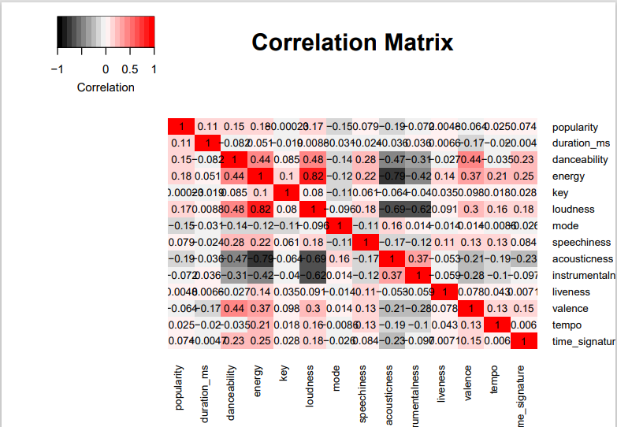
Correlation Matrix
Danceability, energy and loudness are significantly positively correlated with each other and negatively correlated with acousticness, instrumentalness
Very high correlation of 0.82 between energy and loudness.
Very high correlation between energy and acousticness of -0.76

Slide 10
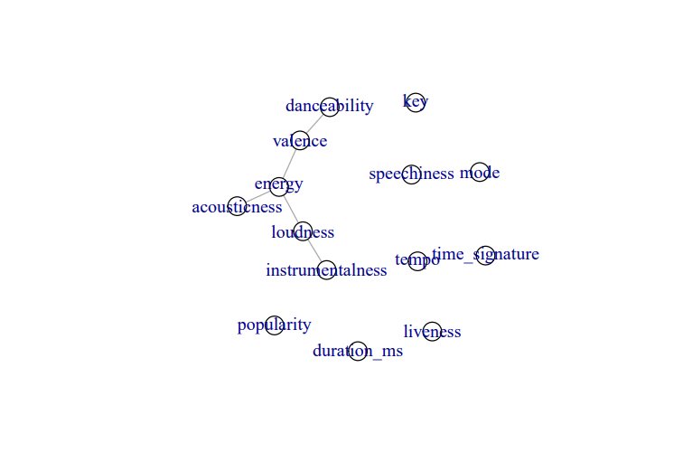
Partial correlation Graph
Threshold=0.3

Slide 11
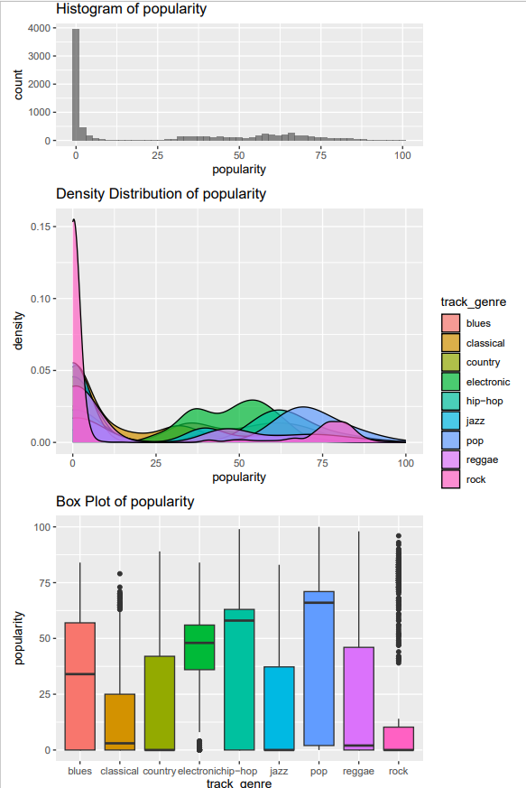
Popularity
Least popular genres: Classical,country, jazz and reggae .
The majority of the rock tracks have a particularly low popularity score , but with a lot of outliers with a very high score.
Most popular genres :pop,hip-hop and electronic.
Hip-hop and pop have the highest spread in popularity values,with a a very high median value but left skewed distributions

Slide 12
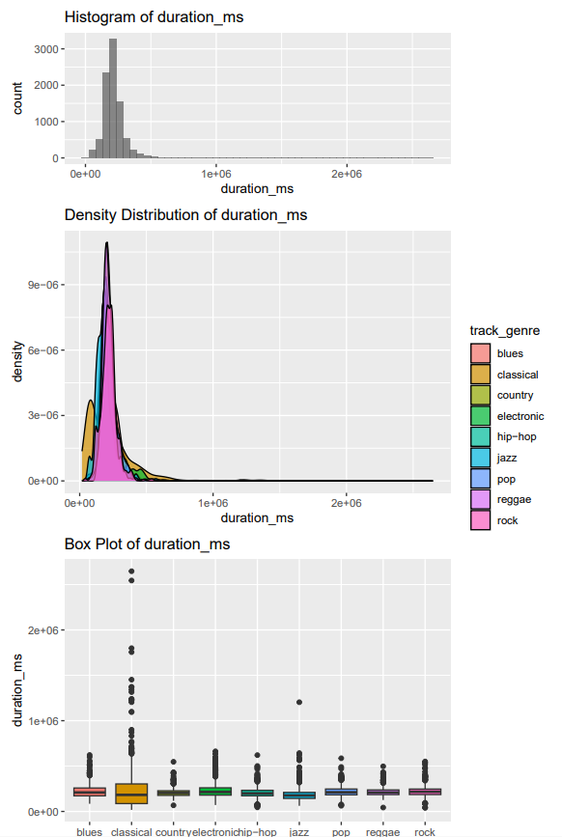
Duration (ms)
All the genres have a relatively similar distribution except the classical genre which has the highest variance and lowest median value.

Slide 13
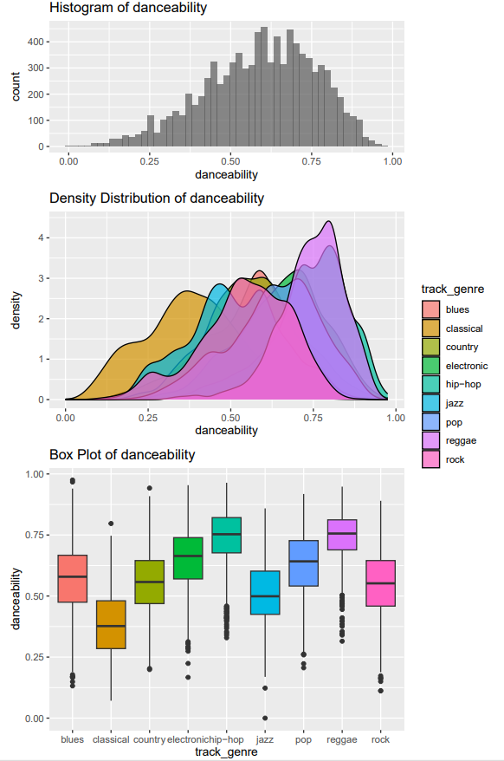
Danceability
Highest Danceability: Hip-Hop and Reggae
Hip-Hop has a slightly higher concentration of tracks near the very maximum value of danceability.
Lowest Danceability: Classical and Jazz.

Slide 14
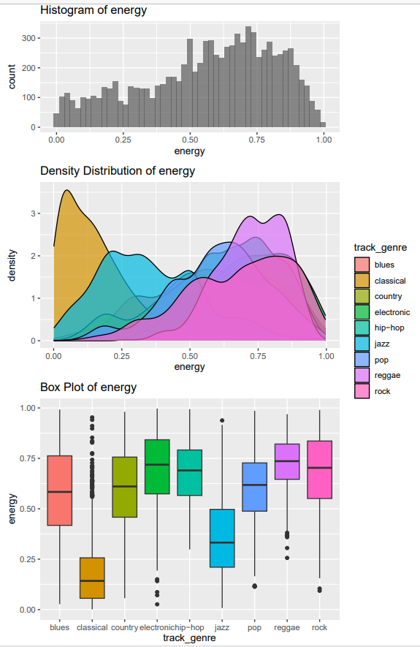
Energy
The distributions of the energy scores are generally similar to danceability but with even lower scores for classical and jazz tracks.
The main differences are that electronic tracks have a higher energy score than hip-hop and rock has a generally much higher energy score compared to danceability.

Slide 15
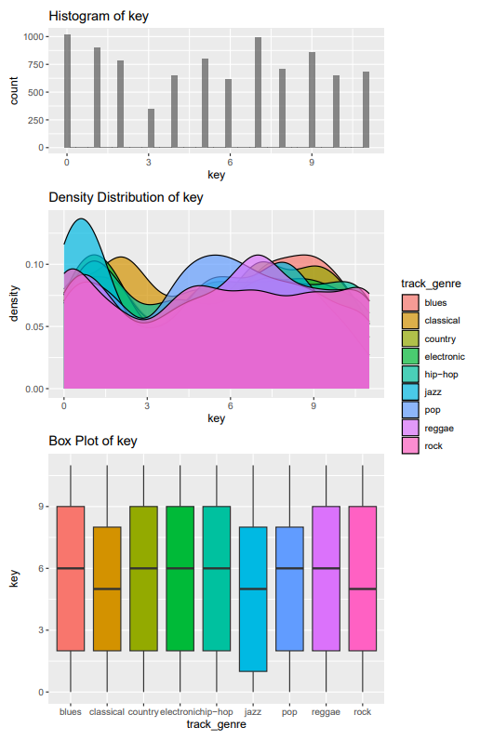
Key
Visually doesn’t have a big effect on the differences between the genres.
Lowest Key median values: jazz,Classical,Rock

Slide 16
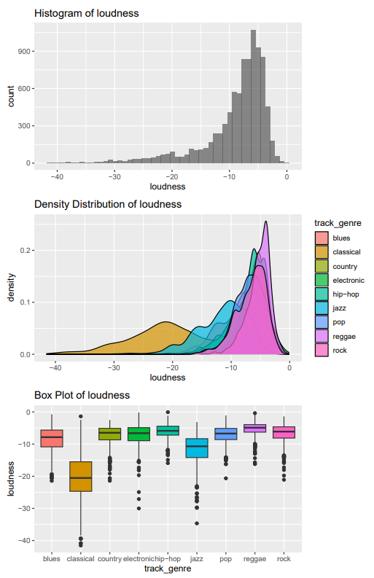
Loudness
Loudest: Reggae and Hip-Hop
Similar distribution to Eneragy(Highly correlated)

Slide 17
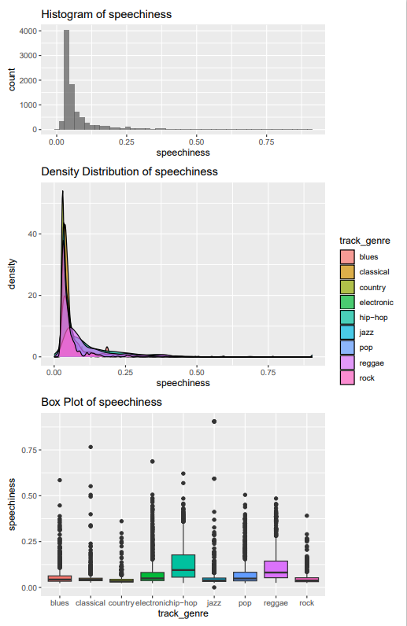
Speechiness
All the genres have a majority of their tracks concentrated at a very low score
country in has the lowest variance
Hip-hop has the highest median value and variance.

Slide 18
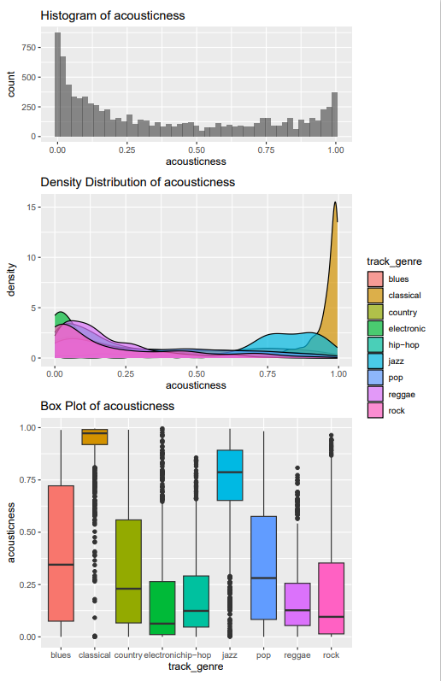
Acousticness
This feature has a high variance for all the genres with the exception of the classical genre which is highly concentrated close to the maximum value of 1.
Highest values: Classical,Jazz
Lowest Values: Electronic, Hip-Hop, Regae

Slide 19
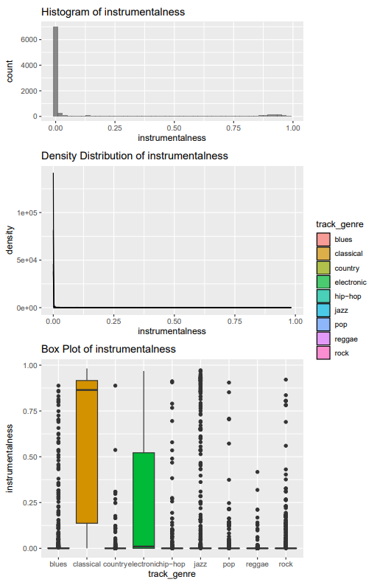
Instrumentalness
Aside from classical and electronic, all the genres have an instrumentalness score close to 0.
Classical has a heavily left skewed distribution with a high variance , and is the only genre with median significantly different from 0.
Electronic has a very right skewed distribution with its median value close to 0 but a very high variance

Slide 20
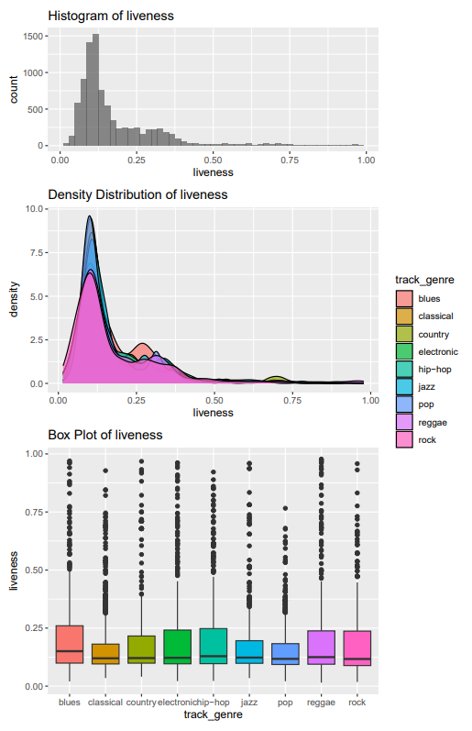
Liveness
Visually there doesn’t seem to be much difference in the liveness distribution of all the genres.
They all have a right skewed distribution with median around 0.12 with the exception of the blues genres which has a slightly higher median value.
There a lot of outliers for each genre.

Slide 21
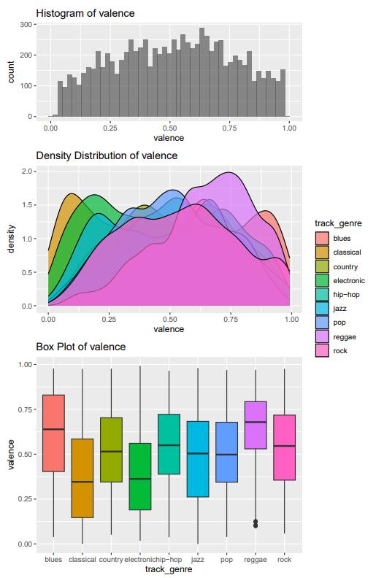
Valence
Highest Valence: Reggae, Blues
Lowest Valence: Classical, Electronic

Slide 22
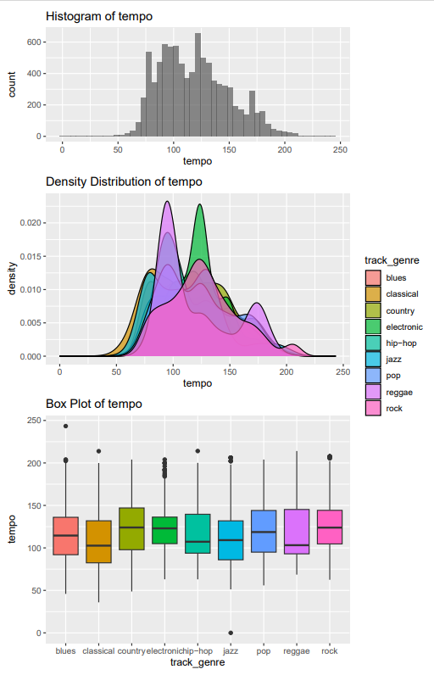
Tempo
The genre distribution are multimodal and have peaks around distinct values.
Reggae and electronic have the most identifiable distributions.

Slide 23
MODELS

Slide 24
Multinomial Logistic Regression
Base Model
Accuracy =49.55% (on test set)
Lowest Class precision: Pop 34.4%, Highest Class precision: Classical 86.7%
Subset Selection
Foward/Backward selection by AIC
Only ‘key’ feature was removed from full set of variables
Accuracy=48.88%
‘Blues’ precision most negatively affected (38% -> 35%)
Backward selection by BIC
Same as the above
Forward selection by BIC
3 features were removed: key,liveness and mode
Accuracy=49.39%

Slide 25
Regularizated Multinomial Logistic Regression
Ridge Regularization
Minimum error Lambda chosen from ten fold cross-validation
Accuracy=49.44%
‘Blues’ precision falls from 37% to 26%
Increase in pop precision from 34% to 38% (previous lowest)
Lasso Regularisation
Lambda chosen with 1 standard error rule from ten fold cross-validation
Accuracy=49.38%
Elastic Net
Lambda and alpha from chosen from ten fold cross-validation
Accuracy=49.56%

Slide 26
Lasso Coefficients
Applied Bootstrap approach to assess the stability and variability of Lasso coefficients across different samples.
Aim to identify important predictors that consistently contribute to the classification of each class while accounting for the variability introduced by the bootstrap resampling process.

Slide 27
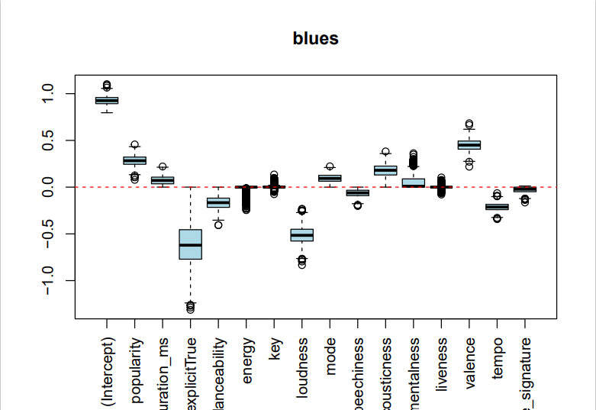
BLUES
Zero coefficients:
Energy
Key
Liveness
Important Coefficients:
Explicit (-)
Valence (+)
Loudness (-)

Slide 28
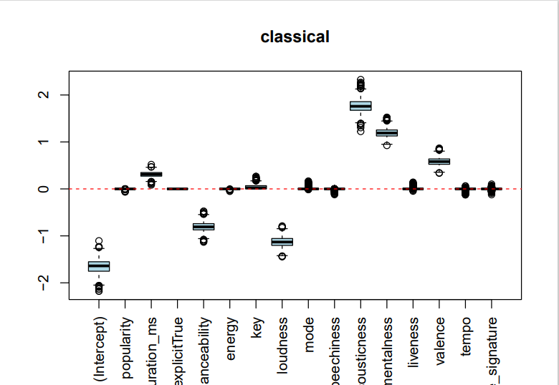
Classical
Zero coefficients:
Popularity
Energy
Key
Mode
Speechiness
Liveness
Tempo
Time signiture
Important Coefficients:
Acousticness (+)
Instrumentalness (+)
Loudness (-)

Slide 29
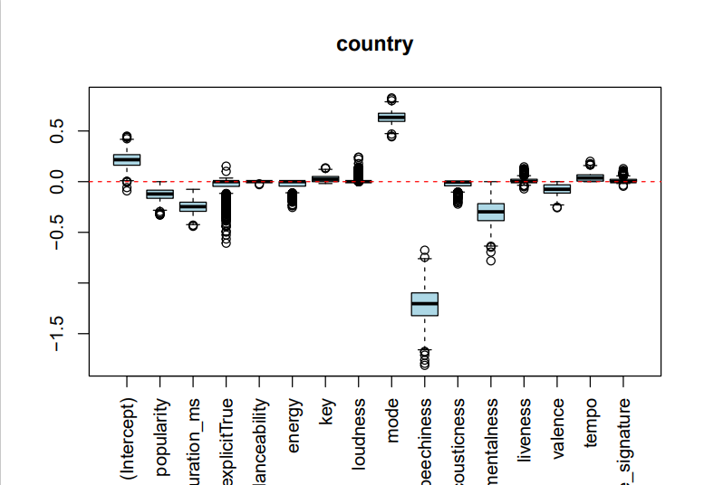
Country
Zero coefficients:
Energy
Danceability
Loudness
Liveness
Time signiture
Important Coefficients:
Speechiness(-)
Mode(+)

Slide 30
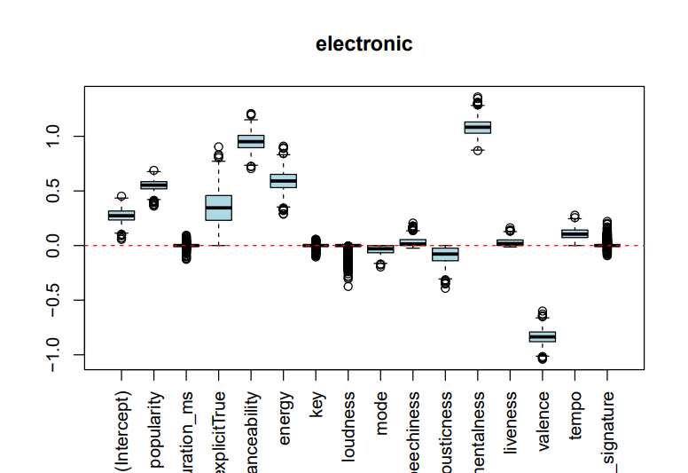
Electronic
Zero coefficients:
Duration
Time signiture
Loudness
Key
Important Coefficients:
Instrumentalness(+)
Danceability(+)

Slide 31
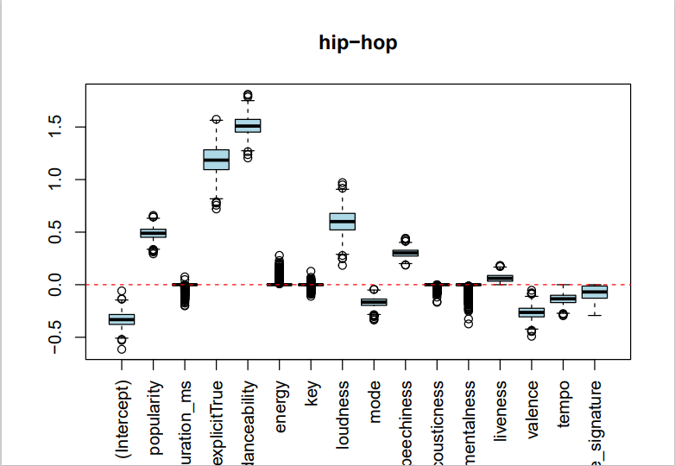
Hip-Hop
Zero coefficients:
Duration
Energy
Key
Acousticness
Instrumentalness
Important Coefficients:
Explicit(+)
Danceability(+)
Loudness(+)

Slide 32
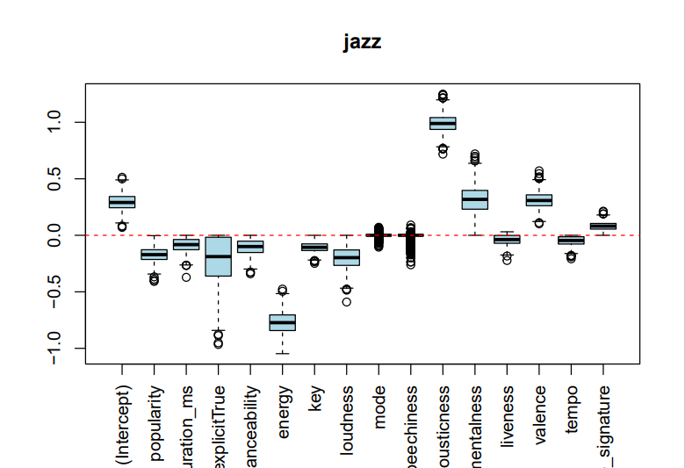
Jazz
Zero coefficients:
Mode
Speechiness
Important Coefficients:
Energy(-)
Acousticness(+)

Slide 33
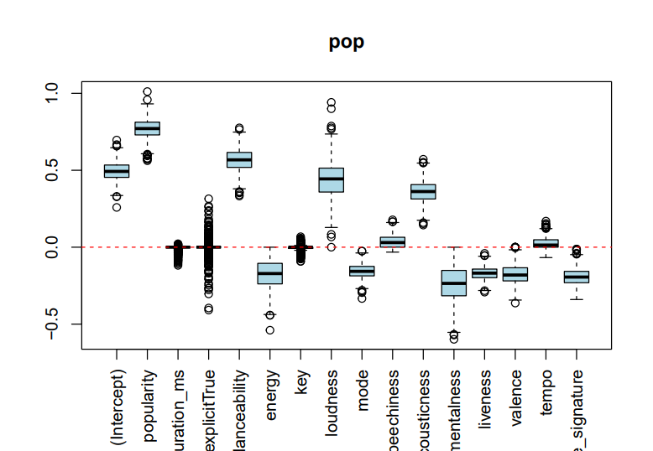
Pop
Zero coefficients:
Duration
Explicit
Key
Important Coefficients:
Popularity (+)
Danceability (+)
Loudness (+)

Slide 34
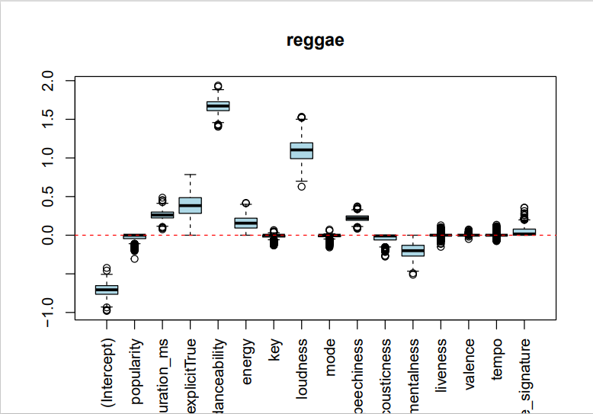
Reggae
Zero coefficients:
Key
Mode
Liveness
Valence
Tempo
Important Coefficients:
Danceability (+)
Loudness (+)

Slide 35
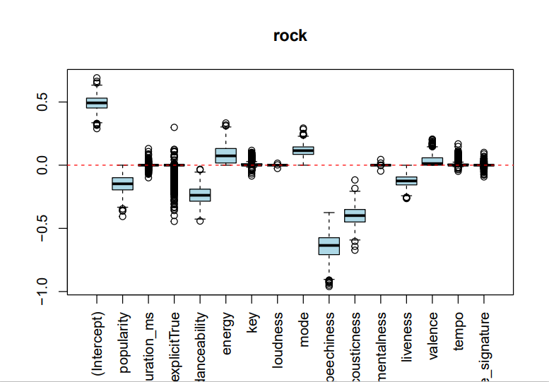
Rock
Zero coefficients:
Duration
Key
Loudness
Instrumentalness
Tempo
Time signiture
Important Coefficients:
Speechiness (-)
Acousticness (-)

Slide 36
K-Nearest Neighbours
The optimal K found from cross-validation was K=1
Accuracy= 54.39%
Low precision of around 40% for Blues, Pop and Hip-Hop
Very High precision of 87% for classical

Slide 37
Random Forest
Applied cross-validation to find the optimal number of variables randomly sampled as candidates at each split when building each tree in the forest: mtry=8
Accuracy=67.78%
Min class precision of 50%: Blues increased by around 10% compared to KNN
Max class precision (classical) is basically the same: 87.67%

Slide 38
Gradient Boosting
Applied cross-validation to select number of trees=2000, interaction depth=10 and shrinkage=0.01
Accuracy = 90%
Lowest class precision is 84.21% for Reggae
Blues precision =88.04% (Lowest in most other models)
Highest precision class Classical = 99.5%

Slide 39
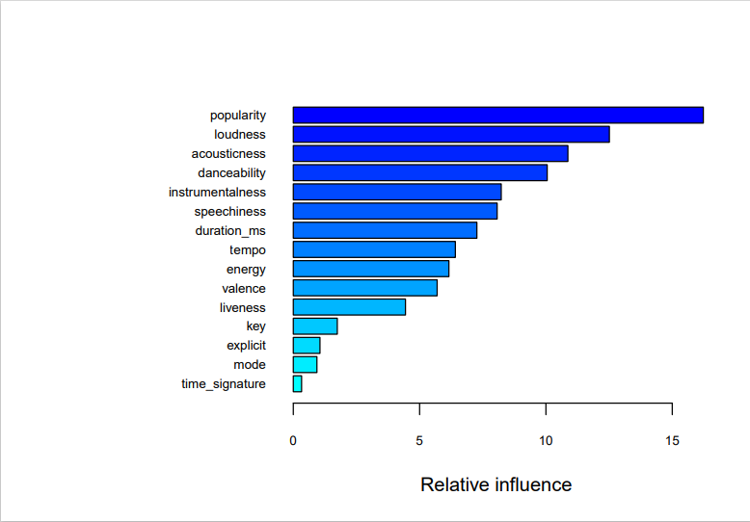
Variable Relative Influence

Slide 40
THANK YOU FOR YOUR ATTENTION

