Slide 1
Implementación de wattmetro
septiembre 2022

Slide 2
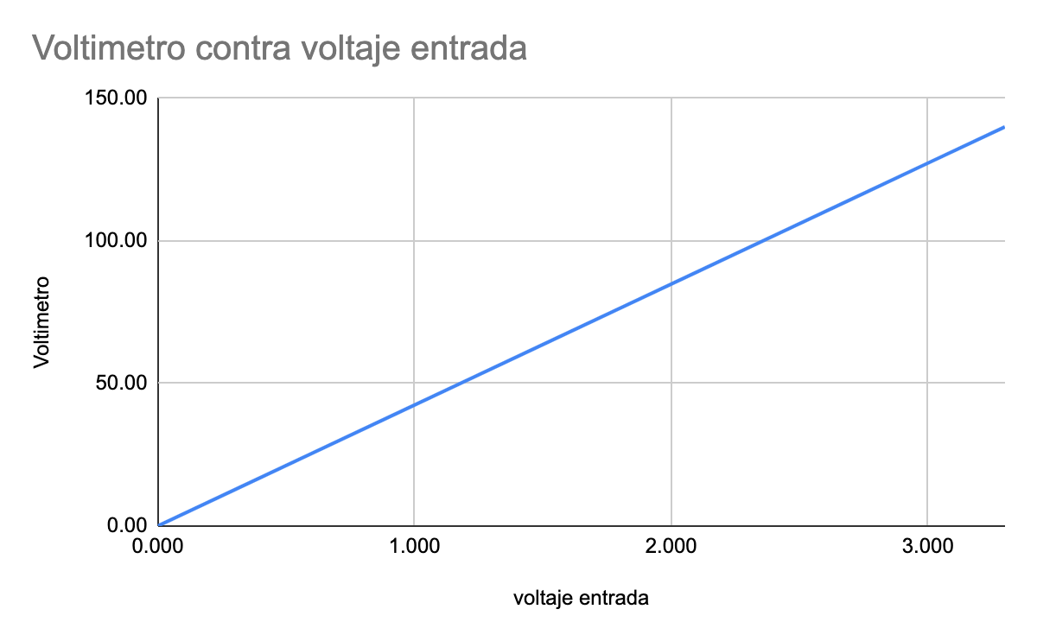
Voltímetro
Vadc 0 - 3.3
Vref = 3.3
Vout = 140
Número bits = 12
Relación = Vadc*Vout/Vref

Slide 3
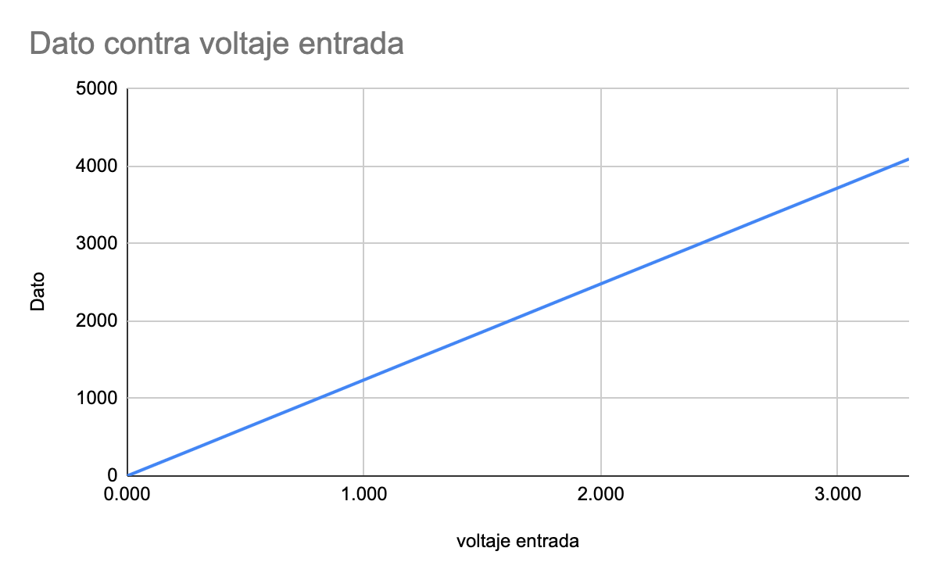
Voltaje
Digital
12 Bits del ADC = 4096 pasos
Vin máximo = 3.3 volts
Relación de conversión = 140/4095
V = dato*140/4095
Analógico
Vbateria = 125
Vdiseño = 140
Vref = 3.3
Relación del divisor = 3.3/140=0.02357
R1 = 1k
R2 = 41.42K

Slide 4
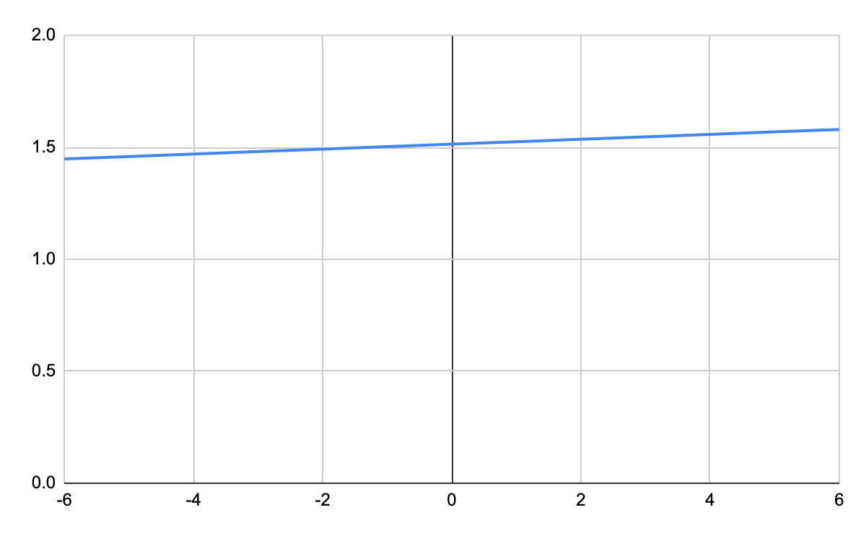
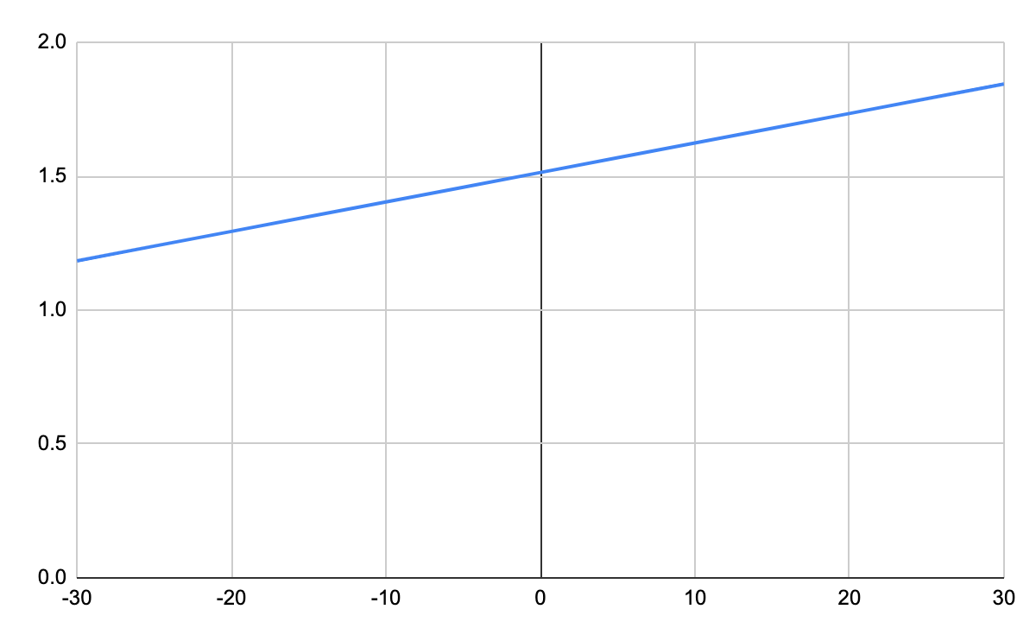
Corriente
Analógico
Inominal = 6 amp
Idiseño = 30 amp
V= 0.01100826854(Iin) + 1.51429751

Slide 5
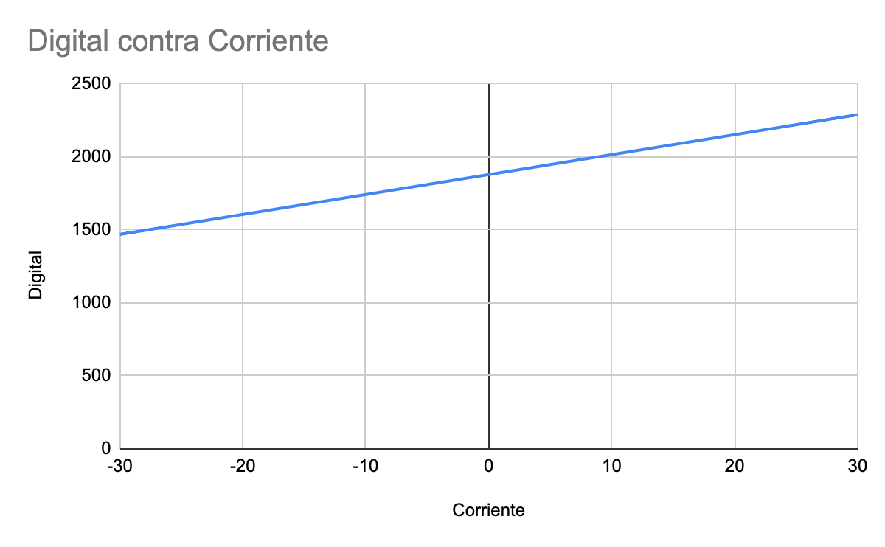
Corriente
Digital
Vadc 1.18 a 1.84 volts
Vref = 3.3
Iout = +-30 AMP
Número bits = 12
Corriente = 0.07320399418*digital -137.5616

Slide 6
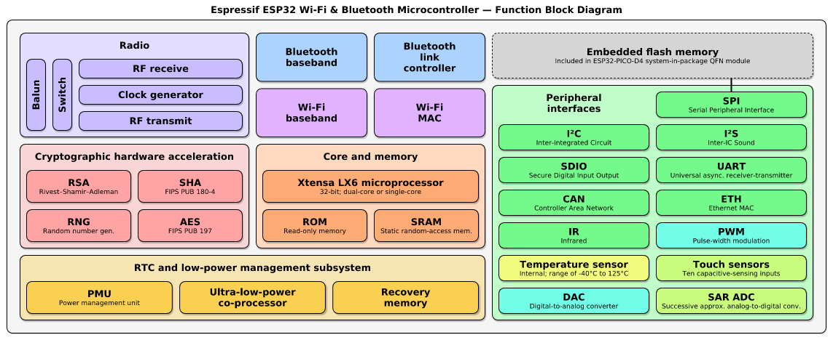
Microcontrolador ESP32

Slide 7
Convertidor A/D
The ESP32 integrates two 12-bit SAR
ADCs supporting a total of 18 measurement channels (analog enabled pins)
ADC1 (8 channels, attached to GPIOs 32 - 39)
ADC2 (10 channels, attached to GPIOs 0, 2, 4, 12 - 15 and 25 - 27) the usage of ADC2 has some restrictions for the application
Each ADC unit supports two work modes, ADC-RTC or ADC-DMA mode
ADC-RTC is controlled by the RTC controller and is suitable for low-frequency sampling operations.
ADC-DMA is controlled by a digital controller and is suitable for high-frequency continuous sampling actions
The ADC should be configured before reading is taken.
desired precision
attenuation by calling functions
read ADC conversion result with

Slide 8
Puerto serial
ESP32 has three UART interfaces
IrDA support
communicating at a speed of up to 5 Mbps
Módulo ESP32-dev conectado utilizando un convertidor USB<->RS232

Slide 9
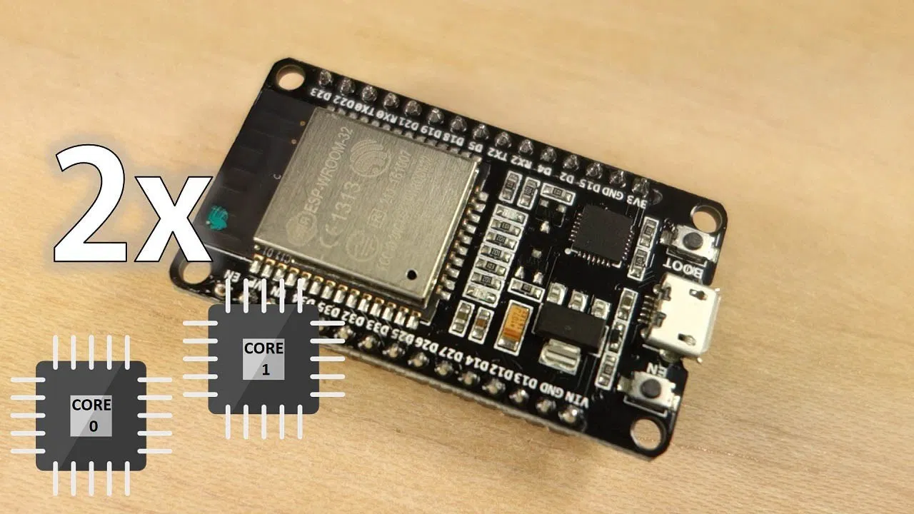
Núcleos del ESP32 0,1
Xtensa® single-/dual-core 32-bit LX6 microprocessor(s), up to 600 MIPS
448 KB ROM
520 KB SRAM
16 KB SRAM in RTC
Funciones para los núcleos
Obtener el núcleo de ejecución xPortGetCoreID()
Crear una manejador de tarea TaskHandle_t Task1
Crear una tarea xTaskCreatePinnedToCore
nombre de Función,nombre de la tarea, tamaño del stack, parámetros de la función, prioridad de la función direcciòn del manejador y núcleo

