Slide 1

Future Tech Network
Felicia Ainslie
Purdue university
it499

Slide 2
Key Points
Software
Hardware
Network Goals
Security Measures
Budget
Notes:
The goal of this meeting is to touch on the areas that will be worked on during this project and uncover any questions or concerns there may be with the project. The Future Tech Network project is critical to the organization’s success as the added computers and network capabilities will allow for the expansion of the current customer base. New computers and network hardware are to be installed along with software and security measures. In this meeting we will also go over briefly what the network goals will be to ensure there are no discrepancies in the organization’s needs. Finally, we will touch on the budget and what will be included in this.

Slide 3

Computers
350 Desktop Monitors
350 Desktops Towers
150 Laptops
Notes:
The systems administrator and software engineer will work together to determine the proper placement of all computers to be installed. They will be responsible for installing the devices and ensuring all associated cabling is functional and connected. Currently, there are several bids out on what devices will be purchased; however, it is certain that they will all be Dell computers running the Windows 10 operating system.

Slide 4

Software
Salesforce CRM
Microsoft Office 365
Paycom
Pidgin
TeamViewer
Basecamp
Notes:
When setting up the computers the software engineer will be responsible for ensuring the proper tools are available on all devices. Salesforce will be used to manage all customer interactions. Paycom will be the software used to track users time, communicate document needs between employees and human resources, document employee development progress or training, and manage payroll. Pidgin is a chat forum that will allow employees throughout the company to quickly communicate with one another. The TeamViewer will help the IT staff help resolve issues with both employee and customer devices. Finally, we will be using Basecamp to assist with tracking project progress for all future projects.

Slide 5
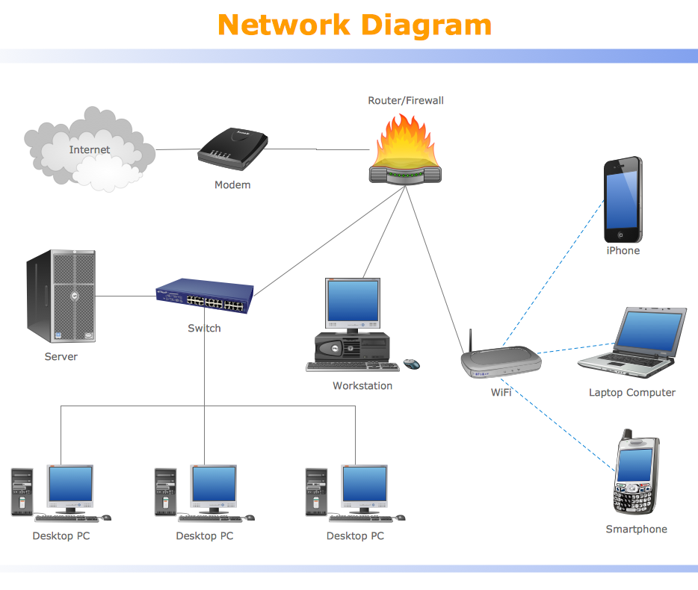
Network Hardware
Cat7 Ethernet Cables
Access Points
Routers
Modems
Switches
Servers
Notes:
Several types of hardware is required to create the Future Tech Network. This network will allow employees to communicate quickly with the users inside the facility in addition to allowing them to access the internet. The network engineer will need to install Cat7 ethernet cables throughout the facility to allow the computers to connect to both the intranet and the internet. Access points, routers, and switches will provide the actual connections between devices and the network. As you can see in the diagram provided the modem will be the piece of equipment used to connect devices to the internet. Finally, the servers will be used to store company data on site.

Slide 6

Network Goals
Floor 2 & 3 100% Coverage
Floor 1 North & South Wings Coverage
30 Mb Download Speeds
10 Mb Upload Speeds
Notes:
The goal of this network is to allow for network connectivity anywhere on the top two floors of the facility in addition to fully covering the north and south wings of the first floor. Being that the facility is roughly 16,000 square feet access points will be strategically placed throughout the building to avoid any dead zones. The first floor has a lower priority than the top two floors as this floor is primarily for meetings and sales associates. Additional access points may be added to the first floor should the need rise. The speed goals for the network are to provide users with a minimum of 30 Mb download and 10 Mb upload speeds. This should prevent unnecessary lag when attempting to assist costumers or complete daily tasks.

Slide 7
Security Measures
/
Physical Locks
Virtual Locks
Avast Antivirus
Power On Notification
Device Use Contract
Notes:
When establishing the network there are several security measures that need to be taken to prevent downtime in the organization. Physical locks will be installed on the server room doors to ensure only authorized parties can access them. Virtual locks will involve a two-factor authentication for device use as well as individual logins with passwords for all applications to be used. When powering a device on a notification will appear on the screen prior to the login screen to inform users of the potential legal repercussions should the device be used inappropriately. Avast has been the chosen antivirus program that will be installed on all devices to prevent potential external harm. Finally, each employee will be required to sign a device use contract to help ensure Future Tech data stays inside the organization.

Slide 8
Budget
Notes:
The estimates shown here were pulled directly from the project’s established budget plan. As predicated, a majority of the budge will be spent on the software and hardware necessary to create the Future Tech Network. The labor costs shown involve totals from the hours worked by the project manager, agenda director, system administrator, software engineer, network engineer, and the testing engineer. The contingency costs planned include costs for additional hardware and labor should the need arise. In the event that the contingency costs are greater than predicted, the overall project cost estimate is $374,800 which falls well under the project’s budget of $600,000.

Slide 9
Associated Costs
Notes:
The associated costs chart shown provides a high level view of the costs throughout the project. In this chart the projected weekly and cumulative costs were merely initial estimates drawn from potential labor and material costs. As you can see, the lines shown here indicate only a slight raise from the initial estimates and the actual costs associated with finishing the Future Tech Network. The lower two lines represented these costs from a weekly view while the top two show the cumulative total increase during the course of the project. While the projected costs were lower in both instances, the actual totals were increased due to the labor required being increased to ensure the project deadline was met.

Slide 10

Questions
Notes:
Are there any remaining questions that may not have been resolved?

Slide 11
References
All Photos shown were from unknown author’s and licensed under CC BY-ND or CC BY-SA.
ALLHDD. (2018). WS-C3850-48P-S Cisco Catalyst 3850 48 Port PoE IP Base. New Bulk Pack. Retrieved from https://www.allhdd.com/networking/switch/48-port/ws-c3850-48p-s-cisco-catalyst-3850-48-port-poe-ip-base.-new-bulk-pack./?src=ggl&gclid=EAIaIQobChMI3cmHkZP23gIVqh6tBh2wxgXuEAQYAiABEgJnz_D_BwE
Avast Software Inc.. (2018). Avast Business Antivirus Pro Plus. Retrieved from https://www.avast.com/en-us/business/products/business-antivirus-pro-plus
Fixr. (2018). Hardwired Computer Network Cost. Retrieved from https://www.fixr.com/costs/hardwired-computer-network
Gildred, J. (2018, May 14). 5 Best Affordable Servers for Small Businesses. Retrieved from https://www.cloudwards.net/best-small-business-server/
Hyde, P. (2018, November 23). The 7 Best Small Business Routers to Buy in 2018. Retrieved from https://www.thebalancesmb.com/best-small-business-routers-4171956
Kaleem, Z. (2017, May 18). How to Estimate Number of Access Points Needed for WiFi Projects. Retrieved from https://www.accessagility.com/blog/how-to-estimate-number-of-access-points-needed
Linksys. (2018). Linksys LAPN600 Business Access Point Wireless Wi-Fi Dual Band 2.4 + 5GHz N600 with PoE. Retrieved from https://www.linksys.com/us/p/P-LAPN600/
Thompson, E. (2017, June 18). How Much Should a Business Computer Cost? Retrieved from https://www.business.org/finance/cost-management/much-computer-cost/

