Slide 1


Future Tech Network
Felicia Ainslie
Purdue University Global
IT499
Notes:
(Intro recording transcript)
As we are getting closer to the end of the project, I felt it was important to go over what has been done so far on the Future Tech Network. Our team has worked well collaboratively and although there are still a few things needed to conclude the project, there is a great deal worth celebrating. In this meeting we will go over the details on what hardware and software will be used, what security measures are in place, and what testing has been completed. The system administrator and software engineer have worked together to get our devices up and running so they may be connected to the Future Tech Network. After a great deal of research, careful deliberation, and thorough negotiations the final software's have been decided and the contracts were on signed on weeks three and four of the project.
We will also go over what components have been purchased for the network structure specifically. Although there were some delays in the hardware deliveries due to the holiday season, as of week five the networking engineer has successfully installed and connected all networking hardware. The network equipment was specially arranged to minimize interference and increase broadcast. This was done by setting up access points throughout the facility, adjusting the network channel being used by the router, and dividing the network up into smaller virtual networks assigned to individual departments.
All team members have worked hard these past few weeks to ensure that the Future Tech Network remains safe from harm. This included developing and implementing security techniques in addition to systematically testing all of software and devices connected to the network. The testing engineer has worked closely with the systems administrator, software engineer, and network engineer to determine the best styles of assessments for ensuring both accessibility and security. The goal of this testing is to ensure that the company’s data remains protected from both internal and external attacks. We also want to be sure that the network is capable of handling the amount of user’s that may be on the network at any given time. This meant developing a detailed plan of action and ensuring the network has a dependable failover in place.
In addition to discussing the tasks that have been completed, I will be discussing what steps the team will be taking in the next two weeks to finish up the project. These tasks include the various testing types that we have determined to be necessary to ensure Future Tech’s goals are achieved. While a briefing of each testing type will be given today, I would like to encourage you to do your own research on the topics and feel free to bring it to our attention if you discover any additional steps we should be taking.
The final week of the project we will be having our users log onto their computers and become familiar with them. We hope to have time to provide training where necessary, although this may need to occur after the project’s completion. We are still looking into a formal training conference that will be directed at specific departments, and we will provide ample notice when the final decisions are made regarding this.
I have placed several documents in front of each of you to reference throughout the presentation. These documents include more details about the project’s final budget, tasks completed or in progress, the schedule, and the scope. Also included is a copy of this presentation with the notes included on the back. Throughout this presentation I will provide time for any questions or concerns after each slide and again at the conclusion to ensure all are addressed. Are there any questions before we begin? Alright, let’s begin.

Slide 2

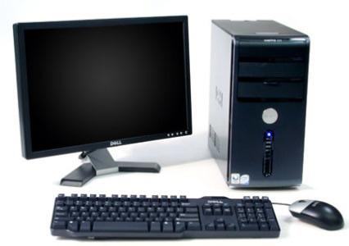

Computers
350 Dell Desktops & Monitors Installed
150 Dell Laptops Installed
Windows 10 OS Installed
1 TB Hard Drive
Devices Tested
Notes:
The Dell Inspiron 22 3000 was the decided desktop of choice due to its price and specs. This device came with 1 TB of hard drive, a 7th generation AMD processor, and a 21.5 inch touch display. The laptops installed were Dell Inspiron 15 3000 with 7th generation Intel i3 processors, 1 TB hard drive, and 15.6 inch displays. All computers came equipped with Windows 10 operation systems and one year warranties. These devices have been tested to ensure they connected appropriately and power on correctly.

Slide 3







Software Vendors
Notes:
The customer relational management system Future Tech will begin to use is by Salesforce, logins for all users have been created. Additionally, Microsoft Office 365 was installed on all devices to be used for all documentations, excel spreadsheets, and presentations. For all forthcoming Future Tech Projects the project management system Basecamp will be used. Groups have already been created in the Basecamp system for future use. Regarding the time, document, benefits, and employee tracking the system being used going forward will be through Paycom. All employees should have already received emails with their login credentials to begin use and can access the system by visiting paycom.com. The remote access software by TeamViewer was installed on all technical support agent devices to allow them to easily assist customers should the need arise. Pidgin was another tool installed on all devices and groups have been created to allow departments or individuals to quickly communicate with one another in real time. Finally, Avast was the chosen antivirus software and has been installed and thoroughly tested on all devices.

Slide 4
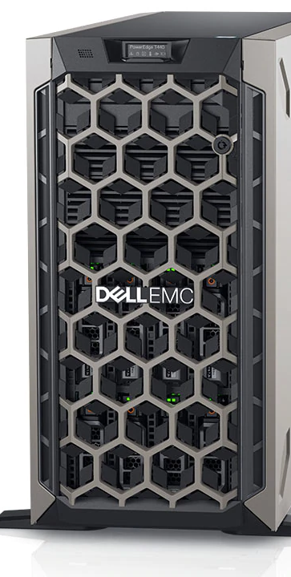
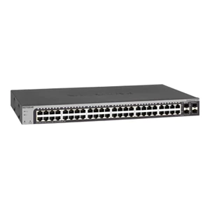
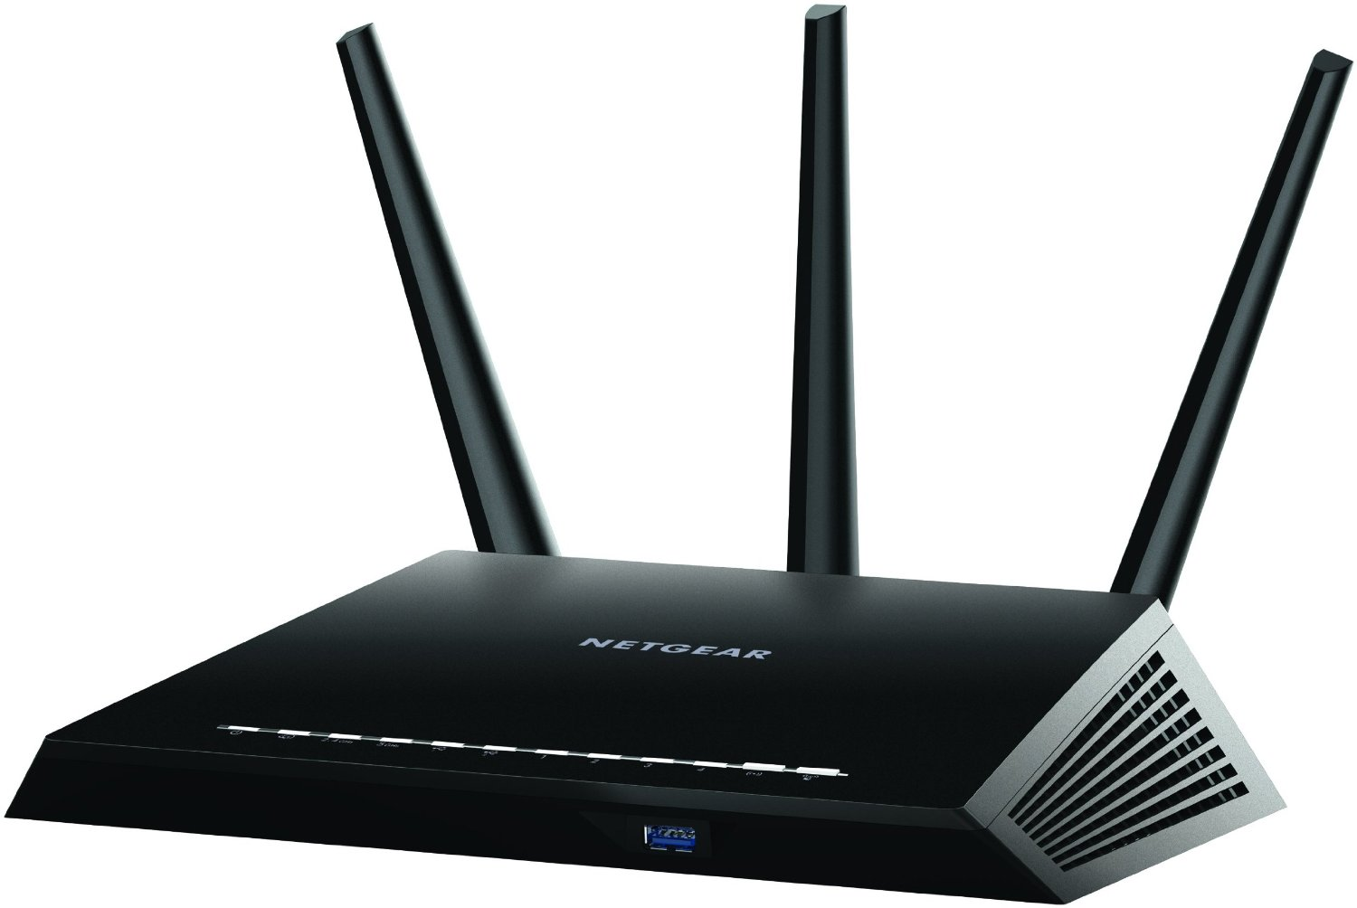

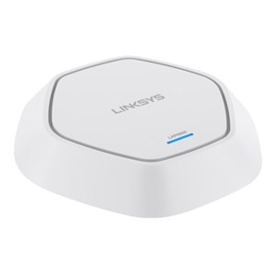
Network Hardware
Cat7 Cables
RJ45 Jacks
PowerEdge T440 Tower Server
48-Port NETGEAR GS748T
NETGEAR Nighthawk R7000
ARRIS SURFboard DOCSIS 3.0
Linksys LAPN600 Business WAP
(Dell, 2018)
(Dell, 2018)
(Dell, 2018)
(ARRIS, n.d.)
Notes:
For the Future Tech Network there were roughly 16,000 square feet of Cat7 cabling installed throughout the three floors to allow connectivity to the network. This involved installing 14 RJ45 jacks throughout the facility to assist with connecting to the internet. Three PowerEdge Servers were added into a dedicated server room on the third floor for data storage and failover. These were then connected to switches leading off onto other devices. To achieve full connection, there were a total of 16 switches installed throughout the facility. The switches were configured to create virtual local area networks for each department to limit traffic and increase broadcast. A total of two NETGEAR routers were then installed: one on each the second and third floors. These routers were connected to switches and configured with new authentication credentials to ensure all network access is restricted to ensure security. The routers were then connected to ARRIS standalone modems to ensure there is limited network down time. Linksys wireless access points were also installed throughout the facility to provide network access for wireless devices throughout the facility.

Slide 5
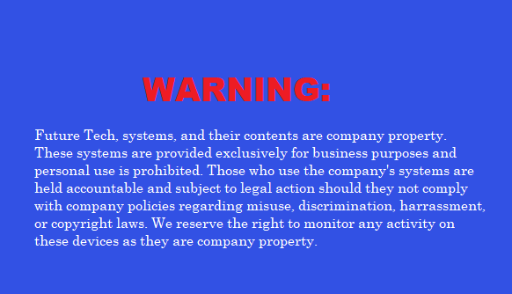

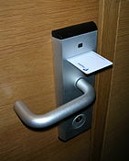
Security Measures
Power On Notification
Device Use Contract
Physical Locks
Virtual Locks
Access Restrictions
Port Security
I Accept
Notes:
Upon powering on any Future Tech device users will be required to accept a warning message as a reminder to only use company property for company related tasks. This will be followed with a personal username and password to gain access to the device. All software programs installed onto devices will also require their own authentication credentials and access restrictions have been set to limit what users can do. Users will also be required to sign device use contracts that further explain how company property and data can and cannot be used. Users who have not signed said contract will not be allowed to use their device until it is signed. All servers and desktops will be equipped with physical locks and access to certain areas will require a special key card given only after device use contract is signed. Additional virtual locks will be added to both the routers and servers on site. In addition to the authentication details the router will have WPA2 security measures that aide in encrypting the company’s data to prevent misuse or destruction. Finally, all devices on site will be configured to have an assigned port to ensure security and all unused ports will be blocked to prevent intrusion.

Slide 6

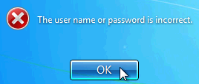
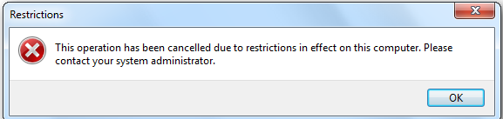
Testing
Connectivity
Authentication Credentials
Access Restrictions
Port Access
Notes:
Here you can see how the desktop of all computers will look in addition to a couple of the security prompts users may see. The first tests completed were just to ensure that the computers were properly connected and powered on correctly. All user logins were tested to ensure that the proper prompts would display if the input was bad. These were also tested to ensure that users could only fail logging in three times before a notification would be sent to the technical department. The computers were also checked to ensure all installed software credentials worked appropriately and prompts were displayed to those who were not granted access. While users will have logins for all applications their access is limited to only what they require for their department. The most recent tests completed consisted of checking the ports for ease of access. During this testing the ports were tested to ensure that only the devices assigned to them could use them. The unused ports were also methodically tested to ensure that they would block intruders.

Slide 7
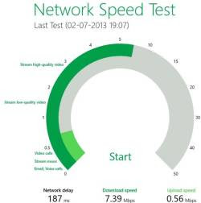
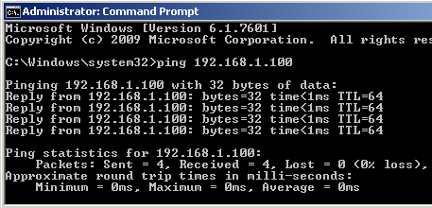
To Do:
Ensure Network Functionality
Test Network Speeds
Test Network Coverage
Pen Testing
Stress Testing
Notes:
While the network hardware has been installed, connected, and configured there are still many tests to be done. For these tests the network engineer will work closely with the testing engineer to ensure the hardware functions correctly. Many other tests will be done to ensure that each device is getting the proper network speeds and that coverage is appropriate for each floor. Pen testing will also be done to simulate cyber attacks on the network and individual devices. Scanning tools will be used during this test phase to discover holes in the network and see how the systems respond to intrusions. Finally, stress tests will be done on the network to see how much it can handle before it essentially breaks: During this the time to recover will also be monitored and documented. The goal of these tests are to ensure that the network correctly responds and help avoid downtime in the future.

Slide 8
References
Some photos shown were from Office Online Pictures by unknown authors and licensed under CC BY-NC-ND, CC BY-SA, or CC BY-SA-NC.
ARRIS. (n.d.). SB6141 DOCSIS 3.0 Cable Modem. Retrieved from https://www.arris.com/surfboard/products/cable-modems/sb6141/
Dell. (2018). Business Laptops, Desktops, Servers & Electronics. Retrieved from https://www.dell.com/en-us/work/shop
NETGEAR. (n.d.). Nighthawk Smart WiFi Router. Retrieved from https://www.netgear.com/home/products/networking/wifi-routers/R7000.aspx

