Slide 1
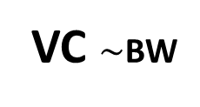
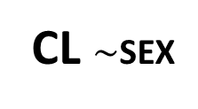
DEPOT
CENTRAL
PERIPH
KA
Q
ALAG
VC $\sim$BW
VP
CL $\sim$SEX

