Slide 1


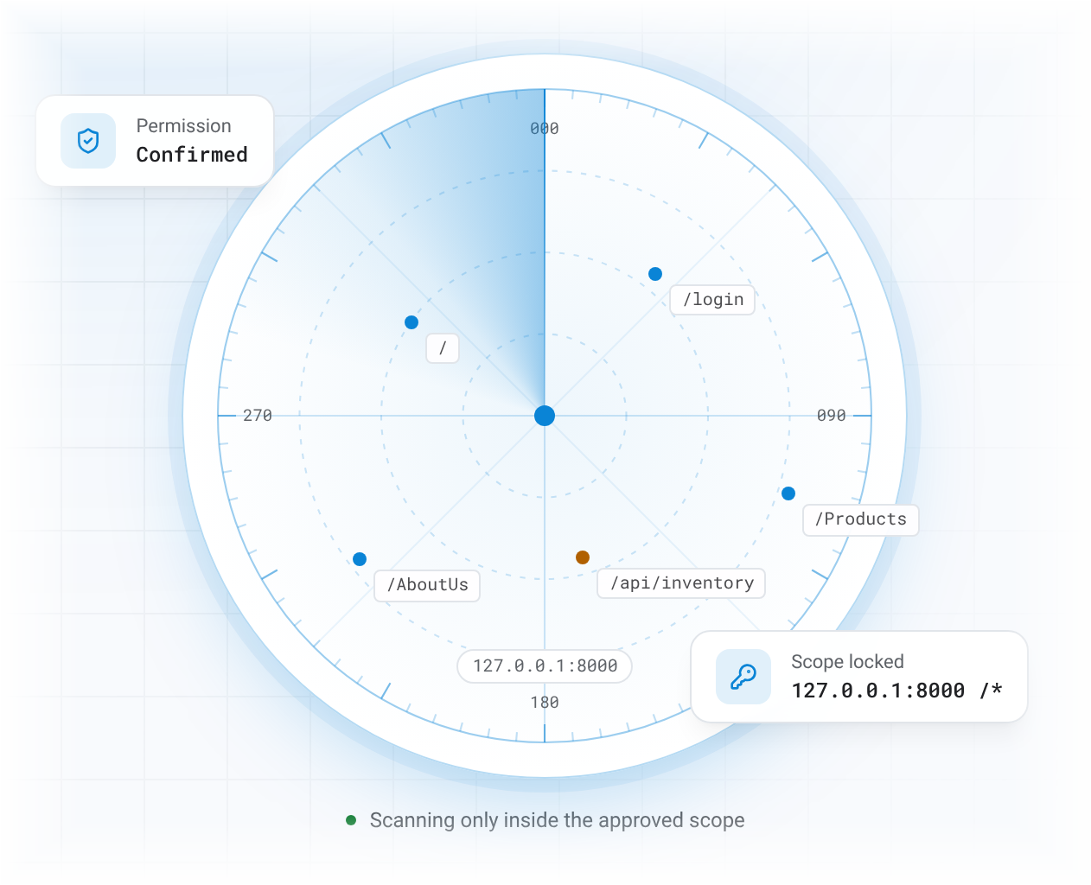
AIVERA
Final project · 2026
Find the weak spots in
UMERCH3.0
before anyone else
does.
AIVERA is our AI-assisted security assessment and vulnerability analysis platform: a locked-down scope, results explained by AI, and fixes confirmed by a person.
Final presentation →
Live demo
01
Notes:
Good day everyone. We are presenting AIVERA, our AI-assisted security assessment and vulnerability analysis platform.
The headline on this slide is the same one on our landing page: find the weak spots in UMERCH3.0 before anyone else does. UMERCH3.0, the UM Merchandise Management System, is the web application we were authorized to assess.
The idea is simple: the scope is locked down first, the results are explained by AI, and every fix and every finding is confirmed by a person.
We will walk through the problem, how AIVERA works, what we found on UMERCH3.0, and then show a live demo.

Slide 2

AIVERA
The problem
Security testing is slow, noisy and easy to get wrong
01
Noisy tool output
Nmap and ZAP produce long technical reports with false positives.
02
Scattered evidence
Findings, evidence and fixes get tracked by hand in spreadsheets.
Assessors spend more time sorting tool output than deciding what is actually a vulnerability.
03
Scope drift
It is easy to lose track of which hosts and paths are authorized.
04
AI can be wrong
Models can sound confident, invent details, and can't see the target.
02
Notes:
Web applications handle logins, personal data and transactions, so they are a frequent target. Assessing one properly is harder than it looks.
First, tools like Nmap and OWASP ZAP produce long, technical output full of false positives. Second, assessors track evidence, decisions and fixes by hand, so results are inconsistent and reports take a long time. Third, it is easy to lose track of exactly what is authorized for testing.
And fourth, AI can speed this up, but it can be confidently wrong and it cannot observe the target system itself. That is the gap AIVERA fills.

Slide 3
AIVERA
Our principle
AI suggests. A person decides.
AIVERA uses existing tools and AI to speed up the work, but only a human assessor can confirm a vulnerability.
6
0
100%
test areas covered
findings confirmed automatically
of actions logged
03
Notes:
This is the one rule the whole platform is built on: AI suggests, a person decides.
The three numbers come straight from our landing page. We cover six test areas. Zero findings are ever confirmed automatically, not by a tool and not by the AI. And one hundred percent of actions are written to the activity log.
This matches the project requirement that AI-generated findings must be verified by an assessor before they count as confirmed vulnerabilities. In AIVERA this is enforced on the server, not just hidden in the interface.

Slide 4
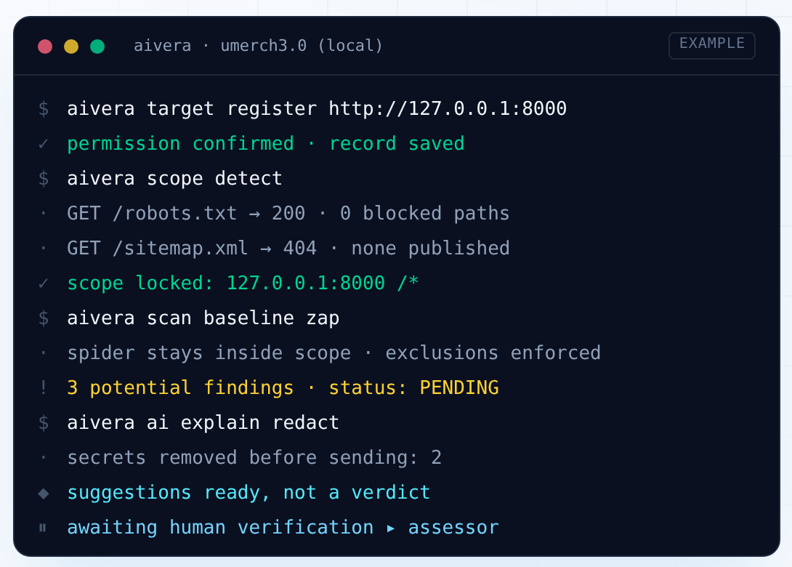

AIVERA
How it works
Every run follows the same rules
Permission first, scope locked, and results held as pending until a person decides. This is what a run against the local UMERCH3.0 copy looks like.
Scope comes from the site's own robots.txt and sitemap.xml
Scanners never leave the approved host and paths
AI suggestions are advice, never a verdict
04
Notes:
This is what a run looks like, shown as a terminal so you can follow every step.
We register the target and confirm permission. AIVERA then detects the scope from the site's own robots.txt and sitemap.xml and locks it to 127.0.0.1 port 8000. The ZAP baseline scan stays inside that scope and enforces exclusions. Anything it finds is marked PENDING.
When we ask the AI to explain a result, secrets are removed before sending, and the answer is labelled as a suggestion, not a verdict. The run ends waiting for human verification by the assessor.

Slide 5







AIVERA
Workflow
From permission to patched in six steps
Each step hands off to the next, and nothing moves forward without the checks before it.
1
2
3
Scope
Recon
Scan or import
Register UMERCH3.0, confirm permission, lock the hosts and paths.
Read robots.txt and sitemap.xml, resolve DNS, map ports and pages.
Bounded Nmap and OWASP ZAP jobs. Out-of-scope results are dropped.
4
5
6
AI analysis
Human verification
Fix and report
Gemini explains findings, ranks urgency and drafts fixes.
An assessor reviews the evidence and confirms or rejects it.
Track fixes to a passed retest, then export a PDF report.
05
Notes:
Here is the full workflow, again exactly as it appears on our site.
One, scope: register the target, confirm permission and lock the hosts and paths. Two, recon. Three, scan or import with Nmap and OWASP ZAP; anything out of scope is dropped. Four, AI analysis with Gemini. Five, human verification. Six, fix and report.
These six steps cover all eight stages in the project brief: define scope, reconnaissance, scanning and security assessment, AI analysis, findings verification, risk assessment and report generation. Our methodology follows NIST SP 800-115 for the process and the OWASP Web Security Testing Guide for individual web tests.

Slide 6





AIVERA
Core features
Built for a careful assessor
The parts of AIVERA that turn raw tool output into decisions you can defend.
Scope that can't be bypassed
Evidence first
AI that shows its work
Every scan, import and finding is re-checked on the server against approved hosts and paths.
Requests, responses and tool output stay attached to each finding.
See exactly what was sent to the model and how many secrets were removed.
Risk you can rank
Checklists per category
Reports from verified data
Likelihood × impact on a 5×5 matrix, so the worst issues are fixed first.
Login, access control, sessions, exposed files and HTTPS, automated and manual.
Unverified items only ever appear in a labelled appendix.
06
Notes:
These six features map directly to the six core features required in the brief.
Scope that can't be bypassed is our target and scope management. Evidence first supports findings verification. AI that shows its work is our AI integration: you can see exactly what was sent to the model. Risk you can rank is the risk assessment. Checklists per category cover the web application security assessment. And reports from verified data is our dashboard and report generation.
Everything shares one database, so when a finding is confirmed, the dashboard, risk register and report update together.

Slide 7











AIVERA
Architecture
System architecture
One approved target in, one verified report out.
Nmap
Assessor
React UI
Express API
Scan job
Human in charge
Web app
Auth + scope
Bounded run
OWASP ZAP
PDF report
Review
Gemini
Database
Normalize
Verified only
Confirm / reject
Redacted input
Prisma
Scope-checked
Scope re-checked on every job
Tools run with fixed arguments
Secrets removed before AI
07
Notes:
This is the architecture. Follow the top row from left to right, then the bottom row back.
The assessor works in the React web app. The Express API checks the user's role, that the target is authorized, the exact host, the approved categories and the scan profile before it accepts a job. The scan job runs Nmap and OWASP ZAP with fixed, bounded arguments; ZAP runs in its own Docker container.
Their output is normalized and scope-checked, so anything outside the approved scope is skipped, and stored in the database as pending findings with evidence. Gemini can then analyse a finding, but only after sensitive values are removed. The assessor reviews the evidence and confirms or rejects it, and the PDF report is built from verified findings only.

Slide 8
AIVERA
Technology
Technology stack
We integrated proven tools instead of building a scanner from scratch.
Frontend
React 19
TypeScript
Vite 7
Tailwind CSS 4
Recharts
Backend
Node.js
Express 5
bcrypt
httpOnly sessions
Database
Prisma ORM
SQLite
Activity log
Security tools
Nmap
OWASP ZAP
Docker
DNS utilities
curl
AI
Google Gemini
@google/genai
Redaction layer
Model fallback
08
Notes:
Our stack. The frontend is React 19 with strict TypeScript, Vite and Tailwind CSS, with Recharts for the charts.
The backend is Node.js with Express 5. Passwords are hashed with bcrypt and sessions use hashed tokens in httpOnly cookies, with role checks on every write. The database is Prisma on SQLite, including an append-only activity log.
For security tools we integrate Nmap and OWASP ZAP, running ZAP inside Docker, plus DNS utilities and curl. For AI we use Google Gemini through the official SDK, with our own redaction layer in front, and automatic fallback to a backup model if the main one is busy.
As the brief allows, we did not build a scanner from scratch; we built the platform that runs, processes and analyses existing tools.

Slide 9




AIVERA
Authorized target
Our authorized target: UMERCH3.0
A local copy of the UM Merchandise Management System (Laravel / PHP).
Ground rules we followed
Permission
Scope locked
Instructor-approved target only
Isolated local copy, not on the internet
Test accounts and synthetic data
No attacks, no data changes, no password guessing
Cookies and secrets redacted in evidence
Confirmed · AUTH-2026-0001
127.0.0.1:8000 /*
Target URL
Method
http://127.0.0.1:8000/
GET/HEAD + code review
09
Notes:
Our authorized target is UMERCH3.0, the UM Merchandise Management System, a Laravel and PHP web store. We assessed a local copy at 127.0.0.1 port 8000 under permission record AUTH-2026-0001, with the scope locked to that host and port.
Our method was read-only: GET and HEAD requests, plus a white-box review of the source code.
On the right are the ground rules we followed, taken from the brief's ethical guidelines: only the approved target, an isolated local copy, test accounts and synthetic data, no attacks or data changes, and redaction of cookies and secrets in all our evidence.

Slide 10
AIVERA
Recon & scanning
What the tools saw
Real scans run through AIVERA against the local UMERCH3.0 copy.
nmap · SCN-0003
OWASP ZAP 2.17.0
$ nmap -sT -sV --version-light -Pn
PORT STATE SERVICE
80/tcp closed http
443/tcp closed https
8000/tcp open http
! PHP/8.4.27 disclosed in banner
Spider in scope · passive rules only
9
alerts raised for assessor review
Missing Content-Security-Policy
No anti-clickjacking header
X-Powered-By leaks PHP version
Missing X-Content-Type-Options
+ SRI, cookie and 3 info items
10
Notes:
These are real results from AIVERA's automated scans.
On the left is Nmap, run as a TCP connect scan with light version detection on ports 80, 443 and 8000. Only 8000 is open, serving HTTP, and the banner discloses PHP 8.4.27. That version leak became part of finding U-05.
On the right is OWASP ZAP 2.17, which spidered the site inside the approved scope with passive rules only. It raised nine alerts, mostly missing security headers, which independently confirm U-05.
One cookie alert is most likely a false positive, because Laravel's XSRF token is meant to be readable by JavaScript. That is exactly why a person reviews every alert instead of trusting the tool.

Slide 11





AIVERA
Assessment coverage
6
Authentication & login
3 findings
Information disclosure
1 finding
security assessment categories covered
Security configuration
1 finding
Access control
The brief asks for at least three. We report what passed as well as what failed.
1 finding
Session management
1 finding
Exposed files & directories
Passed
11
Notes:
The brief requires at least three assessment categories. We covered six.
Authentication and login security produced three findings, including our only critical one. Information disclosure, security configuration, access control and session management each produced one finding.
Exposed files and directories passed: .env, the .git folder, composer.json, phpinfo and the vendor autoload all return 404, and the Laravel log returns 403. We also confirmed the session ID is regenerated after login, so session fixation passed.
Reporting what passed matters too: it shows the assessment was complete and honest.

Slide 12
AIVERA
Findings
7 findings on UMERCH3.0
Suggested severity from evidence. Each one is confirmed or rejected by the assessor.
1 Critical
3 Medium
3 Low
U-01
Hard-coded administrator credentials
Authentication
Critical
U-02
/debug-env exposes configuration
Info disclosure
Medium
U-03
Weak brute-force protection
Authentication
Medium
U-04
Plain-text password fallback
Authentication
Medium
U-05
Missing security headers
Configuration
Low
U-06
Public inventory API, CORS *
Access control
Low
U-07
Session cookie Secure flag not enforced
Session
Low
12
Notes:
In total we recorded seven findings: one critical, three medium and three low.
The critical one is hard-coded administrator credentials, which we'll look at next. The mediums are the unauthenticated debug-env route, weak brute-force protection, and a plain-text password comparison fallback. The lows are missing security headers, a public inventory API that allows any origin, and the session cookie Secure flag not being enforced by default.
Each finding is linked to its evidence in AIVERA, mapped to a CWE and an OWASP Top 10 category, and has a recommended fix.
[Before presenting: confirm in AIVERA that each finding has been verified, and update any severity that changed.]

Slide 13
AIVERA
Finding spotlight
FND-0004 · U-01
AI analysis
Hard-coded administrator credentials
Vulnerability explanation · Gemini
Critical
CWE-798
OWASP A07
Suggested severity
Critical
What we found
The login code accepts one fixed username and password and signs the visitor in as Admin, creating the account if needed.
Model confidence
High
Values redacted
7
Why it matters
The values are in the source code and Git history, so anyone with the code can take over the admin side.
Advice, not a verdict. The assessor verifies by reproducing the login on the local copy.
How to fix
Remove the special case, seed the first admin from .env with a hashed password, and rotate the admin password.
13
Notes:
Our most serious finding, U-01: hard-coded administrator credentials, rated critical.
In the login controller, before the normal login runs, the code checks for one fixed username and password. If they match, the visitor is signed in as Admin, and the account is even created if it doesn't exist. Because the values are in the source code and Git history, anyone with the code can take over the admin side.
It maps to CWE-798, Use of Hard-coded Credentials, and OWASP Top 10 2021 A07, Identification and Authentication Failures. The fix is to delete the special case, create the first admin from a password in the environment file, store it hashed, and change the admin password wherever this code ran.
On the right is AIVERA's AI analysis: Gemini also suggested critical with high confidence, and seven sensitive values were removed before anything was sent. But it is advice, not a verdict; the assessor confirms by reproducing it on the local copy.

Slide 14

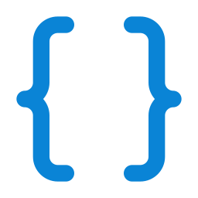


AIVERA
AI integration
AI that shows its work
Gemini helps the assessor think. It can never change a finding's status.
Evidence
Remove secrets
Gemini
Validate JSON
Save model + input
Assessor decides
Six AI modes
Used on UMERCH3.0
Scan interpretation
Vulnerability explanation
Explained U-01 (hard-coded credentials)
Interpreted the ZAP scan: CSP and frame-ancestors advice
Drafted remediation after each automated scan
Remediation advice
Risk prioritization
Test recommendations
Assessment summary
14
Notes:
AI integration is a big part of the rubric, so here is exactly how it works.
Evidence first goes through our redaction layer, which removes passwords, tokens, cookies and keys. Only then is it sent to Gemini. The answer is forced into a JSON schema and validated. Every analysis is saved with the model name and the exact redacted text that was sent, so anyone can audit it. Then the assessor decides; AI output can never change a finding's status.
AIVERA has six AI modes, well above the two required, and none of them is a general chatbot: each one works on real scan data or findings. On UMERCH3.0 we used vulnerability explanation on U-01, scan interpretation on the ZAP scan, and remediation drafts.
One honest limitation: when the main Gemini model returned 'high demand' errors, AIVERA automatically fell back to a backup model, and it records which model actually answered.

Slide 15
AIVERA
Human verification
Every finding passes through a person
A finding can only become confirmed through the verification route.
Confirmed
Retest
Resolved
To confirm, the assessor records
Needs a passed retest + manual approval
Notes
Pending
Rejected
Decision reason
Evidence attestation
Needs review
Second confirmation
Every decision is written to the activity log.
15
Notes:
This is the finding lifecycle, and it is how we keep a person in charge.
Every finding, whether it came from a tool, the AI or manual testing, starts as Pending. The assessor reviews the evidence and moves it to Confirmed or Rejected. If the evidence is incomplete, it goes to Needs review first.
To confirm a finding, the assessor must enter notes and a decision reason, attest that the evidence was reviewed, and give a second confirmation. The server enforces this, not just the interface.
A confirmed finding then goes through remediation and can only become Resolved after a passed retest and manual approval. Every decision goes into the activity log.

Slide 16



AIVERA
Risk & remediation
Risk you can rank, fixes you can track
5
10
15
20
25
Remediation board
4
8
12
16
20
3
6
9
12
15
To do
In progress
Retest
Resolved
Likelihood
2
4
6
8
10
Each fix has an owner, priority and due date
Overdue tasks raise notifications
Resolved only after a passed retest and approval
1
2
3
4
5
Impact
16
Notes:
When a finding is confirmed, AIVERA automatically creates a risk record.
On the left is the five by five risk matrix: likelihood times impact gives a score from 1 to 25, coloured from green for low to red for critical. The assessor can adjust the rating, so the most dangerous issues are fixed first.
On the right is the remediation board. Each confirmed finding becomes a task with an owner, priority and due date, moving from To do, to In progress, to Retest, and finally Resolved. Overdue tasks raise notifications, and nothing can be marked resolved without a passed retest and manual approval.

Slide 17

AIVERA
Dashboard & reports
Reports built from verified data
AIVERA
Security Assessment Report
UMERCH3.0 (local) · AUTH-2026-0001
The dashboard and report are calculated from stored data. Only confirmed findings count as vulnerabilities.
01
Scope & authorization
02
Methodology
7-step report wizard
03
Verified findings
Verified findings only
04
Evidence
Real PDF download
05
Risk ratings
Data origin labelled on every item
06
Recommendations
17
Notes:
The dashboard shows the state of the assessment at a glance: confirmed, critical, pending and resolved counts, findings by severity, and trends. Every number is calculated from stored data, and only confirmed findings count as vulnerabilities.
Reports are made with a seven-step wizard. The report includes scope and authorization, methodology, verified findings, evidence, risk ratings and recommendations, and downloads as a real PDF.
Every item is labelled by data origin, so simulated or imported data can never be mistaken for real evidence, and unverified items only appear in a labelled appendix.
[Tip: in Canva, you can place a real screenshot of the AIVERA dashboard next to the report.]

Slide 18

AIVERA
Ethics & safety
01
Only targets with written permission can be scanned
02
Live scanning stays off until the exact host is allowlisted
It only tests what you're allowed to test
03
Passwords, tokens, cookies and keys removed before AI
04
Three roles: administrator, assessor and viewer
AIVERA is built for authorized assessment of UMERCH3.0. Testing anything without written permission is not allowed, and the system is designed to stop it.
05
Every action written to the activity log
06
API keys stay on the server, never in the browser
18
Notes:
Ethics is part of the grading, and it shaped how we built the platform.
We only tested the instructor-approved target, used test accounts and synthetic data, never scanned public websites or the university network, performed no destructive attacks, and never sent credentials or confidential data to a public AI service.
AIVERA enforces this itself: only targets with written permission can be scanned, live scanning stays off until the exact host is allowlisted, secrets are removed before anything reaches the AI, there are three roles, every action is logged, and API keys never leave the server.

Slide 19



AIVERA
Team
Team & contributions
Each member will explain and demonstrate their own part.
[Member name]
[Member name]
[Member name]
[Member name]
[Member name]
Project lead & docs
Frontend developer
Backend & database
Security tester
AI integration
Proposal, documentation, final report
Dashboard, findings, verification, PDF
API, auth & roles, database, tool parsing
Target setup, scanning, evidence, verification
Gemini, prompts, redaction, AI evaluation
19
Notes:
Our team has five roles.
The project lead coordinated the schedule and wrote the proposal, documentation and final security report. The frontend developer built the dashboard, findings and evidence views, verification screens and PDF export. The backend and database developer built the REST API, authentication and roles, the database, and the Nmap and ZAP parsing with scope enforcement. The security tester set up the target, ran the scans, collected evidence and verified findings. The AI integration member connected Gemini, designed the prompts, built the redaction and evaluated the AI output.
[Replace each [Member name] with your names.]

Slide 20


AIVERA
Live demo
Live demonstration
The path we will walk through now.
1 Sign in
2 Register target
3 Run scan
4 AI analysis
5 Verify
6 Export PDF
as assessor
scope + permission
Nmap + ZAP
explain a finding
confirm or reject
verified report
$ npm run dev:full · :4000 + :5173
20
Notes:
Now we'll switch to the live demo, following this path.
One, sign in as the security assessor. Two, register the authorized target with its scope and permission record. Three, start an automated assessment with Nmap and OWASP ZAP in passive mode. Four, open a finding and run an AI analysis, including what data was sent to the model. Five, review the evidence and confirm or reject the finding, and watch the dashboard update. Six, generate the report and download the PDF.
[Before the demo: run 'npm run dev:full', make sure Nmap and Docker are running, and keep a backup screen recording in case something fails.]

Slide 21


AIVERA
Limitations & next steps
Where AIVERA goes next
Honest about what AI and our platform can't do yet.
Current limitations
Next steps
AI can be wrong, so it stays advisory
Only passive ZAP checks are automated
No authenticated or active scanning yet
Background jobs don't resume after a restart
Isolated scan workers with egress controls
Authenticated and active scan profiles
Tamper-evident audit log
Scheduling and non-web adapters
21
Notes:
We want to be honest about the limits.
AI can be wrong, which is why it stays advisory. Our automated ZAP runs are passive only. We don't yet support authenticated or active scanning. And background jobs run inside the API process, so they don't resume if the server restarts.
Next, we would move scanners into isolated workers with network egress controls, add authenticated and active scan profiles with proper approval, make the audit log tamper-evident, and add scheduling plus adapters for non-web systems.

Slide 22


AIVERA
Thank you. Questions?
AIVERA does the heavy lifting. A person makes the final call.
Open the live demo →
Ask a question
22
Notes:
To sum up: AIVERA combines Nmap, OWASP ZAP and Gemini into one platform that scopes, scans, explains, verifies, rates and reports, while keeping a human assessor responsible for every confirmed vulnerability.
Thank you for listening. We're happy to take your questions.

