Slide 1
Dynamical downscaling of a global seasonal forecast for Luxembourg
CCLM and SEAS5

Slide 2
SEAS5
SEAsonal forecast System 5 (SEAS5) from the ECMWF
Part of the
  Copernicus Climate Change Service (C3S)
  WMO Subseasonal-to-Seasonal Prediction Project (S2S)

Slide 3
SEAS5 - Uses
NEMO ocean model with
  0.25° ORCA grid
  75 vertical levels
  LIM2 sea ice model
ECMWF IFS atmospheric model with
  Reduced 0320 gaussian grid (grid spacing of appr. 36 km
  91 vertical levels
  20 minute time-step

Slide 4
SEAS5 - Uses
  Extended settings to improve representation of processes that affect seasonal skill, such as
    Reduced non-orographic gravity wave drag
    Tropospheric sulphate aerosol that follows decadally varying CMIP5 climatology
Coupling
  Gaussian method for interpolation in both directions
  Interval of 1 hr allows resolution of diurnal cycle

Slide 5
SEAS5 - Specifications
51-member ensemble, created using a combination of
  SST and atmospheric initial condition perturbations
  Activations of stochastic physics (same as in medium-range ENS – SPPT3 scheme and stochastic backscatter)
Seasonal forecast produced each month
Initial date of the 1st of each month
Run for 7 months

Slide 6
SEAS5 - Specifications
Forecast data and products released at 12Z UTC on every 5th of each month
Every fourth month release of an additional forecast

Slide 7
MARS retrieval script
geogrid reference files
GRIB to NC
gridfile_EU
global files ECMWF
resize script
gridfile_GR
dir-tree creating
EU files
GR files
Manual download into “dirref”
20180301
20180301
20180401
20180401
EOBS data
20180501
20180501
Changing names/units
of EOBS data
20180601
20180601
Matching: temporal scale,
spatial scale, NA values
Verification directory “work”
daymean
timesizing
regridding
fieldmean
masking
eobs
msk_*(0-50)
msk_ensmn*
fldmn_*(0-50)
fldmn_ensmn*

Slide 8
Data streams in MARS retrievals
MMSF (IFS direct output)
MSMM (IFS monthly output)
WASF (Wave model direct output)
SWMM (Wave model monthly output)
MMSA (Real-time forecast anomalies)
For all the data streams ECMWF “system” is “5”

Slide 9
MMSF – Multi-model seasonal forecast
IFS direct output
Atmosphere model output fields at 6-, 12- or 24-hour intervals
Accumulated fields contain accumulated value of field from the start of the forecast

Slide 10
MSMM - Multi-model seasonal forecast atmospheric monthly means
IFS monthly output
Monthly means of all output fields for forecasts and re-forecasts
For accumalated fields, the monthly mean rate of accumulation is calculated
For each monthly mean field, climate mean of corresponding 1993-2016 re-forecast is calculated → archived as HCMEAN in MSMM stream

Slide 11
Wave Models
WASF: Direct output from wave model at 24 hr intervals
SWMM: Monthly mean wave model output

Slide 12
MMSA – Real-time forecast anomalies
Forecast monthly means are calculated relative to a climate mean formed from the appropriate 1993-2016 re-forecasts
Calculated for each ensemble member and for all monthly mean fields
Archived as FCMEAN in MMSA stream

Slide 13
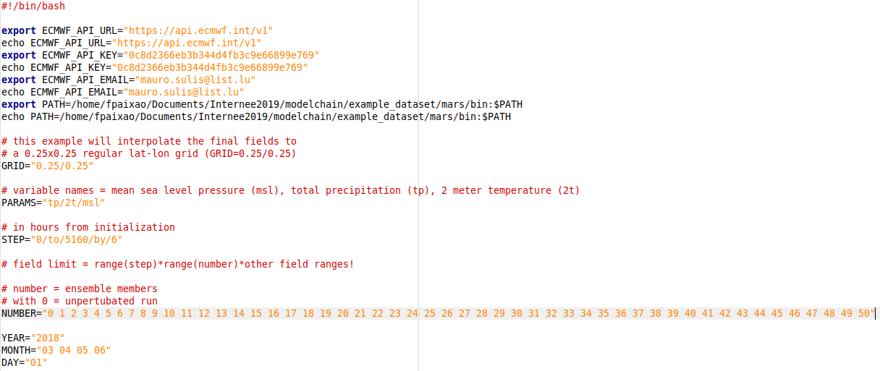
MARS – retrieval script

Slide 14
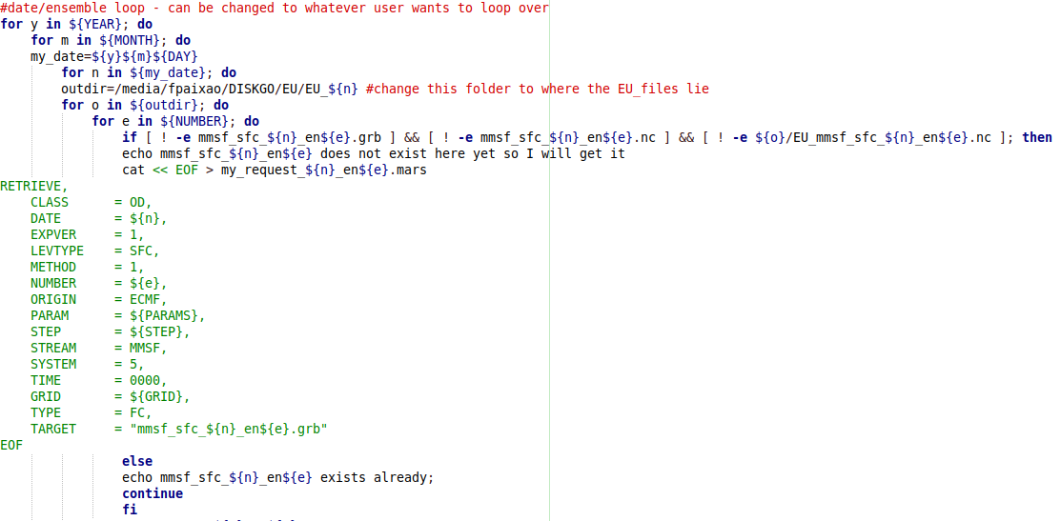
MARS – retrieval script

Slide 15
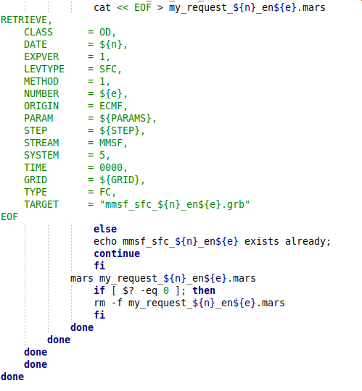
MARS – retrieval script

Slide 16
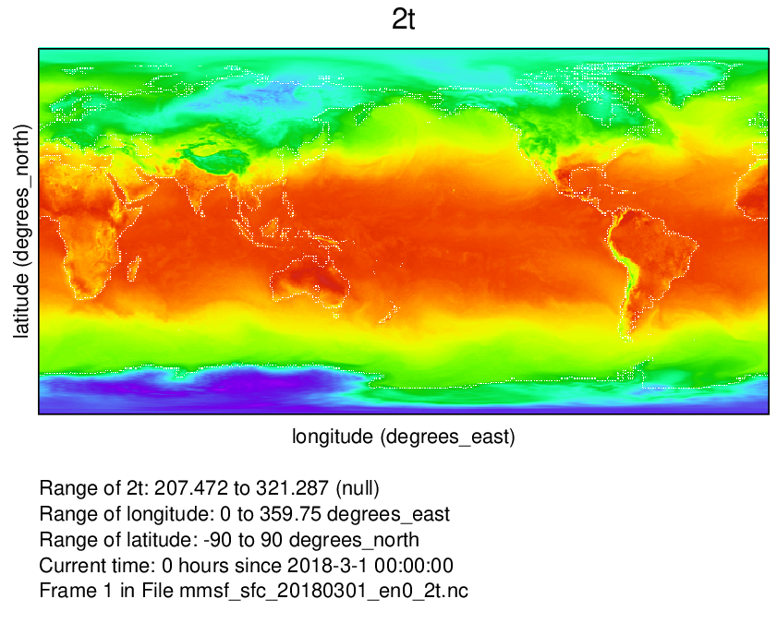
Global file raw (Created with Ncview)

Slide 17
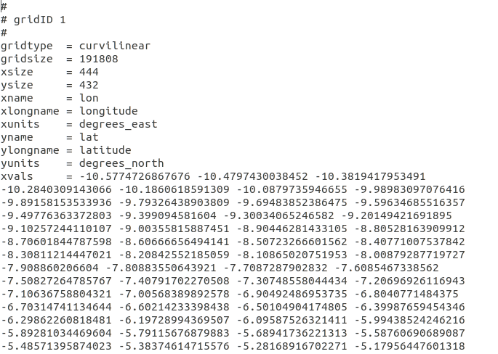
Regridding/resizing
First script: transforming GRIB files to netCDF
Creating grid files with
  Geogrid file for EU CORDEX
  Geogrid file for Great Region (GR)
By extracting xvals/yvals and checking grid information via cdo griddes (unfortunately all manually)
.
.
.

Slide 18
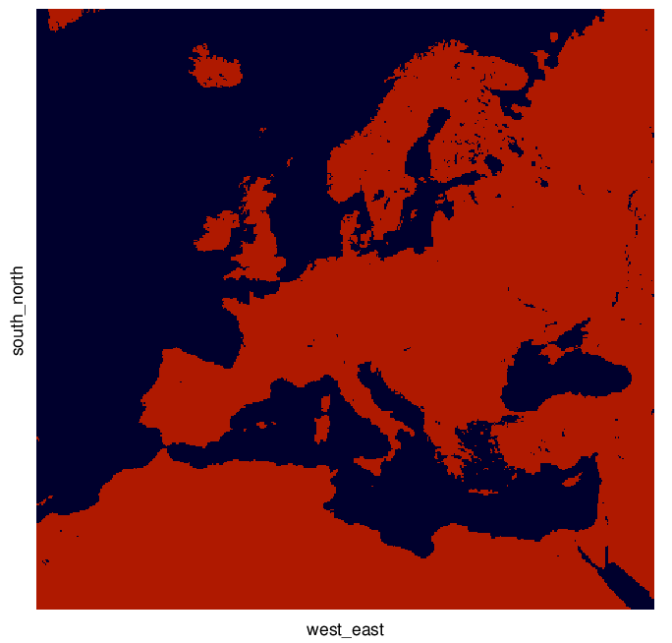
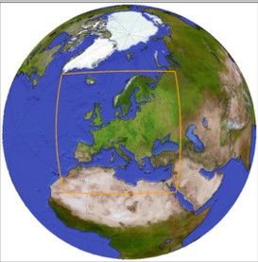
EU CORDEX domain
http://www.cordex.org/domains/cordex-region-euro-cordex/
Geogrid file landmask (created with Ncview)

Slide 19
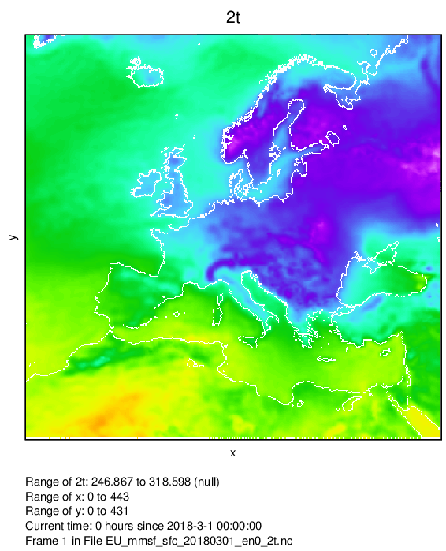
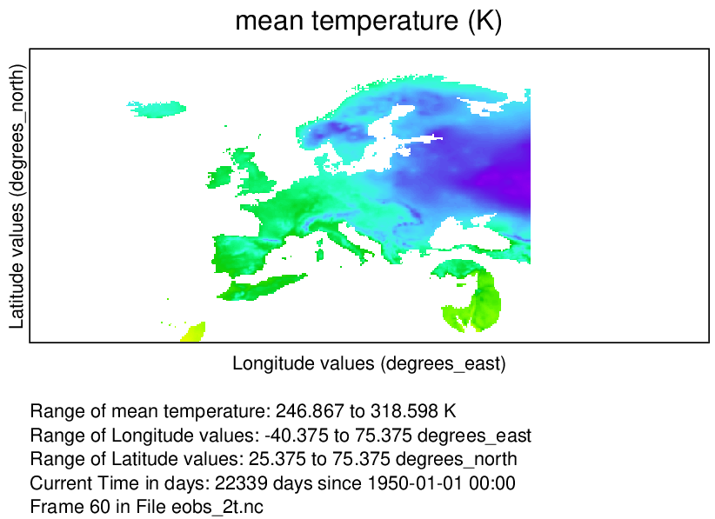

Slide 20
Matching EOBS and SEAS5
Timeframe
  EOBS: daily ensemble mean for years 2011-2019
  SEAS5: 6 hrly continuous forecast (fc) of 51 ensemble members for 7 months from initialization (ini) date each
    4 different ini dates/lead times:
      01.03/04/05/06.2018 (up to 3 months of lead time)
Spacial scale/Resolution
  EOBS:
    gridsize: 464x201
    lon: -40.375 to 75.375 by 0.25 degrees_east
    lat: 25.375 to 75.375 by 0.25 degrees_north

Slide 21
Matching EOBS and SEAS5
Spacial scale/Resolution
  SEAS5:
    gridsize: 444x432
    lon: -47.60582 to 68.72884 degrees_east
    lat: 20.57643 to 73.68497 degrees_north
Units
  EOBS: 2 m temperature in °C, precipitation in mm (thickness_of_rainfall_amount)
  SEAS5: 2 m temperature in K, precipitation in m (total precipitation)

Slide 22
Verification metrics
What kind of data do I want to verify?
What do I want to verify?
Which measures are qualified?

Slide 23
Verification metrics
What kind of data do I want to verify?
Daily, monthly and seasonal means for JJA
Different spacial scales: EU CORDEX, GR, PRUDENCE ME (mid-europe)
There is four sets that are to be verified:
Continuous “nonprobabilistic” predictands
Discrete “nonprobabilistic” predictands
Continuous probabilistic predictands
Discrete probabilistic predictands

Slide 24
Verification metrics
What do I want to verify?
Quality
Refers to correspondence between forecast and observation
Forecast skill
Relative accuracy of set of forecasts in comparison to set of standard reference forecast (climatological values of predictand are common)

Slide 25
Verification metrics
What do I want to verify?
Attributes of Quality that are important to verify
Accuracy
Bias
Reliability
Resolution
Discrimination
Sharpness

Slide 26
Verification metrics
1)
Mean absolute error - MAE
Root mean squared error – RMSE
Mean error - ME (Bias)
Conditional Quantile Plots
Skill score drawn from MSE (mean squared error) in reference to a climatological mean as baseline

Slide 27
Verification metrics
2)
“yes/no statement”
Contingency Table (2x2)

Slide 28
Verification metrics
3)
Continuous ranked probability score – CRPS

Slide 29
Verification metrics
4)
Brier score
Decomposition of Brier score
Reliability diagram

Slide 30
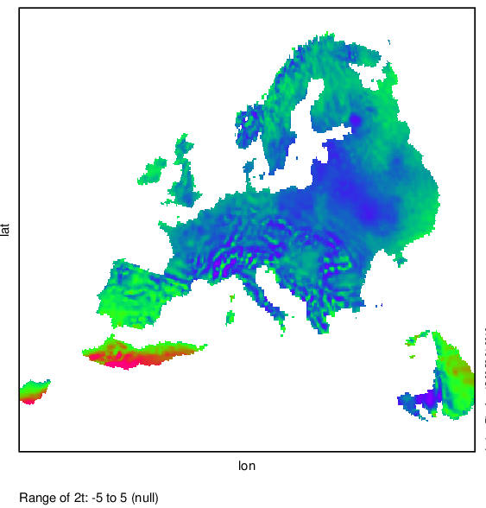
03.01.2018 – seasonal bias

Slide 31
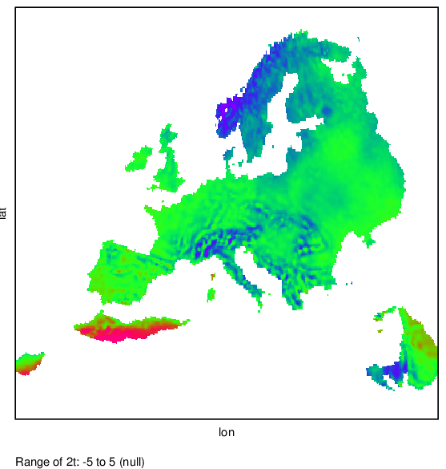
04.01.2018 – seasonal bias

Slide 32
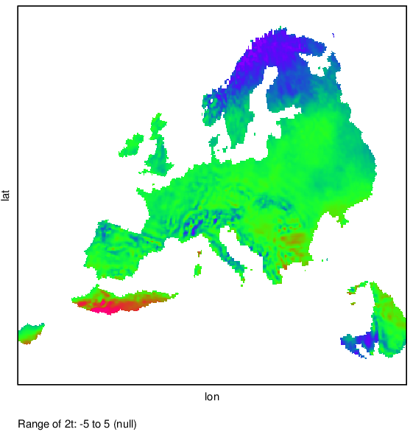
05.01.2018 – seasonal bias

Slide 33
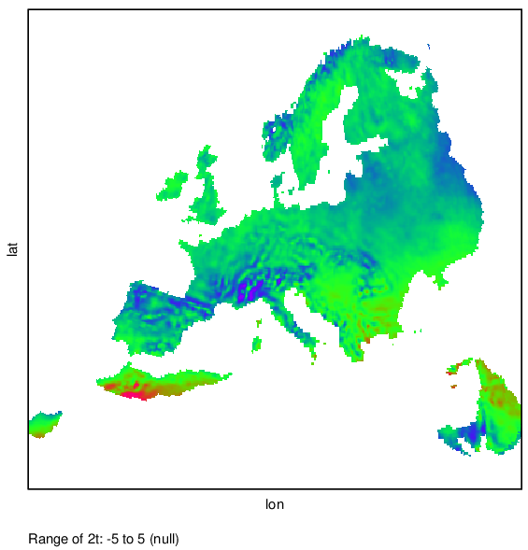
06.01.2018 – seasonal bias

Slide 34
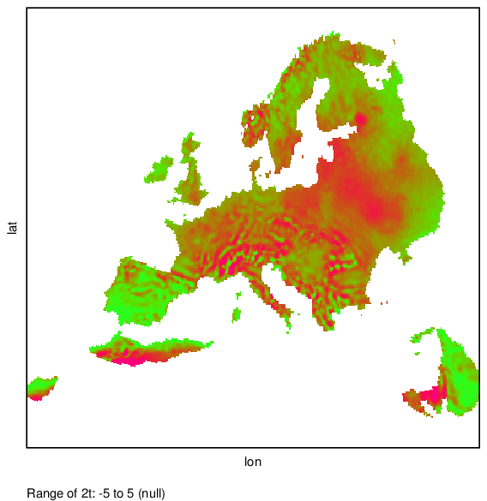
03.01.2018 – seasonal rmse

Slide 35
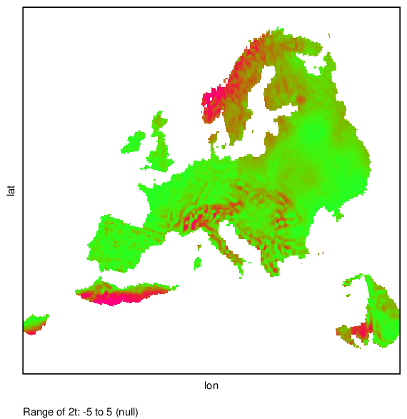
04.01.2018 – seasonal rmse

Slide 36
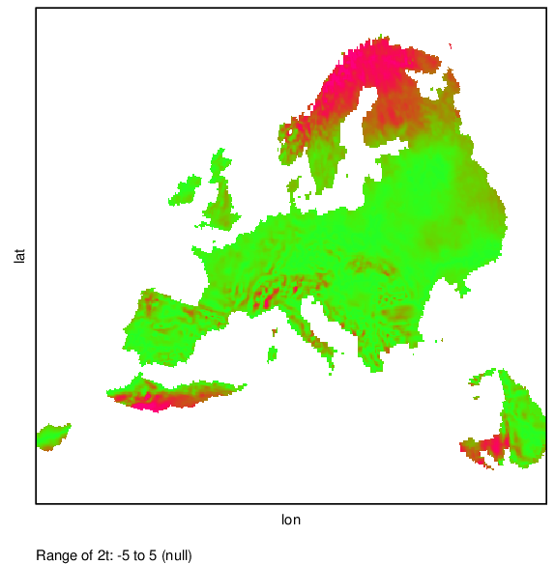
05.01.2018 – seasonal rmse

Slide 37
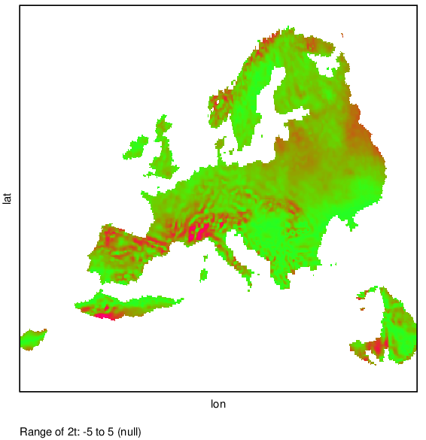
06.01.2018 – seasonal rmse

