Slide 1
Eigenes Tiefdruckgebiet
1) gcm to cclm für den jeweiligen Monat der Tiefdrucks berechnen
Globaler Antrieb: ERA-I (data/gcm/erai/xxx)
Europa – bleibt
2) cclm to cclm
Eigene Region anpassen

Slide 2
Newgrp nmm2
Skripte kopieren – neue OutputOrdner
Hilfe für grid Infos: cdo griddes auf die ERA-I Dateien
Gcm → clm
Run_int2lm
&GRID_IN (Anpassen für das ERA-I grid als neuen Input)
ie_in_tot = 512, je_in_tot = 256, ke_in_tot = 60,
pcontrol_fi = 30000.,
ke_soil_in = 3,
czml_soil_in = 0.035, 0.175, 0.640, 1.775,
startlon_in_tot = -180.,
startlat_in_tot = -89.46282,
endlat_in_tot = 89.46282,
endlon_in_tot = 179.2969,
dlat_in=0.703125, dlon_in=0.703125,
pollat_in = 90.0, pollon_in =180.0,
&DATA
yinext_lfn='cafYYYYMMDD00.nc',
yinext_cat='${SPDIR}/data/gcm/erai/YYYY_MM',
yin_cat='${SPDIR}/data/gcm/erai/YYYY_MM',
&CONTRL
itype_rootdp = 3,
lprog_qi = .TRUE.,

Slide 3
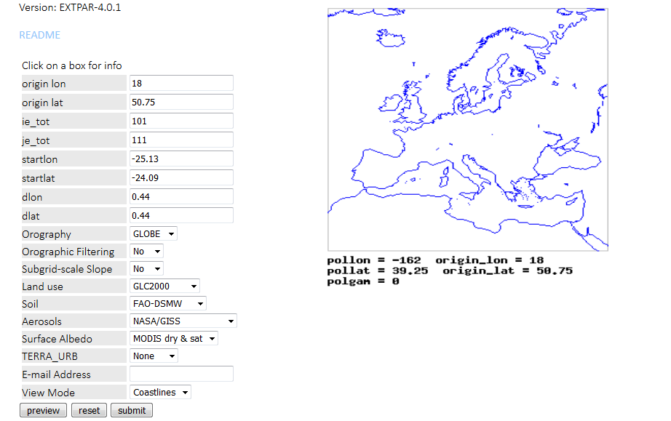
https://www.clm-community.eu/076568/index.php.en

Slide 4
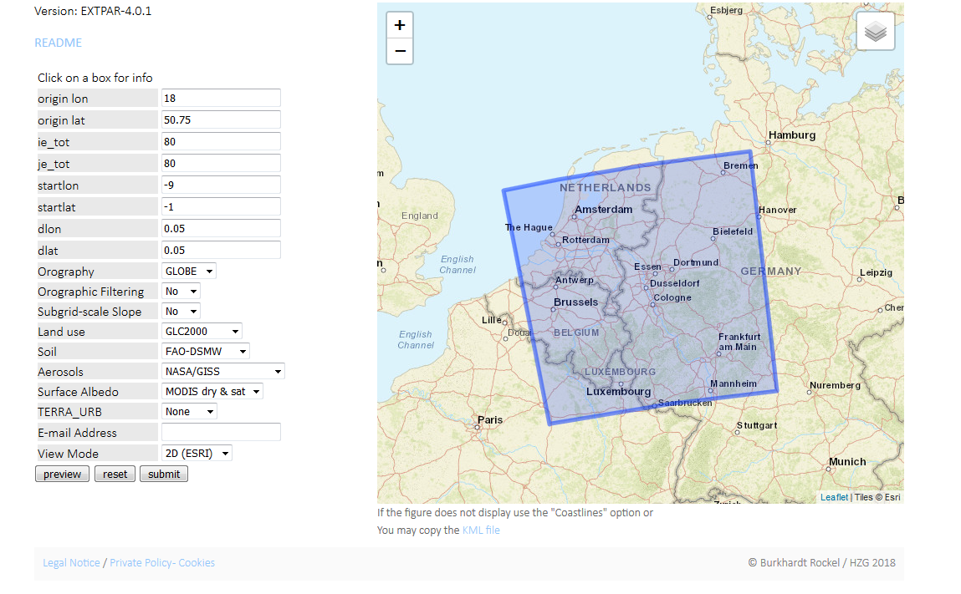
Clemens: Wiebke, Köln, 28.Feb.1990

Slide 5
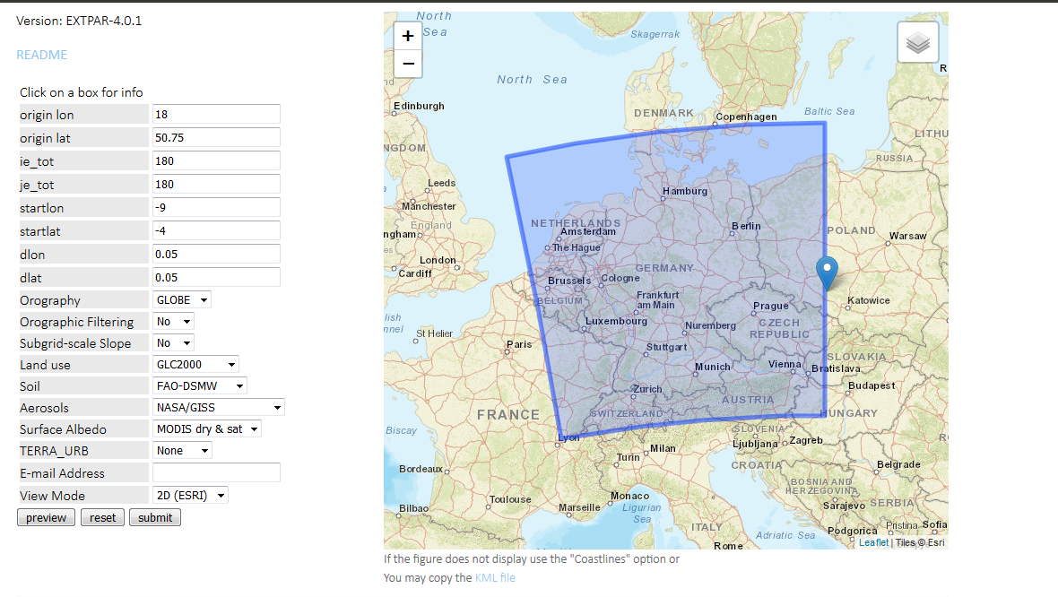
Felicitas: Egon, Deutschland, Mitte Januar 2017

Slide 6
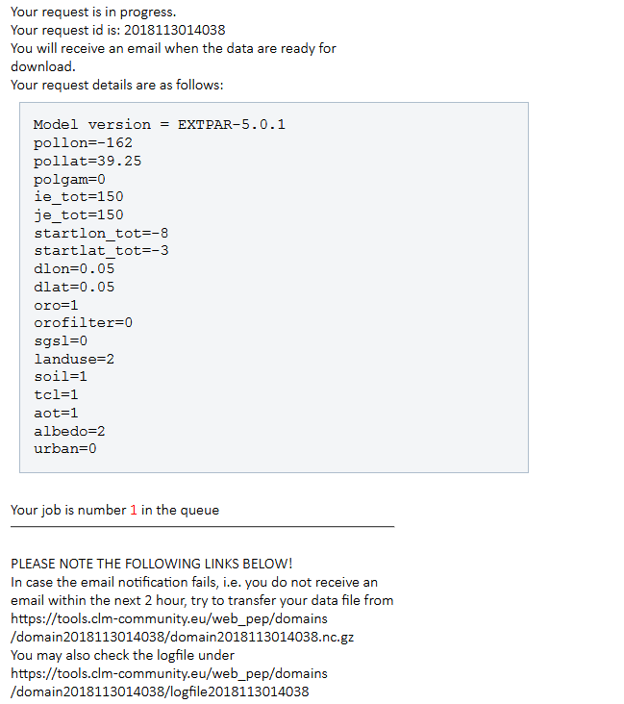

Slide 7
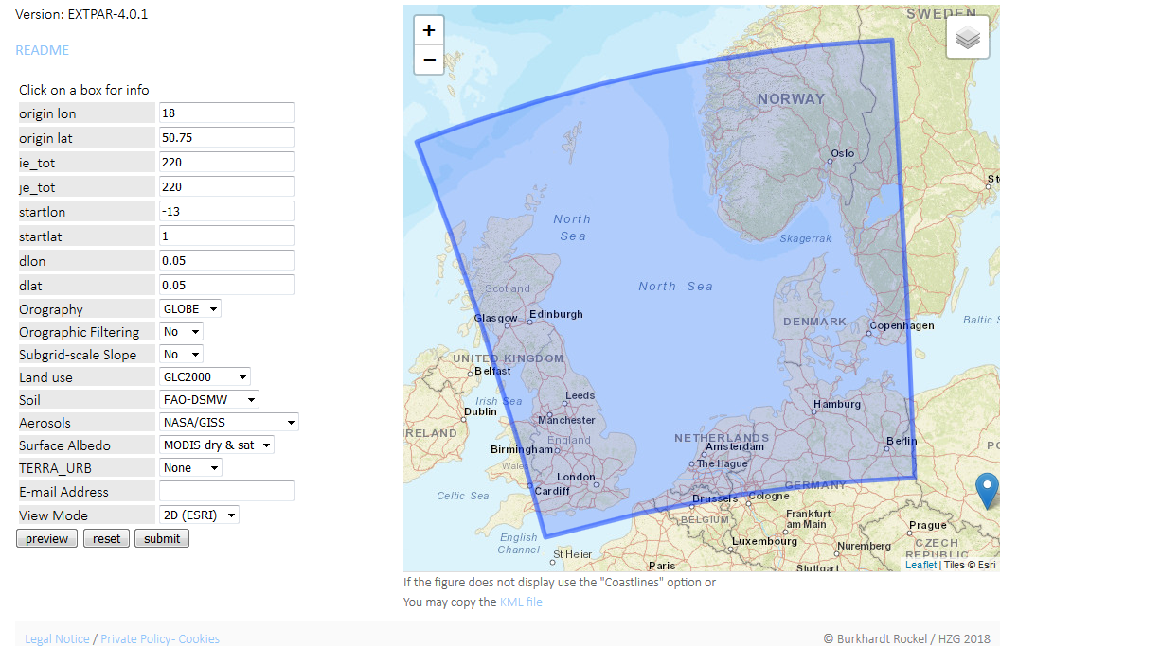
Mustafa; Oratia, Nordsee, 30 Oktober 2000

Slide 8
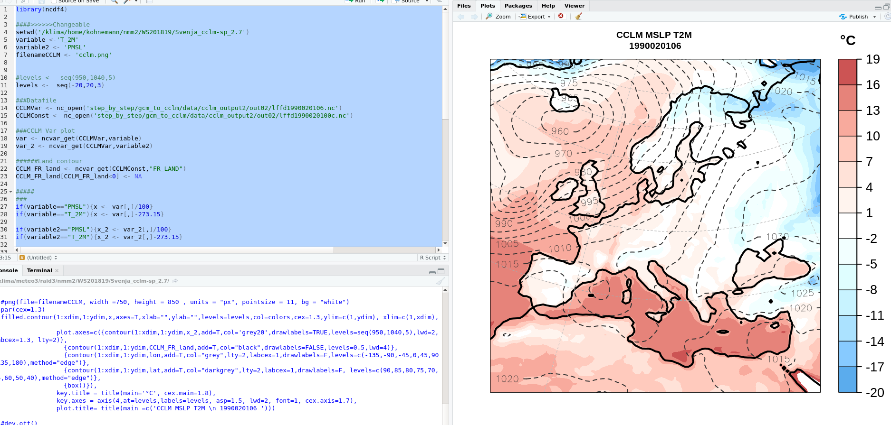
/Svenja_cclm-sp_2.7/plotten

Slide 9
SPDIR=/klima/meteo3/raid3/nmm2/WS201819/Svenja_cclm-sp_2.7
SPDIR=/klima/meteo3/raid3/nmm2/WS201819/cclm-sp_2.7
ydate_ini='1990020100', ydate_end='1990030100',
ydate_ini='2000010100', ydate_end='2000020100',
ydir_restart='${SPDIR}/step_by_step/gcm_to_cclm/data/cclm_output2/restarts/'
ydir_restart='${SPDIR}/step_by_step/gcm_to_cclm/data/cclm_output/restarts/‘
ydirini='${SPDIR}/step_by_step/gcm_to_cclm/data/int2lm_output2/',
ydirini='${SPDIR}/step_by_step/gcm_to_cclm/data/int2lm_output/',
ydirbd='${SPDIR}/step_by_step/gcm_to_cclm/data/int2lm_output2/',
ydirbd='${SPDIR}/step_by_step/gcm_to_cclm/data/int2lm_output/',
ydir='${SPDIR}/step_by_step/gcm_to_cclm/data/cclm_output2/out01/',
ydir='${SPDIR}/step_by_step/gcm_to_cclm/data/cclm_output/out01/',
ydir='${SPDIR}/step_by_step/gcm_to_cclm/data/cclm_output2/out02/',
ydir='${SPDIR}/step_by_step/gcm_to_cclm/data/cclm_output/out02/',
ydir='${SPDIR}/step_by_step/gcm_to_cclm/data/cclm_output2/out03/',
ydir='${SPDIR}/step_by_step/gcm_to_cclm/data/cclm_output/out03/',
Gcm → clm
Run_cclm

Slide 10
SPDIR=/klima/meteo3/raid3/nmm2/WS201819/Svenja_cclm-sp_2.7
SPDIR=/klima/meteo3/raid3/nmm2/WS201819/cclm-sp_2.7
ydate_ini='1990020100', hstart=0.0, hstop=744, hincbound=3,
ydate_bd='1990020100', linitial=.TRUE., lboundaries =.TRUE.,
ydate_ini='2000010100', hstart=0.0, hstop=744, hincbound=3,
ydate_bd='2000010100', linitial=.TRUE., lboundaries =.TRUE.,
itype_rootdp = 3,
itype_rootdp = 4,
ielm_tot=76, jelm_tot=76, kelm_tot=40, <<- ---- 4 Randpixel abziehen, 2 pro Seite
pollat = 39.25, pollon = -162.0,
dlon=0.05, dlat=0.05,
ielm_tot=60, jelm_tot=65, kelm_tot=40,
pollat = 40., pollon = -170.0,
dlon=0.0625, dlat=0.0625,
startlat_tot = -0.9, startlon_tot = -8.9, <<- ---- 2 Randpixel von Startseite abziehen
startlat_tot = 0., startlon_tot = 3.5,
ie_ext=80, je_ext=80,
ylmext_lfn='domainKoeln.nc',
ie_ext=300, je_ext=350,
ylmext_lfn='mid-europe_00625.nc',
yinext_lfn='lffd1990020100c.nc',
yinext_cat='${SPDIR}/step_by_step/gcm_to_cclm/data/cclm_output2/out01',
yin_cat='${SPDIR}/step_by_step/gcm_to_cclm/data/cclm_output2/out01',
ylm_cat='${SPDIR}/step_by_step/cclm_to_cclm/data/int2lm_output2/',
yinext_lfn='lffd2000010100c.nc',
yinext_cat='${SPDIR}/step_by_step/gcm_to_cclm/data/cclm_output/out01',
yin_cat='${SPDIR}/step_by_step/gcm_to_cclm/data/cclm_output/out01',
ylm_cat='${SPDIR}/step_by_step/cclm_to_cclm/data/int2lm_output
clm → clm
Run_int2lm

Slide 11
SPDIR=/klima/meteo3/raid3/nmm2/WS201819/Svenja_cclm-sp_2.7
SPDIR=/klima/meteo3/raid3/nmm2/WS201819/cclm-sp_2.7
startlat_tot = -0.9, startlon_tot = -8.9,
pollat = 39.25, pollon = -162.0,
dlon=0.05, dlat=0.05,
startlat_tot = 0., startlon_tot = 3.5,
pollat = 40., pollon = -170.0,
dlon=0.0625, dlat=0.0625,
ie_tot=76, je_tot=76, ke_tot=40,
ie_tot=60, je_tot=65, ke_tot=40,
ydate_ini='1990020100', ydate_end='1990030100',
ydate_ini='2000010100', ydate_end='2000020100',
ydirini='${SPDIR}/step_by_step/cclm_to_cclm/data/int2lm_output2/',
ydirini='${SPDIR}/step_by_step/cclm_to_cclm/data/int2lm_output/',
ydirbd='${SPDIR}/step_by_step/cclm_to_cclm/data/int2lm_output2/',
ydirbd='${SPDIR}/step_by_step/cclm_to_cclm/data/int2lm_output/',
ydir='${SPDIR}/step_by_step/cclm_to_cclm/data/cclm_output2/out01/',
ydir='${SPDIR}/step_by_step/cclm_to_cclm/data/cclm_output/out01/',
ydir='${SPDIR}/step_by_step/cclm_to_cclm/data/cclm_output2/out02/',
ydir='${SPDIR}/step_by_step/cclm_to_cclm/data/cclm_output/out02/',
ydir='${SPDIR}/step_by_step/cclm_to_cclm/data/cclm_output2/out03/',
ydir='${SPDIR}/step_by_step/cclm_to_cclm/data/cclm_output/out03/',
clm → clm
Run_cclm

Slide 12
R-Script anpassen an neues Modellgebiet
– Mit anderen Wettercharts vergleichen
Sturmentwicklung darstellen
Einfache Statistiken (daymean etc.)
Messstationen im DWD Data Archive suchen und vergleichen
https://www.dwd.de/DE/leistungen/klimadatendeutschland/klarchivtagmonat.html#buehneTop
-Pixel im CCLM Gebiet rausschreiben mit cdo remapnn xxxx
-R-Skript schreiben Messung vs. Modell

