Slide 1
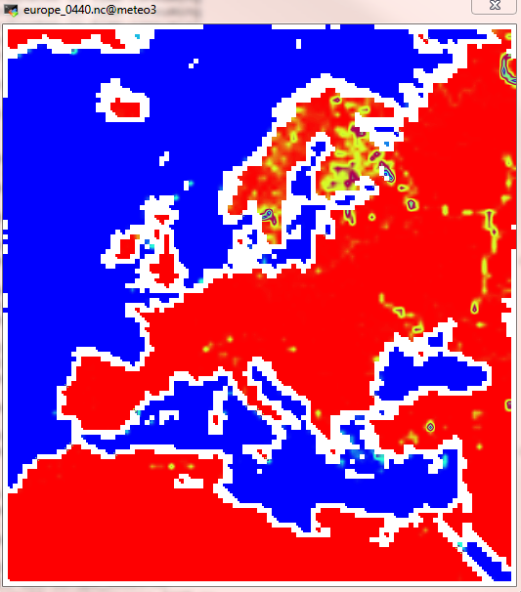
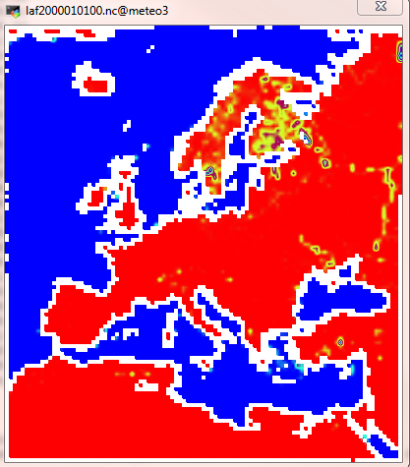
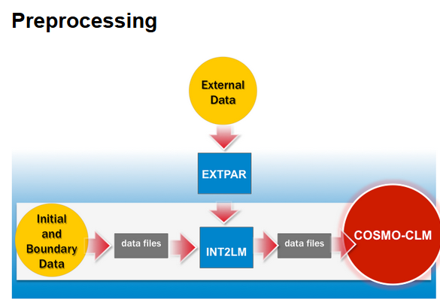
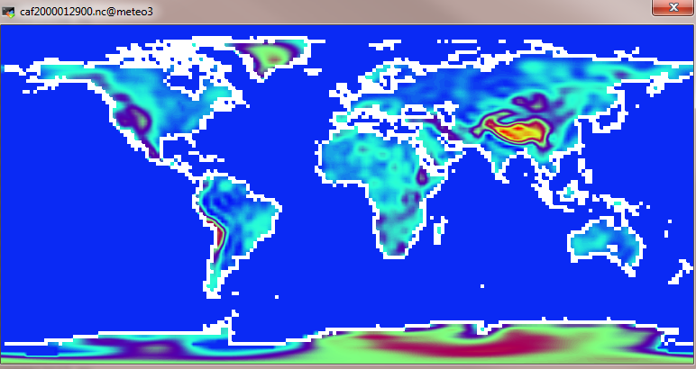


Slide 2
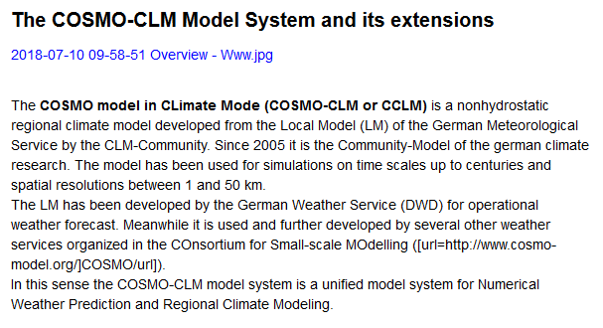

Slide 3
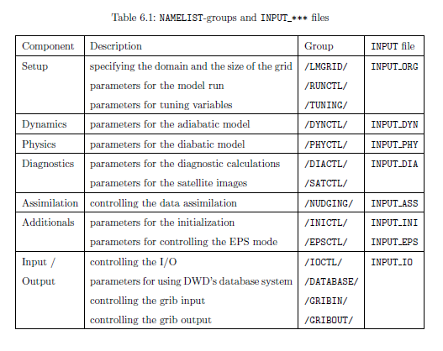
COSMO needs a NAMELIST-input to specify runtime parameter
Splitted into several groups

Slide 4
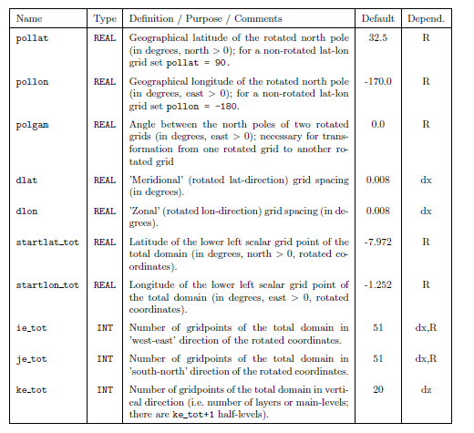
Setup: LMGrid – Model Domain and Reference Atmosphere
Lat-lon coordinates of the pole and rotated grid
Position of the model domain within the rotated grid
The size and resolution of the model grid
And parameteres for the reference atmosphere

Slide 5
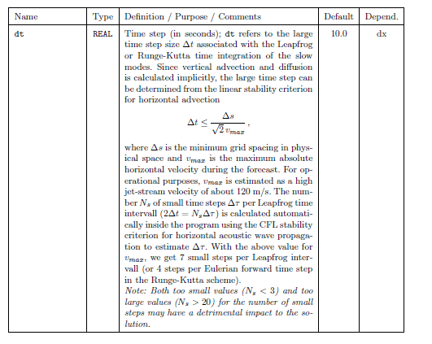
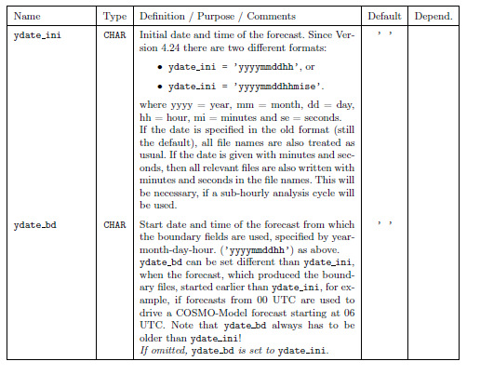
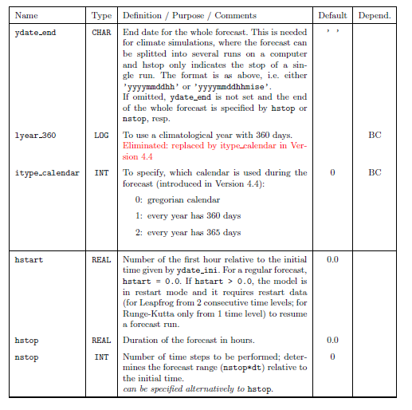
Setup: RUNCTL – Parameters for the Model Run
Initial time, forecast range, time step and calendar used
Basic control parameters
Parameters related to artificial initial and boundary conditions
Parameters for parallel and sequential executions
Parameters for diagnostic min/max model output
Parameters for debug purposes

Slide 6

Setup: TUNING – Parameters for tuning dynamics and physics
Intendent to use mainly by experts!
The parameters can be used the behavior of the model to special regions, applications and resolutions

Slide 7


7) Input/Output: IOCTL – Controlling the GRIB I/O
Basic control parameters
Writing (and reading) Restart Files
Additional specifications for NetCDF-IO
Reading and writing „Ready-Files“
Controlling soil moisture analysis
7)GRIBIN – Controlling the Grib Input
Control parameters for initial data
Control parameters for boundary data
Additional parameters for continuous data assimilation
7) GRIBOUT – Controlling the Grib Input

Slide 8
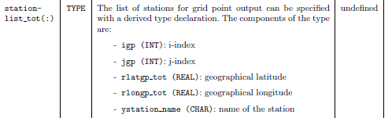
2) DYNCTL – Parameters for the Adiabatic Model
Main switches for the time integration
Parameters for the semi-implicit time-integration scheme
Parameters for RUNGE-Kutta Scheme
Parameters for the lateral boundary conditions
Horizontal diffusion
Lower and upper boundary conditions
Additional numerical filters
Spectral nudging
PHYCTL – Parameters for the Diabatic Model
Grid-Scale Precipitation
Radiation
Moist Convection
Vertical turbulent diffusion
Surface layer fluxes
Soil processes
Sub grid scale orography
DIACTL – Parameters for Diagnostic Output
Grid point output in a specific form (meteographs)
Control Output for a quick-look monitoring of the model run
6) INICTL – Parameters for the Model Initialization
5) NUDGING – Controllong the Data Assimilation

Slide 9

/klima/home/kohnemann/nmm2/WS201819/cclm-sp_2.7/step_by_step/gcm_to_cclm/data/cclm_output
In out01:
W_SO soil water content
W_SNOW surface snow amount
W_I lwe thickness of canopy water amount
W vertical wind velocity
V V-component of wind
U U-component of wind
T_SO soil temperature
T_SNOW snow surface temperature
T_S soil surface temperature
T temperature
QV_S surface specific humidity
QV specific humidity
QS specific snow content
QR specific rain content
QI specific cloud ice content
QC specific cloud liquid water content
PP deviation from reference pressure
FRESHSNW freshness of snow
Constant file:
HHL height
HSURF surface height
FIS surface geopotential
FC Coriolis parameter
FR_LAND land-sea fraction
SOILTYP soil type
FOR_E ground fraction covered by evergreen forest
FOR_D ground fraction covered by deciduous forest
SSO_STDH standard deviation of sub-grid scale orography
SSO_GAMMA anisotropy of sub-grid scale orography
SSO_THETA angle between principal axis of orography and east
SSO_SIGMA mean slope of sub-grid scale orography
ALB_DRY dry soil albedo
ALB_SAT saturated soil albedo

Slide 10
/klima/home/kohnemann/nmm2/WS201819/cclm-sp_2.7/step_by_step/gcm_to_cclm/data/cclm_output
In out02:
RUNOFF_S surface runoff
RUNOFF_G subsurface runoff
H_SNOW thickness of snow
CLCM medium cloud cover
CLCL low cloud cover
CLCH high cloud cover
AVMFL_S averaged northward stress
AUMFL_S averaged eastward stress
AEVAP_S surface evaporation
RELHUM_2M 2m relative humidity
V_10M V-component of 10m wind
U_10M U-component of 10m wind
T_2M 2m temperature
QV_2M 2m specific humidity
PS surface pressure
PMSL mean sea level pressure
DURSUN duration of sunshine
CLCT total cloud cover
ATHB_T averaged TOA outgoing longwave radiation
ATHB_S averaged surface net downward longwave radiation
ASOB_S averaged surface net downward shortwave radiation
ASOB_T averaged TOA net downward shortwave radiation
ASHFL_S averaged surface sensible heat flux
ALHFL_S averaged surface latent heat flux
ALB_RAD surface albedo
TOT_PREC total precipitation amount
SNOW_GSP large scale snowfall
RAIN_GSP large scale rainfall
SNOW_CON convective snowfall
RAIN_CON convective rainfall

Slide 11
/klima/home/kohnemann/nmm2/WS201819/cclm-sp_2.7/step_by_step/gcm_to_cclm/data/cclm_output
In out03 (300,400,500,800,850hPa):
RELHUM relative humidity
V V-component of wind
U U-component of wind
T temperature
QV specific humidity
FI geopotential

Slide 12
Vertical coordinate:
k Z(k) P0(k)
1 22700.0000 40.2617
2 20800.0000 53.9582
3 19100.0000 69.9812
4 17550.0000 88.5358
5 16150.0000 109.2943
6 14900.0000 131.6959
7 13800.0000 154.9601
8 12785.0000 179.8255
9 11875.0000 205.2591
10 11020.0000 232.1785
11 10205.0000 260.8520
12 9440.0000 290.6994
13 8710.0000 322.0619
14 8015.0000 354.7448
15 7355.0000 388.5191
16 6725.0000 423.4133
17 6130.0000 458.8960
18 5565.0000 494.9887
19 5035.0000 531.0771
20 4530.0000 567.5646
21 4060.0000 603.4411
22 3615.0000 639.1762
23 3200.0000 674.1020
24 2815.0000 707.9242
25 2455.0000 740.8198
26 2125.0000 772.0769
27 1820.0000 801.9229
28 1545.0000 829.6353
29 1295.0000 855.4984
30 1070.0000 879.3281
31 870.0000 900.9547
32 695.0000 920.2247
33 542.0000 937.3394
34 412.0000 952.0786
35 303.0000 964.5774
36 214.0000 974.8783
37 143.0000 983.1576
38 89.0000 989.4914
39 49.0000 994.2036
40 20.0000 997.6309
41 0.0000 1000.0000

Slide 13
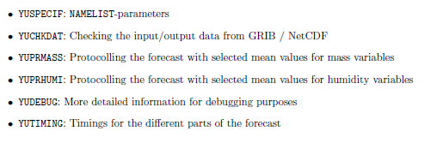
nmm2/WS201819/cclm-sp_2.7/step_by_step/gcm_to_cclm/log_cclm
& Stationsdaten

Slide 14
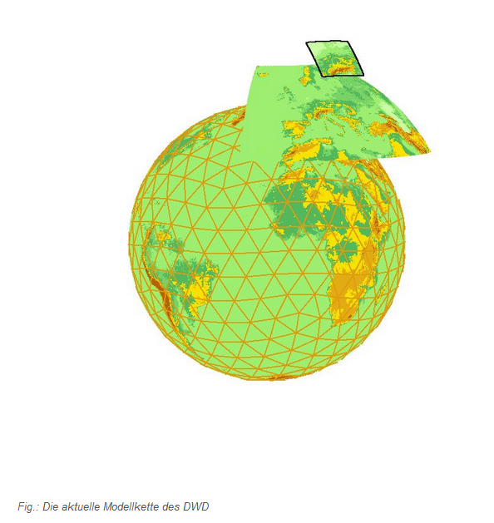

Das aktuelle numerische Wettervorhersage- und Notfallsystem des Deutschen Wetterdienst
Modellkette mit sukzessiv höherer Auflösung: numerischer Aufwand wächst mit Anzahl der Gitterpunkte
Der schnellste Hochleistungsrechner ist zu eingeschränkt um weltweit mit hoher Auflösung zu rechnen (!)
Modellkette:
Globalmodell ICON: weltweit mit Maschenweite von 13km auf 90 Schichten in der Vertikalen (265 Mio. Gitterpunkte).
ICON-EU: Europa mit Maschenweite von 6.5km auf 60 Schichten (39,5 Mio. Gitterpunkten)
COSMO-D2: Regionalmodell für Deutschland mit Maschenweite von 2.2km und 65 Schichten (30Mio. Gitterpunkte)

