Slide 1

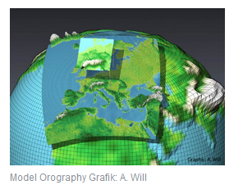
COnsortium for Small scale MOdeling
The COSMO model is the nonhydrostatic operational weather prediction model applied and further developed by the national weather services joined in the COnsortium for SMall scale MOdeling (COSMO).
nonhydrostatic limited-area atmospheric prediction model
Use:
Numerical weather prediction (NWP)
Regional climate modeling (RCM)
Software package free of charge for scientific and educational purposes

Slide 2
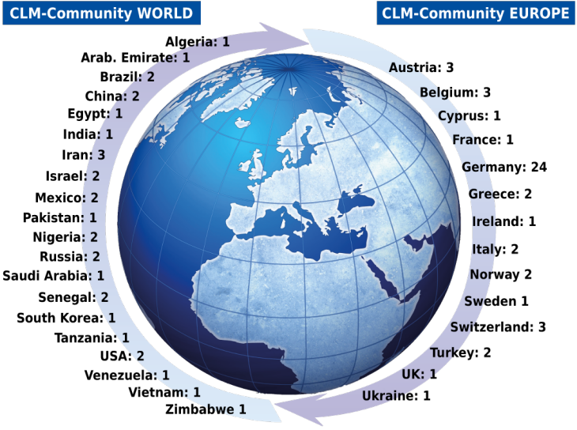
COSMO-CLM is an atmosphere model coupled to the soil-vegetation model TERRA. Additionally, there is the possibility to use COSMO-ART (Vogel at al., 2009), which enables the calculation of the interactions of trace gases and aerosol with the atmospheric radiation. Other regional processes in the climate system like ocean and ice sheet dynamics, plant responses, aerosol-cloud interaction, and the feedback to the GCM driving the RCM are still prescribed or neglected.

Slide 3
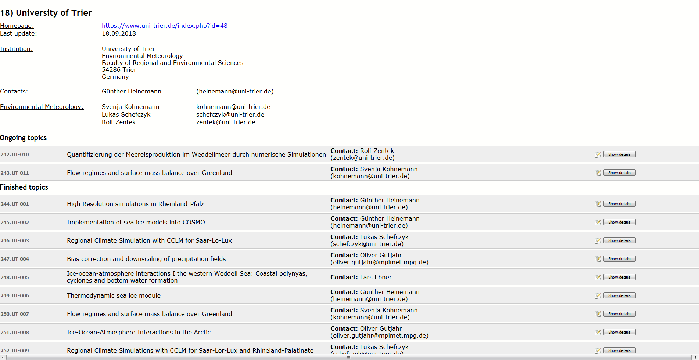


Slide 4
Basic version of COSMO-Model (formerly known as Lokal Modell (LM)) has been developed at the Deutscher Wetterdienst (DWD).
COSMO-Model + Globalmodell (GME) + corresponding data assimilation schemes form the NWP System at DWD (since 1999)
Meso-α und meso-β scale (1,3,7km)
based on primitive hydro-thermodynamical equations
describing a compressible non-hydrostatic flow in a moist atmosphere
without any scale approximations
in a rotated geographical coordinate system
Surface height following
Variety of physical processes are taken into account by parametrization schemes

Slide 5
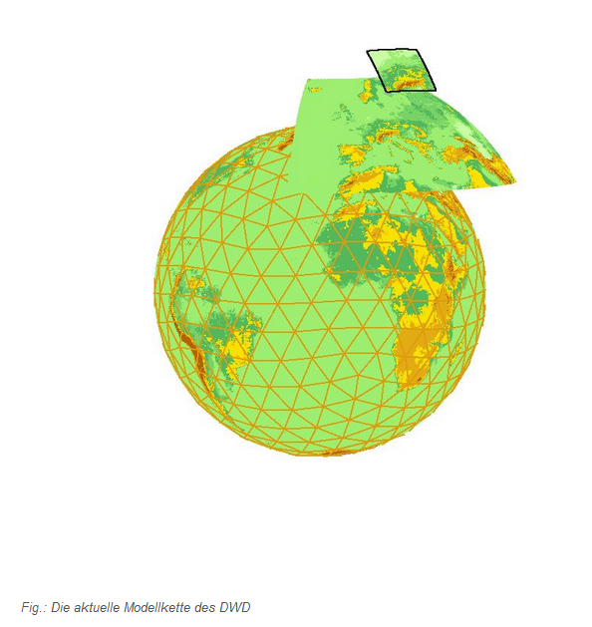

Gitter über Erdoberfläche und für jeden Punkt werden die Gleichungen für Wind, Druck Temperatur, Feuchte …. einmal berechnet.
Horizontal und vertikal!
Problem:
Entscheidung zwischen Rechenaufwand und Auflösung.
Warum simulieren wir nicht direkt Deutschland?

Slide 6
Das aktuelle numerische Wettervorhersage- und Notfallsystem des Deutschen Wetterdienst
Modellkette mit sukzessiv höherer Auflösung: numerischer Aufwand wächst mit Anzahl der Gitterpunkte
Der schnellste Hochleistungsrechner ist zu eingeschränkt um weltweit mit hoher Auflösung zu rechnen (!)
Modellkette:
Globalmodell ICON: weltweit mit Maschenweite von 13km auf 90 Schichten in der Vertikalen (265 Mio. Gitterpunkte).
ICON-EU: Europa mit Maschenweite von 6.5km auf 60 Schichten (39,5 Mio. Gitterpunkten)
COSMO-D2: Regionalmodell für Deutschland mit Maschenweite von 2.2km und 65 Schichten (30Mio. Gitterpunkte)

Slide 7
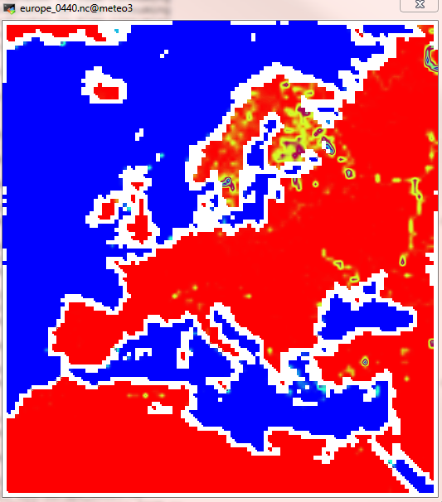
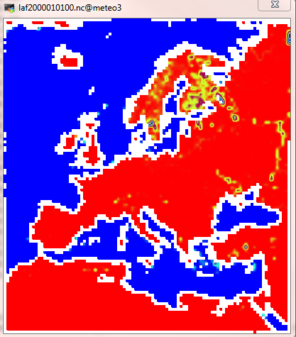
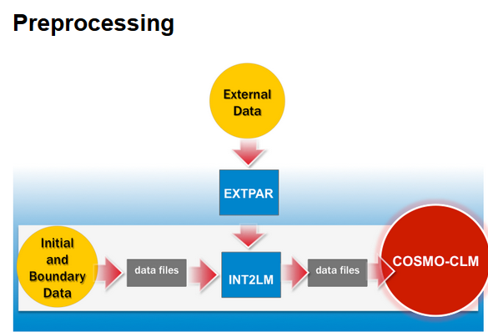
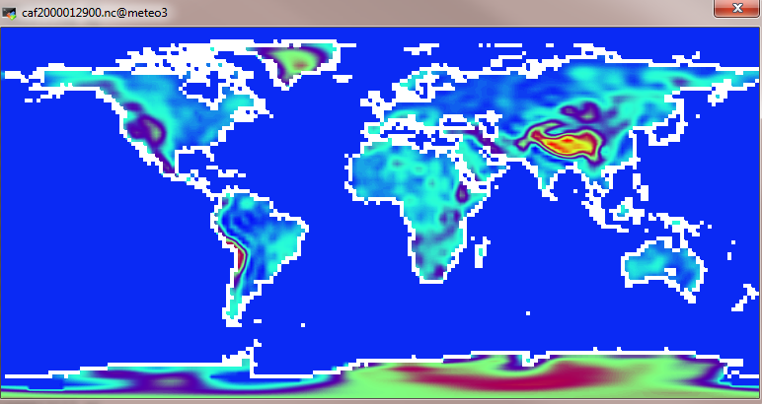


Slide 8
1) Was benötigt COSMO als Ausgangsdaten? Was muss übergeben werden? Konstant oder variabel?
2) Woher nehmen wir die?
3) Wie passen wir die Auflösung an?
WepPep
Documentation: https://www.hzg.de/ms/clm-community/076548/index.php.en
http://cosmo-model.org/content/model/documentation/core/default.htm

Slide 9
Preprocessing
2
1
3
The COSMO-CLM model needs initial and boundary data from a global model (or reanalysis) and external parameters on the simulation grid as input.
Three steps are necessary to prepare the data:
1) Conversion of the driving model data to INT2LM input conform netCDF format (“prepreprocessor”; for some models, such converter programs are available) For some input data, this step has already been made and the INT2LM-ready data are provided at the DKRZ computers (see "Model -> support -> CCLM@DKRZ”).
2) Processing of the external parameters for interpolation of the physical properties of the region and the vegetation to the grid of the COSMO-CLM. This program is called “EXTPAR” (External Parameter for Numerical Weather Prediction and Climate Application). A web-based version (called WebPEP) is available using the standard input data.
3) Finally the interpolation program INT2LM calculates the initial and boundary conditions using the EXTPAR results and interpolating the coarse grid model fields to the COSMO-CLM grid.

Slide 10
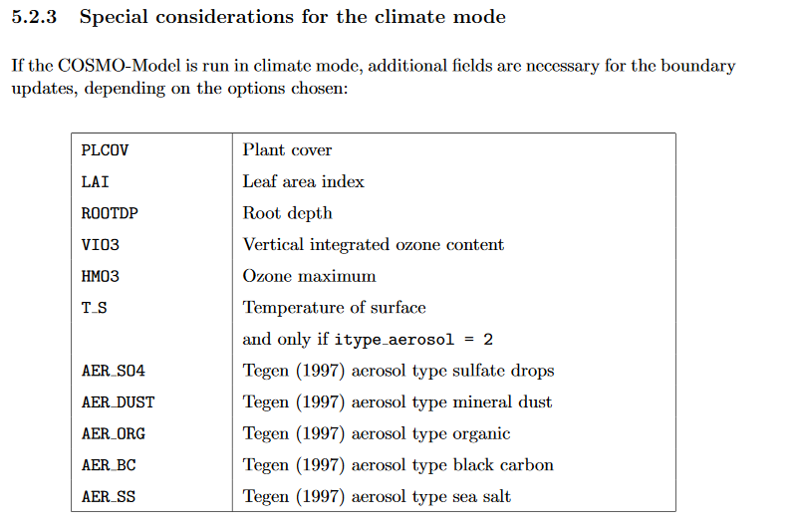
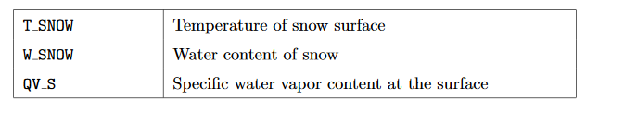
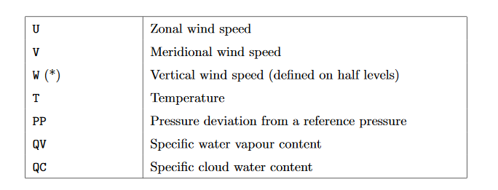
1) Boundary Data for the COSMO-Model (Reanalysen, Modellen …)
1
→ Atmospheric variables and some surface variables

Slide 11
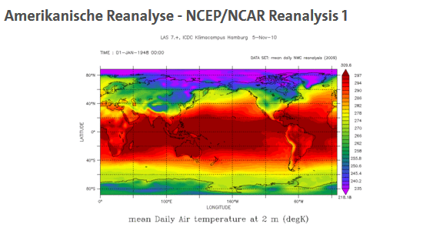
Reanalysen:
1
In den numerischen Wettermodellen werden Millionen Beobachtungen assimiliert. Das Ergebnis, die resultierenden Analysen, sind dreidimensionale, konsistente Beschreibung des atmosphärischen Zustandes. In diesem Sinne kombinieren Analysen die Vorteile des Modelles mit den Vorteilen der Beobachtungen.

Slide 12
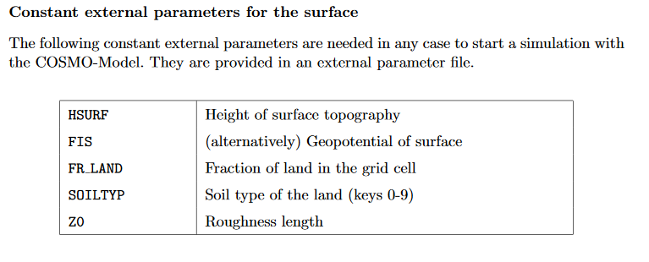
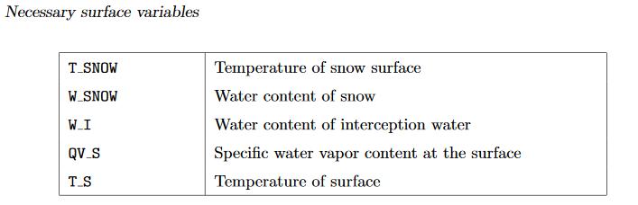
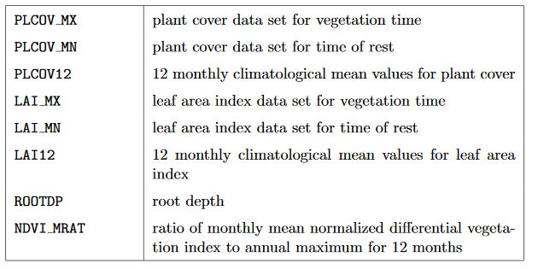
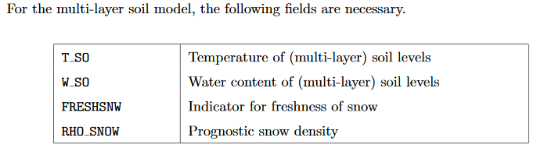
2
2
Constant or assimilated every 03,06,09,12 … hours

Slide 13
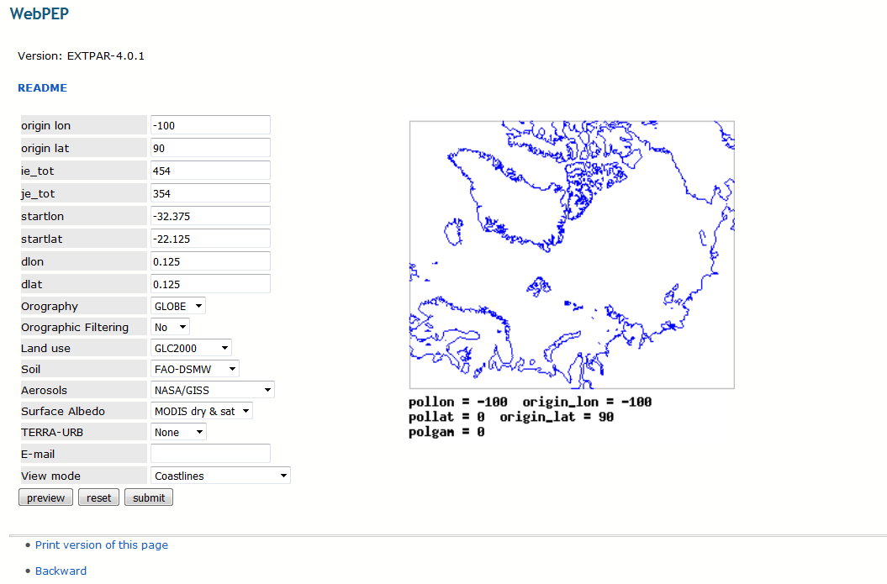
2) Extpar (all)
Here you can find all reference configurations for the preparation of the time invariant data describing the properties of the earth surface, the soil and the vegetation named external parameters. They are used by int2lm for preparation of initial and boundary conditions.
2

Slide 14
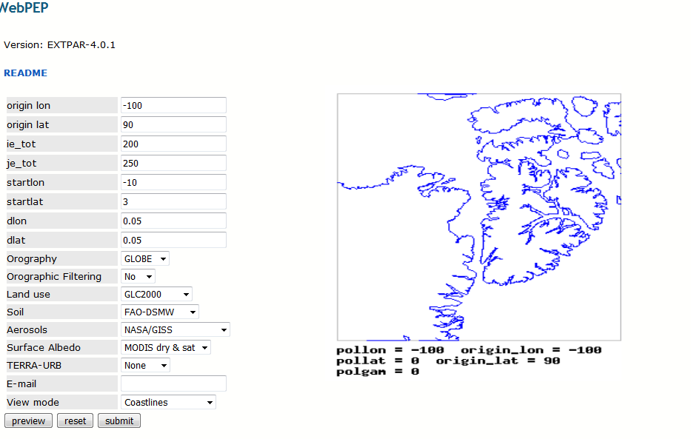
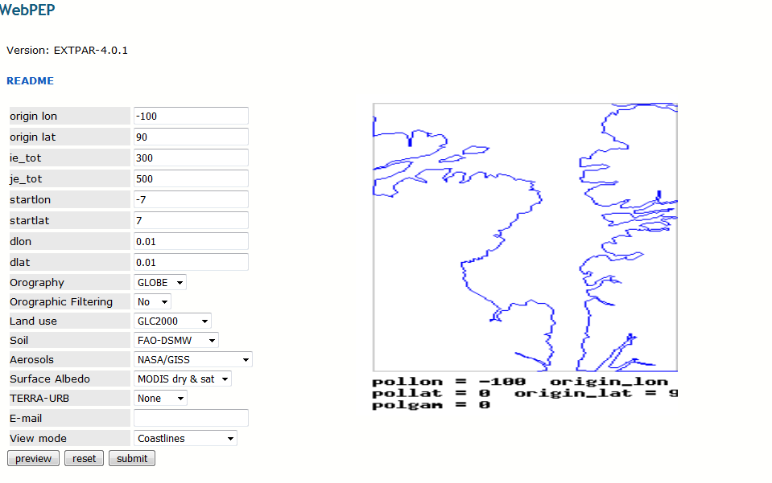
2
111.11km * 0.05= 5.555km
111.11km * 0.01= 1,1111km

Slide 15
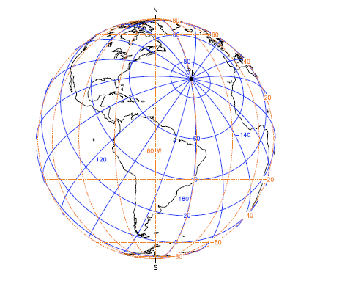
Exkurs:
Model equations are formulated with respect to rotated lat/lon-grid with coordinates (λ,ϕ), height (z)
Most natural and convenient way
to take the spherical shape
of the earth into account
Numerical problems:
the convergence of the meridians
the resulting pole singularities
Solution:
pole is tilted
equator runs through the center of the model domain

Slide 16
INT2LM
Here you can find all reference configurations for preparation of initial and boundary conditions of the COSMO model and it's previous LM or CLM model versions. Each of them is used together with one or more of the reference COSMO (or CLM) configurations for NWP, CLM or ART applications made available in the namelist tool.
https://tools.clm-community.eu/NLT_v2/portal/index.php?page=2000&model=int2lm
3

Slide 17
3) run int2lm → interpolating the coarse grid model fields to the COSMO-CLM grid
Meteo3:
/klima/meteo3/raid3/nmm2/WS201819/cclm-sp_2.7/step_by_step/gcm_to_cclm
→ Script: run_int2lm
3
Namelist-InputFile:
-CONTRL – parameters for the model run
-GRID_IN – specifying the domain and size of the coarse grid
-LMGRID – specifying the domain and the size of the COSMO-MODEL grid
-Data – controlling the grid input and output
-PRICTR – controlling grid point output

Slide 18
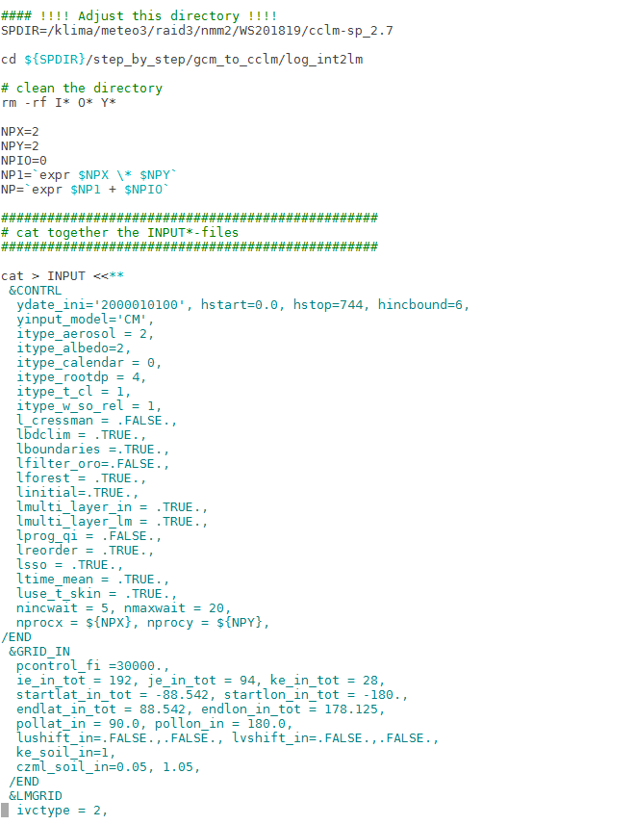
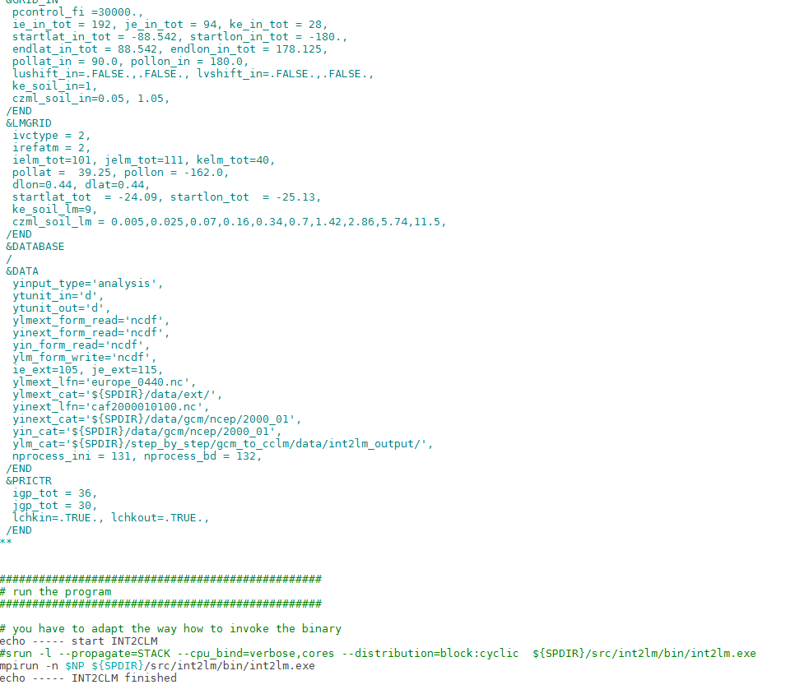
Namelist-InputFile:
-CONTRL – parameters for the model run
-GRID_IN – specifying the domain and size of the coarse grid
-LMGRID – specifying the domain and the size of the COSMO-MODEL grid
-Data – controlling the grid input and output
-PRICTR – controlling grid point output

Slide 19
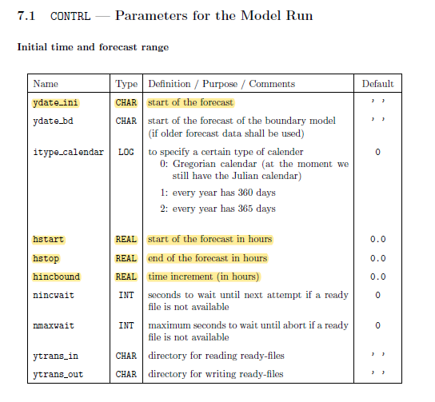
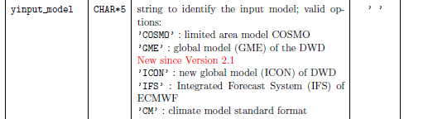
Namelist-InputFile:
-CONTRL – parameters for the model run
-GRID_IN – specifying the domain and size of the coarse grid
-LMGRID – specifying the domain and the size of the COSMO-MODEL grid
-Data – controlling the grid input and output
-PRICTR – controlling grid point output

Slide 20
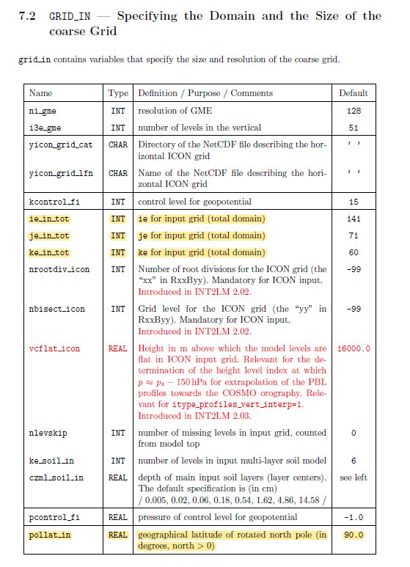
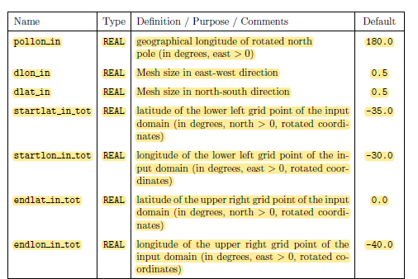
Namelist-InputFile:
-CONTRL – parameters for the model run
-GRID_IN – specifying the domain and size of the coarse grid
-LMGRID – specifying the domain and the size of the COSMO-MODEL grid
-Data – controlling the grid input and output
-PRICTR – controlling grid point output
Data Input!!!

Slide 21
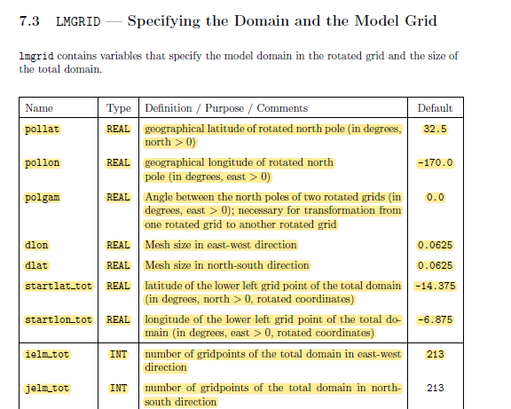
Namelist-InputFile:
-CONTRL – parameters for the model run
-GRID_IN – specifying the domain and size of the coarse grid
-LMGRID – specifying the domain and the size of the COSMO-MODEL grid
-Data – controlling the grid input and output
-PRICTR – controlling grid point output
Data Output!!!

Slide 22
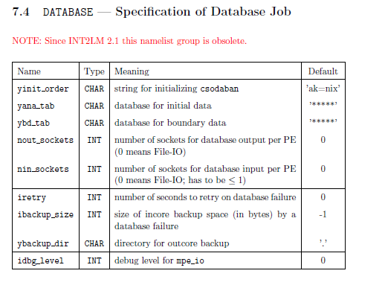
Namelist-InputFile:
-CONTRL – parameters for the model run
-GRID_IN – specifying the domain and size of the coarse grid
-LMGRID – specifying the domain and the size of the COSMO-MODEL grid
-Data – controlling the grid input and output
-PRICTR – controlling grid point output

Slide 23
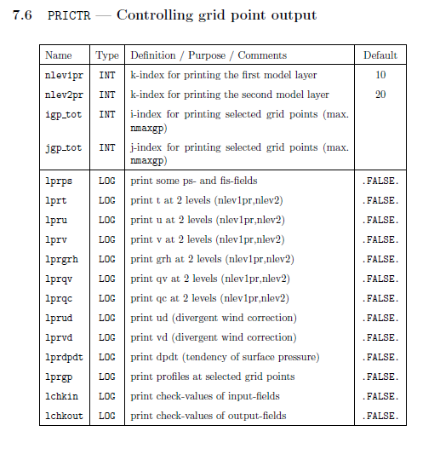
Namelist-InputFile:
-CONTRL – parameters for the model run
-GRID_IN – specifying the domain and size of the coarse grid
-LMGRID – specifying the domain and the size of the COSMO-MODEL grid
-Data – controlling the grid input and output
-PRICTR – controlling grid point output

Slide 25
High resolved atmosphere - ocean - ice interaction in the Arctic
Forcing
Sea Ice
ERA-Interim
SST
Skin temperature of sea ice
3D-forcing variables
OSISAF 1987 - 2002
AMSR-E/2 2002-2017
Land mask
SIC
ERA-5
SST
Skin temperature of sea ice
3D-forcing variables
PIOMAS
SIT
INT2lm
1.20
COSMO-CLM
5.0_clm1
Adaptation Arctic
2-layer thermo-dynamic sea ice module (Schröder et al. 2011)
Roughness length (Charnock)
Sea – ice albedo (Koltzow)
Tile approach surface energy fluxes for fractional sea ice (Gutjahr et al., 2016)
Started daily
Spin up – 6hrs
Turbulence tuning (Zentek et al.)
COSMO-CLM is the community model of the German regional climate research community jointly further developed by the CLM-Community.

Slide 26
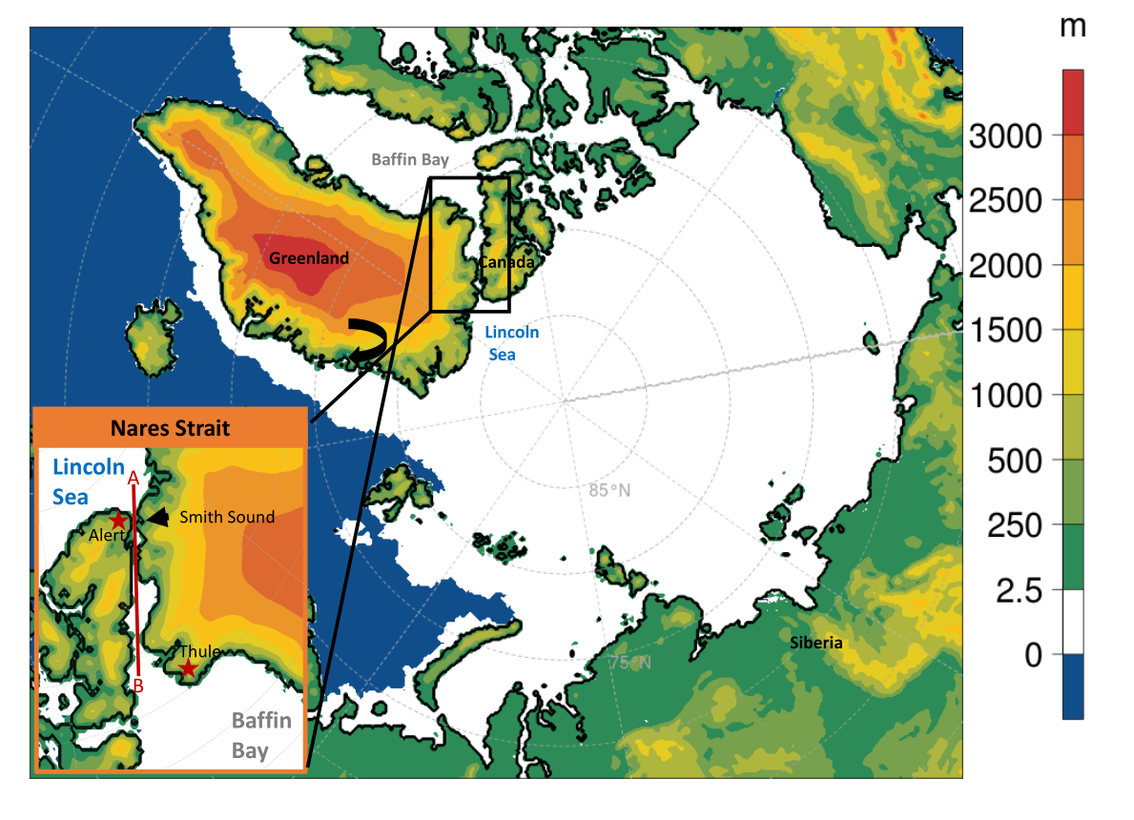
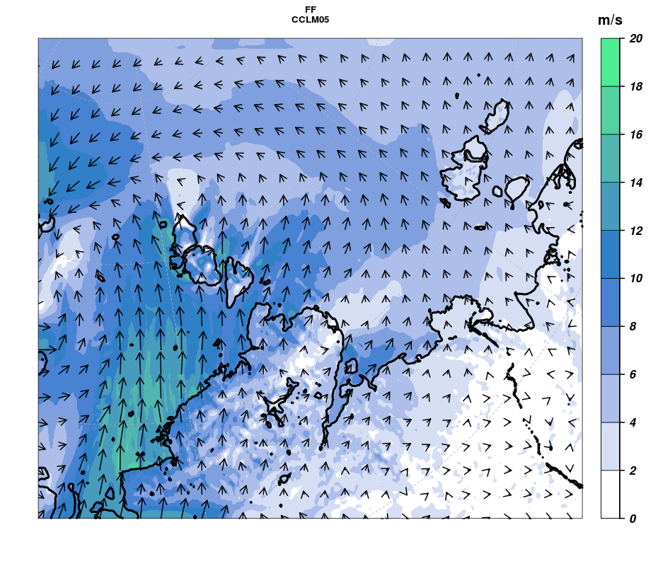
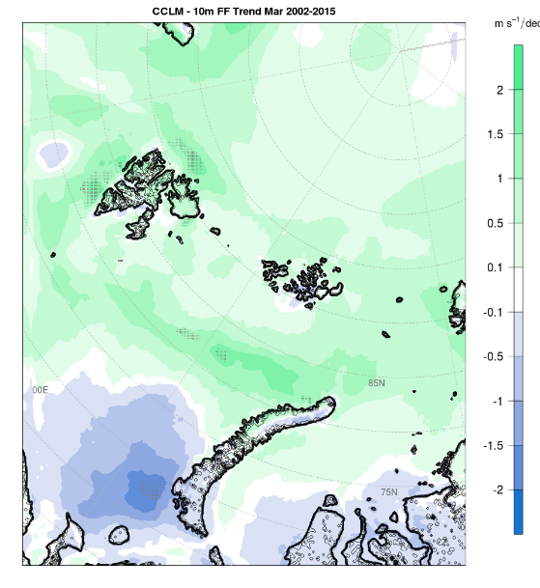
CCLM 15 – C15
15km
Nov-Apr 1987/88 – 2016/17
ERA-Interim
CCLM 05 – C05
5km
ERA-5
CCLM 05 – C05
5km
2002/03-2014/15
Nested in CCLM15

Slide 27
Aufgabe vom 09.11.2018 bis nächste Woche
Sucht euch einen Sturm (Zyklone) innerhalb Europas den ihr simulieren wollt (1979-2017).
(wetter3.de)

