Slide 1
SPI (Serial peripheral interface)Protocol
Presented By
Abhishek
Mahesh

Slide 2
Introduction to SPI
Features Of SPI
Block Diagram
Types Of SPI
Working Of SPI
Data Transmission
Advantages
Applications

Slide 3
Introduction to SPI
Serial peripheral interface (SPI) is one of the most widely used interfaces between microcontroller and peripheral ICs such as sensors, ADCs, DACs, SRAM, and others.
wire SPI devices have four signals:
Clock (SPI CLK, SCLK)
Chip select (CS)
Master out slave in(MOSI)
Master in slave out(MISO)

Slide 4
Features Of SPI
SPI is a synchronous
Full duplex
Multi slave communication
Speed is up to 10m/bits
Data transmission from both side LSB to MSB and MSB to LSB

Slide 5
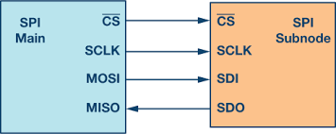
Block Diagram
The device that generates the clock signal is called the main. Data transmitted between the main and the sub node is synchronized to the clock generated by the main. SPI devices support much higher clock frequencies compared to I²C interfaces. Users should consult the product data sheet for the clock frequency specification of the SPI interface.

Slide 6
Data Transmission
To begin SPI communication, the main must send the clock signal and select the sub node by enabling the CS signal. Usually chip select is an active low signal; hence, the main must send a logic 0 on this signal to select the sub node. SPI is a full-duplex interface; both main and sub node can send data at the same time via the MOSI and MISO lines respectively. During SPI communication, the data is simultaneously transmitted (shifted out serially onto the MOSI/SDO bus) and received (the data on the bus (MISO/SDI) is sampled or read in)

Slide 7
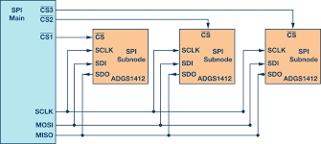
Types Of SPI
Regular SPI Mode

Slide 8
Regular SPI Mode
In regular mode, an individual chip select for each sub node is required from the main. Once the chip select signal is enabled (pulled low) by the main, the clock and data on the MOSI/MISO lines are available for the selected sub node. If multiple chip select signals are enabled, the data on the MISO line is corrupted, as there is no way for the main to identify which sub node is transmitting the data.

Slide 9
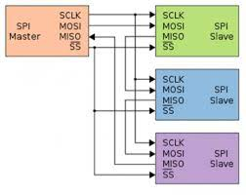
Types Of SPI
2. Daisy-Chain Method

Slide 10
Daisy-Chain Method
In daisy-chain mode, the sub nodes are configured such that the chip select signal for all sub nodes is tied together and data propagates from one sub node to the next. In this configuration, all sub nodes receive the same SPI clock at the same time. The data from the main is directly connected to the first sub node and that sub node provides data to the next sub node and so on.

Slide 11
Advantages:
Support full-duplex communication, which means data can be transmitted and received at the same time.
Better signal integrity, supporting high-speed applications.
The hardware connection is simple, only four signal lines are needed (some applications can be reduced to three).
No transceiver required.
The slave device does not need to address

Slide 12
Applications
It is used in real time clocks.
It is used in LCD and LED.
It is also used in video games.

Slide 13
THANK YOU

