Slide 1

PIC18F458 TIMERS
A PRESENTATION ON
By:
DHARANI K R
SIVA BRAHMAM

Slide 2
CONTENTS
PIC18F458 INTRODUCTION
WHY WE NEED TIMERS?
TYPES OF TIMERS
3.1. CONTROL REGISTERS
3.2. BLOCK DIAGRAM
3.3. OPERATION

Slide 3
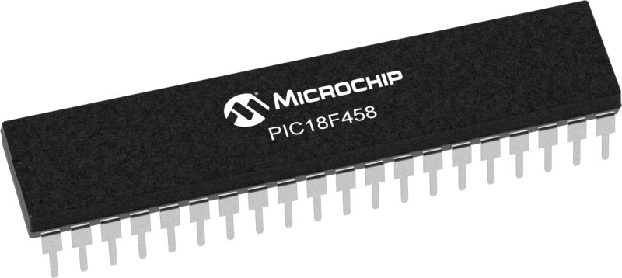
PIC18F458 INTRODUCTION
PIC microcontroller was developed in the year 1993 by microchip technology.
PIC18 range is based on 16-bit instruction architecture incorporating advanced RISC architecture which makes it highest performer among the all 8-bit PIC families.
PIC18F458 is a high-performance microcontroller and has a higher amount of Flash memory than other chips in the 8-bit family.
The PIC18F458 Microcontroller includes 32kb of internal flash Program Memory, together with a large RAM area and an internal EEPROM. An 8-channel 10-bit A/D convertor is also included within the microcontroller, making it ideal for real-time systems and monitoring applications.

Slide 4
WHY WE NEED TIMERS?
Timers are used for introducing delay, counting events, generating waveforms, and also for PWM generation.
Timer will help to create timing intervals in a system so that the user gets the control over his code to perform some time dependent tasks or functions.
The Timer register can have the following bit length.
a) 8 bit timers – These can count between 0-255
b)16 bit timers – These can count between 0-65536
c) 32 bit timers – These can count between 0-4294967296

Slide 5
TYPES OF TIMERS IN PIC18F458
TIMER0
TIMER1
TIMER2
TIMER3

Slide 6
TIMER0 MODULE
Timer0 can work as both 8-bit and 16-bit modes timer/counter.
Selectable clock source (internal or external).
Interrupt-on-overflow from FFh to 00h in 8-bit mode and FFFFh to 0000h in 16-bit mode.
Software programmable Prescaler.

Slide 7

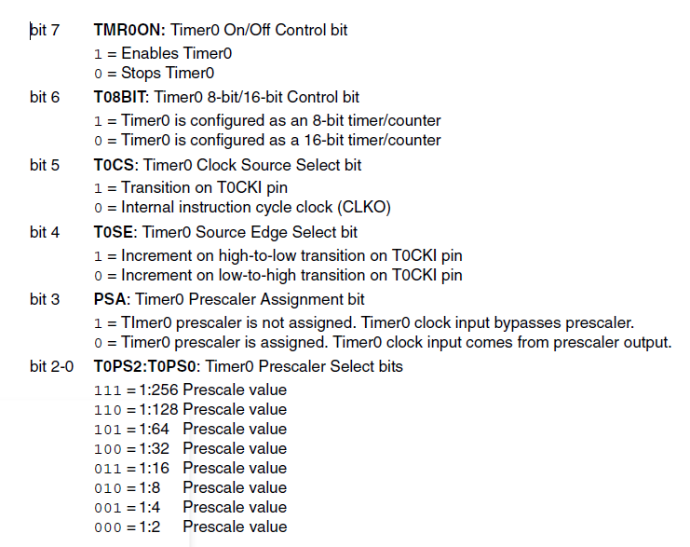
T0CON: TIMER0 CONTROL REGISTER

Slide 8
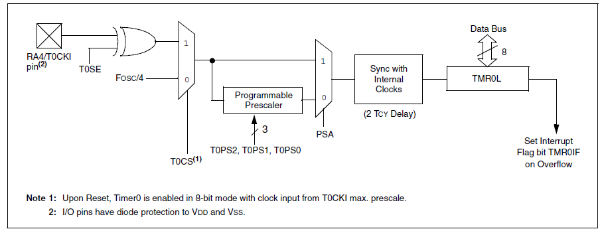
TIMER0 BLOCK DIAGRAM IN 8-BIT MODE

Slide 9
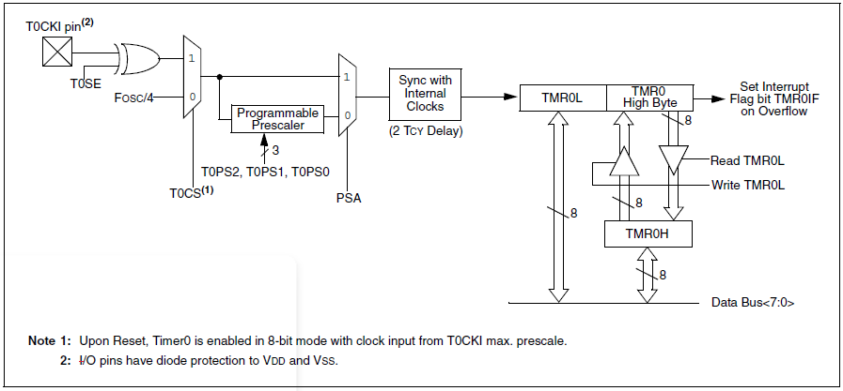
TIMER0 BLOCK DIAGRAM IN 16-BIT MODE

Slide 10
TIMER0 OPERATION
Timer0 canTimer mode is selected by clearing the T0CS bit.
Timer0 will increment either on every rising or falling edge of pin RA4/T0CKI.
The incrementingedge is determined by the Timer0 Source Edge Select bit (T0SE).
Clearing the T0SE bit selects the rising edge.
When an external clock input is used for Timer0, it must meet certain requirements.
The requirements ensure the external clock can be synchronized with the internalphase clock (TOSC).
Also, there is a delay in the actual incrementing of Timer0 after synchronization.

Slide 11
TIMER1 MODULE
Timer1 can work as 16-bit timer or counter
Readable and writable 8-bit registers (TMR1H and TMR1L)
Selectable clock source (internal or external)
Interrupt-on-overflow from FFFFh to 0000h

Slide 12

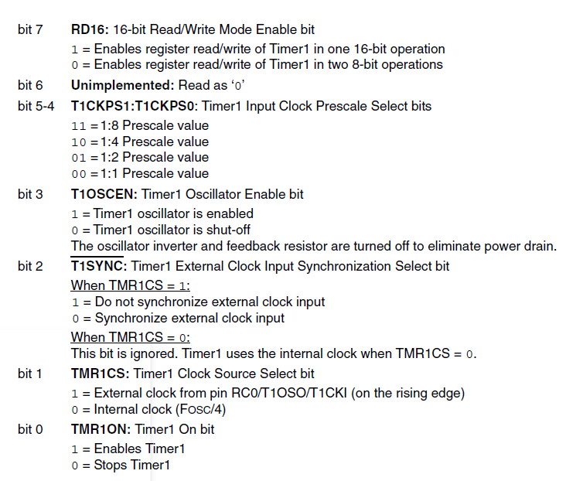
T1CON: TIMER1 CONTROL REGISTER

Slide 13
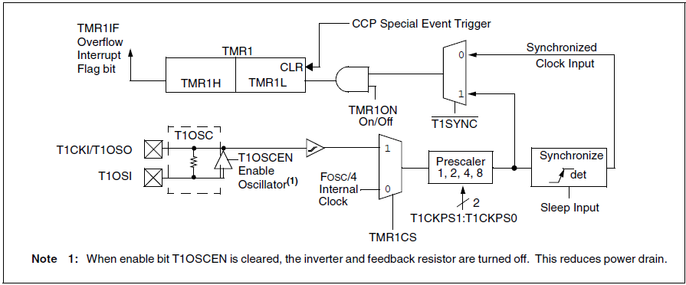
TIMER1 BLOCK DIAGRAM IN 16-BIT MODE

Slide 14
TIMER1 OPERATION
1. Timer1 can operate in one of these modes:
• As a timer
• As a synchronous counter
• As an asynchronous counter
2. The operating mode is determined by the clock select bit, TMR1CS (T1CON register).
3. When TMR1CS is clear, Timer1 increments every instruction cycle.
4. When TMR1CS is set, Timer1 increments on every rising edge of the external clock input or the Timer1 oscillator, if enabled.
5. When the Timer1 oscillator is enabled (T1OSCEN is set), the RC1/T1OSI and RC0/T1OSO/T1CKI pins become inputs. That is, the TRISC<1:0> value is ignored.
6. Timer1 also has an internal “Reset input”. This Reset can be generated by the CCP module

Slide 15
TIMER2 MODULE
8-bit Timer and Period registers (TMR2 and PR2, respectively)
Software programmable prescaler (1:1, 1:4 and 1:16)
Software programmable postscaler (1:1 – 1:16)
Interrupt on TMR2 to PR2 match

Slide 16

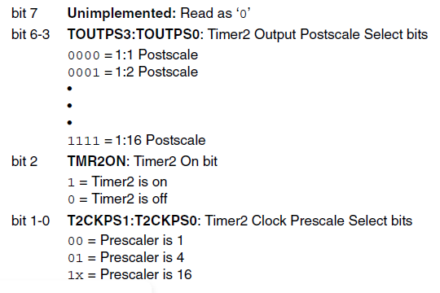
T2CON: TIMER2 CONTROL REGISTER

Slide 17
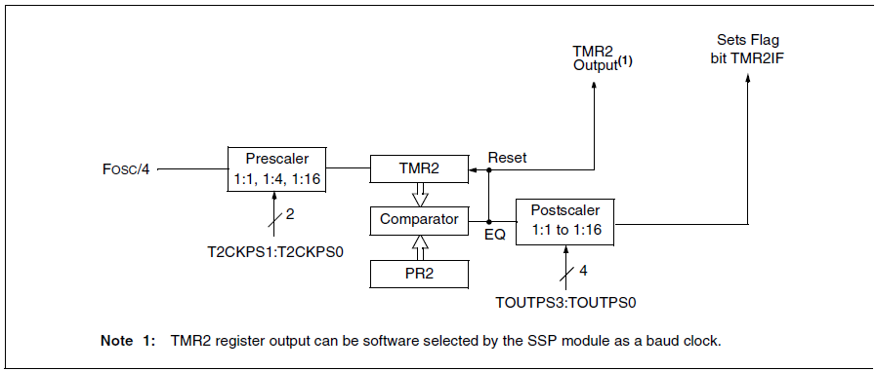
TIMER2 BLOCK DIAGRAM

Slide 18
TIMER2 OPERATION
Timer2 can be used as the PWM time base for the PWM mode of the CCP module.
The TMR2 register is readable and writable and is cleared on any device Reset.
The input clock (FOSC/4) has a prescale option of 1:1, 1:4 or 1:16, selected by control bits T2CKPS1:T2CKPS0 (T2CON register).
The match output of TMR2 goes through a 4-bit postscaler (which gives a 1:1 to 1:16 scaling inclusive) to generate a TMR2 interrupt.

Slide 19
TIMER3 MODULE
Timer3 can work as 16-bit timer or counter
Readable and writable 8-bit registers (TMR3H and TMR3L)
Selectable clock source (internal or external)
Interrupt-on-overflow from FFFFh to 0000h

Slide 20

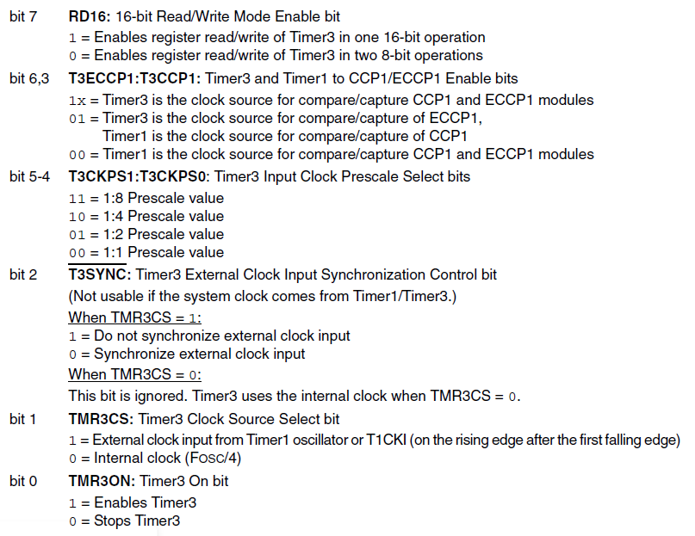
T3CON: TIMER3 CONTROL REGISTER

Slide 21
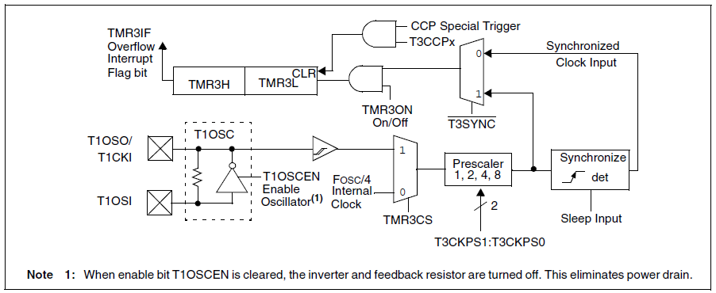
TIMER3 BLOCK DIAGRAM

Slide 22
TIMER3 OPERATION
1. Timer3 can operate in one of these modes:
• As a timer
• As a synchronous counter
• As an asynchronous counter
2. The operating mode is determined by the clock select bit, TMR3CS (T3CON register).
3. When TMR3CS = 0, Timer3 increments every instruction cycle.
4. When TMR3CS = 1, Timer3 increments on every rising edge of the Timer1 external clock input or the Timer1 oscillator, if enabled.
5. When the Timer1 oscillator is enabled (T1OSCEN is set), the RC1/T1OSI and RC0/T1OSO/T1CKI pins become inputs. That is, the TRISC<1:0> value is ignored.
6. Timer3 also has an internal “Reset input”. This Reset can be generated by the CCP module

Slide 23
THANK YOU

