Slide 1




OSI Layers in Automotive Networks
.

Slide 2
Outline
OSI Reference Model
Simplified generic Architecture for Automotive Serial Busses
Automotive Bus Systems in the OSI Model
Automotive Bus Systems in the OSI Model: Example of the CAN Bus
Automotive Bus Systems in the OSI Model: Example of the FlexRay Bus

Slide 3
Why OSI Model?
OSI Model has two layers – upper layers and lower layers.
The upper layer deals with application issues using the software.
Application layers are nearest to the users.
The layer above another one refers to the upper layer.
The lower layer deals with data transport using hardware and software.
Lowest layer is the physical layer as it deals with information placed on the physical medium.
Allows users to understand network communication.
Different network layers allow easier troubleshooting.
The development of new technology is easier to understand through this model.
Comparison of primary functional relationships is possible on various layers.

Slide 4
OSI Reference Model
ECU 1 ECU 2
Protocol
Application Protocol
Data
Application A
Application B
Application
Application
Presentation
Presentation
Session
Session
Transport
Transport
Network
Network
Communication Protocol
Data Link
Data LInk
Bit Transmission Protocol
Physical
Physical
Transmission medium

Slide 5
Simplified generic Architecture for Automotive Serial Busses
Application
Application
Communication
Communication controller
Communication
Communication
controller
Communication Protocol
Physical Layer Definition
Transceiver
Transceiver

Slide 6


Automotive Bus Systems in the OSI Model: Example of the CAN Bus
▪ Logical Link Control (LLC) Acceptance Filtering Overload Notification Recovery Management ▪ Medium Access control(MAC) Data Encapsulation/Decapsulation Frame Coding Error Detection/Signaling/Handling
7 Application
6 Presentation
5 Session
4 Transport
3 Network
2 Data Link
1 Physical
▪ Physical Signaling (PLS) Bit Encoding/Decoding Bit Time Synchronization ▪ Physical Medium attachment(PMA) Driver/Receiver Characteristics ▪Media Dependant Interface(MDI) Connectors

Slide 7
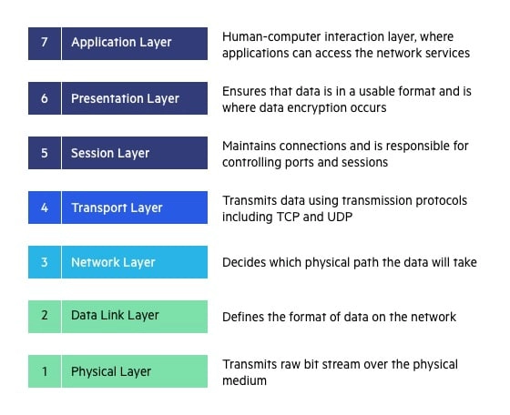
Layers……

Slide 8
1. Physical Layer
It is the last layer of the model responsible for preparing physical devices in the network for data acceptance. It can also terminate the connection between two nodes of a network.
This layer takes in raw data which goes to higher layers later. It also converts digital bits into other signals.
Functions of Physical Layer of OSI Model
It enables bit synchronization using a clock that controls both sender and receiver.
It also controls the transmission rate or several bits sent per second.
This layer decides the ideal topology type for node arrangement in a network.
It decides the transmission mode between the devices.
The physical consist of – Hub, Repeater, Modem, and Cables.

Slide 9
2. Data Link Layer
This layer allows access to get the data by breaking it into frames for easier analysis. This ensures that data is error-free and reaches the next layer in time. It sends data in the form of packets. It has two sub-layers –
Logical Link Control is for transferring the packets to the next layer by identifying the protocol address from the header. Media Access Control Layer creates a link to the network’s physical layer. This by obtaining the receiver’s address using Address Resolution Protocol.
Functions of Data Link Layer of OSI Model:
It frames the data in a way that is meaningful to the receiver using special bit patterns.
It adds physical addresses of both sender and receiver in every frame.
This layer controls error by detecting and retransmitting frames.
It controls the flow by calculating the amount of data before receiving it.
It determines the extent of control devices have in a given time.
Network Interface Card handles this layer using devices like switch & bridge

Slide 10
7. Application Layer
This is the layer where users interact with the data. The layer identifies communication partners that will allow data transmission for an application. Some of the applications are – Browsers, Messengers, etc. Desktop Layer is another word for this layer.
Functions of the Application layer of OSI Model:
File management by allowing users to access, retrieve and manage the files on a remote computer.
Allows users to go ahead with email forwarding and storage.
Provides distributed database sources and global information about several objects.

Slide 11
There are several CAN physical media attachment (PMA) sub-layers standardized
The physical medium attachment (PMA) options include:
CAN high-speed transceiver with optional low-power and optional selective wake-up capability (ISO 11898-2:2016)
CAN SIC (signal improvement capability) transceiver (CiA 601-4)
CAN XL SIC transceiver (CiA 610-3)
CAN low-power/fault-tolerant transceiver (ISO 11898-3:2006)
CAN truck/trailer transceiver (ISO 11992-1)
Single-wire CAN (SWC) transceiver (SAE J2411) – not more recommended for new designs

Slide 12
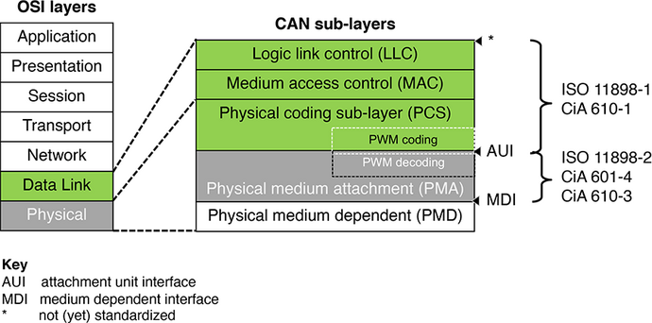
There are three CAN data link layer generations: Classical CAN data link layer (1st generation) CAN FD data link layer (2nd generation) CAN XL data link layer (3rd generation)
)
.
All three generations use the same non-destructive bus-arbitration method. They support standardized data frame formats as well as error and overload frames. Remote frames are only featured by Classical CAN.

Slide 13
Automotive Bus Systems in the OSI Model: Example of the FlexRay Bus
▪ Logical Link Control (LLC) Protocol Operation Control
▪ Medium Access control(MAC) Message Framing Communication Cycle
7 Application
6 Presentation
5 Session
4 Transport
3 Network
2 Data Link
1 Physical
▪ Physical Signaling (PLS)
Bit Encoding/Decoding
Bit Time Synchronization
▪ Physical Medium attachment(PMA) Driver/Receiver Characteristics ▪Media Dependant Interface(MDI) Connectors

Slide 14
FlexRay?
What is FlexRay used for?
FlexRay is a communication bus designed to ensure high data rates, fault tolerance, operating on a time cycle, split into static and dynamic segments for event-triggered and time-triggered communications.
Where is FlexRay protocol used?
FlexRay is a serial communication technology that is used in particular for data communication in very safety-critical use areas in the automobile. Differential signaling on each pair of wires reduces the effects of external noise on the network without expensive shielding.
What is difference between can and FlexRay?
CAN is used in soft real-time systems. For example: In engines, power trains, chassis, battery management systems, etc. FlexRay is used in a hard real-time system

Slide 15
CONCLUSION
In reference to the OSI Data Communication Model, the Serial Interface of CAN, FlexRay and LIN Busses typically needs 3 OSI Layers for On-Board Communication excepted OBD: the Physical Layer, the Data Link Layer and the Application Layer
The most Bus covers all the 7 OSI Layers for On-Board Communication
The Transport Layer is used for Off-Board Communication like Diagnosis and also for OBD on these typical Automotive Area Networks. The Layers 3 and 4 can be used for Vehicle On-Board Communication in Car2X Communication Applications
Therefore, for a Control Data Communication that occurs in an In-vehicle closed Network, the need of the Layer 2 is justified.

Slide 16
Thank You for your Attention
Presentation by
ARUNKUMAR P & YUGADARSHINI

Slide 17
Transmitting data in CAN
while
if
MAIN
FUNCTION 1
FUNCTION2
TXB0CONbits.TXREQ==0 &&CANCON==0X08
Configuration mode setting
Baud rate setting
Pin port settings
(using data sheet)
Setting the Tx buffer register using the given data with std data frame identifier

