Slide 1

CAN Error Detection
presented By
Vishal
kantineni Dinesh

Slide 2
AGENDA
How Errors Identify In CAN
Overview
Types of Errors
Bit Error
Bit Stuffing Error
CRC Error
ACK Error
Form Error
Handling of Error Mangement
Status Of CAN Node
Bus Off State

Slide 3
HOW CAN IDENTIFY THE ERRORS
Error handling is built into into the CAN protocol and is of great importance for the performance of a CAN system.
The error handling aims at detecting errors in messages appearing on the CAN bus, so that the transmitter can retransmit an erroneous message.
Every CAN controller along a bus will try to detect errors within a message. If an error is found, the discovering node will transmit an Error Flag, thus destroying the bus traffic.
The other nodes will detect the error caused by the Error Flag (if they haven’t already detected the original error) and take appropriate action, i.e. discard the current message.
Each node maintains two error counters: the Transmit Error Counter and the Receive Error Counter. There are several rules governing how these counters are incremented and/or decremented

Slide 4
Overview
CRC ERROR
FORM ERROR
STUFF ERROR
BIT ERROR
ACK ERROR

Slide 5
Following error types are Detected
Bit error : transmitted and received bit are different (except in arbitration, acknowledgement and passive error)
Bit stuffing error : more than five bits of equal polarity inside of a frame are detected
CRC error : receive CRC code doesn’t match with the calculated code
ACK error : transmitting node receives no dominant acknowledgement bit (no receiver accepts the transmission message)
Form error: fixed-form bit field contains one ore more illegal bits e. g. violation of end of frame EOF format, CRC- or ACK-delimiter.

Slide 6
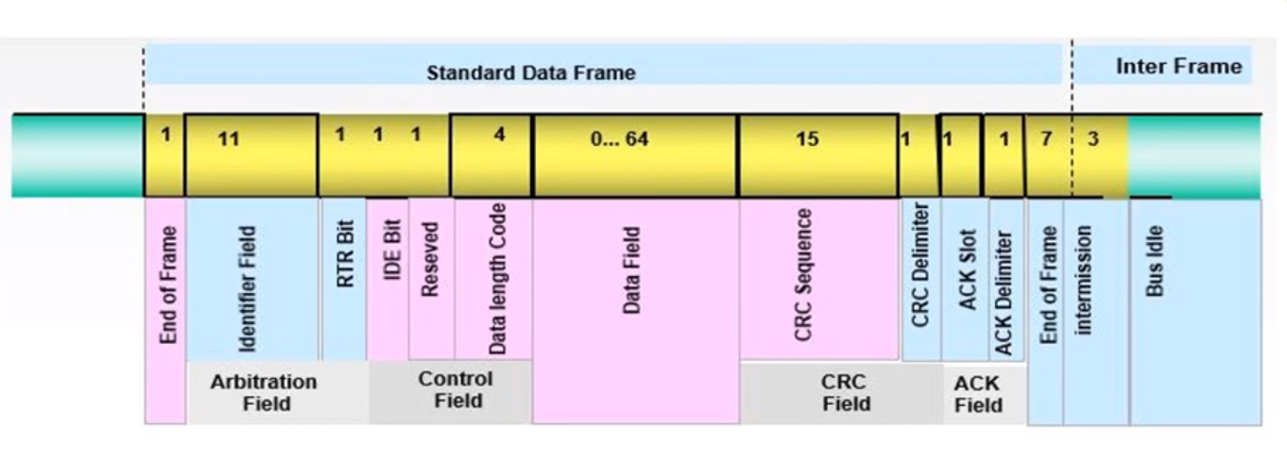
BIT ERROR

Slide 7
BIT ERROR
Bit Error occurs if a transmitter,
Sends a dominant bit but detects a recessive bit on the bus line or,
Sends a recessive bit but detects a dominant bit on the bus When a dominant bit is detected instead of a recessive bit, no error occurs during the Arbitration Field or the Acknowledge Slot because,
these fields must be able to be overwritten by a dominant bit in order to achieve arbitration and acknowledge functionality

Slide 8
BIT STUFFING ERROR
If six consecutive bits with the same polarity are detected between Start of Frame and the CRC Delimiter, the bit stuffing rule has been violated.
A stuff error occurs and an Error Frame is generated. The message is then repeated.

Slide 9
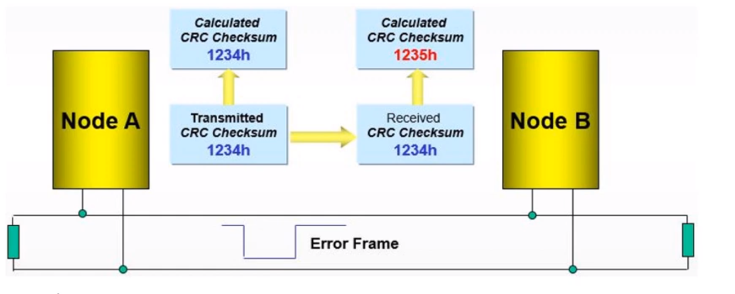
CRC ERROR
This CRC sequence is transmitted in the CRC Field of the CAN frame.
The receiving node also calculates the CRC sequence using the same formula and performs a comparison to the received sequence.
If node B detects a mismatch between the calculated and the received CRC sequence , then a CRC error has occurred.
Node B discards the message and transmits an Error Frame to request retransmission of the garbled frame.

Slide 10
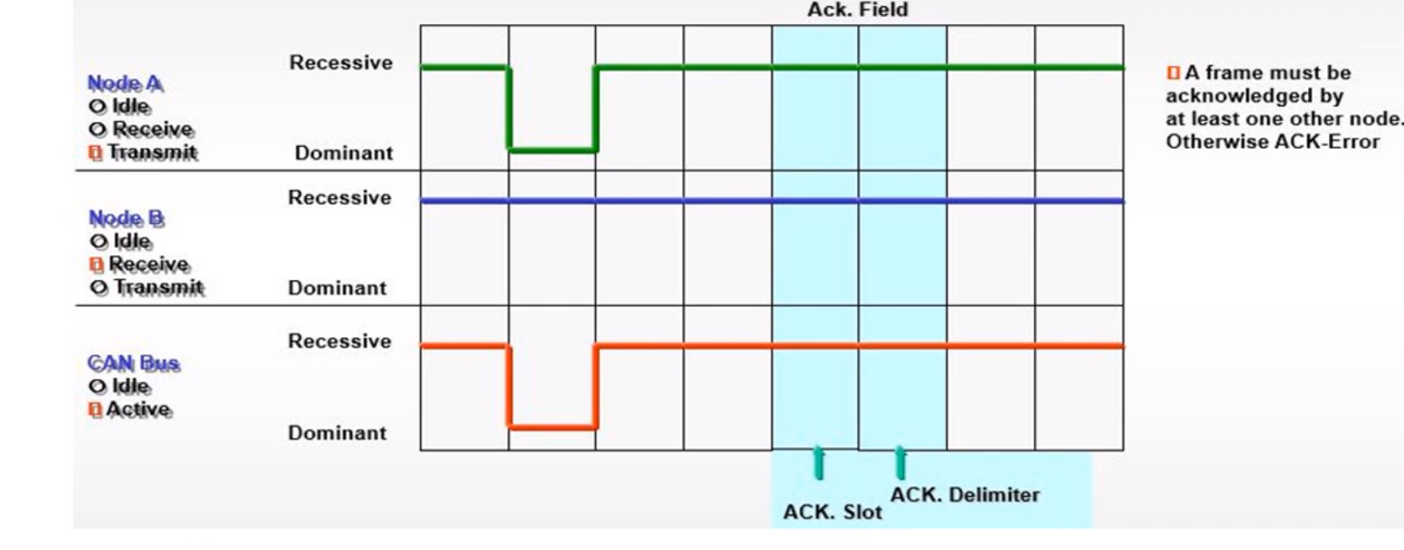
ACKNOWLEDGEMENT ERROR
Acknowledge Error has occured and the message has to be repeated. No Error Frame is generated, though.

Slide 11
FORM ERROR
If a transmitter detects a dominant bit in one of the four segments:
CRC Delimiter,
Acknowledge Delimiter
End of Frame
Interframe Space
Then a Form Error has occurred and an Error Frame is generated. The message will then be repeated.

Slide 12
HANDLING OF ERROR MANGEMENT
The error management unit is used to: ♦ cancel erroneous messages at all CAN nodes ♦ to disconnect nodes from the CAN bus, if they detect/generate to many errors
The error management unit uses two error counters: ♦ a receive error counter REC ♦ a transmit error counter TEC
The CAN controller may work in three different states: ♦ error active : state for each detected error there is generated an active error flag (queue of six consecutive dominant bits) ♦ error passive state : for each detected error there is generated an passive error flag (queue of six consecutive recessive bits) ♦ bus off state :if to many errors are detected by one node, this node is automatically disconnected from the bus

Slide 13
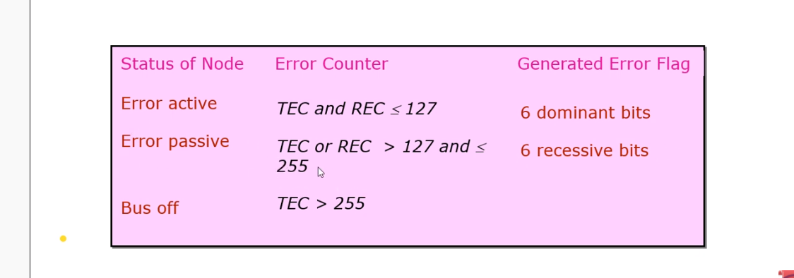
STATUS OF CAN NODE
. The CAN node status levels are switched depend on the values of TEC and REC:
.Error active : Transmit Error Counter TEC and Receive Error Counter REC are less than 128 (CAN node after reset TEC=REC=0).
. Error passive TEC or REC is greater than 127 and TEC is less than 255
.Bus off :TEC is greater than 255

Slide 14
BUS OFF STATE
A unit is in bus off state when
its Transmit Error Counter (TEC) is greater than 255: TEC > 255
Note: The value of the Receive Error Counter (REC) is of no importance.
In bus off state a unit
is practically disconnected from the bus
cannot receive and transmit anything any more
can only leave bus off mode via a hardware reset OR a software reset and subsequent initialization carried through by the host (BOSCH specification: TEC and REC are set to zero and the unit must receive 128 times a field of 11 consecutive recessive bits)

Slide 15
THANK YOU

