Slide 1
Automotive Sales Analytics Dashboard
Key Insights & Strategic Recommendations
Feli-Tech Consult | March 2026

Slide 2
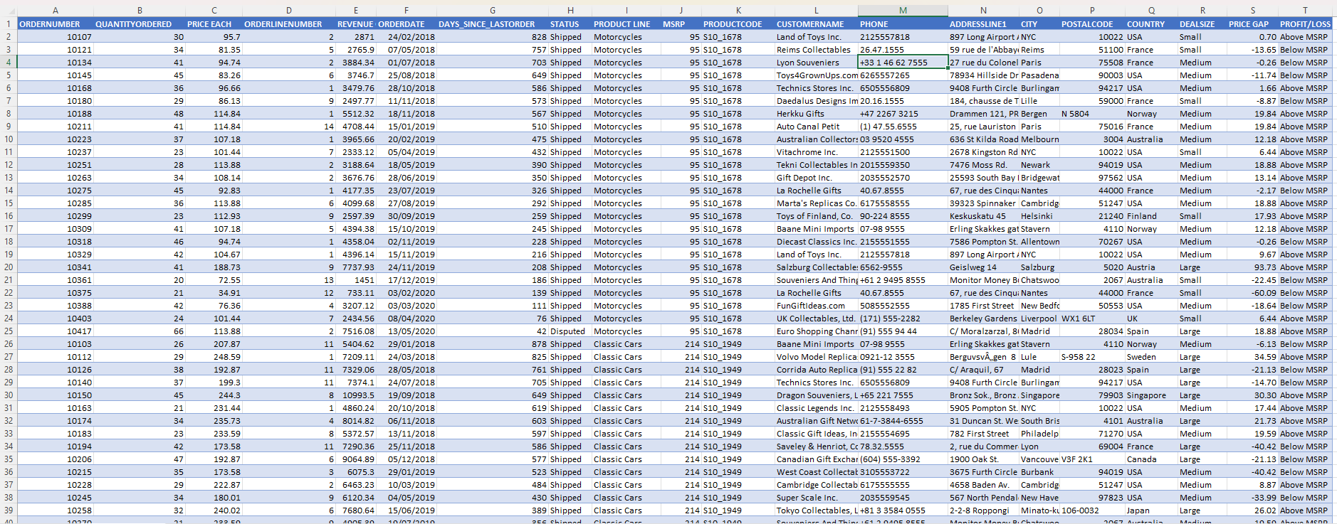
Dataset Overview

Slide 3
Executive Summary
Revenue vs Target: $9.76M vs $5M (195% of target)
Top Countries Contribution: USA 45.4%, France 49.1% (Combined 94.5%)
Key Takeaway: Strong revenue performance but highly concentrated in two countries.

Slide 4
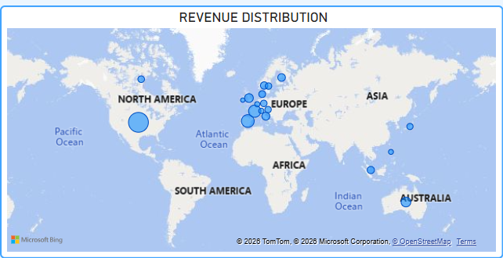
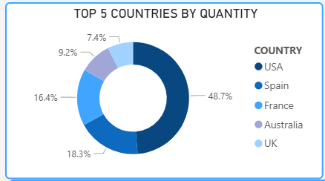
Geographic Performance
Primary regions: North America and Europe drive most revenue.

Slide 5
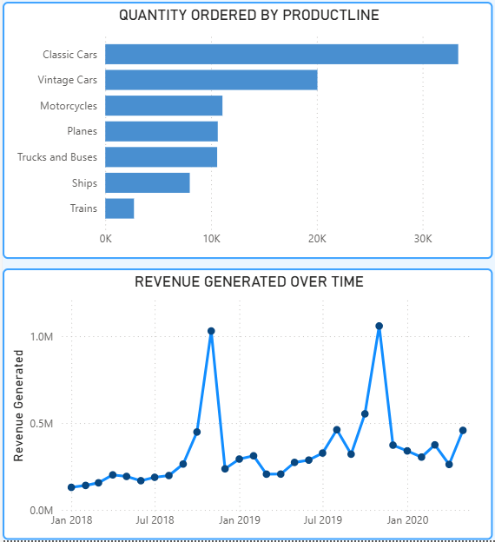
Product Performance
Top selling product lines: Classic Cars and Vintage Cars (60%+ of orders).
Low volume product lines: Ships and Trains.
Revenue peak: $2.2M in July 2019.
Operational note: 1.6% dispute spike in Jan 2020.
Insight: Classic & Vintage cars dominate but sell below MSRP.

Slide 6
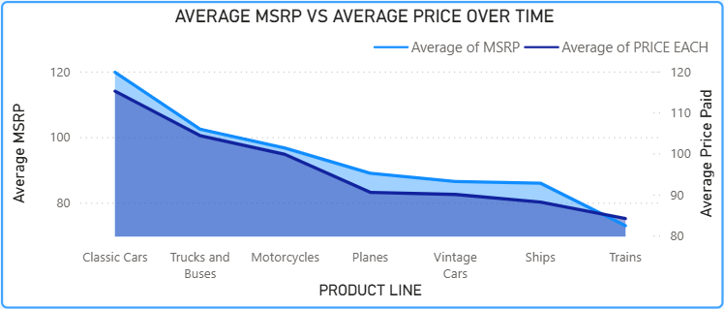
Pricing Analysis – MSRP vs Actual Price
All product lines sell below MSRP indicating widespread discounting.
Largest discounts observed in Planes and Ships.
Smallest discount seen in Trains.
Insight: High sales volume but compressed margins due to pricing strategy.

Slide 7
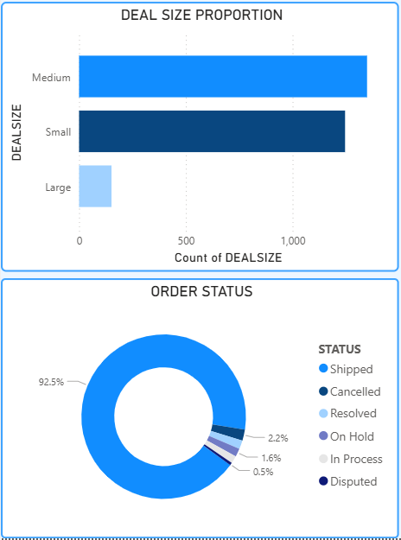
Order Status & Deal Size
Shipped orders account for ~95% of total orders.
Cancelled / Disputed / On Hold represent ~5%.
Noticeable dispute spike in January 2020.
Small deals make up more than 70% of total orders.
USA and France generate about 95% of revenue.
Insight: Upsell opportunities exist with small deal segments.

Slide 8
Strategic Recommendations
Launch targeted campaigns in Spain and Australia to reduce country concentration risk.
Review discount strategies for Motorcycles and Classic Cars to protect margins.
Investigate root cause of January 2020 dispute spike.
Bundle low‑volume items (Ships, Trains) with top sellers to increase turnover.
Monitor Asia and Africa for long‑term growth opportunities.

Slide 9
Final Thought / Call to Action
Current performance is strong but fragile.
Strategic diversification and margin optimization are key for sustainable growth.
Next Steps:
Schedule a deep‑dive meeting on discounting policies.
Assign team to analyze dispute causes.
Develop marketing plan for Spain and Australia.

Slide 10
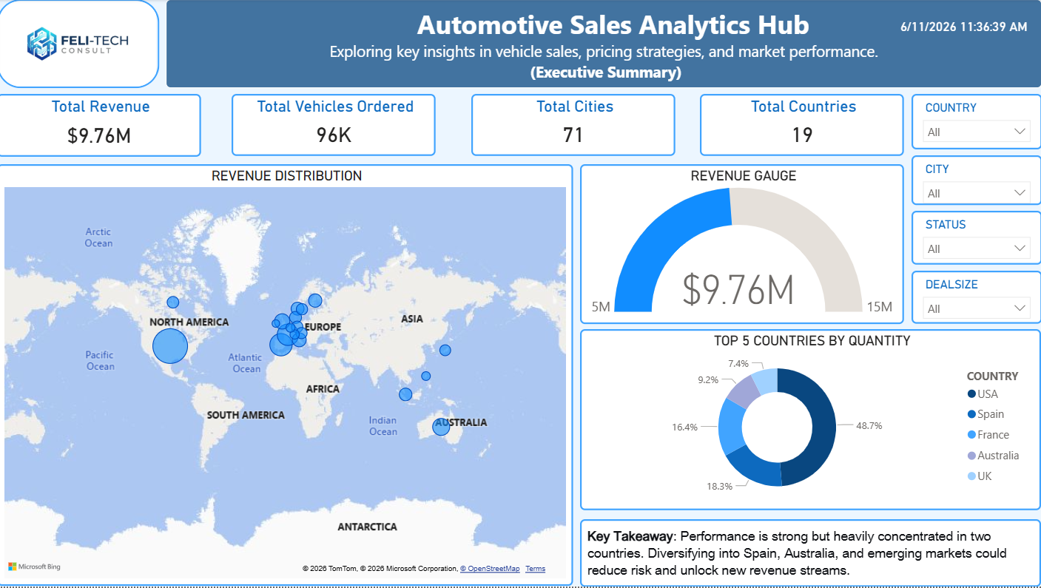
Executive Summary

Slide 11
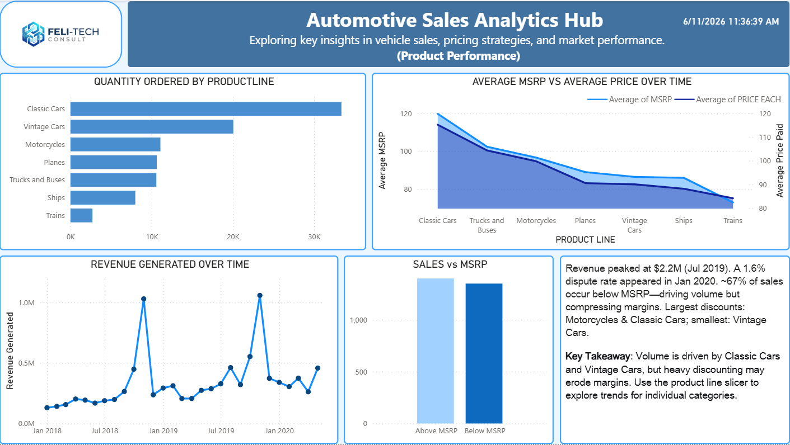
Product Performance

Slide 12
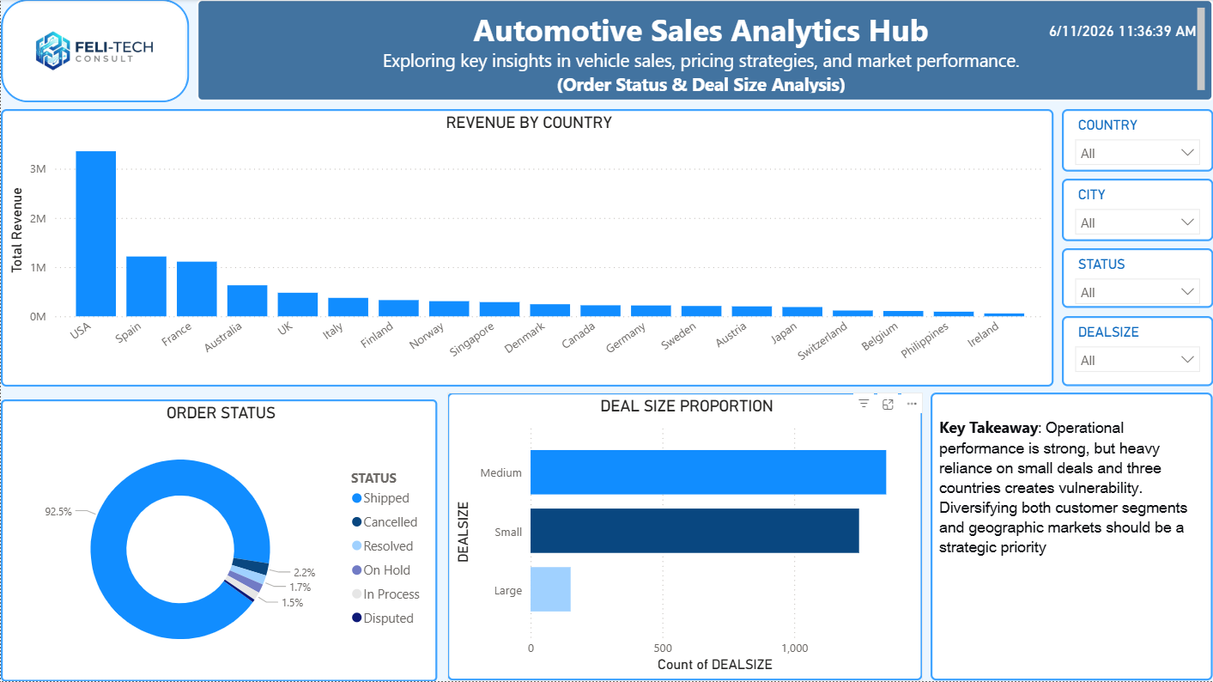
Order Status & Deal Size Analysis

Slide 13
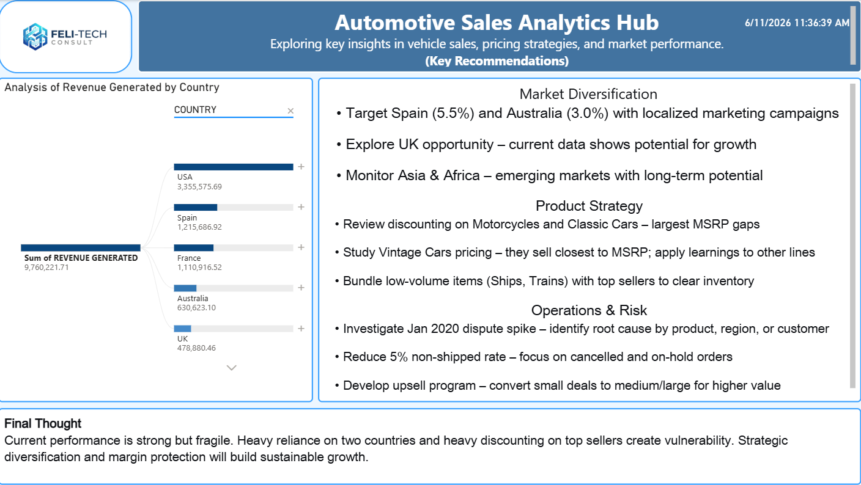
Key Recommendations

Slide 14
Thank You!!!!

