Slide 1
Introduction to pytest
Installation, Usage, and Best Practices Pytest
By: Hu Jian

Slide 2
Test
01
install pytest
02
pytest assert
03
pytest fixtures
04
pytest parameriztions

Slide 3
What is pytest?
PART 01

Slide 4
What is pytest?
A framework for writing and running tests in Python.
Popular in unit testing due to its simplicity, powerful features, and rich plugins.
Supports both simple assertions and complex test suites.

Slide 5
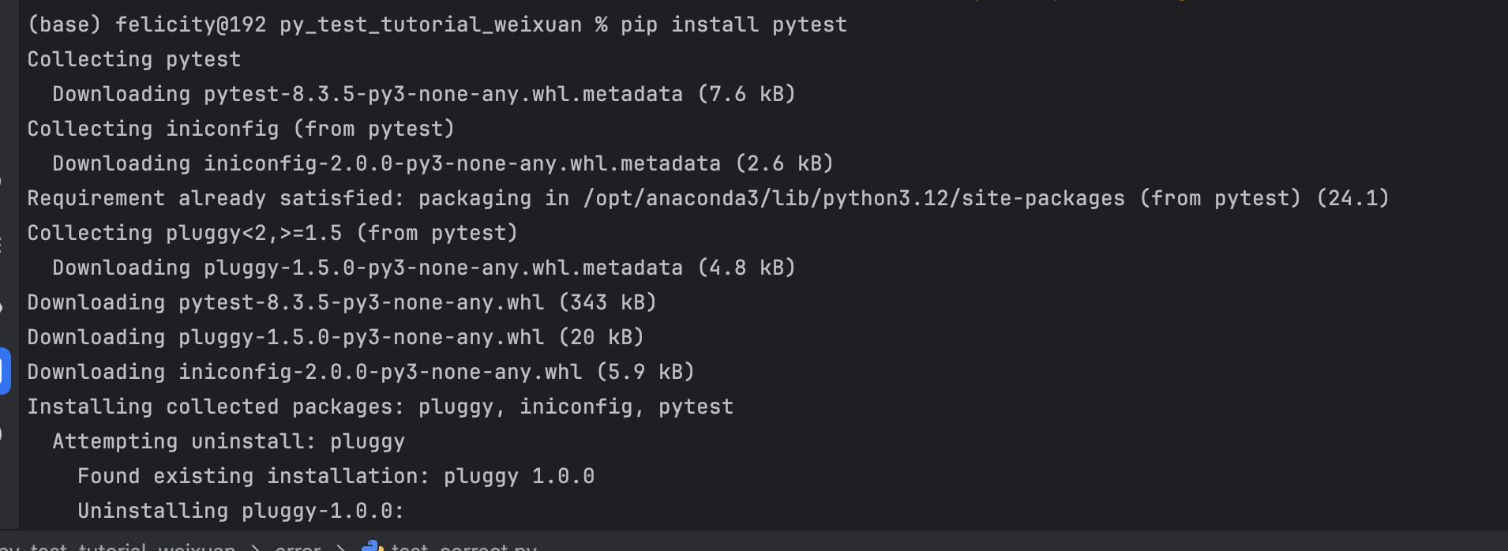
Installing pytest
pip intall pytest
Pytest is a third-party package that can be installed via pip.

Slide 6
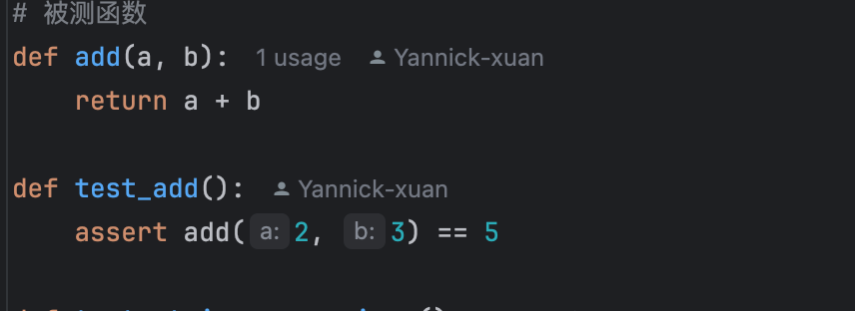
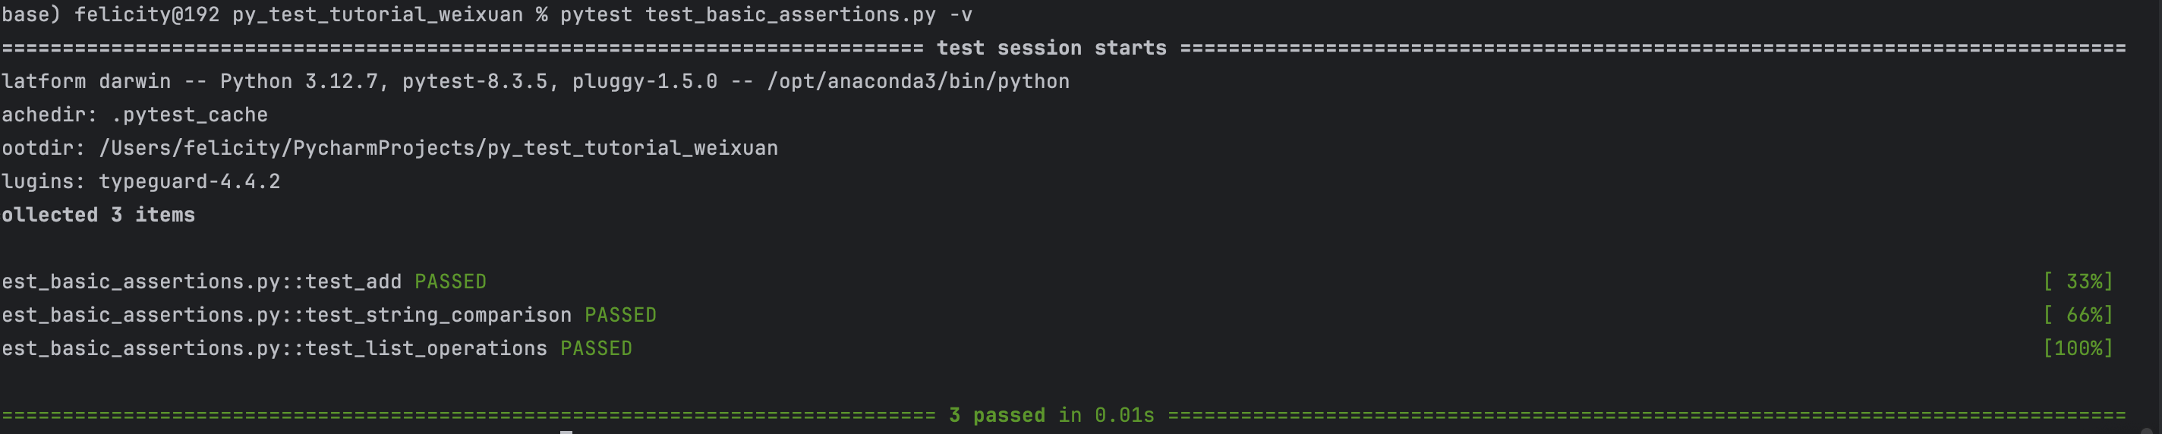
Creating Your First Test Case
This is a simple test function that checks if add returns the correct sum.
The -v flag provides verbose output, showing which tests passed or failed.

Slide 7
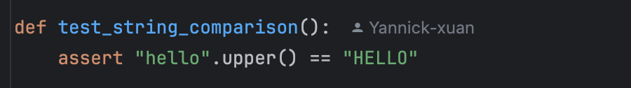
Test File Structure and Assertions
Naming Conventions:
Files should start or end with test_, like test_math.py.
Functions should start with test_.
Assertions:
Core of pytest, checks conditions and raises errors when failed.

Slide 8
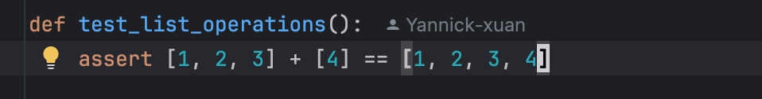
Assertions with Lists

Slide 9
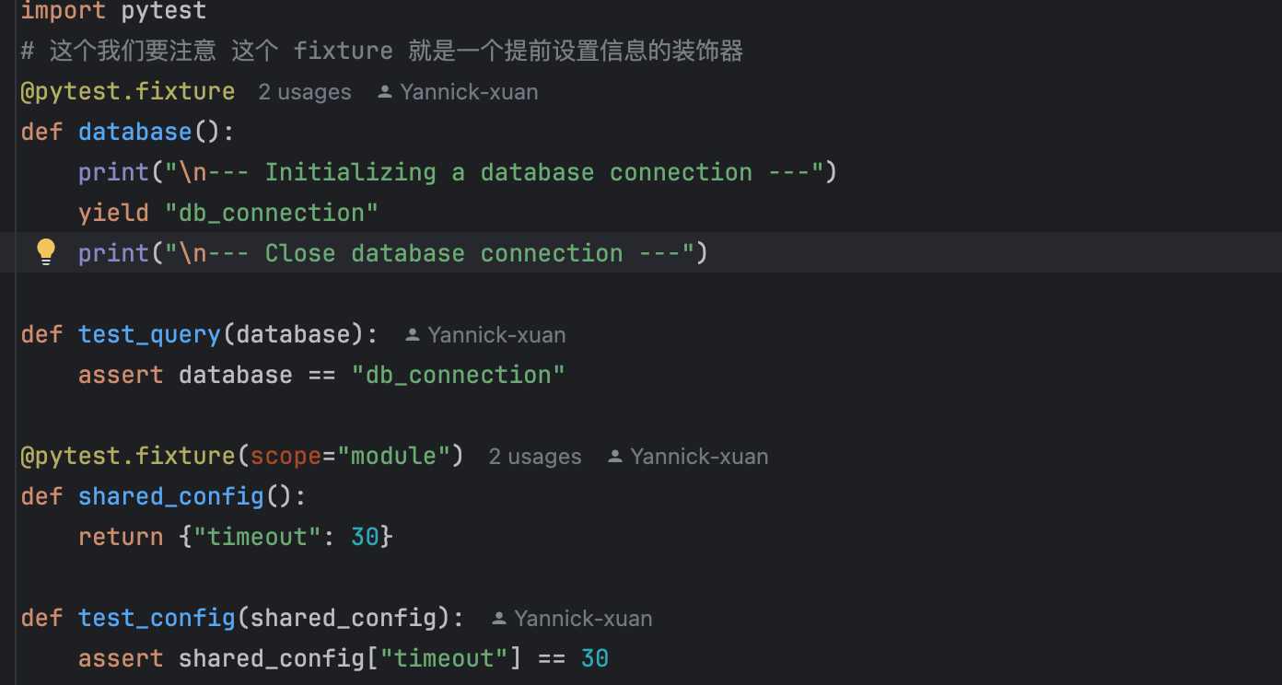
Fixture Mechanism
Purpose: Fixtures help setup preconditions or resources for tests (e.g., database connections).
When the database connection is simulated, a variable of the connection is simulated in advance, which means that the simulation is successful

Slide 10
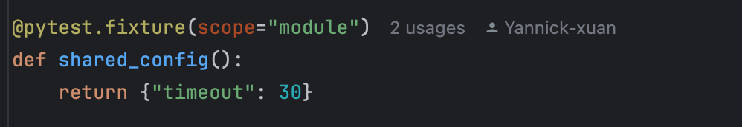
Scope Control in Fixtures
You can control the lifetime of a fixture with scope.
All functions can access this variable
The fixture is created once per test module and shared across all tests in that module.

Slide 11
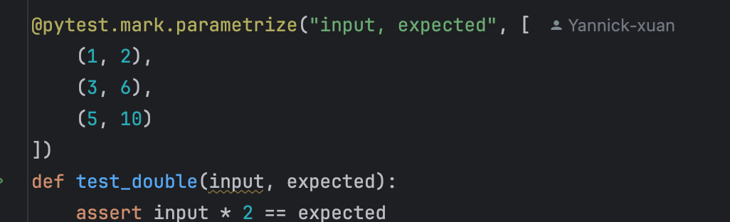
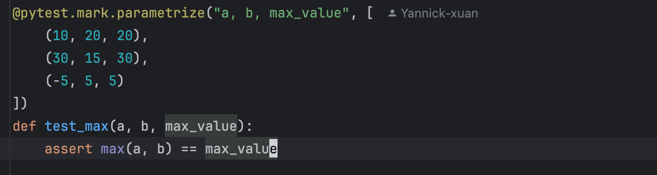
Parameterized Testing
Single Parameter:
Multiple Parameters:

Slide 12
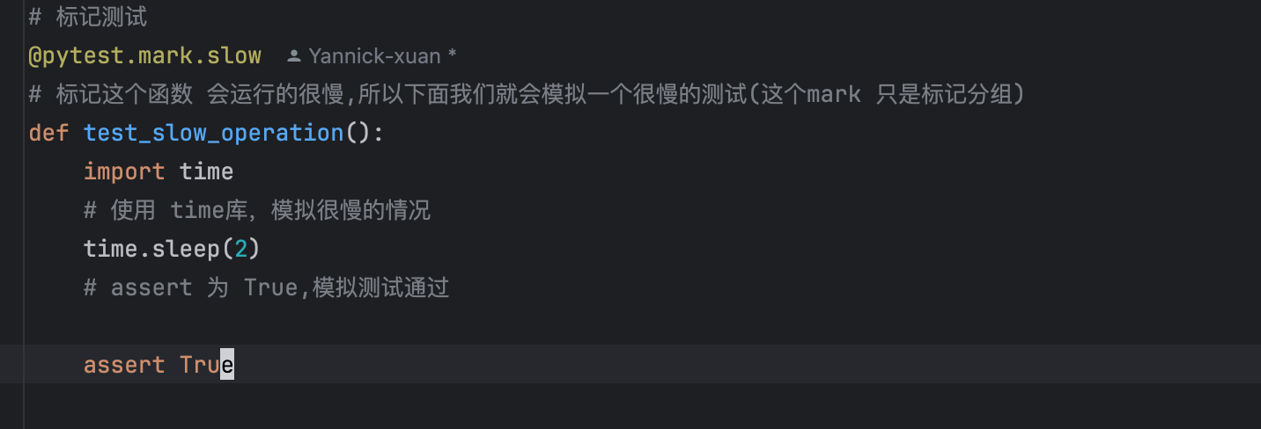
Markers in pytest
Custom Markers:
Markers help organize tests into categories such as slow
fast or slow

Slide 13
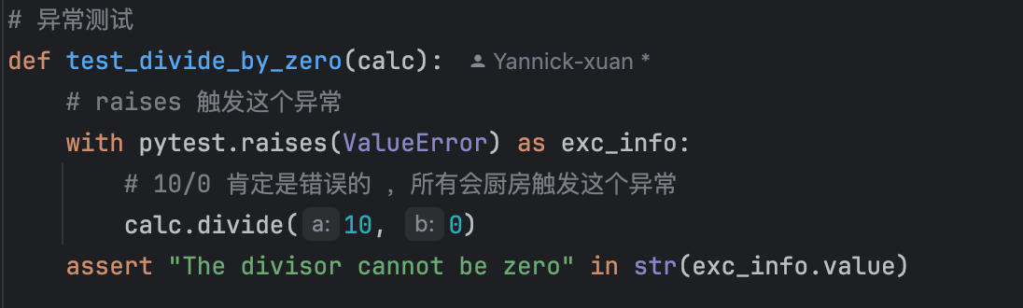
Testing for Exceptions
pytest.raises is used to check if certain exceptions are raised during test execution.

Slide 14




单击此处添加标题
Basic Test Structure
Fixtures
Parameterized Tests
Exception
tests using fixtures, including controlling their scope
Raises an exception test
Understanding how to write simple tests with assertions and run them with pytest.
Using parameterization to run the same test with different sets of input data.

Slide 15
THANK YOU
pytest learning
By : Hu Jian

