Slide 1
Scientific Machine Learning
PINN Biodiesel processes

Slide 2
Outline
Theory
  Chemical Reactions
  ODE for bio diesel reaction
  Application for Neural Networks
Project overview
Arteficial Data + PINN
Experiemental Data
  Modelling with ODE
  PINN with experimental Data

Slide 3

mass action kinetics of chemical reactions
Definition: Law of mass action:
The rate of a chemical reaction is proportional to the product of the concentrations of its reactants.
Example
2 H₂+O ₂ $\begin{matrix}5 \\ \text{⇌} \\ 0.5\end{matrix}$ 2 H₂O

Slide 4

The Problem
Chemical reactions that are a) reversable b) parallel
A) $A+B\begin{matrix}k_{1} \\ \text{⇌} \\ k_{2}\end{matrix}C$
B) $A+B\underset{→}{k_{1}}C$
$A+B\begin{matrix}k_{1} \\ \text{⇌} \\ k_{3}\end{matrix}D+E$
k_{i} reaction constant
A, B, C… Educts and products of chemical reaction

Slide 5


ODE of a chemical reaction
Chemical reaction:
$l_{1}S_{1}+…+l_{ρ}S_{ρ}\begin{matrix}k_{} \\ \text{⇌} \\ k_{−1}\end{matrix}{l^{′}}_{1}P_{1}+…+{l^{′}}_{γ}P_{γ}$
Rate of reaction:
$k[S_{1}]^{l_{1}}…[S_{ρ}]^{l_{ρ}}$
Rate of inverse reaction:
$k_{−1}[P_{1}]^{{l′}_{1}}…[P_{γ}]^{{l′}_{γ}}$
$S_{i}{,P}_{i}$reactants and products respectively
$l_{i}{,l′}_{i}$stoichiometric coefficients
$k{,k}_{−1}$kinetic consatants
${[S}_{i}]{,[P}_{i}]$concetration of reactants and products respectively

Slide 6


$$l_{1}S_{1}+…+l_{ρ}S_{ρ}\begin{matrix}k_{} \\ \text{⇌} \\ k_{−1}\end{matrix}{l^{′}}_{1}P_{1}+…+{l^{′}}_{γ}P_{γ}$$
ODE:
$$\frac{d[S_{1}]}{dt}=l_{1}k_{−1}{[P}_{1}]^{{l′}_{1}}…{[P}_{γ}]^{{l^{′}}_{γ}}−l_{1}k{[S}_{1}]^{l_{1}}…{[S}_{ρ}]^{l_{ρ}}$$
.
.
.
$\frac{d[S_{ρ}]}{dt}=$…
$$\frac{d[P_{1}]}{dt}=l_{1}k{[S}_{1}]^{l_{1}}…{[S}_{ρ}]^{l_{ρ}}−l_{1}k_{−1}{[P}_{1}]^{{l′}_{1}}…{[P}_{γ}]^{{l^{′}}_{γ}}$$
.
.
.
$$\frac{d[P_{γ}]}{dt}=…$$
Example
2 H₂+O ₂ $\begin{matrix}5 \\ \text{⇌} \\ 0.5\end{matrix}$ 2 H₂O
$\frac{d[H_{2}]}{dt}=$2·0.5[H₂O]² - 2·5[H₂]² [O₂]
$\frac{d[O_{2}]}{dt}=$0.5[H₂O]² - 5[H₂]² [O₂]
$\frac{d[H_{2}O]}{dt}=$2·5 [H₂]² [O₂]- 2·5[H₂O]²

Slide 7
Why neural networks?
Complex reaction networks and chain reactions
Complex with more educts and conditions
Reconstructing the the reverse/finding the ODEs
Based on empircal data-> incomplete information
ODEs predicted ideally (always well mixed for example, temperature changes not considred etc)
Neural network can optimises predictions

Slide 8
Current Topic
April 22, 2025
Modeling Chemical Reaction Networks Using Neural Ordinary Differential Equations
September 13, 2023
Physics-Enhanced Neural Ordinary Differential Equations: Application to Industrial Chemical Reaction Systems
January 20, 2021
Autonomous Discovery of Unknown Reaction Pathways from Data by Chemical Reaction Neural Network

Slide 9
Biodiesel Project
Experimental data
Given
Artefical data
Create data with known ODE and add noise

Slide 10
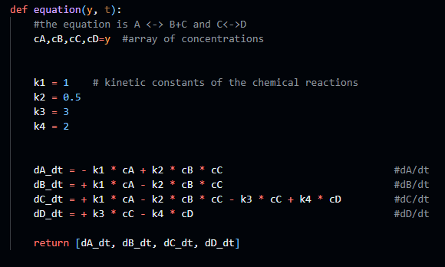



Arteficial Data
Create new data for the reaction
$A+B\begin{matrix}k_{1} \\ \text{⇌} \\ k_{2}\end{matrix}C$
$B\begin{matrix}k_{3} \\ \text{⇌} \\ k_{4}\end{matrix}C$
Solve ODE and add noise

Slide 11
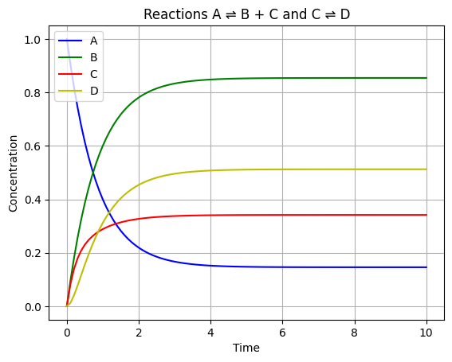
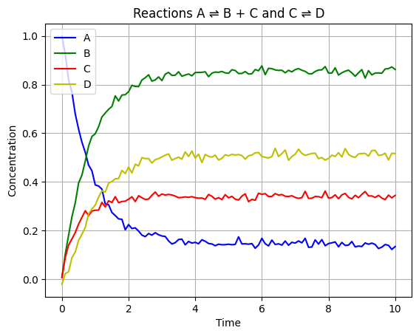
Results and results with added noise

Slide 12
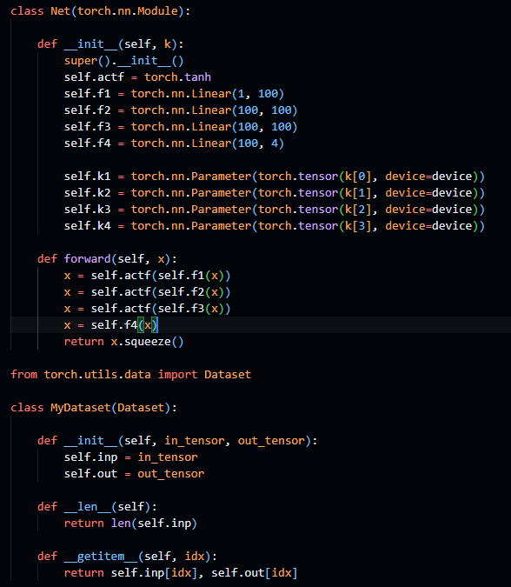
PINN for arteficial DAta
Network definition

Slide 13
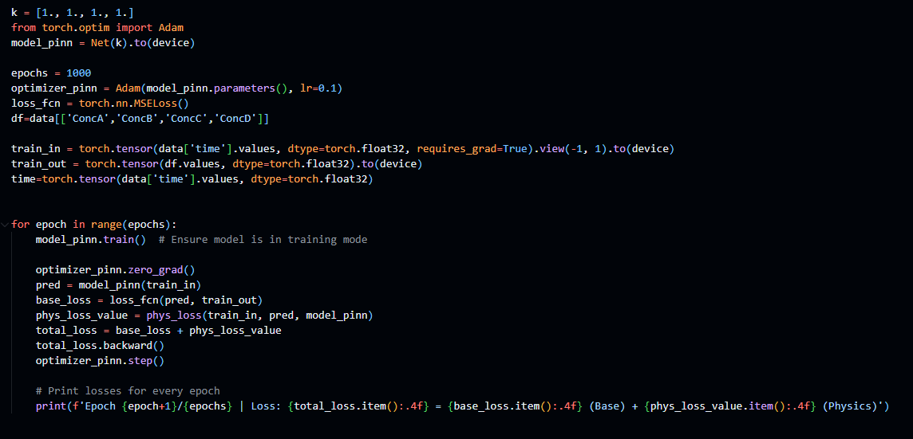
Loss: 0.0185 = 0.0185 (Base) + 0.0000 (Physics) for k=1,1,1,1
Loss: 0.1842 = 0.1752 (Base) + 0.0090 (Physics) for k = 7., 10., .1, 3.

Slide 14
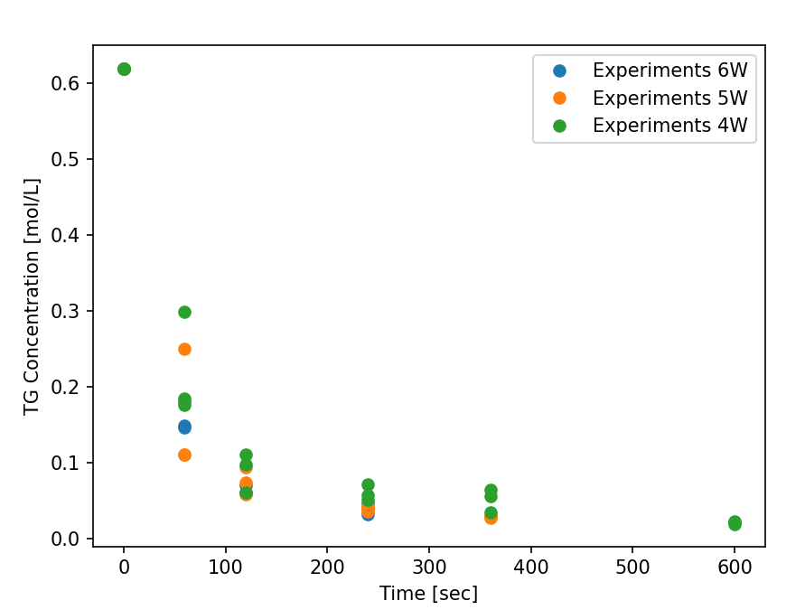
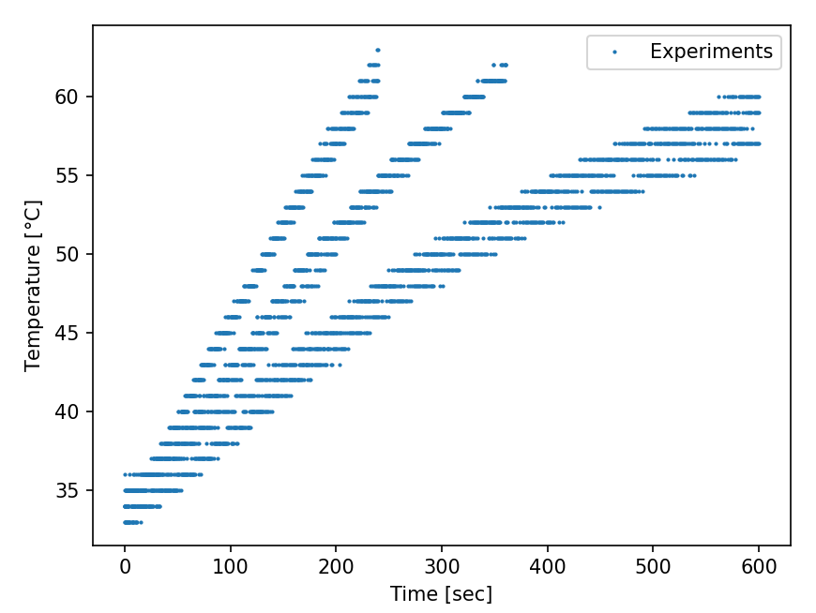
Experimental Data
- 3 different Microwave power inputs
The Higher the Mw power the shorter the experiment duration
Outputs:
  Concentrations: TG,DG,MG,G,ME
  Temperature
Problems:
  Variance between different Experiements

Slide 15
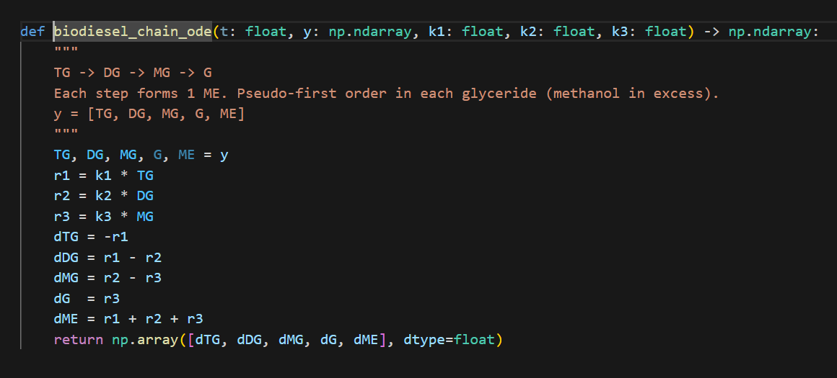
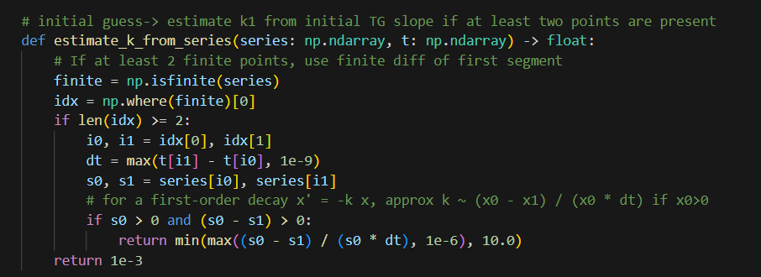
Modelling with ode
Creates a Model and solves ODE based on the experiment data
First estimates the k values
Solves ODE

Slide 16
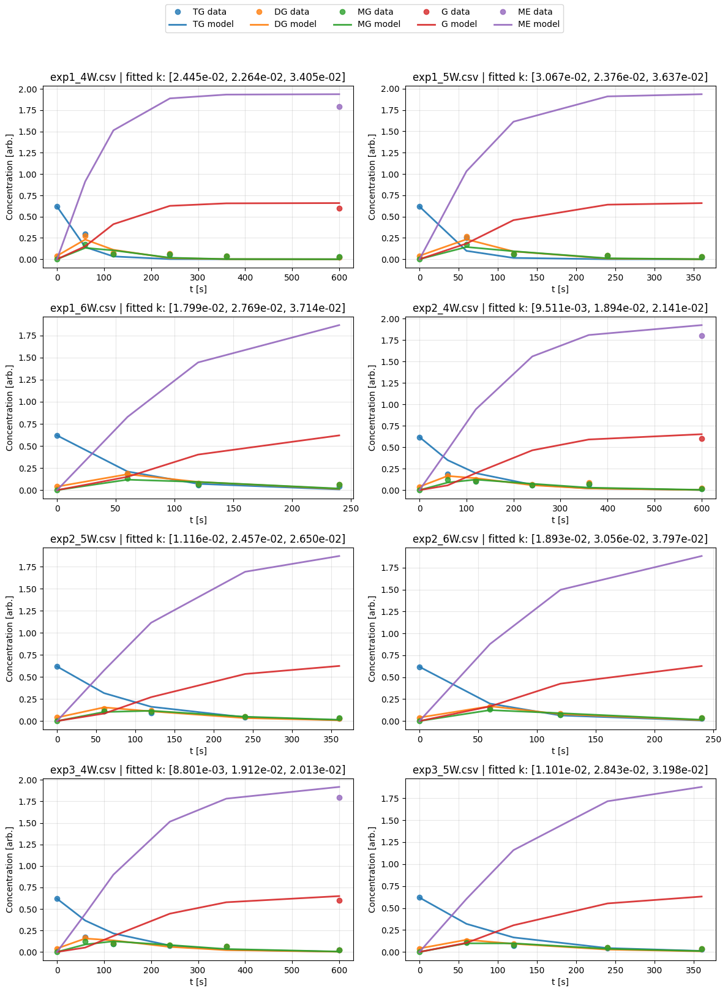
Simulation with ode

Slide 17
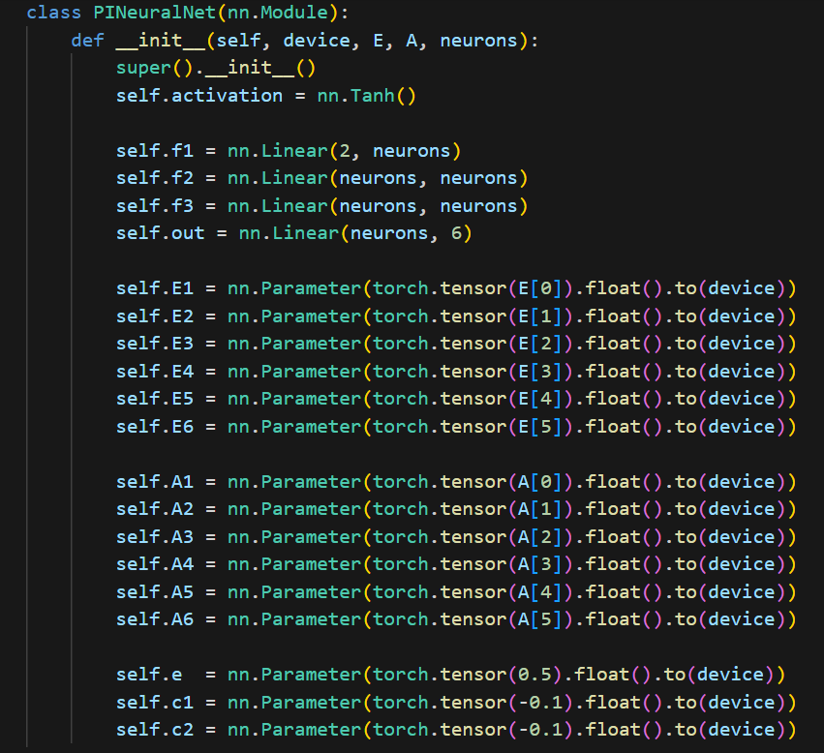
Experimental Pinn
A: estimate of k‘
E: estimate of k‘‘

Slide 18
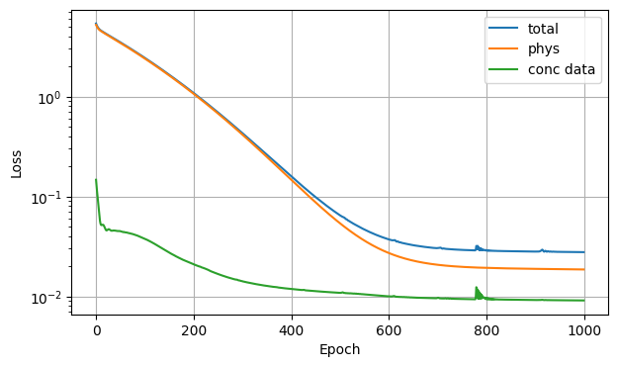
Results
Loss:
total=2.809e-02 | phys=1.887e-02 concentration=9.211e-03
Energy balance parameters:
  e = 0.1734
  c1 = -0.4205
  c2 = -0.4085

Slide 19
Sources
https://pages.di.unipi.it/milazzo/teaching/AA1819-CMCS/slides/04-ChemicalReactionMetaphor.pdf
Reduktion biochemischer Differentialgleichungen, Bachelorarbeit, Christian Schilli, Februar 2010
Autonomous Discovery of Unknown Reaction Pathways from Data by Chemical Reaction Neural Network, Weiqi Ji and Sili Deng, The Journal of Physical Chemistry A 2021 125 (4), 1082-1092 DOI: 10.1021/acs.jpca.0c09316
Modeling Chemical Reaction Networks Using Neural Ordinary Differential Equations, Anna C. M. Thöni, William E. Robinson, Yoram Bachrach, Wilhelm T. S. Huck, and Tal Kachman, Journal of Chemical Information and Modeling 2025 65 (9), 4346-4352 DOI: 10.1021/acs.jcim.5c00296
Physics-Enhanced Neural Ordinary Differential Equations: Application to Industrial Chemical Reaction Systems, Farshud Sorourifar, You Peng, Ivan Castillo, Linh Bui, Juan Venegas, and Joel A. Paulson Industrial & Engineering Chemistry Research 2023 62 (38), 15563-15577 DOI: 10.1021/acs.iecr.3c01471

