Slide 1

Programação Orientada a Objetos 2
Prof. Marcelo Maia

Slide 2
POO 2
?

Slide 3
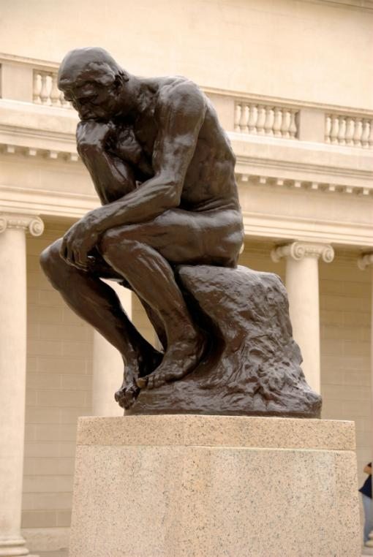
Reuso de Software (Pense a Respeito)
O que é reusar software?
Por que reusar é importante?
Que experiência você já teve com reuso?
Quais os problemas quando se pretender reusar?
The Thinker (1902)

Slide 4
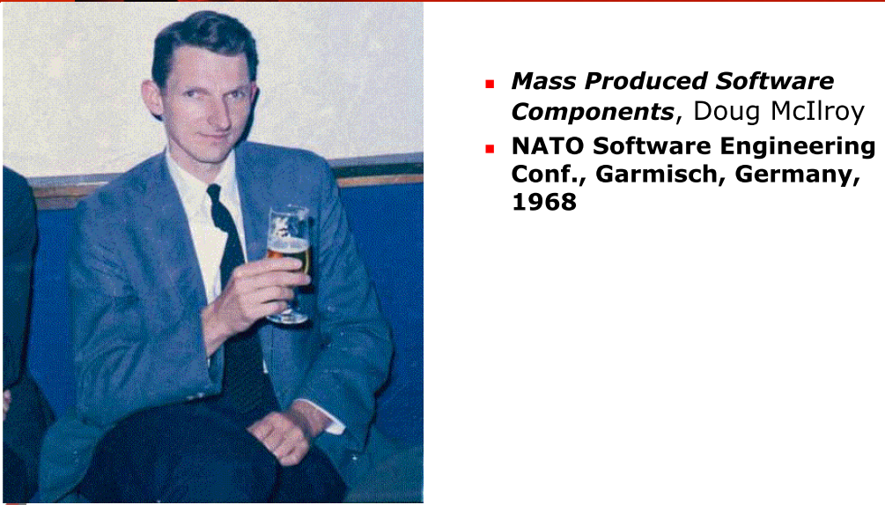
Origem...

Slide 5
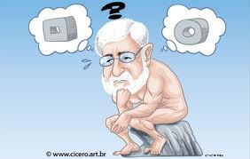
Reuso do Conhecimento
Antes da Escrita
Se não fosse a escrita
Talvez até hoje estaríamos “reinventando a roda”
Imprensa
Internet
Se você acha que tem uma idéia brilhante....

Slide 6

Internet
O que significa reuso do conhecimento considerando a Internet?

Slide 7
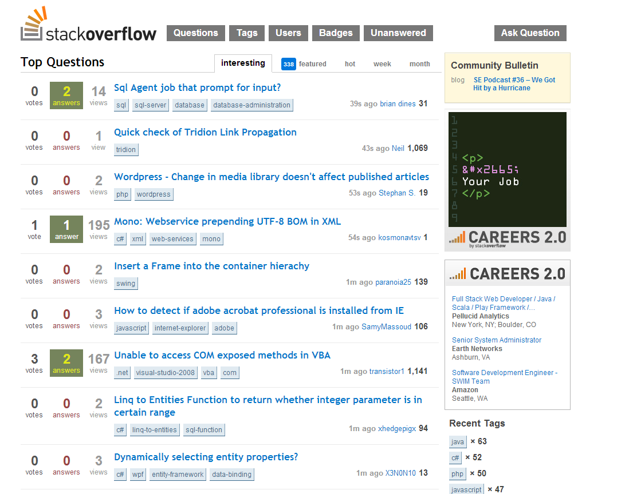

Slide 8
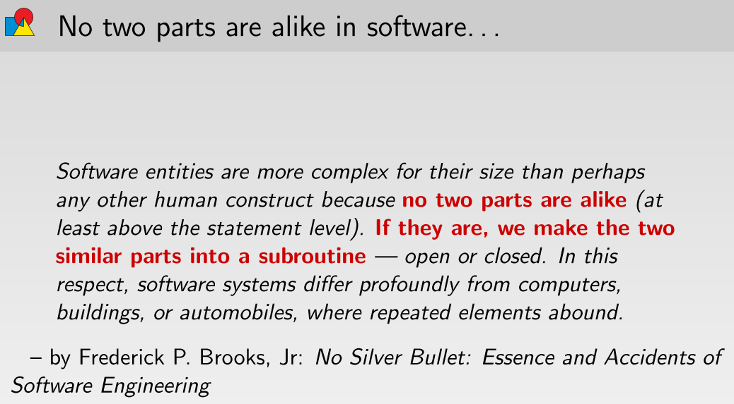
Até que ponto isto é verdade?

Slide 9
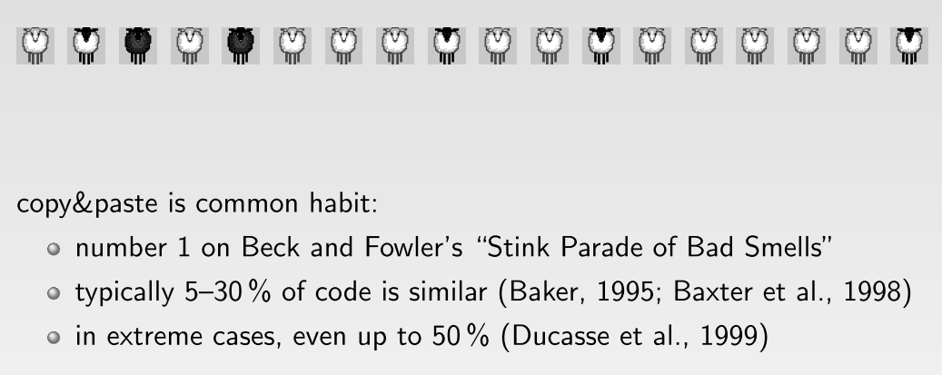

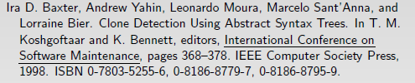

Redundância em software

Slide 10
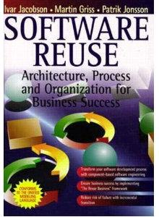
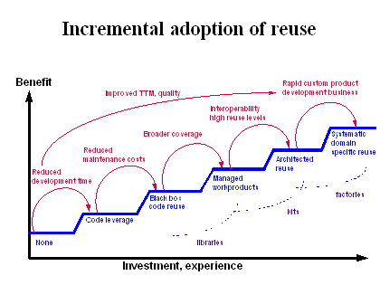

Slide 11


Slide 12
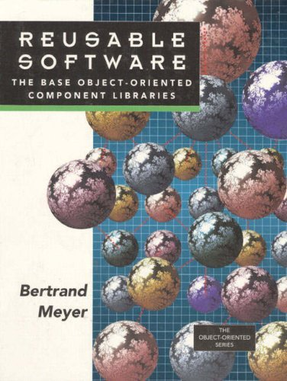
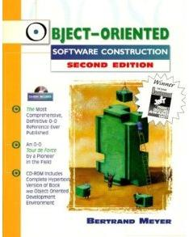

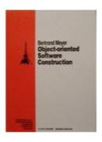

Slide 13
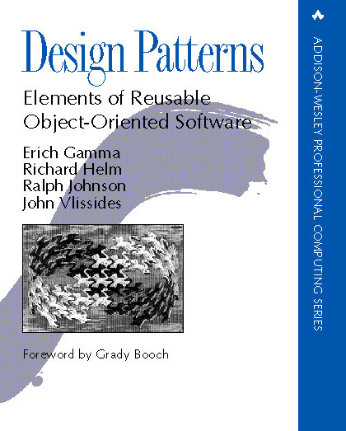

Slide 14
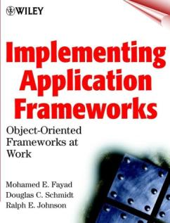
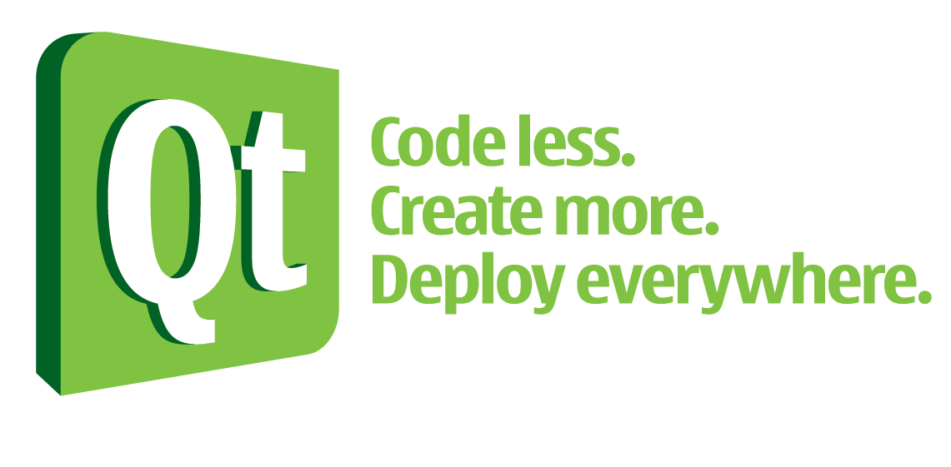

Slide 15
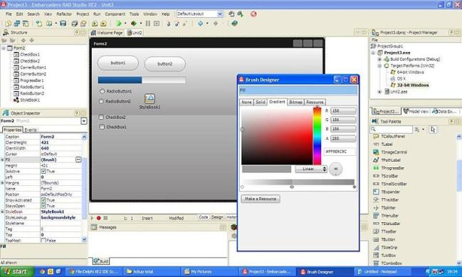
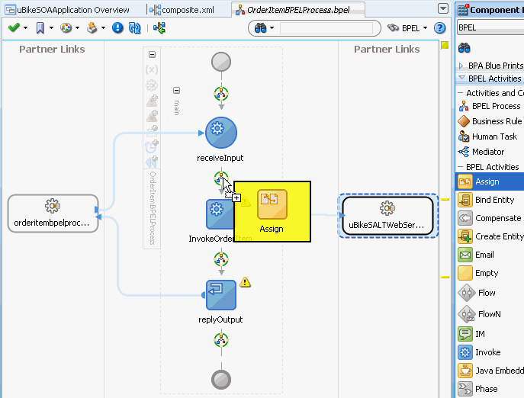

Slide 16
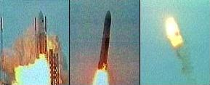
Qualidade no Reuso!
CUIDADO!!!!
Ariane 5

Slide 17

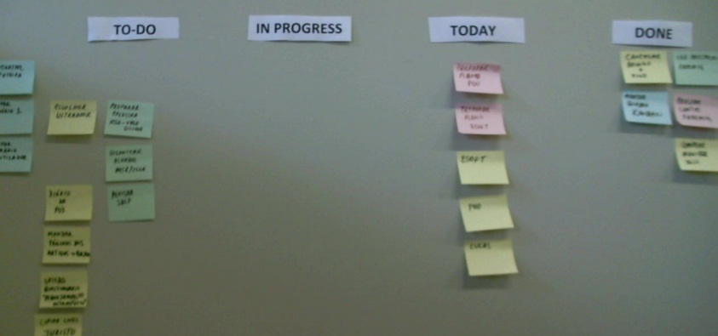
Plano do curso
Ver no Moodle
Senha do Moodle: poo2
Elemento mais importante do curso:
TRABALHO PRÁTICO
Aproveitem as semanas vazias
Kanban

Slide 18

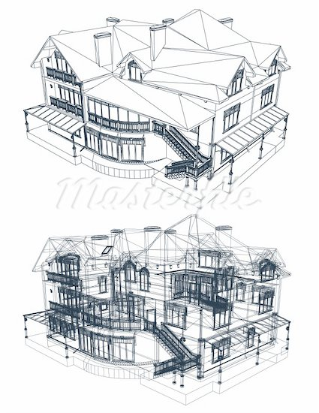
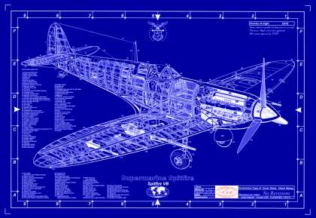
O que é projeto?

Slide 19
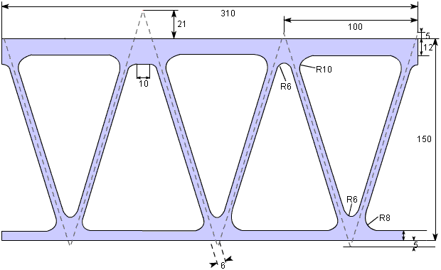

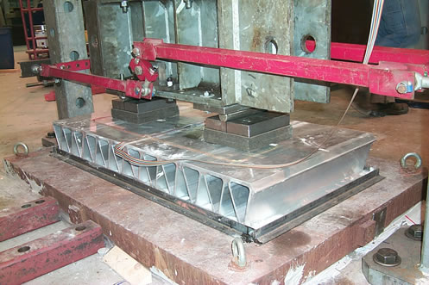
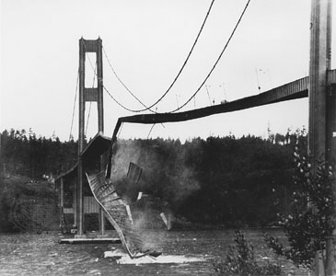
Qualidade de projeto

Slide 20
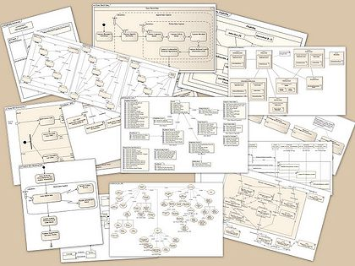
Como projetamos em software?
Take a piece of paper and write down two principles that guide you - considerations that are important or indicators that you have a good design.
Notes:
We do this as a 10 minute Think-Pair-Share exercise. As students suggest principles group them together when there is commonality. Keep the list available to highlight when student offered principles reappear on slides in this lecture.

Slide 21
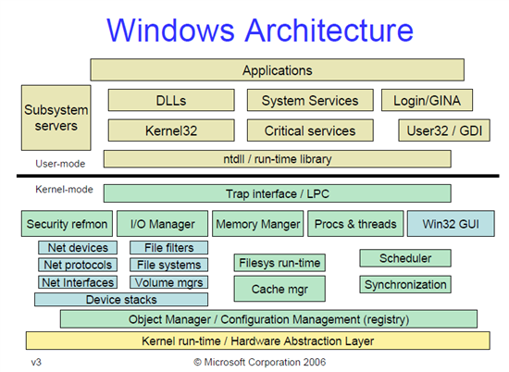




Como projetamos em software?
Notes:
We do this as a 10 minute Think-Pair-Share exercise. As students suggest principles group them together when there is commonality. Keep the list available to highlight when student offered principles reappear on slides in this lecture.

Slide 22

Primeiros Princípios OO
Encontre os substantivos → objetos/estado
Encontre os verbos → comportamento; métodos/funções

Slide 23
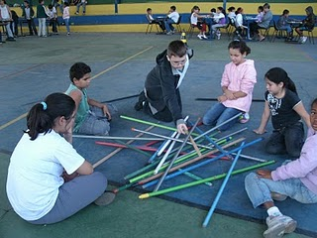
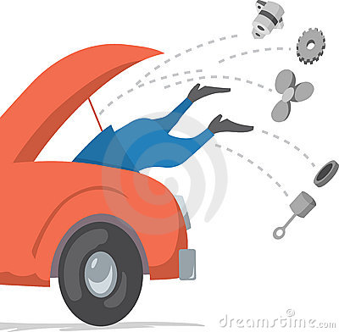
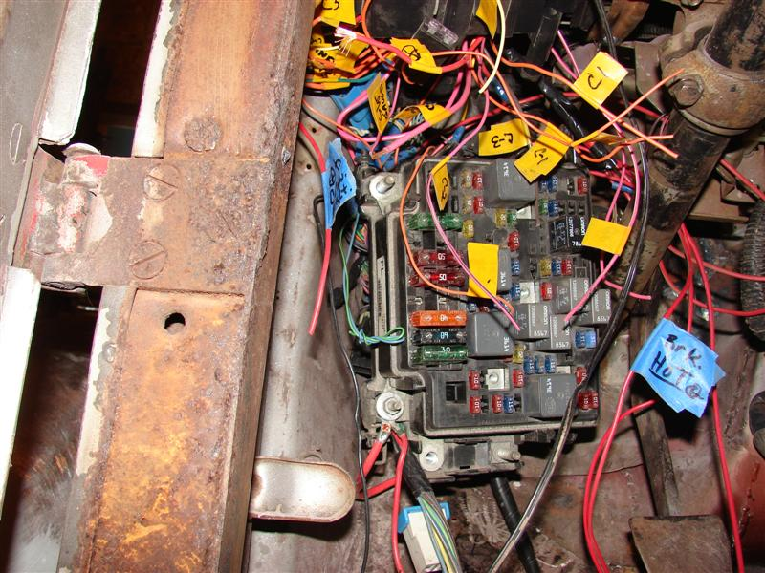
3 características de projetos ruins
Rigidez – difícil de mudar porque cada mudança altera muitas outras partes.
Fragilidade – quando você faz uma mudança, partes inesperadas deixam de funcionar
Imobilidade – é difícil de reusar em outras aplicação porque não pode ser desemaranhada da aplicação atual

Slide 24
Exemplo de um pequeno sistema com GUI

Slide 25
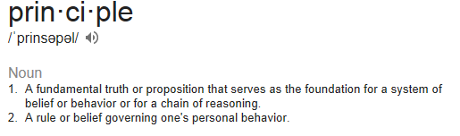

Princípios = guia para evitar o pior
Single Responsibility Principle
Open Close Principle
Liskov's Substitution Principle
Interface Segregation Principle
Dependency Inversion Principle

Slide 26
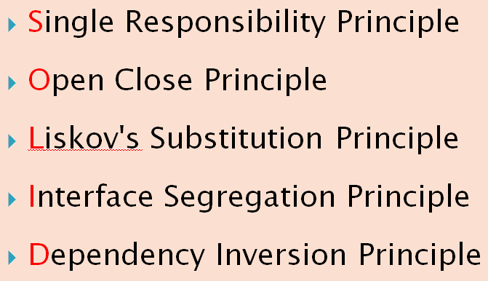
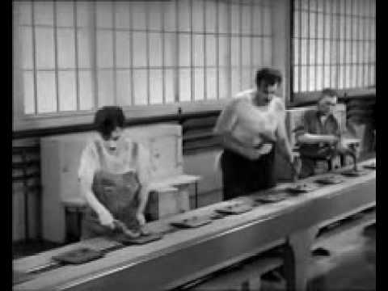
Single Responsibility Principle

Slide 27
Single Responsibility Principle
A class should have only one reason to change.
This principle states that if we have 2 reasons to change for a class, we have to split the functionality in two classes.
Each class will handle only one responsibility and on future if we need to make one change we are going to make it in the class which handle it.
When we need to make a change in a class having more responsibilities the change might affect the other functionality of the classes.
Single Responsibility Principle was introduced Tom DeMarco in his book Structured Analysis and Systems Specification, 1979.

Slide 28

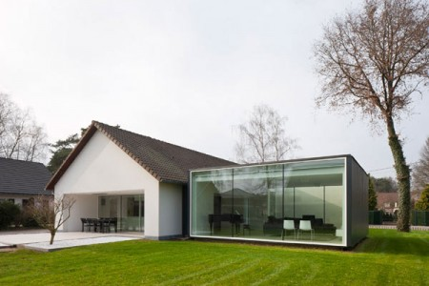

Open Close Principle

Slide 29
Open Close Principle
Software entities like classes, modules and functions should be open for extension but closed for modifications.
You can consider it when writing your classes to make sure that when you need to extend their behavior you don’t have to change the class but to extend it.
Backward compatibility, regression testing, �…
Use of Abstract Classes and concrete classes for implementing their behavior.

Slide 30
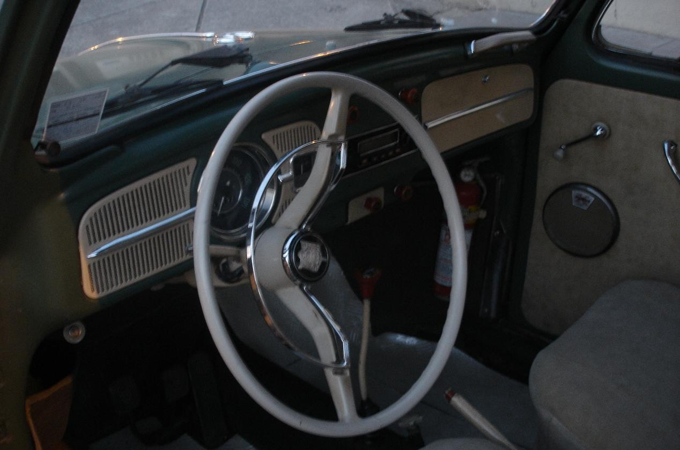
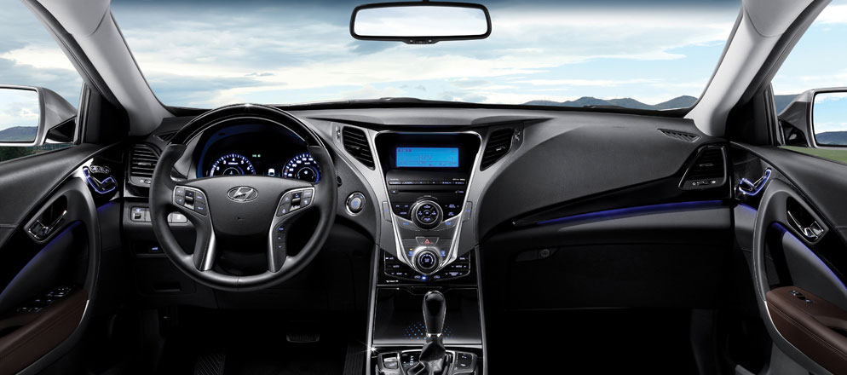
Liskov's Substitution Principle
O que tem de comum e diferente?

Slide 31
Liskov's Substitution Principle
Functions That Use References To Base (Super) Classes Must Be Able To Use Objects Of Derived (Sub) Classes Without Knowing It
Se sabe dirigir um fusca, vai dirigir um coreano moderno
If a function does not satisfy the LSP, then it probably makes explicit reference to some or all of the subclasses of its superclass.
Dirigir só com o piloto automático quebra o LSP
Such a function also violates the Open-Closed Principle, since it may have to be modified whenever a new subclass is created.
O piloto automático do coreano vai ser diferente do piloto automático da BMW
Fusca vs Hyundai
Fusca vs Hyundai
Fusca vs Hyundai

Slide 32
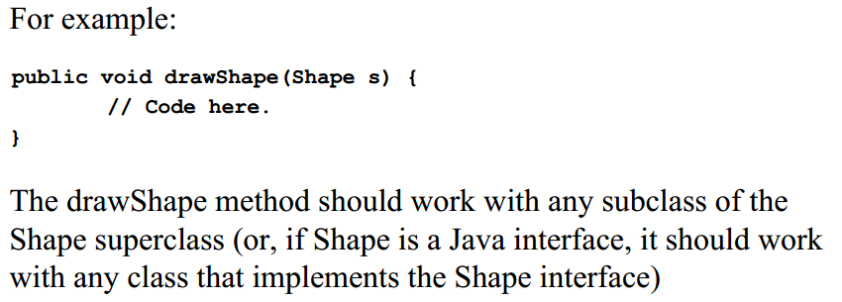
Liskov's Substitution Principle

Slide 33

Interface Segregation Principle

Slide 34
Interface Segregation Principle
Clients should not be forced to depend upon interfaces that they don't use.
Take care how we write our interfaces:
add only methods that should be there.
Otherwise, the classes implementing the interface will have to implement those methods as well.
?
interface Worker {
lunch();
}
class Robot implements Lunch {
lunch () {
// não faz nada
}
}
Pense em um problema que
interface Trabalhador
pode impor para a
Classe Robô
implementar

Slide 35

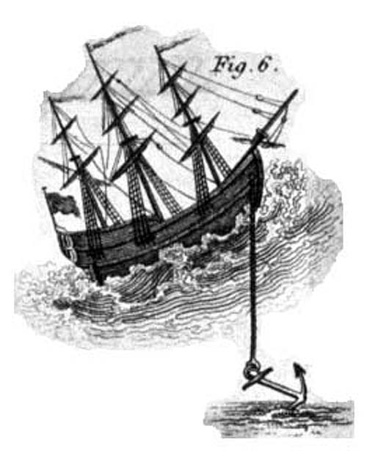
Dependency Inversion Principle

Slide 36
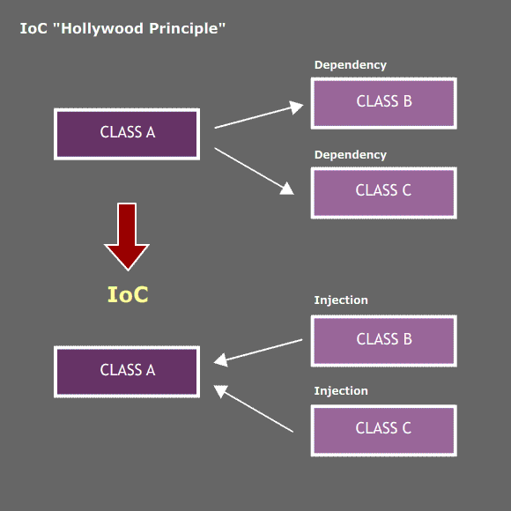
Dependency Inversion Principle
High-level modules should not depend on low-level modules. Both should depend on abstractions.
Abstractions should not depend on details. Details should depend on abstractions.
Dependency Inversion Principle states that we should decouple high level modules from low level modules:
instead of writing our abstractions based on details, the we should write the details based on abstractions.
Dependency Inversion or Inversion of Control
referring to the way in which the dependencies are realized.
In the classical way when a software module(class, framework, … need some other module, it initializes and holds a direct reference to it. This will make the 2 modules tight coupled.
In order to decouple them the first module will provide a hook(a property, parameter, …) and an external module controlling the dependencies will inject the reference to the second one.
By applying the Dependency Inversion the modules can be easily changed by other modules just changing the dependency module.

Slide 37
Key Design Concepts
General
Cohesion
Coupling
Information hiding
Encapsulation
Creation
Binding time
Notes:
Our students have at least heard of coupling and cohesion in a prior class. They understand coupling simply as lines between classes. More important will be trying to get them to be willing to have a few more lines on a class diagram in exchange for a more cohesive design. This is the first that our students are presented with the concept of delegating work to other objects.
Our students ignore the “behavior follows data” design principle more than any other. The symptom is often a “main” class called manager or controller. This is surrounded by a number of data container classes that only have accessors and mutators. Where is the behavior associated with that data? Probably in the manager or controller class. Good object-oriented design practice keeps those two together. I sing the behavior follows data refrain in almost every class session.

