Slide 1
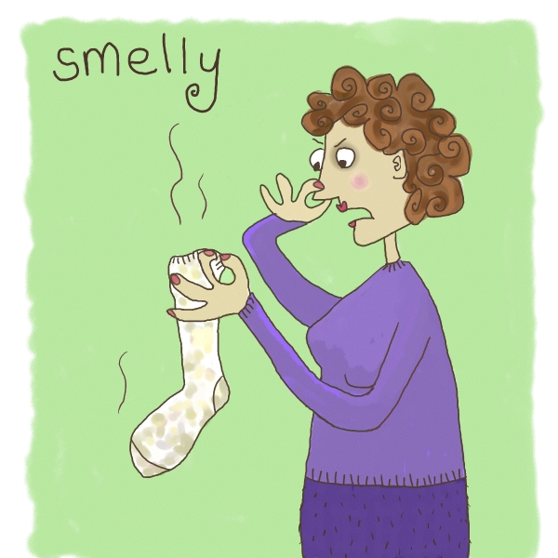
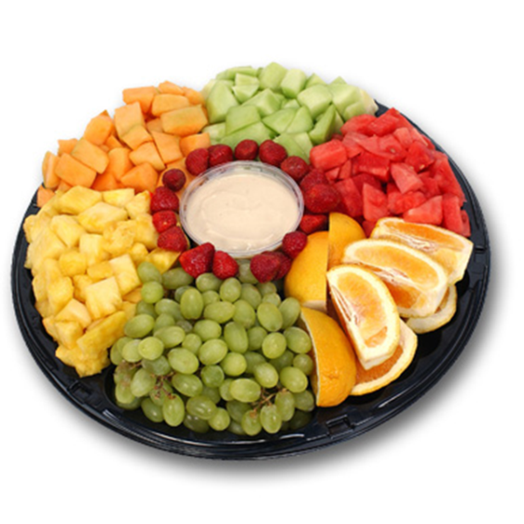
Bad Smells and Refactoring
Prof. Marcelo Maia

Slide 2
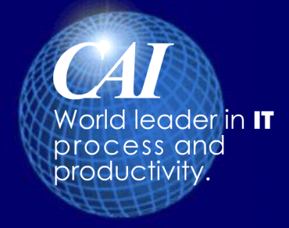
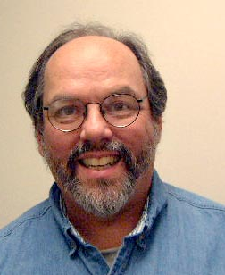
2. What is technical debt?
Dívida Técnica
Ward Cunningham
Invented the wiki in 1994
Coined the term at OOPSLA in 1992
Technical Debt includes those internal things that you choose not to do now, but which
will impede future development if left undone. This includes deferred refactoring.
Technical Debt doesn't include deferred functionality, except possibly in edge cases where delivered functionality is "good enough" for the customer, but doesn't satisfy some standard (e.g., a UI element that isn't fully compliant with some UI standard).
Notes:
The web browser didn’t become popular until 1994 so inventing the wiki then is impressive

Slide 3
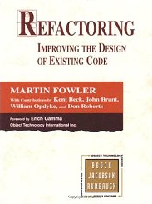
História de refactoring
Refactoring sempre foi feito informalmente.
A tese de doutorado de William Griswold foi o primeiro trabalho acadêmico para refatoração de programas funcionais e procedimentais.
A tese de William Opdyke em 1992, tratou do refactoring de programas OO.
O livro de Martin Fowler cristalizou a área.

Slide 4

Legibilidade
Which code segment is easier to read?
Sample 1
if (date.before(IV) || date.after(FV))
taxa = qtde * tI + tSI;
else
taxa = qtde * tV;
Sample 2
if (estamosNoVerao(date))
taxa = taxaVerao(quantidade);
else
taxa = taxaInverno(quantidade);

Slide 5

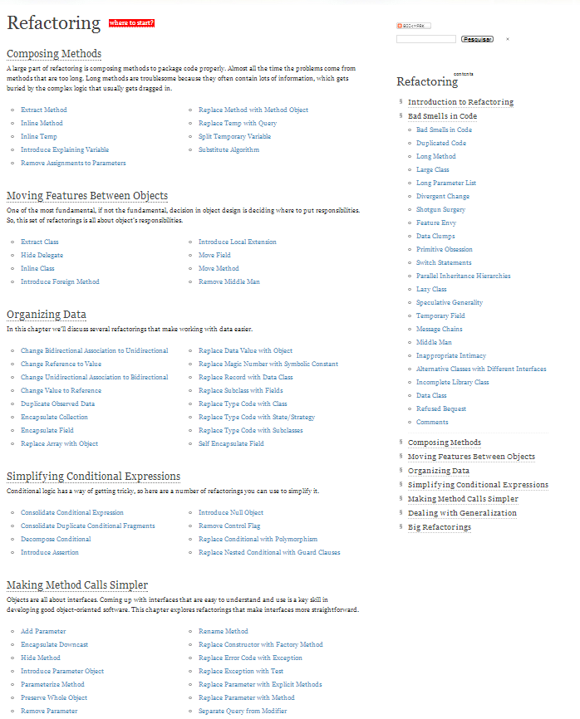
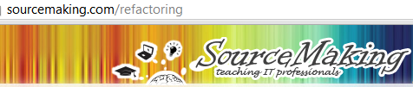
Bad Smells in Code
Duplicated code
Long Method
Large Class
Long Parameter List
Comments
Feature Envy

Slide 6
Duplicated code
There is obvious duplication
Such as copy and paste
There are unobvious duplications
Such as parallel inheritance hierarchies
Similar algorithms
Remedy
Extract Method
Pull Up Field

Slide 7
Feature Envy
A method that seems more interested in some other classes than the one it is in
Remedy
Move Method
Extract Method

Slide 8
Extract Method
void printOwning(double amount){
printBanner();
// print details
System.Console.WriteLine(string.Format(“name: “, name);
System.Console.WriteLine(string.Format(“amount: “, amount);
}
void printOwning(double amount){
printBanner();
printDetails(amount);
}
void printDetails(double amount){
System.Console.WriteLine(string.Format(“name: “, name);
System.Console.WriteLine(string.Format(“amount: “, amount);
}

Slide 9
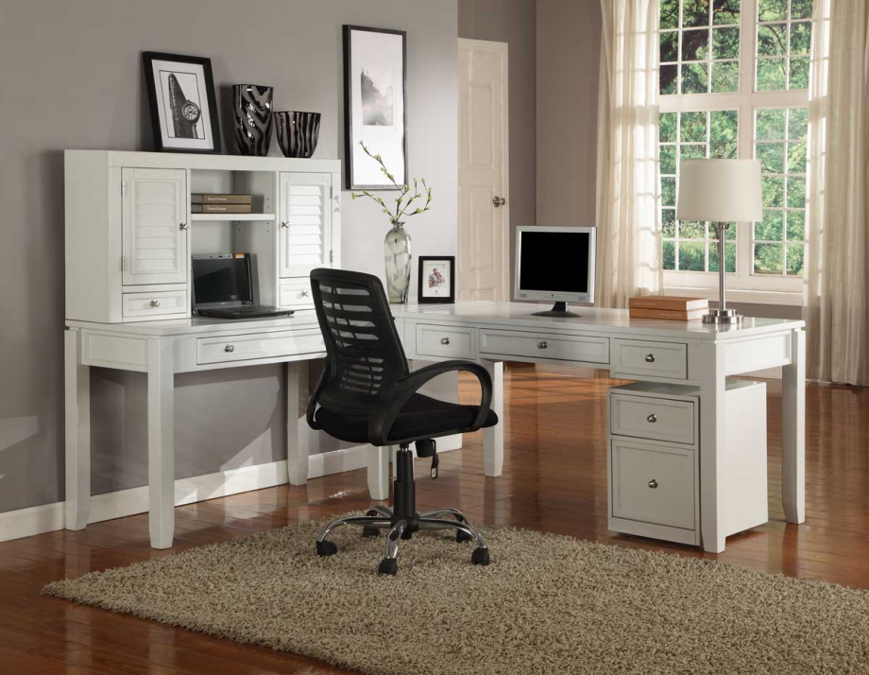
Moving Features between object
One of the most fundamental, if not the fundamental, decision in object design is deciding where to put responsibilities.
Locality Principle

Slide 10
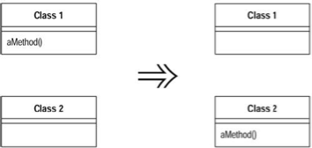
Move Method Princípio da Localidade
A method is, or will be, using or used by more features of another class than the class on which it is defined.
Create a new method with a similar body in the class it uses most. Either turn the old method into a simple delegation, or remove it altogether.

Slide 11
Move Method na prática
class Project {
Person[] participants;
}
class Person {
int id;
boolean participate(Project p) {
for(int i=0; i<p.participants.length; i++) {
if (p.participants[i].id == id) return(true);
}
return(false);
}
}
... if (x.participate(p)) ...
class Project {
Person[] participants;
boolean participate(Person x) {
for(int i=0; i<participants.length; i++) {
if (participants[i].id == x.id) return(true);
}
return(false);
}
}
class Person {
int id;
}
... if (p.participate(x)) ...

Slide 12
Comments
Comments – be suspicious!
Comments represent a failure to express an idea in the code
Remedy
Extract Method
Rename Method

Slide 13
Extract Method
void printOwing(double amount)
{
printBanner();
//print details
WriteLine("name:" + _name);
WriteLine("amount" + amount);
}
void printOwing(double amount)
{
printBanner();
printDetails(amount);
}
void printDetails(double amount)
{
WriteLine("name:" + _name);
WriteLine("amount" + amount);
}

Slide 14
Long Method
Good OO code is easiest to understand and maintain with shorter methods with good names
Long methods tend to be harder to read and understand
Remedy
Extract Method
Replace Temp with Query
Replace Method with Method Object
Decompose Conditional

Slide 15
Replace Temp with Query
double basePrice = _quantity *
_itemPrice;
if(basePrice > 1000) {
return basePrice * 0.95;
}
else {
return basePrice * 0.98;
}
double getBasePrice() {
return _quantity * _itemPrice;
}
if(getBasePrice() > 1000) {
return getBasePrice() * 0.95;
}
else {
return getBasePrice() * 0.98;
}

Slide 16
Long parameter list
Functions should have as few parameters as possible
Remedy
Replace Parameter with Method
Preserve Whole Object
Introduce Parameter Object

Slide 17
Introduce Parameter Object
Customer
amountInvoicedIn(Date start, Date end)
amountRecivedIn(Date start, Date end)
amountOverdueIn(Date start, Date end)
Customer
amountInvoicedIn(DateRange range)
amountRecivedIn(DateRange range)
amountOverdueIn(DateRange range)

Slide 18
Switch Statements
Type cases are evil because they tend to be duplicated many times
Remedy
Replace Type Code with Subclasses
Replace Type Code with State / Strategy
Replace Conditional with Polymorphism
Replace Parameter with Explicit Methods
Introduce Null Object

Slide 19
Replace Parameter with Explicit Methods
void setValue(String name, int value) {
if(name.Equals(“height”))
{
_height = value;
return;
}
if(name.Equals(“width”))
{
_width = value;
return;
}
}
void setHeight(int value)
{
_height = value;
}
void setWidth(int value)
{
_width = value;
}

Slide 20
Inline Method
Before Refactoring
After Refactoring
int getRating() {
return (moreThanFiveLateDeliveries()) ? 2 : 1;
}
boolean moreThanFiveLateDeliveries() {
return _numberOfLateDeliveries > 5;
}
int getRating() {
return (_numberOfLateDeliveries > 5) ? 2 : 1;
}

Slide 21
Split Temporary Variable
double temp = 2 * (_height + _width);
WriteLine(temp);
temp = _height * _width;
WriteLine(temp);
double perimeter = 2 * (_height + _width);
WriteLine(perimeter);
double area = _height * _width;
WriteLine(area);
Notes:
You have a temporary variable assigned to more than once, but is not a loop variable nor a
collecting temporary variable.
Make a separate temporary variable for each assignment.

Slide 22
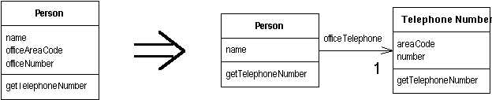
Extract class
You have one class doing work that should be done by two. Create a new class and move the relevant fields and methods from the old class into the new class.

Slide 23
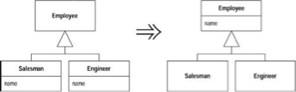
Pull up Field
Two subclasses have the same field. Move the field to the superclass.

Slide 24
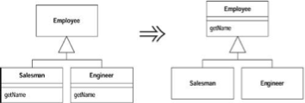
Pull up Method
Two subclasses have the same method. Move the method to the superclass.

Slide 25
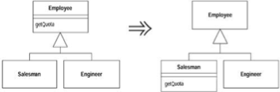
Push Down Method
Behavior on a superclass is relevant only for some of its subclasses. Move it to those subclasses

Slide 26
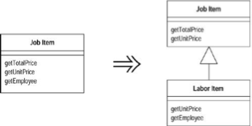
Extract Subclass
A class has features that are used only in some instances. Create a subclass for that subset of features

Slide 27
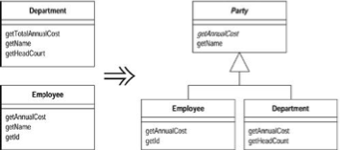
Extract Superclass
You have two classes with similar features. Create a superclass and move the common features to the superclass.

