Slide 1

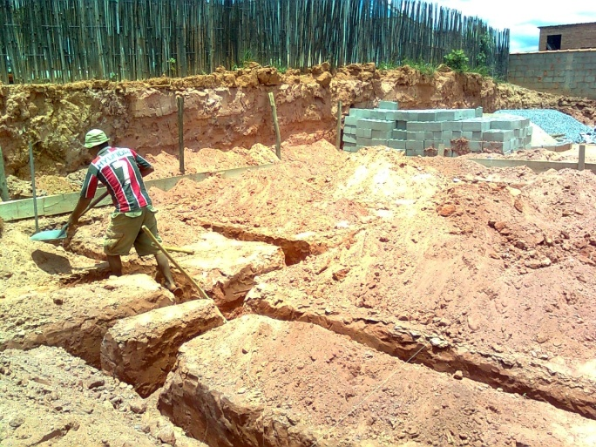
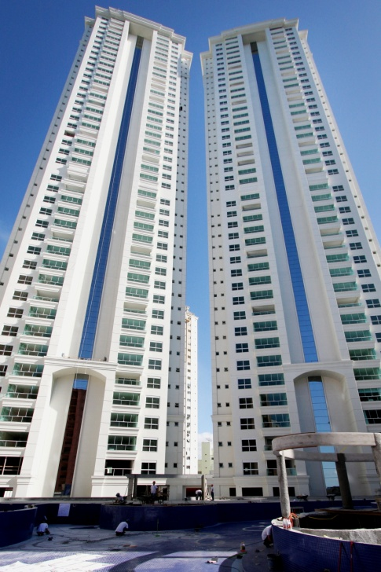
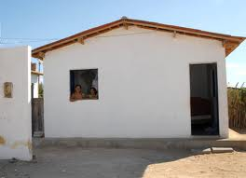
Construtor (Builder)
Para fazer fundação: BateEstaca

Slide 2
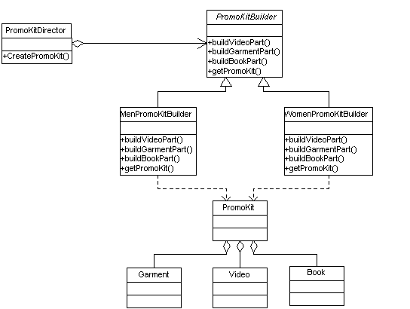
Builder

Slide 3
Builder
public abstract class PromoKitBuilder { protected PromoKit promoKit = new PromoKit(); public abstract void buildVideoPart(); public abstract void buildGarmentPart(); public abstract void buildBookPart(); public abstract PromoKit getPromoKit();
}
// Director
public class PromoKitDirector {
public PromoKit createPromoKit(PromoKitBuilder builder) {
builder.buildVideoPart(); builder.buildGarmentPart(); builder.buildBookPart();
return builder.getPromoKit();
}
}

Slide 4
Builder
// Integration with overal application
public class Application {
public static void main(String[] args) {
String gendre = "M";
PromoKitDirector director = new PromoKitDirector();
PromoKitBuilder promoKitBuilder = null;
if (gendre.equals("M")) {
promoKitBuilder = new MenPromoKitBuilder();
}
else if (gendre.equals("F")) {
promoKitBuilder = new WomenPromoKitBuilder();
} else {
// ....
}
PromoKit result = director.createPromoKit(promoKitBuilder);
}
}

Slide 5
Builder
public class MenPromoKitBuilder extends PromoKitBuilder {
public void buildVideoPart() {
// add videos to PromoKit based on men-specific preferences
}
public void buildGarmentPart() {
// add men garments to PromoKit
}
public void buildBookPart() {
// add books to PromoKit based on men-specific preferences
}
public PromoKit getPromoKit() {
return promoKit;
}
}
public class WomenPromoKitBuilder extends PromoKitBuilder {
public void buildVideoPart() {
// add videos to PromoKit based on women-specific preferences
}
public void buildGarmentPart() {
// add women garments to PromoKit
}
public void buildBookPart() {
// add books to PromoKit based on women-specific preferences
} public PromoKit getPromoKit() {
return promoKit;
}
}

Slide 6
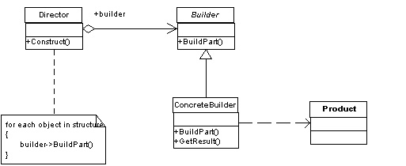
Builder

Slide 7
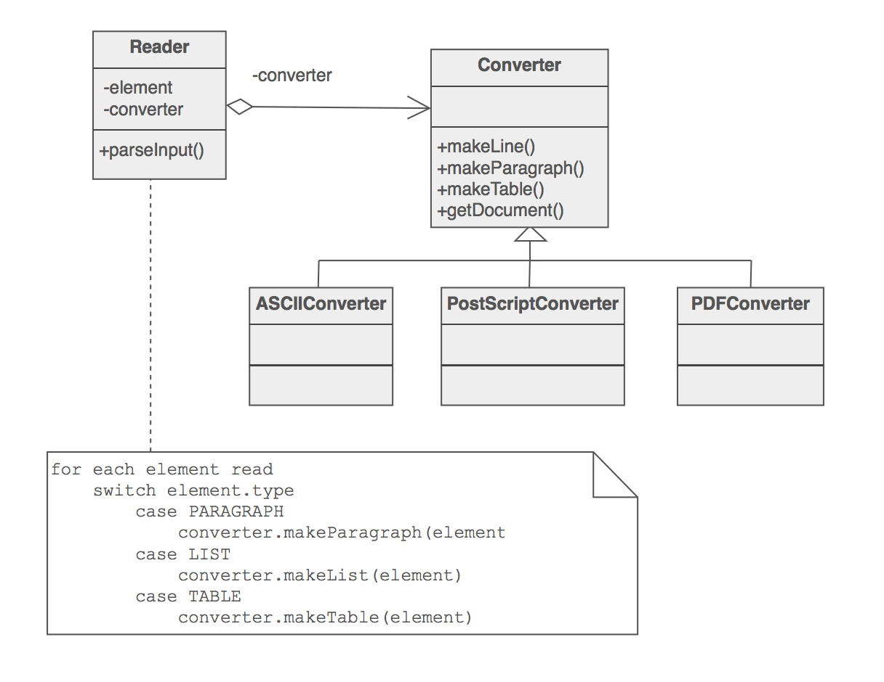
Outro Exemplo

