Slide 1
Frameworks Orientados a Objetos
Marcelo Maia

Slide 2


Por que?
Uma base …
dezenas, centenas, milhares de aplicações
Economia
Fazer uma vez, vender muitas vezes
Produtos altamente customizados
Porque
Word, Excel, Powerpoint ao invés de
Document?
PIM para dentista, engenheiro, médico,
PIM para atleta
PIM para trabalho, lazer

Slide 3
Como?
Bibliotecas
Linguagens de Domínio Específico
Geradores de aplicações
Compilação condicional
Frameworks

Slide 4
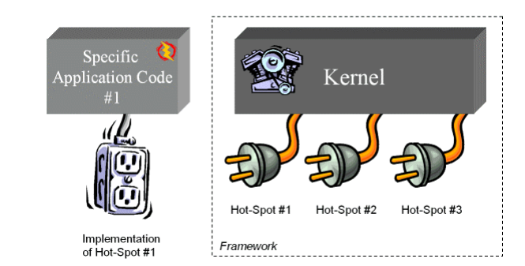
O que?
A framework is a reusable, “semi-complete” application that can be specialized to produce custom applications

Slide 5
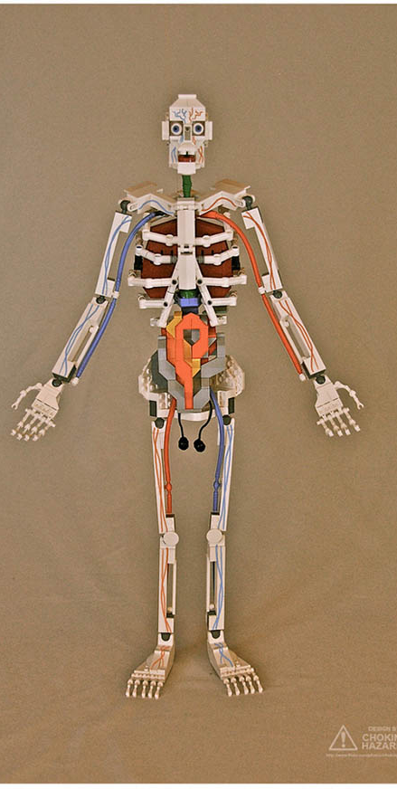
O que?
A framework is a reusable, “semi-complete” application that can be specialized to produce custom applications
Diferença com biblioteca de classes
Components in a framework work together to provide a generic architectural skeleton for a family of related applications.
Complete applications can be composed by
inheriting from and/or
instantiating framework components.
In contrast, class libraries are less domain-specific and provide a smaller scope of reuse.
For instance, class library components like classes for Strings, complex numbers, arrays, and bitsets are relatively low-level and ubiquitous across many application domains.

Slide 6
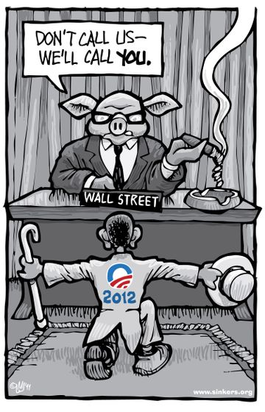
O que?
A framework is a reusable, “semi-complete” application that can be specialized to produce custom applications
Diferença com biblioteca de classes
Class libraries are typically passive, i.e., they perform their processing by borrowing threads of control from self-directed application objects.
In contrast, frameworks are active, i.e., they control the flow of control within an application via event dispatching patterns like Reactor and Observer.
The “inversion of control” in the run-time architecture of a framework is often referred to as The Hollywood Principle, i.e., ``Don't call us, we'll call you.''

Slide 7
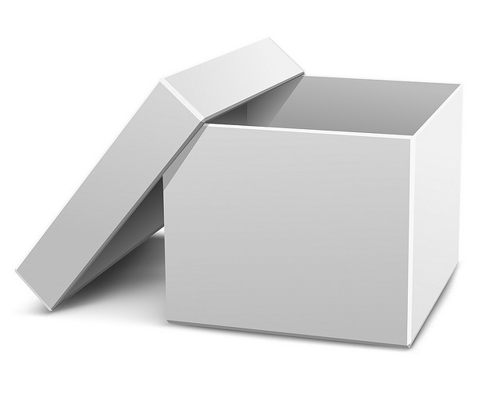
White-box Frameworks
Some frameworks rely heavily on inheritance, others on polymorphic composition -- which should you use?
Therefore
Use inheritance, build a white box framework by generalizing from classes individual applications.
Use patterns like Template Method and Factory Method [Gamma] to increase the amount of reusable code in the super-classes from which you are inheriting.
Don’t worry if applications don’t share any concrete classes, though they probably will.

Slide 8

Hot / Frozen Spots
As you develop applications based on your framework, you may see similar code being written over and over again.
Aplique refactoring para eliminar o código redundante
Extract method
Pull up method
…
Frozen spots define the overall architecture of a software system, that is to say its basic components and the relationships between them. These remain unchanged (frozen) in any instantiation of the application framework.
Hot spots represent those parts where the programmers using the framework add their own code to add the functionality specific to their own project.

Slide 9
Black-box framework
Some frameworks rely heavily on inheritance, others on polymorphic composition. Which should you use?
Use inheritance to organize your component library and composition to combine components into applications.
Essentially, inheritance will provide a taxonomy of parts easy to browse and composition will allow for maximum flexibility in application development.
When it isn’t clear which is the better technique for a given component, favor composition.
...

Slide 10
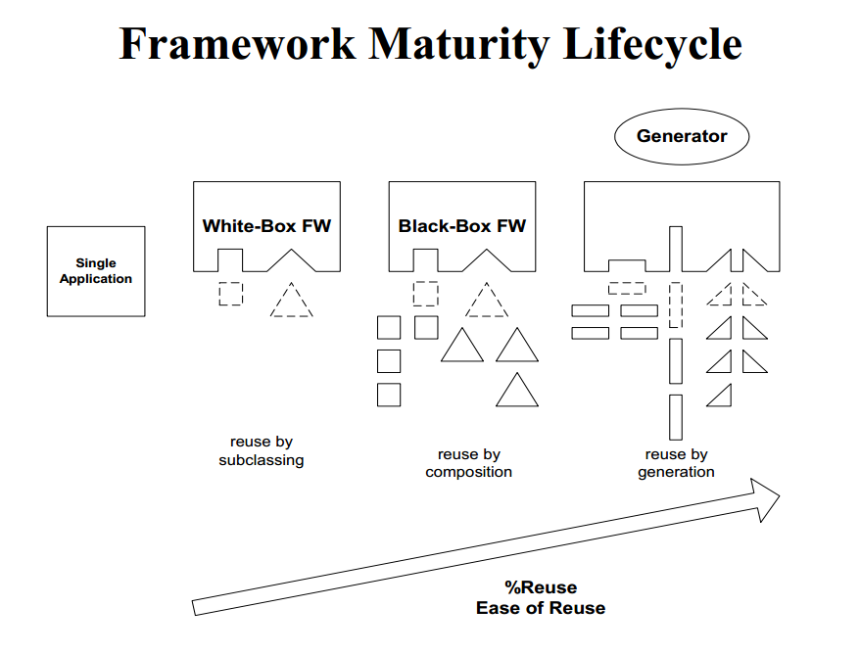
Evolution towards black box
White box reuse
when the user needs to understand and perhaps modify
implies that a new similar part is created
sacrifices “delegation of ownership”
“recycling”
Black box reuse
when the asset can be reused without modification of internals
raises the level of abstraction
“delegation of ownership”

Slide 11
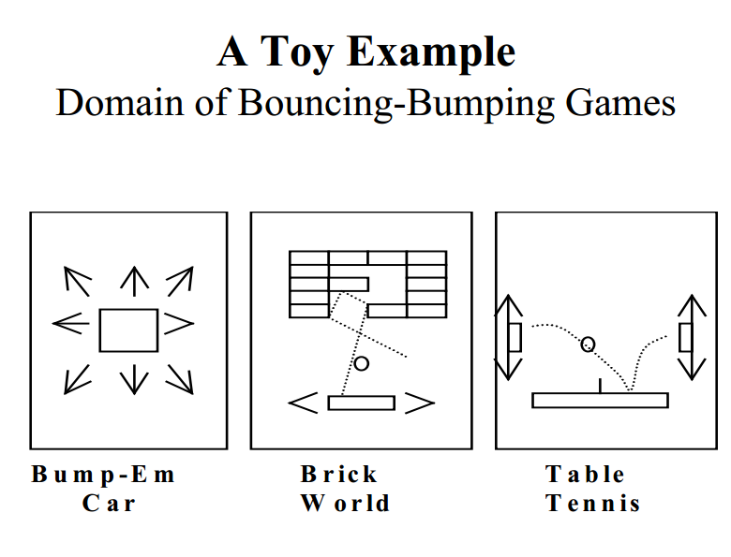

Slide 12
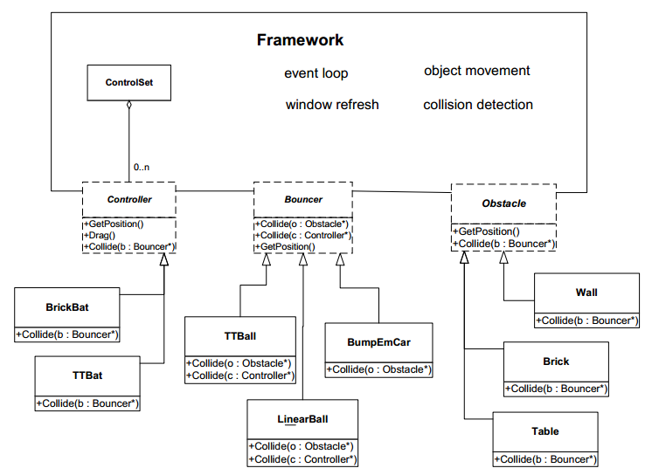

Slide 13
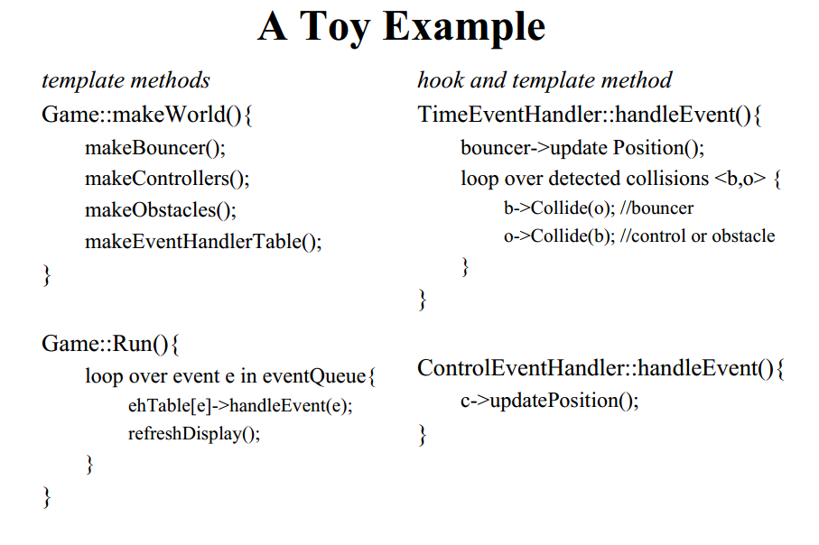
Usando Template Method em Frameworks

Slide 14
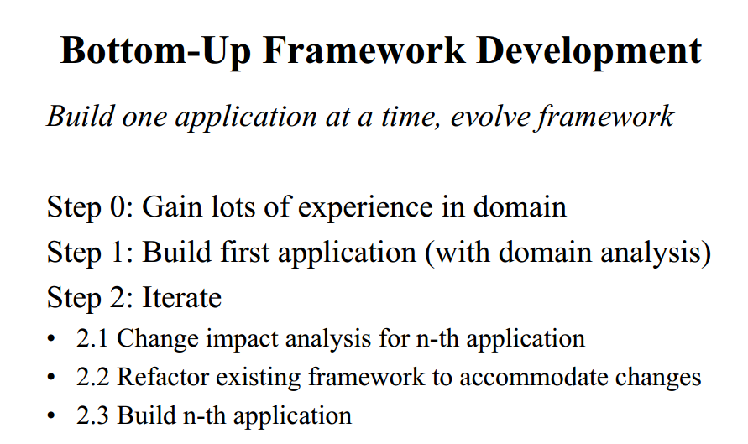

Slide 15
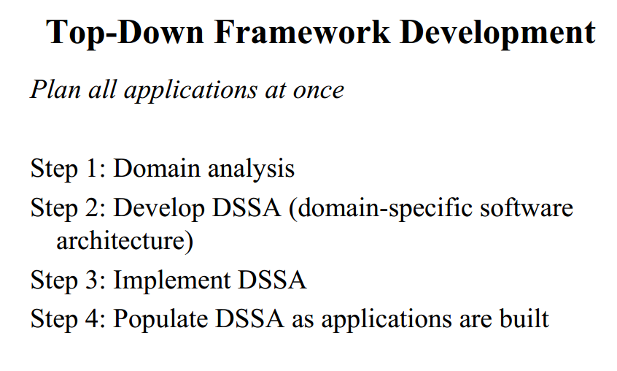

Slide 16
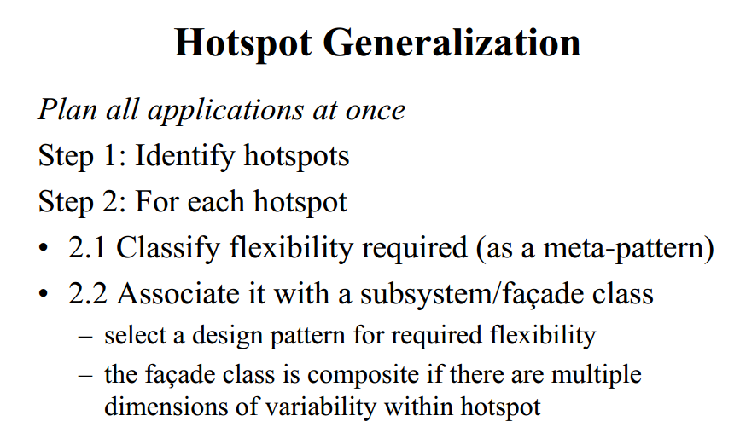

Slide 17
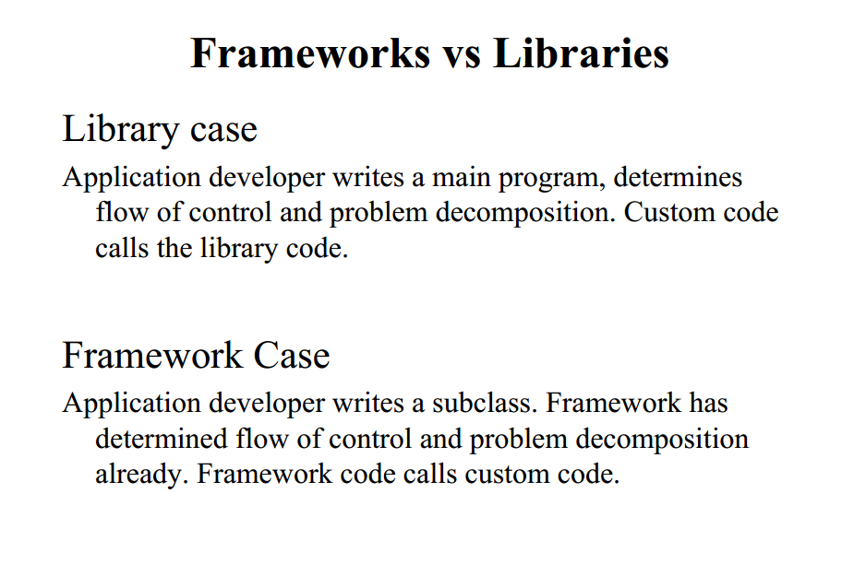
Resumindo

Slide 18
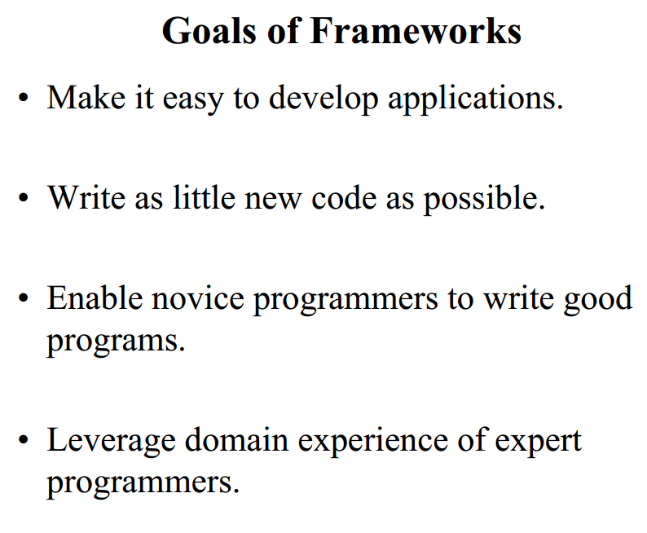
Resumindo

