Slide 1

Open set domain adaptation
Politecnico di Torino
Data Analysis and Artificial Intelligence
Andres Felipe Corredor Pablos S287298
Fulvio Raddi S284539
Jorge Luis Lora S292930
Michel Jreige S288005

Slide 2

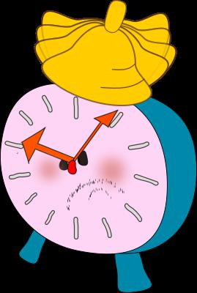
Introduction of the problem

Slide 3

Knowing the unknown

Slide 4
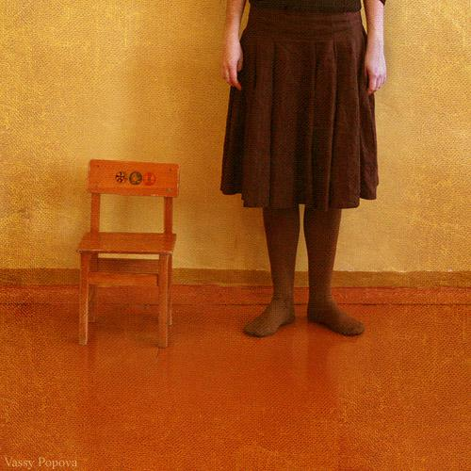


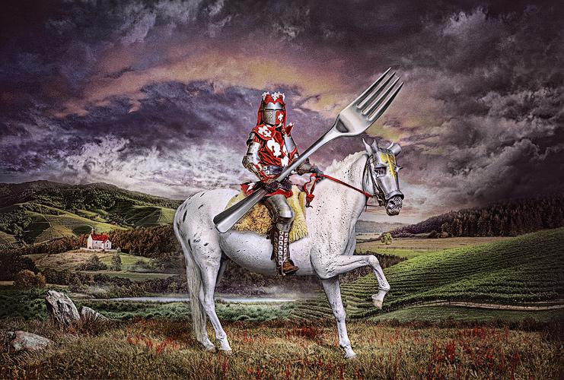

Joint Supervision Training
$L=L_{C_{1}}+ α_{1}L_{R_{1}}$ + λ Center_Loss
Chair
Candle
Fork

Slide 5
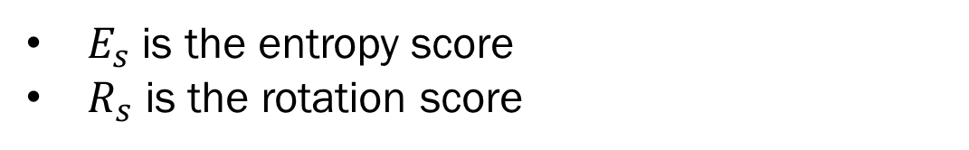

Normality score
$$N=max⁡\{E_{s},R_{s}\}$$
$E_{s}$is the entropy score
$R_{s}$ is the rotation score

Slide 6
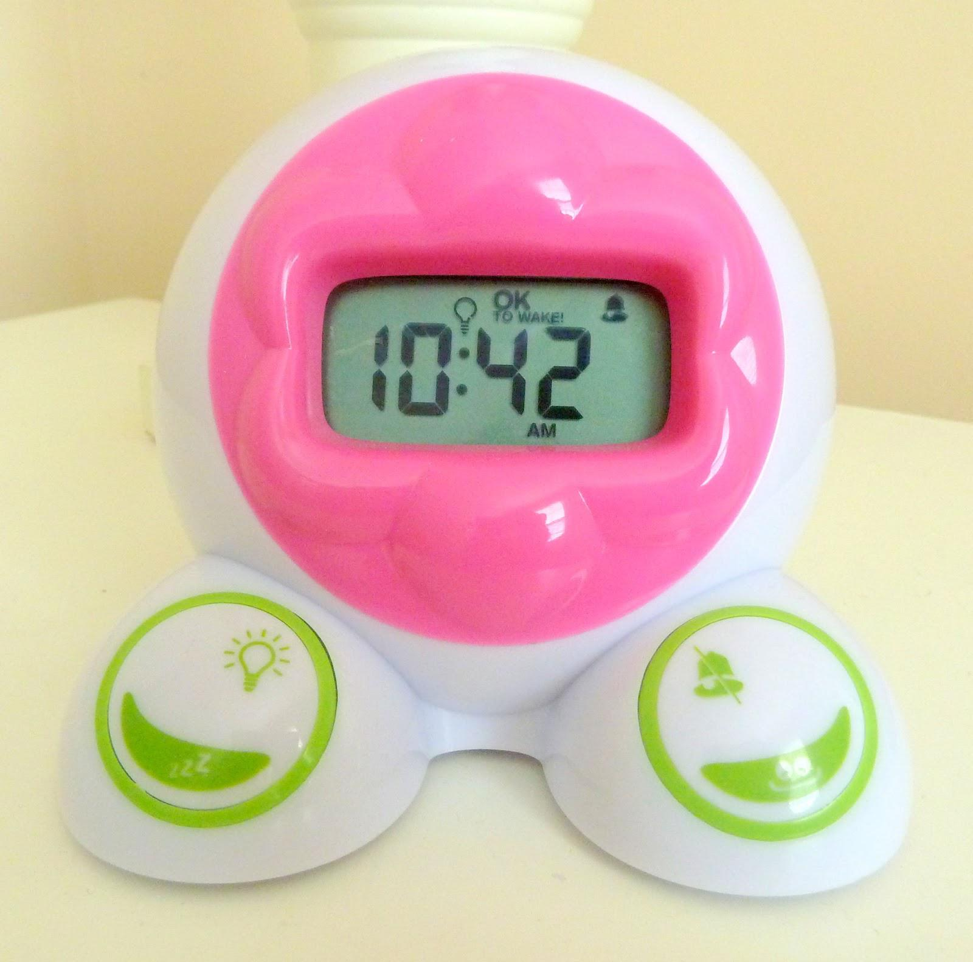
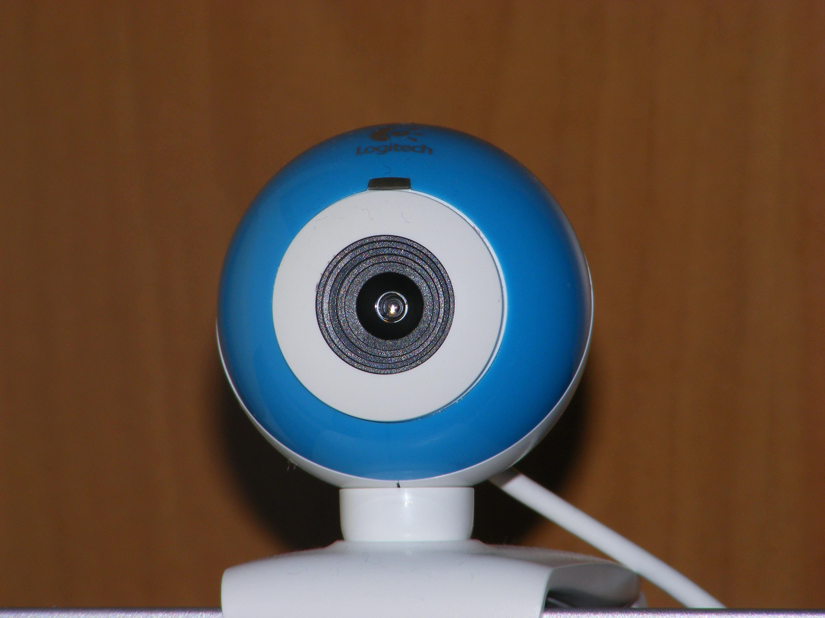
Known and Unknown separation
N >= th
CLOCK
N < th

Slide 7

Domain Alignment
Here, in simple words, we try to get a label for the known objects using a combination of two losses, while not forcing the same distribution of objects :
$$L=L_{C_{2}}+ α_{2}L_{R_{2}}$$
The classifier is trained either to label the known object or to reject it as unknown
&

Slide 8
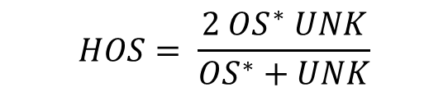
Metric Evaluation
OS*: Accuracy of the known classes.
UNK: Accuracy of the unknown classes.
HOS: Harmonic mean of the 2 accuracies.
$$HOS= \frac{2 OS^{∗} UNK}{OS^{∗}+UNK}$$
The adoption of HOS, as the criterion for performance, allowed to consider both tasks of identifying known and unknown samples.

Slide 9

Ablation for $α_{1}$ and $α_{2}$
Threshold=0
Centerloss=0

Slide 10
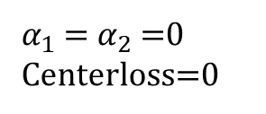
Ablation for the threshold
$α_{1}$= $α_{2}$=0
Centerloss=0

Slide 11
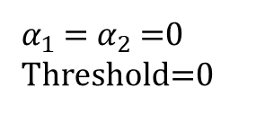
Ablation for Centerloss
$α_{1}$= $α_{2}$=0
Threshold=0

Slide 12
Domain Shift
$α_{1}$= $α_{2}$=1.5, Threshold=-0.4, Centerloss=0.

Slide 13
Improvements
Problems:
Low Performance: AUROC & HOS
Domain Shift(real world)
Limited resources
Centerloss implementation
Possible Solutions:
More exhaustive training
Improved database
Early stopping

Slide 14
Thank you for your attention!
GitHub Repository:
https://github.com/FelipeCorredor73/DAAI_OPEN_SET_ROS.git

