Slide 1

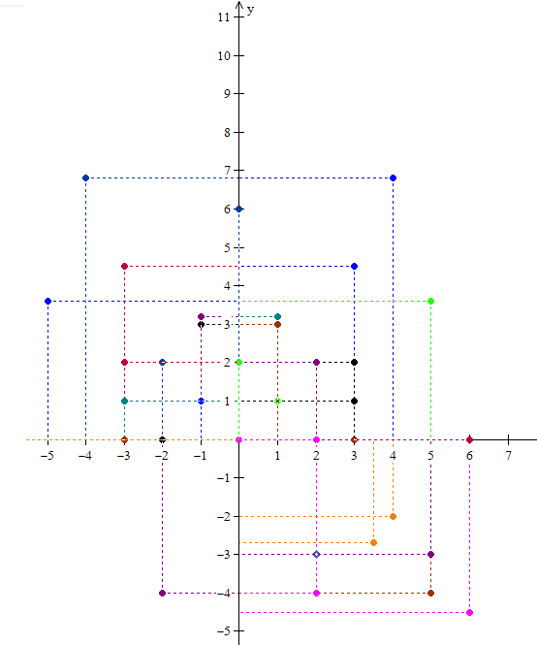
Arvore de busca KD-Tree
Estrutura de Dados KD-Tree
Felipe Ferreira
eng.ffn@gmail.com

Slide 2
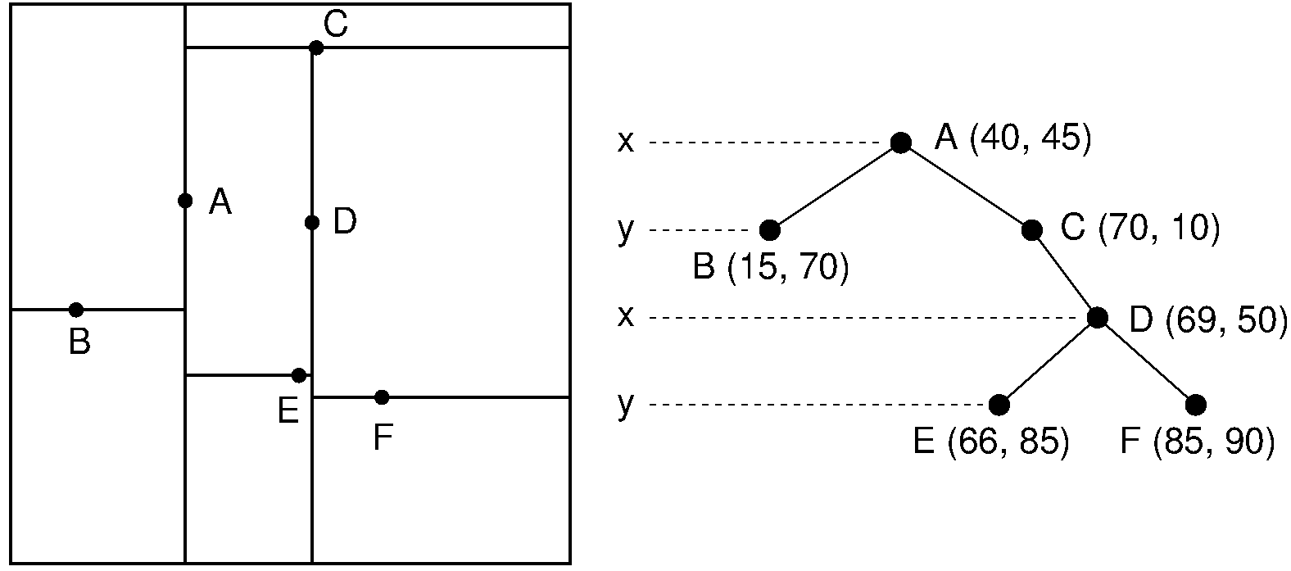

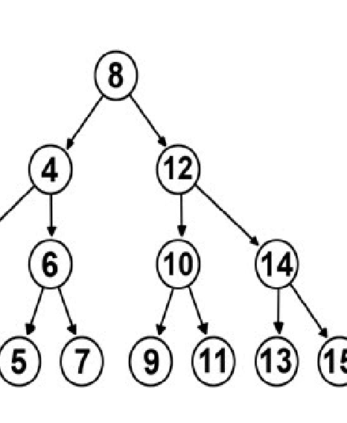
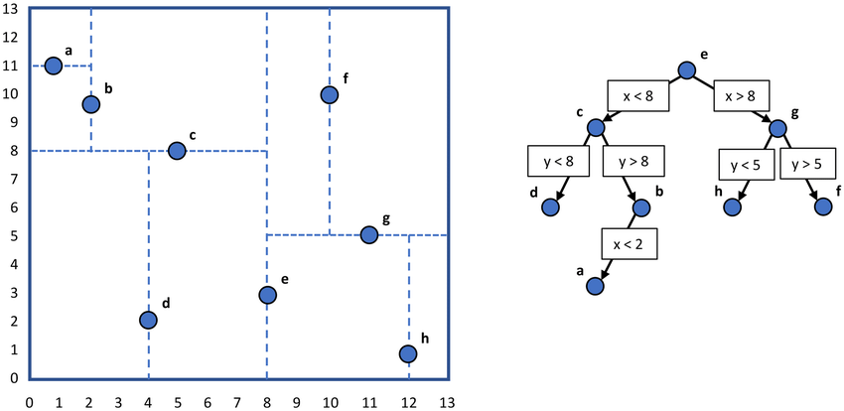
Estrutura ABB e KD-Tree

Slide 3
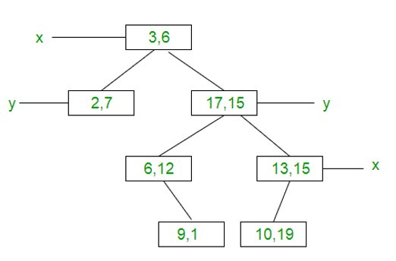
Exemplo De Inserção Típica
1.
6.
2.
4.
3.
(3, 6), (17, 15), (13, 15), (6, 12)
(9, 1), (2, 7), (10, 19)
7.
5.

Slide 4
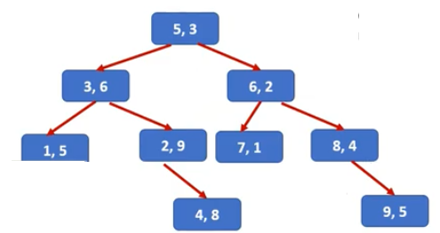
Criando Arvore Balanceada
(6 , 2), (7, 1), (3, 6), (2, 9), (4, 8), (8, 4), (5, 3), (1, 5), (9, 5);
(Sort X) Dim;
(1 , 5), (2, 9), (3, 6), (4, 8), (5, 3), (6, 2), (7, 1), (8, 4), (9, 5);
(Sort Y) Dim;
(1, 5), (3, 6), (4, 8), (2, 9) , (5, 3), (7, 1), (6, 2), (8, 4), (9 , 5);
(Sort X) Dim;
(1, 5), (3, 6), (2, 9), (4 , 8), (5, 3), (7, 1), (6, 2), (8, 4), (9 , 5);

Slide 5
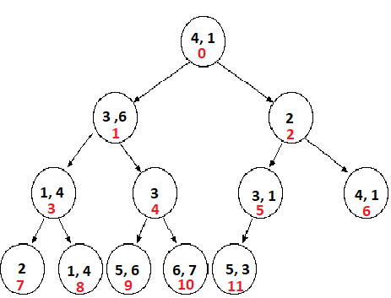
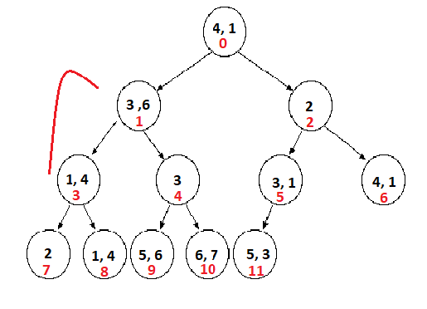
Analisando HeapMin devolvido no Algoritmo
(4, 1), (3, 6), (2), (1, 4), (3), (3, 1), (4, 1), (2), (1, 4), (5,6) , (6 , 7), (5,3)
0 1 2 3 4 5 6 7 8 9​ 10 11

Slide 6
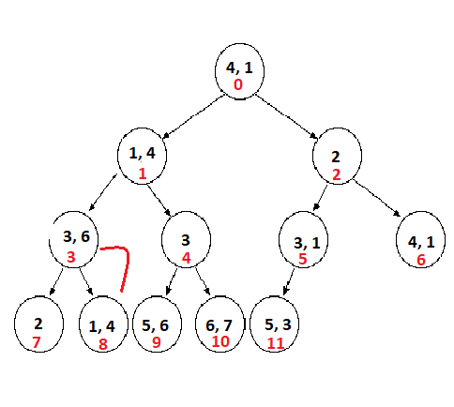
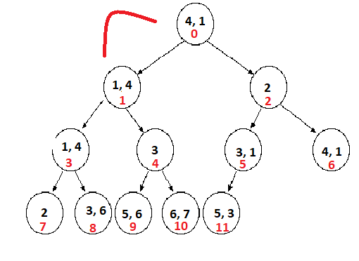

Slide 7
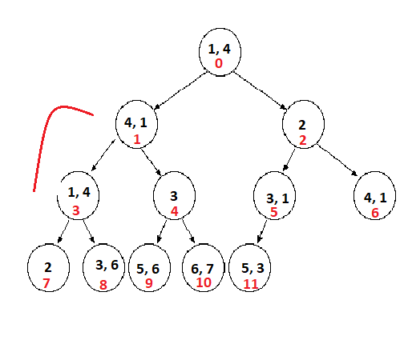
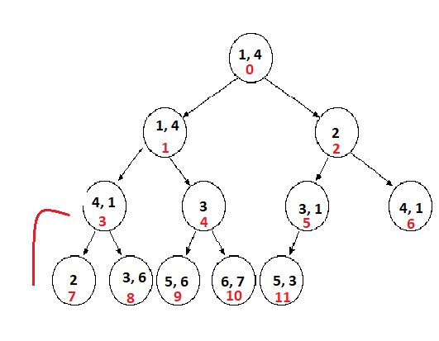

Slide 8
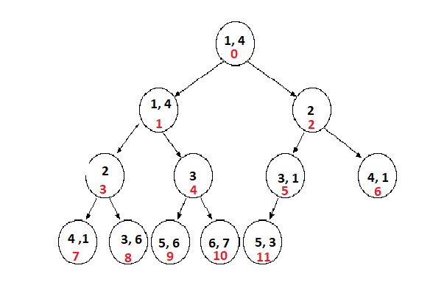
(1, 4), (1,4), (2), (2), (3), (3, 1), (4, 1), (4,1), (3,6), (5,6) , (6 , 7), (5,3)​
0 1 2 3 4 5 6 7 8 9​ 10 11​

Slide 9
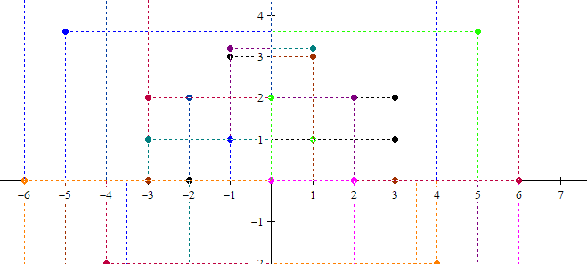

Algoritmo

