Slide 1
CHAPTER 6
Choose who you serve and how you want to be remembered.
Segmentation cuts the market. Targeting picks the slice. Positioning wins a rung in the buyer's mind.
MKTG 4333 / Principles of Marketing
An AI-Integrated Approach
Notes:
Open by asking the room a quick question. Of all the marketing decisions a firm makes in a year, which one most often goes wrong before any tactical work starts. Take two or three answers. Most students will say pricing or advertising. Tell them the answer this chapter argues for is the strategy step before any of that. Then orient them. The lecture walks the three stages in order: segmentation, targeting, positioning. The destination is one diagnostic students can run on a brand they know. The bar for the end of class is that every student can write a positioning statement for a brand and defend its target, not just describe what STP stands for.
Discussion: Of the four Ps, which decision goes wrong first when STP is missing?
Time: ~60s

Slide 2
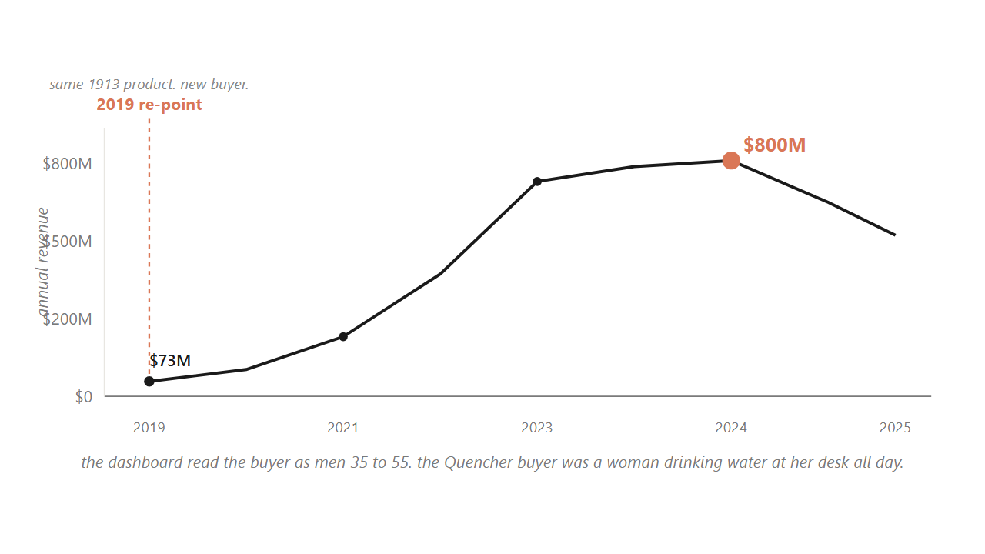
HOOK
02 / 22
Stanley almost killed its best product, then re-pointed the same 1913 cup at a buyer its dashboards were not counting.
The Quencher buyer was a woman drinking water at her desk all day, not the outdoorsman the firm had been built around since 1913.
Source: Stanley revenue trajectory, 2018 to 2024 (BusinessOfFashion, WSJ).
Notes:
Walk the room through the climb. Stanley had been selling rugged insulated bottles since 1913, mostly to men aged 35 to 55 doing outdoor work. Inside that picture the 40-ounce Quencher looked so minor that Stanley had nearly stopped making it. The actual buyer was a woman drinking water at her desk all day, found on a shopping blog the firm was not even reading. Stanley kept the heritage mark, re-pointed the product with pastel drops, and revenue went from about 73 million in 2019 to past 750 million by 2023. Pause here and ask the room what changed. Nothing about the cup. The buyer changed. That is the chapter in one example. Tell students they will see this same move with two other brands by the end of class.
Discussion: Stanley did not change the cup. So what changed? Name it as specifically as you can.
Time: ~75s

Slide 3
PART 1 OF 5
1
Part 1. One model: segment, target, position.
Three stages, in order. We build the funnel once and return to a named stage in every section.

Slide 4
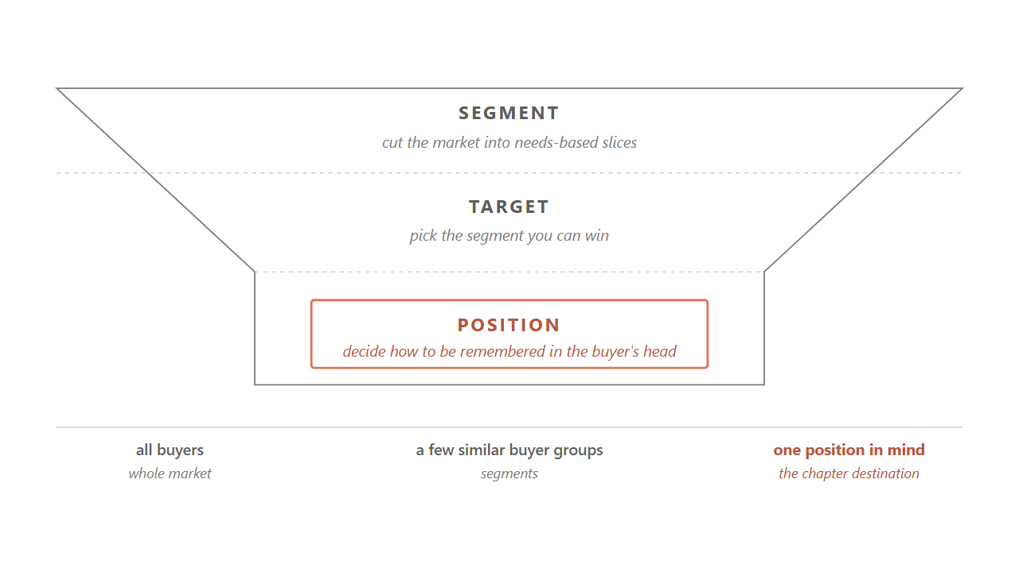
6.1 / THE MODEL
04 / 22
STP is three stages in order, and the chapter returns to a named stage in every section.
Segment the market. Target the slice you can win. Position the brand in the mind of the buyers you chose.
Source: Kotler, Keller & Chernev, Marketing Management 16e (2022).
Notes:
Hold up the funnel. Tell students this is the picture the whole chapter hangs on, and we are going to return to a named stage at the start of every section. Walk the three stages from the top. Segmentation cuts a wide market into a few groups whose needs are alike inside the group. Targeting picks which of those groups the firm will actually serve, which is the choice the firm is paying you to make. Positioning decides how the brand wants to be remembered in the chosen group's head. Do not let students start memorizing these three words yet. Tell them we will run the insulated-cup market through each stage and the logic will feel natural by the end.
Discussion: Why does positioning come last? What information does it need from the first two stages?
Time: ~75s

Slide 5
PART 2 OF 5
2
Part 2. Segmentation: how to cut the market.
Four bases, one deeper benefit layer, a five-test filter to keep research from masquerading as a target.

Slide 6
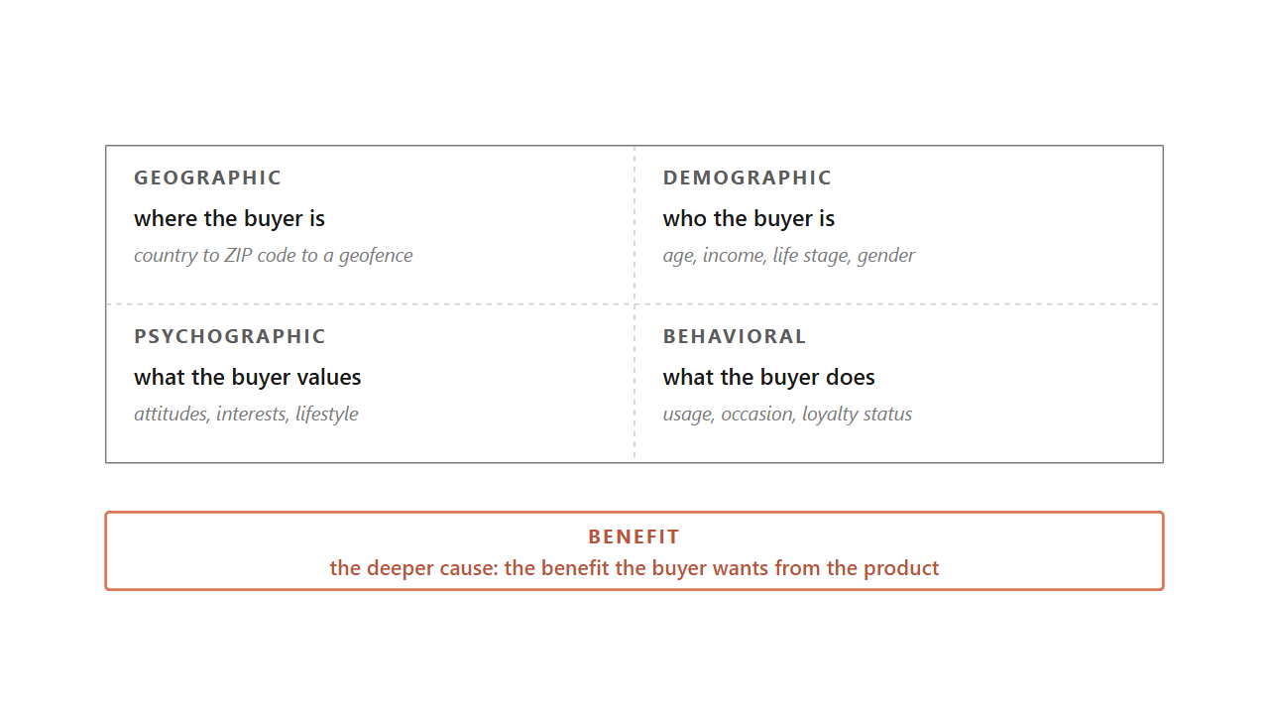
6.2 / FOUR BASES
06 / 22
Four standard bases answer four different questions about the buyer, and the working segmentations combine two or three.
Geographic asks where. Demographic asks who. Psychographic asks what the buyer values. Behavioral asks what the buyer does.
Source: Kotler et al. (2022); Smith, Journal of Marketing (1956).
Notes:
Walk the four bases as four different questions about the same buyer. Where the buyer is, who the buyer is, what the buyer believes, what the buyer actually does. Each one is useful, none of them is enough alone, and a working segmentation usually combines two or three. Then surface the deeper claim underneath them. The four bases describe a segment after the fact. What actually drives the buyer is the benefit they want, which is why two people with identical age, income, and ZIP code can want completely different things from the same product. The 1968 toothpaste study cut the market on benefit and found Worriers wanting decay prevention, Sociables wanting bright teeth, Sensories wanting flavor, and Independents wanting low price. A demographic cut collapses those four into one group and misses the structure.
Discussion: Pick a category you know. What benefit cut would split it that the demographic cut would miss?
Time: ~75s

Slide 7
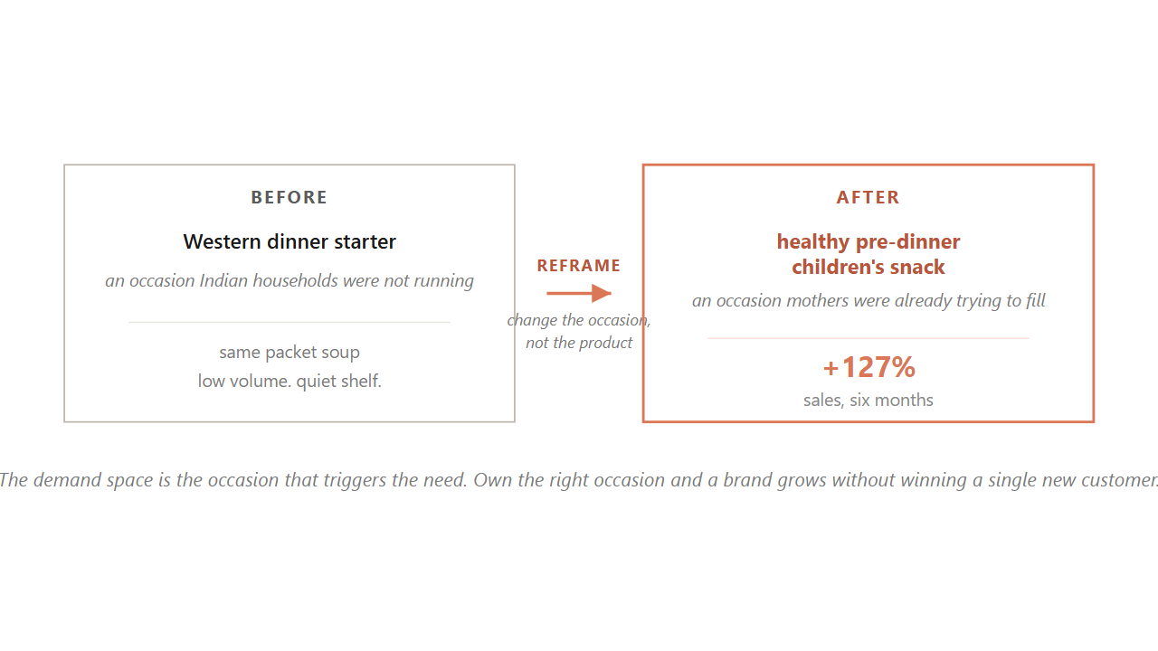
6.2 / DEMAND SPACE
07 / 22
Knorr reframed packet soup in India from a Western dinner starter to a pre-dinner children's snack, and sales rose 127% in six months.
The demand space is the occasion that triggers the need. Own the right occasion and a brand grows without winning a single new customer.
Source: Knorr India case, Unilever (2014); Christensen & Raynor on Jobs-to-be-Done.
Notes:
Hold up the Knorr case as the strongest worked example of behavioral segmentation done right. Knorr's packet soup in India was selling badly because Indian households were not running the Western dinner-starter occasion. Knorr did not reformulate the product. They reframed it. The same packet soup became a healthy pre-dinner snack for children, an occasion Indian mothers were already trying to fill. Sales rose 127 percent in six months. Tell students this is the single most useful behavioral cut they will use in their careers. The demand space is the intersection of an occasion and the need that occasion carries. One buyer can sit in several demand spaces in a day, so the same person hires coffee to wake up at seven and to socialize at four. A brand that owns the right occasion grows without winning a single new customer.
Discussion: Pick a brand you use. What occasion does it own? What occasion could it claim that it does not?
Time: ~90s

Slide 8
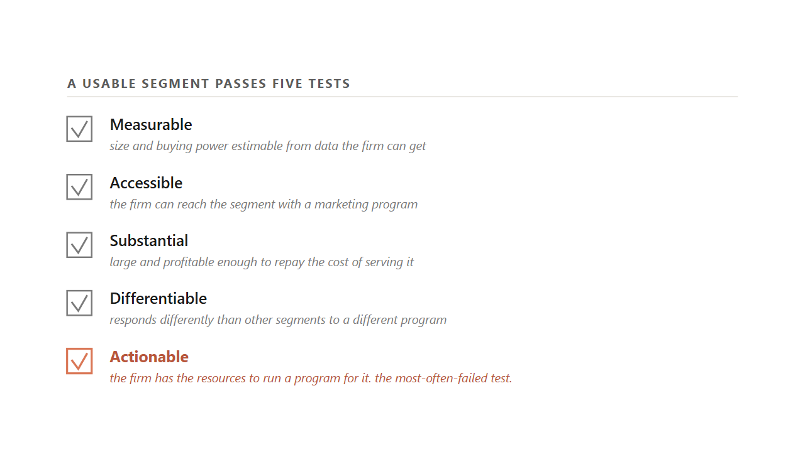
6.2.2 / THE FILTER
08 / 22
A slice is only a usable segment when it passes five tests, and actionable is the one most teams fail.
Measurable, accessible, substantial, differentiable, actionable. A slice that fails any one is research, not a target.
Source: Kotler et al. (2022); Wedel & Kamakura, Market Segmentation 2e (Kluwer, 2000).
Notes:
Walk each criterion with a one-line test. Measurable: can the firm estimate the segment's size from data it can get. Accessible: can the firm reach the segment with a marketing program. Substantial: is the segment large and profitable enough to repay the cost of serving it. Differentiable: does the segment respond differently than others to a different program. Actionable: does the firm have the resources to actually run a program for it. Tell students the last one is the one most teams fail. A team can identify a perfect segment that the firm cannot afford to serve, and that segment is not yet a target. It is research. Then close on the named-set rule. Drop any one of the five and you are calling research a strategy.
Discussion: Which of the five most often blocks a startup from a segment it identifies?
Time: ~75s

Slide 9
PART 3 OF 5
3
Part 3. Targeting: the segment you can win.
Compatibility before attractiveness. The strategic step before the tactical step. The ethics line you do not cross.

Slide 10
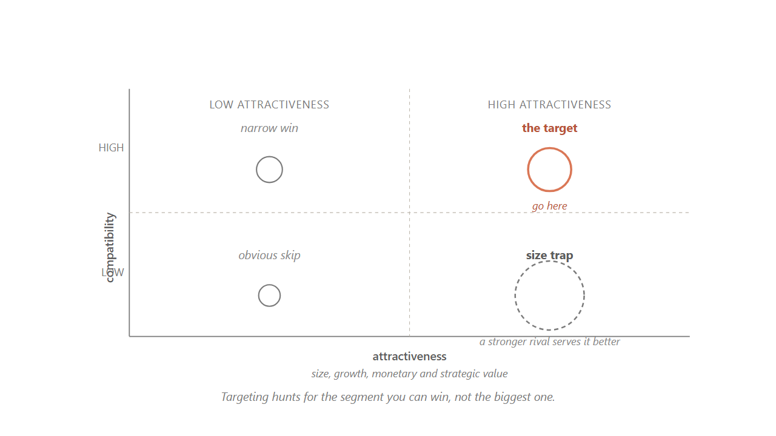
6.3 / SIZE TRAP
10 / 22
Targeting hunts for the segment you can win, because the size of the prize is what makes losing the big one expensive.
A segment can be big, growing, and profitable and still be the wrong fight if a stronger rival already serves the buyers better than you could.
Source: Kotler et al. (2022); Palmatier & Sridhar, Marketing Strategy 2e (2021).
Notes:
Hold up the grid. The two axes are target compatibility (whether you can outdo rivals at serving these buyers) and target attractiveness (whether these buyers create more value for you than another segment would). Walk the four cells. Upper-right is the segment to go after. Lower-left is the obvious skip. The lower-right is the size trap, where a tempting large bubble lives. Tell students this is where good teams lose money. A segment can be huge, growing, and full of profitable buyers, and still be the wrong target if a stronger rival already serves those buyers better. The size of the prize is exactly what makes losing the fight expensive. Targeting is not segment maximization. It is asking which slice you can win.
Discussion: Name a startup that walked into a size trap in the last three years. What was the rival they could not beat?
Time: ~80s

Slide 11
PART 4 OF 5
4
Part 4. Positioning: the work in the buyer's head.
Mental ladders. The Bernbach move. Points of parity and points of difference. The statement that holds it all.

Slide 12
6.4 / DEFINITION
12 / 22
Positioning is not what you do to a product, it is what you do to the mind of the buyer.
Avis changed how buyers ranked it without touching the cars, the prices, or the staff.
Source: Ries & Trout, Positioning (McGraw-Hill, 1981).
Notes:
Read the 1981 definition aloud. Positioning is not what you do to a product, it is what you do to the mind of the buyer. Tell the room this is the cleanest definition in the marketing literature, written 45 years ago and still right. The mind is too small to hold the flood of claims aimed at it every day, so it screens almost all of them out and keeps room for only a handful of brands per category, ranked in an order the buyer can recite without thinking. Your job in positioning is to win one of those slots and the meaning that comes with it. Then come back to Avis. The 1962 campaign changed how buyers ranked Avis without changing one thing about the cars, the prices, or the agents. That is what it looks like when positioning works.
Discussion: Pick a brand you bought recently. What rung do you put it on, and why that one?
Time: ~60s

Slide 13
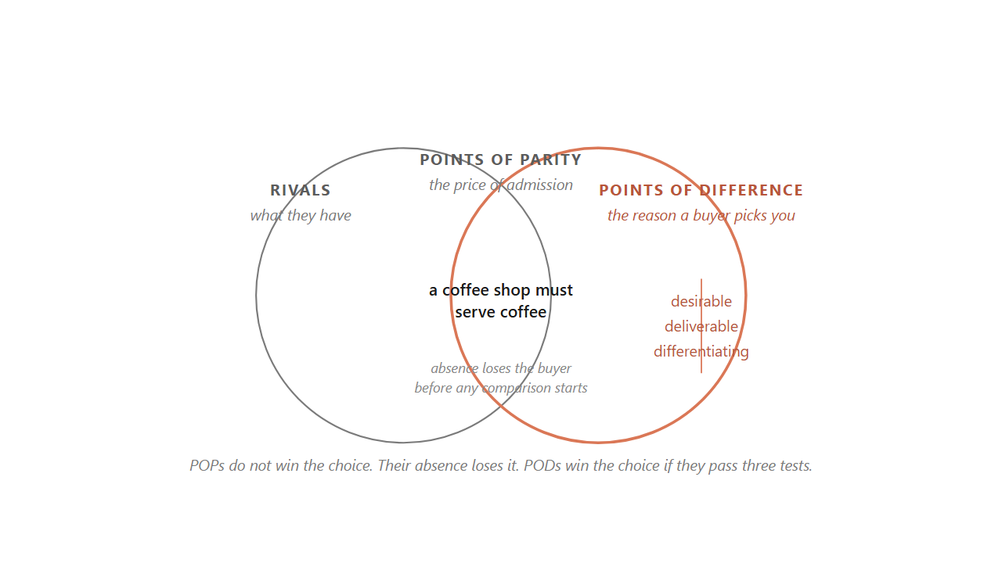
6.5 / POP AND POD
13 / 22
Points of parity earn the brand a place in the category. Points of difference win the choice.
POPs do not win the choice; their absence loses it before any comparison starts. A POD only holds if it passes three tests.
Source: Keller, Strategic Brand Management 5e (2020); Kotler et al. (2022).
Notes:
Hold up the two circles. Walk the room through the two questions every positioning decision answers. What does every buyer expect any brand in this category to deliver, and what does this one brand offer that no rival can match. The first answer is the brand's points of parity. The second is its points of difference. The overlap of the two circles is what every brand needs just to belong. The edge that sticks out is the only thing buyers will choose this brand for. Tell the room the parity side is the one managers most often forget. A coffee shop without coffee is not in the category at all. A travel agency that cannot book flights and hotels is disqualified before any comparison starts. The POD is what wins the choice, but only after the POPs have earned the brand a seat at the table.
Discussion: For your favorite brand: name two POPs and one POD. Did the POD pass all three tests?
Time: ~85s

Slide 14
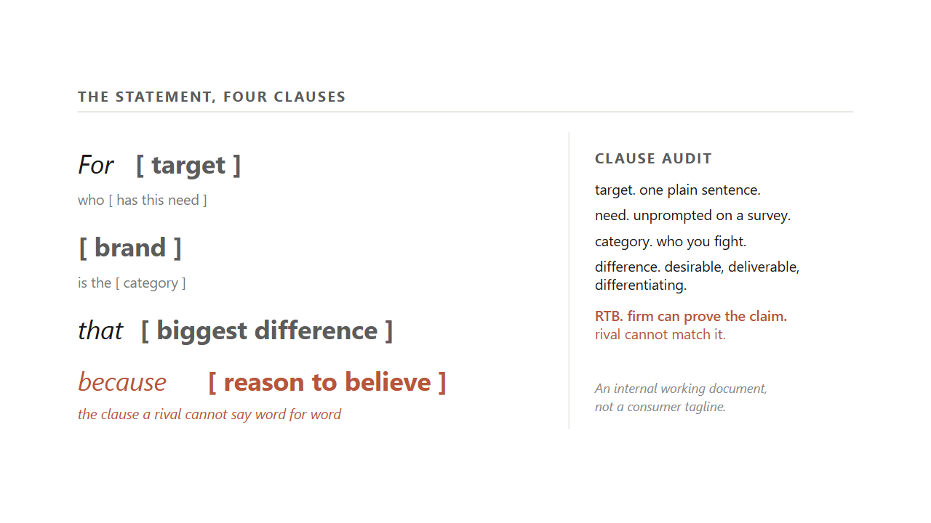
6.5.3 / THE STATEMENT
14 / 22
The positioning statement is one sentence, four clauses, and the RTB is the clause a rival cannot say word for word.
For target who need, brand is the category that biggest difference because reason to believe. An internal working document, not a tagline.
Source: Kotler et al. (2022); Palmatier & Sridhar (2021).
Notes:
Read the template aloud, slowly, clause by clause. For target who need, brand is the category that biggest difference because reason to believe. Tell students the statement is the artifact that turns everything we have done so far into something a team can work from. It is an internal working document for the brand team and the agency, not a consumer tagline. It almost never appears in an ad word for word, though every ad should trace back to one of its clauses. Walk the clause audit. Target: one plain sentence. Need: unprompted on a survey. Category: who you fight. Difference: passes desirable, deliverable, differentiating. RTB: the firm can prove the claim and the rival cannot match it. The RTB is the one most often weak because teams write it like a slogan instead of like evidence.
Discussion: Write a positioning statement for the campus coffee shop. Then audit your RTB.
Time: ~95s

Slide 15
PART 5 OF 5
5
Part 5. Reading the map, and reconciling the sharp critique.
Perceptual maps, dead air, the double-jeopardy law, mental and physical availability.

Slide 16
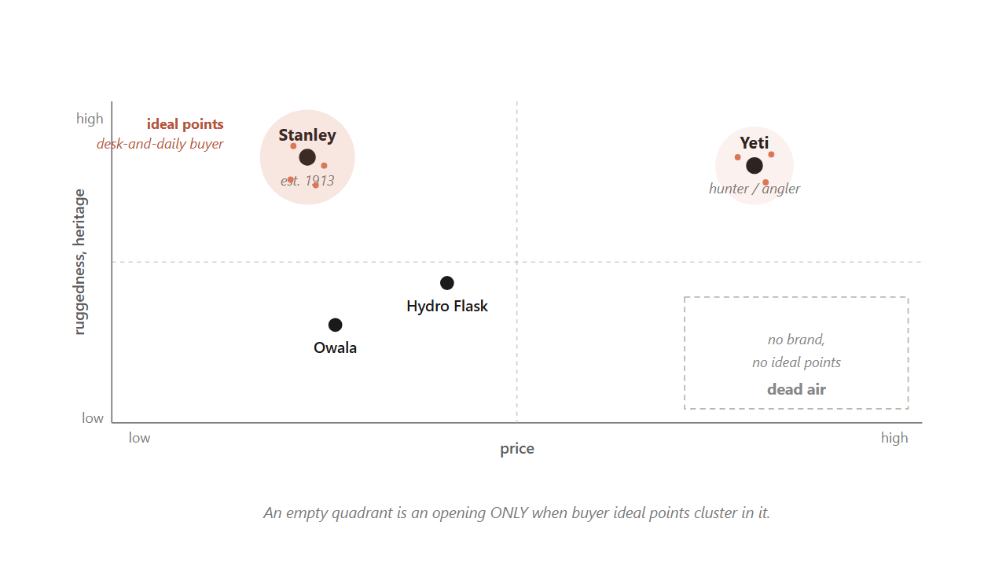
6.6 / THE MAP
16 / 22
An empty quadrant is an opening only when buyer ideal points cluster in it. Otherwise it is dead air.
The brand-only map hides which yardstick the buyer is using. The joint-space map shows where the demand actually lives.
Source: Hauser & Koppelman, JMR 16 (1979); Wedel & Kamakura (2000).
Notes:
Hold up the map. Tell students this is the single most reusable tool from the chapter. The mental ladder ranked brands on one line. The map shows several brands at once on two attributes, which is closer to how a buyer's mind actually compares options. Walk the insulated-drinkware example. Stanley sits upper-left, mid price and high heritage from 1913. Yeti sits upper-right, premium with a hunter and angler story. Hydro Flask and Owala fill the middle. Now look at the lower-right quadrant: empty, looks like an opening. Pause here. Tell the room the load-bearing move is to lay buyer ideal points on the same canvas. The ideal-point clusters sit on the existing brands, not in the empty corner. That corner is dead air the incumbents already priced in. An empty quadrant is an opening only when buyer ideal points cluster in it.
Discussion: What axes would you draw for the streaming-music category? Where do the ideal points cluster?
Time: ~95s

Slide 17
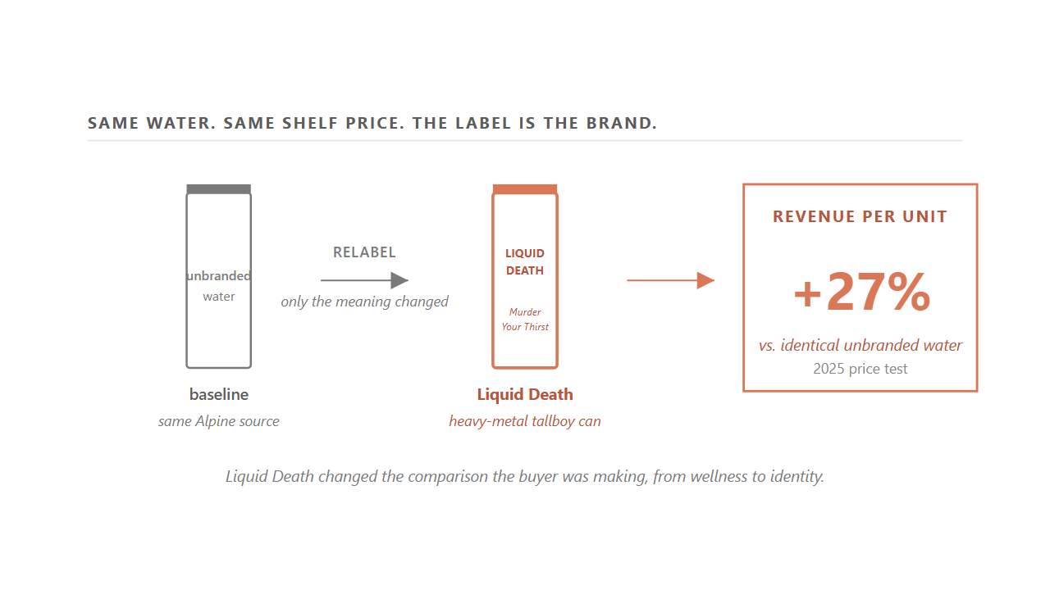
6.6.2 / REFRAME
17 / 22
Liquid Death entered a flat category by changing the comparison the buyer was making, and earned 27% more revenue per unit at the same shelf price.
The water never changed. The meaning did. A position built on identity does not care whether the can holds water or caffeine.
Source: Liquid Death Series E filings (2024); 2025 price test (Liquid Death internal study).
Notes:
Walk the Liquid Death case as the central worked example of positioning. In 2018 bottled water was a mature, low-margin shelf where every brand competed on the same notes of purity and wellness. Mike Cessario left the product ordinary on purpose, real Alpine water in a 16-ounce tallboy can, and put all the work on the meaning. The can borrowed the look of cheap beer. The tagline was Murder Your Thirst. The whole identity read as the opposite of a wellness brand. Tell students what changed was the comparison the buyer was making. Against Smartwater the brand reads too loud. Against wellness culture itself, the can offers a different identity. The 2025 price test makes the point concrete. Shown the same Alpine water at the same shelf price, the can labeled Liquid Death earned about 27 percent more revenue per unit than the identical unbranded water. That is the cash value of the meaning alone.
Discussion: What other categories are ripe for a Liquid Death style reframe? Why those?
Time: ~100s

Slide 18
6.7.2 / RECONCILIATION
18 / 22
STP picks the category the brand competes in. The penetration laws govern growth once that choice is locked.
Toyota's launch of Lexus was the STP move. Growing Lexus afterward was a penetration question. Two laws, two jobs.
Source: Sharp (2010); Kotler et al. (2022); Toyota Lexus launch case.
Notes:
Pose the reconciliation as the chapter's intellectual hinge. The two sides look like they contradict each other. STP says pick a small slice and serve it deeply. The penetration laws say reach more category buyers, not the same buyers harder. Tell the room they reconcile the moment you give each one its own job. STP chooses which category a brand competes in and what it wants to mean inside it. The penetration laws describe how the brand grows once that choice is locked. Walk Toyota's launch of Lexus as the worked case. Choosing the Lexus name, the luxury frame, the dealer separation from Toyota dealers, was the STP move. Growing Lexus afterward was a penetration question. Lexus pushed for more dealers and more buying occasions, not harder loyalty from the owners it already had. The size of the slice is not the real argument. The argument is which question you are answering.
Discussion: What is the STP question for your favorite brand right now? What is the penetration question?
Time: ~85s

Slide 19
CLOSING
Closing. Three brands, one diagnostic.
Stanley, Trader Joe's, Liquid Death. Then the four-step diagnostic you carry into a client project.

Slide 20
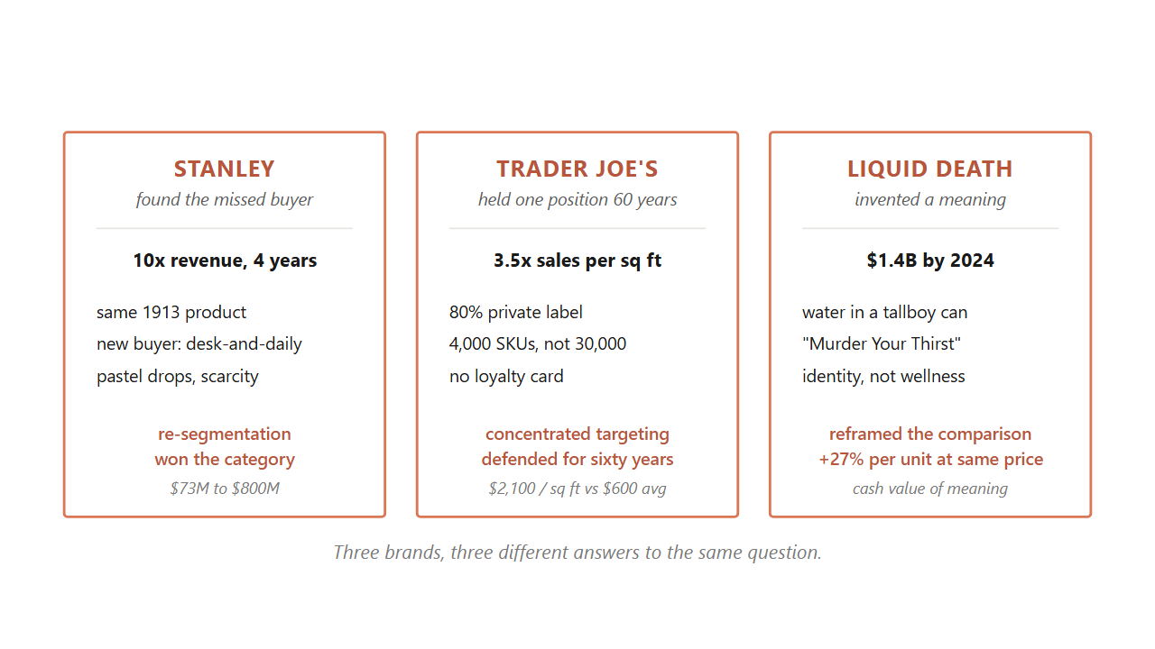
6.8 / THREE BRANDS
20 / 22
Three brands, three different answers to the same question of who you serve and what you mean to them.
Stanley re-pointed the same product at a missed buyer. Trader Joe's held one position for sixty years. Liquid Death invented a meaning.
Source: Composite of the three running cases. Sources for each are listed on the section slides above.
Notes:
Walk the three brands one more time as worked applications of the chapter. Stanley found a buyer its own dashboards were not counting. The 1913 product never changed. Revenue moved from about 73 million to past 750 million in four years because the segment was re-pointed. Trader Joe's did the opposite. It picked one narrow buyer in 1967 and held that concentrated position for almost sixty years by defending three points of difference together. Holding the position is itself the advantage. Liquid Death entered a flat category by inventing a meaning no one had claimed. The water never changed. The 27 percent revenue premium at the same shelf price is the cash value of the meaning alone. Tell the room these are three different answers to the same question: which buyers do you serve, and what do you want to mean to them.
Discussion: Which of the three commitments is most fragile? Which is most defensible? Why?
Time: ~105s

Slide 21
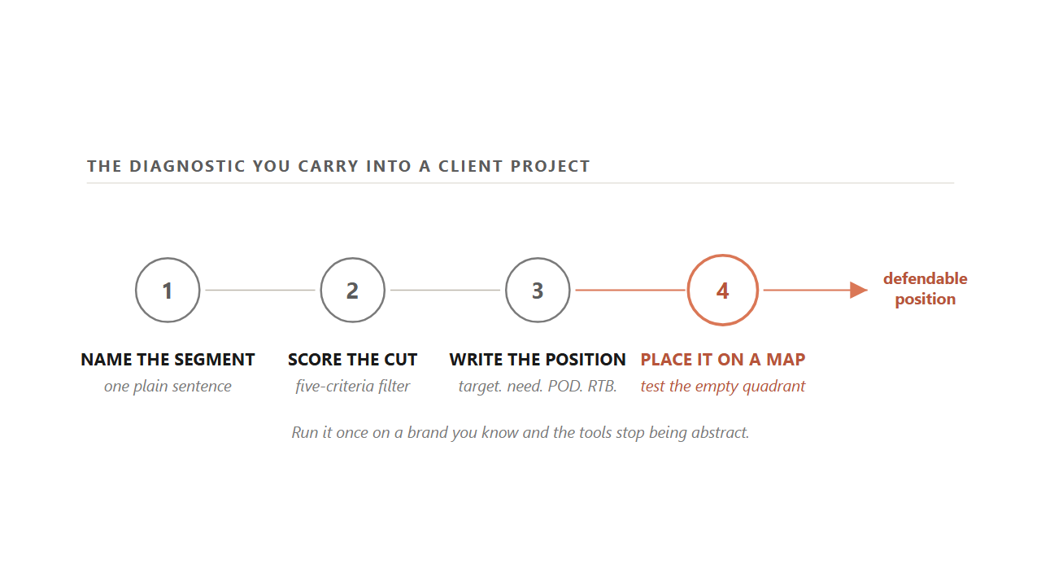
6.9 / THE DIAGNOSTIC
21 / 22
The four-step diagnostic you carry into a client project, in the order the chapter teaches it.
Name the segment in one sentence. Score it on the five criteria. Write the positioning statement. Place the brand on a map and test the empty quadrant.
Source: Synthesis of Kotler et al. (2022), Ries & Trout (1981), Sharp (2010).
Notes:
Wrap by giving the room the diagnostic they will use on client projects. Walk it in order. One: name the segment the brand serves in one plain sentence. If you cannot say it in a sentence, the brand is chasing nobody in particular, which is the everybody trap. Two: score that segment on the five criteria from Part 2. Measurable, accessible, substantial, differentiable, actionable. A slice that fails any one is research, not a target. Three: write the position. Fill the template. For target who need, brand is the category that biggest difference because reason to believe. Test the POD against desirable, deliverable, differentiating, and cut any clause a rival could say word for word. Four: place the brand on a perceptual map. Pick the two attributes the buyer actually cares about, plot the brand and two rivals, find the empty quadrant. Then ask the harder question: are there buyer ideal points in that corner, or is it dead air? Run it once on a brand you know and the tools stop being abstract.
Discussion: Pick a brand you bought this week. Run all four steps on it before the next class.
Time: ~100s

Slide 22
TAKEAWAYS
22 / 22
Choose who you serve, decide how you want to be remembered, and read the map for the empty quadrant before you walk into it.
STP picks the rung the brand asks the buyer to remember it on. Chapter 7 is the work of building and defending that web.
Notes:
Wrap the class by summarizing the moves students can run on Monday morning. One: cut on benefit, not just on label. The four bases describe a segment after the fact, but the benefit is the cause of the choice. Two: run the five-criteria filter before you call a slice a target. Actionable is the test most teams fail. Three: walk the strategic step before the tactical step. Translate the strategy sentence into the customer profile, and score the profile on effectiveness and cost efficiency. Four: claim the rung the buyer has already given you, the cheapest positioning move available. Five: write the position in the four-clause template and audit each clause. Six: read the perceptual map only after you have laid the buyer ideal points on it. The next chapter walks how memory itself decides a purchase, the work of building and defending the brand's web of associations.
Discussion: Of the six moves on this slide, which one will you actually run on a brand you know this week?
Time: ~80s

