Slide 1
CHAPTER 6
Choose who you serve and how you want to be remembered.
Segmentation cuts the market. Targeting picks the slice. Positioning wins a rung in the buyer's mind.
MKTG 4333 / Principles of Marketing
An AI-Integrated Approach
Notes:
Open by asking the room a quick question. Of all the marketing decisions a firm makes in a year, which one most often goes wrong before any tactical work starts. Take two or three answers. Most students will say pricing or advertising. Tell them the answer this chapter argues for is the strategy step before any of that. Then orient them. The lecture walks the three stages in order: segmentation, targeting, positioning. The destination is one diagnostic students can run on a brand they know. The bar for the end of class is that every student can write a positioning statement for a brand and defend its target, not just describe what STP stands for.
Discussion: Of the four Ps, which decision goes wrong first when STP is missing?
Time: ~60s

Slide 2
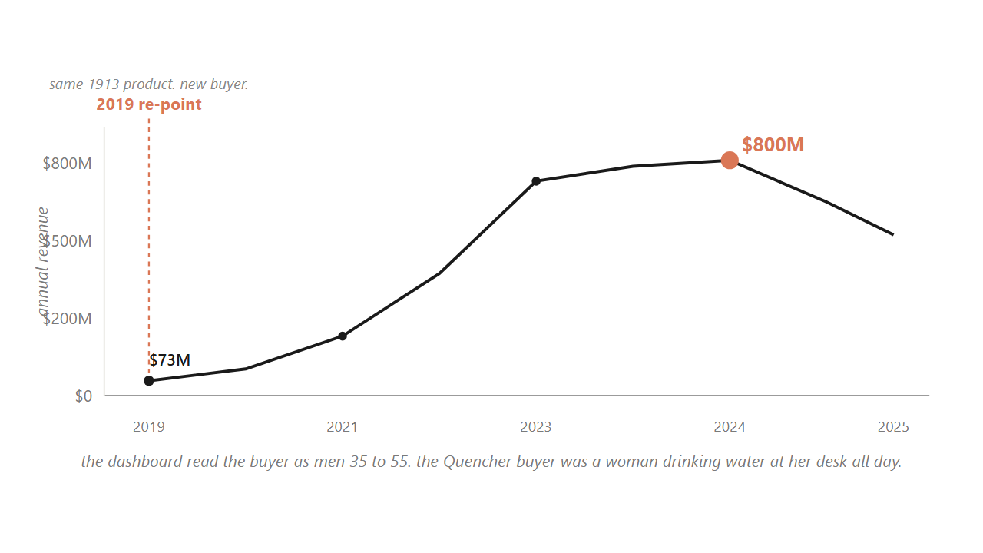
HOOK
02 / 51
Stanley almost killed its best product, then re-pointed the same 1913 cup at a buyer its dashboards were not counting.
The Quencher buyer was a woman drinking water at her desk all day, not the outdoorsman the firm had been built around since 1913.
Source: Stanley revenue trajectory, 2018 to 2024 (BusinessOfFashion, WSJ).
Notes:
Walk the room through the climb. Stanley had been selling rugged insulated bottles since 1913, mostly to men aged 35 to 55 doing outdoor work. Inside that picture the 40-ounce Quencher looked so minor that Stanley had nearly stopped making it. The actual buyer was a woman drinking water at her desk all day, found on a shopping blog the firm was not even reading. Stanley kept the heritage mark, re-pointed the product with pastel drops, and revenue went from about 73 million in 2019 to past 750 million by 2023. Pause here and ask the room what changed. Nothing about the cup. The buyer changed. That is the chapter in one example. Tell students they will see this same move with two other brands by the end of class.
Discussion: Stanley did not change the cup. So what changed? Name it as specifically as you can.
Time: ~75s

Slide 3
PART 1 OF 5
1
Part 1. One model: segment, target, position.
Three stages, in order. We build the funnel once and return to a named stage in every section.

Slide 4
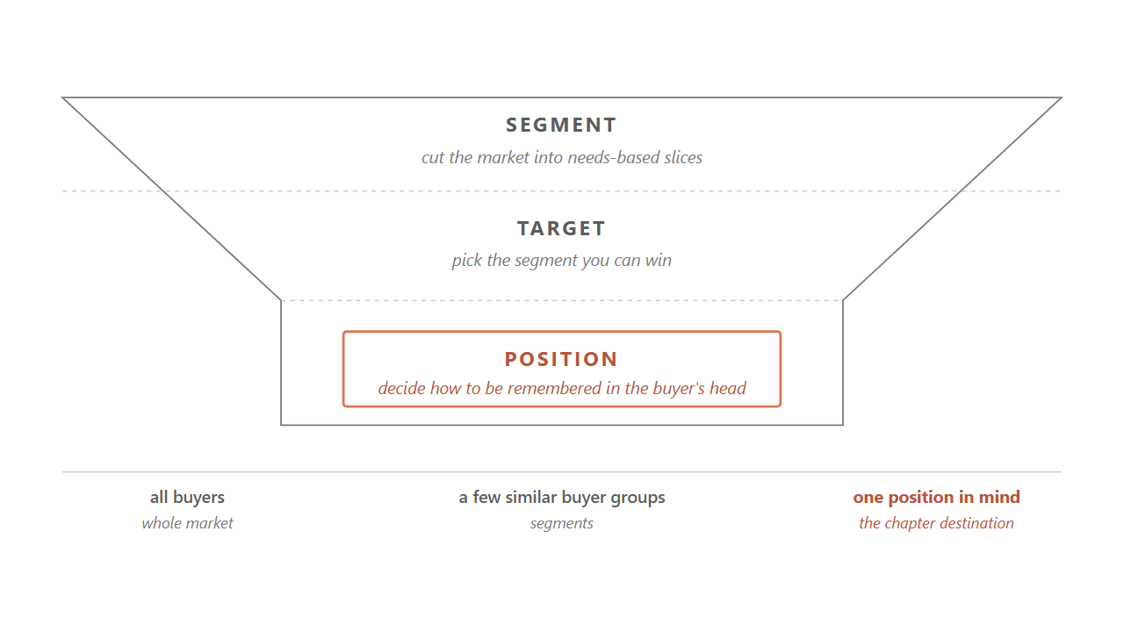
6.1 / THE MODEL
04 / 51
STP is three stages in order, and the chapter returns to a named stage in every section.
Segment the market. Target the slice you can win. Position the brand in the mind of the buyers you chose.
Source: Kotler, Keller & Chernev, Marketing Management 16e (2022).
Notes:
Hold up the funnel. Tell students this is the picture the whole chapter hangs on, and we are going to return to a named stage at the start of every section. Walk the three stages from the top. Segmentation cuts a wide market into a few groups whose needs are alike inside the group. Targeting picks which of those groups the firm will actually serve, which is the choice the firm is paying you to make. Positioning decides how the brand wants to be remembered in the chosen group's head. Do not let students start memorizing these three words yet. Tell them we will run the insulated-cup market through each stage and the logic will feel natural by the end.
Discussion: Why does positioning come last? What information does it need from the first two stages?
Time: ~75s

Slide 5
6.1 / WHY STP EXISTS
05 / 51
A brand that means something to everyone means something specific to no one.
The buyer's head holds room for three to seven brands per category, often closer to three. A brand with no clear claim never makes the list.
Source: Ries & Trout, Positioning (McGraw-Hill, 1981).
Notes:
Tell students the failure this chapter is trying to prevent has a name. The everybody trap. A firm that refuses to choose a buyer tries to serve all of them and ends up standing for nothing in particular. Think of a radio station that plays every genre to please everyone. Nobody tunes in on purpose because it is no one's favorite anything. Tie this to the mechanical reason. The buyer's head holds room for only three to seven brands per category, often closer to three. So a brand without a clear claim never makes the buyer's short list, no matter how much money it spends. The fix is to pick a target, claim one specific thing, and accept the cost of the buyers who wanted something else.
Discussion: Name a brand you think is in the everybody trap right now. Why?
Time: ~60s

Slide 6
6.1 / THREE RESPONSES
06 / 51
There are three ways to answer that buyers differ, and the middle path is the default in 2026.
1
Mass marketing. One offer for everyone. Ford's Model T worked until Chevrolet split the market by color and price.
2
Segment-based marketing. A few groups, each with its own offer. The default in 2026 for most consumer categories.
3
One-to-one marketing. Each buyer is a slice of one. Stitch Fix assembling a box against one style file.
Source: Smith, Journal of Marketing (1956); Kotler et al. (2022).
Notes:
Reveal each response in order. Mass marketing treats everyone as one group and sells them the same thing. Ford's Model T ran this way for 15 years, one car in one color at one price, until Chevrolet split the market in the late 1920s and the single black car stopped being enough. Segment-based marketing cuts buyers into a few groups that resemble each other and serves one or more of them. That is the default in 2026 for most consumer categories, because buyers differ too much for one offer and tailoring is cheap enough that segmenting pays. One-to-one marketing pushes segmentation to the limit, treating each buyer as a slice of one. It works when each buyer's lifetime value is high enough to cover the cost. For most categories the middle path is the answer.
Discussion: Pick one category where mass marketing still works. What makes it the exception?
Time: ~60s

Slide 7
PART 2 OF 5
2
Part 2. Segmentation: how to cut the market.
Four bases, one deeper benefit layer, a five-test filter to keep research from masquerading as a target.

Slide 8
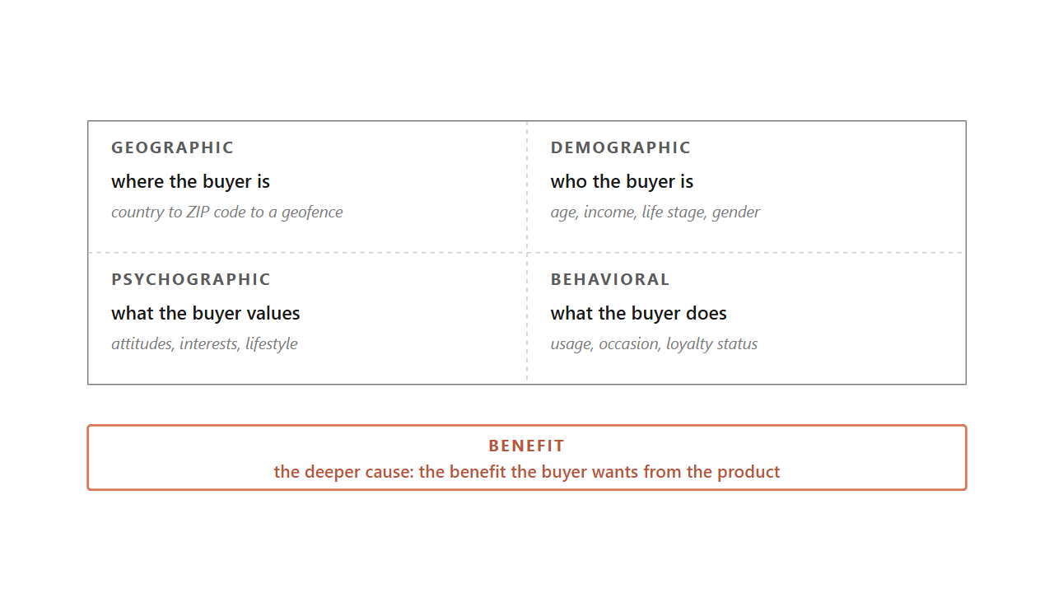
6.2 / FOUR BASES
08 / 51
Four standard bases answer four different questions about the buyer, and the working segmentations combine two or three.
Geographic asks where. Demographic asks who. Psychographic asks what the buyer values. Behavioral asks what the buyer does.
Source: Kotler et al. (2022); Smith, Journal of Marketing (1956).
Notes:
Walk the four bases as four different questions about the same buyer. Where the buyer is, who the buyer is, what the buyer believes, what the buyer actually does. Each one is useful, none of them is enough alone, and a working segmentation usually combines two or three. Then surface the deeper claim underneath them. The four bases describe a segment after the fact. What actually drives the buyer is the benefit they want, which is why two people with identical age, income, and ZIP code can want completely different things from the same product. The 1968 toothpaste study cut the market on benefit and found Worriers wanting decay prevention, Sociables wanting bright teeth, Sensories wanting flavor, and Independents wanting low price. A demographic cut collapses those four into one group and misses the structure.
Discussion: Pick a category you know. What benefit cut would split it that the demographic cut would miss?
Time: ~75s

Slide 9
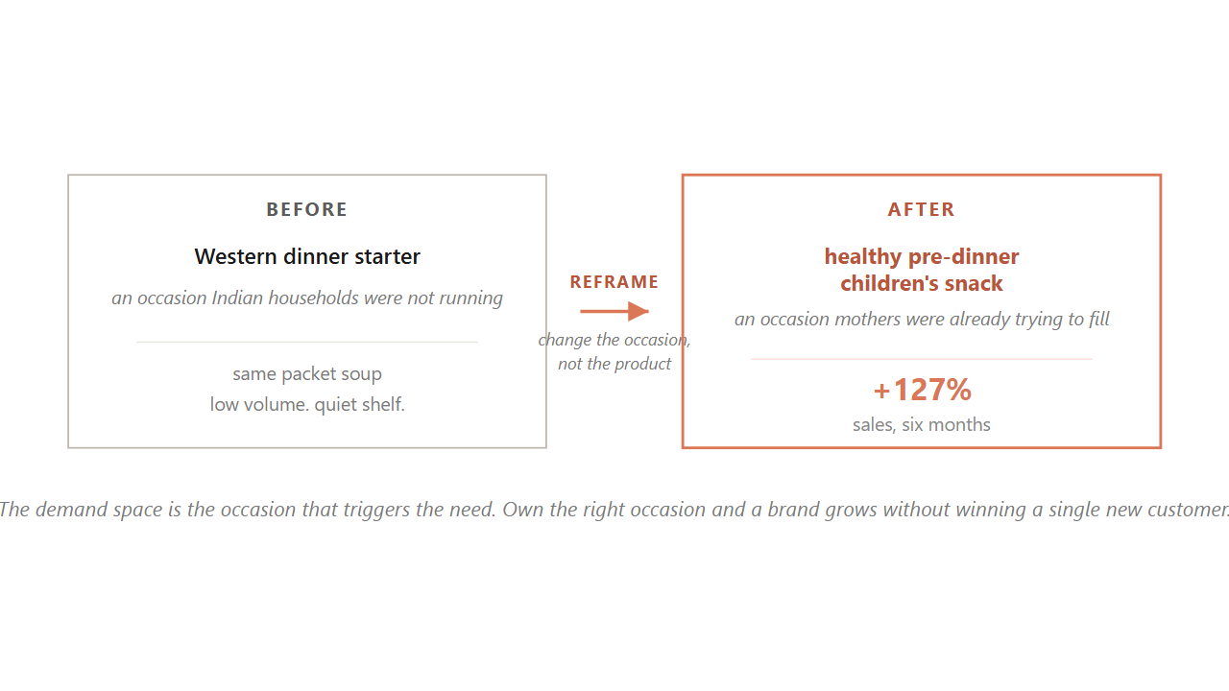
6.2 / DEMAND SPACE
09 / 51
Knorr reframed packet soup in India from a Western dinner starter to a pre-dinner children's snack, and sales rose 127% in six months.
The demand space is the occasion that triggers the need. Own the right occasion and a brand grows without winning a single new customer.
Source: Knorr India case, Unilever (2014); Christensen & Raynor on Jobs-to-be-Done.
Notes:
Hold up the Knorr case as the strongest worked example of behavioral segmentation done right. Knorr's packet soup in India was selling badly because Indian households were not running the Western dinner-starter occasion. Knorr did not reformulate the product. They reframed it. The same packet soup became a healthy pre-dinner snack for children, an occasion Indian mothers were already trying to fill. Sales rose 127 percent in six months. Tell students this is the single most useful behavioral cut they will use in their careers. The demand space is the intersection of an occasion and the need that occasion carries. One buyer can sit in several demand spaces in a day, so the same person hires coffee to wake up at seven and to socialize at four. A brand that owns the right occasion grows without winning a single new customer.
Discussion: Pick a brand you use. What occasion does it own? What occasion could it claim that it does not?
Time: ~90s

Slide 10
6.2.1 / BENEFIT
10 / 51
Benefit segmentation belongs underneath the four bases because the benefit is the cause of the buyer's choice.
The 1968 toothpaste study split the market into Worriers, Sociables, Sensories, and Independents. Same age and income, four different brand choices.
Source: Haley, Journal of Marketing 32 (1968).
Notes:
Walk the worked case live. The 1968 toothpaste benefit study fielded a 20 to 30 item rating battery measuring which benefits buyers cared about. Cluster analysis on the rating matrix recovered four groups. Worriers wanted decay prevention and bought Crest. Sociables wanted bright teeth and bought Ultra Brite. Sensories wanted flavor and bought Stripe. Independents wanted lowest price and bought private label. Tell students the deep lesson. Those four buyers can share the same demographic cell and make four different choices. The benefit is the cause, the demographic is downstream. Then add the practical bridge. You recover the benefit groups with the survey, then layer a descriptor profile on top so the segments become reachable on a media platform. Without the descriptors, the cuts are clean but unusable.
Discussion: What benefit do you actually want from your phone, separate from what the brand says?
Time: ~70s

Slide 11
6.2.1 / B2B
11 / 51
The four bases carry straight into B2B markets with the variables swapped, and behavior beats firmographics.
Hillrom switched from cutting hospital customers by bed count to cutting by behavior, found the cost of serving prime accounts ran 4 to 5 times too high, and lifted operating income per employee by 51%.
Source: Kotler et al. (2022) on Hillrom; Webster & Wind B2B framework (1972).
Notes:
Tell students the four bases were written for consumers but carry straight into business markets with the variables swapped out. Firmographics replace demographics: industry, company size, revenue, location. In place of psychographics, what matters is the buying center, the group of people inside the firm who together sign off on a purchase. Volume and order frequency stand in for usage rate. Walk the Hillrom example. The hospital-bed maker had long cut its market by bed count, a firmographic. When it switched to a behavioral cut and split customers into key and prime accounts, it found the cost of selling to prime customers ran four to five times too high. Realigning the effort lifted operating income per employee 51 percent without adding a single new product.
Discussion: Pick a B2B firm you know. What does it cut its market on? What would a behavioral cut surface?
Time: ~65s

Slide 12
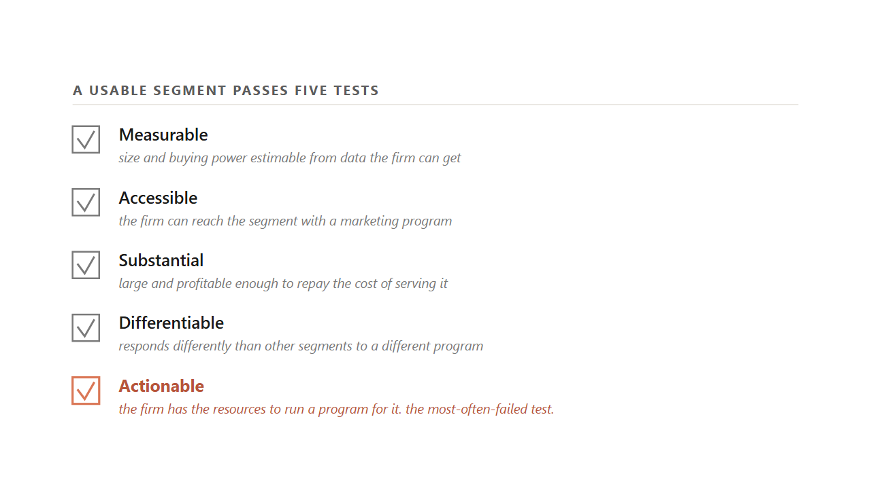
6.2.2 / THE FILTER
12 / 51
A slice is only a usable segment when it passes five tests, and actionable is the one most teams fail.
Measurable, accessible, substantial, differentiable, actionable. A slice that fails any one is research, not a target.
Source: Kotler et al. (2022); Wedel & Kamakura, Market Segmentation 2e (Kluwer, 2000).
Notes:
Walk each criterion with a one-line test. Measurable: can the firm estimate the segment's size from data it can get. Accessible: can the firm reach the segment with a marketing program. Substantial: is the segment large and profitable enough to repay the cost of serving it. Differentiable: does the segment respond differently than others to a different program. Actionable: does the firm have the resources to actually run a program for it. Tell students the last one is the one most teams fail. A team can identify a perfect segment that the firm cannot afford to serve, and that segment is not yet a target. It is research. Then close on the named-set rule. Drop any one of the five and you are calling research a strategy.
Discussion: Which of the five most often blocks a startup from a segment it identifies?
Time: ~75s

Slide 13
6.2.2 / HONESTY CHECK
13 / 51
If a team cannot describe a segment in one plain sentence, it is probably a statistical artifact the next data refresh will rearrange.
Fit between two and six segments, then keep whichever count still holds up on next quarter's data. The honesty check before any pitch.
Source: Wedel & Kamakura (2000); Kamakura & Russell, JMR (1989).
Notes:
Pose the honesty check. A team finishes a cluster analysis and presents four segments with statistically significant differences across attitudinal variables, and asks you to sign off. Walk the room through what to ask. Can someone describe each segment in one plain English sentence. If not, the segments are probably noise the next data refresh will rearrange. Then the second test: does the same cut reappear when you refit on next quarter's data. If the labels move and the centers drift, the segments were never real types of buyer. Tell students the standard production procedure is to fit between two and six segments, compare Bayesian Information Criterion on a holdout window, and pick the lowest. Segment counts above six rarely improve fit and rarely reappear on the next refit.
Discussion: Why does describing a segment in one sentence work as a noise filter?
Time: ~60s

Slide 14
6.2.2 / REFIT
14 / 51
Segmentation is not a one-time deliverable, and a 2025 monitoring framework names five lifecycle events a quarterly refit catches.
Birth, death, merge, split, drift. Stanley's slide through 2025 is the over-fit the regular refit is supposed to catch.
Source: Segment-monitoring framework (2025); Stanley fiscal 2024-2025 disclosures.
Notes:
Tell students the segmentation work is not a one-time deliverable handed to a consultancy. The customer base drifts. A 2025 monitoring framework names five lifecycle events a centroid-matching pass detects between consecutive refits. Birth is a new cluster the firm has to decide whether to serve. Death is a cluster leaving. Merge is two clusters collapsing, which signals overfit. Split is one cluster fanning out, which signals underfit. Drift is a same-identity cluster whose center has moved past a calibrated threshold. Tie this back to Stanley. The 2019-2023 boom over-fit the desk-and-daily woman. By 2025 the social channel that built the segment also read it as full, and demand cooled. The regular refit is meant to catch that earlier.
Discussion: What signal would you watch to tell a birth from a drift?
Time: ~65s
Skip if short.

Slide 15
BRIDGE
Cutting the market hands you a list of slices. Picking the slice you can win is a different question.
Next: targeting and the trap that catches teams hunting the biggest segment instead of the winnable one.

Slide 16
PART 3 OF 5
3
Part 3. Targeting: the segment you can win.
Compatibility before attractiveness. The strategic step before the tactical step. The ethics line you do not cross.

Slide 17
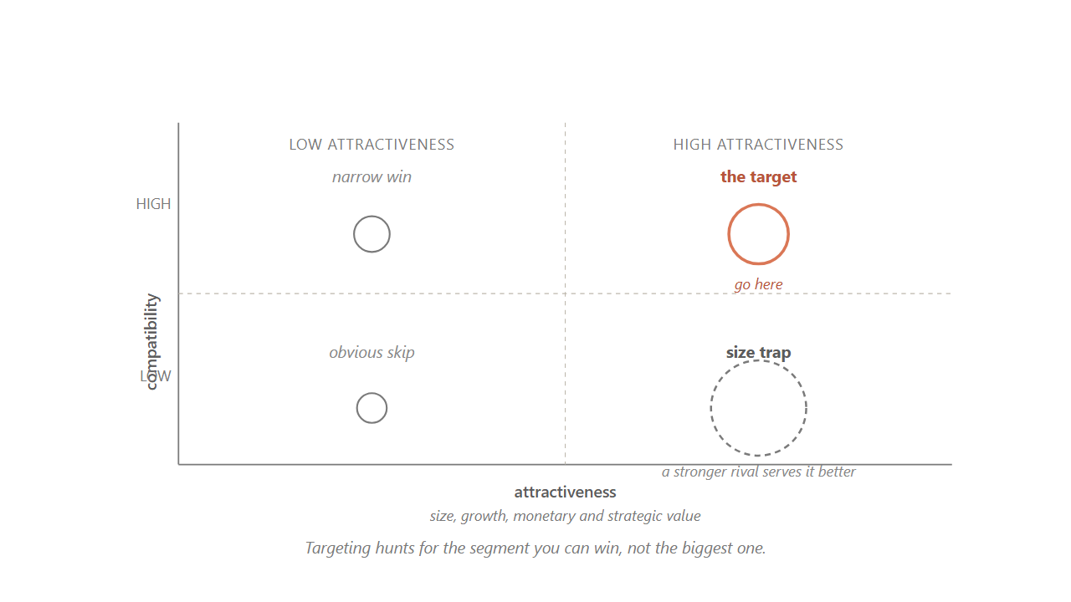
6.3 / SIZE TRAP
17 / 51
Targeting hunts for the segment you can win, because the size of the prize is what makes losing the big one expensive.
A segment can be big, growing, and profitable and still be the wrong fight if a stronger rival already serves the buyers better than you could.
Source: Kotler et al. (2022); Palmatier & Sridhar, Marketing Strategy 2e (2021).
Notes:
Hold up the grid. The two axes are target compatibility (whether you can outdo rivals at serving these buyers) and target attractiveness (whether these buyers create more value for you than another segment would). Walk the four cells. Upper-right is the segment to go after. Lower-left is the obvious skip. The lower-right is the size trap, where a tempting large bubble lives. Tell students this is where good teams lose money. A segment can be huge, growing, and full of profitable buyers, and still be the wrong target if a stronger rival already serves those buyers better. The size of the prize is exactly what makes losing the fight expensive. Targeting is not segment maximization. It is asking which slice you can win.
Discussion: Name a startup that walked into a size trap in the last three years. What was the rival they could not beat?
Time: ~80s

Slide 18
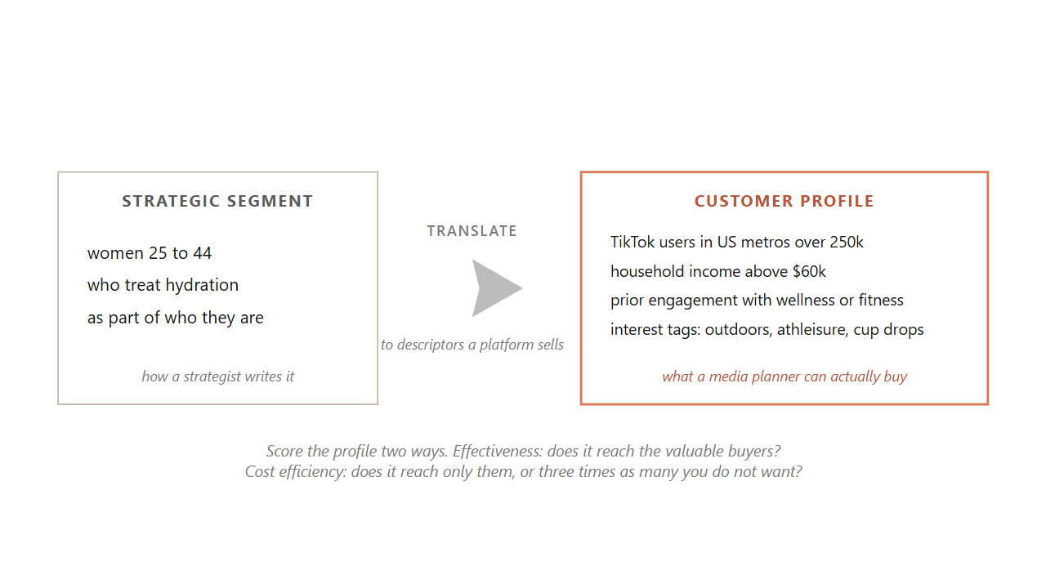
6.3 / THE BRIDGE
18 / 51
The strategic segment is how a strategist writes it. The customer profile is what a media planner can actually buy.
Translate a strategy sentence about who and why into descriptors a platform sells. The bridge between the two is the load-bearing step.
Source: Kotler et al. (2022).
Notes:
Walk the bridge. The strategic step asks two questions about you and the segment together. Can you create more value for these buyers than rivals can. And can these buyers create more value for you than another segment would. Walk the strategic step first, because there is no sense buying ads against buyers you have no business serving. Then the tactical step. A strategic segment is written the way a strategist thinks: women 25 to 44 who treat hydration as part of who they are. No ad platform sells a treats-hydration-as-identity checkbox. So you translate that sentence into descriptors a platform can target. The descriptor list is the customer profile. You score it two ways that pull against each other. Effectiveness is whether it reaches the valuable buyers. Cost efficiency is whether it reaches only those buyers or also a much larger crowd who happen to share the descriptors.
Discussion: What is the strategic-to-tactical bridge for your own brand? Write the strategy sentence in one line first.
Time: ~90s

Slide 19
6.3 / THREE STRATEGIES
19 / 51
Three targeting strategies sit on a focus-versus-breadth ladder, and the right pick is arithmetic, not principle.
1
Concentrated. One segment, served deeply. Porsche on the enthusiast. The small-firm play, the cost is no fallback.
2
Differentiated. Several segments, each with its own offer. GM's 1920s ladder beat Ford's single Model T.
3
Undifferentiated. One offer for everyone. Ford and Coca-Cola Classic once did it. Rare in 2026.
Source: Kotler et al. (2022); Smith, Journal of Marketing (1956).
Notes:
Reveal each strategy in order. Concentrated picks one segment and serves it deeply. Porsche on the sports-car enthusiast, a campus food truck on late-night vegan ramen, Liquid Death's 2018 entry. The tight focus pays off when the segment is right. It sinks you when the segment moves because there is nowhere to fall back to. Differentiated serves several segments at once, each with its own offer, accepting the cost of parallel product lines because the scale recoups it. GM's 1920s Sloan ladder of Chevrolet to Cadillac, P&G's laundry portfolio. Undifferentiated goes after everyone with one offer. Ford's Model T, Coca-Cola Classic. Rare in 2026 because a focused rival picks off the most profitable buyers. The chooser between the three is arithmetic, not principle. As buyer differences grow and tailoring gets cheaper, the answer shifts.
Discussion: Which of the three does your favorite brand use? Why is that the right pick for it?
Time: ~75s

Slide 20
6.3 / PRE-TEST
20 / 51
A synthetic-respondent panel is a useful first cut before a $40,000 field study, but cannot replace real buyers.
A 2025 audit found five steady drifts in simulated buyers that rewording the prompt cannot fix: stereotyping, blurring, representation bias, ideological bias, hyper-rationality.
Source: Twin-2K-500, Marketing Science (2025); synthetic-respondent audit (2025).
Notes:
Tell students this is the part of the job most of them will meet first on a brand team. The old way to ask whether a segment is worth serving was to commission a field study at about 40,000 dollars for one category in one market. The 2026 way adds a free first pass. You hand the screening survey to a panel of language-model-simulated buyers, the largest academic version being Twin-2K-500 with about 2,000 simulated buyers from the American Life Panel, and read the results in minutes for the cost of an API call. The catch is the 2025 audit found five steady drifts that rewording cannot fix: stereotyping, blurring, representation bias, ideological bias, and hyper-rationality. So pre-test with the twins to find the two or three strongest candidates, validate against real humans before you spend.
Discussion: What kind of question would you trust the synthetic panel on? What would you not?
Time: ~70s
Skip if short.

Slide 21
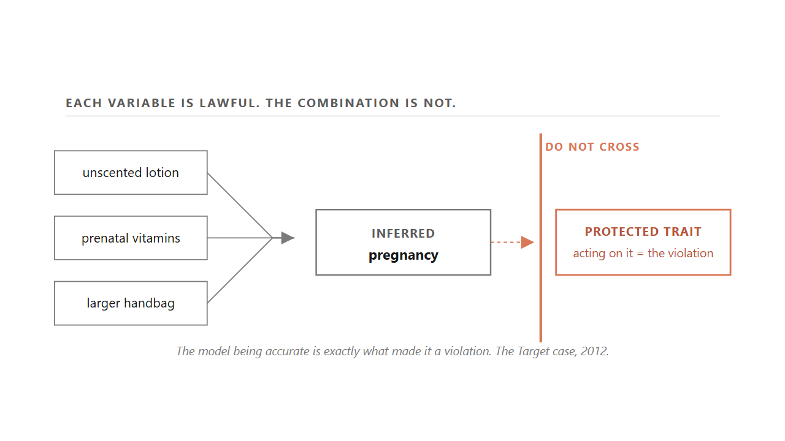
6.3.1 / THE LINE
21 / 51
The same machinery that finds the buyer you want can find buyers you have no right to single out.
Target read a teenager's lotion-and-vitamin shift as a pregnancy signal and mailed coupons before she told her family. The model was right, and acting on it was the violation.
Source: Duhigg, NYT Magazine (2012); GDPR Art. 9; COPPA (1998).
Notes:
Walk the case carefully because students underestimate it. Target's model in 2012 read a teenage shopper's shift toward unscented lotion, prenatal vitamins, and a larger handbag as a pregnancy signal, with about 87 percent confidence in the second trimester. Target mailed her baby coupons. Her father saw them at the kitchen table and complained to the store, then later had to apologize. Tell the room the lesson is not that the model was wrong. It was that it was right, and acting on the inference was the violation. Three risks recur. Targeting on lawful descriptors that combine into a protected-class inference is a hazard even when each variable is fine alone. Targeting children triggers COPPA. Charging different buyers different prices off a behavioral read crosses into manipulation. Since 2018, GDPR in Europe and a wave of US state laws have put hard fences around this.
Discussion: Where exactly is the do-not-cross line for your own brand?
Time: ~90s

Slide 22
BRIDGE
You picked the buyer. Now you decide how that buyer remembers the brand.
Next: positioning, mental ladders, and the 1962 Avis move that ran on the rung the buyer had already given the brand.

Slide 23
PART 4 OF 5
4
Part 4. Positioning: the work in the buyer's head.
Mental ladders. The Bernbach move. Points of parity and points of difference. The statement that holds it all.

Slide 24
6.4 / DEFINITION
24 / 51
Positioning is not what you do to a product, it is what you do to the mind of the buyer.
Avis changed how buyers ranked it without touching the cars, the prices, or the staff.
Source: Ries & Trout, Positioning (McGraw-Hill, 1981).
Notes:
Read the 1981 definition aloud. Positioning is not what you do to a product, it is what you do to the mind of the buyer. Tell the room this is the cleanest definition in the marketing literature, written 45 years ago and still right. The mind is too small to hold the flood of claims aimed at it every day, so it screens almost all of them out and keeps room for only a handful of brands per category, ranked in an order the buyer can recite without thinking. Your job in positioning is to win one of those slots and the meaning that comes with it. Then come back to Avis. The 1962 campaign changed how buyers ranked Avis without changing one thing about the cars, the prices, or the agents. That is what it looks like when positioning works.
Discussion: Pick a brand you bought recently. What rung do you put it on, and why that one?
Time: ~60s

Slide 25
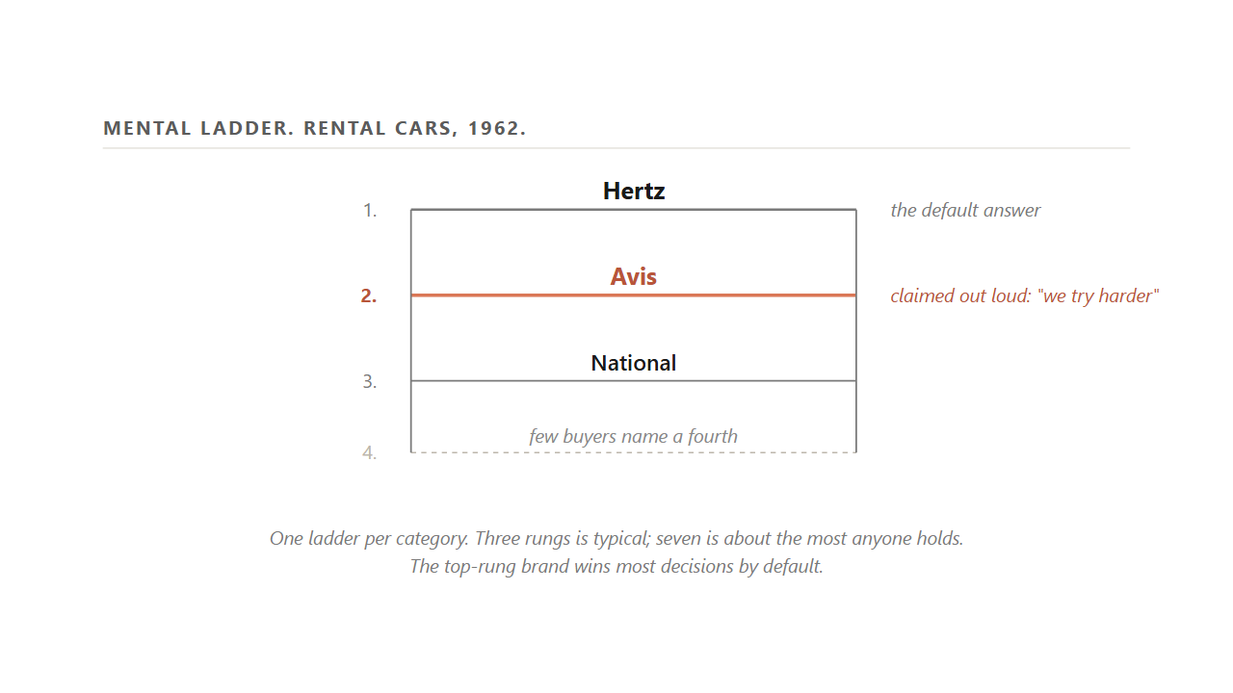
6.4 / THE LADDER
25 / 51
A mental ladder ranks brands by category, the top rung is the default, and Avis claimed the second rung out loud.
One ladder per category. Three rungs is typical, seven is about the ceiling. Avis named the rung the buyer had already handed it.
Source: Ries & Trout (1981); DDB Avis campaign brief (1962).
Notes:
Hold up the ladder. Tell students they carry one of these in their head for every category they buy in. In rental cars in 1962, most buyers ranked Hertz first, Avis second, National third, and could not name a fourth without help. Avis had lost money for thirteen straight years arguing with that ranking. The agency built a campaign around the line, Avis is only number two in rent-a-cars, so we try harder. The brand stopped pretending to be Hertz and asked the buyer to value the extra effort that came with being second. First year cleared 1.2 million, second year 2.6, third year 5 million. Five years in, ITT bought the company. The cars did not change. The position did. Tell the room that is the cheapest positioning move available: claim the rung the buyer has already given you.
Discussion: Pick a category. Read the ladder from memory. Who is on rung two, and have they claimed it?
Time: ~85s

Slide 26
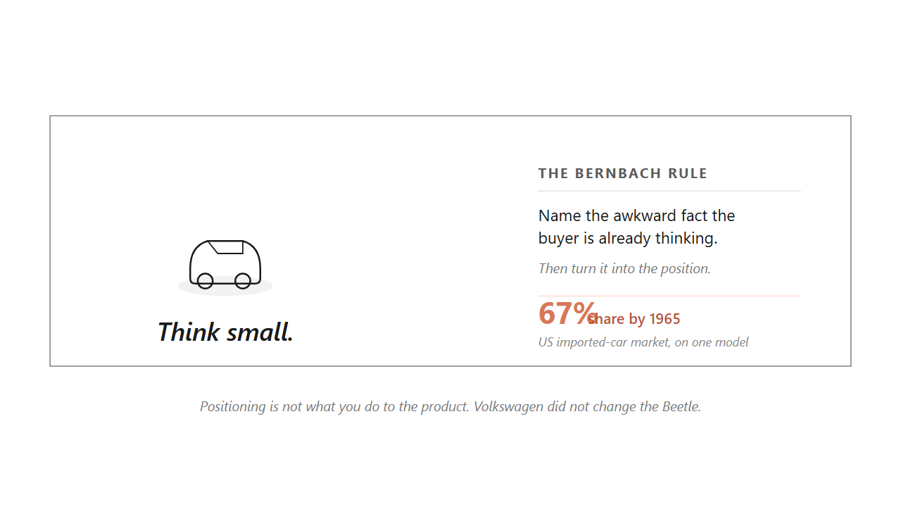
6.4 / BERNBACH
26 / 51
Volkswagen launched the Beetle in 1959 under Think Small, turning the size buyers would notice anyway into the position.
By 1965 the Beetle held 67% of the US imported-car market on one model. The Bernbach rule: name the awkward fact the buyer is already thinking.
Source: DDB Volkswagen campaign launch (1959); Sutton & Klein on the Bernbach rule.
Notes:
Walk the room through the second worked case from the same agency. In 1959, Detroit was racing toward bigger sedans. Volkswagen was selling a small German car nobody had quite figured out how to position. DDB ran the page with the Beetle low and small in a wide white field, under two words: Think Small. The Bernbach creative rule was that the buyer already knows when a claim is implausible, so the ad should open by naming the awkward fact the buyer is already thinking. Small was the awkward fact. The campaign turned it into a virtue. By 1965 the Beetle held 67 percent of the US imported-car market on one model. Tell students Volkswagen did not change the Beetle. They named the rung the buyer had already coded in their head and asked the buyer to read it as good.
Discussion: What awkward fact about your favorite brand could it claim out loud and turn into a position?
Time: ~75s

Slide 27
6.4 / THREE MOVES
27 / 51
Three positioning moves stack by what it costs you to fail, cheapest first.
1
Claim the rung you already have. Avis on second place, the cheapest move, the win is the easy admit.
2
Find an empty creneau on a different dimension. Rolex on expensive watches, Michelob on expensive domestic beer.
3
Reposition the competition. Tylenol on Bayer's stomach side effects, the hardest, reached only when even empty rungs are taken.
Source: Ries & Trout (1981); Tylenol-Bayer 1970s repositioning case.
Notes:
Reveal each move in order. The first is the cheapest. Take the rung the buyer has already handed you and claim it out loud. Avis ran this on second place. The second move opens when the top of the ladder is full but a rung sits empty on a different dimension, the gap the positioning literature calls a creneau. If you cannot be first in a category, build a new category you can be first in. Rolex's was the expensive watch, Michelob's was the expensive domestic beer. The third move is the hardest, reached only when even the empty rungs are taken: reposition the competition. Tylenol did this to Bayer in the early 1970s. The ads listed aspirin's stomach effects before the Tylenol name appeared, forcing buyers to separate the molecule from the relief so the rung dissolved under Bayer. Bayer's counter-launch spent 110 million dollars and got 25 million back in the first year. A captured position decays if you do not defend it.
Discussion: Pick a brand on the second or third rung of a category. Which of the three moves is open to it right now?
Time: ~90s

Slide 28
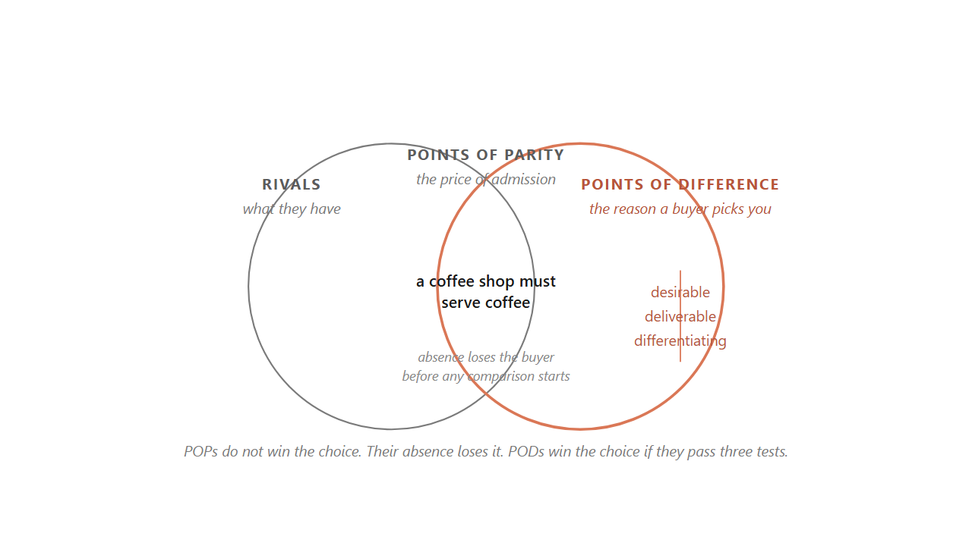
6.5 / POP AND POD
28 / 51
Points of parity earn the brand a place in the category. Points of difference win the choice.
POPs do not win the choice; their absence loses it before any comparison starts. A POD only holds if it passes three tests.
Source: Keller, Strategic Brand Management 5e (2020); Kotler et al. (2022).
Notes:
Hold up the two circles. Walk the room through the two questions every positioning decision answers. What does every buyer expect any brand in this category to deliver, and what does this one brand offer that no rival can match. The first answer is the brand's points of parity. The second is its points of difference. The overlap of the two circles is what every brand needs just to belong. The edge that sticks out is the only thing buyers will choose this brand for. Tell the room the parity side is the one managers most often forget. A coffee shop without coffee is not in the category at all. A travel agency that cannot book flights and hotels is disqualified before any comparison starts. The POD is what wins the choice, but only after the POPs have earned the brand a seat at the table.
Discussion: For your favorite brand: name two POPs and one POD. Did the POD pass all three tests?
Time: ~85s

Slide 29
6.5.1 / POD TESTS
29 / 51
Three tests every POD has to pass, and a difference any rival could copy by next quarter is really a POP that has not commoditized yet.
1
Desirable. Buyers in the target want the attribute and name it unprompted when asked what matters.
2
Deliverable. The firm can prove the claim and keep proving it. A claim you cannot back loses more buyers than no claim.
3
Differentiating. No rival can already credibly say the same thing on a normal product-development calendar.
Source: Keller (2020), Strategic Brand Management.
Notes:
Reveal each test with a one-line read. Desirable asks whether buyers in the target actually want the attribute, the test being whether they name it on their own when you ask what matters about the category. Deliverable asks whether the firm can prove the claim and keep proving it. Differentiating asks whether rivals can already credibly say the same thing. Tell students the trap is that lots of teams build a POD that passes one or two of the three but not all. A POD a rival can match by next quarter is really a POP that has not commoditized yet. Patagonia's one-percent-since-1985 environmental pledge passes all three because no rival can backdate forty years of compounded giving.
Discussion: Which of the three tests do most brand teams miss? Why that one?
Time: ~70s

Slide 30
6.5.2 / POP TYPES
30 / 51
Points of parity come in three named kinds, and missing any one shows up after the campaign is already live.
1
Category POP. The price of admission. A coffee shop must serve coffee, a campus food truck must take cards.
2
Correlational POP. Defends against a bad assumption a strength would trigger. Trader Joe's pairs quality with low price.
3
Competitive POP. Matches a rival's POD enough that buyers stop treating it as decisive. Visa's accepted-anywhere neutralized AmEx's prestige.
Source: Kotler et al. (2022); Keller (2020).
Notes:
Walk each type with the canonical example. A category POP is the price of admission. A coffee shop has to serve coffee, a campus food truck has to take cards. Buyers treat its absence as disqualification before any brand comparison starts. A correlational POP defends against a bad assumption a buyer would draw from one of your own strengths. Buyers assume some things trade off: cheap means low quality, fast means careless. So a brand that wins on one side has to say out loud it has not lost on the other. Trader Joe's quality-at-a-low-price claim is the textbook case, and the cell managers miss most often. A competitive POP matches a rival's point of difference just enough that buyers stop treating it as decisive. Visa's accepted-anywhere neutralized AmEx's prestige for buyers who did not want their card refused.
Discussion: Pick a brand. Name one of each kind of POP it carries. Which kind is hardest to spot from the outside?
Time: ~75s

Slide 31
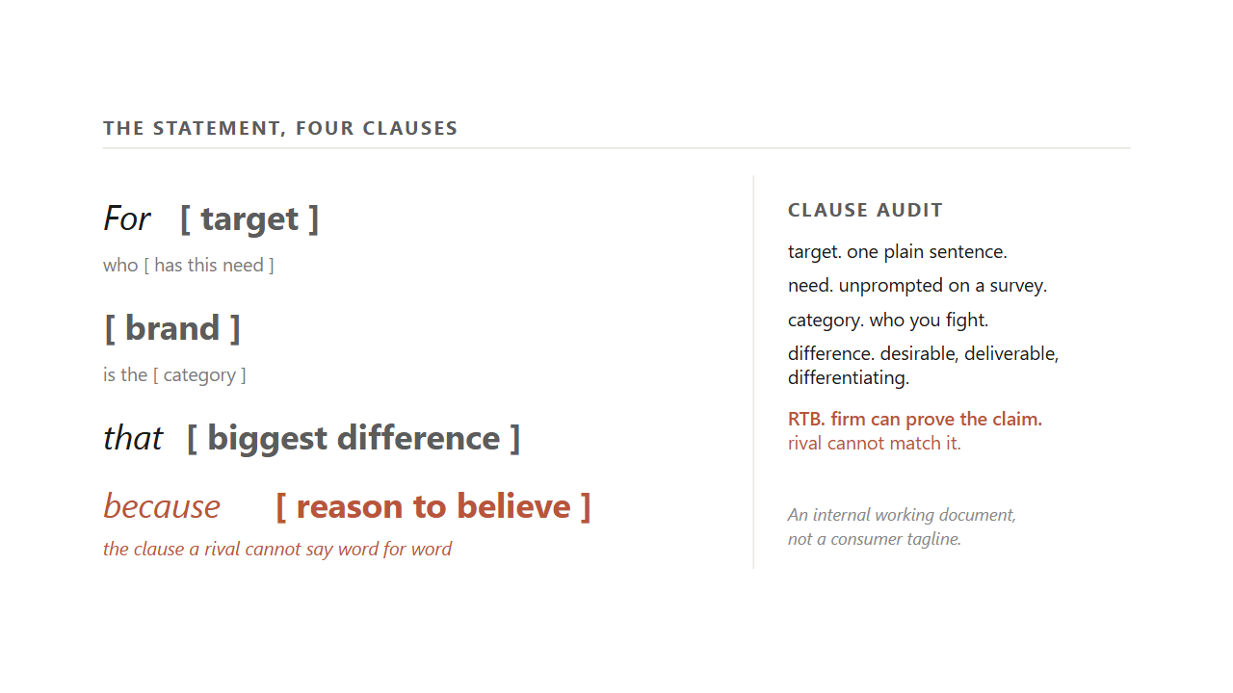
6.5.3 / THE STATEMENT
31 / 51
The positioning statement is one sentence, four clauses, and the RTB is the clause a rival cannot say word for word.
For target who need, brand is the category that biggest difference because reason to believe. An internal working document, not a tagline.
Source: Kotler et al. (2022); Palmatier & Sridhar (2021).
Notes:
Read the template aloud, slowly, clause by clause. For target who need, brand is the category that biggest difference because reason to believe. Tell students the statement is the artifact that turns everything we have done so far into something a team can work from. It is an internal working document for the brand team and the agency, not a consumer tagline. It almost never appears in an ad word for word, though every ad should trace back to one of its clauses. Walk the clause audit. Target: one plain sentence. Need: unprompted on a survey. Category: who you fight. Difference: passes desirable, deliverable, differentiating. RTB: the firm can prove the claim and the rival cannot match it. The RTB is the one most often weak because teams write it like a slogan instead of like evidence.
Discussion: Write a positioning statement for the campus coffee shop. Then audit your RTB.
Time: ~95s

Slide 32
6.5.4 / STRADDLE
32 / 51
BMW straddled two frames at once, where each frame's POPs doubled as the other's PODs.
The luxury car with performance against Cadillac. The performance car with luxury against Corvette. A straddle works only if both legs stay credible.
Source: Kotler et al. (2022); Aaker on brand straddles.
Notes:
Tell students sometimes a brand wants to be considered inside two categories at once. The textbook calls this straddle positioning. BMW's classic US positioning is the example. Against Cadillac, BMW is the luxury car with performance PODs. Against Corvette, BMW is the performance car with luxury PODs. Each frame's points of parity double as the other frame's points of difference. The brand named a new category, luxury performance, that neither old frame held. Tell the room the trade-off is that both pairs must stay credible. Palm Pilot and Apple Newton tried to straddle pager and laptop. Buyers judged the device a poor pager and a poor laptop at once, and the category folded before the technology caught up. A straddle has to clear the three POD tests in both frames, which is roughly twice the work.
Discussion: Pick a brand you think is straddling two frames right now. What is its risk if one leg fails?
Time: ~70s
Skip if short.

Slide 33
6.5.5 / BULL'S-EYE
33 / 51
A brand holds its position together with one diagram drawn as four concentric rings.
Center: a three-to-five word mantra. Next: POPs and PODs. Next: the proof. Outer: brand personality. Every campaign decision passes the rings.
Source: Keller (2020); the Starbucks bull's-eye worked case.
Notes:
Tell students the brand-positioning bull's-eye is the holder for everything we have built. The center ring is the brand mantra, three to five words like Starbucks's rich, rewarding coffee experience or Disney's fun family entertainment, written for the team, not the ad. The next ring out holds the POPs and PODs. The third holds the proof behind them. The outer ring holds the brand's personality and look. Tell students this is how brand teams at real firms actually check work. Every campaign decision gets read against the rings before it ships. If the proposed creative does not align with the mantra, the brand has drifted off its position. The mantra is short enough that every employee can recite it, and concrete enough that a brief can be checked against it line by line.
Discussion: Write a three-word mantra for your favorite brand. Could every employee defend it from the brief?
Time: ~65s
Skip if short.

Slide 34
BRIDGE
The ladder ranks brands on one line. The map shows which yardstick the buyer is even using.
Next: the perceptual map, the empty quadrant, and the Liquid Death reframe.

Slide 35
PART 5 OF 5
5
Part 5. Reading the map, and reconciling the sharp critique.
Perceptual maps, dead air, the double-jeopardy law, mental and physical availability.

Slide 36
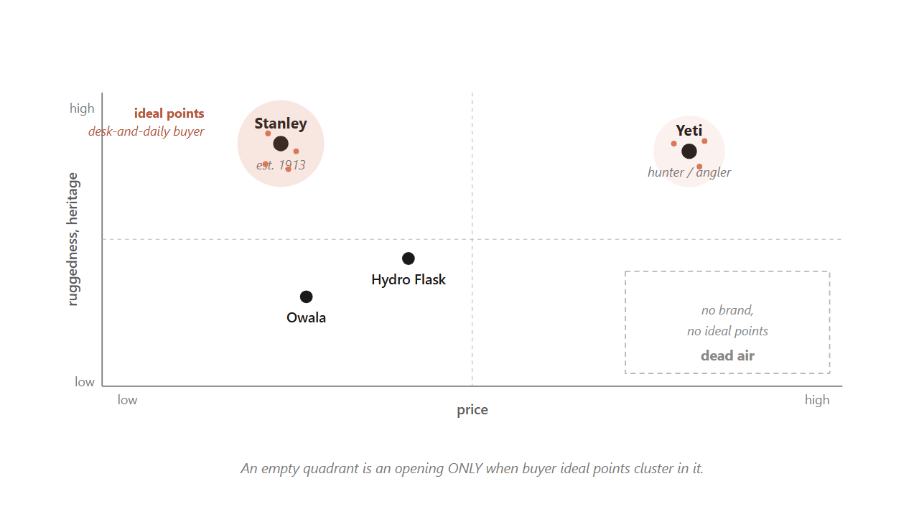
6.6 / THE MAP
36 / 51
An empty quadrant is an opening only when buyer ideal points cluster in it. Otherwise it is dead air.
The brand-only map hides which yardstick the buyer is using. The joint-space map shows where the demand actually lives.
Source: Hauser & Koppelman, JMR 16 (1979); Wedel & Kamakura (2000).
Notes:
Hold up the map. Tell students this is the single most reusable tool from the chapter. The mental ladder ranked brands on one line. The map shows several brands at once on two attributes, which is closer to how a buyer's mind actually compares options. Walk the insulated-drinkware example. Stanley sits upper-left, mid price and high heritage from 1913. Yeti sits upper-right, premium with a hunter and angler story. Hydro Flask and Owala fill the middle. Now look at the lower-right quadrant: empty, looks like an opening. Pause here. Tell the room the load-bearing move is to lay buyer ideal points on the same canvas. The ideal-point clusters sit on the existing brands, not in the empty corner. That corner is dead air the incumbents already priced in. An empty quadrant is an opening only when buyer ideal points cluster in it.
Discussion: What axes would you draw for the streaming-music category? Where do the ideal points cluster?
Time: ~95s

Slide 37
6.6.1 / CONSTRUCTION
37 / 51
You cannot just declare the two axes, because the pair you would draw from the boardroom may not be the pair buyers use.
A 1979 head-to-head on commuter ratings found factor analysis beat discriminant and MDS on predictive validity. Recover the axes from rating data, not from the brief.
Source: Hauser & Koppelman, JMR 16 (1979).
Notes:
Tell the room the most common map mistake is declaring the axes in the boardroom. The pair you would draw from your own brief may not be the pair buyers use. If buyers in 2026 sort drinkware on individualistic-versus-communal and playful-versus-serious, a premium-versus-value map you drew first will predict their choices badly. The test is direct: the map is only worth using if its two dimensions predict real purchase choices on a holdout sample, the same rule the targeting step demanded. Walk the production procedure. Factor analysis is the default. The 1979 Chicago commuter head-to-head found it beat discriminant analysis and multidimensional scaling on predictive validity, on interpretability for non-statisticians, and on ease of use from standard rating instruments.
Discussion: Pick a category. What two axes would you ASSUME first, and what two would buyer ratings probably surface?
Time: ~65s

Slide 38
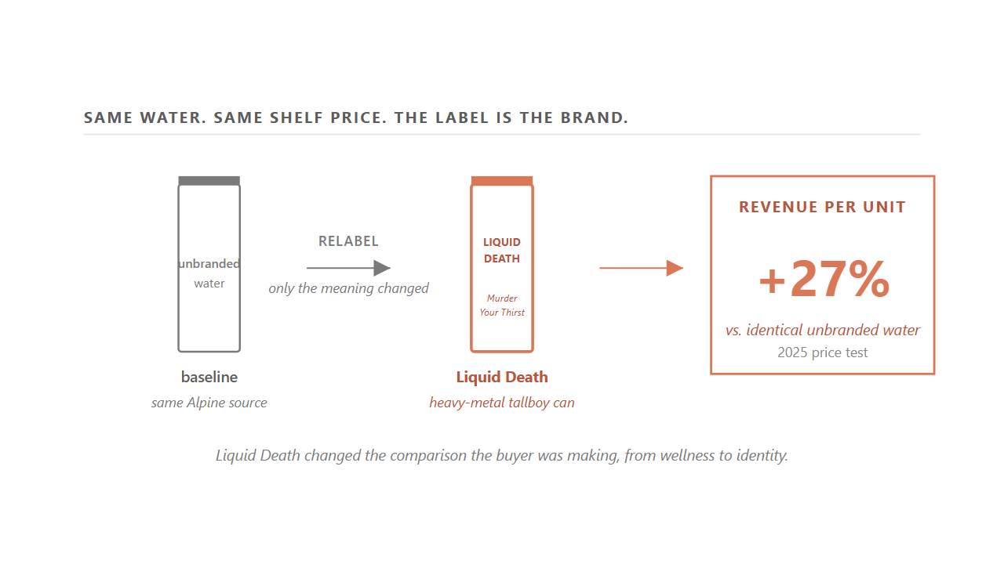
6.6.2 / REFRAME
38 / 51
Liquid Death entered a flat category by changing the comparison the buyer was making, and earned 27% more revenue per unit at the same shelf price.
The water never changed. The meaning did. A position built on identity does not care whether the can holds water or caffeine.
Source: Liquid Death Series E filings (2024); 2025 price test (Liquid Death internal study).
Notes:
Walk the Liquid Death case as the central worked example of positioning. In 2018 bottled water was a mature, low-margin shelf where every brand competed on the same notes of purity and wellness. Mike Cessario left the product ordinary on purpose, real Alpine water in a 16-ounce tallboy can, and put all the work on the meaning. The can borrowed the look of cheap beer. The tagline was Murder Your Thirst. The whole identity read as the opposite of a wellness brand. Tell students what changed was the comparison the buyer was making. Against Smartwater the brand reads too loud. Against wellness culture itself, the can offers a different identity. The 2025 price test makes the point concrete. Shown the same Alpine water at the same shelf price, the can labeled Liquid Death earned about 27 percent more revenue per unit than the identical unbranded water. That is the cash value of the meaning alone.
Discussion: What other categories are ripe for a Liquid Death style reframe? Why those?
Time: ~100s

Slide 39
6.6.3 / CONCENTRATED
39 / 51
Trader Joe's held one narrow position for almost sixty years by defending three points of difference together.
Shelves about 80% private-label. Roughly 4,000 SKUs, an eighth of a normal grocer. No loyalty card. Relax any one and the brand slides toward the mid-market.
Source: Coulombe founder interviews; dunnhumby Retailer Preference Index (2024).
Notes:
Walk Trader Joe's as the worked case for concentrated targeting held over decades. Founder Joe Coulombe aimed at one narrow buyer in 1967: the educated, middle-income, food-curious shopper that neither the giant supermarket nor the bare-bones discounter served well. The position rests on three points of difference the chain still defends. About 80 percent of what is on the shelf carries the Trader Joe's name, the reverse of a normal supermarket. A store stocks only around 4,000 items, roughly one-eighth of a conventional grocer, and that narrowness pays for the work of finding unusual products. The chain refuses a loyalty card, betting its buyer values a curated store more when everyone pays the same price. Relax any one of the three and the chain slides toward the ordinary mid-market grocer the category already has too many of. Holding the position is itself the advantage. The cost is the wider market the chain gives up.
Discussion: What would Trader Joe's lose if it added a loyalty card? Be specific.
Time: ~75s

Slide 40
6.6.3 / VALUES TARGETING
40 / 51
Patagonia runs one meaning through two doors, with a 1985 environmental pledge no rival can backdate.
Worn Wear repair-and-resale reaches a younger buyer through a different price-and-age door. STP does not cap a brand at one target forever.
Source: Patagonia 1% for the Planet annual report (2024); Worn Wear FY25 disclosures.
Notes:
Pose Patagonia as the values-based contrast. The target has been psychographic since 1973: buyers for whom the company's environmental record is part of the product. That cut sorts the climber and the retired Sierra Club volunteer into the same target even though their ages do not overlap. The point of difference is hard to fake. Since 1985 Patagonia has pledged one percent of sales to environmental groups regardless of profit, passing 140 million dollars by 2024. In 2022 the founder moved the whole company into a trust whose profits fund climate work. A rival cannot match forty years of compounded giving by starting today. Then add the second door: Worn Wear, the repair-and-resale channel launched in 2017. It reaches a buyer about ten years younger who can afford the same jacket repaired but not new. Same values-based segment. Two doors. STP does not cap a brand at one target forever.
Discussion: What is your favorite brand's pledge equivalent to Patagonia's one percent? Could a rival actually match it?
Time: ~80s

Slide 41
BRIDGE
Everything so far told you to pick a small slice and serve it well. A second body of evidence says the opposite.
Next: the double-jeopardy law, the Yorkie failure, and how STP and penetration reconcile.

Slide 42
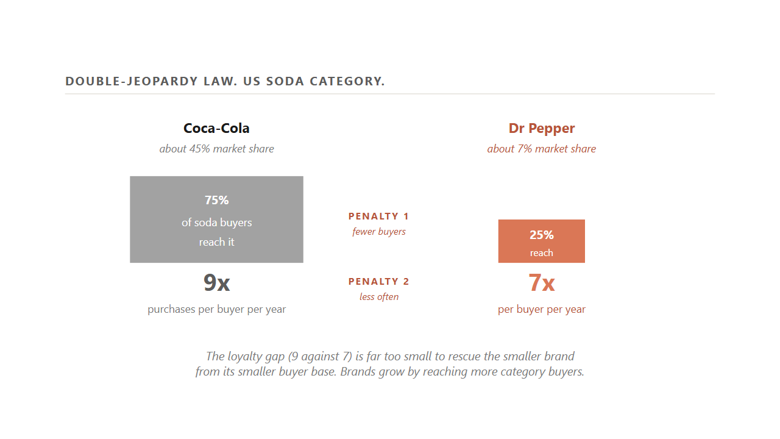
6.7 / DOUBLE JEOPARDY
42 / 51
A smaller brand gets hit twice: fewer buyers reach it, and the buyers it keeps purchase slightly less often.
Coca-Cola: 75% of soda buyers, 9 times a year. Dr Pepper: 25% of buyers, 7 times. The loyalty gap is far too small to rescue the smaller brand.
Source: Ehrenberg, Goodhardt & Barwise, JMR (1990); Sharp, How Brands Grow (2010).
Notes:
Tell students the second body of evidence comes from forty years of watching what households actually buy, scanner by scanner, across roughly fifty categories. The first finding is the double-jeopardy law. A smaller brand gets hit twice, because fewer people buy it at all, and the few who do buy it slightly less often than the big brand's buyers do. Walk the soda numbers. Coca-Cola, at about 45 percent of the market, is bought by roughly three-quarters of soda buyers, around nine times a year each. Dr Pepper, at about 7 percent, is bought by maybe a quarter of buyers, around seven times each. The small brand loses most of the pool and serves the rest a little less. The loyalty gap of seven against nine is far too small to close the difference. Tie it to the implication: a brand is small because it reaches few buyers, and you grow it by reaching more, not by digging deeper into the ones you have.
Discussion: Why is the loyalty gap so small? Why do buyers of one brand also buy the others?
Time: ~90s

Slide 43
6.7.1 / YORKIE
43 / 51
A UK chocolate bar called Yorkie ran It's Not For Girls, cut off half its buyer pool, and watched sales fall for years.
Narrow targeting costs you exactly that much when the penetration evidence is staring back at you.
Source: Sharp, How Brands Grow (2010); Nestle UK Yorkie campaign (2002).
Notes:
Hold up Yorkie as the warning. A brand that ignores the penetration evidence can shrink itself on purpose. In 2002 the UK chocolate bar Yorkie ran the line, It's Not For Girls. The campaign was intended to be playful. The mechanical effect was to cut off half of every buyer pool the brand could reach. Sales fell for years afterward. Tell students this is the textbook case for what narrow targeting costs when the penetration evidence is staring back at you. A brand cannot grow by halving its addressable pool. Even if every remaining buyer became fanatically loyal, the math does not close because of double jeopardy.
Discussion: What other brands have shrunk themselves on purpose? What did the math look like for them?
Time: ~60s

Slide 44
6.7.2 / RECONCILIATION
44 / 51
STP picks the category the brand competes in. The penetration laws govern growth once that choice is locked.
Toyota's launch of Lexus was the STP move. Growing Lexus afterward was a penetration question. Two laws, two jobs.
Source: Sharp (2010); Kotler et al. (2022); Toyota Lexus launch case.
Notes:
Pose the reconciliation as the chapter's intellectual hinge. The two sides look like they contradict each other. STP says pick a small slice and serve it deeply. The penetration laws say reach more category buyers, not the same buyers harder. Tell the room they reconcile the moment you give each one its own job. STP chooses which category a brand competes in and what it wants to mean inside it. The penetration laws describe how the brand grows once that choice is locked. Walk Toyota's launch of Lexus as the worked case. Choosing the Lexus name, the luxury frame, the dealer separation from Toyota dealers, was the STP move. Growing Lexus afterward was a penetration question. Lexus pushed for more dealers and more buying occasions, not harder loyalty from the owners it already had. The size of the slice is not the real argument. The argument is which question you are answering.
Discussion: What is the STP question for your favorite brand right now? What is the penetration question?
Time: ~85s

Slide 45
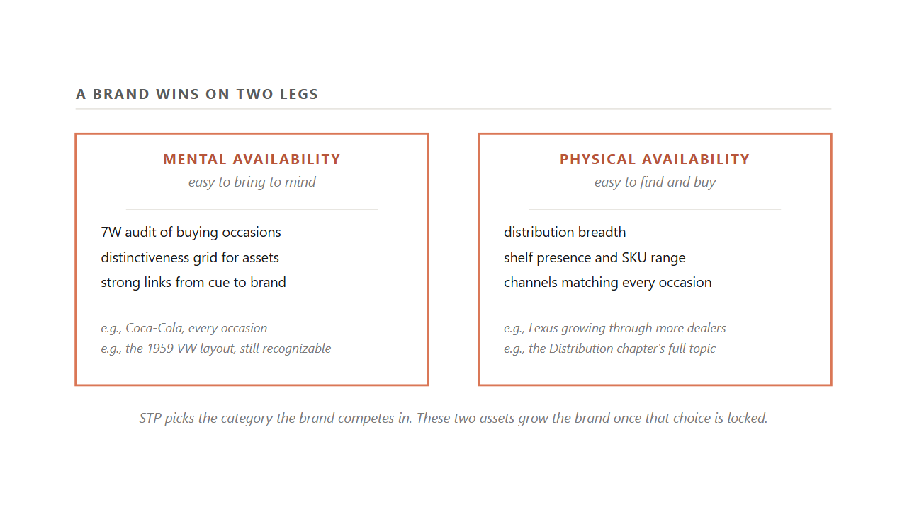
6.7.3 / AVAILABILITY
45 / 51
A brand wins on two legs: easy to bring to mind, and easy to find and buy.
Mental availability is the 7W audit and the distinctiveness grid. Physical availability is the Distribution chapter's full topic.
Source: Sharp (2010); Romaniuk, Building Distinctive Brand Assets (2018).
Notes:
Hold up the pair. Tell the room the penetration tradition says a brand grows by building two market-based assets at once. Mental availability is being easy to bring to mind in a buying situation, built from the breadth and freshness of the links between the brand and the occasions, cues, and category entry points its buyers carry in memory. Physical availability is being easy to find and buy: distribution breadth, shelf presence, and the number of occasions and channels through which a buyer can actually purchase the brand. Tie it back to Lexus. Growing Lexus turned on physical availability: more dealers, more occasions. The chapter on distribution takes physical availability up in full. The point here is that both legs matter. A brand can be easy to think of and still lose the sale if it is hard to buy. A brand can be easy to buy and still lose the sale if no one thinks of it at the moment of need.
Discussion: For a brand you know, which leg is weaker right now? What would you change first?
Time: ~80s

Slide 46
6.7.4 / TOOLS
46 / 51
The penetration tradition hands you two named tools to build mental availability.
1
Distinctiveness Grid. Score every brand asset on prevalence and uniqueness. Upper-right is icons you defend.
2
7W audit of category entry points. Count how many occasions a buyer spontaneously connects to the brand: why, when, where, while doing what, with whom, with what, how feeling.
3
Nine or more occasions reads as top-tier mental availability. Median brand sits at three to five.
Source: Romaniuk, Building Distinctive Brand Assets (2018); Sharp (2010).
Notes:
Reveal each tool with one worked beat. The Distinctiveness Grid scores every brand asset (a logo, a color, a tagline, a packaging shape) on two axes. Prevalence is the share of category buyers who attribute the asset to the brand. Uniqueness is the share who would not mistake it for a competitor. Upper-right are icons the brand defends. The other three corners sort into refresh, build, and retire. The 7W audit counts how many distinct buying occasions a brand's buyers can spontaneously recall it for, across seven prompts: why, when, where, while doing what, with whom, with what, and how feeling. A brand linked to nine or more occasions is a top performer. The typical brand sits at three to five with room to grow. A brand a buyer thinks of in only one narrow corner of life is exactly the brand the duplication-of-purchase law catches first.
Discussion: Pick a brand and run the 7W audit on it in your head. How many occasions can you name?
Time: ~75s
Skip if short.

Slide 47
CLOSING
Closing. Three brands, one diagnostic.
Stanley, Trader Joe's, Liquid Death. Then the four-step diagnostic you carry into a client project.

Slide 48
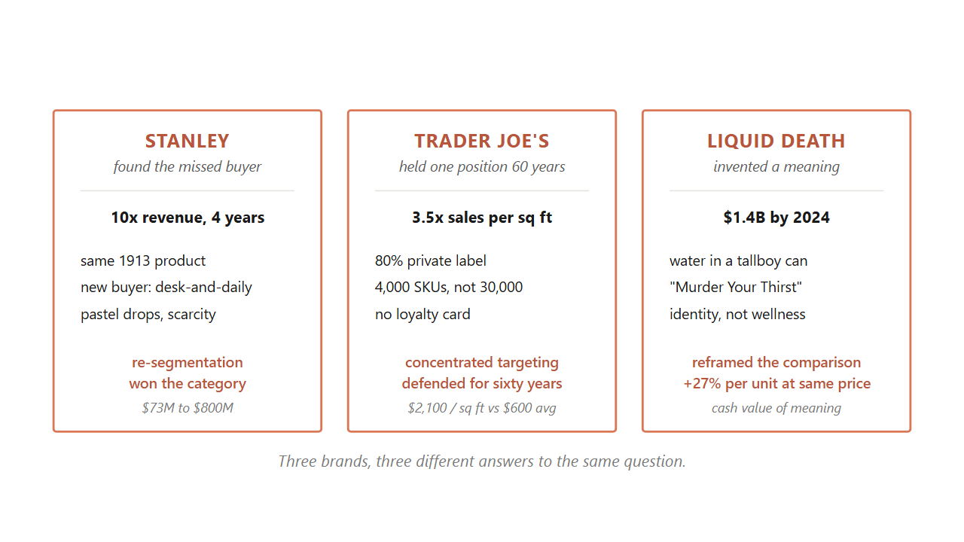
6.8 / THREE BRANDS
48 / 51
Three brands, three different answers to the same question of who you serve and what you mean to them.
Stanley re-pointed the same product at a missed buyer. Trader Joe's held one position for sixty years. Liquid Death invented a meaning.
Source: Composite of the three running cases. Sources for each are listed on the section slides above.
Notes:
Walk the three brands one more time as worked applications of the chapter. Stanley found a buyer its own dashboards were not counting. The 1913 product never changed. Revenue moved from about 73 million to past 750 million in four years because the segment was re-pointed. Trader Joe's did the opposite. It picked one narrow buyer in 1967 and held that concentrated position for almost sixty years by defending three points of difference together. Holding the position is itself the advantage. Liquid Death entered a flat category by inventing a meaning no one had claimed. The water never changed. The 27 percent revenue premium at the same shelf price is the cash value of the meaning alone. Tell the room these are three different answers to the same question: which buyers do you serve, and what do you want to mean to them.
Discussion: Which of the three commitments is most fragile? Which is most defensible? Why?
Time: ~105s

Slide 49
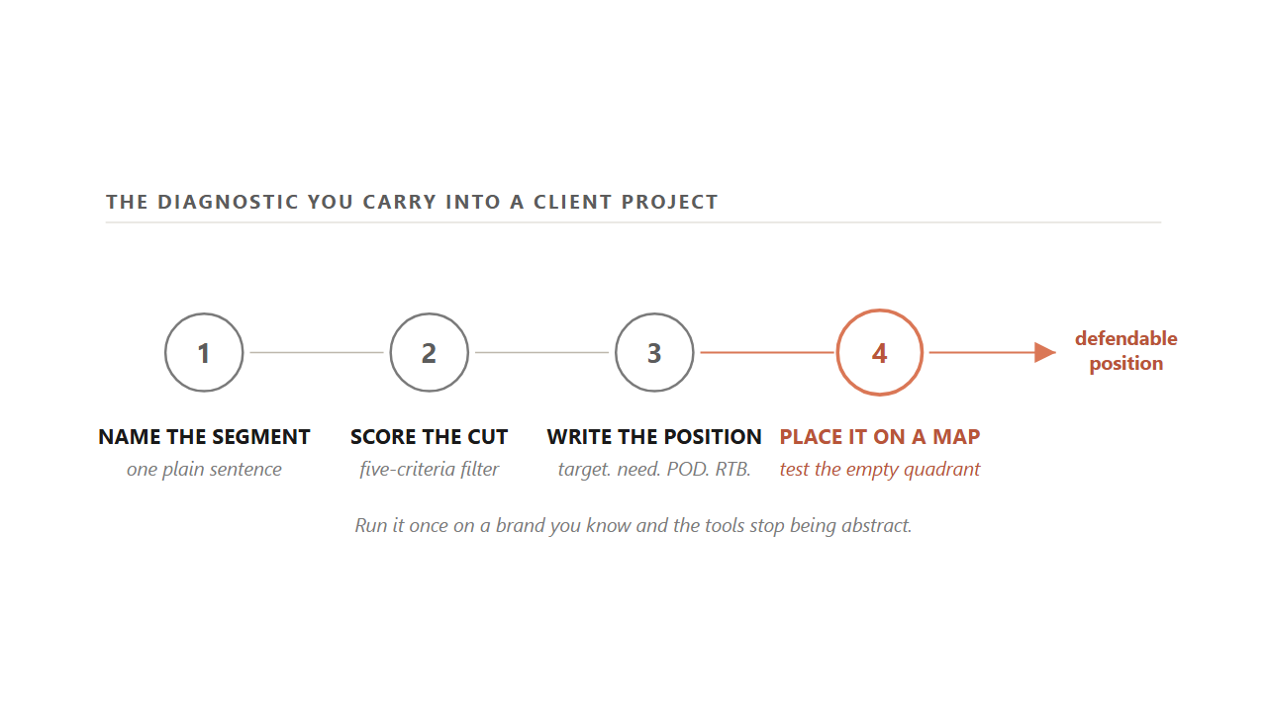
6.9 / THE DIAGNOSTIC
49 / 51
The four-step diagnostic you carry into a client project, in the order the chapter teaches it.
Name the segment in one sentence. Score it on the five criteria. Write the positioning statement. Place the brand on a map and test the empty quadrant.
Source: Synthesis of Kotler et al. (2022), Ries & Trout (1981), Sharp (2010).
Notes:
Wrap by giving the room the diagnostic they will use on client projects. Walk it in order. One: name the segment the brand serves in one plain sentence. If you cannot say it in a sentence, the brand is chasing nobody in particular, which is the everybody trap. Two: score that segment on the five criteria from Part 2. Measurable, accessible, substantial, differentiable, actionable. A slice that fails any one is research, not a target. Three: write the position. Fill the template. For target who need, brand is the category that biggest difference because reason to believe. Test the POD against desirable, deliverable, differentiating, and cut any clause a rival could say word for word. Four: place the brand on a perceptual map. Pick the two attributes the buyer actually cares about, plot the brand and two rivals, find the empty quadrant. Then ask the harder question: are there buyer ideal points in that corner, or is it dead air? Run it once on a brand you know and the tools stop being abstract.
Discussion: Pick a brand you bought this week. Run all four steps on it before the next class.
Time: ~100s

Slide 50
6.9 / CALLBACK
50 / 51
Stanley re-pointed the same 1913 cup by running this same four-step diagnostic, just the slow way.
The dashboard read low Quencher sales as a weak product. The diagnostic read it as a misnamed segment. The product never changed.
Source: Stanley press releases and analyst calls, 2018-2024.
Notes:
Close by tying the diagnostic back to the opening. Stanley did this audit the slow way around 2019. The dashboard read low Quencher sales as a weak product, and the obvious move was to cut it. The diagnostic read the same numbers as a misnamed segment. The buyer who wanted the cup was a woman drinking water at her desk all day, answering a question Stanley was not even asking. Stanley re-pointed the same 1913 product at the buyer it had found, and revenue moved from 73 million to past 750 million in a few years. The product never changed. Only the buyer did. Tell the room that is what this chapter's machinery looks like when it works.
Discussion: What was the first sign Stanley had a segment problem, not a product problem?
Time: ~70s

Slide 51
TAKEAWAYS
51 / 51
Choose who you serve, decide how you want to be remembered, and read the map for the empty quadrant before you walk into it.
STP picks the rung the brand asks the buyer to remember it on. Chapter 7 is the work of building and defending that web.
Notes:
Wrap the class by summarizing the moves students can run on Monday morning. One: cut on benefit, not just on label. The four bases describe a segment after the fact, but the benefit is the cause of the choice. Two: run the five-criteria filter before you call a slice a target. Actionable is the test most teams fail. Three: walk the strategic step before the tactical step. Translate the strategy sentence into the customer profile, and score the profile on effectiveness and cost efficiency. Four: claim the rung the buyer has already given you, the cheapest positioning move available. Five: write the position in the four-clause template and audit each clause. Six: read the perceptual map only after you have laid the buyer ideal points on it. The next chapter walks how memory itself decides a purchase, the work of building and defending the brand's web of associations.
Discussion: Of the six moves on this slide, which one will you actually run on a brand you know this week?
Time: ~80s

