Slide 1
CHAPTER 10
Pricing is the only mix decision that brings in revenue.
Every other decision spends money. Price is the one that captures it.
MKTG 4333 / Principles of Marketing
An AI-Integrated Approach
Notes:
Open by asking the room a quick question: of the four Ps, which one is the only one that creates revenue rather than spending it? Take two or three answers. Most students will guess product or place. Reveal that price is the only one. Then orient them to the chapter: this lecture walks the floor (cost), the frame (competitor), the ceiling (value), and the ceiling above the ceiling (fairness) that finally caught up with EpiPen. Set expectations: by the end, students should be able to defend a price, not just calculate one.
Discussion: Of the four Ps, which is the only one that captures revenue rather than spending it?
Time: ~60s

Slide 2
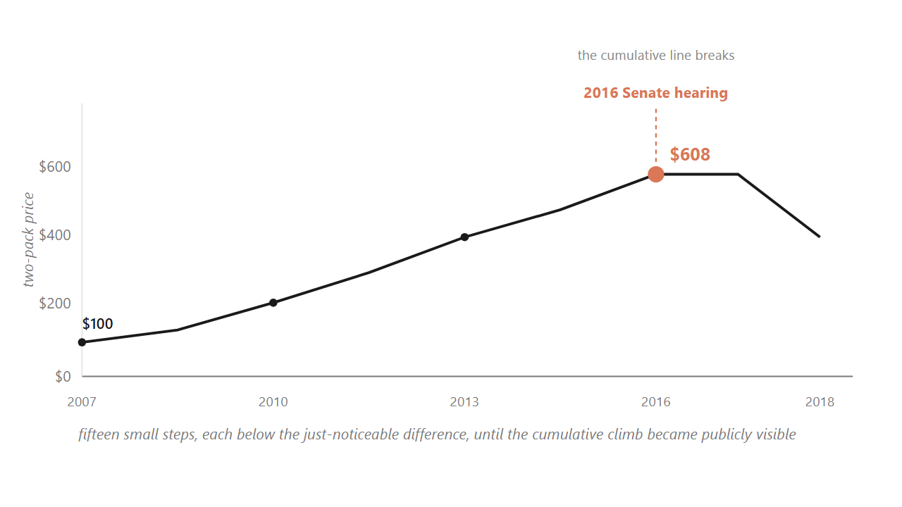
HOOK
02 / 31
EpiPen climbed from $100 to $608 across nine years, then broke at a Senate hearing in 2016.
Fifteen small steps, each below the just-noticeable difference, until the cumulative line became publicly visible.
Source: U.S. Senate Special Committee on Aging hearings (2016); Reuters on Mylan EpiPen 2007-2016.
Notes:
Walk students through the climb. The drug did not change. The injector did not change. Mylan held about 90 percent of the market. Parents had no substitute. Each individual step was small enough to draw no public reaction. That worked for nine years. Then in 2016 a Senate hearing made the cumulative line publicly visible, and within a year Mylan committed to a half-price generic. Pause here. Ask the room: what changed? Nothing about the cost or the product. What changed was the fairness ceiling. Tell them this is where the chapter ends, so they should hold this image as the destination.
Discussion: What changed in 2016 that brought the price down? Nothing about cost or product. So what?
Time: ~75s

Slide 3
PART 1 OF 5
1
Part 1. Why a 1% price move beats a 1% volume move.
Asymmetric leverage. The math of the highest-leverage decision in marketing.

Slide 4
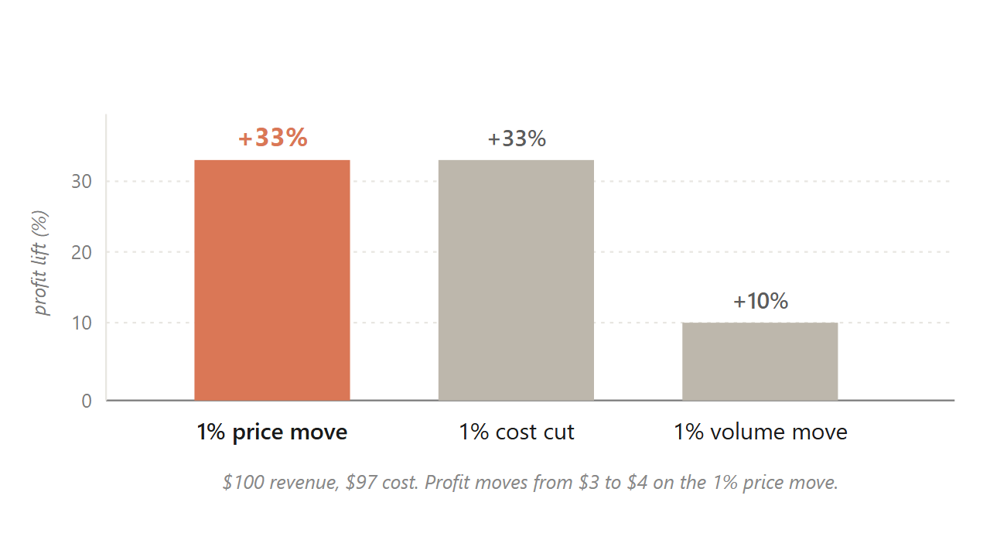
10.1 / ASYMMETRIC LEVERAGE
04 / 31
At a 3% margin, a 1% price move lifts profit about 33%; a 1% volume move lifts it only about 10%.
Extra price needs no extra cost. Extra volume drags its share of cost.
Source: Marn & Rosiello, HBR (1992); Simon-Kucher engagement record; figures illustrate the 3% net-margin case.
Notes:
Hold up the bars. The price bar and the cost-cut bar look identical at plus 33 percent. The volume bar is one third the height. Walk the arithmetic out loud once: 100 dollars revenue, 97 dollars cost, 3 dollars profit. Raise the price one percent, revenue goes to 101, cost holds at 97, profit goes to 4. That is a 33 percent jump in profit on a 1 percent move. Then ask the room: to get the same extra dollar through volume, how many more units would you need? About 33 percent more, because each extra unit drags its share of cost. The price lever is structurally bigger than the volume lever, and yet most pricing teams are paid on volume.
Discussion: Most pricing managers are paid on volume targets. Given this chart, why is that a misallocation of incentives?
Time: ~80s

Slide 5
10.1
05 / 31
Netflix climbed from $7.99 in 2010 to $15.99 in 2024 because one more streamed minute costs nearly nothing.
The marginal-cost asymmetry is why the moves passed through; a grocer raising margarine cannot do the same.
Source: Netflix Q4 2024 earnings; Antenna Q126 State of Subscriptions.
Notes:
Show why digital products carry the lever so cleanly. The cost of streaming one more minute to one more household rounds to zero. Bandwidth is fractions of a cent. The content is already produced. So each price move passes through almost directly to the bottom line. Contrast a grocery chain raising margarine a dollar. The next tub still has to be bought, shipped, and warehoused. Same logic, different scale of payoff. This is the structural reason software pricing is studied separately from physical-goods pricing.
Discussion: What categories carry the asymmetry like Netflix? What categories carry it weakly, like the grocer?
Time: ~60s

Slide 6
PART 2 OF 5
2
Part 2. Cost is the floor. Competitor is the frame. Value is the ceiling.
Four approaches to setting the number, and only one is tied to the buyer's wallet.

Slide 7
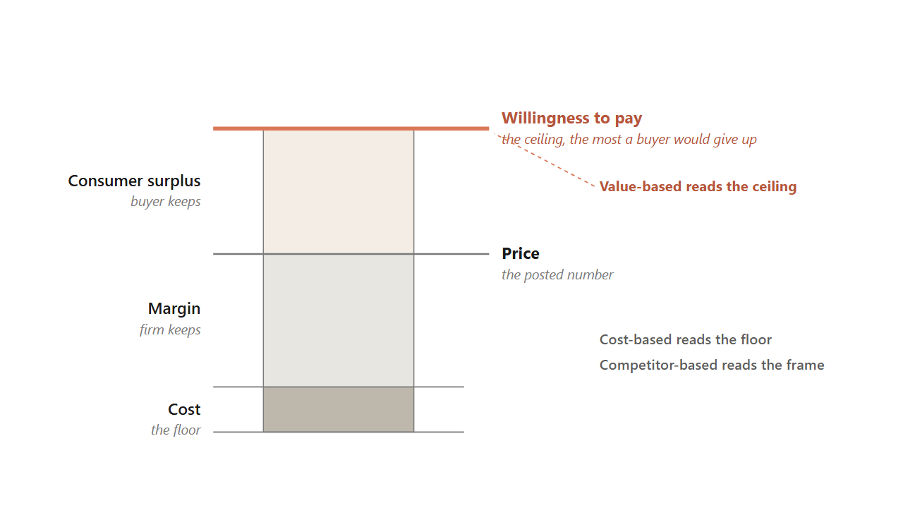
10.2 / THE VALUE STICK
07 / 31
The price lives between cost and willingness to pay, and the ceiling is the buyer's, not the firm's.
Cost-based reads the floor. Competitor-based reads the frame. Value-based reads the ceiling.
Source: Kotler, Keller & Chernev, Marketing Management 16e (2022).
Notes:
This diagram is the central image of the chapter. Walk the stack bottom to top. Cost sits at the floor. The margin is what the firm keeps between cost and price. Above the price is the consumer surplus, what the buyer keeps. The top of the stick is willingness to pay, the most that buyer would have given up. Now show the strategic move. Three of the four pricing approaches read different lines on this stick. Cost-based reads the floor. Competitor-based reads the frame somewhere in the middle. Value-based asks what is the buyer's ceiling, and tries to push the price up the surplus. The chapter's argument is that most firms anchor on cost because it is easy to measure, and leave money on the table at the top.
Discussion: If two buyers see the same product, why might their willingness-to-pay ceilings be different?
Time: ~90s

Slide 8
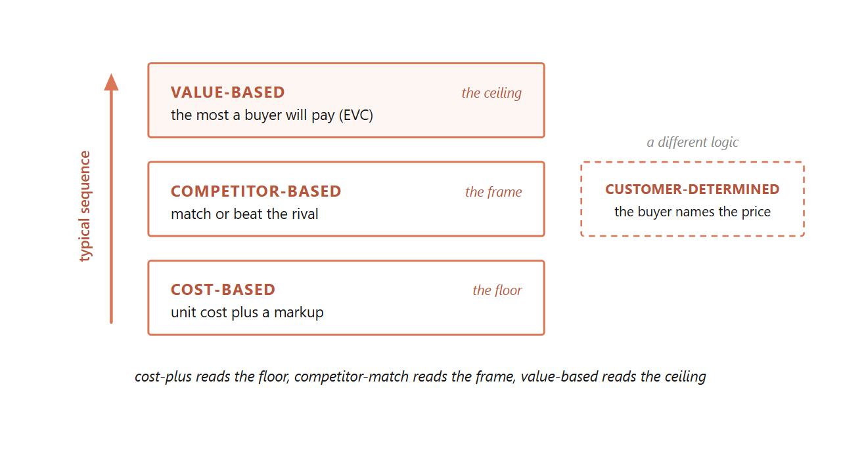
10.2 / FOUR APPROACHES
08 / 31
A firm typically climbs the ladder: cost first, then competitor, then value.
Customer-determined pricing is a separate mode where the buyer names the number.
Source: Dean, Managerial Economics (Prentice-Hall, 1951); Kotler et al. (2022).
Notes:
Use this slide to introduce all four approaches at once. Cost-plus is honest and easy to defend, but it leaves the ceiling unread. Competitor-match is the floor of strategic thinking, but it can spiral into price wars. Value-based requires willingness-to-pay data and organizational resolve, but it is the only approach tied to what the buyer would actually pay. Customer-determined is a different logic entirely: the buyer names the price, the firm accepts or rejects. Tell students they will see all four in their careers, and the question is which one fits each product and buyer.
Discussion: Name a product you bought recently. Which of the four approaches did the seller probably use?
Time: ~75s

Slide 9
10.2.1
09 / 31
Cost-based pricing survives because cost is easy to measure, but it leaves the ceiling unread.
Regulated utilities are its honest home: a regulator allows a return and the price is worked backward.
Source: Kotler et al., Marketing Management 16e (2022).
Notes:
Cost-plus is the default because firms know their costs. A 50 percent markup on a 60 dollar unit gets a 90 dollar sticker. Done. The failure mode is that buyers do not pay for what a product cost the firm; they pay for what it is worth to them. So cost-plus consistently leaves dollars on the table where willingness to pay is high. The honest home for cost-plus is regulation: when a utility's regulator allows a specified return, the price is calculated backward from the return at forecast volume. That is target-rate-of-return pricing.
Discussion: If cost is so easy to measure, why does relying on it cost the firm money?
Time: ~50s

Slide 10
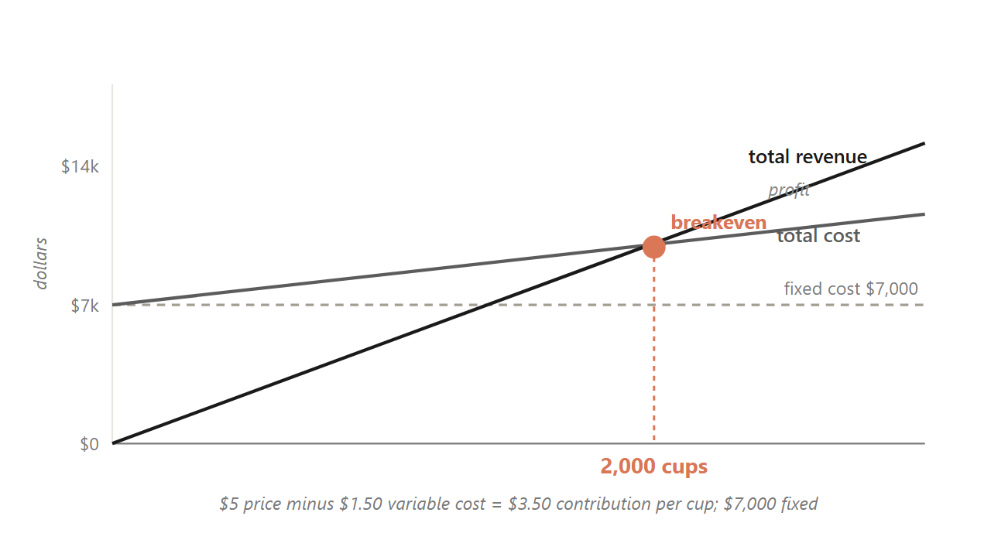
10.2.1 / BREAKEVEN
10 / 31
A $5 drink that costs $1.50 breaks even at 2,000 cups, because the contribution margin sets the target.
Total fixed costs divided by per-unit contribution margin gives the volume to clear.
Source: Kotler et al. (2022); illustrative campus-drink figures.
Notes:
Before any price can be fair or competitive it has to cover the firm's costs. The tool that finds the floor is breakeven analysis. Walk the math live. A 5 dollar campus drink costs 1.50 in ingredients per cup, so each cup contributes 3.50. If the semester's fixed costs are 7,000 dollars, you break even at 2,000 cups. Now make it real. Ask: what if you raised the price to 6? Margin widens to 4.50, breakeven drops to about 1,556 cups. What if you cut to 4? Margin thins to 2.50, breakeven pushes to 2,800. The lesson is that the contribution margin, not the sticker, sets how hard the volume target is. This is the same asymmetry from slide 4, read from the cost floor instead of the profit line.
Discussion: At a $5 price, how many cups must you sell to make a $3,500 profit on top of fixed costs?
Time: ~90s

Slide 11
10.2.2
11 / 31
Competitor-based pricing anchors to rivals, and the danger is the reflexive match.
1
Why did the rival move? A real cost change holds, a quarter-end push reverses.
2
Is it permanent or temporary? Permanent needs a structural answer; temporary needs only a promotion.
3
What does not responding cost? Measure share loss in scanner data over four to eight weeks.
4
What does my response trigger next? Match plus deeper promotion reads as willingness to escalate. Think two moves ahead.
Source: Kotler et al. (2022); Publix vs Walmart 2024.
Notes:
Competitor-based pricing lives in commodity and grocery aisles. In 2024 Publix cut prices below Walmart on about 500 items. The temptation when a rival cuts is to match automatically. That can start a price war the firm did not want, or worse, signal a willingness to escalate. Walk these four questions as the diagnostic before you respond. The point is to think two moves ahead, not one. Pause on question one: a real cost cut holds, a quarter-end shelf push reverses within ninety days. Diagnosing the why changes the right response.
Discussion: If your competitor drops price 10 percent next Monday, which of the four questions do you ask first?
Time: ~75s

Slide 12
10.2.3
12 / 31
Value-based pricing asks what the product is worth to a buyer who would otherwise buy the alternative.
This is the only one of the four approaches tied directly to the buyer's wallet.
Source: Kotler et al. (2022), Ch 11.
Notes:
Three pricing approaches answer three different questions. Cost-plus asks: what did this cost me to make? Competitor-match asks: what does the rival charge? Value-based asks a different question entirely: what is this worth to my buyer, if their alternative is the next product on the shelf? Only the third question is tied to the buyer's wallet. The tool that answers it is economic value to customer, the EVC walk we look at next.
Discussion: Why does asking 'what did this cost me' often produce the wrong price?
Time: ~45s

Slide 13
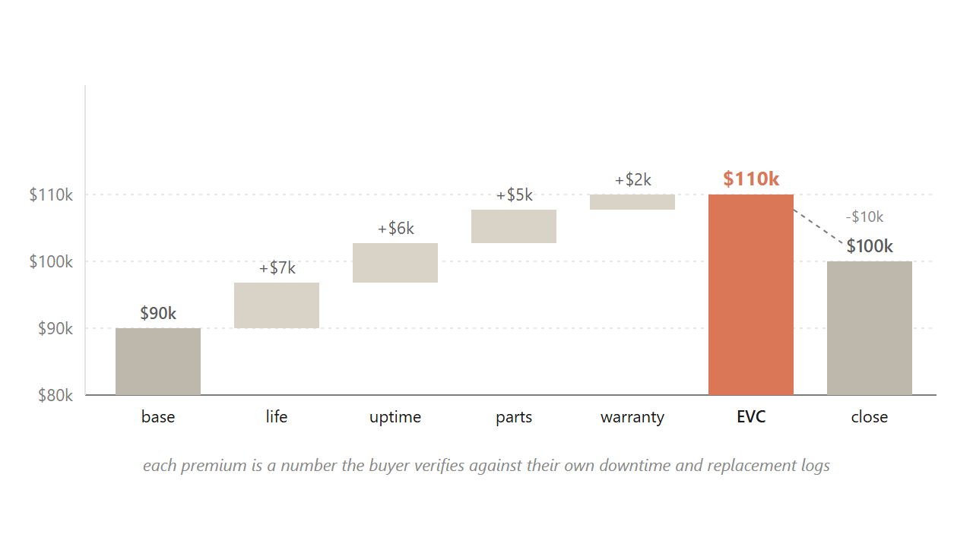
10.2.3 / EVC
13 / 31
Caterpillar builds $90K to a $110K ceiling, then closes at $100K, capturing premium a competitor-match gives away.
Each premium is a number the buyer verifies against their own downtime logs.
Source: Kotler et al. (2022); the Caterpillar value-walk worked example.
Notes:
Walk students through this build live. The dealer opens at the 90,000 dollar competitor-equivalent base, the number procurement has already anchored on. Then attaches a premium to each attribute where the Caterpillar is better. Longer component life: seven thousand, justified by a longer replacement cycle. Fewer breakdowns: six thousand, justified by less idle rental time. Same-day parts: five thousand, justified by avoiding three days of idle equipment on a paving contract. Warranty: two thousand. That sums to a 110,000 dollar EVC. The dealer does not post the full 110, because a value-based pitch almost always closes at a discount that lets both sides feel they captured something. The pitch closes at 100, the buyer signs at 100, the dealer captures 10,000 of premium a competitor-match would have given away. The discount is the closing move. The EVC walk is what made the discount possible.
Discussion: Why does the dealer leave 10,000 dollars on the table at close? Why not push for the full 110?
Time: ~100s

Slide 14
BRIDGE
Value-based pricing only works as well as the firm's read of willingness to pay.
Next: how do you measure what buyers will pay before you launch?

Slide 15
PART 3 OF 5
3
Part 3. Willingness to pay varies from one buyer to the next.
Elasticity, the Van Westendorp method, and conjoint analysis.

Slide 16
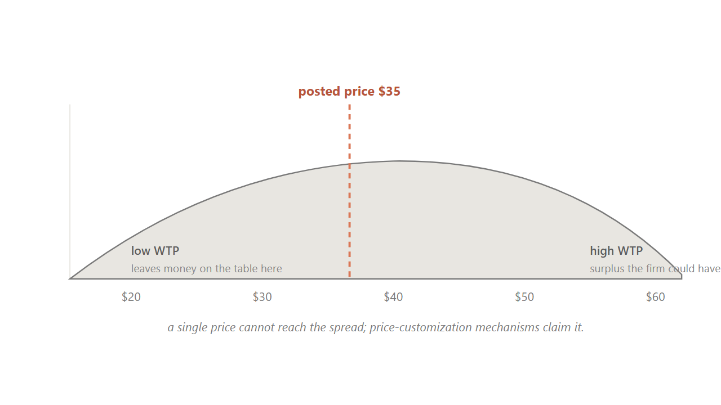
10.3
16 / 31
Willingness to pay spreads across buyers, which is why a single posted price always misses someone.
Some buyers would have paid more. Some would have paid only less. The spread gives the demand curve its slope.
Source: Kotler et al. (2022); generic WTP distribution.
Notes:
Hold up a familiar product, like a Stanley tumbler. Ask the room: what would you pay? Get four or five answers. They will spread from twenty dollars to sixty dollars. That spread is willingness to pay, and it varies across buyers. The dashed line in the chart is a posted price, say thirty-five dollars. To the left of the line, the firm is leaving money on the table on buyers who would have paid more. To the right, the firm is losing buyers who would have bought at less. The spread is exactly why a single price always misses on both sides, and why the customization staircase from the last section exists.
Discussion: What would you actually pay for a Stanley tumbler? Show of hands at $25, $35, $45, $55.
Time: ~75s

Slide 17
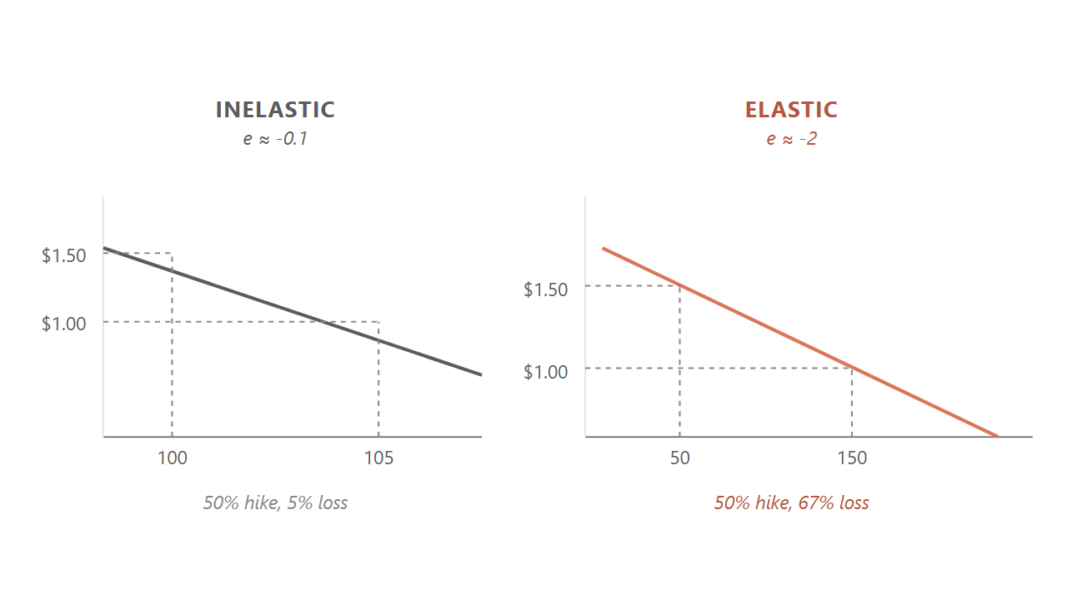
10.3.1
17 / 31
A 10% price hike that cost 15% of volume means the tumbler is elastic at -1.5.
Below -1, an increase loses more than it adds; close to zero, it passes through to profit.
Source: Bijmolt, van Heerde & Pieters, JMR 42 (2005), 1,851 elasticities, mean -2.62.
Notes:
Elasticity puts a number on how strongly volume responds to price. Walk through the worked case. A campus dealer raises the Stanley from 45 to 49.50, a 10 percent move. Weekly volume falls from 200 to 170, a 15 percent drop. Elasticity is the percent change in quantity divided by the percent change in price: negative 15 over 10, which is negative 1.5. That is elastic. The increase is a net loss for the firm. Then show the two curves on the slide. The steep inelastic curve loses almost no volume from the same hike. The shallow elastic curve loses half the volume. The cross-category average is around negative 2.62, but each brand needs to know where it sits.
Discussion: If elasticity is close to zero, the firm has pricing power. Name a category that sits close to zero.
Time: ~80s

Slide 18
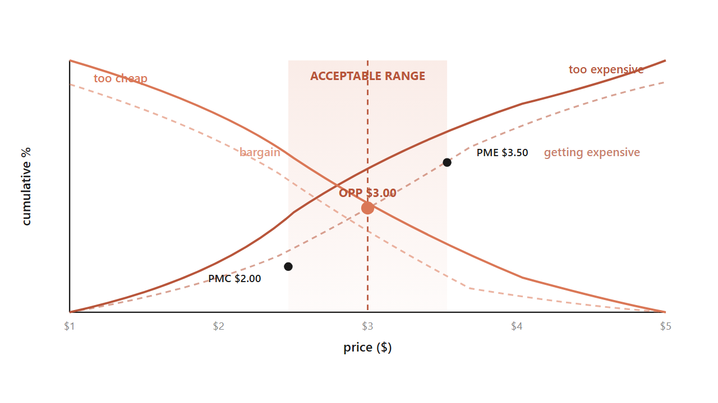
10.3.3 / VAN WESTENDORP
18 / 31
Four questions cross to bound an acceptable price band, even before the product is on the shelf.
Too expensive, too cheap, getting expensive, bargain. Where the curves cross is the band.
Source: Van Westendorp, 29th ESOMAR Congress (1976).
Notes:
The PSM is the launch-stage tool. Every respondent answers four indirect questions about the same product. At what price is it so expensive you would not buy. At what price is it so cheap that quality must be poor. At what price does it start to feel expensive but still worth considering. At what price is it a bargain. You aggregate the answers into cumulative curves. The curves cross at four landmark points. The crossing of too-cheap and too-expensive is the optimal price point, the center of the band. The crossings with bargain mark the upper and lower edges. Below the lower edge the product reads as cheap and stops being a deal. Above the upper edge it reads as gouging. The acceptable band is what sits between.
Discussion: Why ask the questions indirectly instead of just asking 'what would you pay?'
Time: ~85s

Slide 19
BRIDGE
These methods give the firm a number; the buyer reads that number against a reference point.
Next: anchoring, decoys, charm endings.

Slide 20
PART 4 OF 5
4
Part 4. Buyers read prices in System 1, against a stored reference point.
Anchoring. The decoy effect. The $9 ending.

Slide 21
10.4.1
21 / 31
The reference price is a weighted moving average of recent exposures, not a single fixed number.
A $600 dress reads moderate next to a $1,200 sibling and expensive next to a $200 one.
Source: Monroe, Pricing: Making Profitable Decisions (McGraw-Hill, 1979/1990/2003).
Notes:
Buyers do not judge prices in absolute terms. They judge them against a reference, which is a moving average of recent exposures plus competitor prices. So the same $600 dress reads moderate next to a $1,200 sibling and expensive next to a $200 one. That is anchoring at work. Two more pieces of vocabulary. The just-noticeable difference, the smallest price change buyers perceive, runs 5 to 15 percent across consumer categories. Below that fraction, the change is invisible margin to the firm. Around the reference price sits a latitude of acceptance, the band inside which buyers accept the price without comparison shopping. The lower edge matters too: cut too far and the product recodes as not the real thing.
Discussion: You see a $300 wine next to two $40 wines. What does the $300 do to your read of the $40s?
Time: ~70s

Slide 22
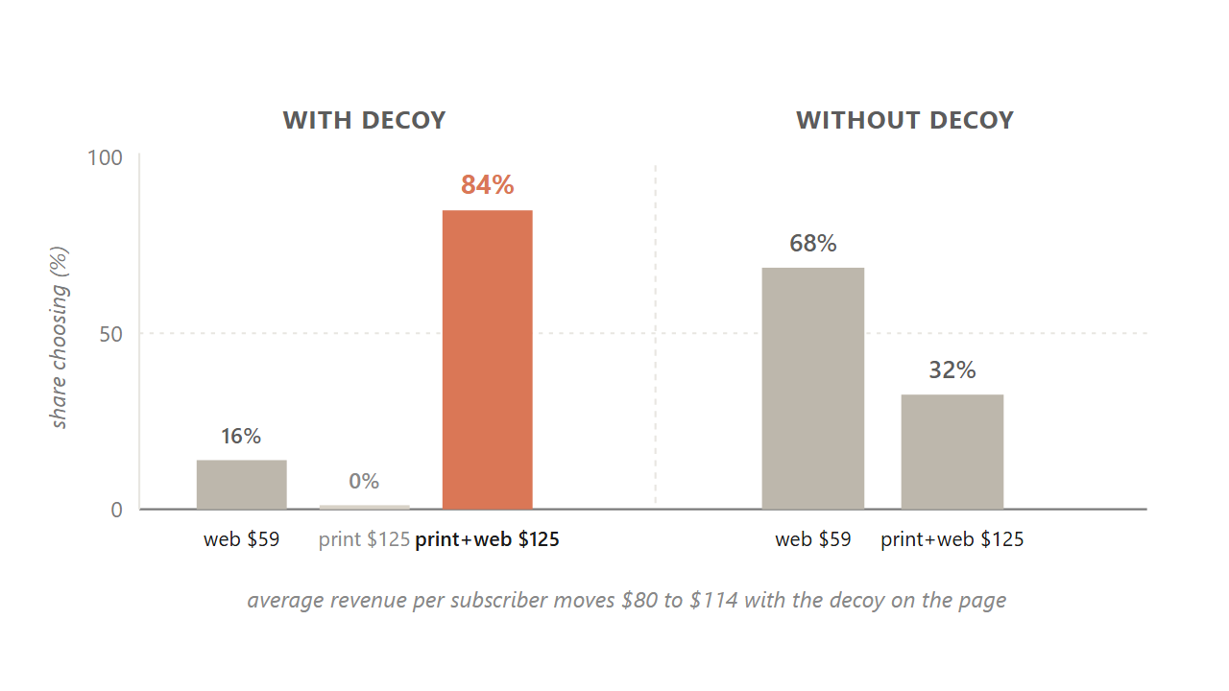
10.4.2 / ASYMMETRIC DOMINANCE
22 / 31
A $125 print-only option nobody picks lifts the bundle from 68% to 84%, because the decoy reframes the comparison.
The decoy is never chosen. It is the firm's lever for making the target option read as the obvious win.
Source: Ariely, Predictably Irrational (2010), MIT replication, n=100 per condition.
Notes:
This is the most-cited case in behavioral pricing. The Economist offered three subscription options. Web only at 59 dollars. Print only at 125. Print plus web at 125. The third option dominates the second on every attribute at the same price. So nobody picks the print-only. Why include it? Because including it shifts choice. With the decoy on the page, 16 percent pick web, 0 percent pick print, and 84 percent pick the bundle. Remove the decoy and the split moves to 68 percent web and only 32 percent bundle. Same two real options, half the bundle revenue. The decoy is never chosen. It is the lever that reframes the comparison so the target reads as the obvious win. Average revenue per subscriber moves from 80 to 114 dollars.
Discussion: Why does the decoy work? What feature does the print-only have to lose by?
Time: ~90s

Slide 23
BRIDGE
All of this has assumed one posted price. What about prices that change minute to minute?
Yield management, surge, and the fairness ceiling that decides whether buyers tolerate it.

Slide 24
PART 5 OF 5
5
Part 5. Dynamic pricing, the fairness ceiling, and three brands that picked an anchor.
When the algorithm is right and the customer is still angry.

Slide 25
10.5
25 / 31
Dynamic pricing lets the number change minute to minute, but its binding constraint is governance, not computing power.
Pricing managers hold back because the recommendation is a black box they cannot defend to a regulator.
Source: Spann, Bertini, Koenigsberg et al., IJRM (2025), 71-manager survey.
Notes:
Most pricing approaches so far assume the firm sets one price and lives with it. Dynamic pricing drops that assumption. The algorithm can change the price minute by minute, channel by channel, even buyer by buyer, as it reads demand and inventory. In theory, this captures more of the surplus a single price leaves on the table. In practice, a 2025 thirteen-author paper surveyed 71 pricing managers from a 25,000-professional panel, and the reported barrier was not technical. Managers hold back because the recommendation is a black box they cannot defend to a regulator, and the fairness exposure runs through their brand. A 2026 dynamic-pricing decision is a brand-and-governance decision wrapped around an algorithm.
Discussion: What does it mean that a pricing recommendation is 'a black box you cannot defend'?
Time: ~70s

Slide 26
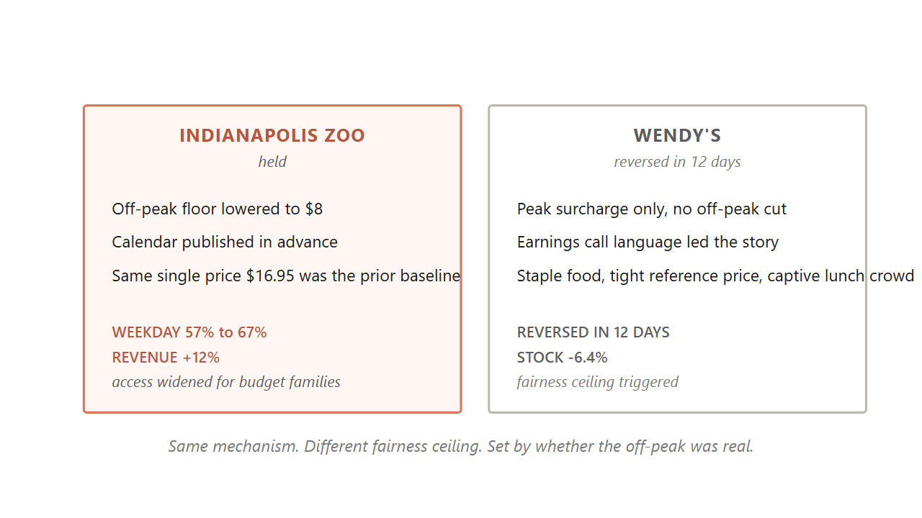
10.5 / CONTRAST
26 / 31
Wendy's reversed in twelve days. The Indianapolis Zoo's grid held.
Same mechanism, opposite fairness ceiling, set by whether the off-peak cut was real and the calendar was published.
Source: Wendy's Q4 2023 earnings call (Feb 2024); CNBC, WSJ, NYT coverage.
Notes:
Hold up the contrast. Wendy's announced dynamic pricing on its February 2024 earnings call. Within twelve days they reversed under viral surge-pricing framing, and the stock dropped 6.4 percent. Why did the Indianapolis Zoo work and Wendy's fail? Three differences. One, the Zoo's off-peak was genuinely lower than the prior single price. Wendy's only announced a peak surcharge with no off-peak cut. Two, the Zoo published the whole calendar in advance. Wendy's mentioned it on an earnings call before any menu-and-value story. Three, the Zoo was a planned outing where families could shift their visit; Wendy's was a captive lunch crowd in a staple-food category with a tight reference price. Same mechanism, opposite fairness ceiling.
Discussion: What single change to Wendy's rollout might have made it survive?
Time: ~80s

Slide 27
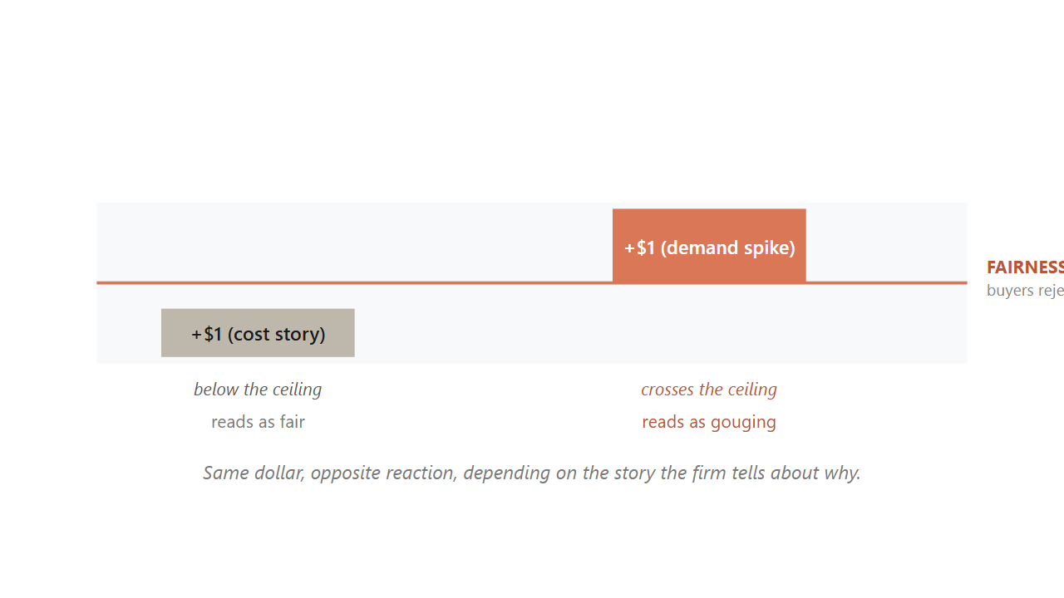
10.7 / DUAL ENTITLEMENT
27 / 31
Buyers grant the firm a reference profit, but not windfall profit from a demand spike.
The same dollar reads as fair after a cost rise and as gouging after a demand spike.
Source: Kahneman, Knetsch & Thaler, AER 76, 4 (1986).
Notes:
This is the deepest finding of the chapter. The 1986 paper named the mechanism the dual-entitlement principle. Buyers grant the firm two separate entitlements. The firm is entitled to defend its reference profit when its costs rise, so a posted increase tied to documented cost inflation reads as fair. The firm is not entitled to capture extraordinary profit from a demand shift, so the same posted increase tied to a heatwave or a hurricane reads as gouging. Same dollar amount, opposite reactions, depending entirely on which story the firm tells about why. This is also why Netflix price-hike emails always cite content investment. The cost story is what makes the increase tolerable. The story matters more than the math.
Discussion: You manage a pizza chain. Cheese costs go up 20%. Storm forecasts a Saturday surge. How do you price for each?
Time: ~90s

Slide 28
CLOSING
Closing. Three brands, three anchors, three structural commitments.
Costco, Patagonia, Liquid Death.

Slide 29
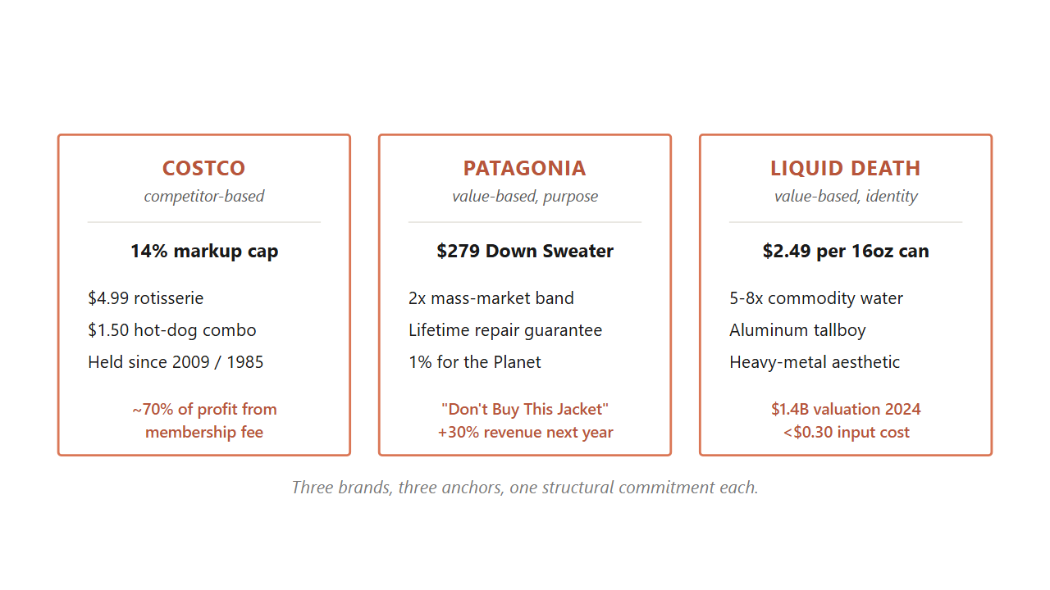
10.8
29 / 31
Costco anchors on competitor-match, Patagonia on value-with-purpose, Liquid Death on value-with-identity.
Each picks one approach as a structural commitment and runs the rest of the business off it.
Source: Costco annual reports 2022-2024; Worn Wear FY25 report; Liquid Death Series E filings 2024.
Notes:
Three brands carry the chapter as worked structural cases. Walk each one in order. Costco is competitor-based at the SKU level: a 14 percent markup cap, $4.99 rotisserie chicken held since 2009, $1.50 hot-dog combo held since 1985. The shelf price is visibly low. About 70 percent of profit comes from the membership fee, which absorbs the margin penalty no unbacked everyday-low-price retailer survives. Patagonia is value-based with purpose: a $279 Down Sweater against a mass-market band of $89 to $149, defended through durability, a lifetime repair guarantee, the 1 percent for the Planet pledge, and the Worn Wear resale program. The 2011 Don't Buy This Jacket ad was the value argument made visible, and revenue rose 30 percent the next year. Liquid Death is value-based with identity: $2.49 for a 16-ounce can of Alpine water, 5 to 8 times Smartwater per ounce, on a $1.4 billion valuation in 2024. The buyer is not purchasing hydration, they are purchasing an identity expression. All three pick one anchor and commit.
Discussion: Which of the three commitments is most fragile? Which is most defensible? Why?
Time: ~110s

Slide 30
10.9 / CALLBACK
30 / 31
Mylan's EpiPen climb worked for nine years because each step sat below the just-noticeable difference.
What broke it was not the marginal cost or the algorithm. It was the fairness ceiling, the same one that ended Wendy's surge in twelve days.
Source: U.S. Senate Special Committee on Aging hearings (2016); Bertini & Koenigsberg, HBR (May 2024).
Notes:
Now bring the whole chapter back to the opening. The EpiPen climb from 100 to 608 worked for nine years for three reasons, all of which the chapter has explained. Each step sat below the just-noticeable difference, the 5 to 15 percent threshold from section 10.4. The cost story was plausible enough to absorb each move under the dual-entitlement principle. And no competitor was positioned to undercut at the wholesale level. What ended it was the same fairness ceiling that caught Wendy's twelve days into surge pricing. Once the cumulative line was visible at a Senate hearing, the dual-entitlement story stopped working. Parents of allergic children were the vulnerable group from the moral-harm model. The product was a life-saving necessity. The firm's stated reason was not one buyers would accept. Within a year, Mylan committed to a half-price generic. The price came down because the fairness ceiling caught up with the climb, not because the marginal cost moved.
Discussion: Knowing what we know now, when should Mylan have stopped raising the price?
Time: ~90s

Slide 31
TAKEAWAYS
31 / 31
Match the EVC walk to the buyer you have, watch the fairness ceiling more carefully than the algorithm.
Cost is the floor, competitor is the frame, value is the ceiling, and fairness is the ceiling above the ceiling.
Notes:
Wrap up by summarizing what students can do on Monday morning. One, build the EVC walk: find the buyer's next-best alternative, attach a dollar premium to each attribute where you are better, close below the full value. Two, run the four-question diagnostic before matching a rival's move. Three, recover the band with the four PSM questions when you have no sales history. Four, run the six-principle audit before any dynamic-pricing rollout. Five, check the fairness ceiling before posting any increase: is there a cost story, is there a lower option, was the change published in advance. The next chapter walks the channel structures that decide whether your price ever reaches the shelf the buyer is standing in front of.
Discussion: Of the five moves on this slide, which is the one you most need to remember?
Time: ~75s

