Slide 1
CHAPTER 10
Pricing is the only mix decision that brings in revenue.
Every other decision spends money. Price is the one that captures it.
MKTG 4333 / Principles of Marketing
An AI-Integrated Approach
Notes:
Open by asking the room a quick question: of the four Ps, which one is the only one that creates revenue rather than spending it? Take two or three answers. Most students will guess product or place. Reveal that price is the only one. Then orient them to the chapter: this lecture walks the floor (cost), the frame (competitor), the ceiling (value), and the ceiling above the ceiling (fairness) that finally caught up with EpiPen. Set expectations: by the end, students should be able to defend a price, not just calculate one.
Discussion: Of the four Ps, which is the only one that captures revenue rather than spending it?
Time: ~60s

Slide 2
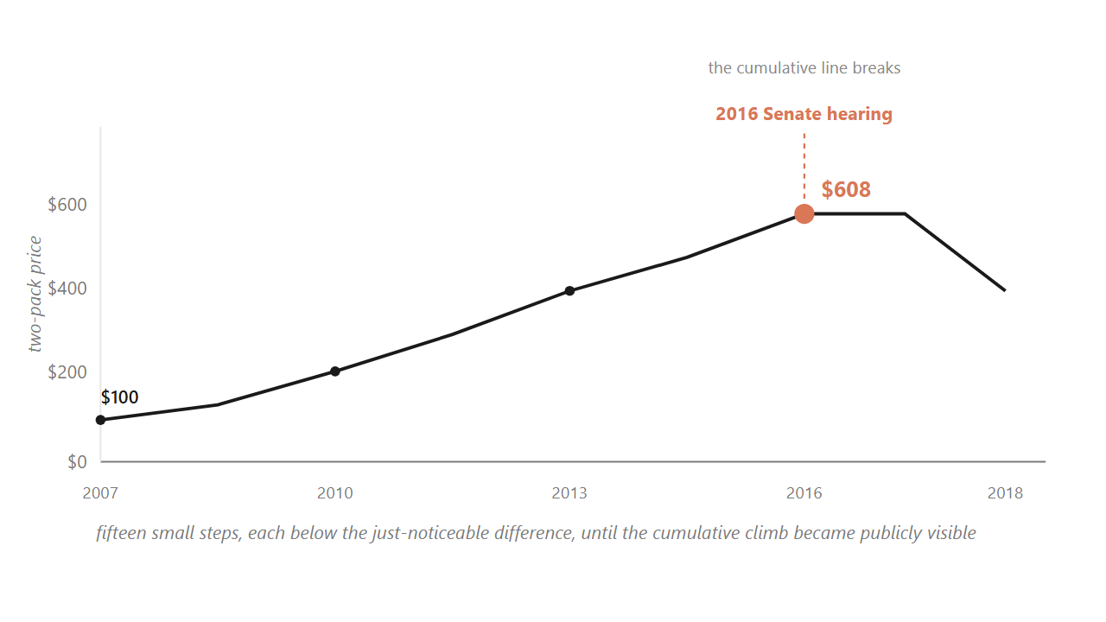
HOOK
02 / 49
EpiPen climbed from $100 to $608 across nine years, then broke at a Senate hearing in 2016.
Fifteen small steps, each below the just-noticeable difference, until the cumulative line became publicly visible.
Source: U.S. Senate Special Committee on Aging hearings (2016); Reuters on Mylan EpiPen 2007-2016.
Notes:
Walk students through the climb. The drug did not change. The injector did not change. Mylan held about 90 percent of the market. Parents had no substitute. Each individual step was small enough to draw no public reaction. That worked for nine years. Then in 2016 a Senate hearing made the cumulative line publicly visible, and within a year Mylan committed to a half-price generic. Pause here. Ask the room: what changed? Nothing about the cost or the product. What changed was the fairness ceiling. Tell them this is where the chapter ends, so they should hold this image as the destination.
Discussion: What changed in 2016 that brought the price down? Nothing about cost or product. So what?
Time: ~75s

Slide 3
PART 1 OF 5
1
Part 1. Why a 1% price move beats a 1% volume move.
Asymmetric leverage. The math of the highest-leverage decision in marketing.

Slide 4
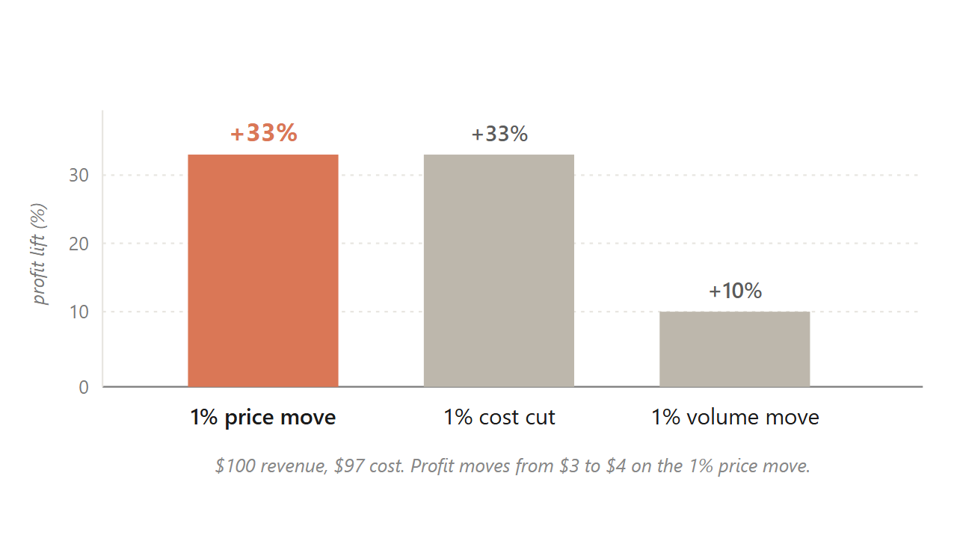
10.1 / ASYMMETRIC LEVERAGE
04 / 49
At a 3% margin, a 1% price move lifts profit about 33%; a 1% volume move lifts it only about 10%.
Extra price needs no extra cost. Extra volume drags its share of cost.
Source: Marn & Rosiello, HBR (1992); Simon-Kucher engagement record; figures illustrate the 3% net-margin case.
Notes:
Hold up the bars. The price bar and the cost-cut bar look identical at plus 33 percent. The volume bar is one third the height. Walk the arithmetic out loud once: 100 dollars revenue, 97 dollars cost, 3 dollars profit. Raise the price one percent, revenue goes to 101, cost holds at 97, profit goes to 4. That is a 33 percent jump in profit on a 1 percent move. Then ask the room: to get the same extra dollar through volume, how many more units would you need? About 33 percent more, because each extra unit drags its share of cost. The price lever is structurally bigger than the volume lever, and yet most pricing teams are paid on volume.
Discussion: Most pricing managers are paid on volume targets. Given this chart, why is that a misallocation of incentives?
Time: ~80s

Slide 5
10.1
05 / 49
Netflix climbed from $7.99 in 2010 to $15.99 in 2024 because one more streamed minute costs nearly nothing.
The marginal-cost asymmetry is why the moves passed through; a grocer raising margarine cannot do the same.
Source: Netflix Q4 2024 earnings; Antenna Q126 State of Subscriptions.
Notes:
Show why digital products carry the lever so cleanly. The cost of streaming one more minute to one more household rounds to zero. Bandwidth is fractions of a cent. The content is already produced. So each price move passes through almost directly to the bottom line. Contrast a grocery chain raising margarine a dollar. The next tub still has to be bought, shipped, and warehoused. Same logic, different scale of payoff. This is the structural reason software pricing is studied separately from physical-goods pricing.
Discussion: What categories carry the asymmetry like Netflix? What categories carry it weakly, like the grocer?
Time: ~60s

Slide 6
10.1 / DOLAN & SIMON
06 / 49
Capturing the lever takes four organizational capacities, and most firms skip the fourth.
1
Viewpoint: pricing is the primary profit lever, not a follow-on of volume.
2
Fact base: measured buyer response, not the team's anchor.
3
Tools: segmentation, bundling, time-based pricing.
4
Resolve: hold the recommended number when the sales force pushes for end-of-quarter discounts.
Source: Dolan & Simon, Power Pricing (Free Press, 1996), four-dimensional power-pricer framework.
Notes:
Reveal each capacity in order. The first three are usually present in any decent organization. The fourth is where most pricing initiatives die. Tell students that this is what you will see in your own careers: someone builds a beautiful pricing model, gets exec approval, and then watches sales reps quietly grant exception discounts to hit their quarterly numbers. Within two quarters the recommended price band has eroded. The lever exists in the math. The resolve is what holds it.
Discussion: Why is the fourth capacity hardest? What incentive structure would actually protect the price?
Time: ~75s

Slide 7
PART 2 OF 5
2
Part 2. Cost is the floor. Competitor is the frame. Value is the ceiling.
Four approaches to setting the number, and only one is tied to the buyer's wallet.

Slide 8
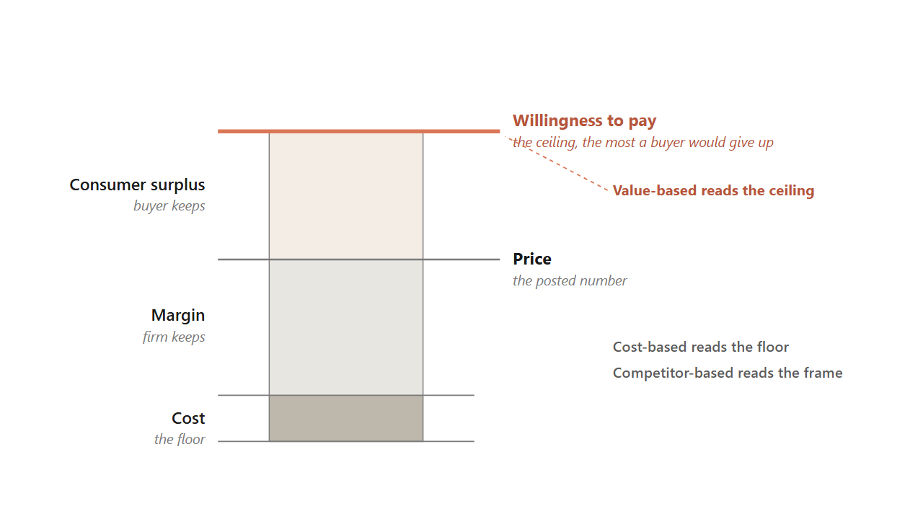
10.2 / THE VALUE STICK
08 / 49
The price lives between cost and willingness to pay, and the ceiling is the buyer's, not the firm's.
Cost-based reads the floor. Competitor-based reads the frame. Value-based reads the ceiling.
Source: Kotler, Keller & Chernev, Marketing Management 16e (2022).
Notes:
This diagram is the central image of the chapter. Walk the stack bottom to top. Cost sits at the floor. The margin is what the firm keeps between cost and price. Above the price is the consumer surplus, what the buyer keeps. The top of the stick is willingness to pay, the most that buyer would have given up. Now show the strategic move. Three of the four pricing approaches read different lines on this stick. Cost-based reads the floor. Competitor-based reads the frame somewhere in the middle. Value-based asks what is the buyer's ceiling, and tries to push the price up the surplus. The chapter's argument is that most firms anchor on cost because it is easy to measure, and leave money on the table at the top.
Discussion: If two buyers see the same product, why might their willingness-to-pay ceilings be different?
Time: ~90s

Slide 9
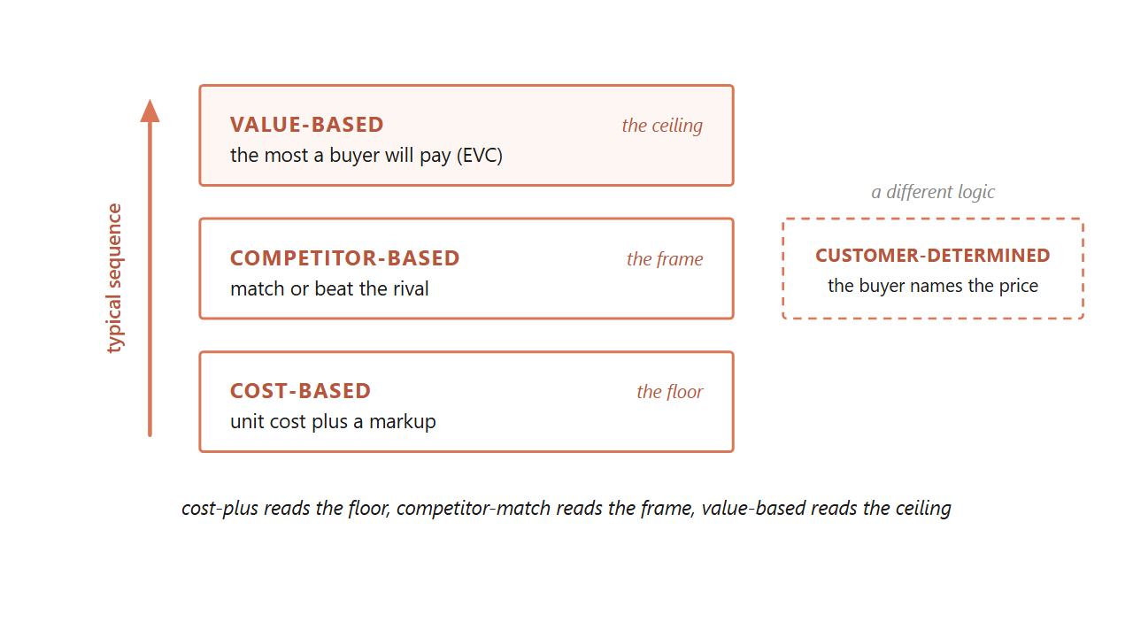
10.2 / FOUR APPROACHES
09 / 49
A firm typically climbs the ladder: cost first, then competitor, then value.
Customer-determined pricing is a separate mode where the buyer names the number.
Source: Dean, Managerial Economics (Prentice-Hall, 1951); Kotler et al. (2022).
Notes:
Use this slide to introduce all four approaches at once. Cost-plus is honest and easy to defend, but it leaves the ceiling unread. Competitor-match is the floor of strategic thinking, but it can spiral into price wars. Value-based requires willingness-to-pay data and organizational resolve, but it is the only approach tied to what the buyer would actually pay. Customer-determined is a different logic entirely: the buyer names the price, the firm accepts or rejects. Tell students they will see all four in their careers, and the question is which one fits each product and buyer.
Discussion: Name a product you bought recently. Which of the four approaches did the seller probably use?
Time: ~75s

Slide 10
10.2.1
10 / 49
Cost-based pricing survives because cost is easy to measure, but it leaves the ceiling unread.
Regulated utilities are its honest home: a regulator allows a return and the price is worked backward.
Source: Kotler et al., Marketing Management 16e (2022).
Notes:
Cost-plus is the default because firms know their costs. A 50 percent markup on a 60 dollar unit gets a 90 dollar sticker. Done. The failure mode is that buyers do not pay for what a product cost the firm; they pay for what it is worth to them. So cost-plus consistently leaves dollars on the table where willingness to pay is high. The honest home for cost-plus is regulation: when a utility's regulator allows a specified return, the price is calculated backward from the return at forecast volume. That is target-rate-of-return pricing.
Discussion: If cost is so easy to measure, why does relying on it cost the firm money?
Time: ~50s

Slide 11
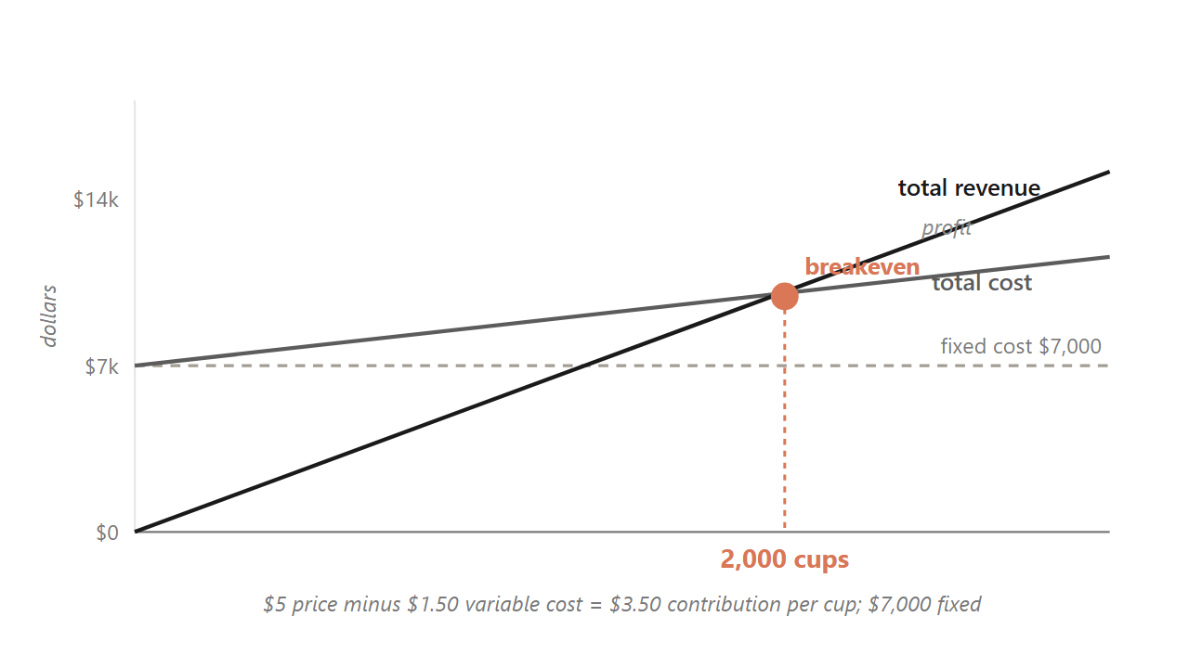
10.2.1 / BREAKEVEN
11 / 49
A $5 drink that costs $1.50 breaks even at 2,000 cups, because the contribution margin sets the target.
Total fixed costs divided by per-unit contribution margin gives the volume to clear.
Source: Kotler et al. (2022); illustrative campus-drink figures.
Notes:
Before any price can be fair or competitive it has to cover the firm's costs. The tool that finds the floor is breakeven analysis. Walk the math live. A 5 dollar campus drink costs 1.50 in ingredients per cup, so each cup contributes 3.50. If the semester's fixed costs are 7,000 dollars, you break even at 2,000 cups. Now make it real. Ask: what if you raised the price to 6? Margin widens to 4.50, breakeven drops to about 1,556 cups. What if you cut to 4? Margin thins to 2.50, breakeven pushes to 2,800. The lesson is that the contribution margin, not the sticker, sets how hard the volume target is. This is the same asymmetry from slide 4, read from the cost floor instead of the profit line.
Discussion: At a $5 price, how many cups must you sell to make a $3,500 profit on top of fixed costs?
Time: ~90s

Slide 12
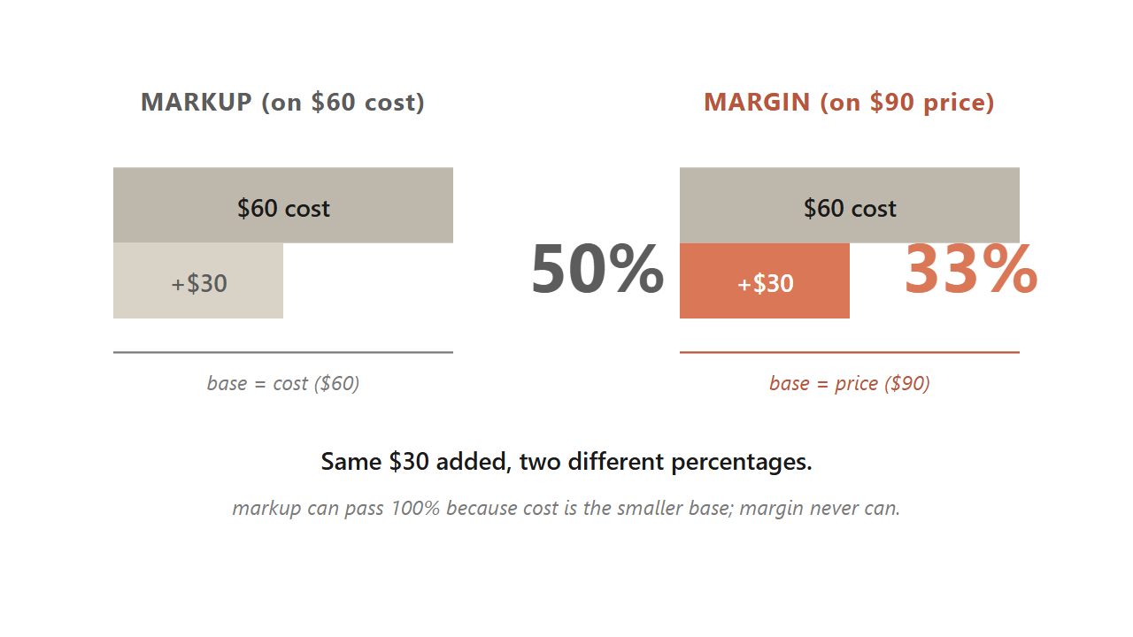
10.2.1 / A DISTINCTION
12 / 49
A 50% markup on cost is only a 33% margin on the same unit, because the bases are different.
Markup uses cost as the base; margin uses price. Mixing them up is how student teams price too thin.
Source: Kotler et al. (2022), Ch 11.
Notes:
This trips up almost everyone the first time. Markup measures the added dollars against cost. Margin measures the same dollars against price. Take a 60 dollar unit sold for 90. The 30 dollars added is a 50 percent markup on the 60 dollar cost. The same 30 dollars is only a 33 percent margin on the 90 dollar price. Markup can run past 100 percent. Margin can never reach 100 percent, because the price always includes the cost. Why does this matter? A student team sets a comfortable-sounding 50 percent markup, then discovers the margin is too thin to cover the fixed costs from the breakeven chart. Always check both numbers.
Discussion: If you sold a 40 dollar unit for 100 dollars, what is the markup percentage? What is the margin?
Time: ~60s

Slide 13
10.2.2
13 / 49
Competitor-based pricing anchors to rivals, and the danger is the reflexive match.
1
Why did the rival move? A real cost change holds, a quarter-end push reverses.
2
Is it permanent or temporary? Permanent needs a structural answer; temporary needs only a promotion.
3
What does not responding cost? Measure share loss in scanner data over four to eight weeks.
4
What does my response trigger next? Match plus deeper promotion reads as willingness to escalate. Think two moves ahead.
Source: Kotler et al. (2022); Publix vs Walmart 2024.
Notes:
Competitor-based pricing lives in commodity and grocery aisles. In 2024 Publix cut prices below Walmart on about 500 items. The temptation when a rival cuts is to match automatically. That can start a price war the firm did not want, or worse, signal a willingness to escalate. Walk these four questions as the diagnostic before you respond. The point is to think two moves ahead, not one. Pause on question one: a real cost cut holds, a quarter-end shelf push reverses within ninety days. Diagnosing the why changes the right response.
Discussion: If your competitor drops price 10 percent next Monday, which of the four questions do you ask first?
Time: ~75s

Slide 14
10.2.3
14 / 49
Value-based pricing asks what the product is worth to a buyer who would otherwise buy the alternative.
This is the only one of the four approaches tied directly to the buyer's wallet.
Source: Kotler et al. (2022), Ch 11.
Notes:
Three pricing approaches answer three different questions. Cost-plus asks: what did this cost me to make? Competitor-match asks: what does the rival charge? Value-based asks a different question entirely: what is this worth to my buyer, if their alternative is the next product on the shelf? Only the third question is tied to the buyer's wallet. The tool that answers it is economic value to customer, the EVC walk we look at next.
Discussion: Why does asking 'what did this cost me' often produce the wrong price?
Time: ~45s

Slide 15
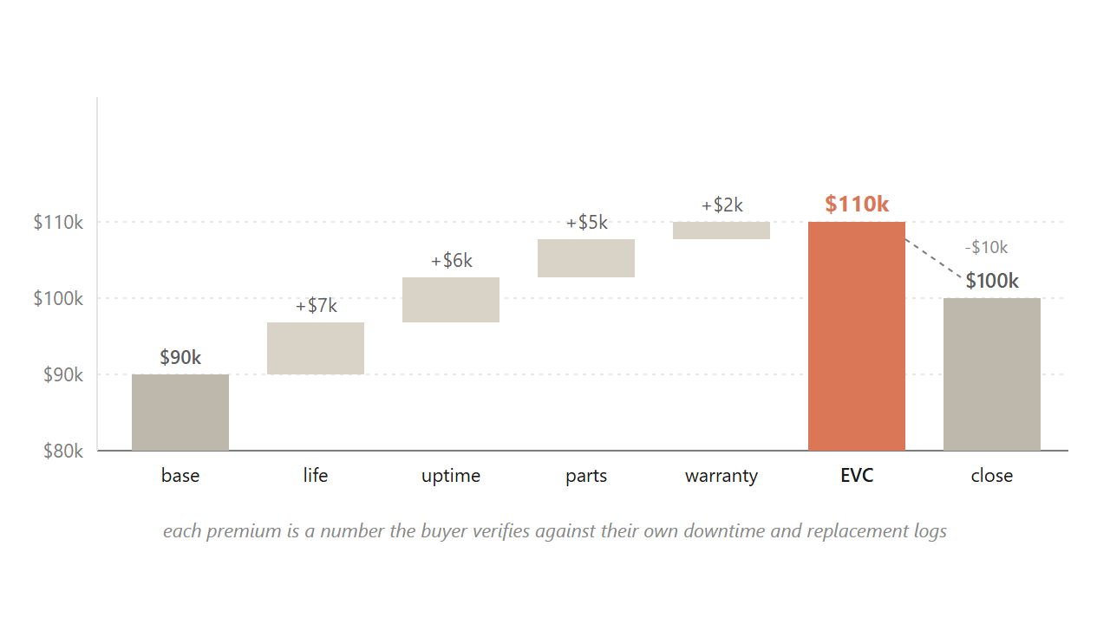
10.2.3 / EVC
15 / 49
Caterpillar builds $90K to a $110K ceiling, then closes at $100K, capturing premium a competitor-match gives away.
Each premium is a number the buyer verifies against their own downtime logs.
Source: Kotler et al. (2022); the Caterpillar value-walk worked example.
Notes:
Walk students through this build live. The dealer opens at the 90,000 dollar competitor-equivalent base, the number procurement has already anchored on. Then attaches a premium to each attribute where the Caterpillar is better. Longer component life: seven thousand, justified by a longer replacement cycle. Fewer breakdowns: six thousand, justified by less idle rental time. Same-day parts: five thousand, justified by avoiding three days of idle equipment on a paving contract. Warranty: two thousand. That sums to a 110,000 dollar EVC. The dealer does not post the full 110, because a value-based pitch almost always closes at a discount that lets both sides feel they captured something. The pitch closes at 100, the buyer signs at 100, the dealer captures 10,000 of premium a competitor-match would have given away. The discount is the closing move. The EVC walk is what made the discount possible.
Discussion: Why does the dealer leave 10,000 dollars on the table at close? Why not push for the full 110?
Time: ~100s

Slide 16
10.2.3 / DOLAN & SIMON
16 / 49
A single price leaves money on the table, so firms run a staircase of five customization mechanisms.
1
Segmentation: Adobe at $20 student vs $60 professional.
2
Nonlinear: Costco's $65 fee plus a per-item shelf price.
3
Bundling: the Disney+, Hulu, and HBO Max trio at one number.
4
Product-line: Apple's SE-to-Pro-Max ladder, same brand five tiers.
5
Time-based: Patagonia's Worn Wear resale at half retail.
Source: Dolan & Simon, Power Pricing (Free Press, 1996).
Notes:
Reveal each mechanism with one famous example. The point is that a single posted price always misses the spread of willingness to pay. A staircase captures more of the curve. Each of these five mechanisms reaches a different slice. Most firms running three of them capture most of the available lift. Pause on Costco for a moment because it shows up again at the end of the chapter as a structural commitment: the membership fee carries the profit, and the shelf price is just visible enough to keep members renewing.
Discussion: Of these five, which one does your favorite brand use? Which combination?
Time: ~75s

Slide 17
10.2.5
17 / 49
Launch high to skim early enthusiasts, or launch low to seed adoption: the Bass q-over-p ratio tells you which.
When q/p is above 7, penetration wins. Below 4, skim wins. A campus drink lives in the high q/p regime.
Source: Bass (1969); Krishnan, Bass & Jain, Management Science (1999).
Notes:
When you launch something new, do you start high or low? Two named postures. Skim launches high to capture the early enthusiasts who would pay almost anything, then walks the price down as they get used up. Apple's iPhone is the classic. Penetration launches low on the bet that visible early adopters pull imitators in behind them. Spotify's free tier is the cleanest version. The 1969 Bass diffusion model gives you a rule. When the imitation cascade is strong, the q over p ratio above seven, penetration wins. When the cascade is weak, below four, skim wins. A campus drink lives in the high q over p regime because every party photo is an imitation channel, so a 4 dollar launch beats an 8 dollar launch on two-semester share.
Discussion: A new productivity app for accountants. Skim or penetrate? Why?
Time: ~70s
Skip if short.

Slide 18
BRIDGE
Value-based pricing only works as well as the firm's read of willingness to pay.
Next: how do you measure what buyers will pay before you launch?

Slide 19
PART 3 OF 5
3
Part 3. Willingness to pay varies from one buyer to the next.
Elasticity, the Van Westendorp method, and conjoint analysis.

Slide 20
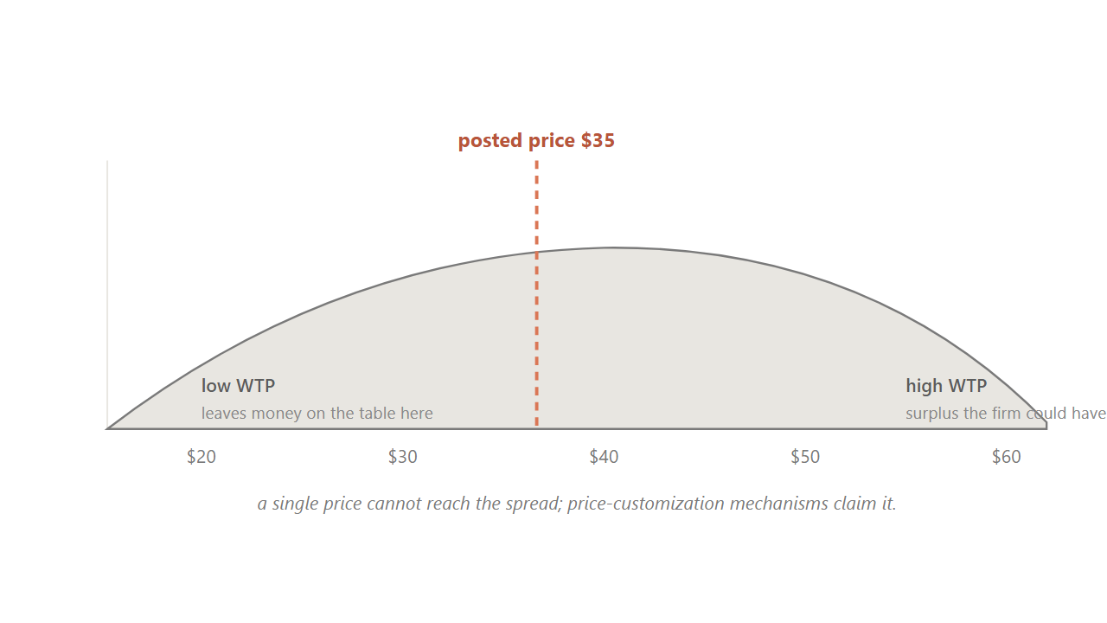
10.3
20 / 49
Willingness to pay spreads across buyers, which is why a single posted price always misses someone.
Some buyers would have paid more. Some would have paid only less. The spread gives the demand curve its slope.
Source: Kotler et al. (2022); generic WTP distribution.
Notes:
Hold up a familiar product, like a Stanley tumbler. Ask the room: what would you pay? Get four or five answers. They will spread from twenty dollars to sixty dollars. That spread is willingness to pay, and it varies across buyers. The dashed line in the chart is a posted price, say thirty-five dollars. To the left of the line, the firm is leaving money on the table on buyers who would have paid more. To the right, the firm is losing buyers who would have bought at less. The spread is exactly why a single price always misses on both sides, and why the customization staircase from the last section exists.
Discussion: What would you actually pay for a Stanley tumbler? Show of hands at $25, $35, $45, $55.
Time: ~75s

Slide 21
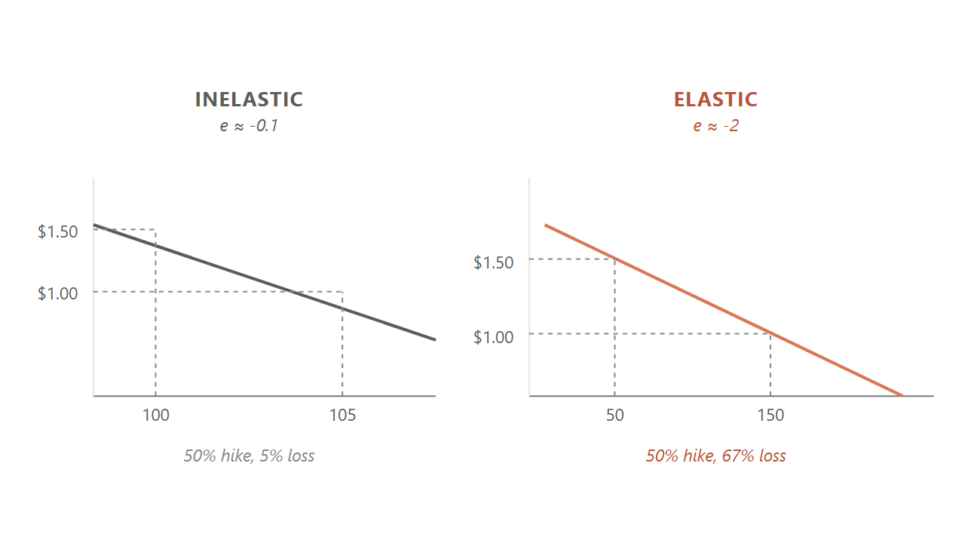
10.3.1
21 / 49
A 10% price hike that cost 15% of volume means the tumbler is elastic at -1.5.
Below -1, an increase loses more than it adds; close to zero, it passes through to profit.
Source: Bijmolt, van Heerde & Pieters, JMR 42 (2005), 1,851 elasticities, mean -2.62.
Notes:
Elasticity puts a number on how strongly volume responds to price. Walk through the worked case. A campus dealer raises the Stanley from 45 to 49.50, a 10 percent move. Weekly volume falls from 200 to 170, a 15 percent drop. Elasticity is the percent change in quantity divided by the percent change in price: negative 15 over 10, which is negative 1.5. That is elastic. The increase is a net loss for the firm. Then show the two curves on the slide. The steep inelastic curve loses almost no volume from the same hike. The shallow elastic curve loses half the volume. The cross-category average is around negative 2.62, but each brand needs to know where it sits.
Discussion: If elasticity is close to zero, the firm has pricing power. Name a category that sits close to zero.
Time: ~80s

Slide 22
10.3.1
22 / 49
Six conditions push a category toward inelastic, and each is a lever the marketer can pull.
1
The product is distinctive: Liquid Death's can does not compete with a plastic bottle.
2
Buyers do not notice the price: Spotify auto-charges on the first of every month.
3
Habits are sticky: a 10-year Costco member keeps the Saturday run after a fee bump.
4
A cost or scarcity story justifies the price: Stanley color drops sell out in 90 seconds.
5
The spend is small relative to income: $2 on a $279 jacket is invisible.
6
A third party pays: a company-billed Salesforce seat hides the price from the user.
Source: Kotler et al. (2022).
Notes:
Walk each condition with the example. The strategic point is that these are not just descriptions; they are levers. A marketer can widen the band of acceptable prices by making the product more distinctive, hiding the price inside an auto-charge, building habits, telling a scarcity story, keeping the spend small relative to income, or finding a third-party payer. The strongest brands stack three or four of these at once. Patagonia stacks distinctive product, a scarcity-and-purpose story, and small relative spend for its buyer base. Spotify stacks auto-charge, habit, and small spend.
Discussion: Pick one of your favorite brands. Which two or three conditions does it stack?
Time: ~80s

Slide 23
10.3.2
23 / 49
Four procedures recover willingness to pay, ordered from cheapest-and-roughest to most-expensive-and-best.
1
Direct asking: cheapest, runs 20-40% below other methods. Buyers under-report.
2
Van Westendorp PSM: four indirect questions, the launch-stage default.
3
Conjoint analysis: bundled-profile choice trade-offs reveal per-feature value.
4
Scanner-data revealed preference: fit a model to what actually sold. Most valid.
Source: Lehmann & Winer, Product Management 4e (McGraw-Hill, 2004), Ch 10.
Notes:
Reveal each method in order. Tell students this is a sequence, not a menu. You start cheap and rough at the prototype stage, then you graduate to richer methods as you spend more money and the launch gets closer. Direct asking is what most teams do first and it is the worst. Van Westendorp is the campus-project default. Conjoint is the textbook gold standard for feature pricing. Scanner data is what you use once the product is on the shelf. The procedures form a sequence: Van Westendorp first, conjoint next, scanner-data when live.
Discussion: If you had $5,000 and three weeks to price a new product, which procedure do you run?
Time: ~75s

Slide 24
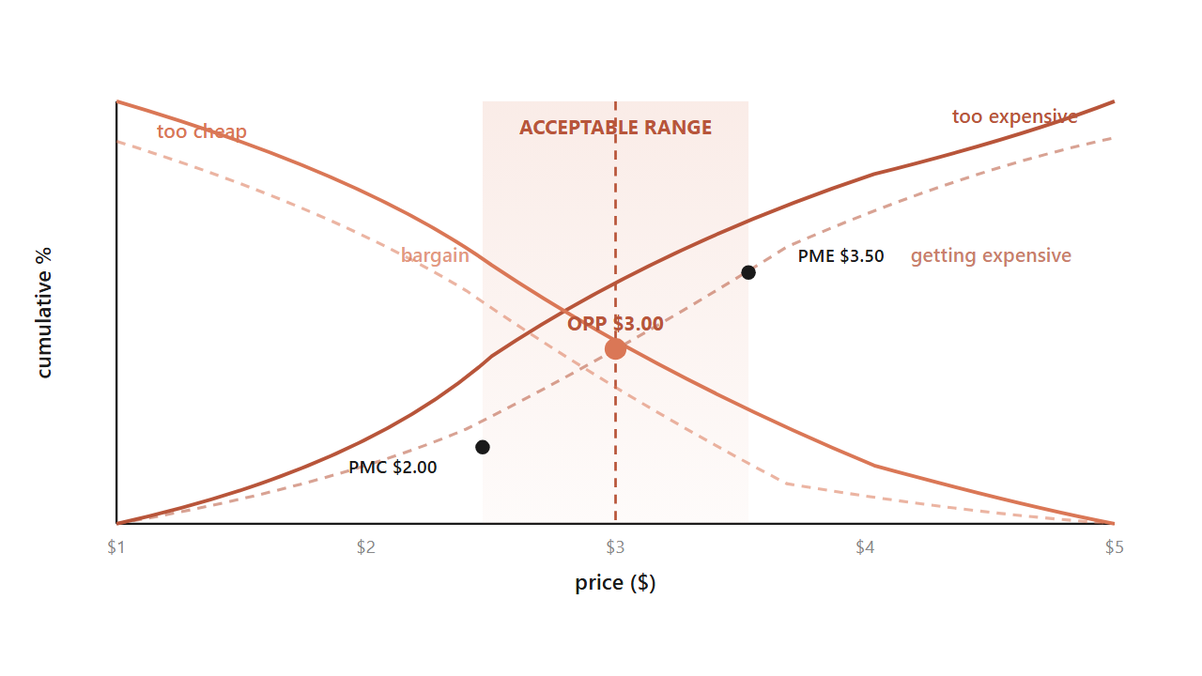
10.3.3 / VAN WESTENDORP
24 / 49
Four questions cross to bound an acceptable price band, even before the product is on the shelf.
Too expensive, too cheap, getting expensive, bargain. Where the curves cross is the band.
Source: Van Westendorp, 29th ESOMAR Congress (1976).
Notes:
The PSM is the launch-stage tool. Every respondent answers four indirect questions about the same product. At what price is it so expensive you would not buy. At what price is it so cheap that quality must be poor. At what price does it start to feel expensive but still worth considering. At what price is it a bargain. You aggregate the answers into cumulative curves. The curves cross at four landmark points. The crossing of too-cheap and too-expensive is the optimal price point, the center of the band. The crossings with bargain mark the upper and lower edges. Below the lower edge the product reads as cheap and stops being a deal. Above the upper edge it reads as gouging. The acceptable band is what sits between.
Discussion: Why ask the questions indirectly instead of just asking 'what would you pay?'
Time: ~85s

Slide 25
10.3
25 / 49
Before you run the survey, do an absurdity walkdown to keep your price grid off your own anchor.
Open with bounds you think ridiculous on both ends, then tighten until each bound is defensible.
Source: Hubbard, How to Measure Anything 3e (Wiley, 2014).
Notes:
Before any survey can measure willingness to pay, the team has to choose the prices the buyer will see. Most teams unconsciously anchor on what they would pay themselves, which biases the whole study. The fix is the absurdity walkdown. Open with bounds you think are ridiculous on both ends, like a tumbler at 10 cents and 400 dollars. Then tighten each bound one click at a time, defending every move, until you can describe a real buyer paying that number. The output is a price range you are roughly 90 percent confident contains the buyer's true willingness to pay. That range becomes the survey grid. Why bother? Because if your survey shows people 40 to 60 dollars, you will never discover the buyer who would pay 80.
Discussion: You are pricing a new energy drink for college students. What are your absurd opening bounds?
Time: ~60s
Skip if short.

Slide 26
10.3.4
26 / 49
Conjoint analysis recovers a dollar value for each feature by forcing buyers to choose between complete bundles.
EINC's roofing study: buyers paid $387 more for longer life and $414 more for better installation, but only $71 more for looks.
Source: Palmatier & Sridhar, Marketing Strategy 2e (Bloomsbury, 2021), Ch 4 EINC case.
Notes:
PSM tells you what buyers will pay for the whole product, but not which feature is doing the work. Conjoint asks a sharper question: which attributes is the buyer actually paying for. You force buyers to choose between complete bundles where attributes vary, and you infer a dollar value per attribute from the trade-offs. The textbook worked case is EINC, a roofing materials firm. They thought their premium came from aesthetics, where they had concentrated R&D for years. The conjoint result said no: buyers would pay 387 more for longer life and 414 more for better installation, but only 71 more for looks. The firm redirected R&D into life and installation, kept the premium price, and picked up share on the dimensions buyers were actually paying for. The smallest part-worth tells you where you are overspending.
Discussion: What did EINC do wrong before the study? What lesson does the smallest part-worth carry?
Time: ~80s
Skip if short.

Slide 27
10.3.1
27 / 49
If volume is weak and a price cut does not lift it, run a matched-market test before you cut again.
Lift one SKU 5% in two look-alike markets, hold for eight weeks, watch the response. A flat result means you were on the inelastic side all along.
Source: Palmatier & Sridhar (2021).
Notes:
Here is a trap that catches lots of brand managers. The brand reads weak volume, cuts price, watches margin erode without a volume lift. Decides the cut was too shallow, cuts again. After two quarters, the price is way down and the volume has barely moved. The diagnostic mistake was assuming the brand was on the elastic side of the demand curve. In reality, the buyers cared more about reliability or social proof than sticker price. The escape from this trap is the matched-market test. Pick two look-alike markets. Lift one SKU 5 percent. Hold for eight weeks. If volume stays flat, you were inelastic the whole time, and another cut was never the cure. The test costs almost nothing relative to a quarter of bad pricing.
Discussion: What is the most expensive consequence of misdiagnosing your category as elastic?
Time: ~70s
Skip if short.

Slide 28
BRIDGE
These methods give the firm a number; the buyer reads that number against a reference point.
Next: anchoring, decoys, charm endings.

Slide 29
PART 4 OF 5
4
Part 4. Buyers read prices in System 1, against a stored reference point.
Anchoring. The decoy effect. The $9 ending.

Slide 30
10.4.1
30 / 49
The reference price is a weighted moving average of recent exposures, not a single fixed number.
A $600 dress reads moderate next to a $1,200 sibling and expensive next to a $200 one.
Source: Monroe, Pricing: Making Profitable Decisions (McGraw-Hill, 1979/1990/2003).
Notes:
Buyers do not judge prices in absolute terms. They judge them against a reference, which is a moving average of recent exposures plus competitor prices. So the same $600 dress reads moderate next to a $1,200 sibling and expensive next to a $200 one. That is anchoring at work. Two more pieces of vocabulary. The just-noticeable difference, the smallest price change buyers perceive, runs 5 to 15 percent across consumer categories. Below that fraction, the change is invisible margin to the firm. Around the reference price sits a latitude of acceptance, the band inside which buyers accept the price without comparison shopping. The lower edge matters too: cut too far and the product recodes as not the real thing.
Discussion: You see a $300 wine next to two $40 wines. What does the $300 do to your read of the $40s?
Time: ~70s

Slide 31
10.4 / ENDOWMENT EFFECT
31 / 49
Owners of a $6 mug demanded $7.12 to give it up; non-owners would only pay $2.87 for the same mug.
Ownership instantly raises the reference price, which is why free trials work and trade-ins beat cash rebates.
Source: Kahneman, Knetsch & Thaler, JPE 98, 6 (1990).
Notes:
The endowment effect is one of the most cited findings in behavioral economics. Cornell undergraduates were randomly given a 6 dollar coffee mug. To part with it, they demanded a median 7.12 dollars. A separate group offered the same mug paid only 2.87 dollars to acquire it. Same mug, opposite sides of the transaction, a roughly two and a half times gap. Ownership instantly lifts the reference price. Tell students this is why free trials work: canceling now reads as a loss. It is why trade-ins outperform equivalent cash rebates: the firm is absorbing the endowment markup. It is also why incumbents have a structural advantage every new entrant has to overcome.
Discussion: Why does Netflix's free month convert better than a $5-off promo of equal value?
Time: ~70s

Slide 32
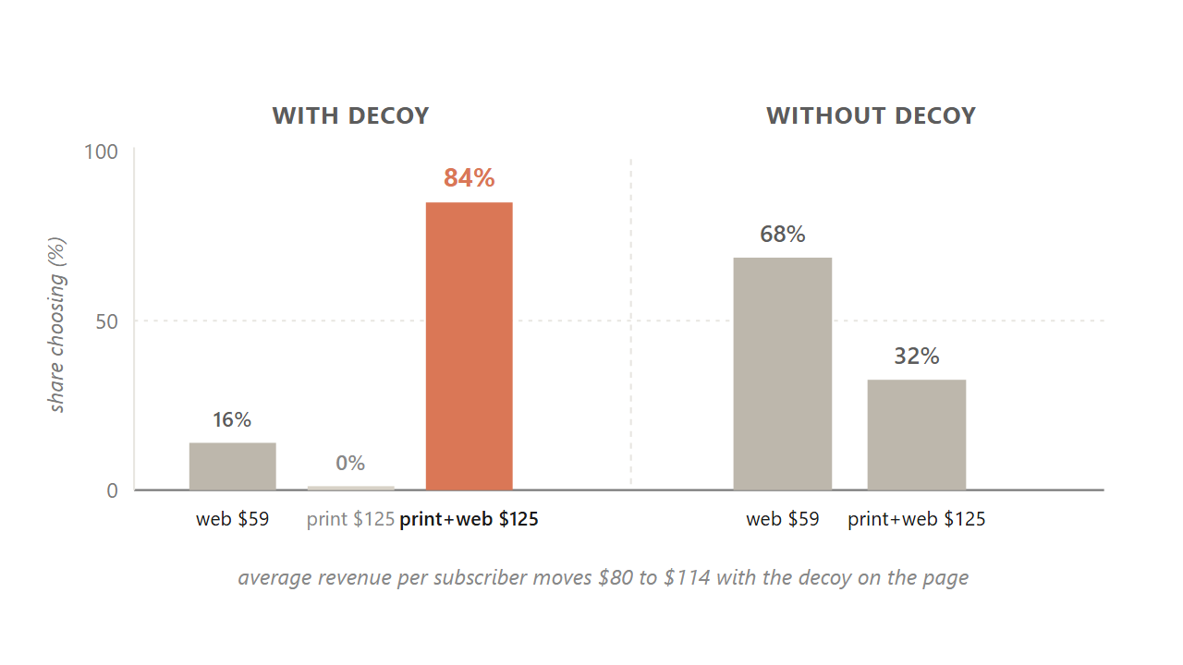
10.4.2 / ASYMMETRIC DOMINANCE
32 / 49
A $125 print-only option nobody picks lifts the bundle from 68% to 84%, because the decoy reframes the comparison.
The decoy is never chosen. It is the firm's lever for making the target option read as the obvious win.
Source: Ariely, Predictably Irrational (2010), MIT replication, n=100 per condition.
Notes:
This is the most-cited case in behavioral pricing. The Economist offered three subscription options. Web only at 59 dollars. Print only at 125. Print plus web at 125. The third option dominates the second on every attribute at the same price. So nobody picks the print-only. Why include it? Because including it shifts choice. With the decoy on the page, 16 percent pick web, 0 percent pick print, and 84 percent pick the bundle. Remove the decoy and the split moves to 68 percent web and only 32 percent bundle. Same two real options, half the bundle revenue. The decoy is never chosen. It is the lever that reframes the comparison so the target reads as the obvious win. Average revenue per subscriber moves from 80 to 114 dollars.
Discussion: Why does the decoy work? What feature does the print-only have to lose by?
Time: ~90s

Slide 33
10.4.2
33 / 49
The compromise effect needs no decoy: a middle option gains share simply by being the defensible middle.
Spotify Free, Premium, and Family is the consumer-software version: the middle price hides in the middle.
Source: Simonson, JCR 16, 2 (1989); meta-analysis by Yang & Lynn (2014), mean +7.6 pp.
Notes:
There is a cousin of the decoy that confuses people: the compromise effect. The compromise effect does not need a dominated option. A middle option gains share simply by being the defensible middle of a trade-off. Spotify Free, Premium, and Family is the consumer-software version. Most buyers pick the middle. It is not the cheapest or the most expensive, so it feels like the safe choice. The meta-analysis puts the lift at about 7.6 percentage points. Practical implication: if you want most buyers to land on a specific tier, design two flanking options that make your target the defensible middle. The decoy is the asymmetric variant. The compromise is the symmetric one.
Discussion: Pick a three-tier product you use. Are you the compromise pick, or did the design push you there?
Time: ~60s
Skip if short.

Slide 34
10.4.3
34 / 49
A 1996 catalog study sold more units at $39 than at either $34 or $44.
The 9-ending reads as a sale signal, so charm works where buyers do not comparison-shop and fails where they look it up.
Source: Anderson & Simester, QME 1, 1 (2003).
Notes:
Charm pricing is one of the most famous and most misunderstood findings. A 1996 MIT and Chicago study rotated a women's clothing item through 34, 39, and 44 dollars across catalog mailings of about 90,000 each. The 39 dollar version sold more units than both the lower and the higher price. Replicated three times. The mechanism is leftmost-digit encoding: buyers read prices left to right and weight the first digit. So 2.99 reads as two-something even when the math says otherwise. The lift is roughly 8 to 24 percent depending on category, and it disappears for buyers who look the number up online. That is why Walmart and fast food use 9-endings, while Apple and Patagonia round to whole numbers. A 9-ending reads as a discount and undercuts a premium position.
Discussion: Why does Patagonia avoid 9-endings? What about your favorite premium brand?
Time: ~70s

Slide 35
BRIDGE
All of this has assumed one posted price. What about prices that change minute to minute?
Yield management, surge, and the fairness ceiling that decides whether buyers tolerate it.

Slide 36
PART 5 OF 5
5
Part 5. Dynamic pricing, the fairness ceiling, and three brands that picked an anchor.
When the algorithm is right and the customer is still angry.

Slide 37
10.5
37 / 49
Dynamic pricing lets the number change minute to minute, but its binding constraint is governance, not computing power.
Pricing managers hold back because the recommendation is a black box they cannot defend to a regulator.
Source: Spann, Bertini, Koenigsberg et al., IJRM (2025), 71-manager survey.
Notes:
Most pricing approaches so far assume the firm sets one price and lives with it. Dynamic pricing drops that assumption. The algorithm can change the price minute by minute, channel by channel, even buyer by buyer, as it reads demand and inventory. In theory, this captures more of the surplus a single price leaves on the table. In practice, a 2025 thirteen-author paper surveyed 71 pricing managers from a 25,000-professional panel, and the reported barrier was not technical. Managers hold back because the recommendation is a black box they cannot defend to a regulator, and the fairness exposure runs through their brand. A 2026 dynamic-pricing decision is a brand-and-governance decision wrapped around an algorithm.
Discussion: What does it mean that a pricing recommendation is 'a black box you cannot defend'?
Time: ~70s

Slide 38
10.5.2
38 / 49
The Indianapolis Zoo moved weekday attendance from 57% to 67% and lifted revenue 12% by publishing a calendar grid.
An $8 Tuesday floor that was lower than the prior single price widened access; the calendar was published in advance.
Source: Talbott, Pricing Solutions Limited (2010); Indianapolis Zoo 2009 implementation.
Notes:
The clearest non-airline yield-management case is the Indianapolis Zoo. They had a single posted adult price of 16.95 that over-priced the empty Tuesday and under-priced the crowded Saturday. So working-poor families who could only visit Saturday faced both the queue and the full price. A pricing consultancy replaced the single price with a published calendar grid: 8 dollar Tuesday floor to 30 dollar peak Saturday. Two design choices separated it from surge pricing. The off-peak price was genuinely lower than the prior single price, so a budget family paid less. And the whole calendar was published in advance. Weekday attendance share moved from 57 to 67 percent. Total revenue rose 12 percent. Access widened for fixed-income families. Yield management is a capacity-allocation tool, and which goal it serves depends on whether the off-peak floor sits below the single-price baseline.
Discussion: What if the Zoo had only published the peak surcharge and kept the 16.95 floor? Same revenue, different brand outcome?
Time: ~90s

Slide 39
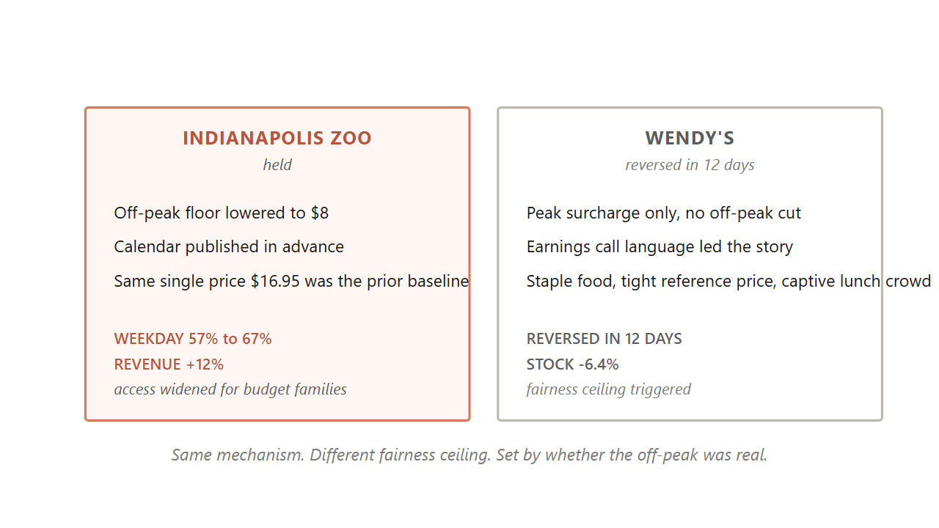
10.5 / CONTRAST
39 / 49
Wendy's reversed in twelve days. The Indianapolis Zoo's grid held.
Same mechanism, opposite fairness ceiling, set by whether the off-peak cut was real and the calendar was published.
Source: Wendy's Q4 2023 earnings call (Feb 2024); CNBC, WSJ, NYT coverage.
Notes:
Hold up the contrast. Wendy's announced dynamic pricing on its February 2024 earnings call. Within twelve days they reversed under viral surge-pricing framing, and the stock dropped 6.4 percent. Why did the Indianapolis Zoo work and Wendy's fail? Three differences. One, the Zoo's off-peak was genuinely lower than the prior single price. Wendy's only announced a peak surcharge with no off-peak cut. Two, the Zoo published the whole calendar in advance. Wendy's mentioned it on an earnings call before any menu-and-value story. Three, the Zoo was a planned outing where families could shift their visit; Wendy's was a captive lunch crowd in a staple-food category with a tight reference price. Same mechanism, opposite fairness ceiling.
Discussion: What single change to Wendy's rollout might have made it survive?
Time: ~80s

Slide 40
10.5.3
40 / 49
Six principles bound a dynamic-pricing rollout: any two violations and the rollout reverses.
1
Explicability: the change reads as fair in terms buyers already hold.
2
Transparency: the rule is inspectable at the moment the buyer sees the price.
3
Cooperative framing: the story is firm and buyer sharing an interest, not extraction.
4
Category tolerance: the category does not carry a tight reference and high frequency.
5
Brand-promise compatibility: the positioning permits price variability.
6
Pre-launch communication: the framing precedes the rollout, not the earnings call.
Source: Bertini & Koenigsberg, HBR (May 2024).
Notes:
Reveal each principle with one 2024 failure case. Wendy's broke principle six, framing the change on an earnings call before any menu story. JetBlue's dynamic checked-bag fee broke principle two, transparency, because buyers at booking could not query the route-demand algorithm. Stonegate's UK pubs broke category tolerance: a familiar pint carries a tight reference price and high frequency. Legoland and Madame Tussauds broke brand-promise compatibility: a family-accessibility promise cannot absorb a weekend surcharge without contradicting 'the family can go any weekend.' The point is that this is a checklist a firm runs before launch, not a constraint hit at reversal.
Discussion: Pick a brand you know that is rumored to be considering dynamic pricing. Which principle is most at risk?
Time: ~90s

Slide 41
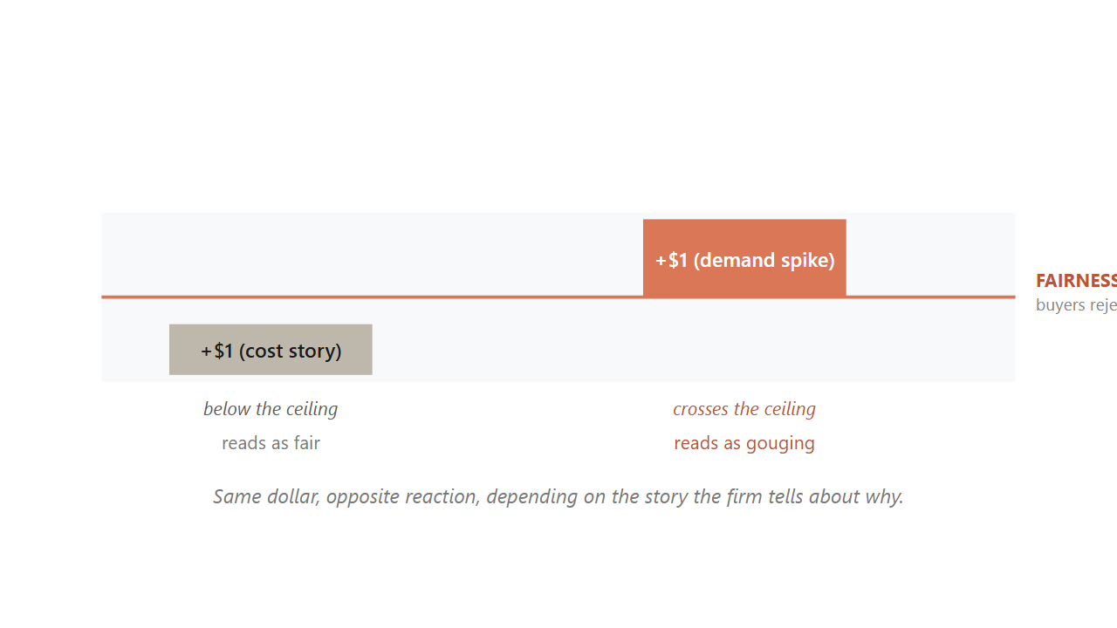
10.7 / DUAL ENTITLEMENT
41 / 49
Buyers grant the firm a reference profit, but not windfall profit from a demand spike.
The same dollar reads as fair after a cost rise and as gouging after a demand spike.
Source: Kahneman, Knetsch & Thaler, AER 76, 4 (1986).
Notes:
This is the deepest finding of the chapter. The 1986 paper named the mechanism the dual-entitlement principle. Buyers grant the firm two separate entitlements. The firm is entitled to defend its reference profit when its costs rise, so a posted increase tied to documented cost inflation reads as fair. The firm is not entitled to capture extraordinary profit from a demand shift, so the same posted increase tied to a heatwave or a hurricane reads as gouging. Same dollar amount, opposite reactions, depending entirely on which story the firm tells about why. This is also why Netflix price-hike emails always cite content investment. The cost story is what makes the increase tolerable. The story matters more than the math.
Discussion: You manage a pizza chain. Cheese costs go up 20%. Storm forecasts a Saturday surge. How do you price for each?
Time: ~90s

Slide 42
10.7
42 / 49
Buyers rated an algorithm-set demographic price gap as more fair than the identical gap set by a human.
The unfairness judgment runs through inferred intent. A human could have chosen otherwise; an algorithm is a rule.
Source: Duani, Barasch & Morwitz, JACR 9, 3 (2024).
Notes:
This finding will surprise students. Four experiments tested the same demographic price gap under two framings: a human pricing manager and an algorithm. Same dollars, same split, same product. Buyers rated the algorithm version as more fair. The path runs through agency and intent attribution in series. A human manager had the freedom to choose otherwise, which invites the inference of an unfavorable intent, that the manager wanted to charge that segment more. An algorithm reads as low-agency, blocking that inference, because a rule-follower could not have wanted anything. The unfairness judgment follows from the inferred intent, not from the dollar gap. But there is a flip. Prosocial pricing, like senior, hardship, and student rates, reverses the result. There a human face is the fairness signal buyers want to see, and an algorithm rolling out a senior discount reads as cold. The rule is binary: put profit-driven personalized pricing behind a published-rule algorithm, but keep a human face on prosocial pricing.
Discussion: Why would the algorithm-vs-human contrast flip for a senior discount?
Time: ~90s
Skip if short.

Slide 43
10.7
43 / 49
When the shelf price is the brand risk, firms reach for less-visible routes.
1
Posted increase: raise the shelf price. Detection is immediate.
2
Absorb: hold price and package, eat the margin.
3
Shrinkflation: hold price, shrink the package. Per-unit price rises invisibly.
4
Skimpflation: hold price and size, substitute cheaper inputs. Hardest to detect.
Source: GAO-25-107451 (Sep 2025); Frito-Lay Doritos 2021 case.
Notes:
When input-cost inflation compresses margin and the dual-entitlement story for a posted increase looks weak, firms have four routes. Walk each one. The 2021 Doritos case is the standard medium-recall example: the share-size bag went from 9.75 to 9.25 ounces, a 5.1 percent per-unit increase with the shelf tag unchanged. Early scanner data showed small share loss to private label that recovered over six to nine months. Frito-Lay captured most of the per-unit margin a posted increase would have produced, with a fraction of the share loss. Tell students this is going to be regulated soon. The September 2025 GAO baseline exists, Casey-Warren S.3819 is in committee, and the architecture mirrors the 2024 Junk Fees Rule. The 2026 move is to separate the disclosure decision from the size decision: post the per-unit change prominently.
Discussion: Is shrinkflation just smart pricing, or is it deceptive? When is the line crossed?
Time: ~85s
Skip if short.

Slide 44
CLOSING
Closing. Three brands, three anchors, three structural commitments.
Costco, Patagonia, Liquid Death.

Slide 45
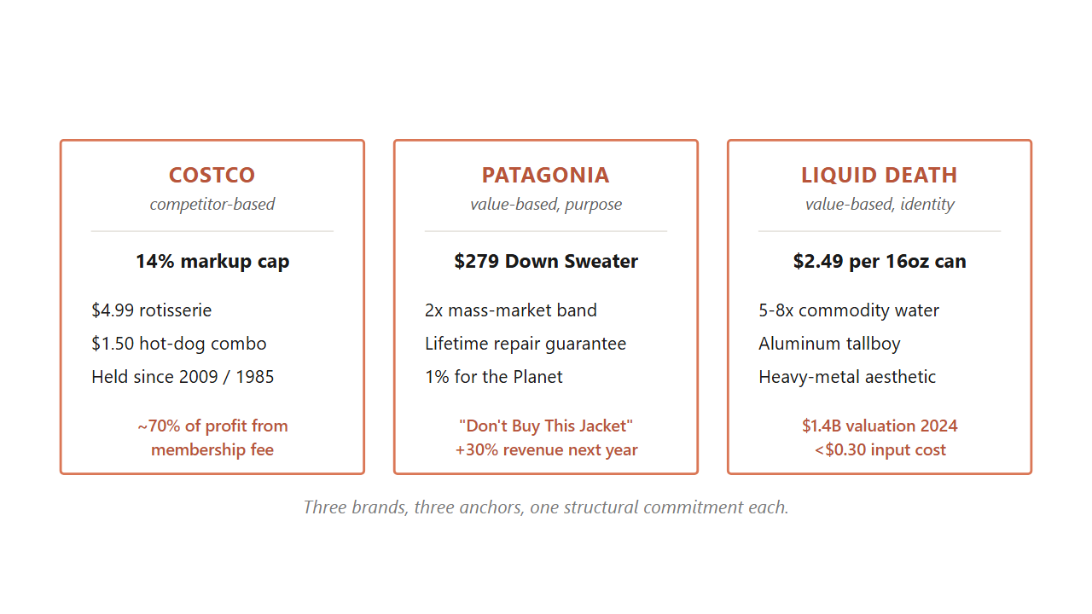
10.8
45 / 49
Costco anchors on competitor-match, Patagonia on value-with-purpose, Liquid Death on value-with-identity.
Each picks one approach as a structural commitment and runs the rest of the business off it.
Source: Costco annual reports 2022-2024; Worn Wear FY25 report; Liquid Death Series E filings 2024.
Notes:
Three brands carry the chapter as worked structural cases. Walk each one in order. Costco is competitor-based at the SKU level: a 14 percent markup cap, $4.99 rotisserie chicken held since 2009, $1.50 hot-dog combo held since 1985. The shelf price is visibly low. About 70 percent of profit comes from the membership fee, which absorbs the margin penalty no unbacked everyday-low-price retailer survives. Patagonia is value-based with purpose: a $279 Down Sweater against a mass-market band of $89 to $149, defended through durability, a lifetime repair guarantee, the 1 percent for the Planet pledge, and the Worn Wear resale program. The 2011 Don't Buy This Jacket ad was the value argument made visible, and revenue rose 30 percent the next year. Liquid Death is value-based with identity: $2.49 for a 16-ounce can of Alpine water, 5 to 8 times Smartwater per ounce, on a $1.4 billion valuation in 2024. The buyer is not purchasing hydration, they are purchasing an identity expression. All three pick one anchor and commit.
Discussion: Which of the three commitments is most fragile? Which is most defensible? Why?
Time: ~110s

Slide 46
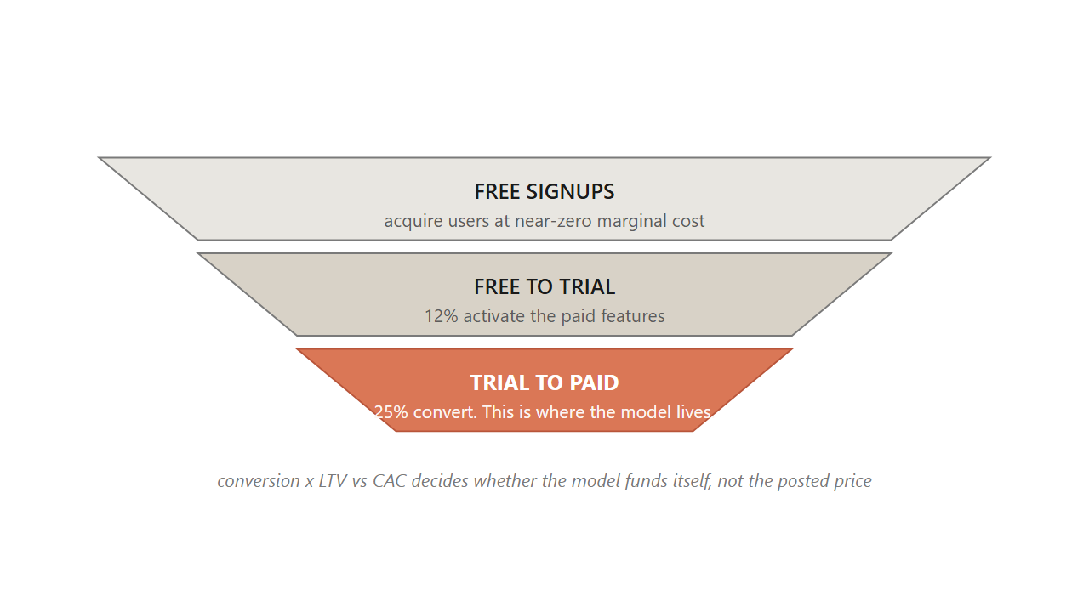
10.6
46 / 49
When marginal cost is near zero, the pricing problem inverts from rationing access to converting it.
Conversion x LTV vs CAC decides whether the model funds itself, not the posted price.
Source: Anderson, Free: The Future of a Radical Price (2009); Spotify Q4 2024 earnings.
Notes:
Yield management rations fixed perishable capacity. Consumer software faces the opposite condition: one more user costs almost nothing and capacity is effectively unlimited. That inversion changes the whole problem. Freemium is a two-tier structure: a free tier with limited features acquires users at near-zero marginal cost, and a paid tier with full features generates revenue. Conversion rates spread widely. Spotify is exceptionally high at about 40 percent, because the integrated free-and-paid app makes the upgrade frictionless. Notion runs around 4 percent. Slack and Dropbox hit 25 to 30 percent on team workspaces, where network effects kick in. The point the funnel makes is that conversion and churn move together. A 10-point lift in conversion looks like a win, but if that lift pulls in less-committed users whose churn is one point higher, lifetime value per user falls and the larger paying cohort is worth less in aggregate.
Discussion: Why is Slack's team conversion so much higher than Notion's individual conversion?
Time: ~90s

Slide 47
10.6
47 / 49
Four pricing families sit on a risk-transfer ladder, from pay-per-use to gainsharing.
1
Pay-per-use: per-unit charge on consumption (Rolls-Royce TotalCare per flight hour).
2
Tiered subscription: fixed fee for a service level (most SaaS).
3
Outcome-based: charge per measurable outcome (HubSpot Breeze at $0.50 per resolved ticket).
4
Gainsharing: a fraction of measured benefit (Persado at a percentage of documented lift).
Source: Bertini & Koenigsberg, The Ends Game (MIT Press, 2020).
Notes:
Most pricing chapters stop at subscription, but a more interesting question sits upstream: is the firm charging the buyer for the product, or for the outcome the buyer is trying to reach? A power-tool firm sells drills, but the buyer is paying for holes in the wall. The four families on this slide sit on a risk-transfer ladder. Pay-per-use puts consumption risk on the firm. Tiered subscription puts it on the buyer for a predictable bill. Outcome-based pays only when the work is done, which is the 2026 default for AI-agent products. Gainsharing moves almost all the risk onto the supplier. Feasibility turns on three gates: measurement, alignment, and control. Michelin's per-kilometer tire program failed on alignment when the sales force was still paid on tire units.
Discussion: For an AI customer-service product, which family fits best? Why?
Time: ~80s
Skip if short.

Slide 48
10.9 / CALLBACK
48 / 49
Mylan's EpiPen climb worked for nine years because each step sat below the just-noticeable difference.
What broke it was not the marginal cost or the algorithm. It was the fairness ceiling, the same one that ended Wendy's surge in twelve days.
Source: U.S. Senate Special Committee on Aging hearings (2016); Bertini & Koenigsberg, HBR (May 2024).
Notes:
Now bring the whole chapter back to the opening. The EpiPen climb from 100 to 608 worked for nine years for three reasons, all of which the chapter has explained. Each step sat below the just-noticeable difference, the 5 to 15 percent threshold from section 10.4. The cost story was plausible enough to absorb each move under the dual-entitlement principle. And no competitor was positioned to undercut at the wholesale level. What ended it was the same fairness ceiling that caught Wendy's twelve days into surge pricing. Once the cumulative line was visible at a Senate hearing, the dual-entitlement story stopped working. Parents of allergic children were the vulnerable group from the moral-harm model. The product was a life-saving necessity. The firm's stated reason was not one buyers would accept. Within a year, Mylan committed to a half-price generic. The price came down because the fairness ceiling caught up with the climb, not because the marginal cost moved.
Discussion: Knowing what we know now, when should Mylan have stopped raising the price?
Time: ~90s

Slide 49
TAKEAWAYS
49 / 49
Match the EVC walk to the buyer you have, watch the fairness ceiling more carefully than the algorithm.
Cost is the floor, competitor is the frame, value is the ceiling, and fairness is the ceiling above the ceiling.
Notes:
Wrap up by summarizing what students can do on Monday morning. One, build the EVC walk: find the buyer's next-best alternative, attach a dollar premium to each attribute where you are better, close below the full value. Two, run the four-question diagnostic before matching a rival's move. Three, recover the band with the four PSM questions when you have no sales history. Four, run the six-principle audit before any dynamic-pricing rollout. Five, check the fairness ceiling before posting any increase: is there a cost story, is there a lower option, was the change published in advance. The next chapter walks the channel structures that decide whether your price ever reaches the shelf the buyer is standing in front of.
Discussion: Of the five moves on this slide, which is the one you most need to remember?
Time: ~75s

