Slide 1





LANGUAGE MATTERS I

Slide 2


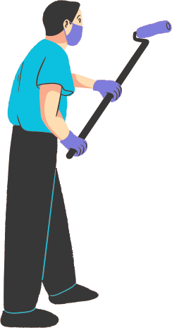

SIMPLE PRESENT: AFFIRMATIVA
I take ballet classes.
I play basketball at school.
I have short blond hair and green eyes.
As frases estão no Simple Present Tense. Observe-as.

Slide 3
USOS DO SIMPLE PRESENT
Condição ou estado permanente:
Ex.: I have brown hair. / I live in France.
Hábitos, fatos, gostos e preferências:
Ex.: On weekends, I play soccer.
I like outdoor activities.

Slide 4
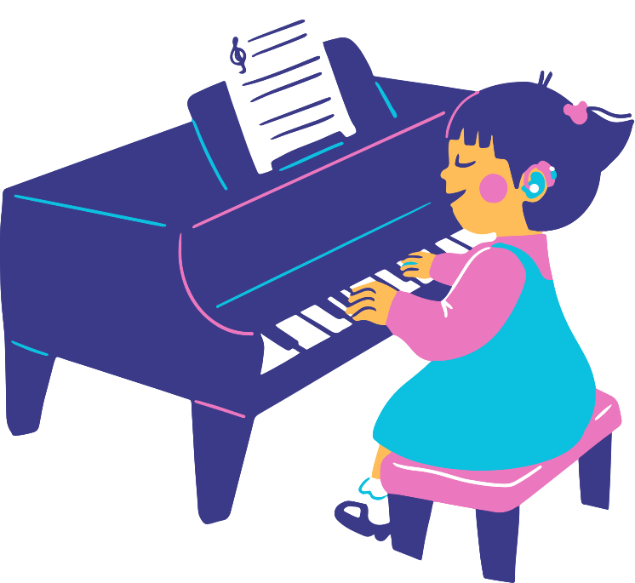
Estrutura: Sujeito + verbo + complemento
  My friends and I go to the club on weekends.
  I have brown hair.
  I love comedy and action movies.
  Verbo no infinitivo SEM "to".

Slide 5
SUJEITO E 3ª PESSOA
Em inglês o sujeito é obrigatório:
"have short hair" não faz sentido.
Só he/she/it acrescenta -s no verbo:
Brenda takes ballet classes.
Thomas lives in Porto Alegre.

Slide 6
Conjugação no Simple Present:
  I live in Brazil. / You live in Rio.
  He lives in Fortaleza. / She lives in Natal.
  It lives approximately 30 years. (tartaruga)
  We live on the coast. / You live in a house.
  They live in a nice apartment.

Slide 7
REGRAS ORTOGRÁFICAS DO -S
-s, -sh, -ch, -o, -x, -z -> acrescenta -es:
passes, washes, watches, fixes, does, goes.
-y após consoante -> -ies: studies, tries.
-y após vogal -> -s: says, obeys, buys.
to have -> has.

Slide 8
SIMPLE PRESENT: NEGATIVA
I don't like to watch TV all day.
Don't = do not (auxiliar do).
I do not like horror movies.
3ª pessoa: does not / doesn't - He doesn't like pizza.

Slide 9
LET'S PRACTICE I - complete com o verbo:
  Liz ____________ (to play) the piano.
  Julie ____________ (to eat) a lot of fruit.
  Ricardo and Fernanda ____________ (to live) in a house.
  Maria ____________ (to have) a big family.
  Barbara ____________ (to love) music.
  Luana and Letícia ____________ (to learn) German.

Slide 10
THANK YOU
for listening!
Fonte Bibliográfica:
LANGUAGE MATTERS I – Simple Present Tense. Material da aula.

