Slide 1
Quality Prediction in a Mining Process
Towards the prediction of Silica Concentrate

Slide 2
Timestamp Manipulation

Slide 3
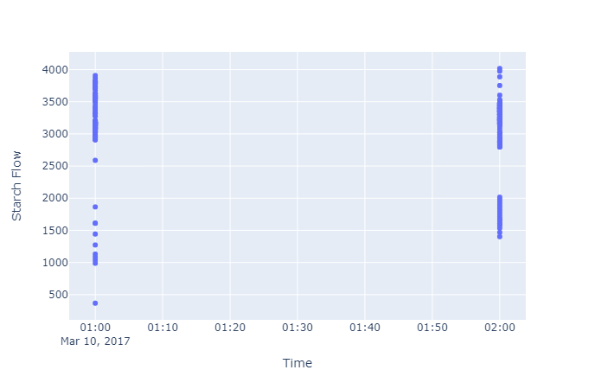
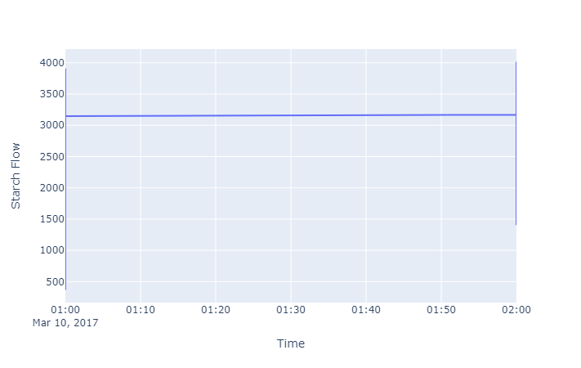
Timestamp Manipulation
There were no NaN values, but some columns were sampled every 20 seconds, while others were sampled on an hourly basis, so the labels within an hour period were all the same. As one can see in the figure below, from a feature that was sampled every 20s, information is getting plotted vertically along the hours.

Slide 4
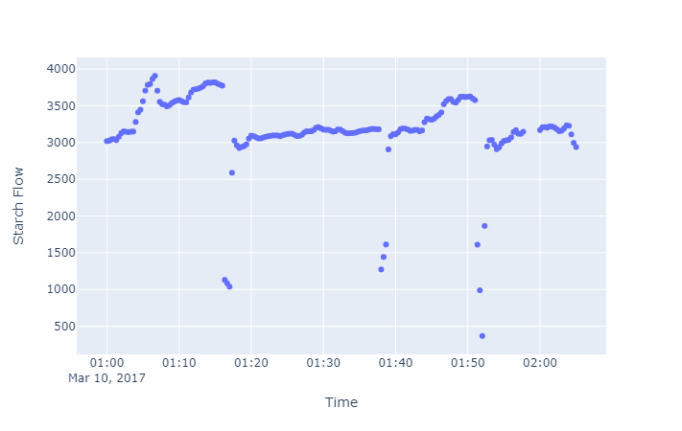
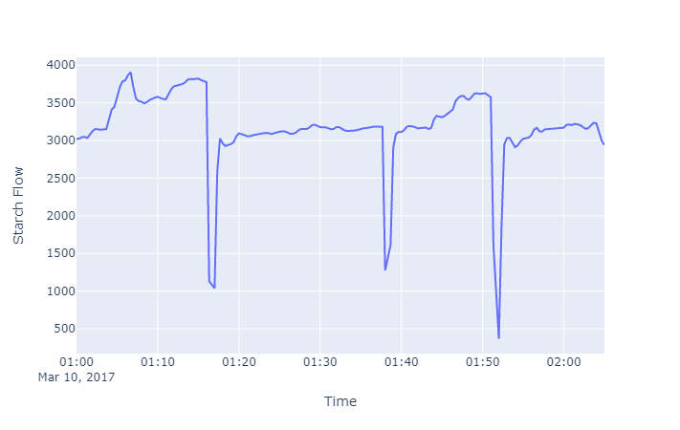
Timestamp Manipulation
A function was created to solve this problem by adding 20s times the label position for each label within the same hour. The pandas “duplicated” method still points to the presence of duplicated labels, but a visual inspection and the use of methods that don’t accept duplicate labels showed the contrary. So, probably the date still contains duplicated labels, but I didn’t understand how to deal with them. The plot below shows how the spatial distribution of the data changed.

Slide 5
Timestamp Manipulation
By grouping data by hour it was verified that most of it indeed had 180 samples per hour - 60 * 3 (3 groups of 20s times 60m == 1h) -, but some were not. The following presents how many samples there were by trash hours and what action was taken:
The first hour had 174 samples. The 318 hours between 2017-03-16 06:00:00 and 2017-03-29 11:00:00, were not present in the data. The data from 2017-03-29 11:00:00 backwards was dropped, losing 3.64% of it. Data imputation would imply fitting a model, which was out of the scope of this challenge.
The hour 2017-04-10 00:00:00 had 179 samples, and was upsampled with forward fill to 180.

Slide 6
% of Silica Concentrate
Target series analysis

Slide 7
Summary Statistics

Slide 8
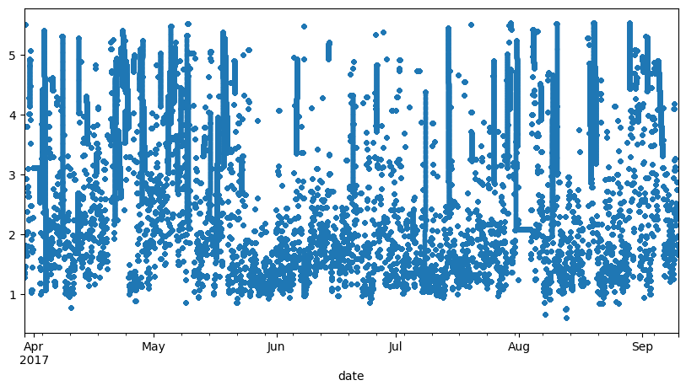
Summary Statistics
count: 710640; mean: 2.3; std: 1.1; min: 0.6; 25% 1.4; 50% 2; 75% 3; max: 5.53 The numbers and the scatter plot indicate high variance.
Notes:
Scatter plot pode mostrar o aumento da variância ao longo do tempo. Tinha visto exemplo com uma trend que ao longo do tempo os pontos iam esparramando. Nesse caso aqui, já tá tudo esparramado desde o início, a variância é alta, acho que indica ruído, mas como eu não tenho conhecimento de domínio não da pra saber se é erro de medição ou se normalmente a % de sílica varia tanto assim mesmo.

Slide 9
Smoothing

Slide 10
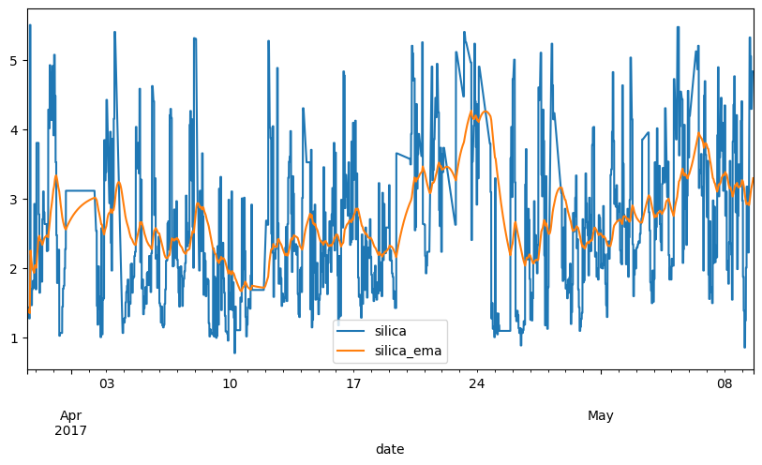
Exponential Moving Average (¼ of the data)
Notes:
Zoom para observar o perfil da suavização

Slide 11
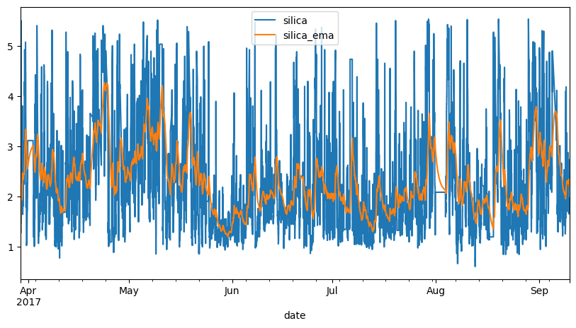
Exponential Moving Average (all data)

Slide 12
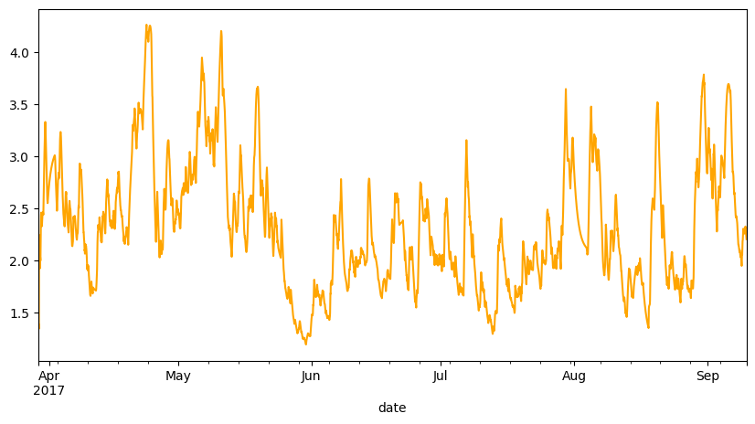
Exponential Moving Average (all data)

Slide 13

Smoothing Conclusions
Despite not being able to see any trends, by smoothing it was possible to notice some kind of season with a changing amplitude and the pattern:
Notes:
O problema é que a suavização aqui foi tão forte que não dá pra tomar esse plot como base, o que não descarta o fato de que a sazonalidade existe.

Slide 14
Stationarity

Slide 15
Stationarity
Augmented Dickey-Fuller (ADF) was used to test stationarity. With the 50% more recent data (the last 355,320 data points) the p-value was close to zero (7.5e-28), so obviously less than 0.05, and therefore it can be considered stationary.

Slide 16
Resampling Policy

Slide 17
Resampling Policy
Since the equipment is unknown, and I lack domain knowledge, all the frequency changes were done by taking the mean of the data - i.e., a resample to minutes is the mean of the last three data points, since the original sample rate is 20s.
Notes:
Enquanto você não sabe a verdade, você não pode afirmar nada, mas pode supor qualquer coisa. Supondo que o equipamento tende a errar a cada três medições: asfreq(“T”) iria literalmente selecionar os erros.
Pode ser visto como uma suavização cada vez mais forte.
Deveria ter usado a média exponencial, porque a média tem um delay.

Slide 18
Distribution & Differencing

Slide 19
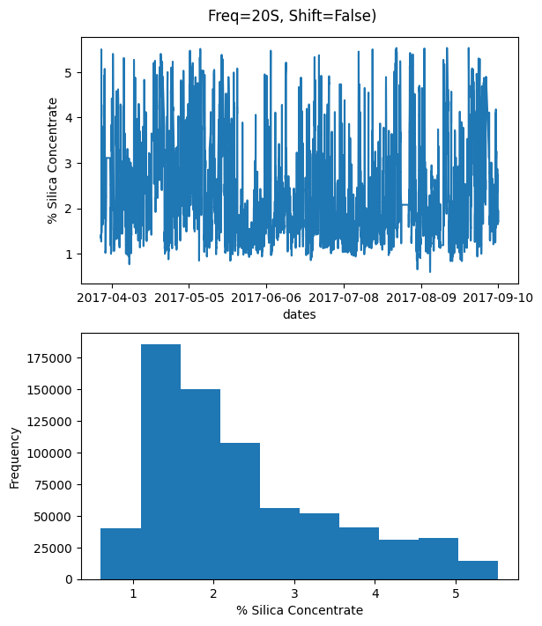
Distribution
Notes:
Distribuição dos dados originais. Se assemelha a uma exponencial negativa.

Slide 20
Differencing
"We difference the data to remove the trend, and this transforms the data to a more normally shaped distribution. [...] Most interesting is how a value changes from one measurement to the next rather than the value’s actual measurement"
Aileen Nielsen
In our case there is no trend, but the distribution isn’t normal. When diminishing the frequency (going from 20s to monthly) the differencing distribution range decreases, and the daily frequency is the most normal.
Notes:
o que a gente vai ver então daqui pra frente é a distribuição da variação dos dados, mais especificamente, quando houver resample, vai ser a dist da variação das médias. variação: pto atual - prox, quer dizer que se a tendência for aumentar a maioria dos pontos vai ser negativa

Slide 21
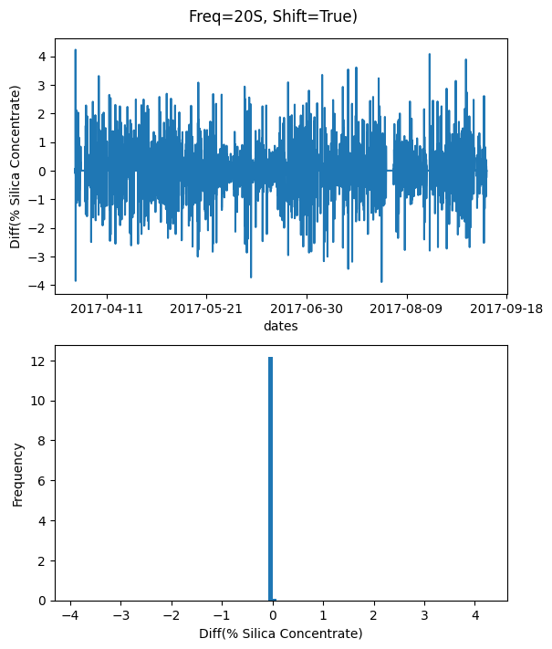
Differencing
Notes:
Poucas variações, se aproximando de saltos constantes de uma medição para outra. O binning aqui devia ta menor

Slide 22
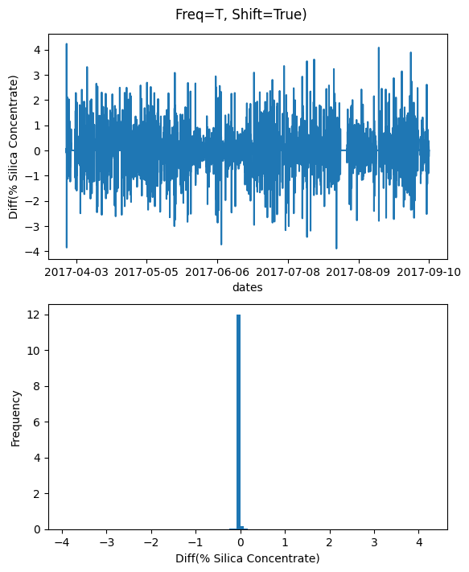
Differencing
Notes:
Mudando p minuto n tem mta diferença, é uma média de 3 em 3 pontos

Slide 23
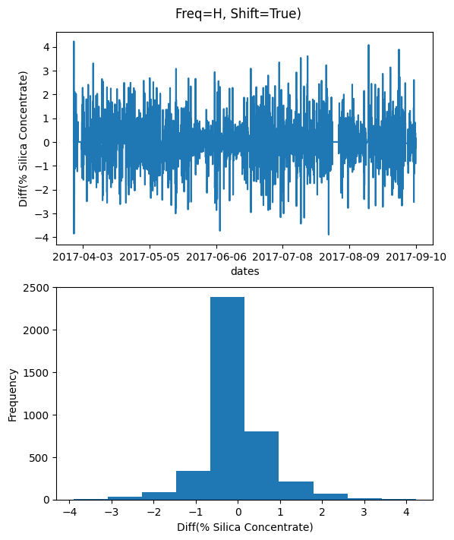
Differencing
Notes:
As diferenças pras horas realmente se aprox mais de uma normal entre + e menos 4

Slide 24
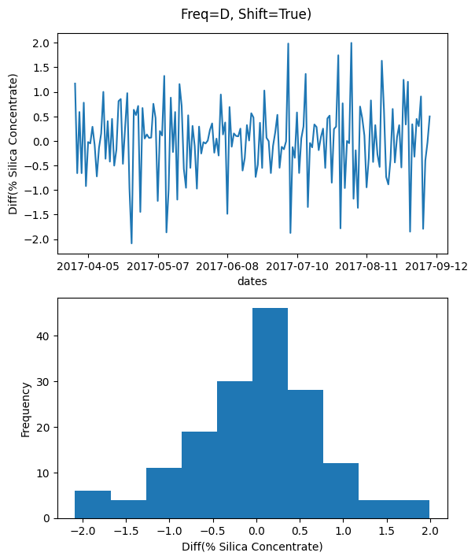
Differencing
Notes:
fica bem uma normal quando a freq é igual aos dias, com uma média variando pra + ou menos 2, ou seja diminuiu o range dessa variação

Slide 25
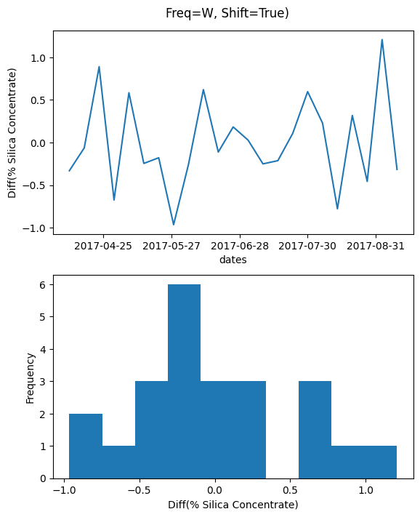
Differencing
Notes:
e aí na semana já vira bagunça, se for pensar é normal mas ta faltando dado ali no meio. o range entre -1 e 1 então não muda muito a média semanal, diminuiu novamente

Slide 26
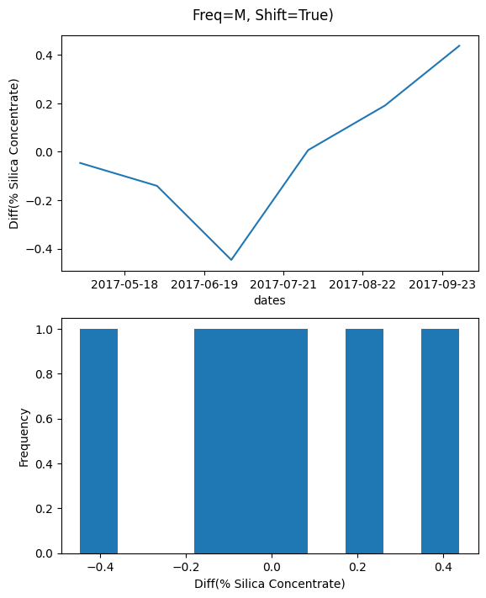
Differencing
Notes:
por mês a gente tem uma diferença pequena entre as médias também, diminuiu mais ainda. então, se vc pegar um intervalo suficientemente grande a média vai ser constante, a diferença das médias tende a 0 com o aumento do intervalo. pro meio do ano vai diminuindo a diferença, e pro final do ano ela vai subindo

Slide 27
Seasonality

Slide 28
Seasonality
The shortcoming with seasonal decomposition models is that it does not capture how a season might change through time. For example, the characteristics of a week of electricity demand in the summer is much different than the winter. This method will determine an average seasonal pattern and leave the remaining information in the residuals. So given your characteristics vary by day of week (mentioned in your other post), this won't capture that.
Aileen Nielsen
The hourly seasonality was the most relevant if we take the amplitude as a parameter. But also, since we are using the mean, the peaks and lows are being cut off.
There was an attempt to first test the correlation and then zoom in when plotting the graphics, but there was no success so far. Currently, the series is being split before applying the correlation. Visual inspections demonstrate that this doesn't affect the season period.

Slide 29
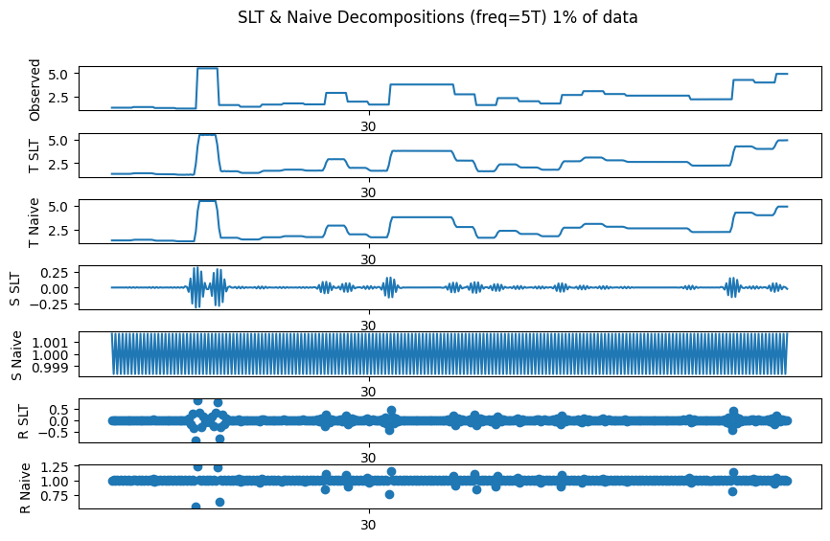
Seasonality
Notes:
Quando o gráfico sobe e desce o SLT apresenta uma variação ,e ela é tão pequena que talvez seja desprezível, e na verdade a variação de todas as sazonalidades foi pequena

Slide 30
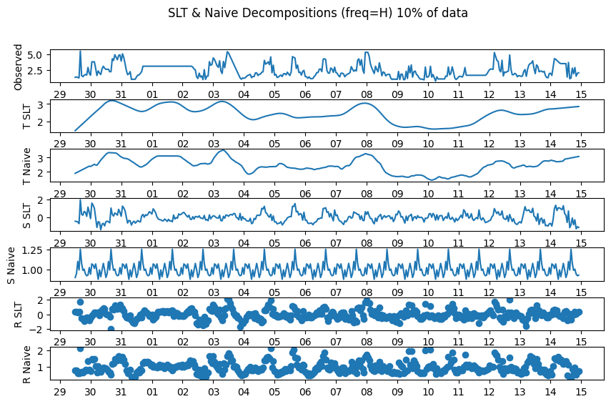
Seasonality
Notes:
Aparenta ter uma sazonalidade, mas não dá pra saber muito bem o período

Slide 31
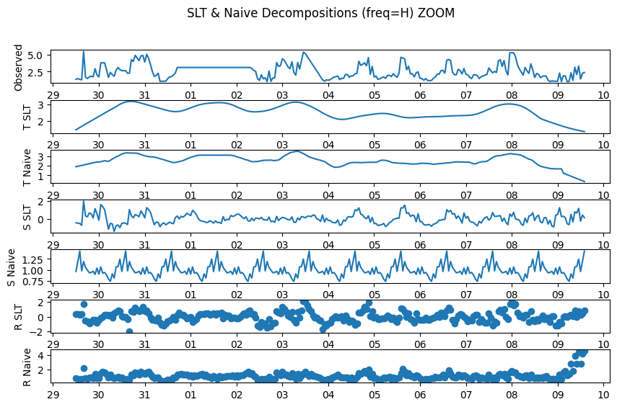
Seasonality
Notes:
Dando um zoom é possível perceber que ela é de aprox 1 dia. O zoom da um lag na sazonalidade, mas o período parece se manter, o que permite uma inspeção visual melhor, mas idealmente o cálculo do período deveria ser numérico. e essa é a com maior range no naive, com 0.5 de amplitude, e 4 no SLT

Slide 32
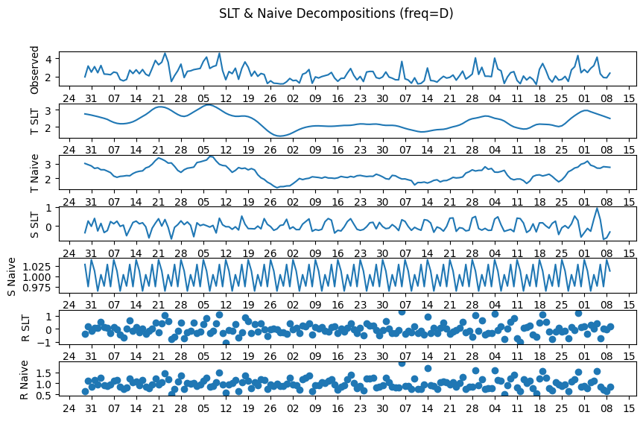
Seasonality
Notes:
A freq de dias também apresenta sazonalidade 0.05 no naive

Slide 33
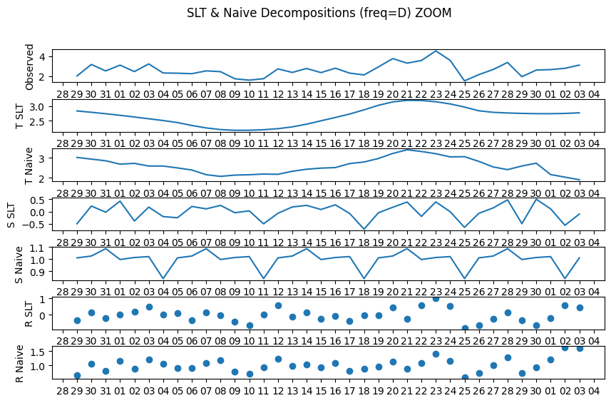
Seasonality
Notes:
Dando um zoom, é possível observar que ela é de aproximadamente 7, com algumas variações no SLT. 0.3 no naive e 1 no slt

Slide 34
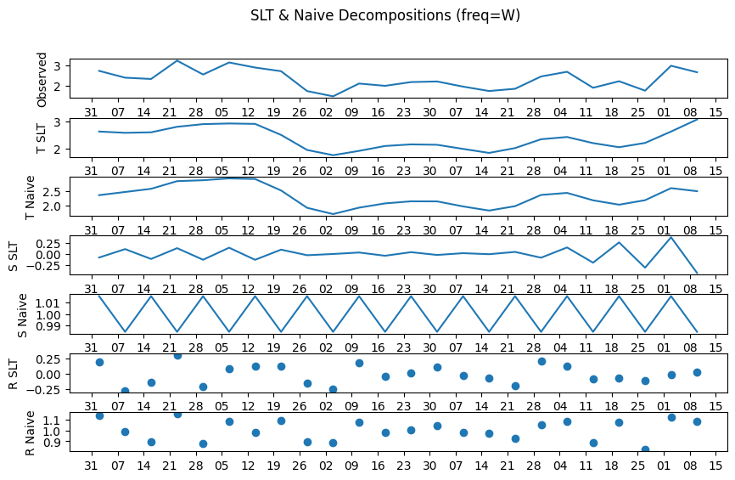
Seasonality
Notes:
Nas semanas é possível notar uma certa sazonalidade também

Slide 35
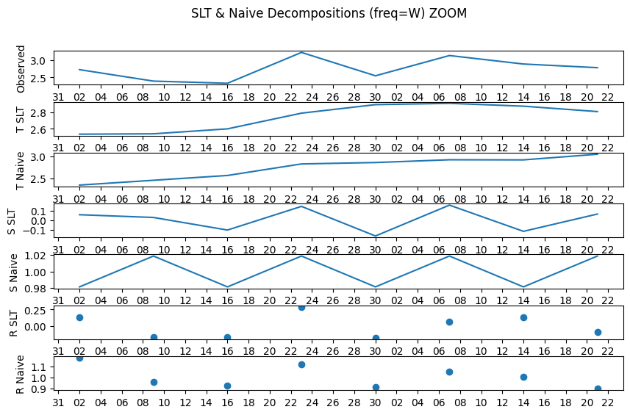
Seasonality
Notes:
Que com um zoom nota-se ser de aprox 14 dias. 0.04 no naive e 0.1 no SLT

Slide 36
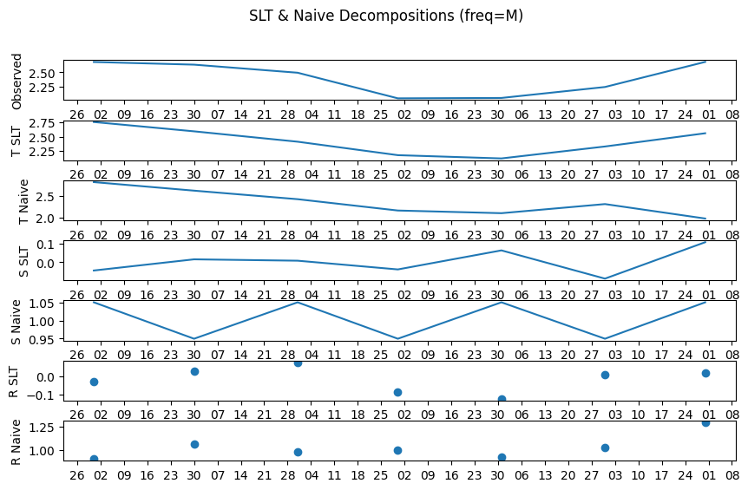
Seasonality
Notes:
Na frequência mensal a sazonalidade parece ser mensal também. 0.1 no naive e 0.2 no SLT

Slide 37
Autocorrelation

Slide 38
Frequency Change Policy (Again)
One of the impacts of taking the mean is that it is a kind of smoothing. A strong smoothing can increase the autocorrelation - empirical conclusion from a test that will be shown latter -, but the mean applied to change frequency didn’t change much in the correlation - conclusion from a visual inspection of autocorrelation plots. In this regard, this work used the mean in autocorrelation over raw data, and just took the last value over already smoothed data.

Slide 39
Frequency Change Policy (Again)
One of the impacts of taking the mean is that it is a kind of smoothing. A strong smoothing can increase the autocorrelation - empirical conclusion from a test that will be shown latter -, but the mean applied to change frequency didn’t change much in the correlation - conclusion from a visual inspection of autocorrelation plots. In this regard, this work used the mean in autocorrelation over raw data, and just took the last value over already smoothed data.

Slide 40
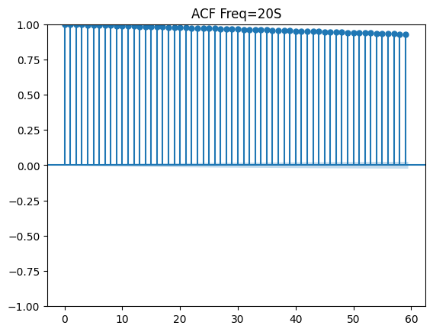
Autocorrelation

Slide 41
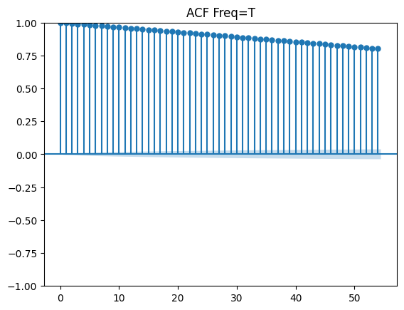
Autocorrelation

Slide 42
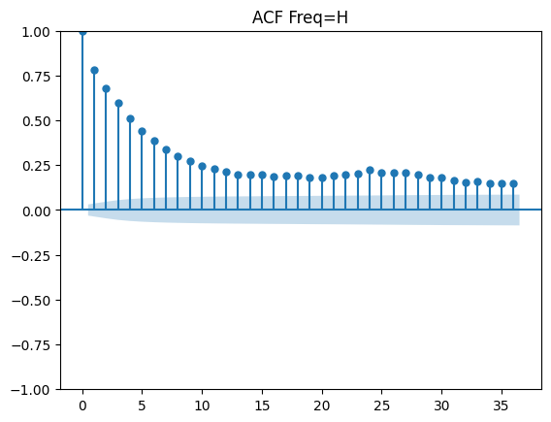
Autocorrelation

Slide 43
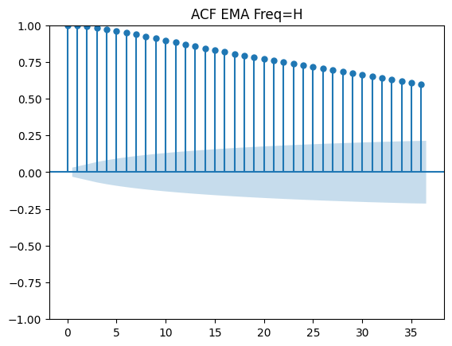
Autocorrelation

Slide 44
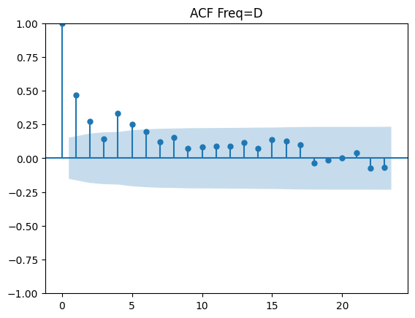
Autocorrelation

Slide 45
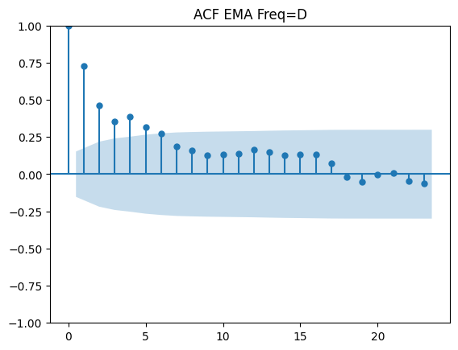
Autocorrelation

Slide 46
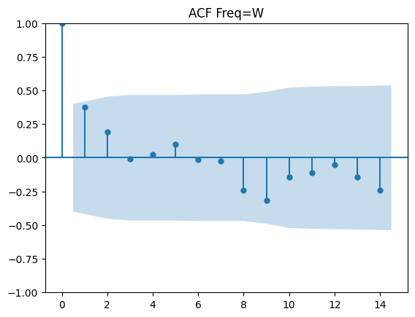
Autocorrelation

Slide 47
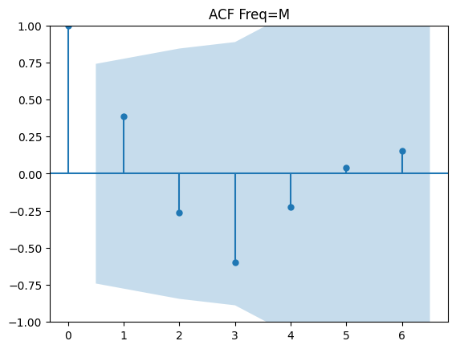
Autocorrelation

Slide 48
Autocorrelation Conclusions
For 20 seconds, minutes, and hours periods, all values are outside the blue shaded area - that represents data out of the 95% confidence interval. So even data with the highest lags have correlation with recent data. That isn’t the case for daily, weekly and monthly frequencies, where much, if not all, the data have no correlation with recent data, showing that forecasting can be done at maximum 2 days ahead.

Slide 49
Modeling

Slide 50
Modeling
The results suggest that classical models that deal with little amount of data, like ARIMA, could be used online with the most recent information to predict for frequencies of 20 seconds, minutes, hours and 2 days with good accuracy. The series with Exponential Moving Average presented a bigger and more uniform correlation for these three frequencies, so it could EMA could be used to improve accuracy but loosing even more data than the resampling already does.

Slide 51
Limitations

Slide 52
Limitations
Lack of domain knowledge.
Probably the resamples should have been done with exponential instead of simple mean, or the asfreq method or mode, or one or another depending on what is being analyzed.

Slide 53
Other Series

Slide 54
Stationarity

Slide 55
Stationarity
The following table presents the p-value of the ADF test for each column. As one can see, all variables are stationary.

Slide 56
Stationarity
% Iron Feed | 1.4e-10 | Flotation Column 06 Air Flow | 7e-12
% Silica Feed | 1.45e-10 | Flotation Column 07 Air Flow | 4.3e-14
Starch Flow | 0 | Flotation Column 01 Level | 10e-30
Amina Flow | 0 | Flotation Column 02 Level | 1e-28
Ore Pulp Flow | 0 | Flotation Column 03 Level | 7.1e-30
Ore Pulp pH | 2.8e-26 | Flotation Column 04 Level | 6.1e-28
Ore Pulp Density | 0 | Flotation Column 05 Level | 1.1e-22
Flotation Column 01 Air Flow | 2.2e-16 | Flotation Column 06 Level | 3.22e-17
Flotation Column 02 Air Flow | 1.4e-14 | Flotation Column 07 Level | 5.3e-20
Flotation Column 03 Air Flow | 3.2e-17 | Iron Concentrate | 2.5e-29
Flotation Column 04 Air Flow | 0 | Silica Concentrate | 7.5e-28
Flotation Column 05 Air Flow | 2.7e-10

Slide 57
Correlation

Slide 58
Correlation
Pearson Correlation was used to verify how much one variable is important to other variables. Differencing made no change - as expected since the variables are stationary.
Time Lagged Cross Correlation ?

Slide 59
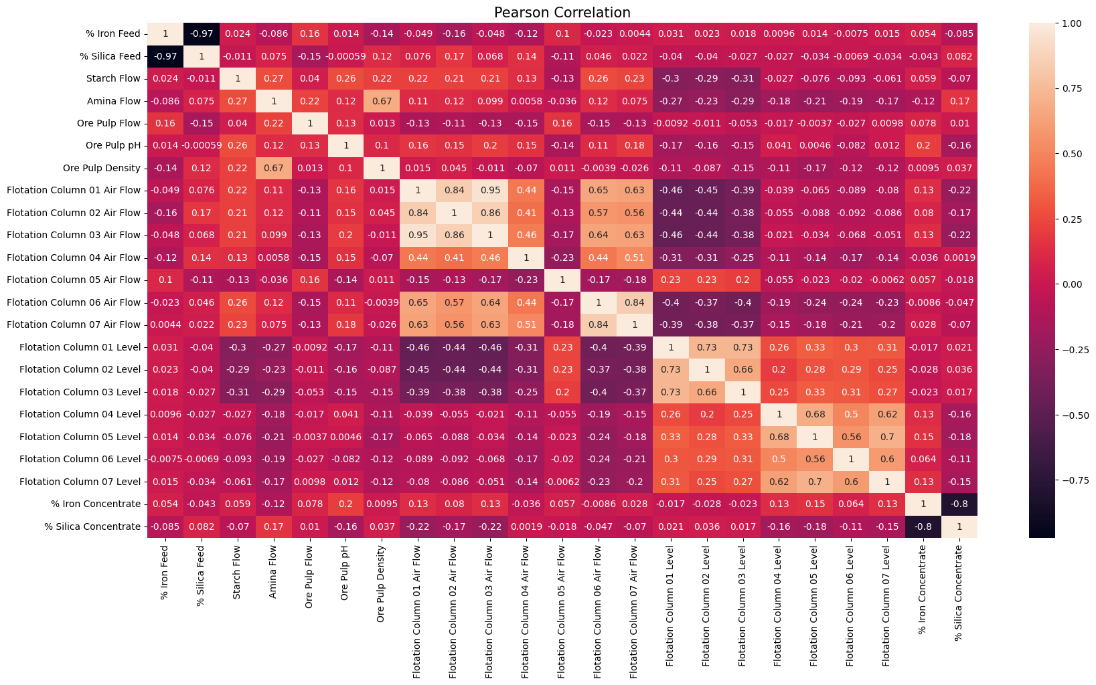

Slide 60
Correlation (Pearson)
Pearson Correlation show that % of Iron Concentrate is negatively strongly correlated with % of Silica Concentrate, and those are final measures taken from the lab, so it would be interesting to predict without them.
Strong correlations that one of the features could be removed in a selection process:
% of Iron Feed and Silica feed (-0.97)
Flotation Column Air Flow 1 and 2 (0.84)
Flotation Column Air Flow 1 and 3 (0.95).
Flotation Column Air Flow 2 and 3 (0.86). (Looks like transitive property.)
So Air Flow Columns 2 & 3 could be removed with 1 preserved.
Flotation Column Air Flow 6 and 7 (0.84).
Flotation Column Level 1 and 2 (0.73).
Flotation Column Level 1 and 3 (0.73).
So Level Column 1 could be removed, but 2 & 3 preserved.

Slide 61
Causality

Slide 62
Causality
Granger causality idea is to predict the value of A using two different models: The first uses past values of A itself. The second uses past values of both A and B. If using past values of B improves our prediction beyond using A alone (as assessed by a statistical test) then we say that B Granger-causes A.
Multivariate versions exist, so you can test the effects of both B and C on A. Typical Granger causality tests are based on autoregressive models, so they assume stationarity, and that causal effects are linear. But, extensions do exist if you need to loosen these assumptions.
Note that Granger causality is not 'true' causality--even if we determine that B Granger-causes A, this doesn't necessarily imply that A would have changed had we directly manipulated B. For example, this could happen if A and B have no direct causal link, but are both driven with different lags by some unobserved, third process H.
fonte: link

Slide 63
Causality (Granger)
% Iron Feed | 0.2810 | Flotation C. 05 Air Flow | 0.8987
% Silica Feed | 0.3680 | Flotation C. 06 Air Flow | 0.1993
Starch Flow | 0.9312 | Flotation C. 07 Air Flow | 0.0334
Amina Flow | 0.5526 | Flotation C. 01 Level | 0.0747
Ore Pulp Flow | 0.9825 | Flotation C. 02 Level | 0.0777
Ore Pulp pH | 0.0001 | Flotation C. 03 Level | 0.2926
Ore Pulp Density | 0.6174 | Flotation C. 04 Level | 0.0268
Flotation C. 01 Air Flow | 0.0000 | Flotation C. 05 Level | 0.0099
Flotation C. 02 Air Flow | 0.0002 | Flotation C. 06 Level | 0.1821
Flotation C. 03 Air Flow | 0.0000 | Flotation C. 07 Level | 0.1009
Flotation C. 04 Air Flow | 0.7877 | % Iron Concentrate | 0.0165

Slide 64
Causality (Granger)
The following features do not Granger causes % of Silica Concentrate, and therefore might be eliminated:
Starch Flow
Amina Flow
Ore Pulp Flow
Ore Pulp Density
Flotation C. 04 Air Flow
Flotation C. 05 Air Flow

Slide 65
Principal Component Analysis

Slide 66
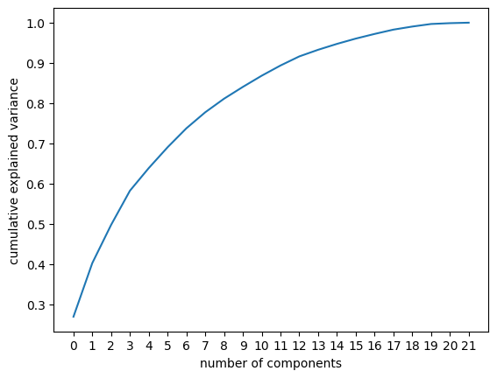
PCA

Slide 67
PCA
With 13 features, we have 90% of the variance. Running PCA setting to get the components that give 90% of the variance, it returns the following variables:
'Flotation Column 01 Air Flow',
'Flotation Column 05 Level',
'% Iron Feed',
'Amina Flow',
'Flotation Column 05 Air Flow',
'% Iron Concentrate',
'Ore Pulp pH',
'Ore Pulp Flow',
'Starch Flow',
'Ore Pulp pH',
'Flotation Column 04 Air Flow',
'Flotation Column 04 Air Flow',
'Flotation Column 06 Level'

Slide 68
PCA
That is 60% of the variables (13 out of 22).

Slide 69
…
Each metric tend to output a different result. Other metrics like Random Forest would be analyzed and all of them would be used in a voting-like process, but there was no time.

Slide 70
Difficulties

Slide 71
Dificuldades
Preparação do Ambiente
  Rodar o VsCode dentro do WSL
  Criar o ambiente virtual (linux não tava a fim de dar permissão de escrita para o virtualenvwrapper)
  Configurar o git com remote source
Crashes com o Plotly
  Criar um subplot com todas as séries para salvar em um htm crashava o kernel do notebook, mas eu pensava que talvez era erro de código (até o plot de uma única série o pc não estava tankando)
Busca por Conhecimento
  O tema é muito abrangente, por mais que se encontre bons materiais uma boa parte destes conteúdos vai estar falando sobre possíveis problemas que não são especificamente o seu.
Crash com ADF (foram mais de 3 hrs p/ calcular para todas as séries)
Crash com Granger

