Slide 1
Week 1 – Lexical Distributional Semantics

Slide 2
The Turing Test
a test for artificial intelligence proposed by Alan Turing (1951) in which the covert substitution of a computer for one of the participants in a keyboard and screen dialogue is undetectable by the other human participant.
Discuss:
what natural language processing applications can you think of?
in the context of 1 or more of these applications, how would you ‘detect’ that the other participant was a computer rather than a human?

Slide 3
Group discussion
Groups of approximately 4-5 students
Discuss question / questions for set amount of time
Report back to main group afterwards
For longer breakout sessions (on the weekly research paper), I will visit the different groups and answer questions

Slide 4
Towards more intelligent NLP
Word tokens often viewed as atomic building blocks of language
But “bag-of-word” models or even “word sequence” models miss a vital ingredient of human language understanding
What is the meaning of a word?
Meaning is generally inferred through
relationships with other words
similarity to other words
lexical semantics

Slide 5
Lecture 1 Overview
Part 1
Part 2
Lexical semantics
word senses
semantic relationships
WordNet
semantic similarity measures based on WordNet
evaluation
Distributional Semantics
bootstrapping semantics from context
cosine similarity
(positive) pointwise mutual information
evaluation
word ambiguity
semantic relationships
sparsity
Much of this is revision from NLE / Applied NLP!

Slide 6
Lecture 1 Questions?
Use the module discussion forum for questions
Or ask them now

Slide 7
Discussion of paper
Ted Pedersen. 2010. Information content measures of semantic similarity perform better without sense-tagged text. In Proceedings of NAACL
See separate question sheet
20-30 minute breakout

Slide 9
Question 1
With reference to Figure 1, what concept is the hypernym of ungulate?
How many hyponyms does carnivore have?
Give an example.
Why do you think the word cat appears twice in the hierarchy?

Slide 10
Question 2
What do you understand by path length?
Give some examples of pairs of words which have a path length of 2
What limitations can you think of in using path length as a measure of semantic similarity?

Slide 11
Question 3
How is information content for a WordNet concept computed from a sense-tagged corpus?
How can information content for a WordNet concept be estimated from untagged data?

Slide 12
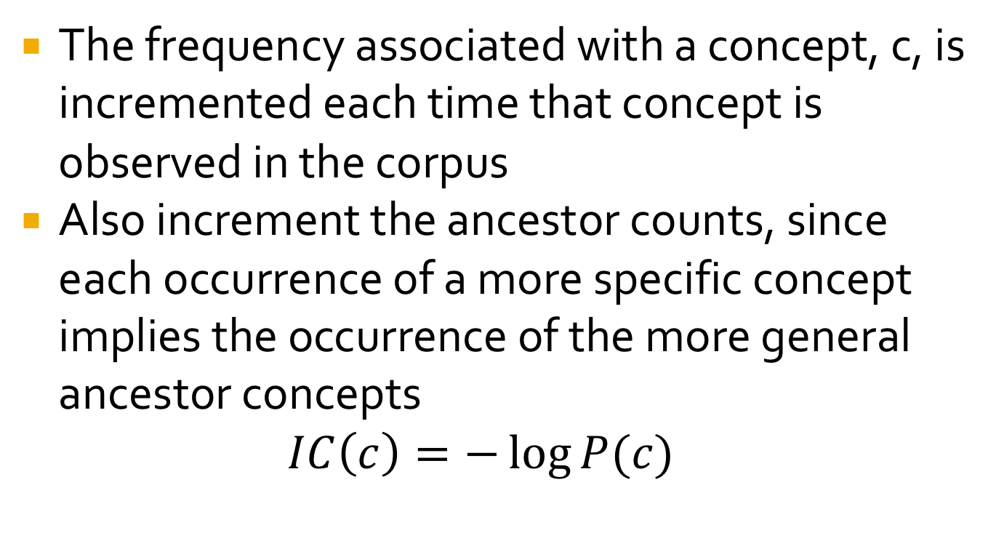
Information Content from sense-tagged data
The frequency associated with a concept, c, is incremented each time that concept is observed in the corpus
Also increment the ancestor counts, since each occurrence of a more specific concept implies the occurrence of the more general ancestor concepts
$$IC\left(c\right)=−\log{P(c)}$$

Slide 13
Information content from untagged data
If the text is untagged, increment counts for all of the possible senses of a word
Divide the frequency of all the occurrences between the different possible senses

Slide 14
Question 4
What is the lowest common subsumer (LCS) of dog and big_cat?
What is the LCS of mammal and reptile?
What is the LCS of poodle and tabby?
Which of these 3 pairs would have the greatest similarity according to the Resnik measure?
What about if you used the Lin measure?
Or a measure based on path length?

Slide 15
Question 5
What is the main experimental conclusion of the paper?
Are you convinced?

Slide 16
Paper conclusions
Semantic similarity measures based on IC can be significantly improved by increasing coverage of the frequency counts
Increased coverage can come from:
annotated data
unannotated data
smoothing
Quantity of data more important than quality!

