Slide 1
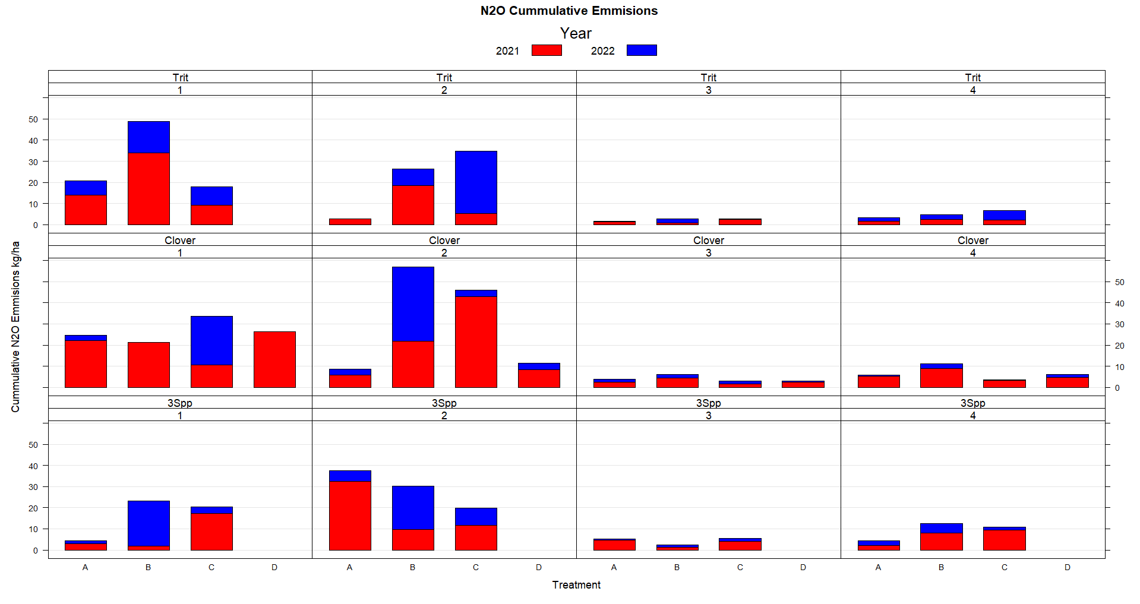

Slide 2
 |  | N2O_Cum_Emisions
 | DF | Sum Sq | Mean Sq
BLOCK. F | 3 | 2160 | 720 | 2.866E-06 | ***
Year | 1 | 338 | 338 | 0.0224 | *
CoverCrop. F | 2 | 28 | 14 | 0.7998 | *
Treatment. | 3 | 404 | 135 | 0.0988
Resi duals | 70 | 4335.6 | 61.94

Slide 3
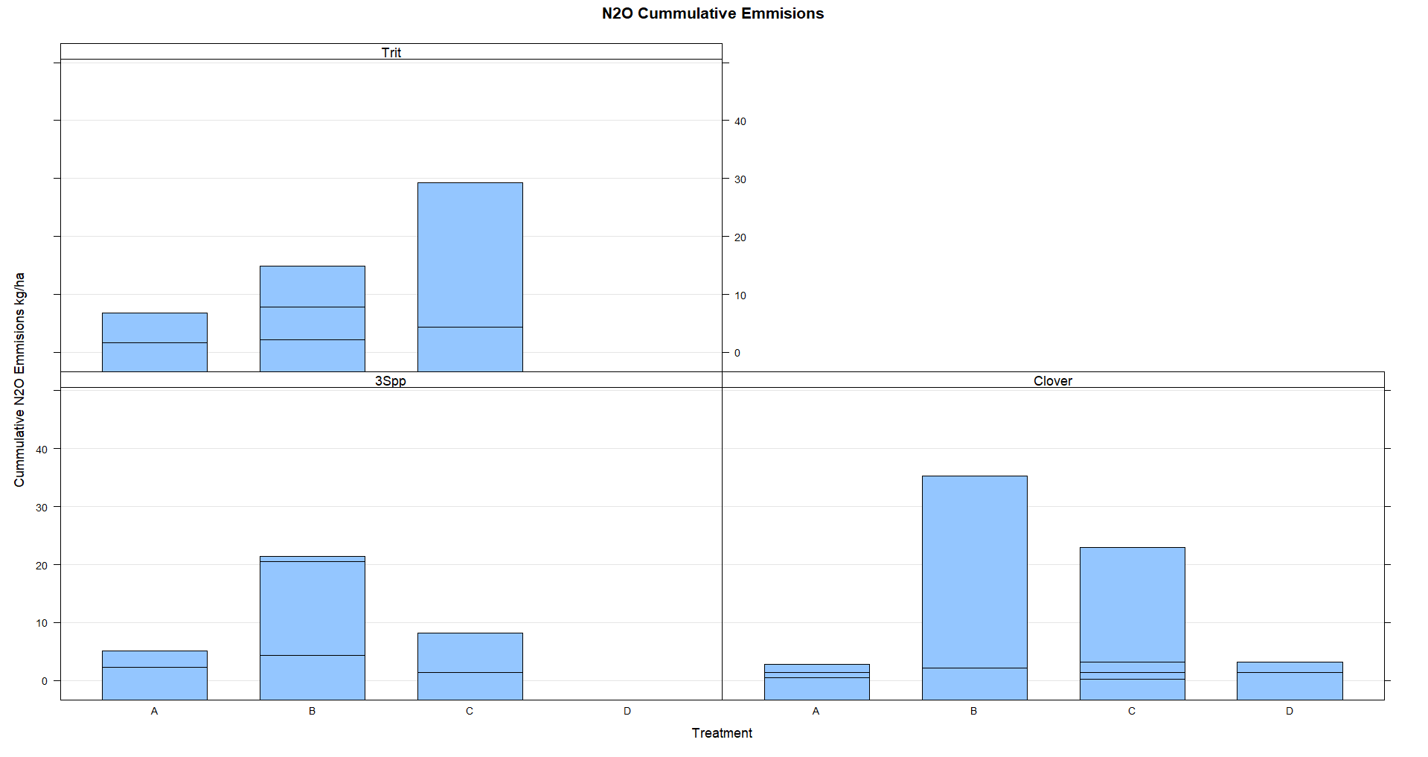

Slide 4
