Slide 1
Predicting the best location for a Steakhouse Branch in Rio de Janeiro

Slide 2
Scenario
Rio is the 2nd more populous city in Brazil and the 6th in the Americas ( ~6.750.000 citizens). With an area of 1,221 km² (486.5 sq mi).
Rio has 162 neighborhoods with enormous variation in the
social and economic aspects (GDP, IDH, etc.)
There are strong competition in the steakhouse market
There's a significant rise in meat prices due to exportation demand
US$25 to US$43 for the "arroba"(15Kg)

Slide 3
Problem
Select the best neighborhoods to a steakhouse branch

Slide 4
Data Sources
Data Rio API (https://data.rio)
Wikipedia (social indicators)
Geolocator API

Slide 5
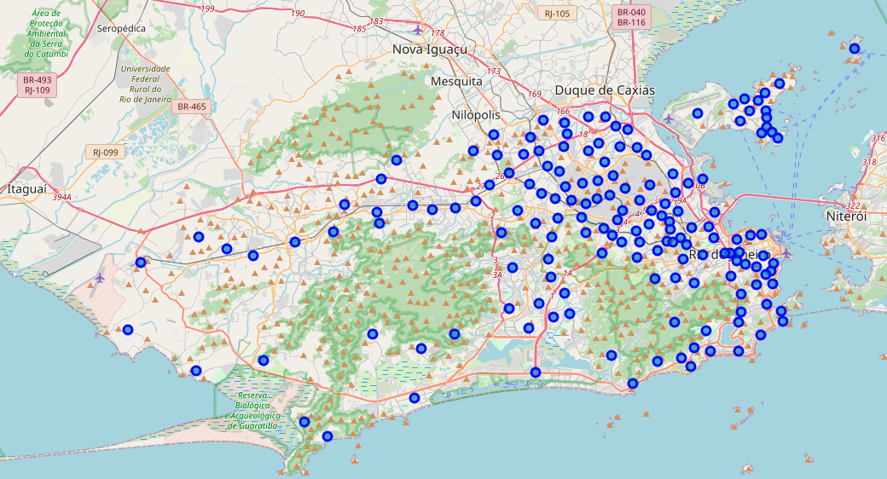
Neighborhood distribution

Slide 6
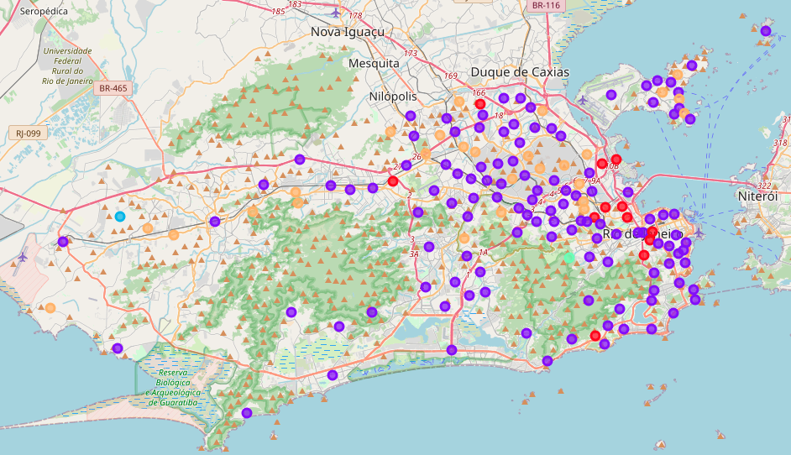
Clustering with K-Means
After retrieving the venues data using Foursquare API, the data was hot-encoded and submitted to k-means clustering

Slide 7
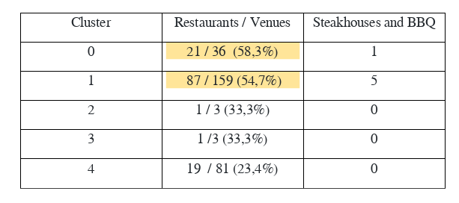
Cluster Analysis
Clusters 0 and 1 are clearly the ones with greater concentration of restaurants
(> 50%) between the 3 most common columns.

Slide 8
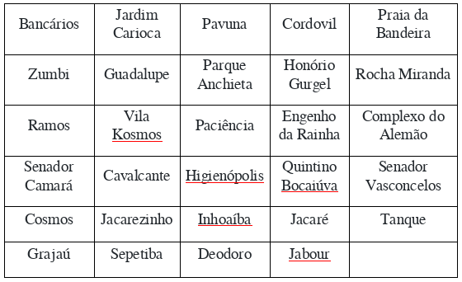
Candidate List
The remaining clusters neighborhoods
Problem: this regions are mostly "false positive"
Poor social conditions is the main cause of low restaurant concentration in this areas

Slide 9
Social Filtering
After submit the candidate list to a filter with the third quarter of income statistics of the city as the intersection factor, just one neighborhood showed both low restaurant concurrency and high social potential.
Grajaú

