Slide 1
Unlocking Customer Value Through
Behavioural Segmentation
RFM Analysis — Customer Intelligence Report
Analysis across 100 customers | 8 of 11 behavioural segments present | 3-year CLV horizon
March 2026
CONFIDENTIAL

Slide 2
Executive Summary
Three findings define the commercial opportunity in this customer base
01
Champions & Loyal represent 15% of customers but deliver 40% of total portfolio CLV
15 customers — avg CLV $1,412 (Champions) and $832 (Loyal). Protecting and deepening these relationships is the highest-return priority.
02
40% of the base shows lapsing signals — representing recoverable CLV at risk
40 customers across Hibernating, Lost, At Risk, and Can't Lose Them segments. Targeted win-back programmes could recapture a meaningful share of this value before permanent churn.
03
40% of customers are in early-stage growth segments with conversion potential
40 customers across New Customer, Promising, and Potential Loyalist. Structured onboarding and loyalty nudges can migrate these cohorts toward higher-value segments.
CONFIDENTIAL — RFM Customer Analysis
2

Slide 3
Methodology
RFM scoring translates transactional data into actionable behavioural profiles
1
2
3
4
5
R — Recency
F — Frequency
M — Monetary
Segmentation
CLV Estimate
Days since last purchase.
Lower recency = higher score (1–5).
Customers scored via percentile rank.
Number of distinct purchases.
Direct ladder: 1 tx → score 1,
5+ tx → score 5.
Total spend to date.
Higher spend = higher score (1–5).
Customers scored via percentile rank.
11 segments assigned via
R×F score matrix — from
Champions to Lost.
avg_order × freq × 3 yrs × 20%
margin. Consistent 3-year
horizon for comparability.
Configuration
Input file:
rfm_mockup.csv
Customers analysed:
100
CLV lifespan:
3 years
Margin assumption:
20%
Segments:
11
Output file:
rfm_analysis.csv
CONFIDENTIAL — RFM Customer Analysis
3

Slide 4
Segment Landscape
The 100-customer base spans 11 segments with a total estimated portfolio CLV of $41,135
Segment
Customers
Share
Avg CLV
Total CLV
Avg Recency
Strategic Priority
Champions
7
7%
$1,412
$9,882
30.0 days
Protect & deepen — highest CLV, highest loyalty
Loyal
8
8%
$832
$6,655
62.0 days
Reward & upsell — consistent, high-value base
Potential Loyalist
15
15%
$599
$8,992
67.0 days
Nudge to loyalty — targeted incentives
Need Attention
5
5%
$512
$2,562
134.0 days
Monitor
New Customer
10
10%
$271
$2,706
88.0 days
Welcome & educate — first impression drives LTV
Promising
15
15%
$244
$3,654
147.0 days
Onboard & engage — early-stage, high conversion upside
Hibernating
20
20%
$192
$3,842
230.0 days
Re-engage — time-sensitive before permanent churn
Lost
20
20%
$142
$2,843
333.0 days
Win-back — selective recovery, low probability
CONFIDENTIAL — RFM Customer Analysis
4

Slide 5
Champions and Loyal customers (15% of base) generate 40% of total portfolio CLV
The classic 80/20 dynamic is present — concentration at the top is both an asset and a risk
Champions — Avg CLV
Loyal — Avg CLV
Portfolio Total CLV
Value Seg. CLV Share
$1,412
$832
$41,135
40%
7 customers | avg recency 30.0 days
8 customers | avg recency 62.0 days
Across all 100 customers
Delivered by 15% of customers
Total CLV by Segment
Champions
$9,882
Loyal
$6,655
Potential Loyalist
$8,992
Need Attention
$2,562
New Customer
$2,706
Promising
$3,654
Hibernating
$3,842
Lost
$2,843
CONFIDENTIAL — RFM Customer Analysis
5

Slide 6
40% of customers show lapsing behaviour — $6,685 in CLV is at risk of permanent loss
Hibernating and Lost segments require time-sensitive intervention to prevent irreversible churn
Hibernating
Lost
20 customers
20 customers
Avg CLV: $192
Avg CLV: $142
Total CLV at risk: $3,842
Total CLV at risk: $2,843
Avg recency: 230.0 days
Avg recency: 333.0 days
Last purchase 193–280 days ago. Single-purchase customers.
High reactivation potential with targeted offer.
Last purchase 280–365 days ago. Lowest recency scores.
Selective win-back only — focus on higher CLV profiles.
⚠ Recommended action: Launch a re-engagement sequence within 30 days for Hibernating customers. Prioritise the top quartile by CLV (above $204). A/B test discount vs. content-led reactivation.
CONFIDENTIAL — RFM Customer Analysis
6

Slide 7
40% of the base are early-stage customers — structured nurture can convert them to high-value segments
New Customer, Promising, and Potential Loyalist cohorts represent the pipeline for future CLV growth
New Customer
Promising
Potential Loyalist
10 customers
15 customers
15 customers
$271
$244
$599
avg CLV
avg CLV
avg CLV
Avg recency: 88.0 days | Avg freq: 1x
Avg recency: 147.0 days | Avg freq: 1x
Avg recency: 67.0 days | Avg freq: 2x
Very recent, first purchase only.
Priority: onboarding experience, second purchase incentive.
Recent, 1–2 purchases. Positive engagement signal.
Priority: loyalty programme invitation, category expansion.
2 purchases, moderate recency.
Priority: reward next purchase, introduce referral mechanic.
Migration target: move Promising and Potential Loyalist customers to Loyal status within 12 months
CONFIDENTIAL — RFM Customer Analysis
7

Slide 8
What the Numbers Could Not See
Reading what customers wrote, alongside what they did
Customers flagged by language
Lifetime value exposed
Need a person, not a campaign
Raised a serious problem
5
$3,502
23
21
Healthy on every purchase measure
8.5% of portfolio
of 100 customers reviewed
Something went wrong, unresolved
FLAGGED BY WHAT THEY SAID, NOT WHAT THEY BOUGHT
CUSTOMER
SEGMENT
LIFETIME VALUE
WHAT IS DRIVING IT
WHY RFM MISSED THEM
CUS5907I
Loyal
$1,051
Service
Still buying on schedule, but sitting on an unresolved failure
CUSCRUYF
Loyal
$762
Competitor
Still buying, while actively weighing up another supplier
CUSKOIXN
Loyal
$743
Service
Still buying on schedule, but sitting on an unresolved failure
CUS65KXV
Potential Loyalist
$652
Service
Still buying on schedule, but sitting on an unresolved failure
CUSOR56F
New Customer
$294
Service
Still buying on schedule, but sitting on an unresolved failure
Why this is invisible to RFM: the model is built entirely from past purchases. A customer who has decided to leave but has not yet stopped buying looks identical to a loyal one — right up until they go. Their words are the only early warning.
Customer messages in this analysis are illustrative sample text, generated to demonstrate the method. Replace with real support and survey data before acting on named accounts.
CONFIDENTIAL — RFM Customer Analysis
8

Slide 9
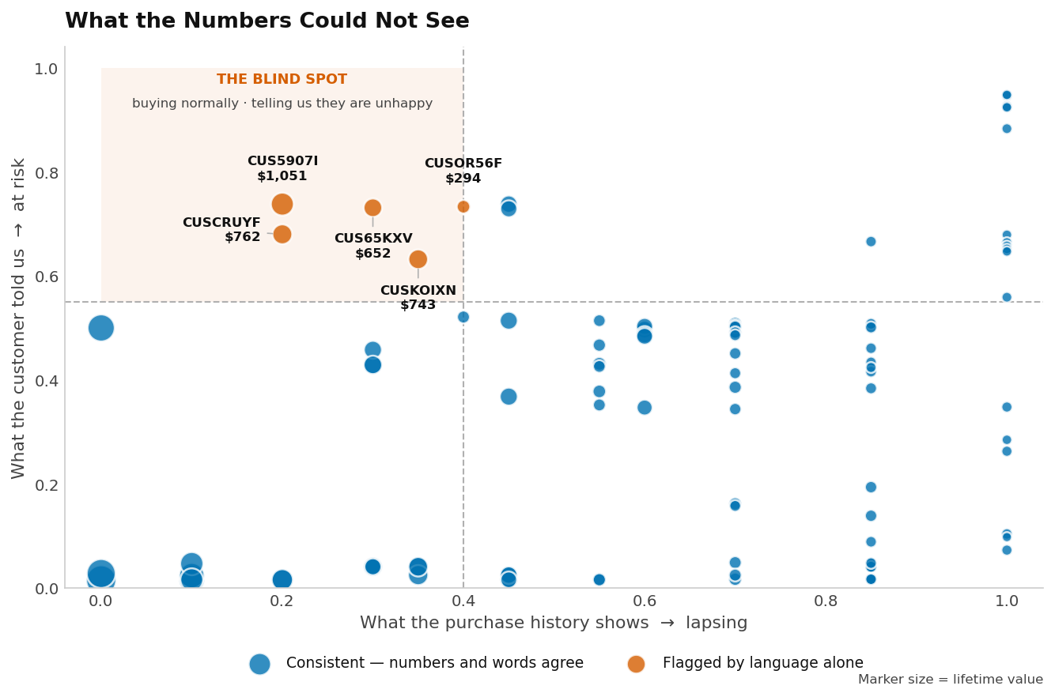
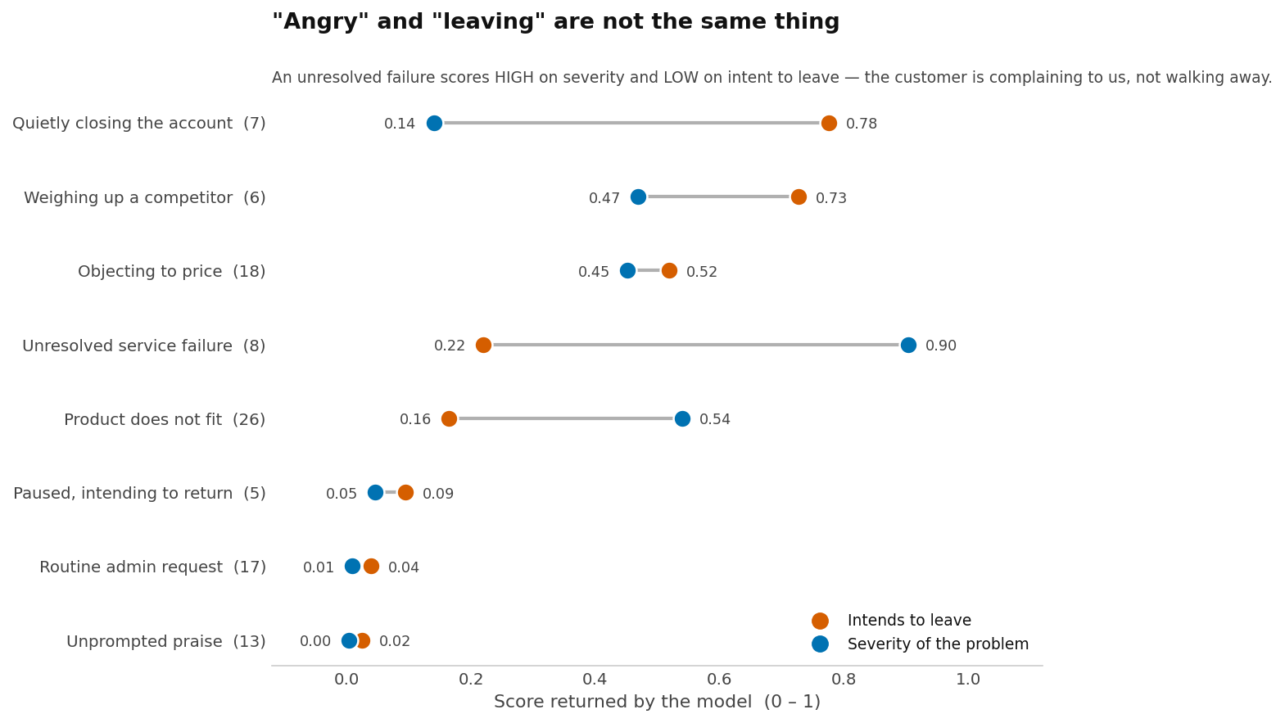
How the Model Read Your Customers
Every customer message scored on two separate questions
Each dot is a customer. Across: what their buying history shows. Up: what they told us. The shaded corner holds customers who are still buying normally while saying they are unhappy — the group a behavioural model cannot surface.
The two questions do not move together. An unresolved failure scores near the top on severity and near the bottom on intent to leave: those customers are complaining to us, not walking away. Treating the two as one number hides both.
Customer messages in this analysis are illustrative sample text, generated to demonstrate the method. Replace with real support and survey data before acting on named accounts.
CONFIDENTIAL — RFM Customer Analysis
9

Slide 10
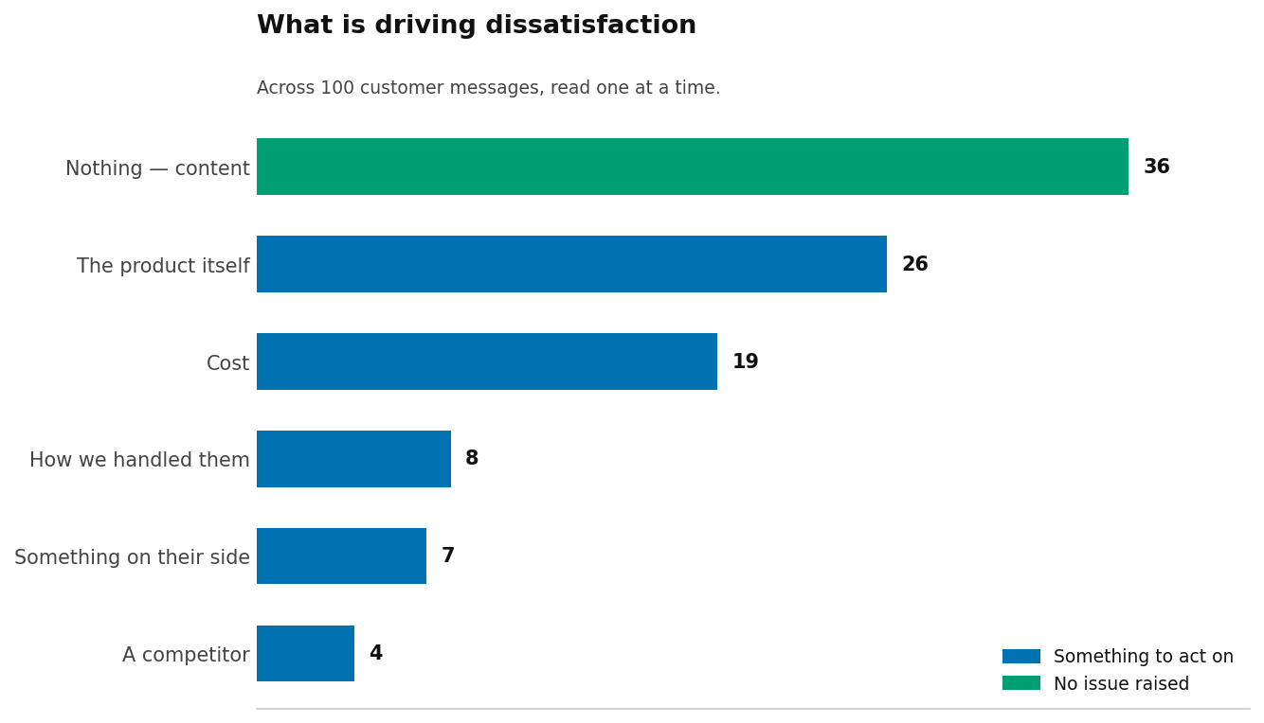
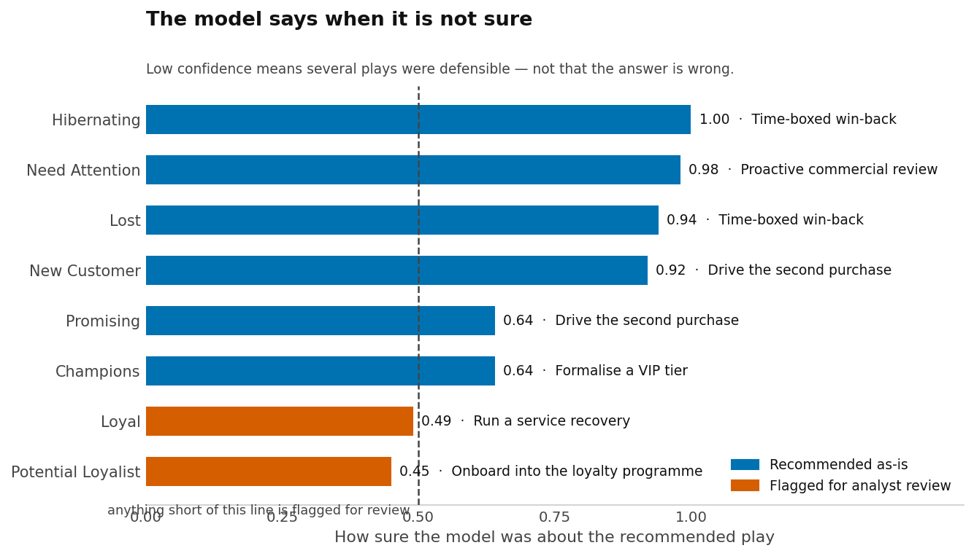
What It Found, and How Sure It Was
The reasons behind the numbers, and where the model declined to commit
Each message was sorted into a single dominant reason. Just over a third raised no issue at all, which is itself useful: it separates the genuinely content from the merely quiet.
The model reports its own certainty. Where one play was clearly right it says so; where several were defensible it does not pretend otherwise, and those go to an analyst rather than onto a recommendation slide.
Customer messages in this analysis are illustrative sample text, generated to demonstrate the method. Replace with real support and survey data before acting on named accounts.
CONFIDENTIAL — RFM Customer Analysis
10

Slide 11
Strategic Recommendations
Plays selected against current data, highest portfolio value first
DEFEND · CHAMPIONS
GROW · POTENTIAL LOYALIST
Formalise a VIP tier
Onboard into the loyalty programme
– Dedicated contact, early access, exclusive pricing tier
– Structured nurture sequence into the loyalty programme
– 7 customers · $9,882 CLV · Account management · cost: High
– 15 customers · $8,992 CLV · Email campaign · cost: Low
– Urgency 0.2 of 3 · No urgency
– Urgency 0.5 of 3 · No urgency
– Selected with 0.64 confidence
– ANALYST REVIEW — confidence 0.45, runner-up was 'vip_programme'
DEFEND · LOYAL
RECOVER · HIBERNATING
Run a service recovery
Time-boxed win-back
– Name the failure, fix it, compensate, manager closes the loop
– Expiring reactivation offer, with a measured control group
– 8 customers · $6,655 CLV · Human — manager · cost: Medium
– 20 customers · $3,842 CLV · Email campaign · cost: Medium
– Urgency 0.6 of 3 · Worth planning
– Urgency 1.9 of 3 · Act this month
– ANALYST REVIEW — confidence 0.49, runner-up was 'vip_programme'
– Selected with 1.00 confidence
CONFIDENTIAL — RFM Customer Analysis
11

Slide 12
Next Steps
Proposed 90-day roadmap to operationalise findings
Days 1–30
Foundation
Days 31–60
Activation
Days 61–90
Optimise
Validate RFM scores against CRM and transaction data
Launch Hibernating win-back email sequence (test vs. control)
Review win-back programme results — iterate messaging and offer
Socialise segmentation with Marketing, CRM, and Analytics teams
Deploy second-purchase incentive to New Customer cohort
Track segment migration rates vs. targets
Define success metrics and baseline KPIs per segment
Onboard Promising customers into loyalty programme
Present first monthly CLV dashboard to leadership
Brief CRM team on Champions & Loyal VIP programme design
Set up monthly RFM refresh cadence in data pipeline
Define Phase 2 scope: predictive churn modelling, CLV uplift testing
CONFIDENTIAL — RFM Customer Analysis
12

Slide 13
Appendix — Full Segment Data
Source: rfm_analysis.csv | 100 customers | Analysis date: March 2026
Segment
# Customers
% Base
Avg CLV
Total CLV
Avg Recency
Avg Frequency
Avg Monetary
Champions
7
7%
$1,412
$9,882
30.0 days
4.6x
$3,396
Loyal
8
8%
$832
$6,655
62.0 days
3x
$2,144
Potential Loyalist
15
15%
$599
$8,992
67.0 days
2x
$1,443
Need Attention
5
5%
$512
$2,562
134.0 days
2x
$1,487
New Customer
10
10%
$271
$2,706
88.0 days
1x
$693
Promising
15
15%
$244
$3,654
147.0 days
1x
$731
Hibernating
20
20%
$192
$3,842
230.0 days
1x
$725
Lost
20
20%
$142
$2,843
333.0 days
1x
$710
CONFIDENTIAL — RFM Customer Analysis
13

Slide 14
How This Was Built
Reading customer language without training a model
WHAT WE ASKED
WHY NOT A TRAINED MODEL
WHAT STAYED ORDINARY CODE
Five plain questions about each
customer's most recent message
The usual approach did not fit
the problem we actually had
The model never touches
a single calculation
– Are they signalling they want to leave?
– A trained classifier learns from examples. It needs thousands of past messages, each labelled by hand by someone who already knew the answer. We have 100 customers and no labels at all.
– Every number is plain arithmetic: the RFM scores, lifetime value, the thresholds, the weights, who makes the list.
– How serious is the problem they describe?
– What is driving it — service, price, the product, a competitor, or something on their side?
– Every new question would mean another labelled set and another training run. Here, adding a question took minutes.
– The model judges meaning. Code owns every calculation and every decision that follows from it.
– Could we still keep them if we acted this fortnight?
– This is the step before machine learning, not a replacement for it. Once enough of these judgments are paired with real outcomes, they become inputs to a conventional model.
– Our first scoring rule was wrong — it treated a furious customer as safe. Fixing it cost nothing, because the answers were already saved and we simply re-scored them. Retraining a model would have meant starting again.
– Does this need a person, or will a campaign do?
– Answers come back as numbers, not paragraphs, so ordinary code can use them directly.
The model reports how sure it is.
2 of 8 recommended plays came back below our confidence bar. Those are marked for analyst review rather than presented as settled. A model that says "I am not sure" is more useful than one that guesses confidently — and it is the difference between a slide you can defend and one you cannot.
Customer messages in this analysis are illustrative sample text, generated to demonstrate the method. Replace with real support and survey data before acting on named accounts.
CONFIDENTIAL — RFM Customer Analysis
14

