Slide 1
Responsible AI
Course: CIS475(Emerging Trends)
Advisor: Brad Olsen
Date: 10/28/2025

Slide 2
Project Statement
Project showcases evidence of the consequences of AI, and solutions.
Notes:
Project showcases evidence of the consequences produced by use and development of AI, and solutions for mitigating these consequences

Slide 3
Purpose
To influence people's to be more thoughtful when using AI

Slide 4
Reasoning
Large data centers can consume up to 5 million gallons per day. ("Yañez-Barnuevo", 2025)
With larger and new AI-focused data centers, water consumption is increasing alongside energy usage and carbon emissions. ("Yañez-Barnuevo", 2025)
By 2030, data centers could account for as much as 11% of U.S. power demand — up from 3% ("LA Times" 2024)
Power Usage during certain times of day or weather conditions can create different impacts on our environmental footprint. ("Carbon Impact of Electric Vehicle Charging," 2024)

Slide 5

Why Does AI Require so much energy?
Because of the computational power required to run these models at the speed seen through modern online chat bots, these models are ran on extremely powerful computers all held together in data centers owned for or paid for by the company. More computational power does not necessarily mean better energy efficiency to produce that power, and often times these powerful computers release large amounts of heat far greater then personal computers, with all of these computers in one single space powerful cooling is needed to keep the computers from overheating. For this reason liquid cooling is used often derived from fresh water sources that run through tubes alongside the machine dissipating the heat from the machines to the water which over time declines as it evaporates through special ducts.

Slide 6
Why Does AI waste so much water?
Because of the computational power required to run these models at the speed seen through modern online chat bots, these models are ran on extremely powerful computers all held together in data centers owned for or paid for by the company. More computational power does not necessarily mean better energy efficiency to produce that power, and often times these powerful computers release large amounts of heat far greater then personal computers, with all of these computers in one single space powerful cooling is needed to keep the computers from overheating. For this reason liquid cooling is used often derived from fresh water sources that run through tubes alongside the machine dissipating the heat from the machines to the water which over time declines as it evaporates through special ducts.

Slide 7
Individual Contributions

Slide 8
Solutions
Limit use of video models like Veo and Sora only to what is necessary
Find and re-use old search prompts for answers instead of re-prompting the model
Use Tools like mlco2 to keep track of energy consumption when using AI models
Disable auto/embedded AI when possible ex. Google Search AI results.
Vote on propositions related to data center development
Use models locally whenever possible

Slide 9
Using Models Locally
LM Studio

Slide 10
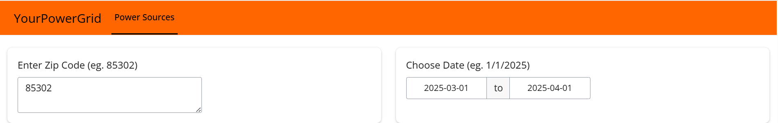
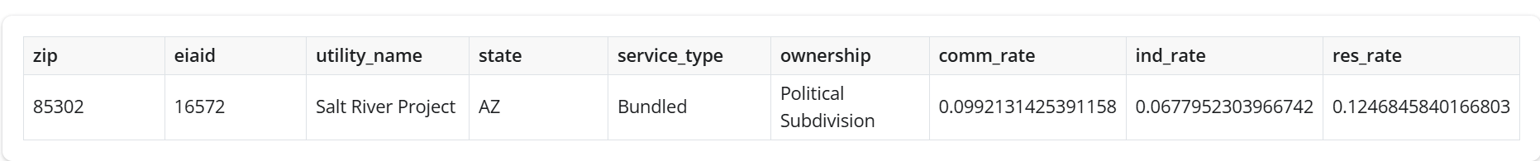
User Input:
Based on the zip code entered the app identifies the utility provider.
The program then retrieves the raw data from the EIA website based on the utility provider and the date range provided and returns back a list of tables and visualizations for the user to easily interpret.

Slide 11
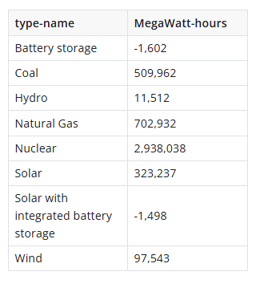
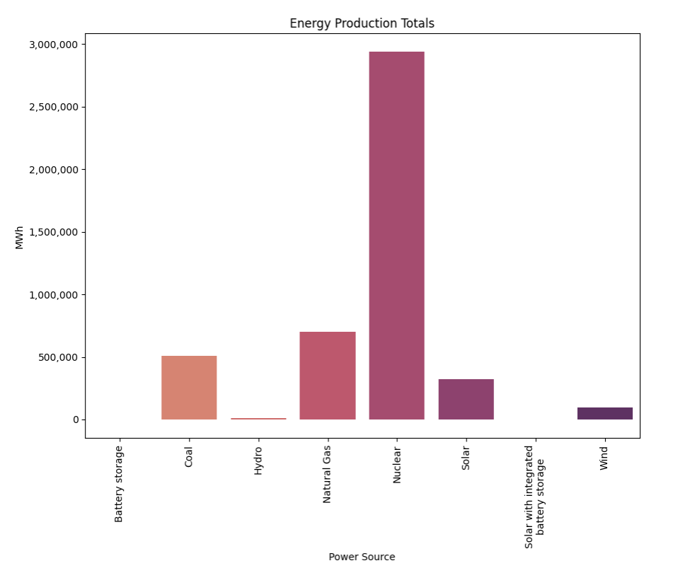
Energy production by source:
Quick Insights:
Nuclear power has been the main source of energy for SRP in the past month
Nuclear and Coal are used more than Solar.
Tesla won’t have as green of a footprint as you initially thought, now you have to invest in solar panels if you decide to buy the house

Slide 12
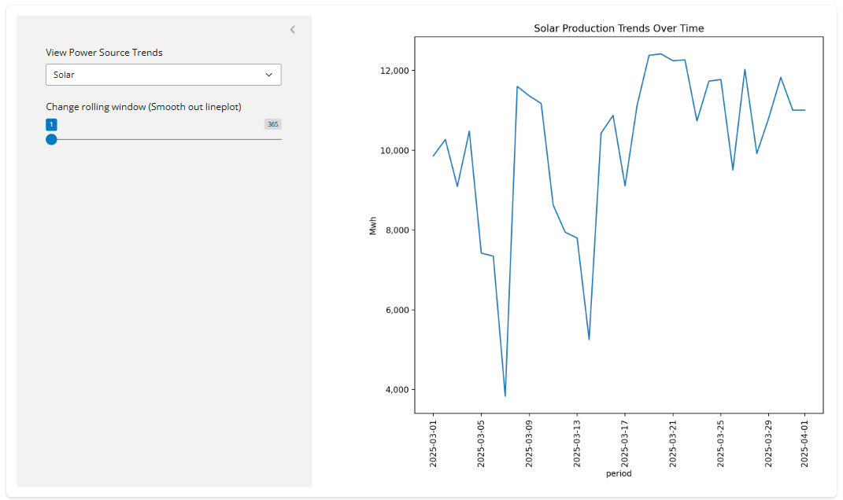
Individual Power Source Trends
Quick Insights:
Dips in Solar Production around March 7th & 14th
Peak Solar production around March 9th & 18th
Maybe I should try charging my tesla on sunnier days and make sure I don’t leave my lights on when I know it’s going to be cloudy

Slide 13
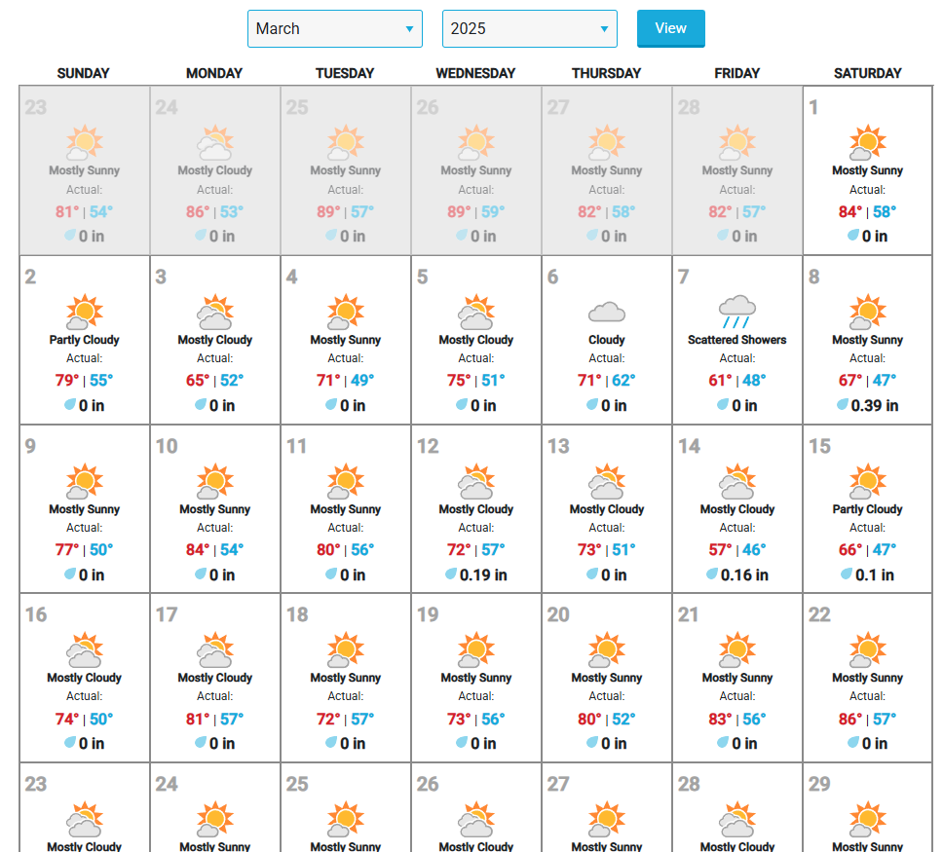
Weather Check
From:
https://www.wunderground.com/calendar/us/az/phoenix/KPHX/date/2025-3
Simply used to verify Solar production example seen in previous slide

Slide 14
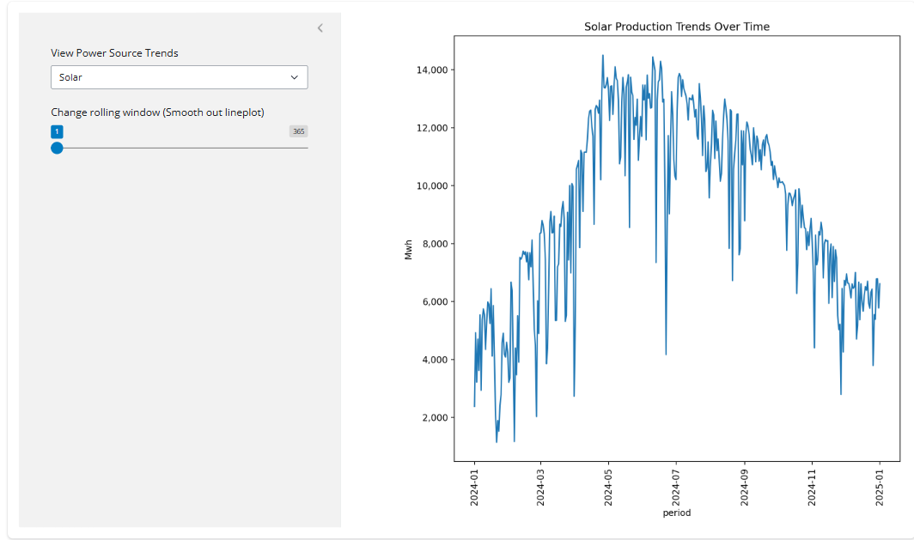
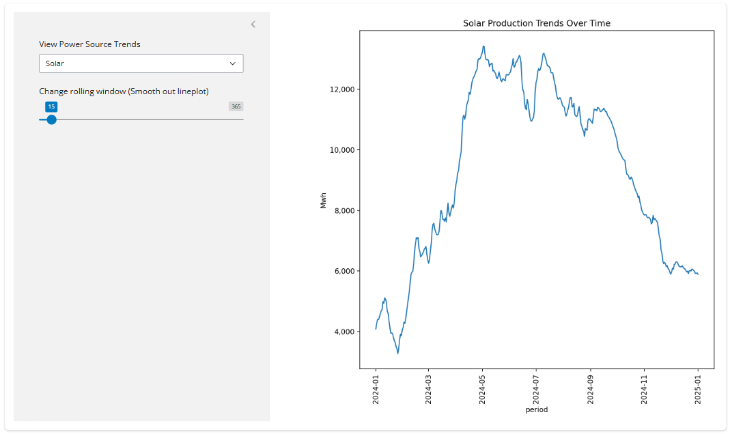
Individual Power Source Trends
Rolling Window Slider:
Suggested use on larger date range (over a year), to smooth out noisy graphs. Though window size can go up to total date range, too large of a window can result in significant data loss and inaccurate graphs.
Ex. 01/01/2024 – 01/01/2025

Slide 15
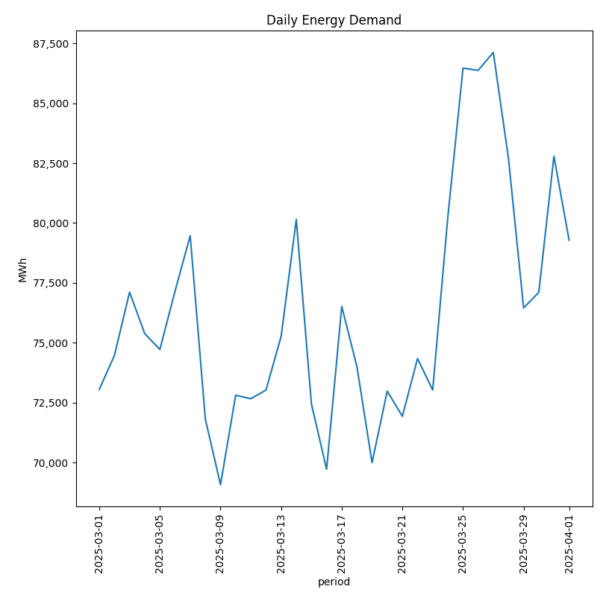
Energy Demand
Consumer demand from the utility provider by days.
One month:
Ex. 03/01/2025 – 04/01/2025
Quick Insights:
Big spikes in Energy Demand starting after March 21st
Could it be Arizona Spring Temperatures that convinced many to turn on their AC?

Slide 16
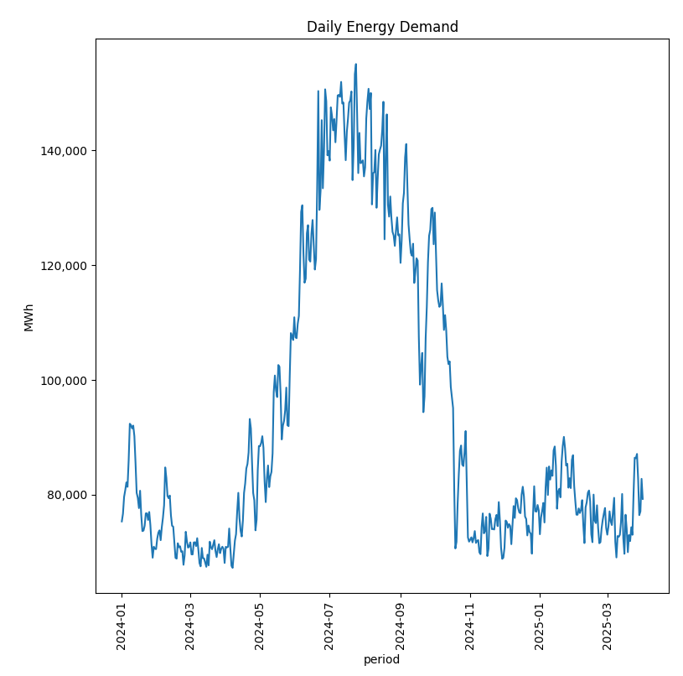
Energy Demand
Consumer demand from the utility provider by days.
One Year
Ex. 01/01/2024 – 01/01/2025
Quick Insights:
Energy Demand is much higher during the summer months, likely due to AC use.
And just as we saw in this year’s March data it seems that last year Energy began to spike around the same time.

Slide 17
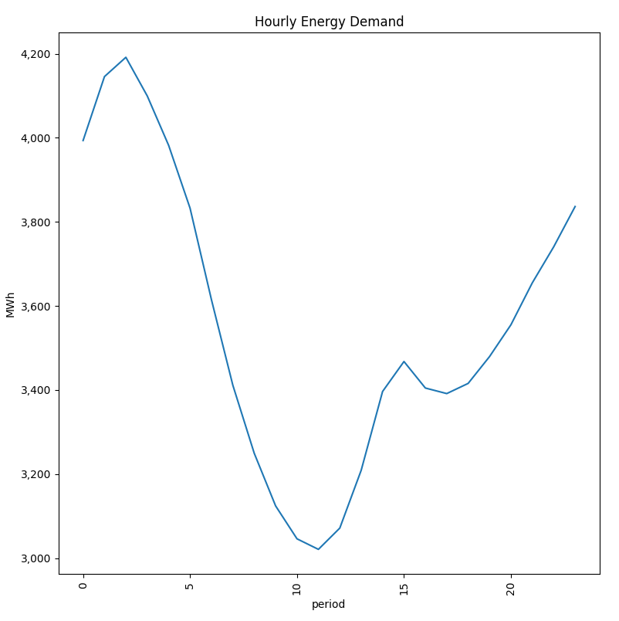
Hourly Demand
Hourly demand by daily average
Ex. 01/01/2024 – 01/01/2025
Quick Insights:
Peak use seems to be around 3 in the morning and steadily falls till around 12 before going back up.

Slide 18
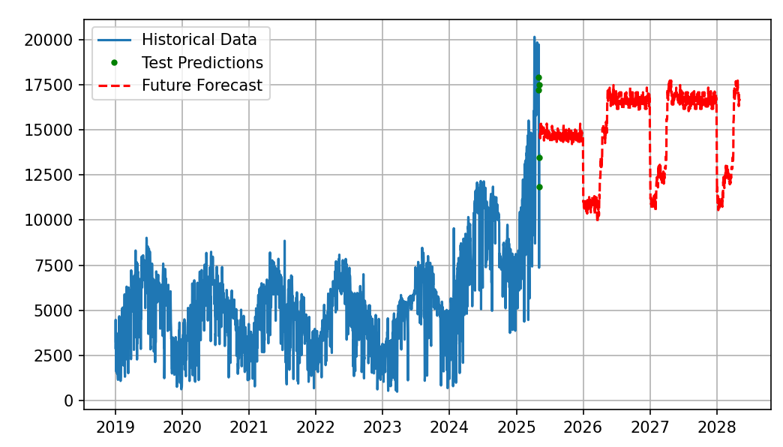
Predictions
Based on comprehensive history of past trends
Ex. 2019-2025 solar production data
Quick Insights:
Assuming spike in Solar power generation continues, these might be the general trends for solar power production in the following years

Slide 19
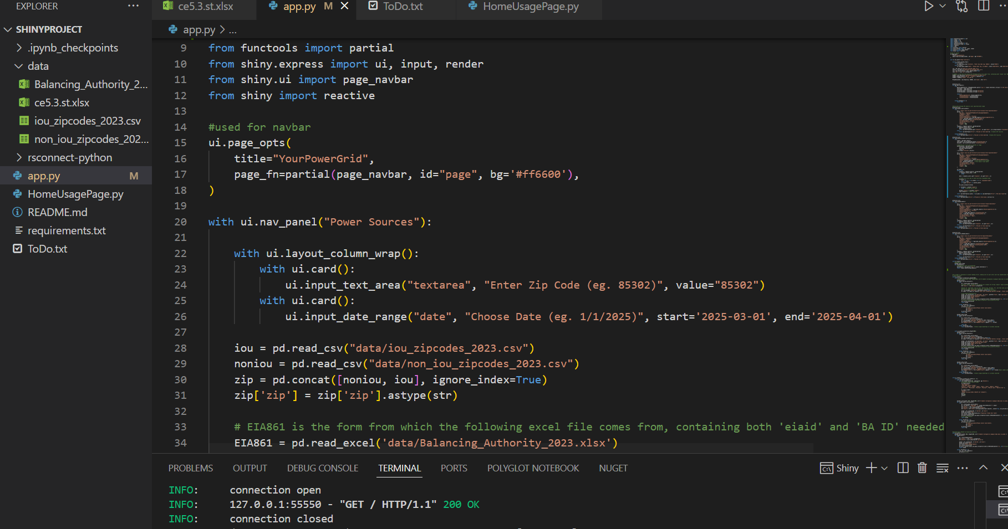
Behind the scenes
Tools Used:
IDE: Visual Studio
Language: Python
WebApp Framework: Shiny for Python

Slide 20
Objectives
Identify source of electricity based on user inputs, and prepare appropriate datasets for further analysis
Merge and integrate datasets into the web app
Analyze and derive insights from the data
Show numeric outputs, and tables based on the user input
Create visualization such as graphs and charts that clearly display these insights
Provide predictions based on previous trends.

Slide 21
Course Skills Used:
Using API’s
Merging Data
Cleaning Data
Working with time series
Working with rolling windows and filling in values
Visualizing trends
Making graphs
Creating predictions.

Slide 22
Challenges:
Predictive models
Data limitations
Error handling while user input is missing

Slide 23
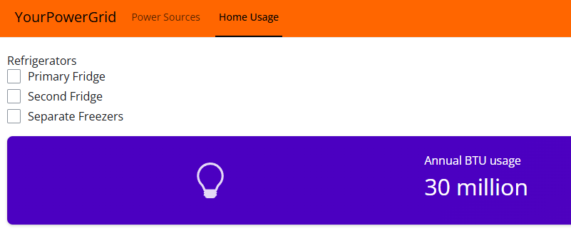
Future Work:
Fine tuning predictive modeling features
Fine tuning web interface for mobile use.
Adding Carbon emission features.
Creating Home Usage page to track more specific household consumption metrics
Example Preview:

Slide 24
Personal Links:
Link to functional web app, hosted through posit https://feliperestrepo101.shinyapps.io/shinyproject/
Contains open-source code for the app, and version history with technical documentation https://github.com/FelipeRestrepo101/HomeEnergySources

Slide 25
Sources:
EIA website grid monitor
  https://www.eia.gov/electricity/gridmonitor/dashboard/electric_overview/US48/US48
API Browser
  https://www.eia.gov/opendata/browser/
Ce5.3 data for average household energy consumption by state
  https://www.eia.gov/consumption/residential/data/2020/index.php?view=state#ce
  https://www.eia.gov/consumption/residential/data/2020/state/pdf/ce5.3.st.pdf
zip codes (2023)
  https://catalog.data.gov/dataset/u-s-electric-utility-companies-and-rates-look-up-by-zipcode-2023

Slide 26
Sources:
show monthly weather history
  https://www.wunderground.com/calendar/us/az/phoenix/KPHX/date/2025-3
Example of utility provider website that did not work:
  https://www.arcgis.com/apps/InformationLookup/index.html?appid=db6e5122fa8245f78f3b4d7b3f474c62
  https://www.epa.gov/egrid/power-profiler#/
EIA-861 Form which helps match balancing authority to eiaid
  https://www.eia.gov/electricity/data/eia861/

