Slide 1

Google
Data Analytics Professional Certificate Capstone
Case Study:
Cyclistic Bike Share
How does a bike-share navigate speedy success?
Google Data Analytics Capstone – Ask, Prepare, Process, Analyze, Share and Act
Author: Felipe Seleme Ribeiro
Date: February 2023

Slide 2
Phase 1 - Ask
To design marketing strategies converting casual riders into annual members, the goal is to determine:
“How do annual members and casual riders use Cyclistic bikes differently?”

Slide 3
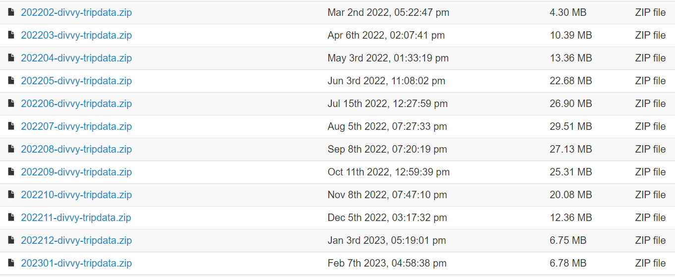
Phase 2 - Prepare
Using Cyclistic’s historical trip data to analyze and identify trends:

Slide 4
Phase 3 - Process
- Checked the data for errors using PyCharm.
- Transformed the data into a unique DataFrame to work with it effectively.
- Documented the cleaning process.

Slide 5
Phase 4 - Analyze
5 main analyzes were carried out:
The ratio of casual users to members in the year
The variations in use among the year
The usage variations between weekdays
The overall average duration of trips per month
Identifying the stations with the largest number of casual users

Slide 6
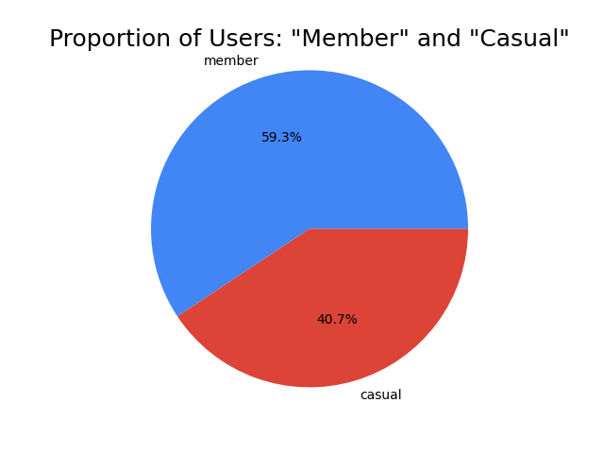
Phase 5 - Share
How can we revert some of the 40,7% casual users into members?

Slide 7
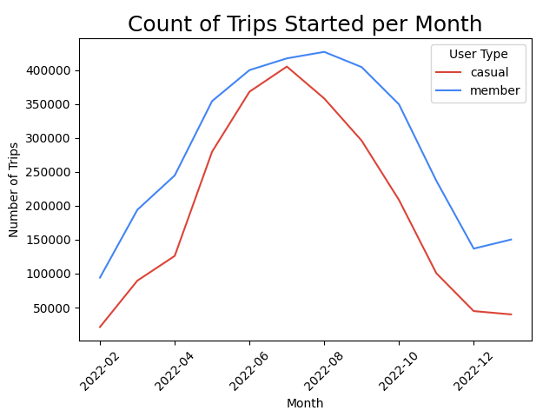
Phase 5 - Share
A marketing action to convert casual users into members should be more effective in the summer, especially in June and July.

Slide 8
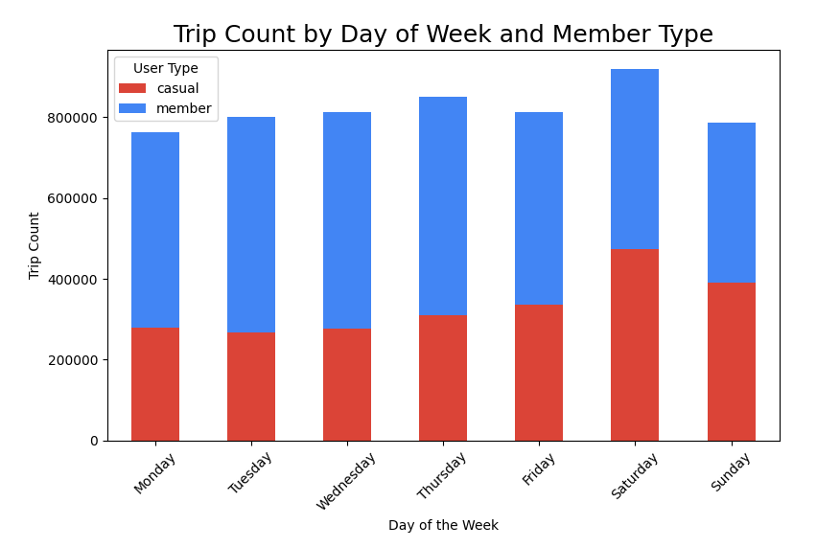
Phase 5 - Share
Weekends seem like the best days to reach casual users.

Slide 9
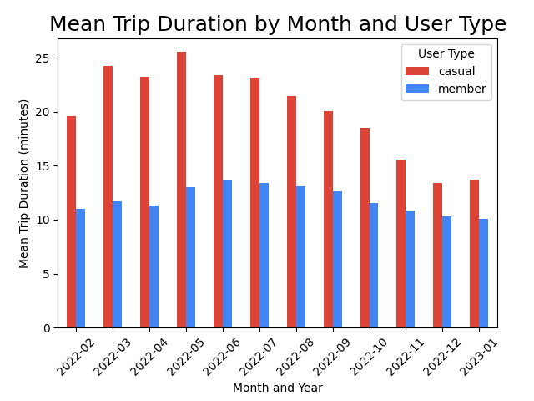
Phase 5 - Share
Casual users clearly tend to ride longer. Members uses the bikes for shorter periods.

Slide 10
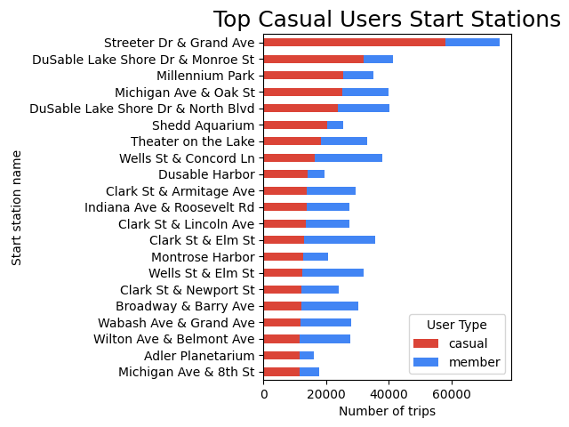
Phase 5 - Share
In addition to the quantity, it is interesting to note the proportions between user types.

Slide 11
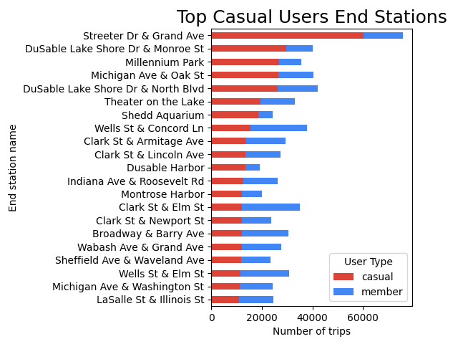
Phase 5 - Share
Stations with a big quantity and proportion of casual users may be the best ones to focus the marketing strategies.

Slide 12
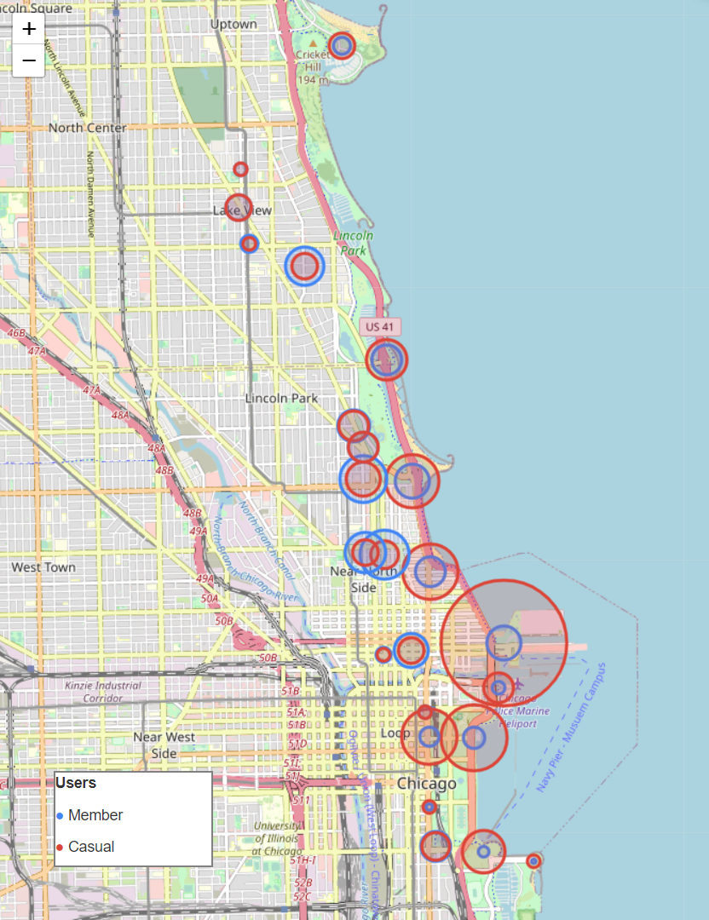
Phase 5 - Share
Top Stations Chicago Map
Stations with a big quantity and proportion of casual users may be the best ones to focus the marketing strategies.

Slide 13
Phase 6 - Act
40,7% are casual users.
Usage increases a lot in the summer.
Weekends seem like the best days to reach casual users.
Casual users clearly tend to ride longer.
Marketing strategies should focus in the top casual user stations.

Slide 14
Phase 6 - Act
This study helped us better understand “How do annual members and casual riders use Cyclistic bikes differently”.
Now we know when and where to focus marketing actions.
It is suggested to carry out a survey at the main stations to understand the casual user's profile and the reasons for not becoming a member.

Slide 15
Google
Data Analytics Professional Certificate Capstone
Google Data Analytics Capstone – Ask, Prepare, Process, Analyze, Share and Act
Author: Felipe Seleme Ribeiro
E-mail: felipeselemeribeiro@gmail.com
Date: February 2023

