Slide 1

Predictive Analysis in Solar Energy using Machine Learning
Strategic Thinking
Felipe Luiz Bauer Steudel
HDip in Data Analytics
May 2025
Notes:
Hello everyone. My name is Felipe Steudel, and this presentation summarizes my project for the Strategic Thinking module. I focused on using machine learning to improve solar energy generation through predictive analytics and anomaly detection.

Slide 2
Motivation & Problem Statement
Solar energy is growing, but efficiency challenges remain.
Lack of effective monitoring increases costs and reduces performance.
Goal: Use data to predict failures and optimize generation.
Notes:
Despite the sustainability of solar energy, plants still have problems with inefficient operation and needless maintenance. Insufficient predictive monitoring is the issue. I wanted to develop models that could forecast power generation and identify performance problems using data from the actual world.

Slide 3
Research Questions & Objectives
Research Questions:
How do temperature and irradiation affect efficiency?
Can we predict failures using sensor data?
Which ML models are best for forecasting?
Objectives:
Enable predictive maintenance
Improve operational efficiency
Forecast energy production accurately
Notes:
The project aimed to answer three key questions around efficiency and prediction using sensor data:
How do temperature and irradiation affect efficiency?
Can we predict failures using sensor data?
Which Machine Learning models are best for forecasting?
The main objectives were to improve maintenance timing, boost plant performance, and predict energy output using machine learning.

Slide 4
Data & Methodology
Source: Kaggle datasets (34 days, India)
Variables: DC/AC Power, Ambient & Module Temperature, Irradiation
Tools: Python, Pandas, Scikit-learn, ARIMA
Models: Linear Regression, Random Forest, ARIMA
Notes:
I used 34 days of sensor and generation data from a solar plant in India. I cleaned and merged the data, did feature selection, and trained three models: Linear Regression, Random Forest, and ARIMA. Python and libraries like Scikit-learn were used.

Slide 5
Key Findings – Feature Importance & EDA
Most important feature: Irradiation
Module Temperature affects efficiency
High correlation between DC and AC Power
Clear daily generation patterns
Notes:
Irradiation was the top predictor of power output. Module temperature also had a significant impact, aligning with theory. Exploratory analysis revealed clear daily patterns and highlighted the importance of environmental factors.

Slide 6
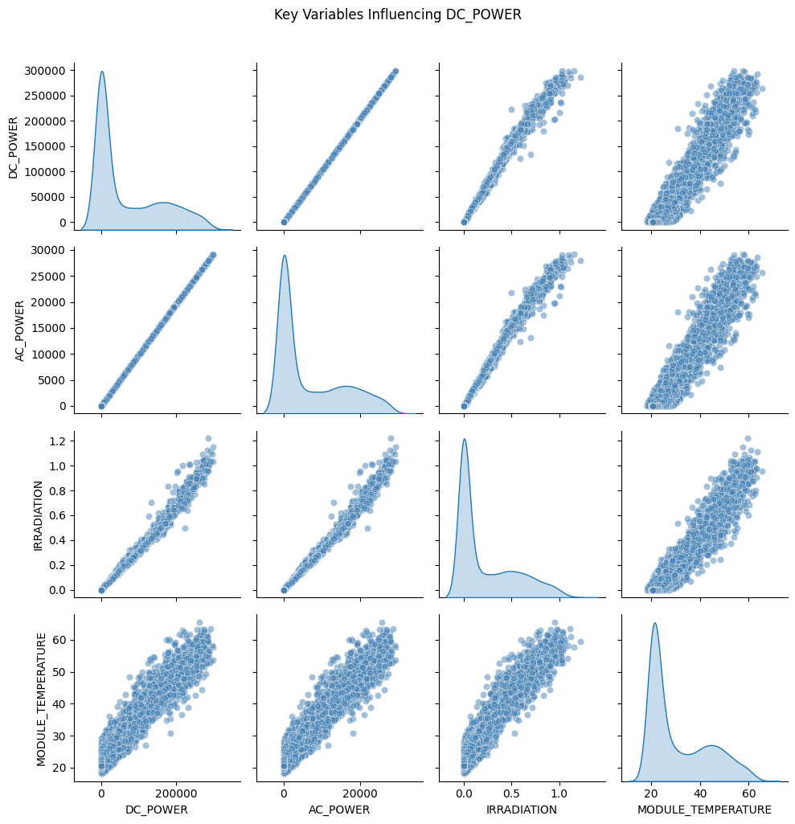
DC Power & AC Power
Notes:
The scatter plot highlights the strong linear relationship between DC_POWER and AC_POWER. Due to this high collinearity, AC_POWER was intentionally excluded from the feature set to prevent data leakage, as both variables represent sequential stages of the same energy conversion process.

Slide 7
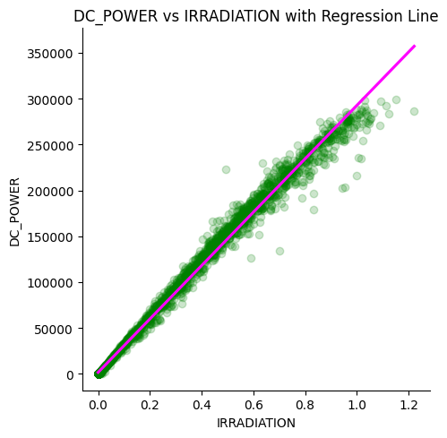
DC Power vs. Irradiation
Notes:
This scatter plot was used to analyze the direct relationship between DC_POWER and IRRADIATION, as solar irradiance is a primary factor influencing photovoltaic output. A strong positive correlation was observed, validating the expected dependency.

Slide 8
Model Results & Evaluation
Model | R² | RMSE
Random Forest | ~0.9933 | ~7206.29
Linear Regression | ~0.9905 | ~8561.39
ARIMA | — | 74,770.96
Notes:
Random Forest outperformed the others, with the highest accuracy and lowest error. Linear Regression was close but less effective for non-linear patterns. ARIMA, using only the power series without external variables, performed poorly.

Slide 9
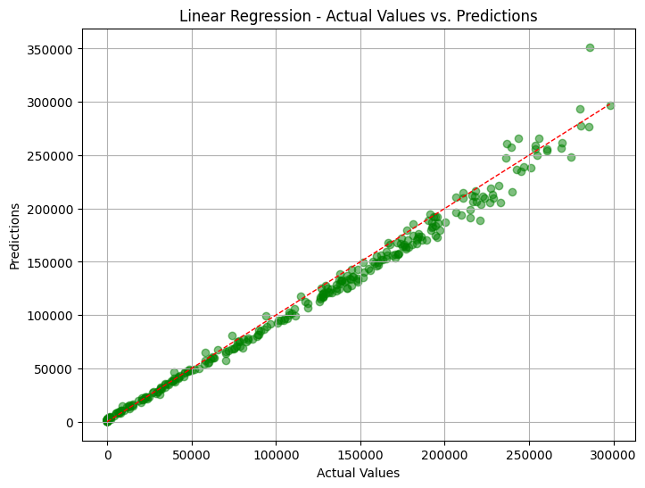
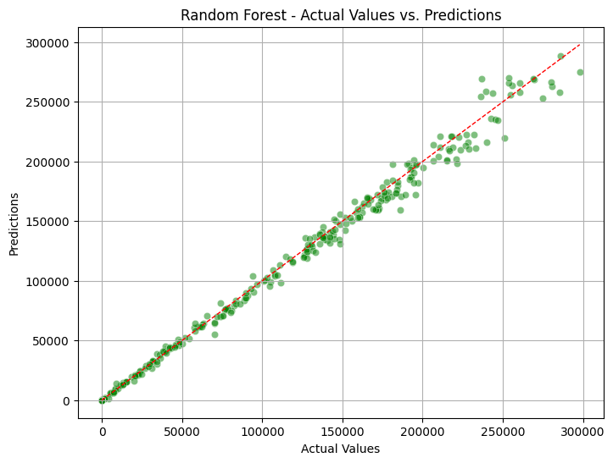
Actual vs. Predicted Plot
Linear Regression
Random Forest
Notes:
The scatter plot for Linear Regression shows a clear alignment along the diagonal, indicating good prediction accuracy. However, slight deviations suggest limitations in capturing non-linear patterns. The Random Forest model, on the other hand, shows predictions closely clustered around the diagonal, demonstrating higher accuracy and better handling of complex relationships.

Slide 10
Conclusion & Future Work
ML helps detect inefficiencies early
Random Forest is the best performer
Future work: Add real-time data, expand to LSTM or deep learning
Notes:
In conclusion, machine learning—especially Random Forest—can greatly improve monitoring in solar plants. The models can help detect faults, predict energy output, and guide maintenance. Future steps include using longer timeframes and deep learning like LSTM for even better results.

