Slide 1
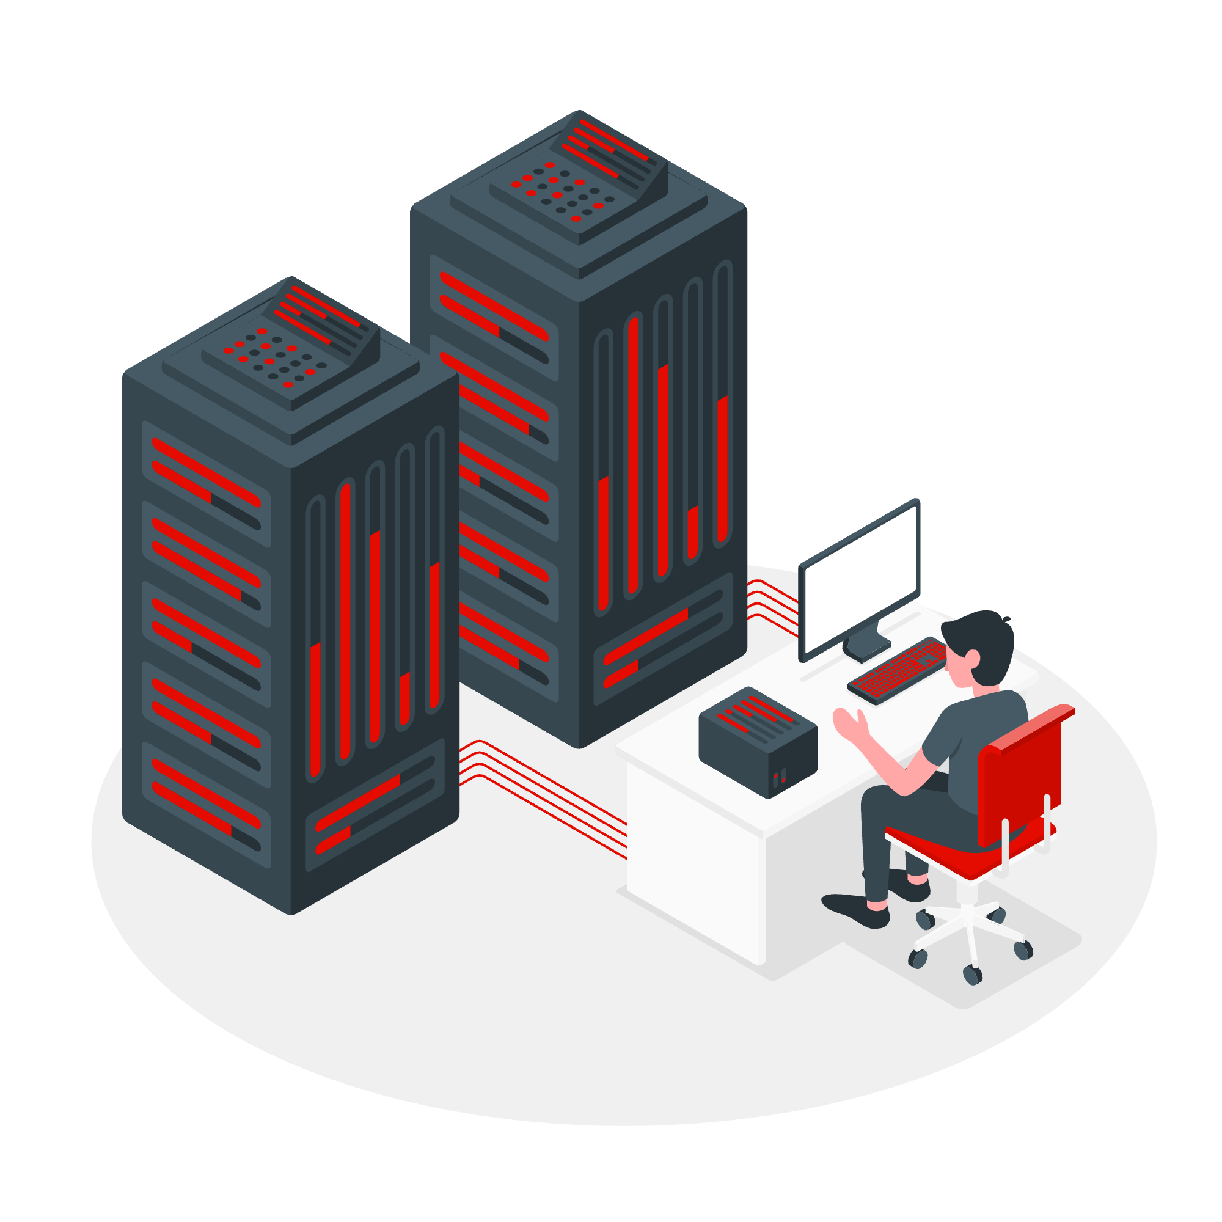

Privacy-Preserving Record Linkage Methods for Homelessness Data
Felipe Castaño Gonzalez
University of Calgary
ENEL 645
Fall 2024

Slide 2
Table of contents
1
2
5
3
4
Results and Discussion
Introduction
Conclusions
Related Work
Materials and Methods
6
References
2

Slide 3

1. Introduction
Canada
235,000
People Experienced Homelessness [1]
18,467
Shelter space [2]
88,6 %
Occupancy rate [3]
Calgary
2,782
Homeless individuals PiT [4]
6,839
Unique individuals accessed Calgary Drop-In Centre [4]
3

Slide 4
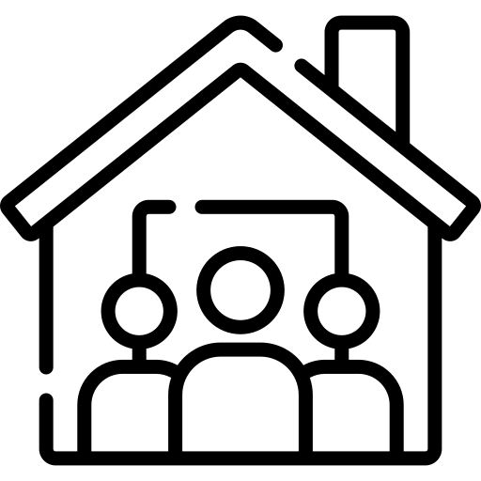

1. Introduction
Shelters
Biggest shelter
2.000 shelters in Calgary [5]
4

Slide 5
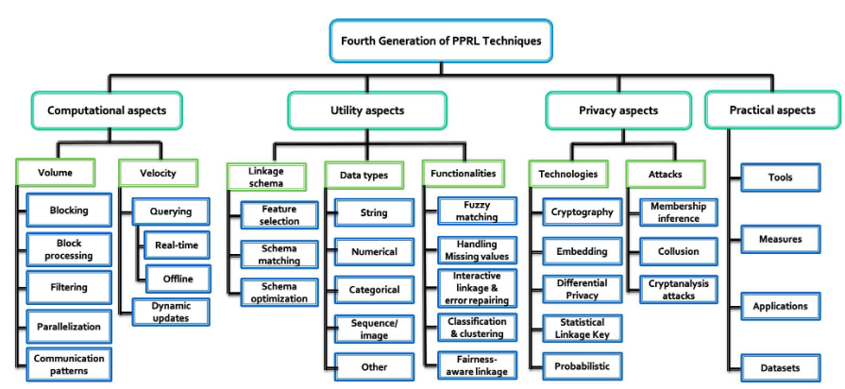
2. Related Work
Fig. 1. A taxonomy of the data-driven (fourth) generation of privacy-preserving record linkage techniques. [6]
5

Slide 6
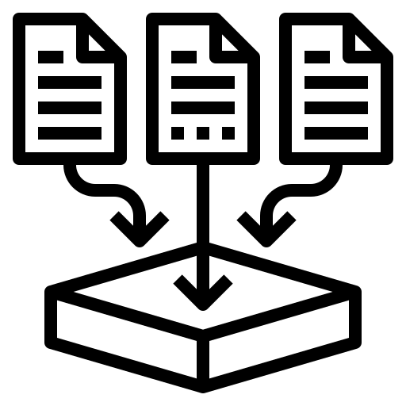
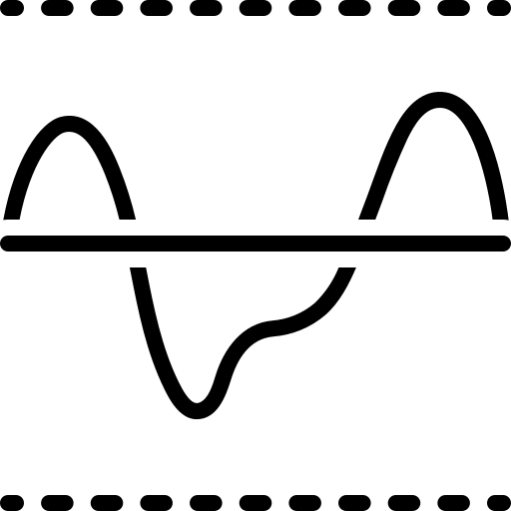


3. Materials and Methods
Dataset
Threshold
Privacy Preserving
Machine Learning
6

Slide 7
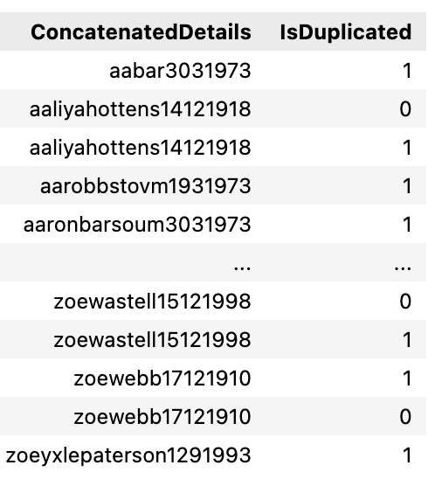
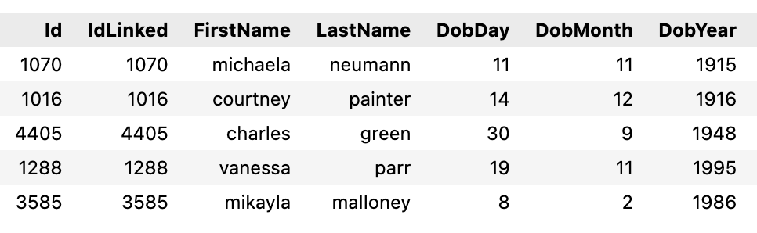
3.1 Dataset
Records = 15.991
Unique = 4.750
Duplicated 11.241
Tab. 1. Raw synthetic dataset based on the Calgary Drop in Centre structure.
Tab. 2. Synthetic dataset after organization.
7

Slide 8
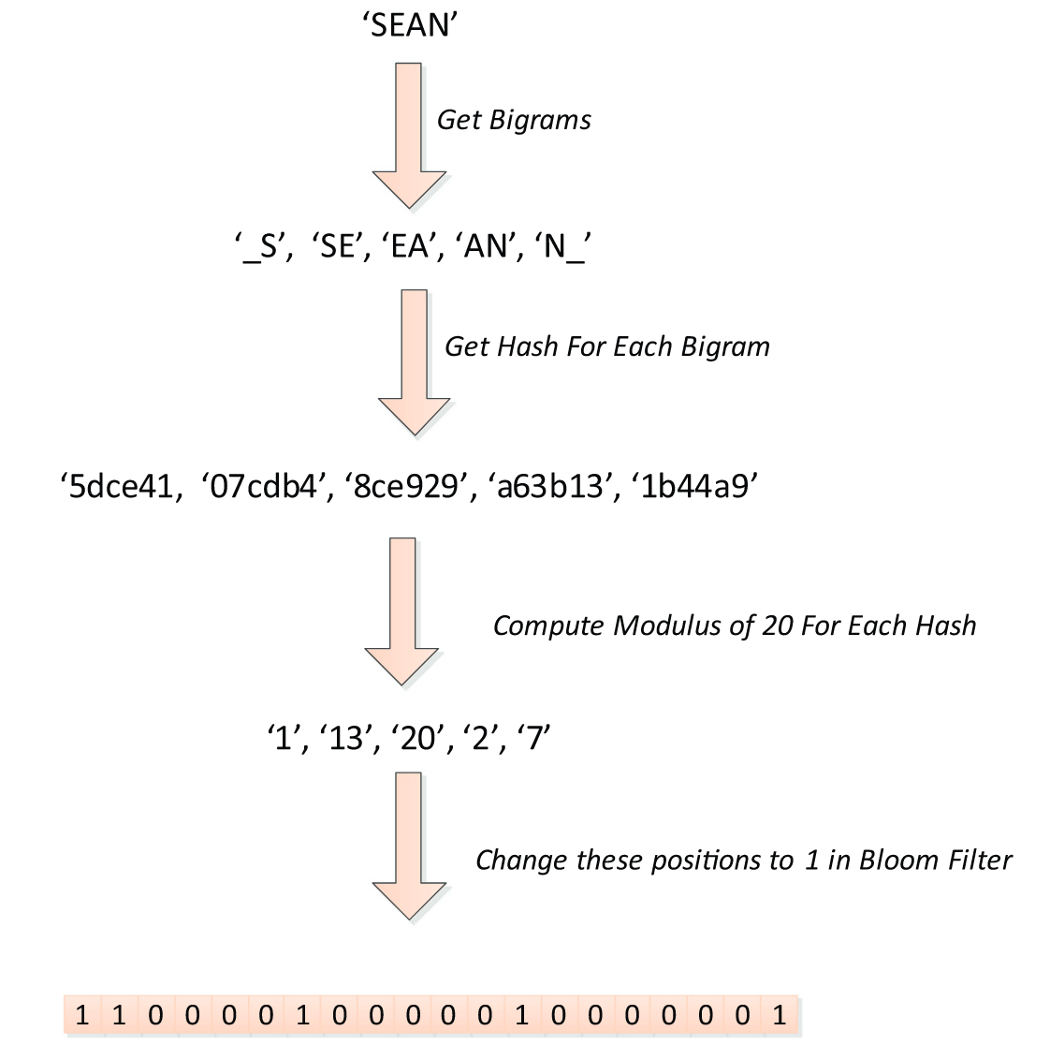
3.2 Privacy preserving
Fig. 2. Example of encoding the name ‘Sean’ into a Bloom Filter of length 20. [7]
8

Slide 9
3.3 Threshold
Applying Bloom Filters [8]
Comparison of records using dice coefficient
Privacy
Compare
1
2
3
4
Creation
Similarity
Dataset created using Python
Threshold based on the Dice Coefficient [9]
9

Slide 10
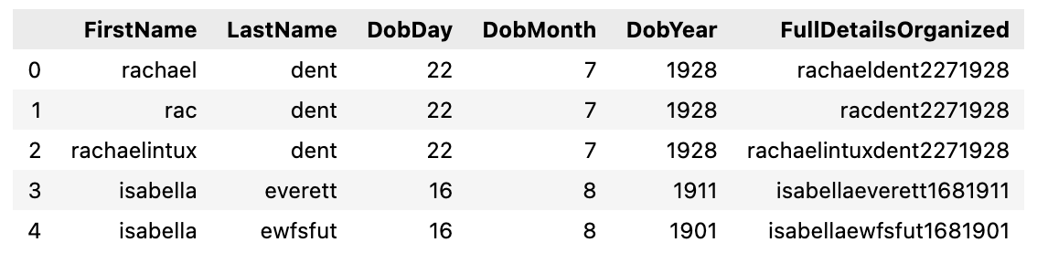
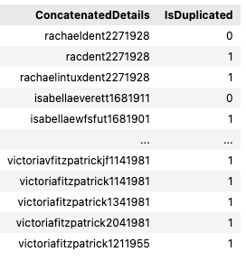
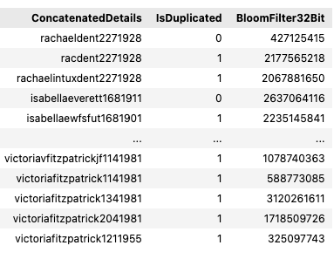
1
Creation
Tab. 3. Complete dataset concatenating the information
Tab. 4. Dataset concatenated with a single or duplicate record
Tab. 5. Dataset concatenated with single or duplicate record and bloom filter the 32 bits.
10

Slide 11
Privacy
2
Fig. 2. Example of encoding the name ‘Sean’ into a Bloom Filter of length 20. [6]
11

Slide 12
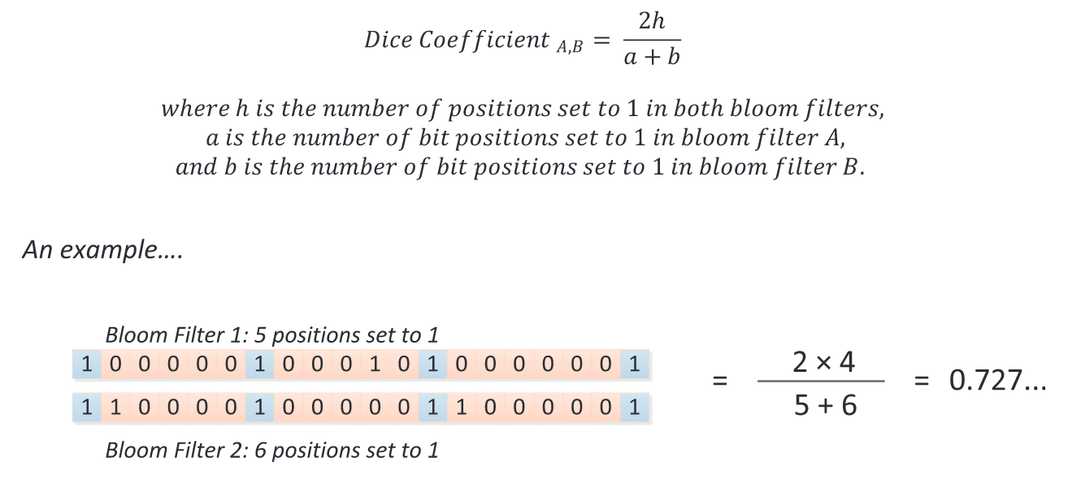
3
Similarity
Fig. 3. Example of calculating string similarity by comparing two bloom filters. [6]
12

Slide 13
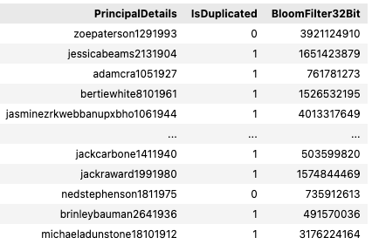
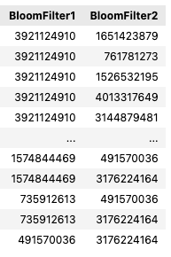
Compare
4
Tab. 6. Dataset concatenated with single or duplicate record and bloom filter the 32 bits.
Tab. 7. Comparison of records with bloom filter
13

Slide 14
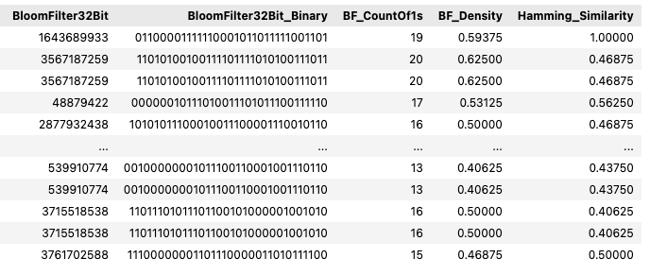

3.4 Machine Learning
XG Boost
Tab. 8. Dataset defined as X for the execution of XG Boost.
Tab. 9. Dataset defined as Y for the execution of XG Boost.
14

Slide 15
4. Results and Discussion
Threshold
Machine Learning
15

Slide 16
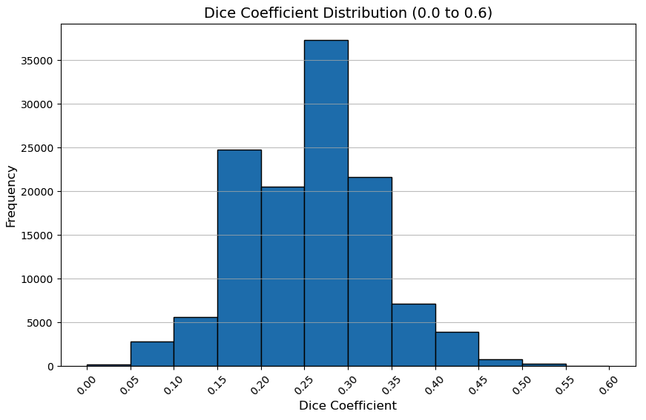
4.1 Threshold
Fig. 4. Histogram of the dice coefficient of all records
16

Slide 17
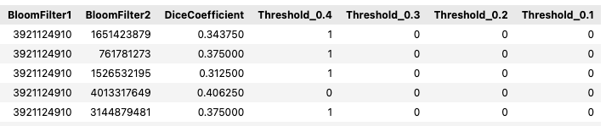
4.1 Threshold
Tab. 8. Comparison of records with dice coefficient and value of thresholds
17

Slide 18
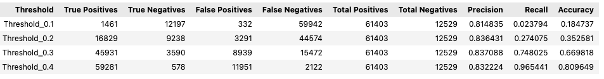
4.1 Threshold
Tab. 9. Results for threshold, precision, recall and accuracy.
18

Slide 19
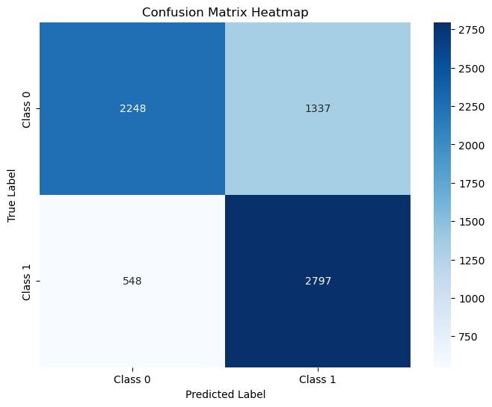
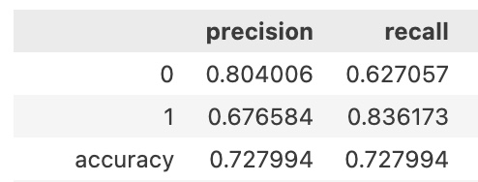
4.2 Machine Learning
Tab. 10. Results for XG Boost, precision, recall and accuracy.
Fig. 5. Confusion matrix for the XG Boost Classifier.
19

Slide 20
5. Conclusions
The use of 32-bit bloom filters can compromise large databases, leading to more false positives.
Threshold adjustments are crucial in imbalanced datasets, where lower thresholds mitigate the imbalance's effect by improving recall, but at the cost of precision.
Effective handling of imbalanced datasets in machine learning models, through techniques like resampling, weighting, or specialized algorithms, is essential to ensure fair representation of both classes and robust performance across metrics.
20

Slide 21
6. References
[1] H. Canada, “Substance-related poisonings and homelessness in Canada: a descriptive analysis of hospitalization data.” Accessed: Aug. 27, 2024. [Online]. Available: https://www.canada.ca/en/health-canada/services/opioids/hospitalizations-substance-related-poisonings-homelessness.html
[2] S. C. Government of Canada, “Homeless Shelter Capacity in Canada from 2016 to 2022, Infrastructure Canada.” Accessed: Aug. 27, 2024. [Online]. Available: https://www150.statcan.gc.ca/t1/tbl1/en/tv.action?pid=1410035301
[3] Homelessness data snapshot: the National Shelter Study 2022 update, [Cat. No.: T94-60/2024E-PDF]. Ottawa, Ontario: Infrastructure Canada, 2024.
[4] “2022-2023 Report To The Community | Calgary Drop-In Centre.” Accessed: Aug. 28, 2024. [Online]. Available: https://calgarydropin.ca/2022-2023-report-to-the-community/
[5] C. Housing, “Supporting Calgarians experiencing homelessness,” https://www.calgary.ca. Accessed: Dec. 02, 2024. [Online]. Available: https://www.calgary.ca/content/www/en/home/social-services/homelessness-in-calgary.html
[6] A. Gkoulalas-Divanis, D. Vatsalan, D. Karapiperis, and M. Kantarcioglu, “Modern Privacy-Preserving Record Linkage Techniques: An Overview,” IEEE Trans. Inf. Forensics Secur., vol. 16, pp. 4966–4987, 2021, doi: 10.1109/TIFS.2021.3114026.
[7] S. M. Randall, A. M. Ferrante, J. H. Boyd, J. K. Bauer, and J. B. Semmens, “Privacy-preserving record linkage on large real world datasets,” J. Biomed. Inform., vol. 50, pp. 205–212, Aug. 2014, doi: 10.1016/j.jbi.2013.12.003.
[8] R. Schnell, T. Bachteler, and J. Reiher, “Privacy-preserving record linkage using Bloom filters,” BMC Med. Inform. Decis. Mak., vol. 9, no. 1, p. 41, Dec. 2009, doi: 10.1186/1472-6947-9-41.
[9] L. R. Dice, “Measures of the Amount of Ecologic Association Between Species,” Ecology, vol. 26, no. 3, pp. 297–302, Jul. 1945, doi: 10.2307/1932409.
21

