Slide 1
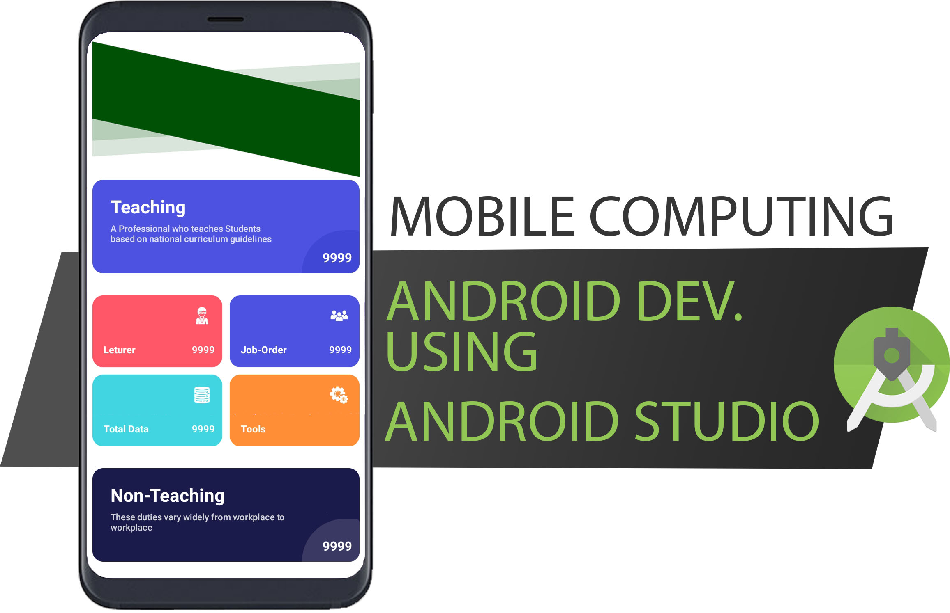

Slide 2

Android SQLITE

Slide 3

Android SQLite
Android SQLite is a very lightweight database which comes with Android OS. Android SQLite combines a clean SQL interface with a very small memory footprint and decent speed. For Android, SQLite is “baked into” the Android runtime, so every Android application can create its own SQLite databases

Slide 4
Android SQLite SQLiteOpenHelper
Android has features available to handle changing database schemas, which mostly depend on using the SQLiteOpenHelper class. SQLiteOpenHelper is designed to get rid of two very common problems. Android SQLiteOpenHelper Reference
When the application runs the first time - At this point, we do not yet have a database. So we will have to create the tables, indexes, starter data, and so on.
When the application is upgraded to a newer schema - Our database will still be on the old schema from the older edition of the app. We will have option to alter the database schema to match the needs of the rest of the app.

Slide 5
SQLiteOpenHelper wraps up these logic to create and upgrade a database as per our specifications. For that we’ll need to create a custom subclass of SQLiteOpenHelper implementing at least the following three methods [ Constructor, onCreate, onUpgrade ].
Constructor : This takes the Context (e.g., an Activity), the name of the database, an optional cursor factory and an integer representing the version of the database schema you are using (typically starting from 1 and increment later).
onCreate(SQLiteDatabase db) : It’s called when there is no database and the app needs one. It passes us a SQLiteDatabase object, pointing to a newly-created database, that we can populate with tables and initial data.
public [JAVA_CLASS_NAME](Context context) {
super(context, DB_NAME, null, DB_VERSION);
}
@Override
public void onCreate(SQLiteDatabase db) {
db.execSQL(CREATE_TABLE_STRING);
}

Slide 6
onUpgrade(SQLiteDatabase db, int oldVersion, int newVersion) : It’s called when the schema version we need does not match the schema version of the database, It passes a SQLiteDatabase object and the old and new version numbers. Hence we can figure out the best way to convert the database from the old schema to the new one.
Android SQLite Database Connection
Before performing any database operations like insert, update, delete records in a table, first open the database connection by calling getWritableDatabase() method as shown below:
@Override
public void onUpgrade(SQLiteDatabase db, int oldVersion, int newVersion) { db.execSQL("DROP TABLE IF EXISTS " + TABLE_NAME);
onCreate(db); //Call onCreate Function
}
dbHelper = new DatabaseHelper(context);
SQLiteDatabase database = dbHelper.getWritableDatabase();

Slide 7
Method to manage SQLITE database
SQLiteDatabase has methods to create, delete, execute SQL commands, and perform other common database management tasks.
execSQL
insert
rawQuery
update
delete
see Android Developer Reference ….

Slide 8
execSQL
Return Type void
execSQL(String sql)
Execute a single SQL statement that is NOT a SELECT or any other SQL statement that returns data.
- db.execSQL(CREATE_TABLE_STRING);
- db.execSQL("DROP TABLE IF EXISTS " + TABLE_NAME);

Slide 9
insert
Return Type long (The row ID of the newly inserted row, or -1 if an error occurred )
long result = insert(String table, String nullColumnHack, ContentValues values)
Convenience method for inserting a row into the database.
CONTENT VALUES
ContentValues are used to insert new rows into tables.
Each Content Values object represents a single table row as a map of column names to values.
Queries in Android are returned as Cursor objects.
public void insert(String name, String desc) {
SQLiteDatabase database = dbHelper.getWritableDatabase();
ContentValues contentValue = new ContentValues();
contentValue.put(COLUMN_NAME_FNAME, VALUE);
contentValue.put(COLUMN_NAME_COURSE, VALUE);
long result = database.insert(TABLE_NAME, null, contentValue);
}

Slide 10
rawQuery
Return Type Cursor (Cursors are what contain the result set of a query made against a database)
Cursor result = rawQuery(String sql_query, null)
Runs the provided SQL and returns a Cursor over the result set.
see Android Cursor Reference
//getWritableDatabase
//( Create and/or open a database that will be used for reading and writing). SQLiteDatabase db = this.getWritableDatabase(); //Cursors are what contain the result set of a query made against a database in Android Cursor res = db.rawQuery( "select * from "+TABLE_NAME, null ); return res;

Slide 11
update
Return Type int (returns the number of rows affected, 0 means no rows were afftected on update)
Int result = update(String table, ContentValues values, String whereClause, null)
//getWritableDatabase ( Create and/or open a database that will be used for reading and writing). SQLiteDatabase db = this.getWritableDatabase(); //ContentValues are used to insert new rows into tables. //Each Content Values object represents a single table row as a map of column names to values ContentValues contentValues = new ContentValues(); //contentValues.put(String Key, VALUE) // LIKE KEY VALUE PAIR //String KEY COLUMN_NAME //VALUE value for COLUMN_NAME //toUpperCase() TO CHANGE string TO UPPERCASE, trim() TO REMOVE WHITE SPACE contentValues.put(COL_STUD_FULL_NAME, VALUE; contentValues.put(COL_STUD_COURSE, VALUE); //returns the number of rows affected int i = db.update(TABLE_NAME, contentValues, COL_STUD_ID + " = " + this.VAR_STUD_ID, null); return i;

Slide 12
delete
Return Type int (returns the number of rows affected, 0 means no rows were afftected on update)
Int result = delete(String table, String whereClause, String[] whereArgs)
//getWritableDatabase
//( Create and/or open a database that will be used for reading and writing). SQLiteDatabase db = this.getWritableDatabase(); //delete(TABLE_NAME, WhereClause on Condition //returns number of rows affected int i = db.delete(TABLE_NAME, COL_ID + "=" + ID, null); return i;

