Slide 1

Computer Club
Welcome/Welcome back
Fun Fact: The Windows key is also called the Super key or the GUI key

Slide 2
What?
I show you computers. How they work what each bit does.
(This stuff isn’t necessary, but I feel that it is interesting to learn)
I teach you how to code…

Slide 3
What is coding/ to code?
Computer code is simple like a set of instructions.
You simple choose the order of the instructions.
It is easy ☺ … if you know what your doing 😐
My aim is to teach you!!!
Nerd speak… 🤓
Definition:
Coding (noun) [ˈkōdiNG]
Any system of symbols and rules for expressing information or instructions in a form usable by a computer or other digital machine for processing or transmitting information.
Also: information or instructions written according to such a system.

Slide 4
I need your emails :)
To: galle_f24@intst.net
Subject: CC (or something similar)
Content: Hello (do whatever)
This will give me your email addresses and names.

Slide 5

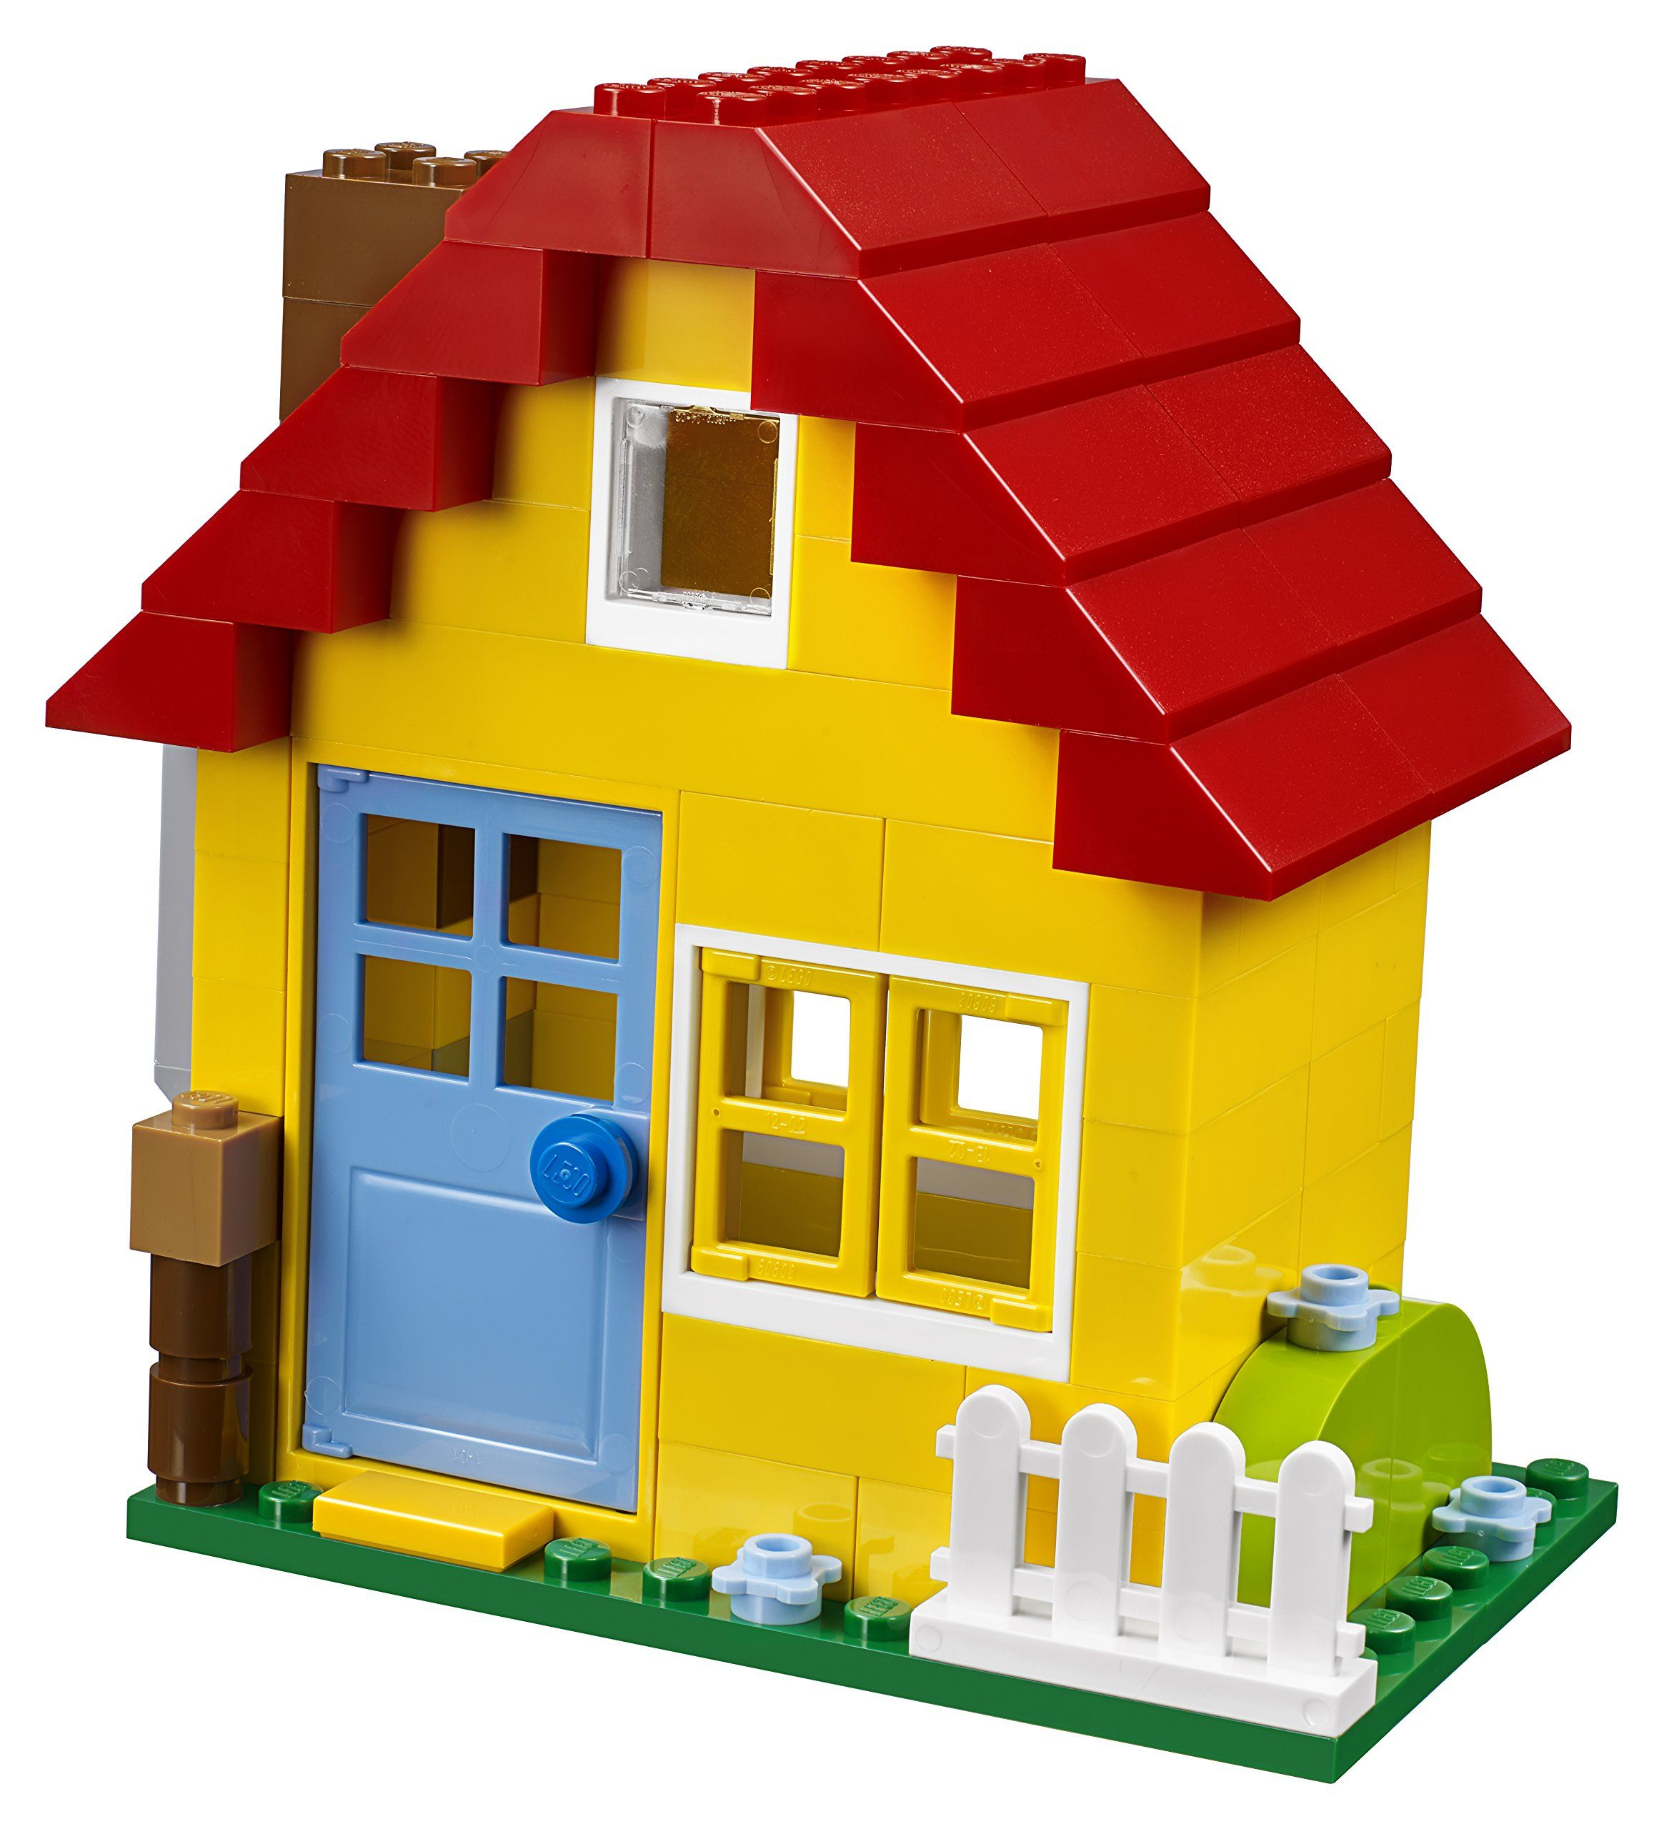


Basic Analogy
+
=

Slide 6
Programming Languages
Insightful analogy
Actual coding languages
Vocabulary and Grammar: Just like English has words and grammar rules, a programming language has commands and syntax.
Sentences and Statements: English sentences convey thoughts, while programming statements perform actions.
Books and Programs: A book is a collection of paragraphs telling a story, just as a program is a collection of functions and statements performing tasks.
Scratch 😀
Python 😀
Javascript 😐
Ruby 😐
Java 😒 ← This is my level of programming
C# (C sharp)😠
C++ 💀

Slide 7

Python
variable = "This is a variable"
CONSTANT = "This is a constant"
Boolean_var = True
Integer_var = 12
String_var = "Hello World"
Float_var = 3.14
List_var = [1, 2, 3, 4, 5]
# Print a message
print("Message:", String_var)
# If-else statement
if Boolean_var:
print("Boolean_var is True")
else:
print("Boolean_var is False")
# For loop
for i in List_var:
print("List item:", i)
This is the language I will teach you this year, it is arguably the simplest of them… aside from Scratch!

Slide 8


Javascript
let variable = "This is a variable";
const CONSTANT = "This is a constant";
let Boolean_var= true;
let Integer_var = 12;
let String_var = "Hello World";
let Float_var = 3.14;
let List_var = [1, 2, 3, 4, 5];
// Print a message
console.log("Message:", String_var);
// If-else statement
if (Boolean_var) {
console.log("Boolean_var is True");
} else {
console.log("Boolean_var is False");
}
// For loop
for (let i of List_var) {
console.log("List item:", i);
}
Slightly more difficult… Minecraft uses Javascript for modding

Slide 9

Ruby
variable = "This is a variable"
CONSTANT = "This is a constant"
boolean_var = true
integer_var = 12
string_var = "Hello World"
float_var = 3.14
list_var = [1, 2, 3, 4, 5]
# Print a message
puts "Message: #{string_var}"
# If-else statement
if boolean_var
puts "boolean_var is True"
else
puts "boolean_var is False"
end
# For loop
list_var.each do |i|
puts "List item: #{i}"
end
About the same difficulty as Javascript

Slide 10
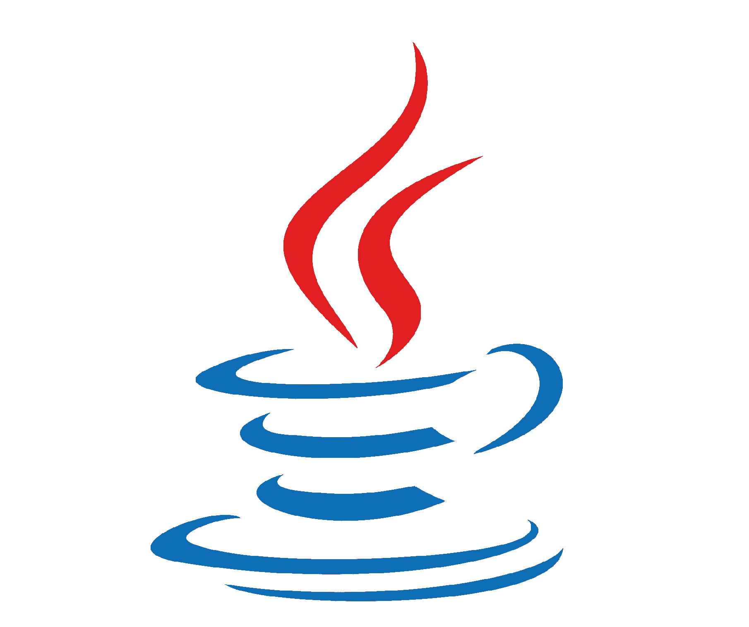
Java
public class Main {
public static void main(String[] args) {
String variable = "This is a variable";
final String CONSTANT = "This is a constant";
boolean Boolean_var = true;
int Integer_var = 12;
String String_var = "Hello World";
float Float_var = 3.14f;
int[] List_var = {1, 2, 3, 4, 5};
// Print a message
System.out.println("Message: " + String_var);
// If-else statement
if (Boolean_var) {
System.out.println("Boolean_var is True");
} else {
System.out.println("Boolean_var is False");
}
// For loop
for (int i : List_var) {
System.out.println("List item: " + i);
}
}
}
Complex

Slide 11
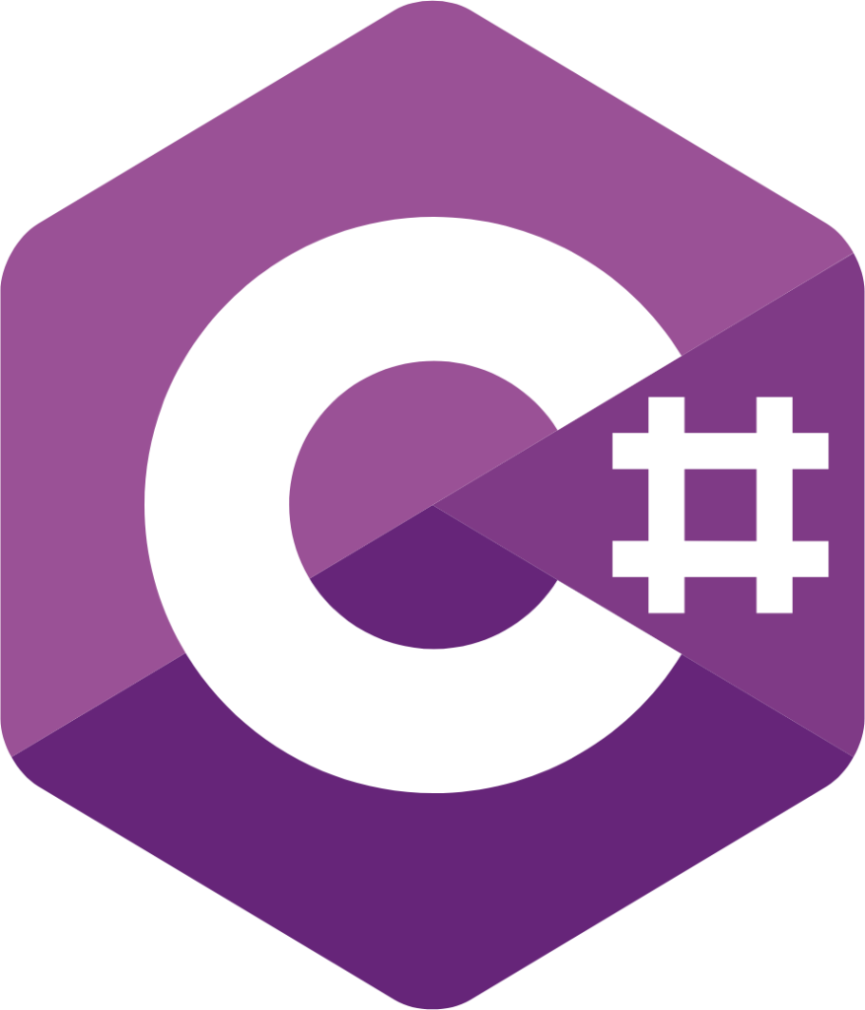

C#
using System;
using System.Collections.Generic;
class Program
{
static void Main()
{
string variable = "This is a variable";
const string CONSTANT = "This is a constant";
bool booleanVar = true;
int integerVar = 12;
string stringVar = "Hello World";
float floatVar = 3.14f;
List<int> listVar = new List<int> { 1, 2, 3, 4, 5 };
// Print a message
Console.WriteLine("Message: " + stringVar);
// If-else statement
if (booleanVar)
{
Console.WriteLine("booleanVar is True");
}
else
{
Console.WriteLine("booleanVar is False");
}
// For loop
foreach (int i in listVar)
{
Console.WriteLine("List item: " + i);
}
}
}
Very complex
Windows is coded in C#
Unity Editor uses C#
Most common in Windows based applications

Slide 12
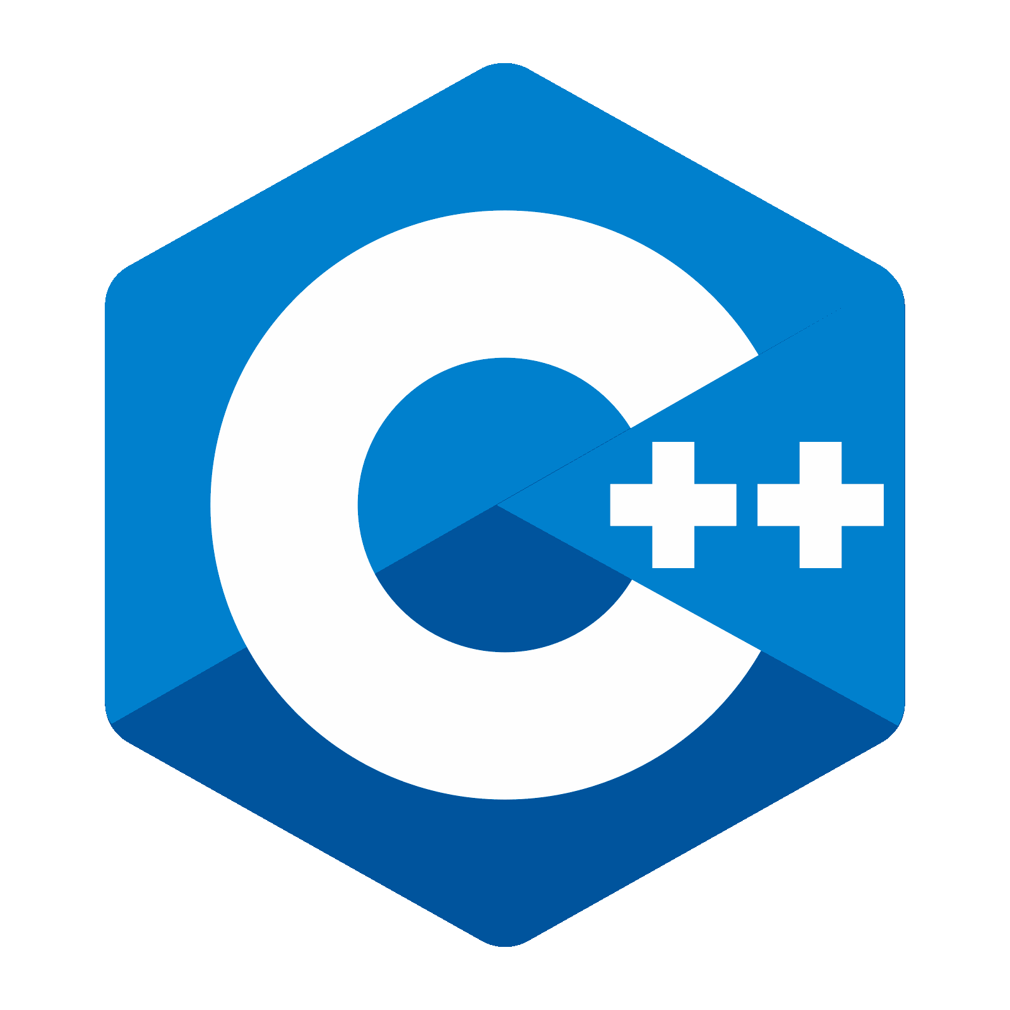
C++
#include <iostream>
#include <string>
#include <vector>
int main() {
std::string variable = "This is a variable";
const std::string CONSTANT = "This is a constant";
bool Boolean_var = true;
int Integer_var = 12;
std::string String_var = "Hello World";
float Float_var = 3.14;
std::vector<int> List_var = {1, 2, 3, 4, 5};
// Print a message
std::cout << "Message: " << String_var << std::endl;
// If-else statement
if (Boolean_var) {
std::cout << "Boolean_var is True" << std::endl;
} else {
std::cout << "Boolean_var is False" << std::endl;
}
// For loop
for (int i : List_var) {
std::cout << "List item: " << i << std::endl;
}
return 0;
}
Deadly difficult
Very manual, very little memory management. Strong knowledge of pointers and Memory Management required

Slide 13
Now, for the work ;)
Hello World :)
Basic Arithmetic
Even or Odd
Single Loop
Lists
String Manipulation
⚠️This is complex, we may not get to it…
Python is EZ !!!!
Simple stuff first…

Slide 14
Requirements
Give me your emails plz :)
Do you already have Visual Studio Code installed?
(the people from last year do)
Are you all using Windows 11?
Can you all access the Microsoft Store?
Can you download it?
Do you get a screen asking for admin?
Q&A First:
Put your hand up if yes,
Keep it down if no.

Slide 15
https://code.visualstudio.com/sha/download?build=stable&os=win32-x64-archive
Press Windows and R (GUI + R)
Type in the web link above…
Wait.
Save to Program Files (x86)
Open Code.exe
Add to taskbar
Done ;)

Slide 16

What is Visual Studio Code
⚠️Mr Murray doesn’t like Visual Studio Code :(
It is an app to make, edit and test code.
It is the best one!!!
Wiki: Visual Studio Code, also commonly referred to as VS Code,^{[10]} is a source-code editor developed by Microsoft for Windows, Linux, macOS and web browsers.^{[11][12]} Features include support for debugging, syntax highlighting, intelligent code completion, snippets, code refactoring, and embedded version control with Git. Users can change the theme, keyboard shortcuts, preferences, and install extensions that add functionality.
In the Stack Overflow 2023 Developer Survey, Visual Studio Code was ranked the most popular developer environment tool among 86,544 respondents, with 73.71% reporting that they use it. ^{[13]}

