Slide 1
24/05/24
Things are going to change…

Slide 2


PYTHON: task to do
Something difficult ☺
Something easy ☹
Make a python project
Allow the user to input a string. Make it so that the script will save the string in a text document in the form of a hex string.
Extra: make it not print out the “0x” at the start of all hex codes (will require research)
Hint: No import modules required
Make a python project
Make it track each key that is pressed and output into the terminal
Extra: make it save to a .txt document (will require research)
Hint: 2 import modules required

Slide 3
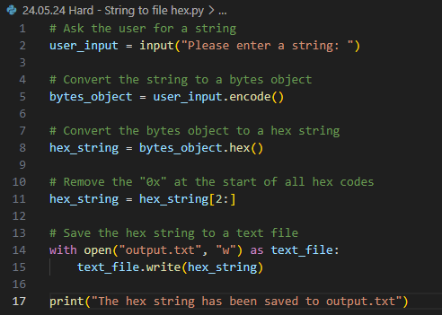
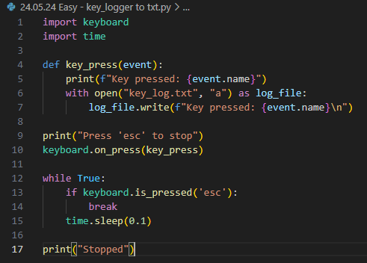
Python: possible solutions

